Slide 1


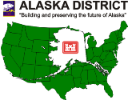


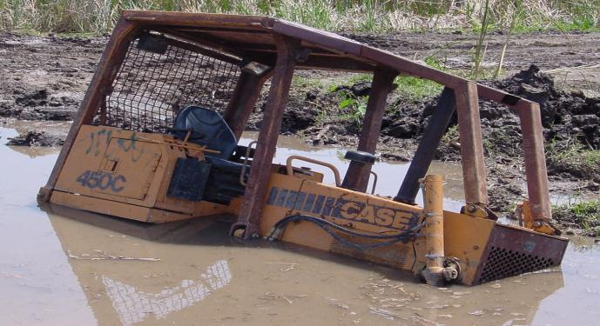



Inspections
Inspecting & Planning to Keep You in Compliance
January 2026

Slide 2
Inspections
Goals of this section:
Learn about inspection reporting requirements
Know:
  Who can inspect;
  Where to inspect; and
  How often to inspect.
Understand recordkeeping requirements.

Slide 3
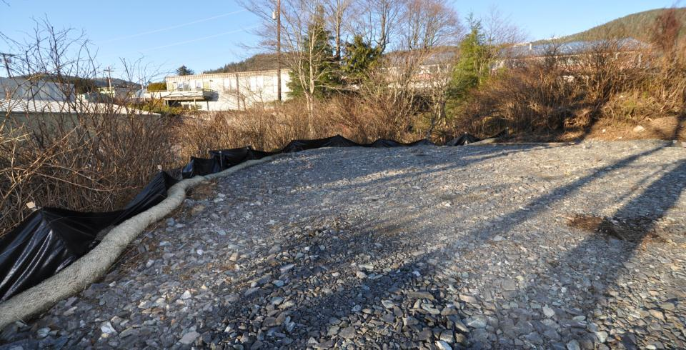
Inspection/Monitoring/Reporting
Ketchikan
Know if your plan is working
Document corrective actions
Notes:
Cert 6
Insert as slide 1, title slide

Slide 4
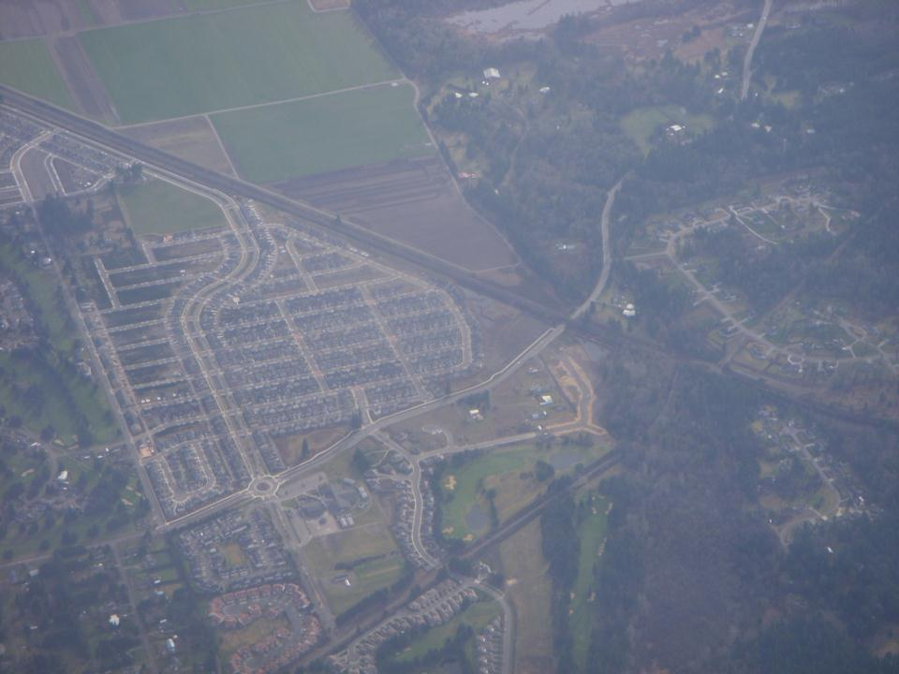
-32nd President
-Franklin D. Roosevelt
“A nation that destroys its soils, destroys itself.”

Slide 5
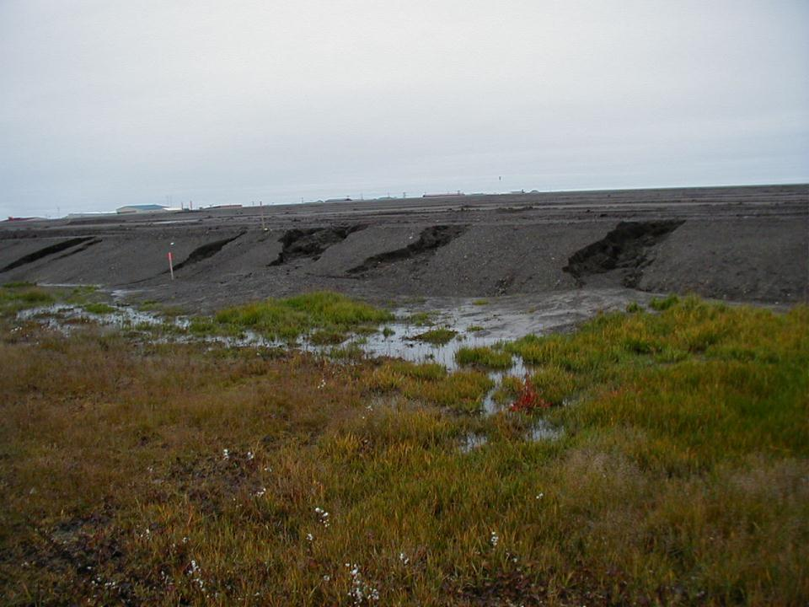
A Contractor that destroys their
site & soils destroys their profits.
Slope Stabilization or Flow Management?
Barrow
Notes:
Is this a slope protection problen or a flow control problem?

Slide 6
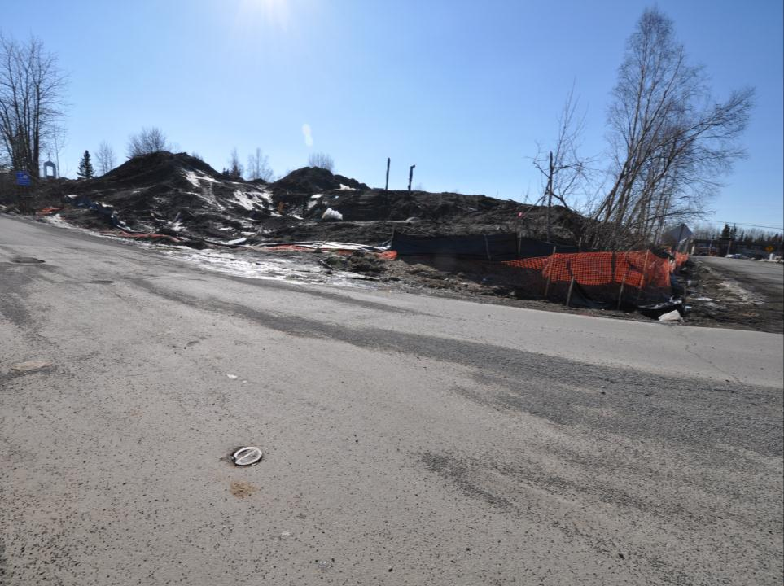
Monitoring & Recordkeeping
Permit Compliance
Adaptive Management Analysis
Risk Management
Anchorage
Notes:
Explain why we must do this, focus on the benefits of compliance.

Slide 7
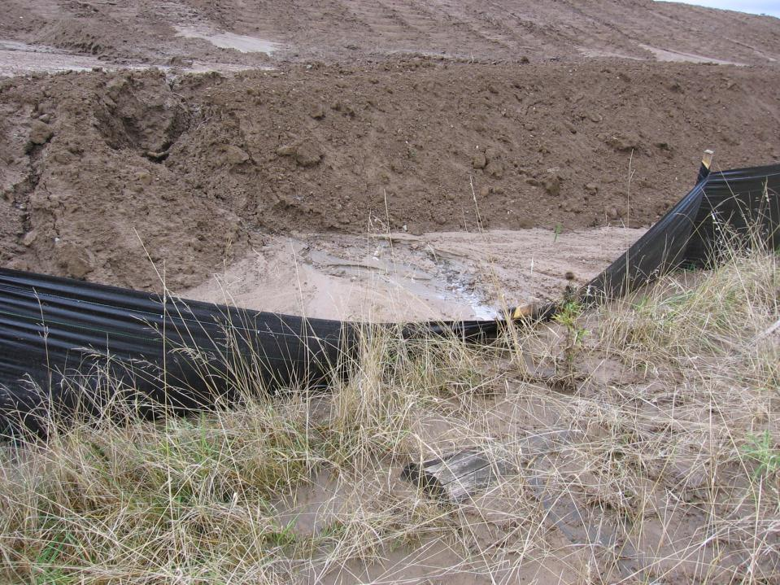
BMP Inspection & Monitoring for Permit Compliance
Visual Inspections
How, what & where do you inspect
Who does inspections
Records & Reporting

Slide 8
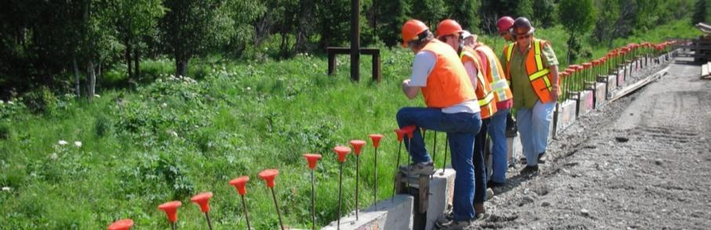
Certified Erosion &
Sediment Control Lead
AK-CESCL: Required on projects that disturb five acres or more
AK-CESCL: Required for Active Treatment System Operators
AK-CESCL must be trained by an approved program.
    (two certified inspectors may be necessary)
    AK-CESCLs are decision-makers in the project process.
    AK-CESCLs inspect BMPs & construction areas.
Notes:
Washington has CESCL, EPA has Responsible person, Oregon recognizes CESCL
In Alaska CESCL can be used to meet “Qualified Person” requirements.

Slide 9
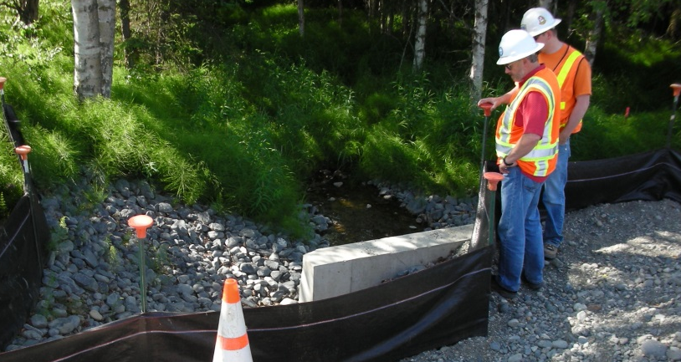
Site Inspections
CGP Part 5.4 Pg. 39
The SWPPP must document the procedures for
performing site inspections specified by Part 6.0 of this
permit, and where necessary, procedures for taking corrective actions in accordance with Part 8.0. At a minimum, the SWPPP must document the following:

Slide 10
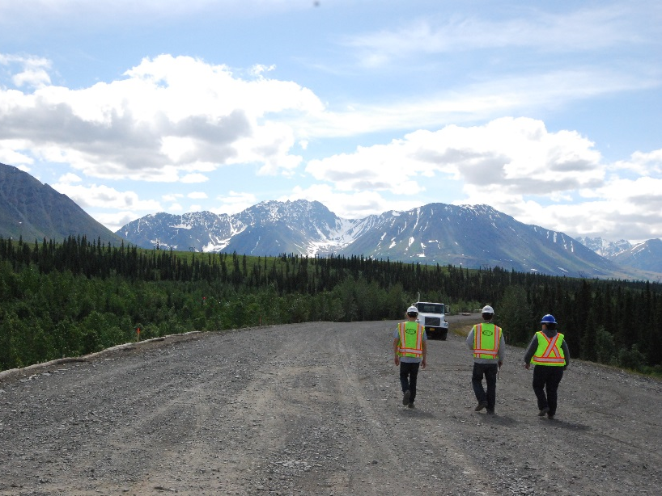
Site Inspections
Person(s) or positions of person(s) responsible for conducting site inspections;
Schedules to be followed for conducting inspections;
Any inspection checklist or form that will be used to collect and summarize data and observations; and
How conditions found that require corrective action will be addressed.
CGP Part 5.4 Pg. 39

Slide 11
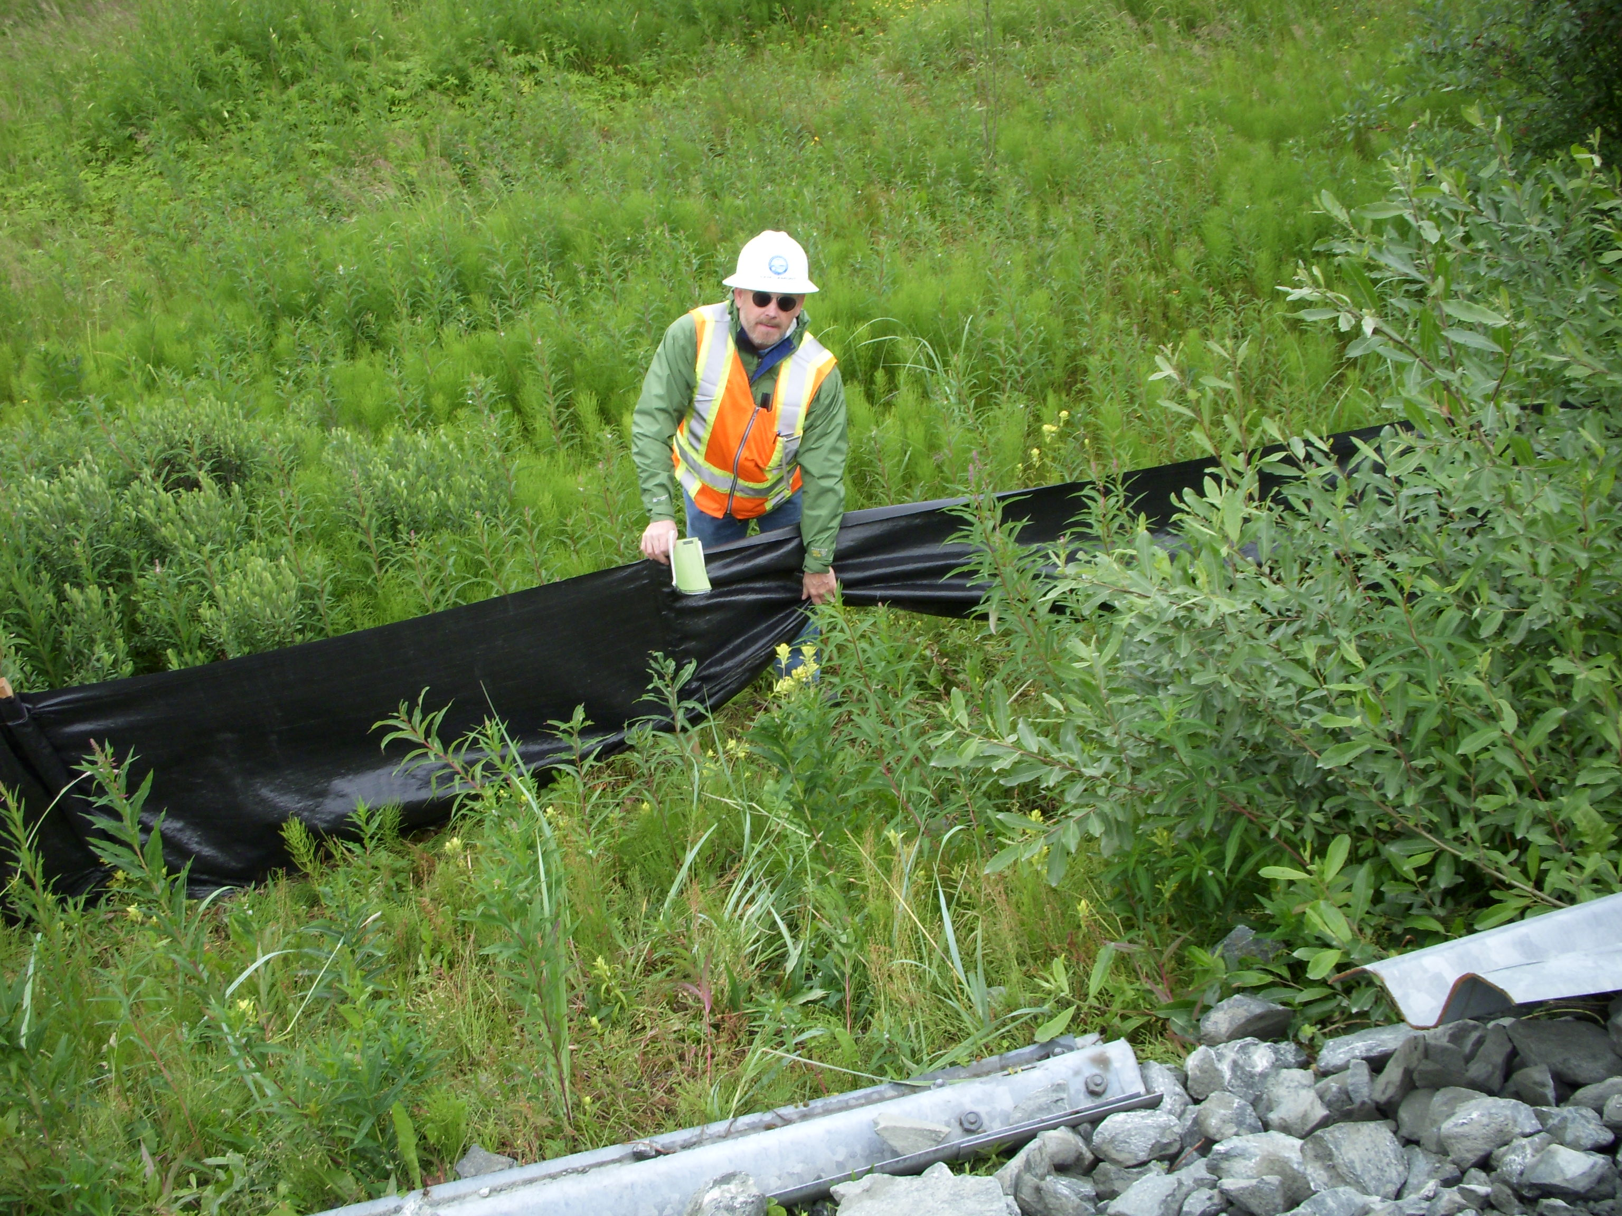
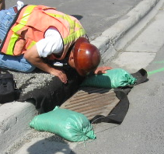
Site Inspections
CGP Part 5.4.2 Pg. 39
A record of each inspection and of any corrective actions taken in accordance with Part 8.0 must be retained with the SWPPP for at least three years from the date that permit authorization expires or is terminated.

Slide 12
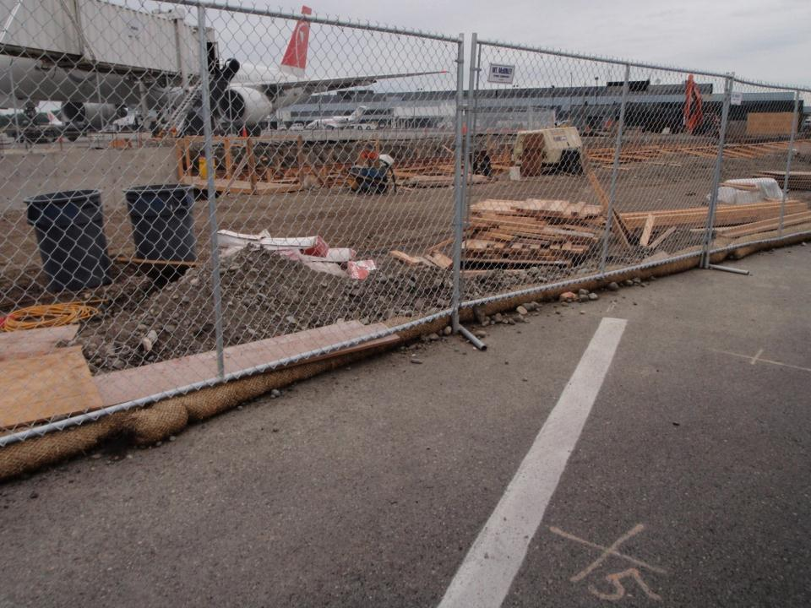
INSPECTIONS
CGP Part 6.0 Pg. 44
Inspection Frequency
A permittee must conduct inspections in accordance with one of three schedules. The SWPPP must specify which schedule will be followed.
ANC

Slide 13
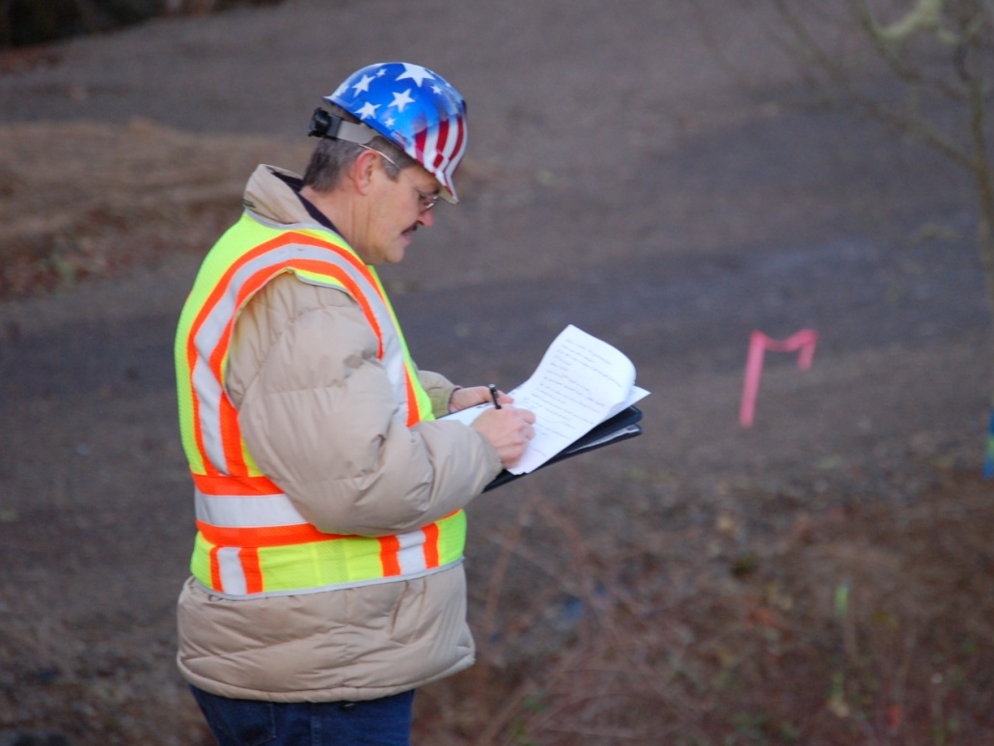
CGP Part 6.0 Pg. 44
Inspection Frequency
A permittee must conduct inspections at one of the following schedule:
Once every seven calendar days; or
Once every 14 calendar days and within 24 hours of the end of a storm event that resulted in a discharge from the site; or
For areas of the state where the mean annual precipitation is forty (40) inches or greater, or relatively continuous precipitation or sequential storm events, inspect at least once every seven (7) calendar days.

Slide 14
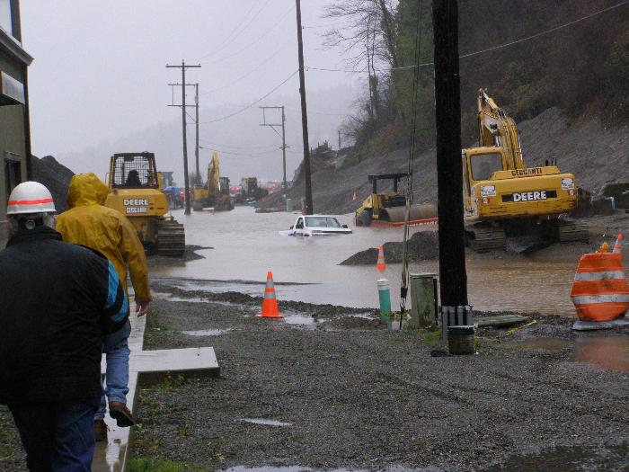
POP QUIZ
It’s been discharging everyday
for the last week. How many
inspections should I have?
Is the truck
a permitted
discharge?

Slide 15
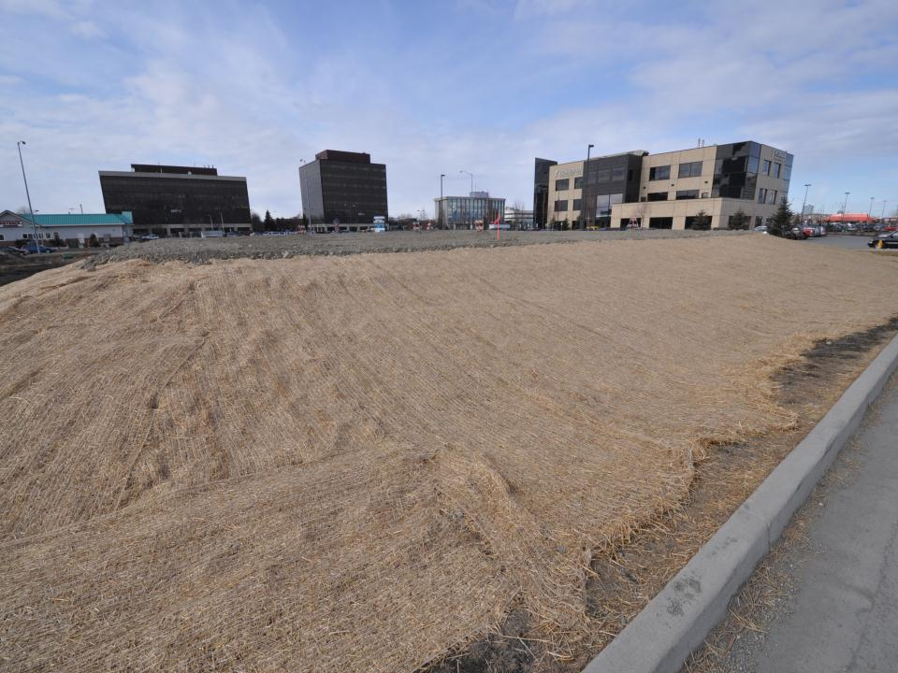
Case-by-Case Reductions in Inspection Frequency
A permittee may reduce inspection frequency in the following situations:
If the entire site is stabilized in accordance with Part 4.5, a permittee may reduce the frequency of inspections to at least once every calendar month (minimum of 7 days separation between inspections) and within two business days of the end of a storm event at actively staffed sites that resulted in a discharge from the site;
CGP Part 6.2 Pg. 44
Anchorage
Notes:
Gravel pad with slopes covered with erosion control blanket

Slide 16
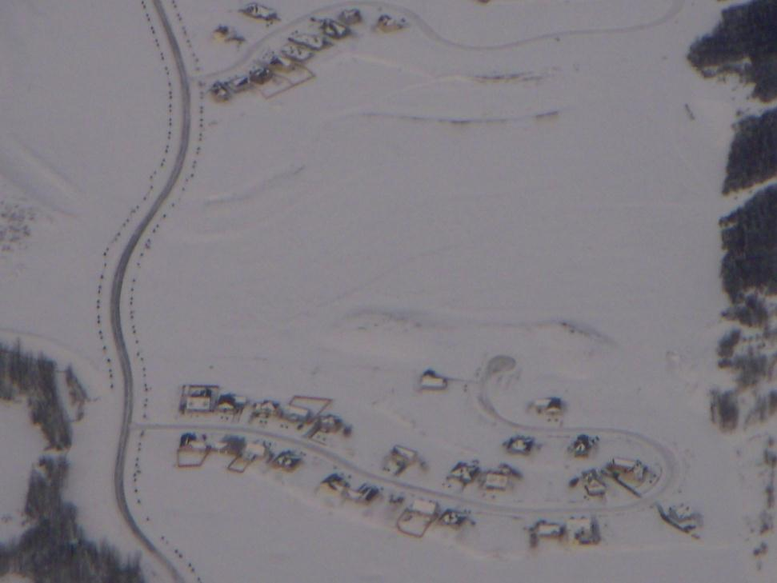
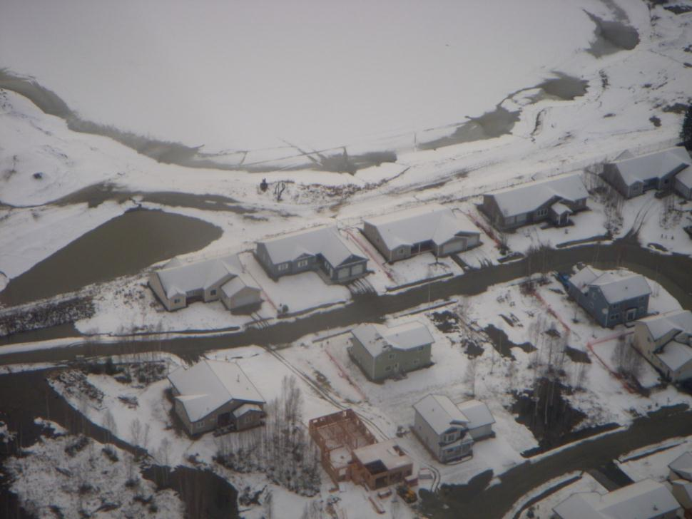
CGP Part 6.2.2 Pg. 44
If portions of the site have achieved final stabilization in accordance with Part 4.5 but construction activity remains on other portions of the site, a permittee may suspend inspections for those portions that have achieved final stabilization; however, the permittee must conduct subsequent inspections within two business days of the end of a storm event that results in a discharge from that portion of the site previously considered finally stabilized;
Anchorage

Slide 17
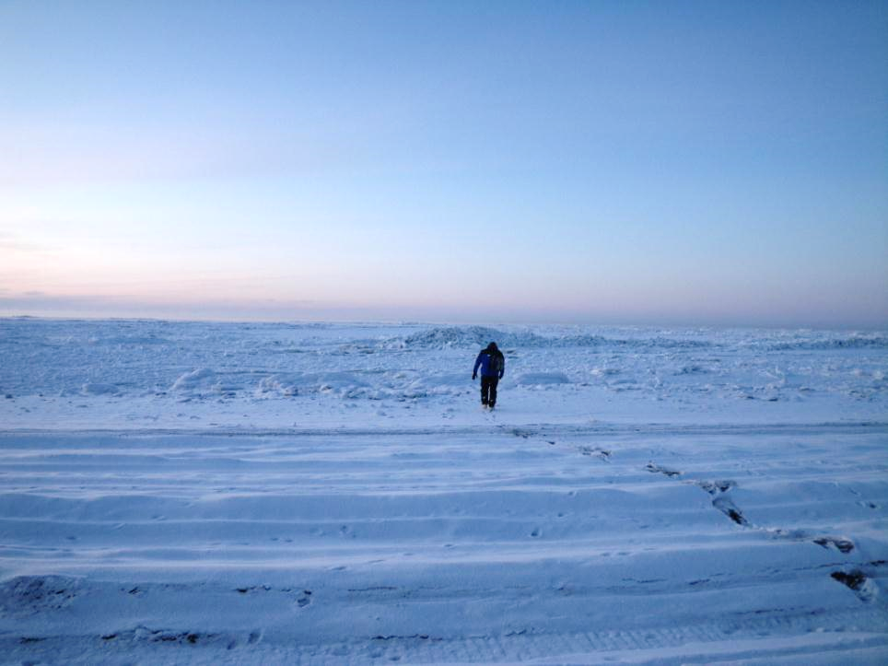
If the project is undergoing winter shutdown (as defined in Appendix C), implemented control measures with Part 4.12 Winter Considerations, and is documented in accordance with Part 5.3.6.9, a permittee may stop inspections 14 calendar days after the anticipated fall freeze-up and must resume inspections in accordance with the SWPPP at least 21 calendar days prior to the anticipated spring thaw; or
CGP Part 6.2.3 Pg. 44

Slide 18
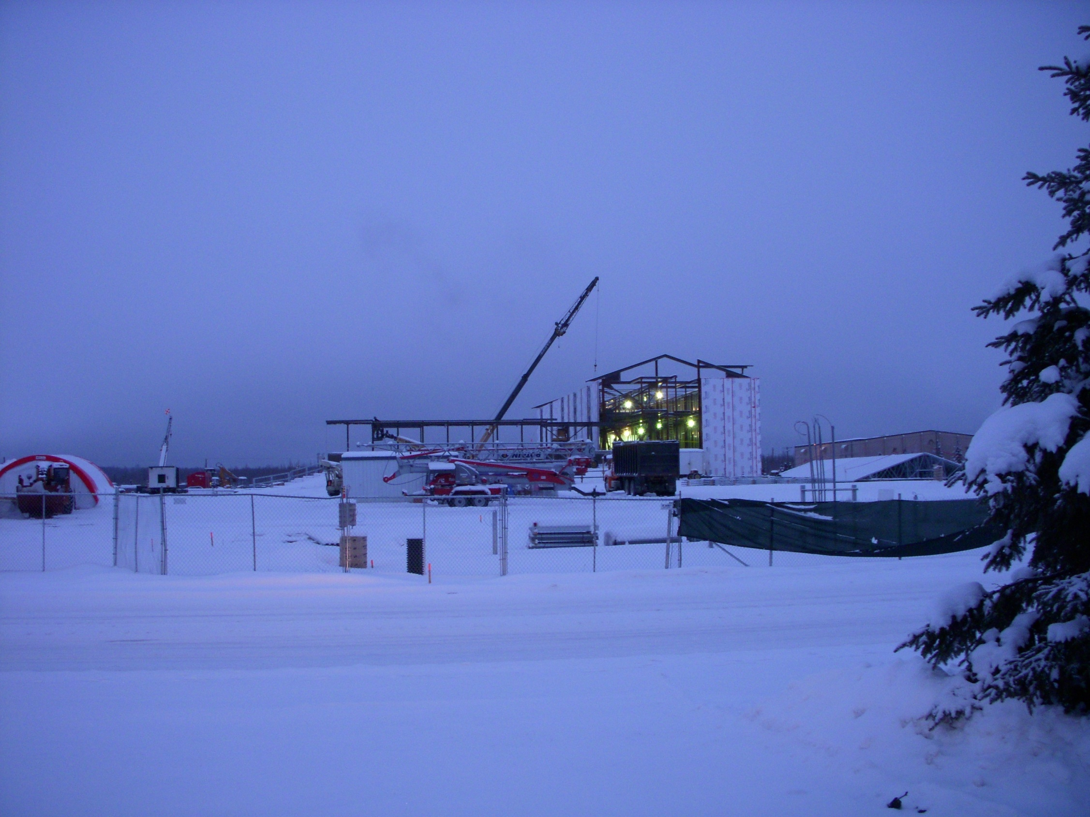
If the project is undergoing winter construction the inspection frequency can be reduced to once per month if runoff is unlikely due to continuous frozen conditions that are likely to continue at the site for at least three (3) months based on historic seasonal averages. If unexpected weather conditions (such as above freezing temperatures or rain events) make discharges likely, the permittee must immediately resume a regular inspection frequency
CGP Part 6.2.4 Pg. 44

Slide 19
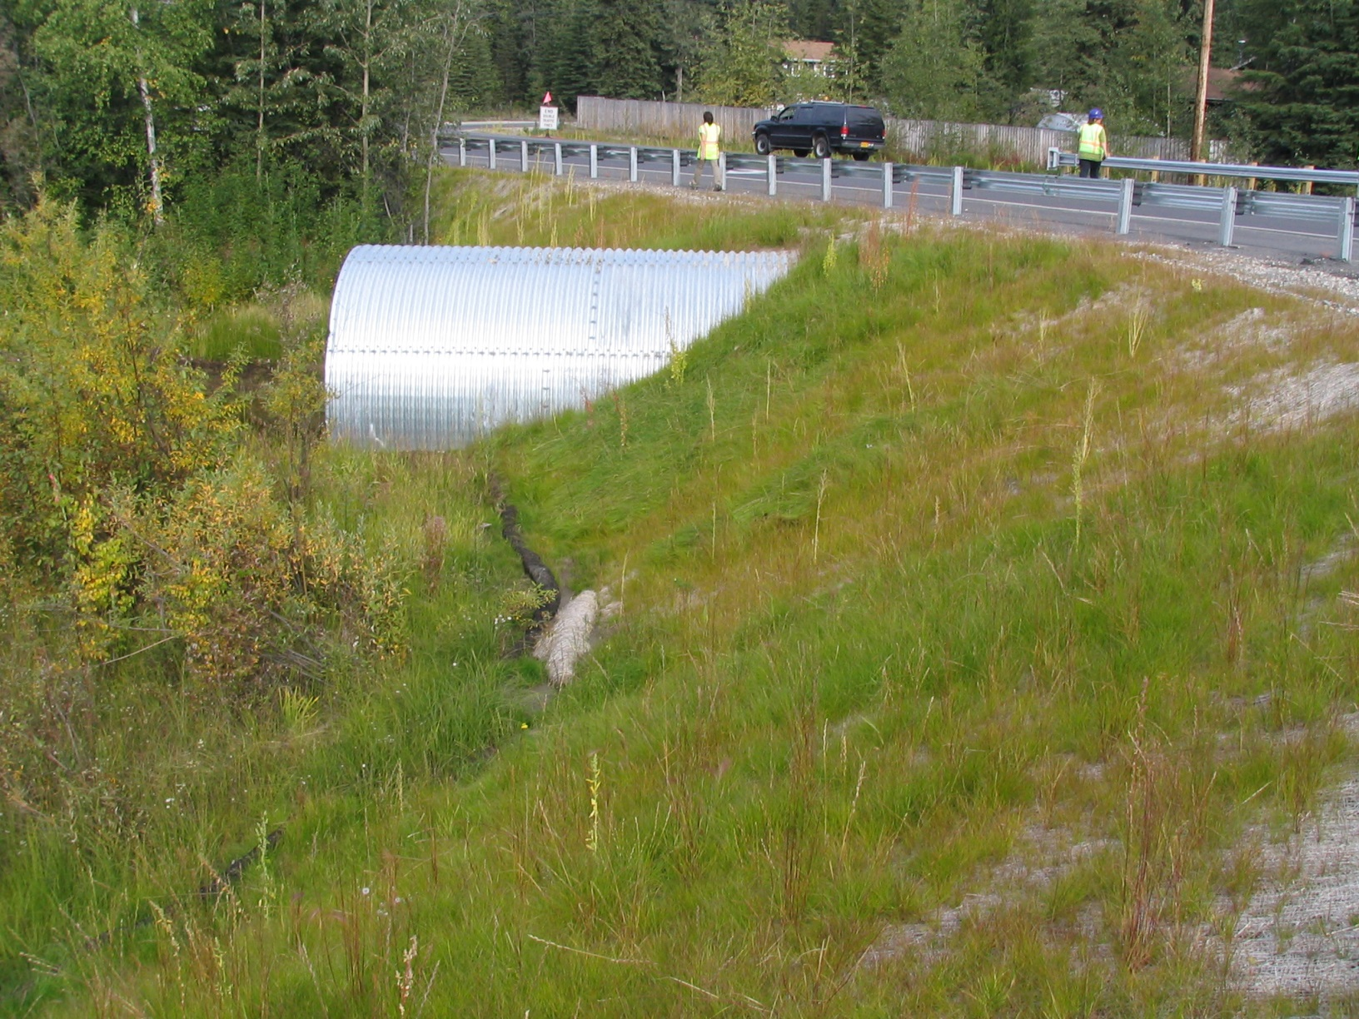
CGP Part 6.2.5 Pg. 44
If the entire site has achieved final stabilization (as defined in Appendix C) and a NOT has been submitted, no further inspection requirements apply to the site.

Slide 20
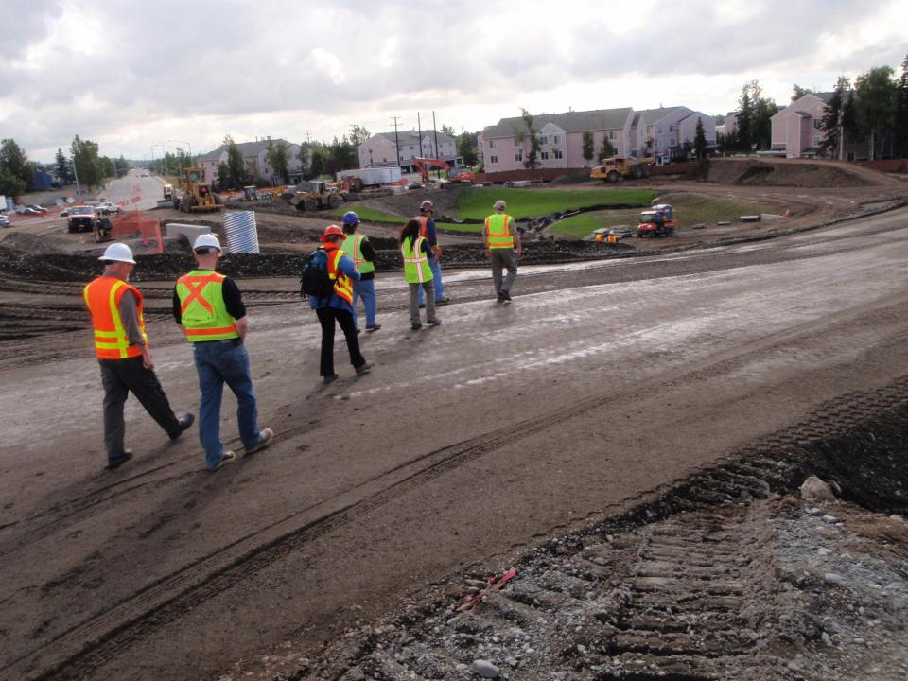
CGP Part 6.3 Pg. 45
Qualified Person
An inspection must be conducted by a qualified person (as defined in the Appendix C) provided by a permittee.
Anchorage
Notes:
Introduce the inspector icon and when it comes up lets fill out the inspection reports.

Slide 21
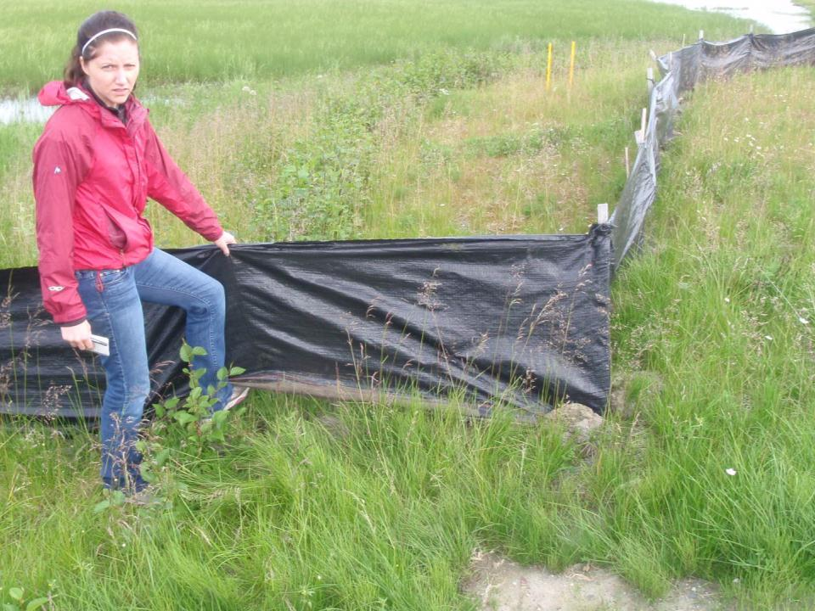
During a site inspection,
a permittee must inspect the following :
2011 CGP 6.4.1
During a site inspection, a permittee must at a minimum inspect the following areas:
Areas disturbed by construction activity
Areas used for storage of materials that are exposed to precipitation
Areas where control measures are installed and maintained, BMP’s
Areas where pollutants have accumulated and may enter storm water
Locations where vehicles enter or exit the site;
Areas where storm water typically flows;
Points of discharge from the site.
Portions of the site where stabilization measures have been initiated.
CGP Part 6.4 Pg. 45

Slide 22
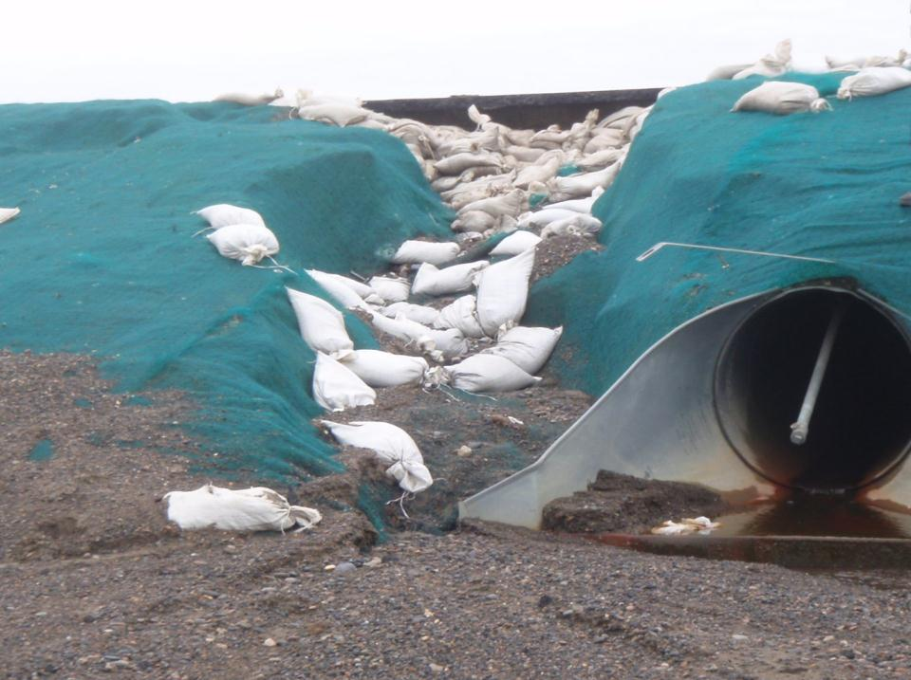
Scope of Inspection
The site inspection shall include the following:
CGP Part 6.4.2 Pg. 45
Check whether all control measures are installed and operating as intended and determine if any control measures need to be replaced, repaired or maintained.
Barrow

Slide 23
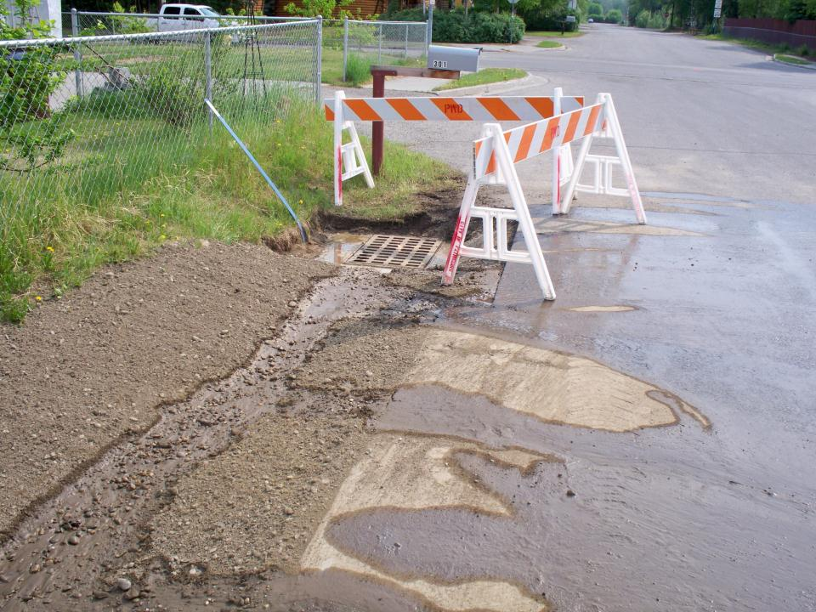
Scope of Inspection
The site inspection shall include the following:
CGP Part 6.4.2 Pg. 45
Check for the presence of accumulated sediment near the project area boundary that has a potential for being washed outside of the project boundary on locations such as roadways or parking lots, storm water conveyance systems, storm water inlets, and discharge points.

Slide 24
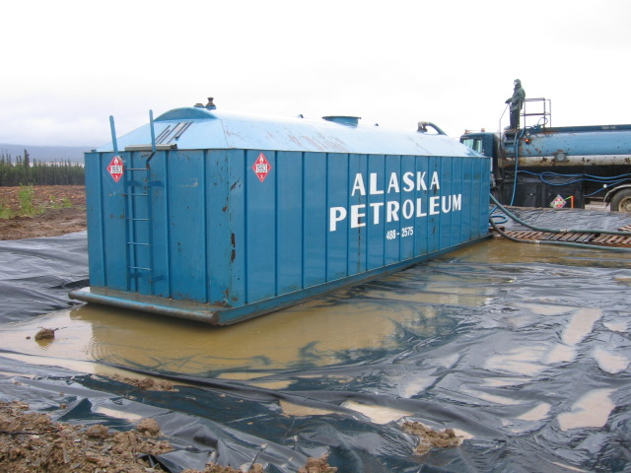
Scope of Inspection
The site inspection shall include the following:
CGP Part 6.4.2 Pg. 45
Check for the evidence of, or the potential for spills, leaks, or other accumulations of pollutants on the site entering the storm water conveyance system or waters of the U.S.

Slide 25
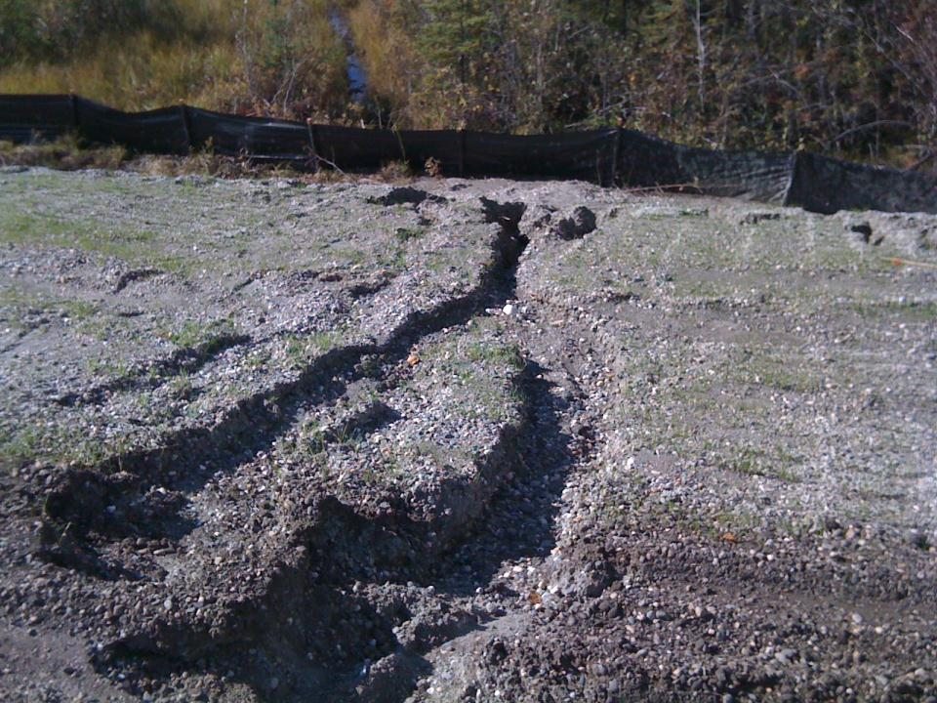
Scope of Inspection
The site inspection shall include the following:
CGP Part 6.4.2 Pg. 45
Describe visible areas where erosion has occurred near the project area boundary that has a potential for being washed outside of the project boundary.
North Pole

Slide 26
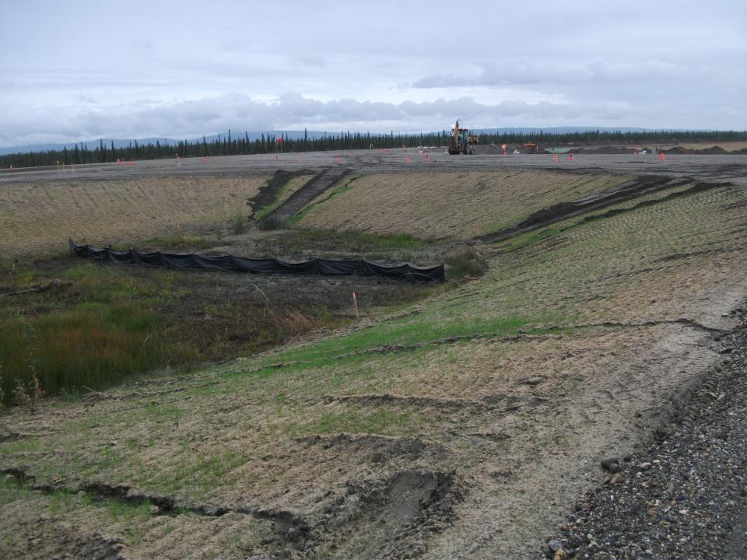
Scope of Inspection
The site inspection shall include the following:
CGP Part 6.4.2 Pg. 45
Identify any locations where new or modified control measures are necessary to meet the requirements in Part 4.0

Slide 27
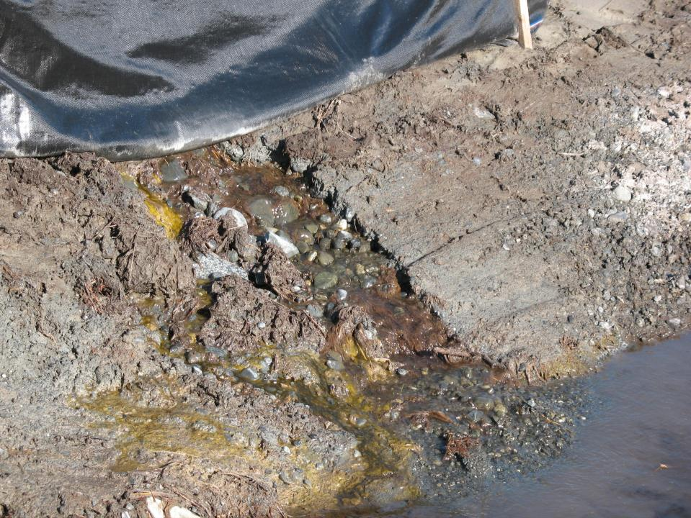
Scope of Inspection
The site inspection shall include the following:
CGP Part 6.4.2 Pg. 45
Identify all points that discharge from the site and describe the conditions that are contributing to that discharge.

Slide 28
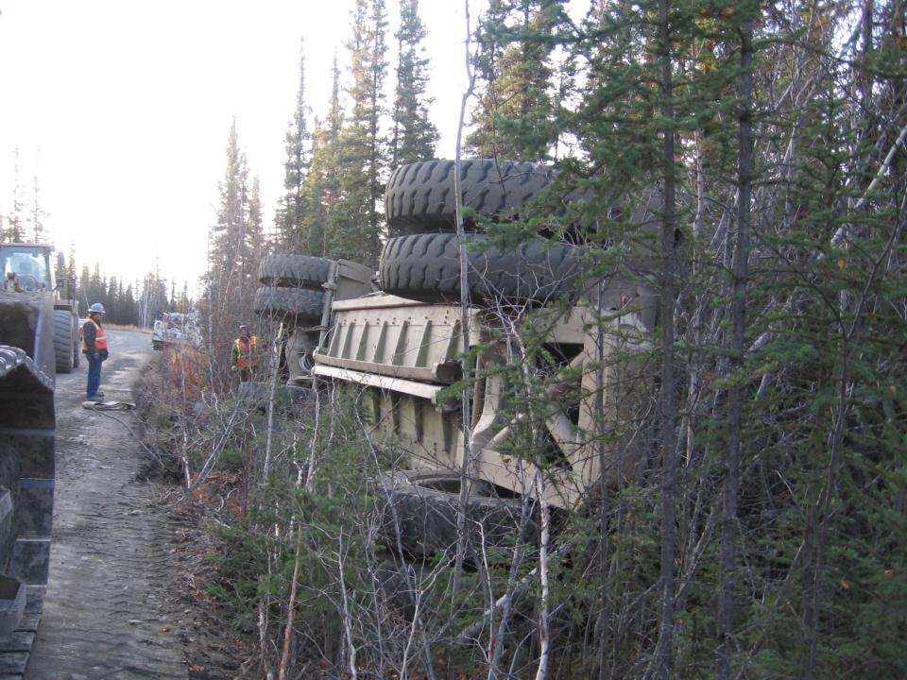
Scope of Inspection
The site inspection shall include the following:
CGP Part 6.4.2 Pg. 45
Any incidents of noncompliance observed and corrective actions taken pursuant to Part 8.0.

Slide 29
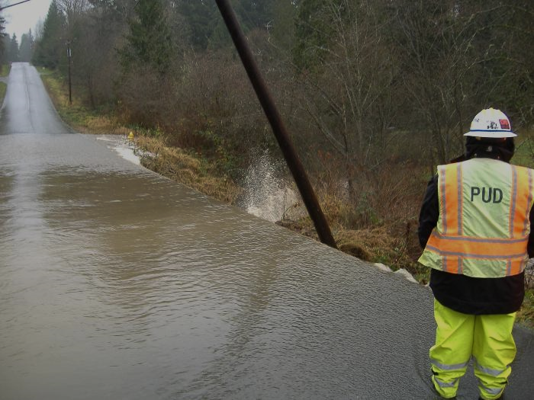
Representative inspections may be performed at linear projects if the areas described in Part 6.4 are inaccessible, unsafe for personnel, would compromise stabilized areas, or would cause additional disturbance of soils.
CGP Part 6.5 Pg. 46

Slide 30
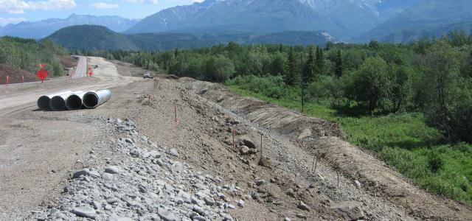
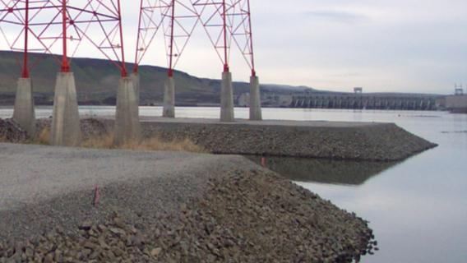
Linear Project Inspections
CGP Part 6.5 Pg. 46
Representative inspections may be performed. Inspect control measures along the site 0.25 mile above and below each access point.
Notes:
If you can drive the project without damaging the revegetation efforts you must inspect the project, This exemption does not apply to road projects that can be easily accessed.

Slide 31
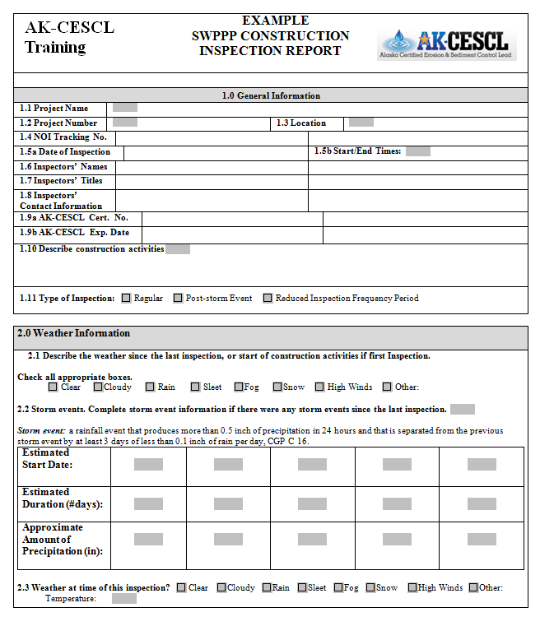

Make Sure Your Inspection Forms Meet All Your Permit
& Contract Requirements!
Notes:
Make sure your report forms, sheets, logs, meet your permit requirements.

Slide 32
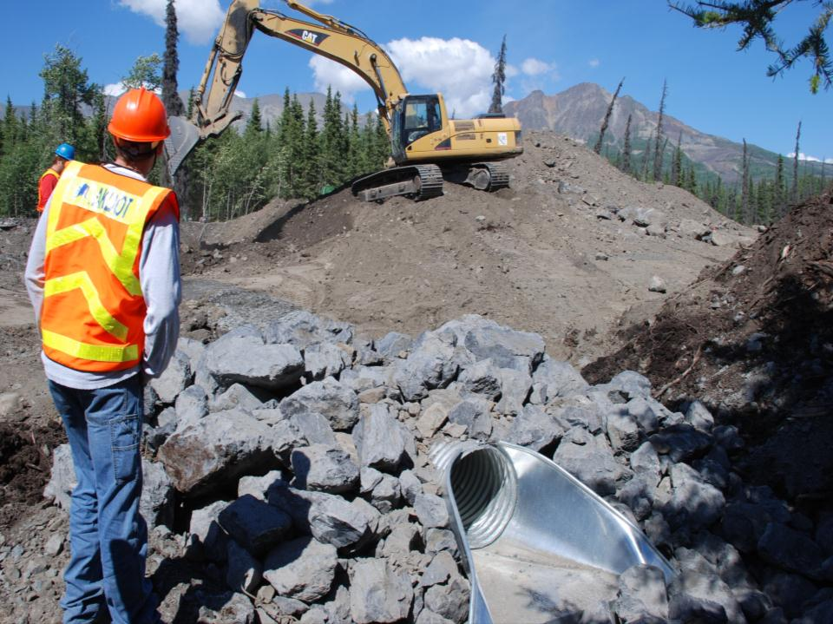
CGP Part 6.7 Pg. 46
AK-CESCL
Inspection Report
At a minimum, the inspection report must include:
The inspection date;
Names, titles, and qualifications of personnel conducting the inspection;
Notes:
Lets start filling out the report

Slide 33
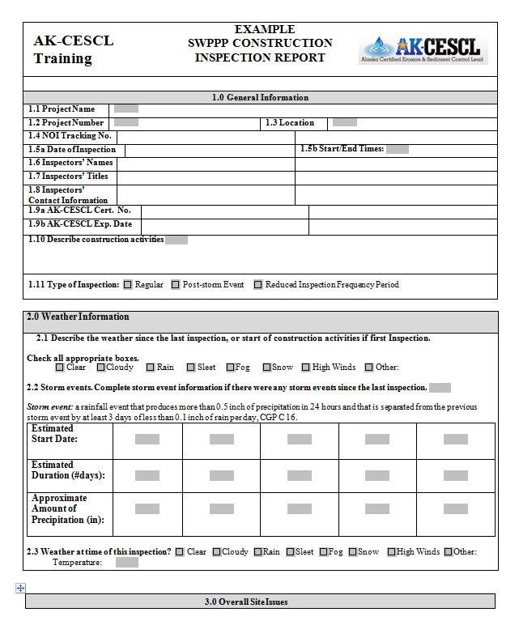

Slide 34
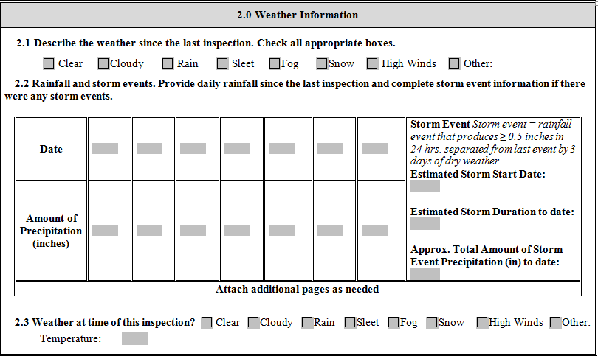

Weather information for the period since the last inspection (or since commencement of construction activity if the first inspection) including a general estimate of the beginning day of each storm event, duration of each storm event, and whether any discharges occurred.
CGP Part 6.7.1.3 Pg. 46

Slide 35
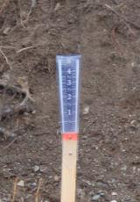
Weather information and a description of any discharges occurring at the time of the inspection;
CGP Part 6.7.1.4 Pg. 46
X
7-14
7-15
Early
am
Rain
all day
drizzle
.40in
X
52 F
Drizzley

Slide 36
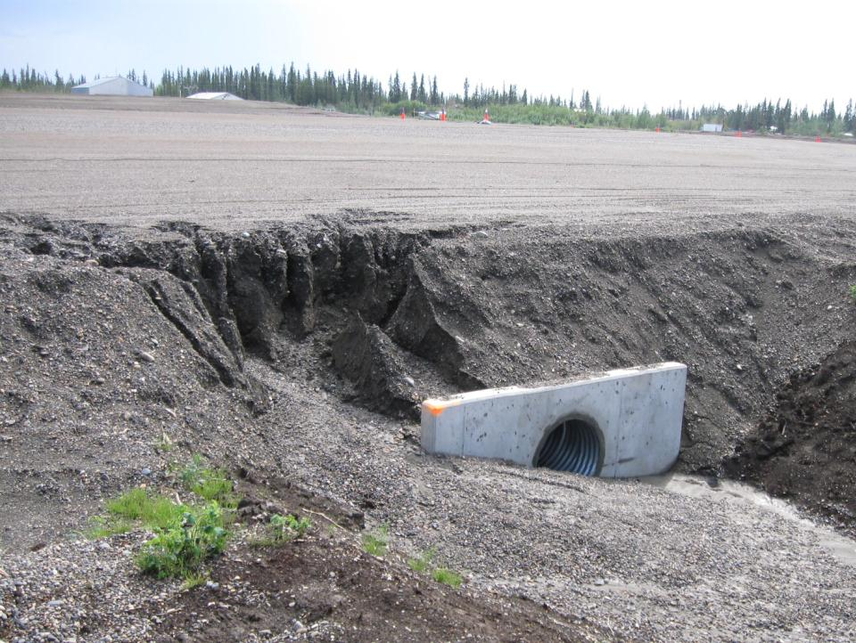
Location(s) of discharges of sediment or other pollutants from the site;
CGP Part 6.7.1.5 Pg. 46
Ft. Yukon

Slide 37
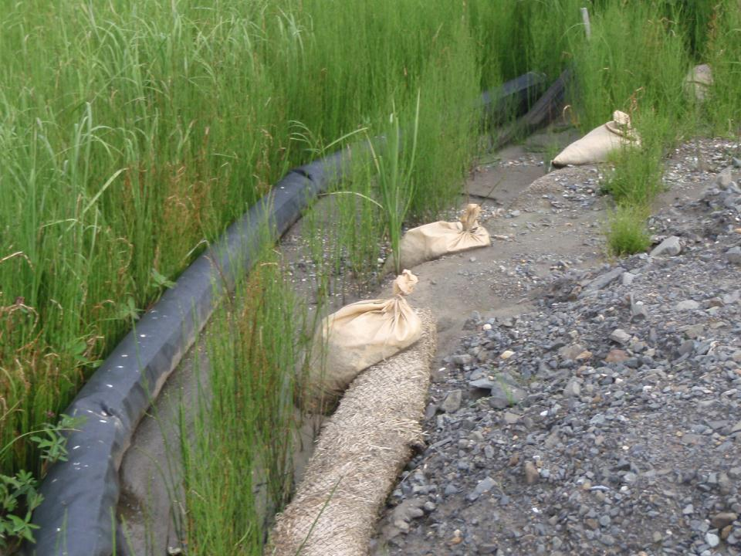
Location(s) of control measures that need to be maintained;
CGP Part 6.7.1.6 Pg. 46
Emmonak

Slide 38
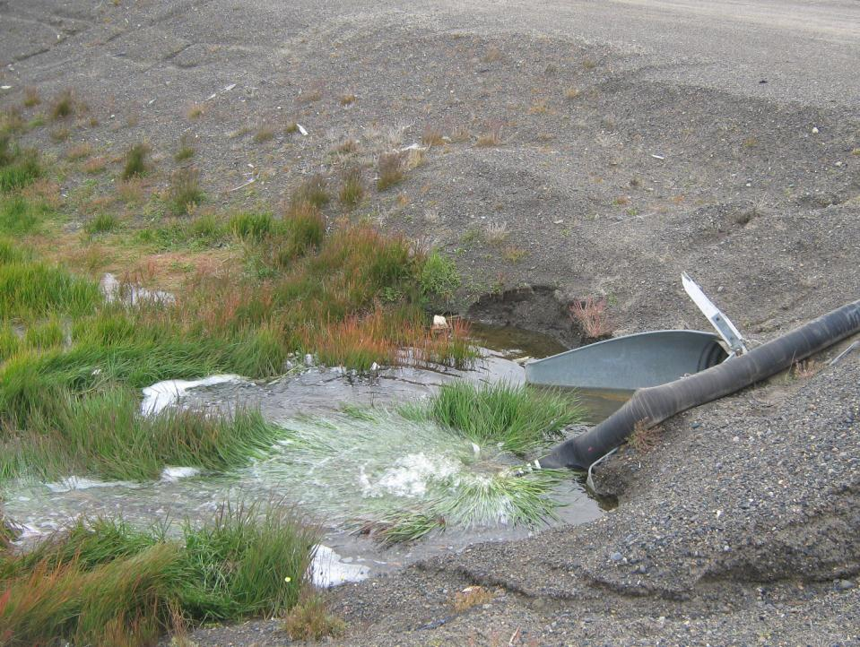
Location(s) where additional control measures are needed that did not exist at the time of inspection; and
Corrective action required, if any, including complete-by dates.
CGP Part 6.7.1.8 & 6.7.1.9 g. 47

Slide 39
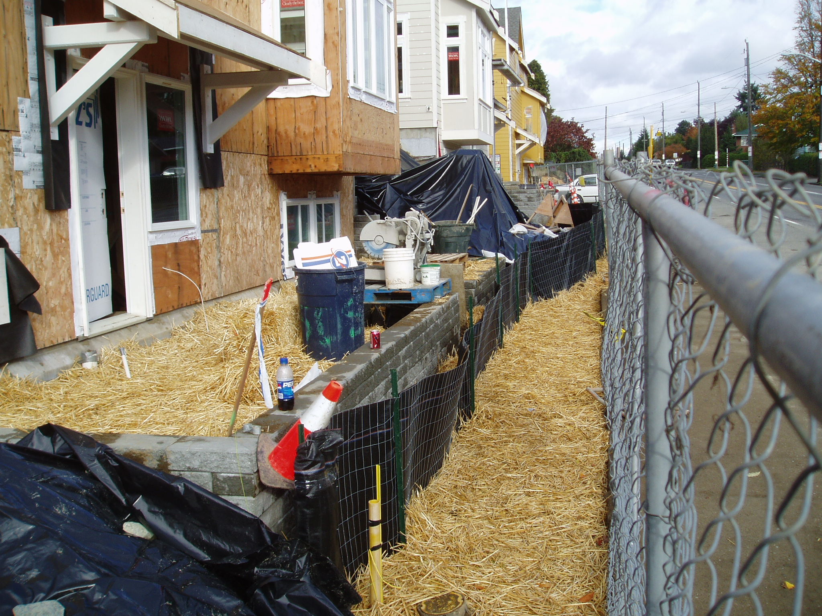
Notes:
Can we go to far?

Slide 40
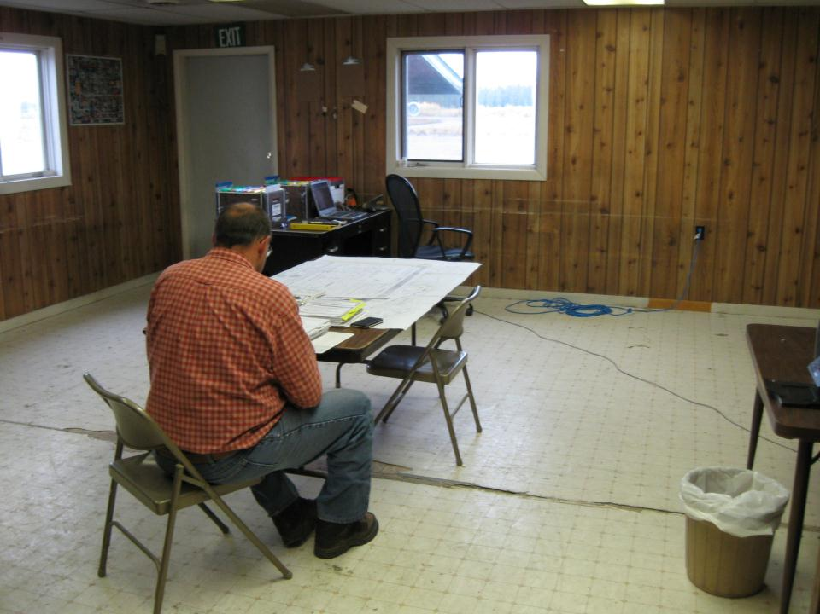

The inspection report must be signed in accordance with Appendix A, Part 1.12.
CGP Part 6.7.2 Pg. 47

Slide 41

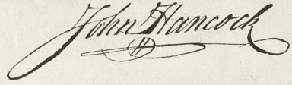
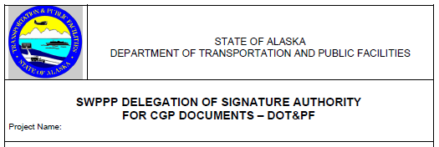
AK DOT&PF Form 25D-107

Slide 42
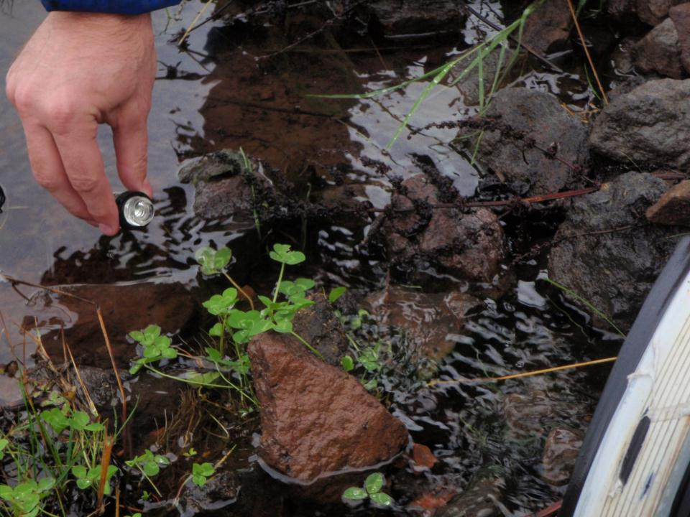
MONITORING
CGP Part 7.0 Pg. 47
When discharging to an Impaired waterbody:
A Permittee Must:
Develop a monitoring plan
Obtain 2 representative samples during each discharge event *
Submit data to DEC
* During normal operating hours
* In safe conditions

Slide 43
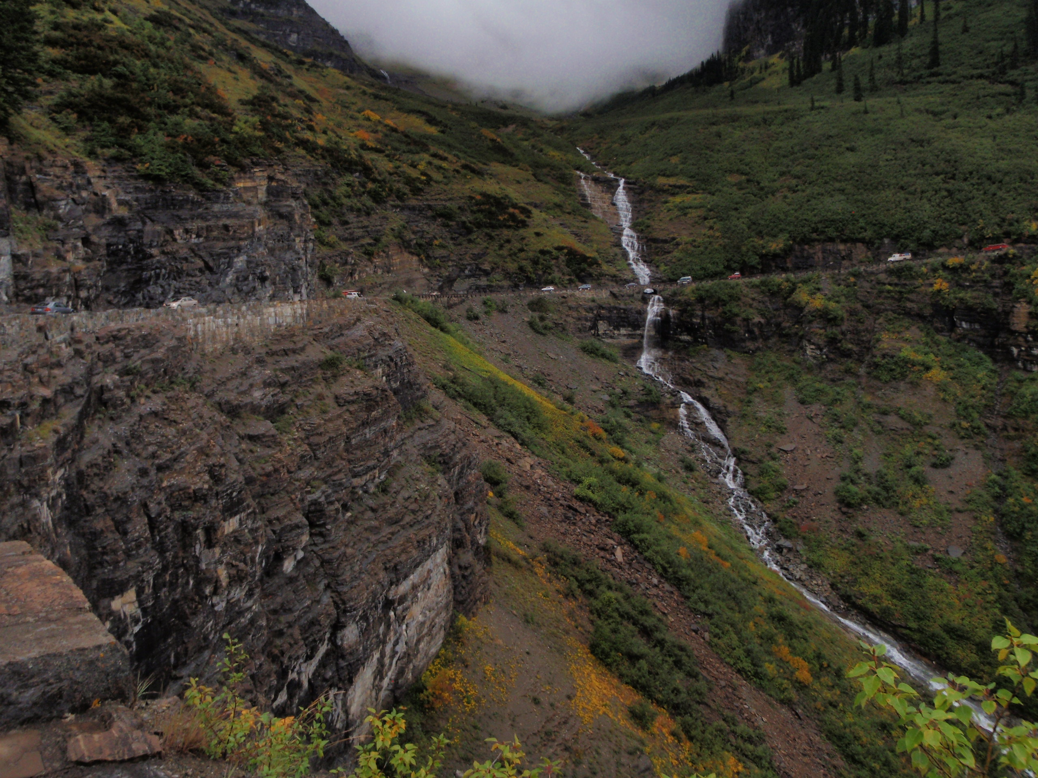
CGP Part 7.3.9 Pg. 49
Rainfall Monitoring
A permittee must use a rain gauge on site or utilize the nearest National Weather Service (NWS) precipitation gauge station to determine the amount of rainfall during a storm event if the NWS gauge used is located within 20 miles of the site.

Slide 44
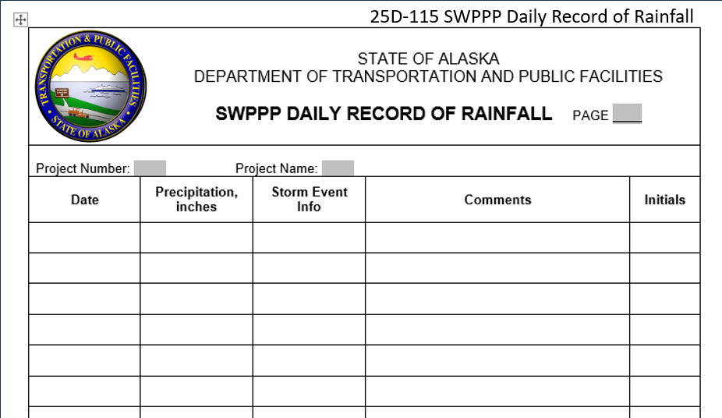
A permittee must maintain daily records of the rainfall amounts and dates of rainfall events as part of the SWPPP, in accordance with Part 9.4.
CGP Part 7.3.9.2 Pg. 49

Slide 45
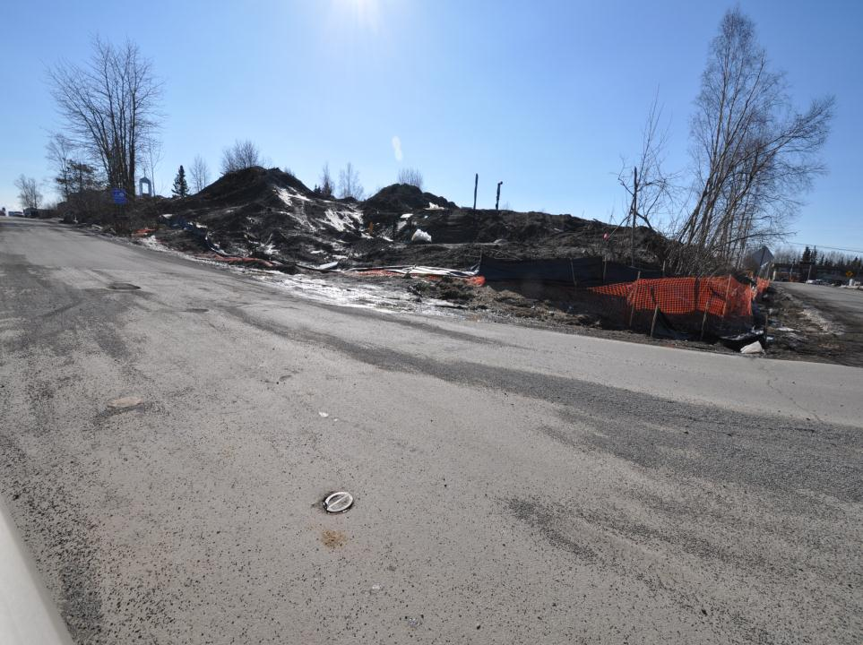
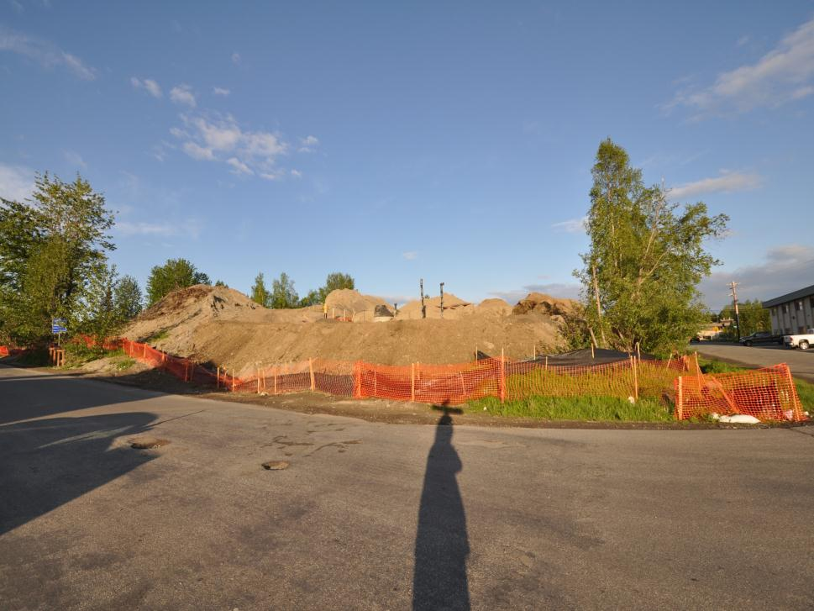
CGP Part 8.0 Pg. 50
Corrective Action Conditions
A permittee must review and revise the selection, design, installation, and implementation of their control measures whenever any of the following conditions are identified, discovered, or made aware of at the site:
Anchorage

Slide 46

Corrective Actions
CGP Part 8.1 Pg. 50
An unauthorized release or prohibited discharge (e.g., spill, leak, or discharge of non-storm water not authorized by permit);
Control measures are not designed, installed, and/or maintained as required in Part 4.0.

Slide 47

Corrective Actions
CGP Part 8.1 Pg. 50
The permittee becomes aware, or DEC determines that the control measures are not operating as intended or are not effective enough to meet the requirements of Part 3.1.2;
An inspection by DEC or EPA official determines that modification to the control measures are necessary to meet the requirements of this permit.

Slide 48

CGP Part 8.1.1.5 Pg. 50
Translation:
See sediment = Take Corrective Action
The accumulation or tracking of sediment in or near any storm water conveyance channels, on roadways or parking lots outside the project area and adjacent to the site, in the immediate vicinity of control measures, at discharge points or entry points into the storm sewer system, or in other areas of the site.
Anchorage

Slide 49

Deadlines for Corrective Actions
CGP Part 8.2 Pg. 51
For conditions that are easily remedied (i.e., removal of tracked sediment, maintenance of control measures, or spill clean-up), the permittee must initiate appropriate steps to correct the problem within 24 hours from the time of discovery and correct the problem as soon as practicable; or
If installation of a new control measure is needed or an existing control measure requires redesign and reconstruction or replacement, the permittee must install the new or modified measure and make it operational within seven calendar days from the time of discovery of the need for the corrective action, unless infeasible;
Homer

Slide 50

Corrective Action Log
CGP Part 8.3 Pg. 51
A permittee must document the following in the corrective action log, within twenty-four (24) hours of discovery of any condition listed in Part 8.1 or upon notification from a subcontractor:
Date the problem was identified;
Summary of corrective action taken or to be taken (or, for conditions triggering corrective actions identified in Part 8.1, where the determination is made that action is not necessary, the basis for this determination);
Notice of whether SWPPP modifications were required; and
Date corrective action completed.
DOT Form 25D-112

Slide 51

Grading & Stabilization Activities Log
Summaries of the following information, or copies of the reports, must be maintained with the SWPPP by the permittee:
CGP Part 5.8.2.1 Pg. 40
Date(s) when grading activities occur;
Description of Grading Activity and Location
Date(s) when construction activities temporarily or permanently cease on a portion of the site;
Date(s) when stabilization measures are initiated;
Description of Stabilization Measure.

Slide 52

Grading & Stabilization Activities Log
The Grading Log is intended to be a continuous chronological record.
Split the site up into areas either by station or mile and use a separate log sheet for each area.
For example, an airport project might separate the runway from the apron work.
CGP Part 5.8.2.1 Pg. 40
Notes:
This form is filled out and initialed by the Contractor’s Superintendent or SWPPP Manager. The purpose of this log is to document compliance with the CGP in regard to grading activities and stabilization.

Slide 53


CGP Part 5.8.2.1 Pg. 40
Grading & Stabilization Activities Log
Grading & stabilization includes, but is not limited to:
Stockpiling of erodible material
Clearing
Grubbing
Excavation
Embankment
Trenching
Backfill
Paving
Topsoil placement

Slide 54

SWPPP Modifications
CGP Part 5.9.1 Pg. 41
A permittee must modify the SWPPP, including site map(s):
Whenever changes are made to construction plans, control measures, good housekeeping measures, monitoring plans, or other activities at the site. This includes changes made in response to corrective actions.
If inspections determine that SWPPP modifications are necessary for compliance with this permit; or
To reflect any revisions to applicable federal, state, tribal, or local law that affect the control measures at the site.
Kenai

Slide 55


Log of SWPPP Modifications
A permittee must keep a log showing dates, name of person authorizing the change, and a brief summary of changes for all significant SWPPP modifications (e.g., adding new control measures, changes in project design, or significant storm events that cause for the replacement of control measures).
CGP Part 5.9.2 Pg. 41
AK DOT&PF Form 25D-114
1
Install TRM @ culvert #5 in flow area
7-14
S. Smith
Date Must be 7 days within the inspection

Slide 56

Site map before SWPPP markup

Slide 57

Site map after SWPPP markup

Slide 58

SWPPP is a “Living Document”
Mark up the plans with changes
Date and initial the changes
Notes:
Clean plan on right, worked plan on left.

Slide 59

SWPPP Site Map
Simple Site
Notes:
Tanana airport on the Yukon River, while a large project the SWPPP site map is pretty simple.

Slide 60

SWPPP Site Map
Complex Site

Slide 61


Does the installation match the details?

Slide 62

Sitka

Slide 63

What should the inspection report say?
Have you signed reports stating that
you are in compliance with the SWPPP & Permit?
Notes:
Beware of committing fraud.

Slide 64

Inspection sites - silt fence
Notes:
Photo: example of inspection point

Slide 65

Perimeter Sediment Control & Discharge Point

Slide 66

Notes:
What is the situation and what should be done?

Slide 67

High Turbidity & Oil Sheen
What do you report?
Notes:
High Turbidity, Visible sheen, Bare Soils, Is there a discharge?

Slide 68


WHAT BMP’s ARE NEEDED FOR COMPLIANCE?
What do the grading logs say?
Notes:
Where are the sediment controls? Is the site stabilized?

Slide 69

SILT FENCE BLOWOUT
SAND BAGS ADDED TO REINFORCE
GULLY FORMING
Notes:
Note the grade and elevation of the ground and the fence, was this installed deep enough?

Slide 70

SAME SILT FENCE FROM THE OTHER SIDE
IS THERE A PROBLEM?
WHAT SHOULD BE IN THE REPORTS?
Notes:
Remember silt fence is an at grade pond. Notice the stake at failure seems higher than the others. The slight J-hook is good design.
Evidence this was working well for a time. Look at the eroded deposition.

Slide 71


Slide 72
Insert Video Silt Fence Installation Techniques

Slide 73

Fugitive Dust

Slide 74

What is on the inspection report?

Slide 75

Inspection takes time
Predicting
problems
takes skills
Observation builds experience!
Notes:
We need to get out and watch the water flowing through the project. Witness the BMP’s in action.

Slide 76


On DOT&PF projects, provide a citation to the BMP Manual or publication used as a source for the BMP, If no published source was used, then the SWPPP or SWPPP amendment must state that “No published BMP manual was used for this design.” Include a drawing and description when designing a BMP.

Slide 77


Example DOT&PF BMP
8oz Geotextile filter fabric
Berm 4’’- 8’’ Varies
Fill
area
Washed
Pea Gravel
Rip Rap
Existing Grade
OHW
No published BMP manual was used for this design.
Designed by Danny Dirt PE, AK-CESCL #007

Slide 78

Is there a detail in the SWPPP for this?

Slide 79

Prior to embankment fill:
1- Install Perimeter berm at OHW
2- Place 4 “ gravel filter layer on berm
Upon completion of the approach fill:
1- Place geotextile fabric
2- Place rip rap on slopes
See detail Plan sheet xxxxx
Describe the sequence and timing of activities that disturb soils and of BMP implementation and removal. Phase earth disturbing activities to minimize un-stabilized areas, and to achieve temporary or final stabilization quickly.

Slide 80

Inspection report
Practice Time:
Paxson

Slide 81


Inspection:
Perimeter Controls
Current site Map
Note:
BMP locations
Notes:
Note where the pink line wattles are supposed to be.

Slide 82

No Perimeter Control
Notes:
The plan does not show that the water will discharge this direction and has no perimeter control. How about a cold patch berm

Slide 83

Unnecessary BMP’s
Sitka
Notes:
The berm under the guard rail will not allow any discharge, all these wattles are unecessary, note that the site map does not indicate that they are even here.

Slide 84


Notes:
Note the last entry is for the plastic to be installed.

Slide 85

Notes:
Map shows marked up SWPPP.

Slide 86

Exposed Soils
Perimeter Controls
Fairbanks
Notes:
This is the picture of the area: no plastic and where is the turbidity curtain? Must update map and drawing

Slide 87

End of Sediment Barrier
Fairbanks
Notes:
Close up to show the turbidity curtain end.

Slide 88

Inspection Requirements: Recordkeeping
Copies of the SWPPP, inspection records, all reports required by the permit, and records of all data used to complete the NOI must be retained for a period of at least 3 years from the date that permit coverage expires or is terminated.

Slide 89

Inspection: What next?
Read Your Permit
Review SWPPP for permit compliance
Change SWPPP within 7 days if necessary
Implement / maintain BMPs
  Within 24 hours / 7 days
  Document BMP maintenance/addition in log book
Notes:
If you don’t document it, It didn't happen.
Pictures, Pictures, Pictures.

Slide 90


Now What?
Right Product? Installed correctly? Maintained?

Slide 91

Notes:
This is the eventual fix for the previous slide.

Slide 92

Maintain BMPs to assure continuous performance. See specific BMP specifications and maintenance requirements in approved Erosion and Sediment Control Manuals
Check sediment control BMPs weekly and after runoff events in dry season and daily in wet season during discharge
Remove temporary BMPs before filling for an NOT.
Advice to inspectors:
Notes:
Again contract is important. Who will take out the measures? How will they be paid?

Slide 93

Bad Stuff:
Garbage
Perimeter control
Bare soil
Maintenance
Good Stuff:
Rain drains
Rock driveways
Clean streets
Notes:
Solid waste, paint

Slide 94

Good Stuff:
No Tracking
Grass Lined Swale
Vegetation Established
Bad Stuff:
Highway Missing in Both Directions
Off ramp relocated to Downstream Location
Repair Costs ???
Notes:
Humor slide

Slide 95


Self Reporting & Policing
Photos Courtesy WADOE

Slide 96

BMP Damage Results In Sediment Discharge

Slide 97

Indication of Slope Failure Under the Blanket
Notes:
Note deposition at the toe of slope due to failure. This slope is too steep for straw blanket.

Slide 98

GUTTERS & RAIN DRAINS?
PLASTIC SHEETING ON SLOPES
STRAW ON EXPOSED SOILS
PERIMETER SILT FENCE
Notes:
What would happen if we hooked up the rain drains?
How would that affect our runoff? Usually at this phase the detention / retention is complete.

Slide 99

Temporary Rain Drains
Plastic Cover
Perimeter Silt Fence
Notes:
What should be monitored here?

Slide 100



Slide 101

Temporary
Downspouts

Slide 102

Temporary
Downspouts

Slide 103

Improper Installation:
Do the monitoring reports describe
& document your permit compliance
or non-compliance?

Slide 104

What should be in the monitoring report?
What action should be taken?
Notes:
Saturated soil sloughing is different from typical erosion.

Slide 105

Visual Inspection:
High Turbidity, Why did the tree fall down?
Is there a flow rate problem here?

Slide 106


Inspection Locations

Slide 107

Inspection involves walking the line….
Notes:
Good inspection requires walking the job site

Slide 108

& Checking all the BMP’s along the way.
Notes:
Inspecting all the BMP’s

Slide 109

Liability Issues for AK-CESCLs
What you are required to do:
  Conduct and document inspections
  Assess BMP performance
  “I certify that this report is true, accurate, and complete, to the best of my knowledge and belief.”
  Determine compliance with SWPPP & Permit
  Detail summary of remedial actions

Slide 110

Always sample and report accurately and promptly
Criminal Action
You are guilty of a Class A misdemeanor if you negligently:
Violates a regulation adopted by the Alaska DEC
Violates a permit
Fails to provide information or provides false information
Makes a false statement, representation, or certification in an application, notice, record, report, permit, or other document
Renders inaccurate a monitoring device or method

Slide 111

Define AK-CESCL’s role in contract, and READ THE CONTRACT!
Indemnity clause?
Some insurers require IC
Don’t indemnify for more than what your insurance/ professional liability policy covers (unless you have deep pockets).
Mutual indemnity
Notes:
Idemnify = indemnify (pay for losses), defend (pay legal costs), hold harmless (protect from third party or your own suit)
Builders’ insurance requires indemnity clauses of subcontractors
If CESCL has prof liab policy, only covered for own negligent acts.
Mutual indemnity means CESCL indemnifies builder for negligent acts and vice versa.
Make sure your indemnity doesn’t transfer to new owner without your agreement.

Slide 112
Access to Records
Agency & Local Jurisdiction Access
  Permit, Coverage Letter, SWPPP, Inspection Logs, and Discharge Data
  Inspection & Entry by Federal, State, or local inspector with credentials
Public Access
  Copy of Records after Written Request
    Procedures vary for various permitting authorities
  Provide to DEC for Public Review

Slide 113
Inspection & Monitoring Review
Who? “Qualified Individual”
AK-CESCL does the inspection & monitoring
What?
All disturbed areas, BMP’s, outfalls, exits, impacted areas
When?
Every 7 days or every 14 days & within 24hr of a storm that causes discharge
Where?
Safely located & marked locations
Why?
Permit requirements & risk management

Slide 114

Be Prepared for your Inspections
Plan for your Inspections
Complete your Inspections

Slide 115

Remember,
An inspection is a
snapshot of the
construction process
The SWPPP is the movie of
the whole process. It is
a critical element for
defending your position,
should you need it.
Notes:
Summarize haw the SWPPP, Inspections, grading Logs etc come together.

