Slide 1
8. CGP Requirements Part 3
Goals of this section:
Become familiar with the types of good housekeeping measures that are required by the CGP
Name on-site pollutants other than sediment
Know the steps required for winter shutdown
Know the what and who of BMP maintenance
Learn the names and functions of common good housekeeping BMPs
January 2022

Slide 2
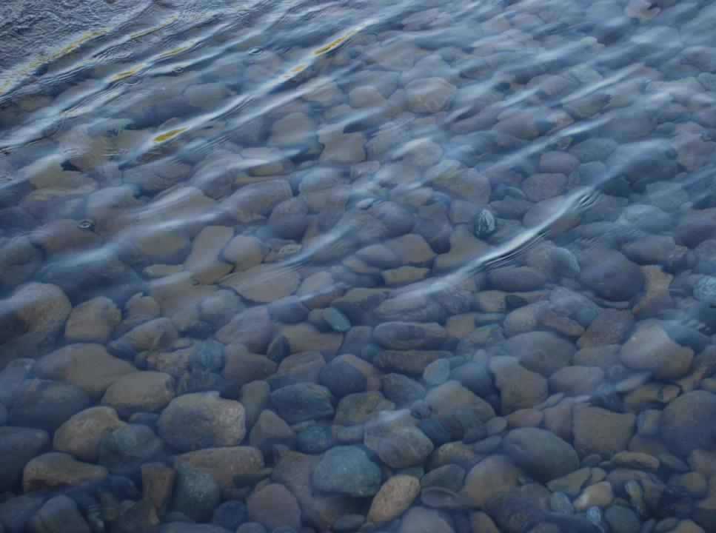

2021 CGP 4.7
4.7 Prohibited Discharge
Wastewater from concrete washout, unless managed by an appropriate control measure;
Wastewater from washout and cleanout of stucco, paint, form release oils, curing compounds and other construction materials;
Fuels, oils, or other pollutants used in vehicle and equipment operation and maintenance; and
Soaps, solvents used in vehicle & equipment washing.

Slide 3
2021 CGP 4.8
Good Housekeeping
A permittee must design, install, implement, and maintain effective good housekeeping measures to prevent and/or minimize the discharge of pollutants.

Slide 4
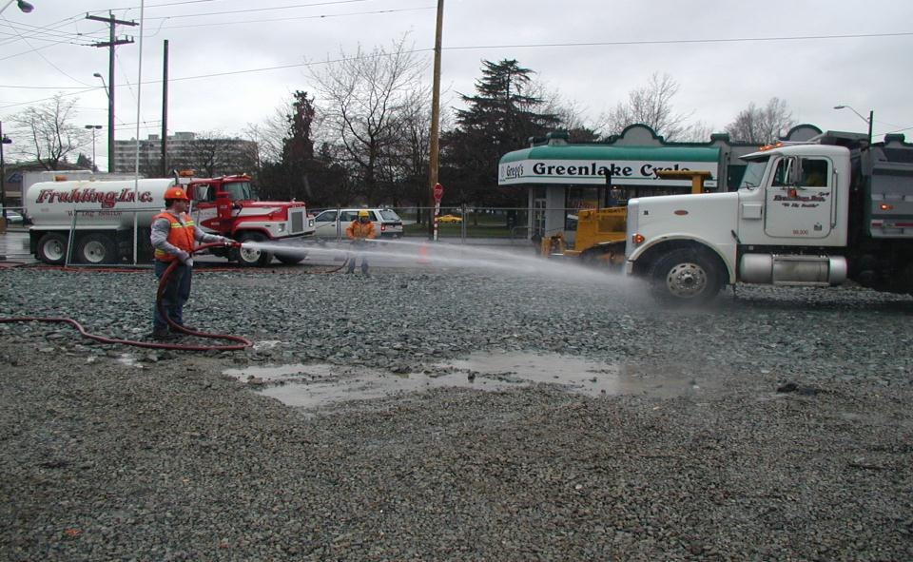
4.8.1 Washing of Equipment and Vehicles
& Wheel Wash-Down
The SWPPP must describe the pollution prevention measures used to eliminate or reduce non-storm water discharges.
BMP
OR SC-11
AKDOT&PF – 42.00
Seattle
Notes:
Stabilize entrance & parking areas with crushed rock to avoid trackout
Tire baths may be necessary in large construction jobs

Slide 5
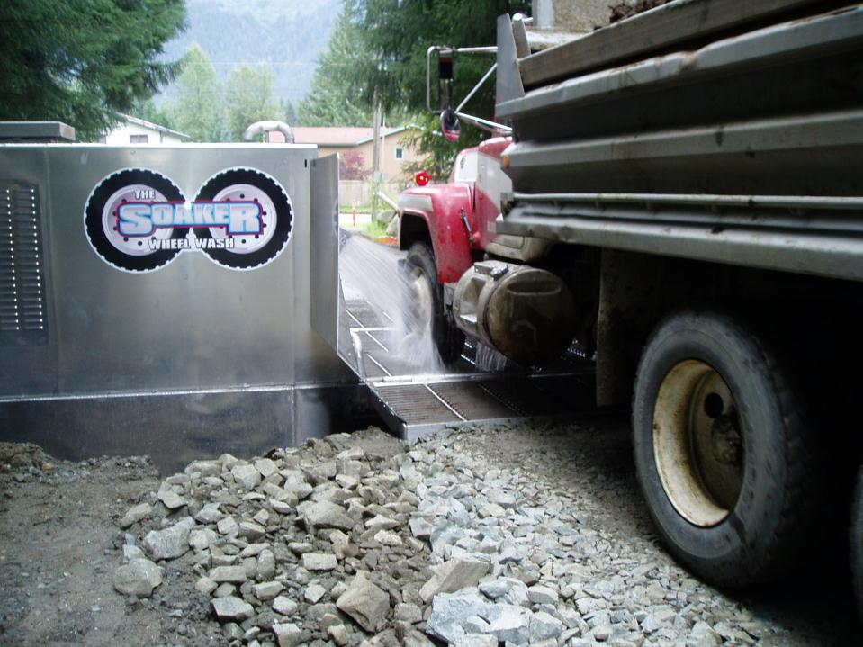
Automated Wheel Washing
Juneau

Slide 6
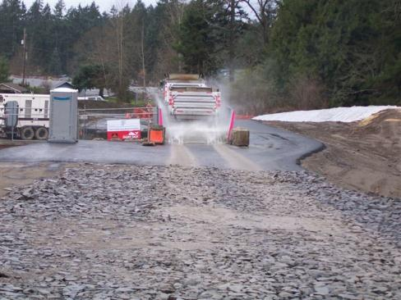
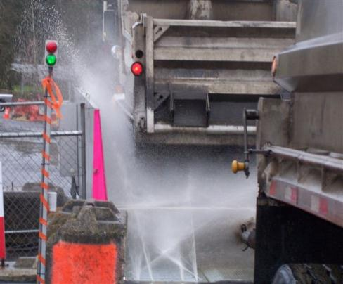
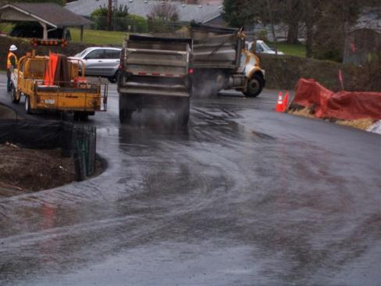
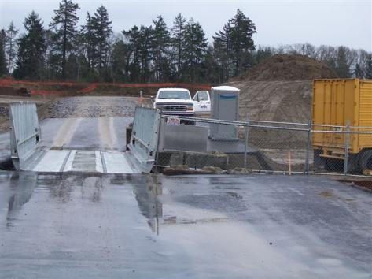
Notes:
Wash Water is Process Water
Note surface drainage back to wheel wash holding tanks for treatment.

Slide 7
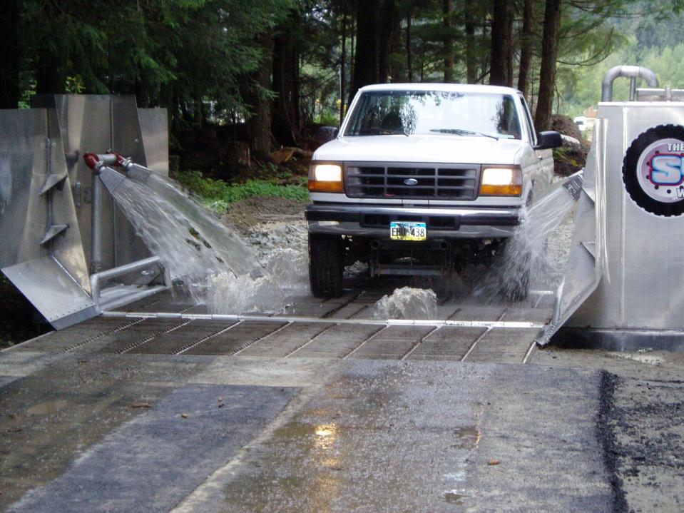
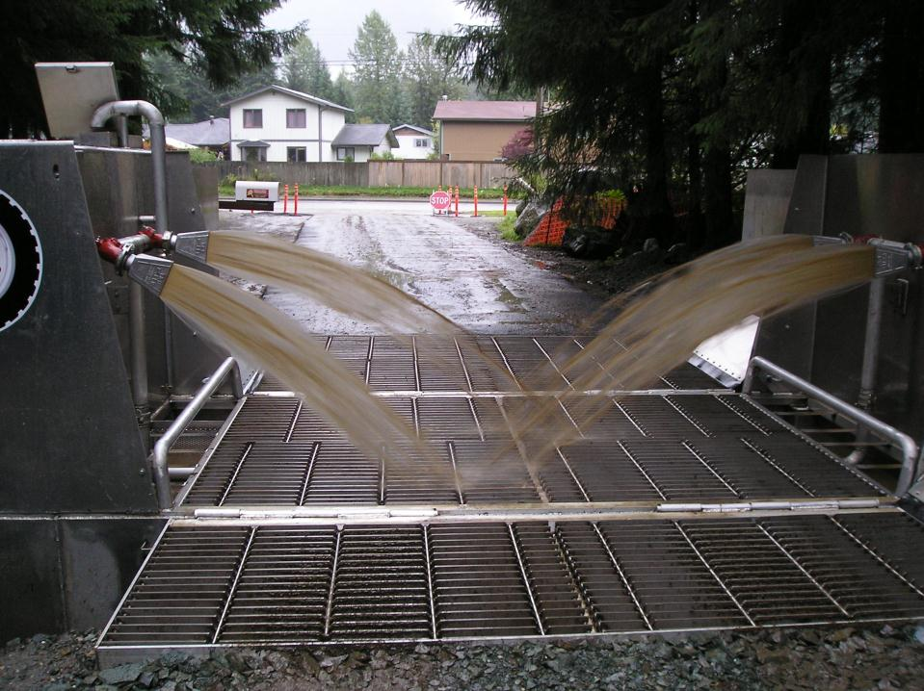
Dirty Wash Water Needs to Be Controlled Too
Juneau

Slide 8
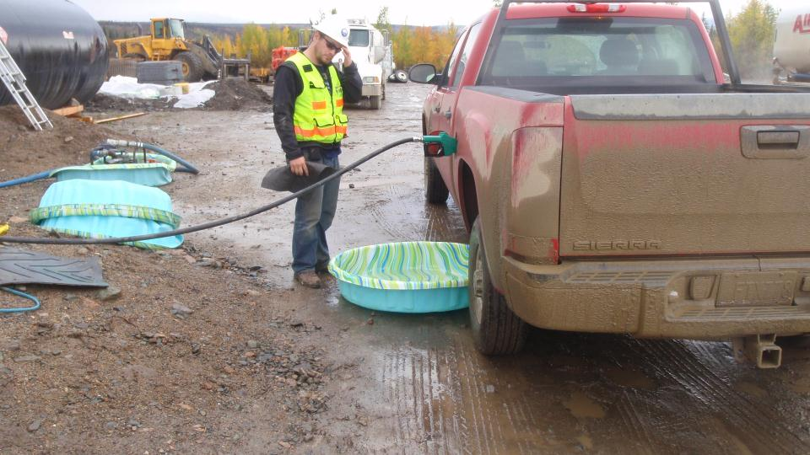
4.8.2 Fueling and Maintenance Areas
Designate areas to be used for fueling and/or maintenance of equipment and vehicles
Taylor Hwy

Slide 9
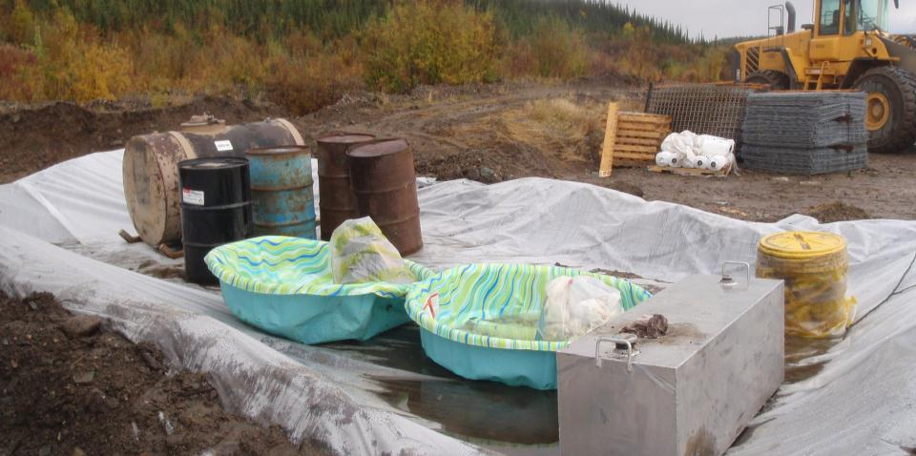
Locate such activities away from conveyance channels, storm drain inlets and waters of the U.S.;
Minimize the exposure to precipitation and storm water or use secondary containment structures designed to eliminate the potential for spills or leaked chemicals
Taylor Hwy

Slide 10
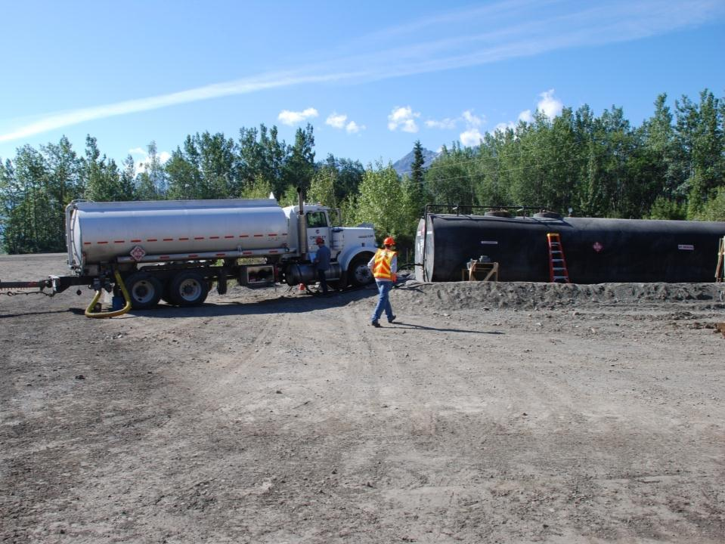
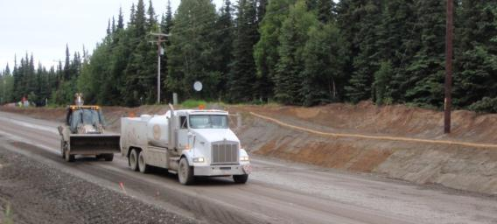
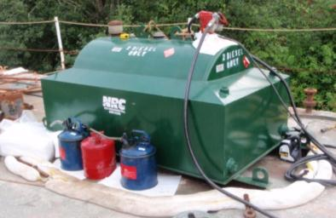
Where & how will fuel be delivered, stored & managed.
Any prohibitions of practices?

Slide 11
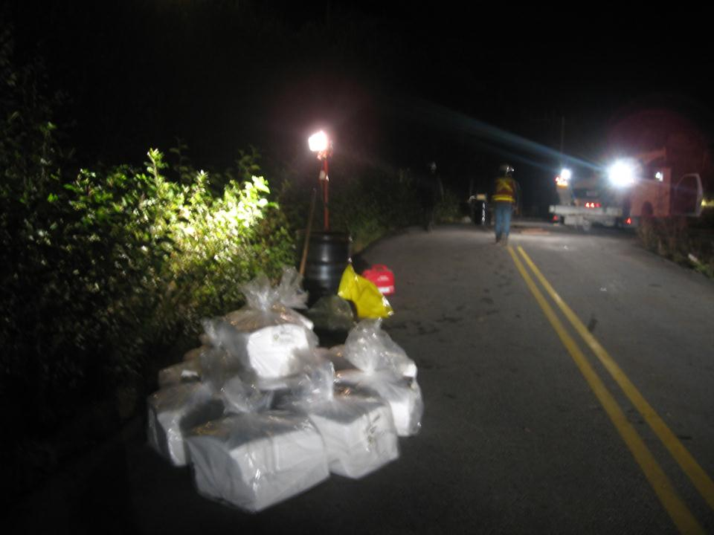
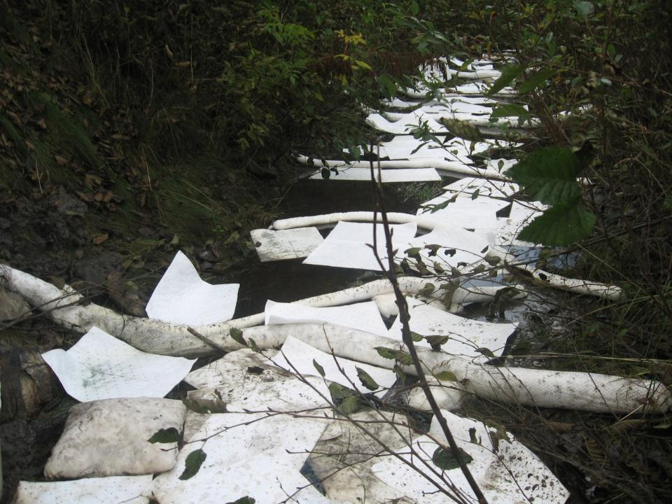
Be Prepared
Clean up spills or contaminated
surfaces immediately

Slide 12
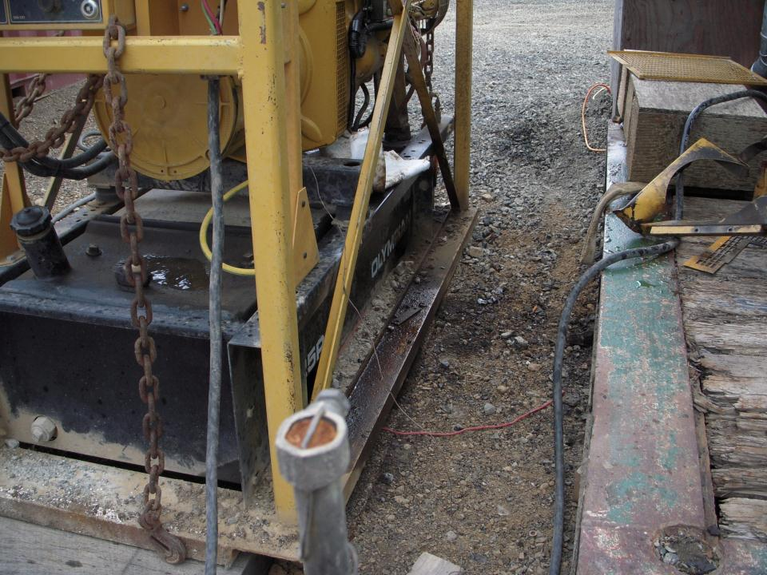
The Never Ending Challenge.
Good Housekeeping
Goodnews

Slide 13
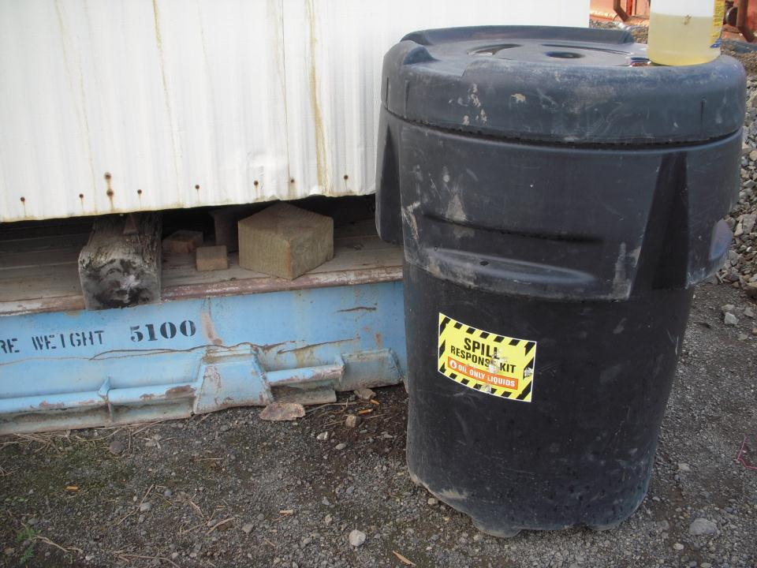
Be Prepared
Ensure adequate clean up supplies are available at all times to handle spills, leaks, and disposal of used liquids
Goodnews

Slide 14
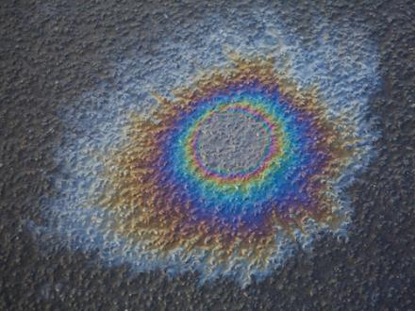
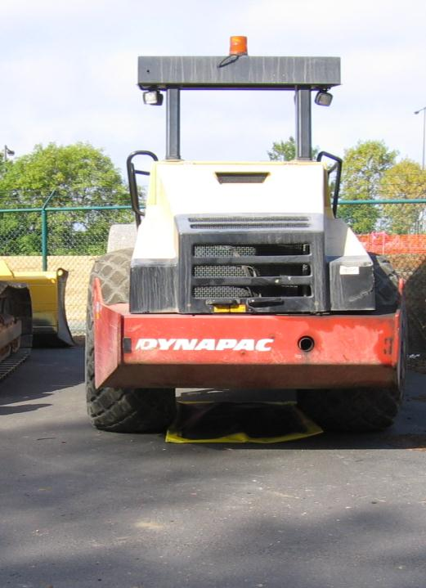
4.8.2.4.3
Use drip pans or absorbents under or around leaky equipment and vehicles

Slide 15
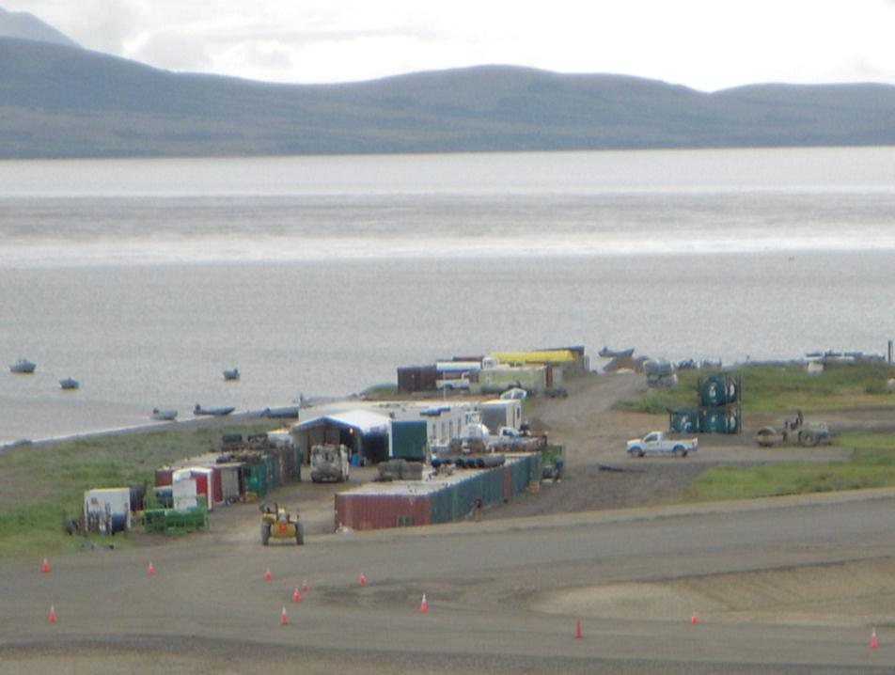
4.8.3 Staging and Material Storage Areas
Designate areas
Minimize the exposure to precipitation and storm water and vandalism for all chemicals, treatment chemicals, liquid products, petroleum products, and other materials that have the potential to pose a threat to human health or the environment.
Goodnews Bay

Slide 16
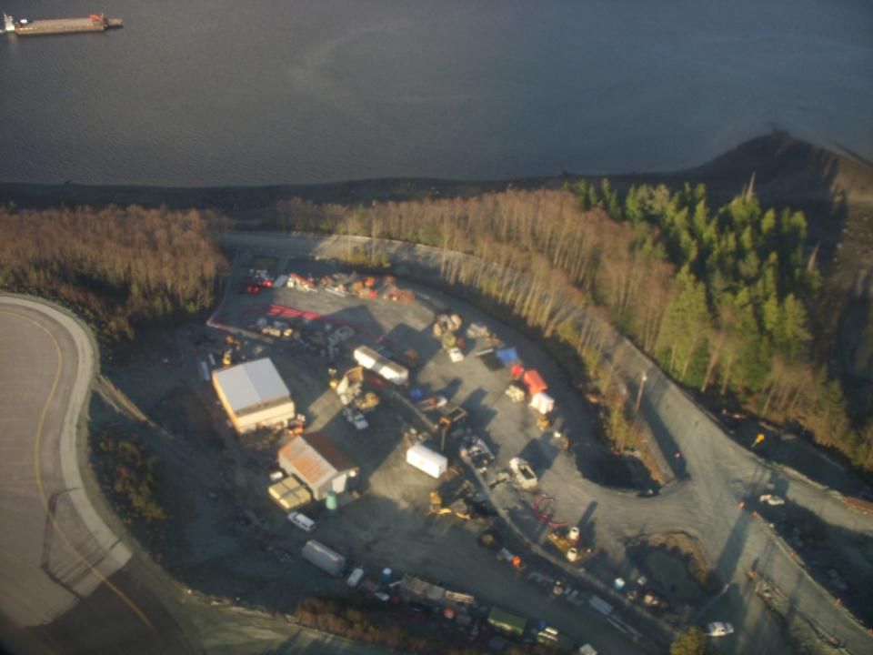
Identify ways to reduce, stop, contain and clean up spills
Dispose of contaminated materials
Train personnel responsible for prevention and response
Equipment
Maintenance
Toilet
Fuel Tanks
Ketchikan
Notes:
Construction sites may be subject to 40 CFR Part 112 regulations that require the preparation and implementation of a SPCC. If your site has a total storage capacity greater than 1,320 gallons and could discharge to navigable waters of the US your facility is subject to 40 CFR Part 112, your SWPPP should reference the SPCC Plan and keep the plan with the SWPPP.

Slide 17
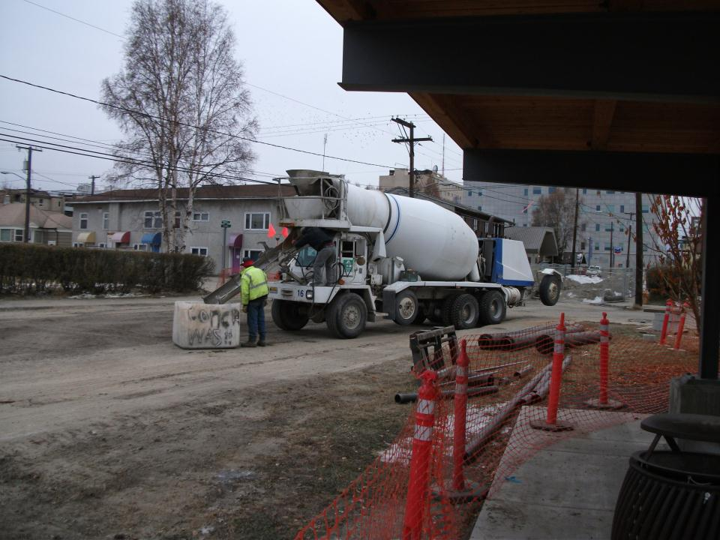
4.8.4 Washout of Applicators/Containers used
for Paint, Concrete, and Other Materials
Direct all concrete, paint, and washout activities into a lined, water-tight container or pit to ensure there is no discharge into the underlying soil and surrounding areas
Fairbanks

Slide 18
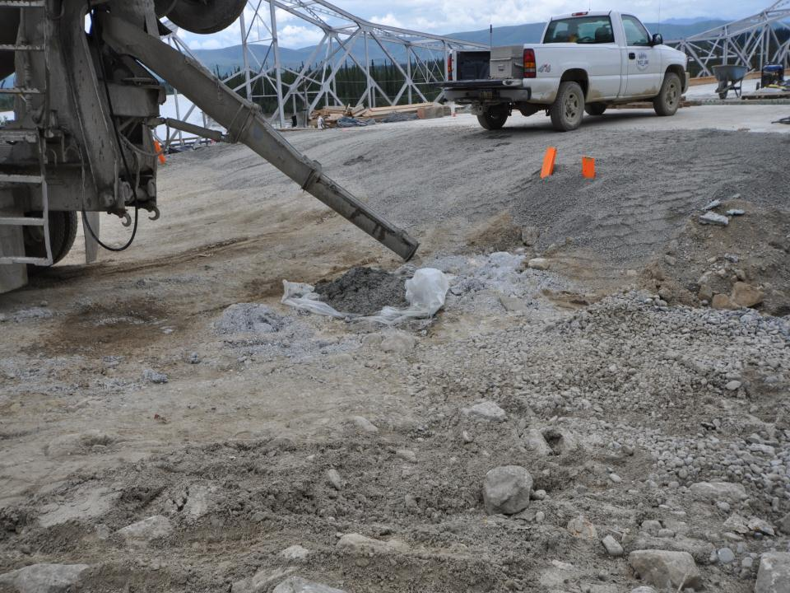

Tok

Slide 19
Concrete Slurry is a Pollutant
Concrete Slurry From Pouring & Sawcutting Pollutes Stormwater With High pH
Do Not Allow Slurry to Mix With Stormwater
If Slurry Mixes With Stormwater Then Treat With Dry Ice or CO2 Sparging
Concrete Clean Up Should Be Done Only in Formed Areas
Unused Concrete Should Be Returned for Recycling

Slide 20
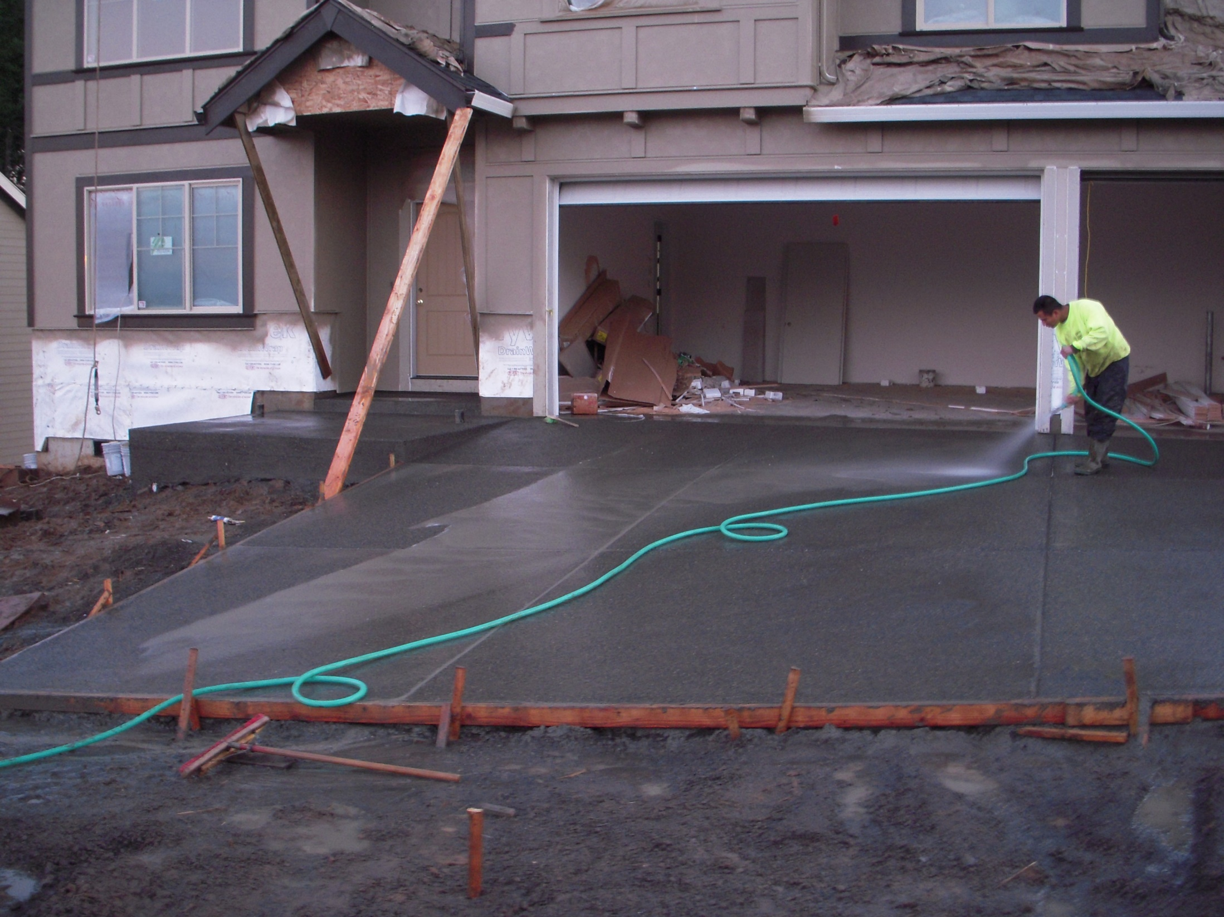

Slide 21
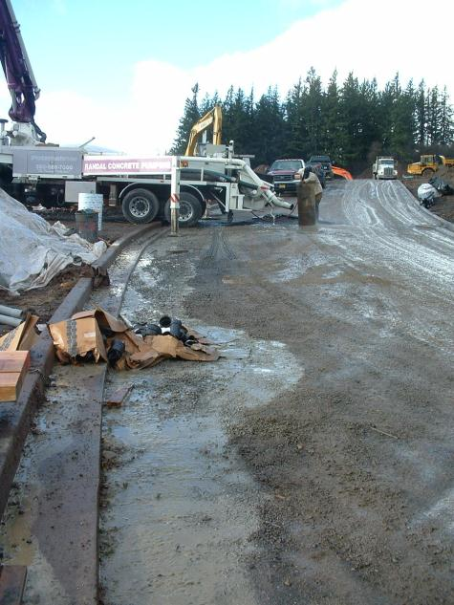
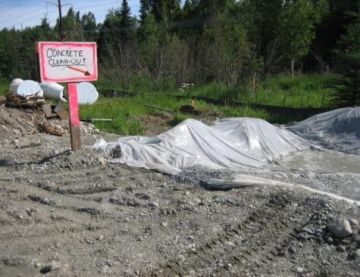
Concrete Handling
Concrete contributes turbidity and High pH
Return unused concrete to plant
Wash chutes, pumps, hand tools into a contained area
BMP
WA C-151
OR NS-14
AKDOT&PF-06.00
Notes:
Includes the finishing tools. Note the pump truck is using no containment. Make sure the containment liner is sufficient for the volume.

Slide 22
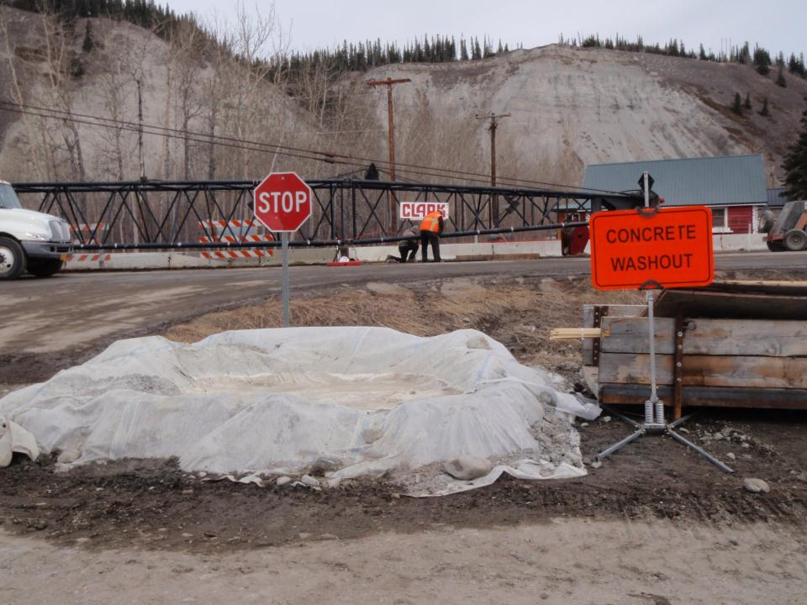
Designate areas to be used for washout

Slide 23
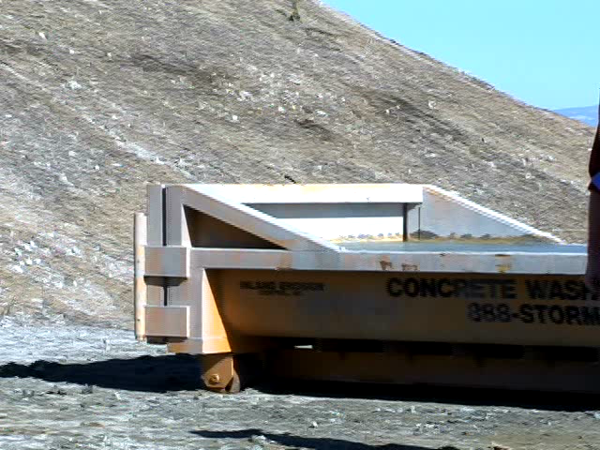
Notes:
Video: Concrete washout

Slide 24
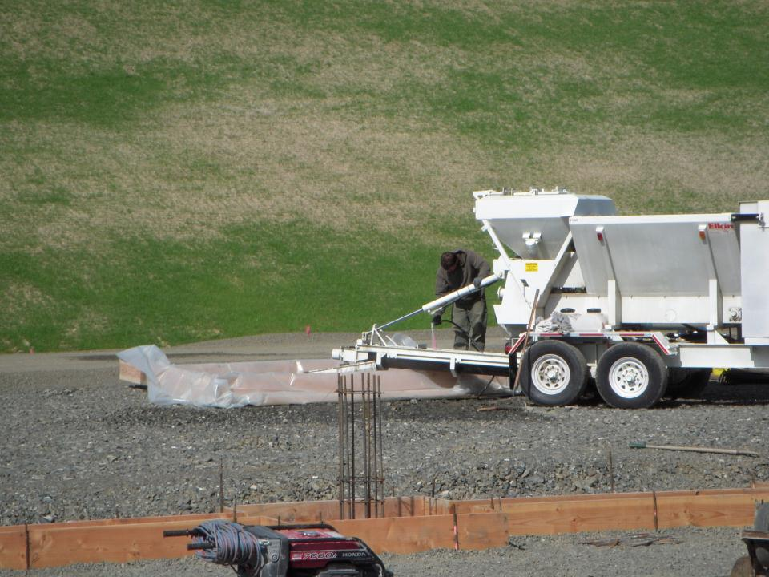
2021 CGP 4.8.4.5
For concrete washout areas, remove hardened concrete waste when it has reached ½ the height of the container or pit
Village Concrete Washout
Goodnews

Slide 25
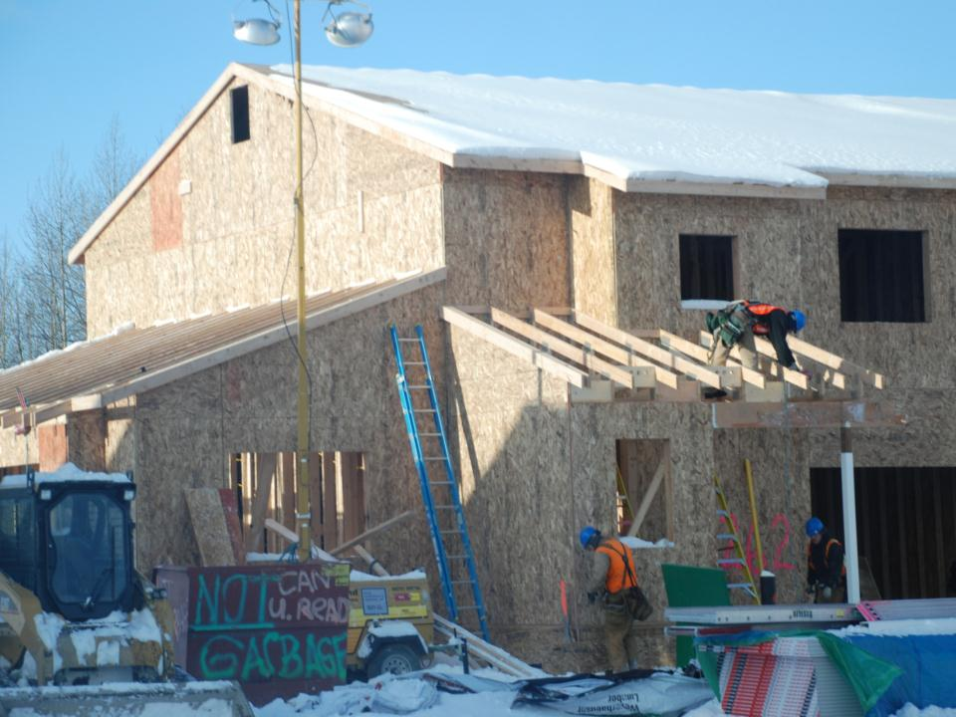
4.8.6 Storage, Handling, & Disposal
of Construction Waste
Provide for storage areas
Store Hazardous / toxic wastes in appropriate containers
Ft. Richardson

Slide 26
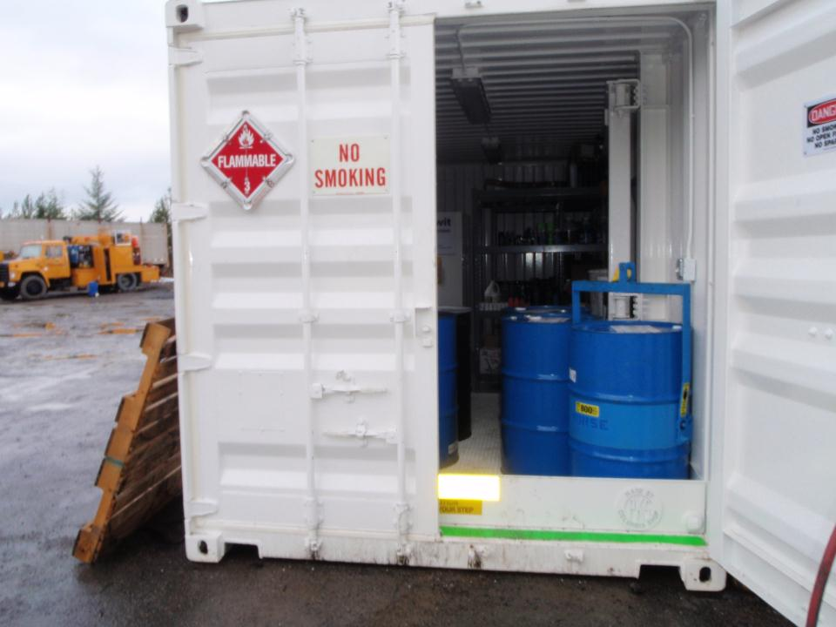
Haz-Mat Storage
Petersburg

Slide 27
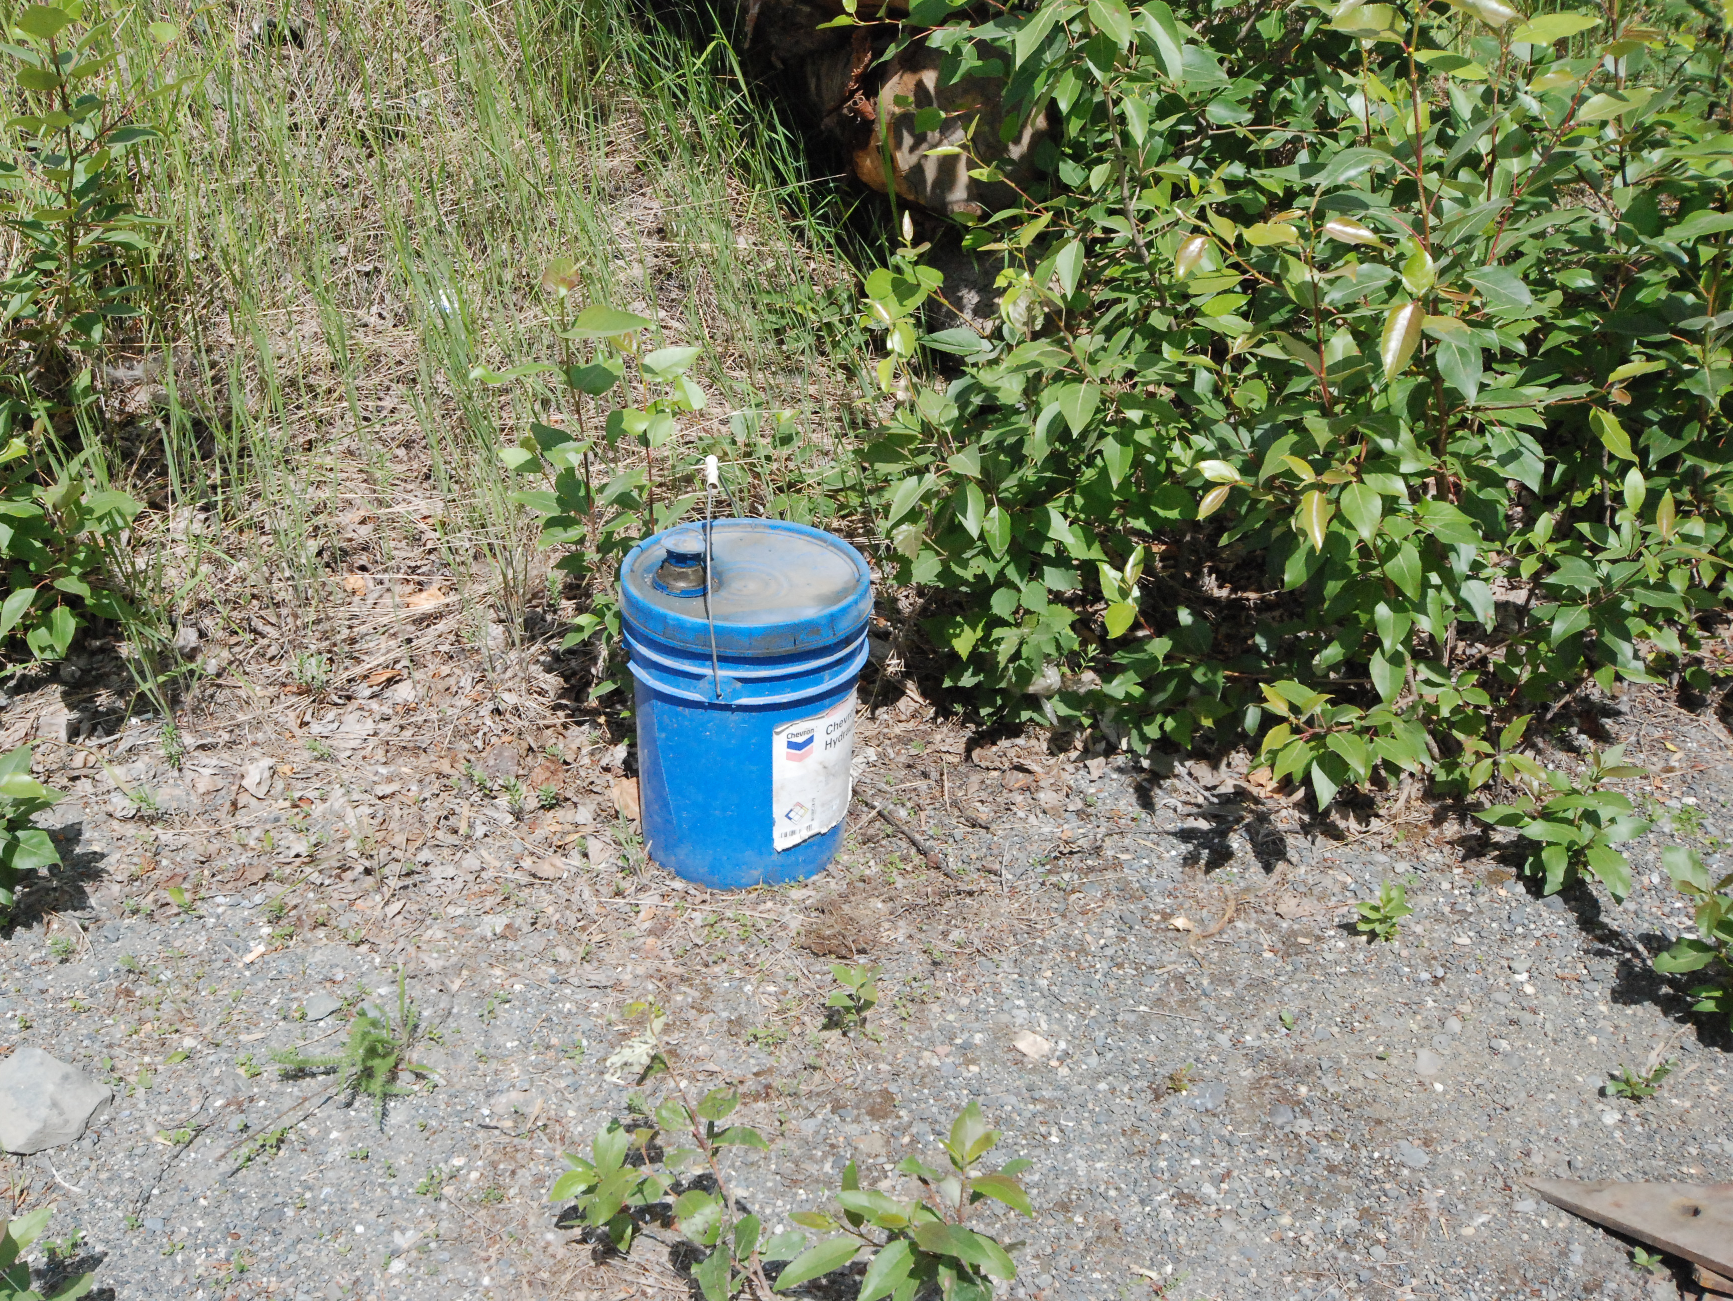
Why is it here?

Slide 28
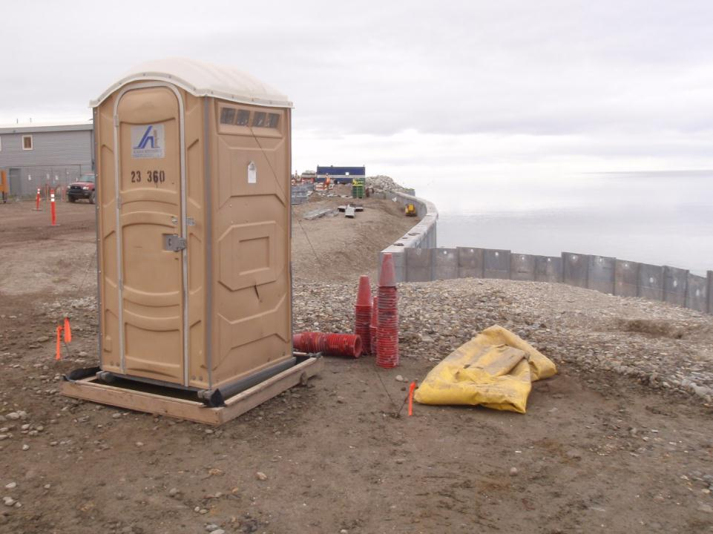
4.8.6.4 Provide containment of portable toilets
Prevent discharges of pollutants to the drainage system or receiving water. Clean and inspect regularly for leaks and spills.
Secondary Containment
Rope tie downs
Kotzebue

Slide 29
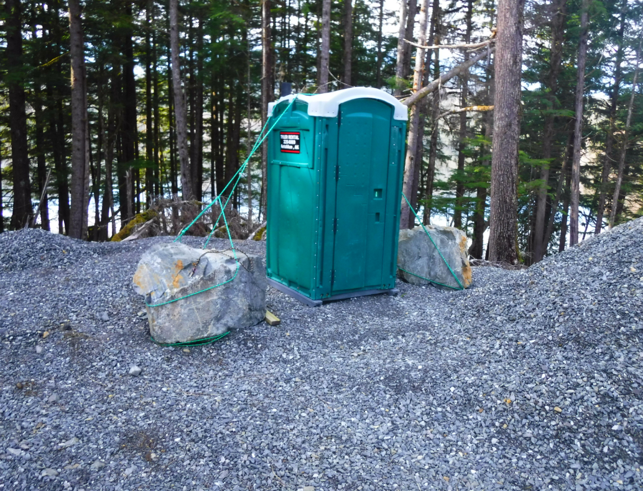
Stuck between rocks & a smelly spot!

Slide 30
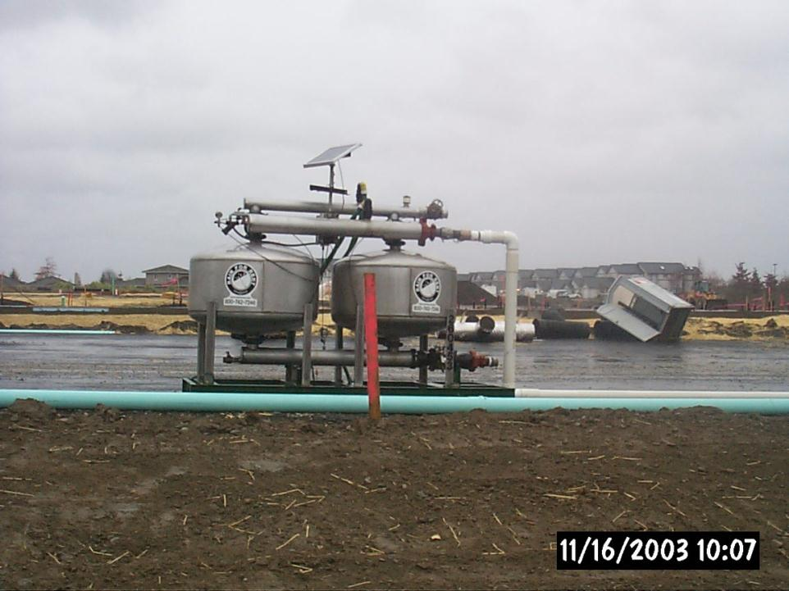
Porta Potty Pollution Prevention Plan
Pee Pee PPP
Photo Courtesy WADOE modified
Notes:
Or a PP PPP for short.

Slide 31
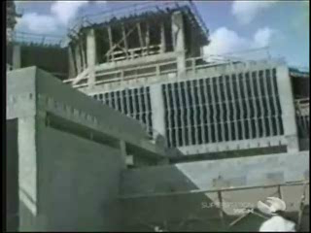
Notes:
Video Clip “Oh Crap 2 for module 2”

Slide 32
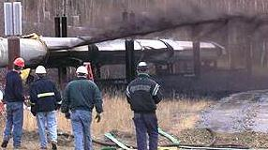

4.9 Spill Notification
9.3.1 A permittee is prohibited from discharging hazardous substances or oil from a spill or other release. Alaska state law (18 AAC 75.300) requires all oil and hazardous substance release be reported to DEC Spill Prevention and Response program. Spill reporting placards can be found at the following webpage: https://dec.alaska.gov/spar/ppr/spill-information/reporting
9.3.2 To report a spill, call the nearest DEC Area Response Team Office:
  Southeast (Juneau) – 465-5340
  Central (Anchorage) – 269-3063
  Northern (Fairbanks) – 451-2121
9.3.3 Outside of normal business hours, the permittee must call (800) 478-9300 to report the spill as soon as the permittee has knowledge of the discharge

Slide 33
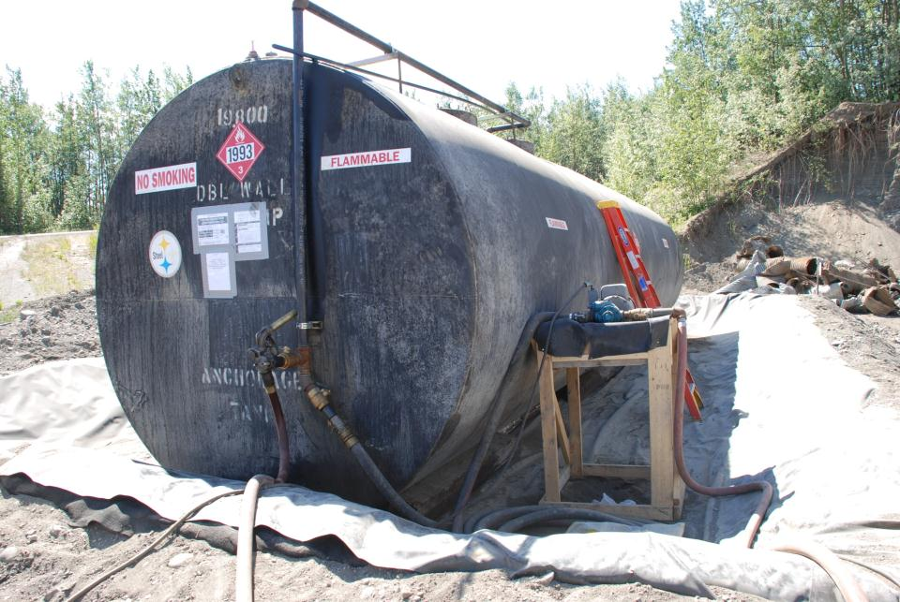
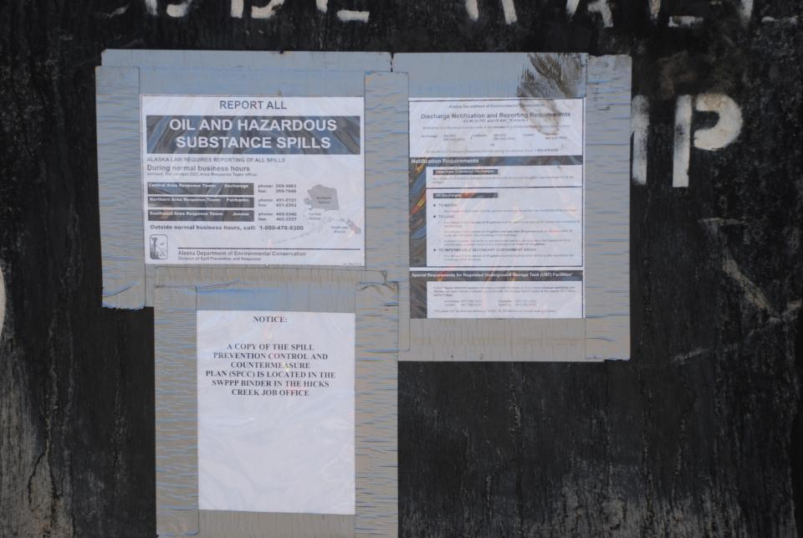
Secondary Containment With Notice

Slide 34
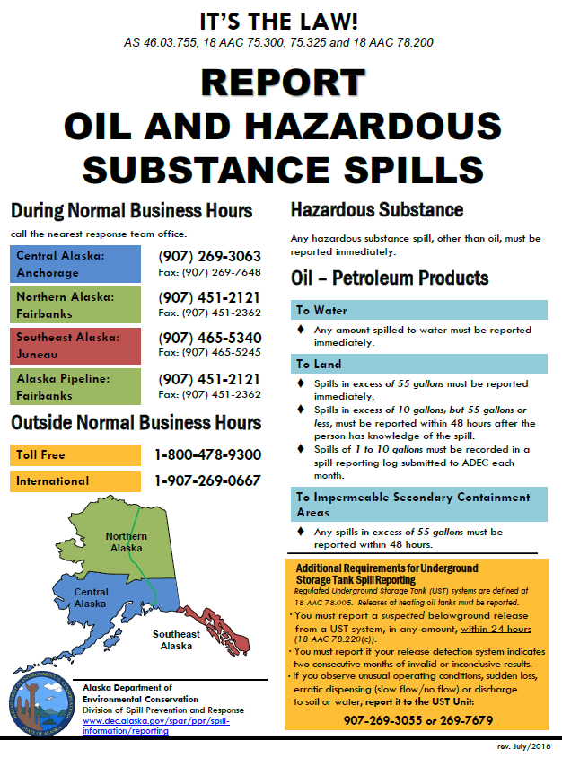

Understand & Follow
All Reporting Requirements
Hazardous, Any Amount
Report Immediately
OIL SPILLS
To Water any amount
Report Immediately
Even if Spills are into
Contained areas
> 55 Gallons = 48 Hours
Report all Spills Between
1 & 10 Gallons Monthly

Slide 35
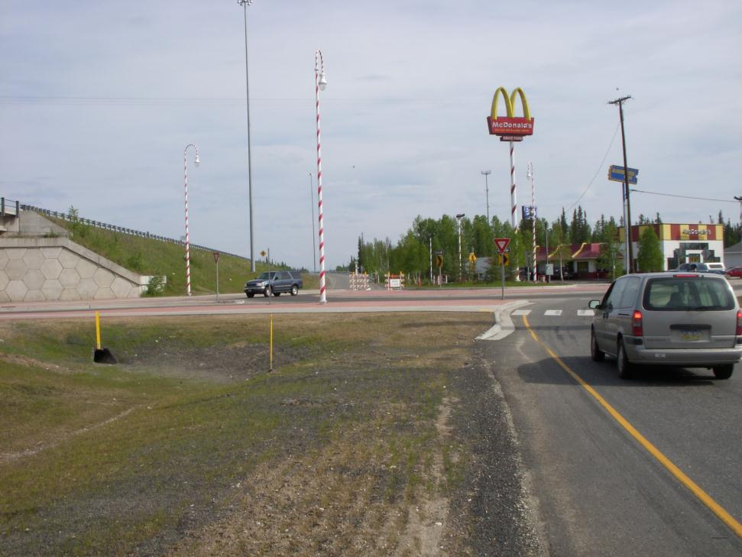
4.11 Permanent Storm Water Management Control
A permittee who constructs, alters, installs, modifies, or operates any part of a permanent storm water management control at a site must submit a copy of the engineering plans for review
North Pole

Slide 36
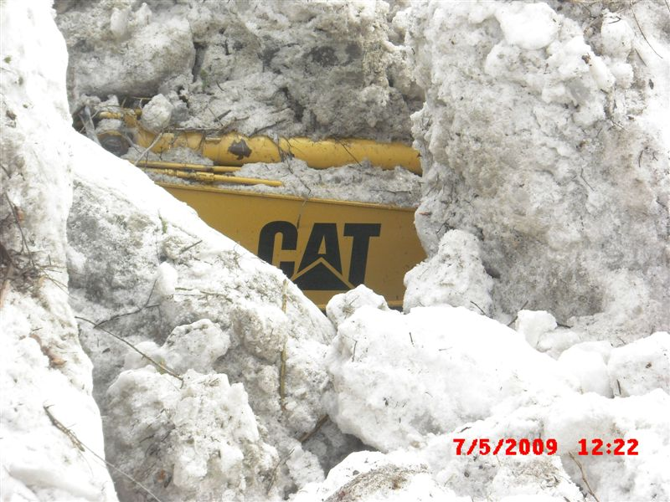
4.12.1 Winter Shutdown
The permittee must identify the anticipated dates of fall freeze-up and spring thaw for their site and plan for winter shutdown.
Frozen ground by itself is not considered stabilization.
A permittee must provide for :
Stabilization of conveyance channels; disturbed slopes, disturbed soils, and soil stockpiles.
Erosion and sediment control measures in anticipation of spring thaw.

Slide 37
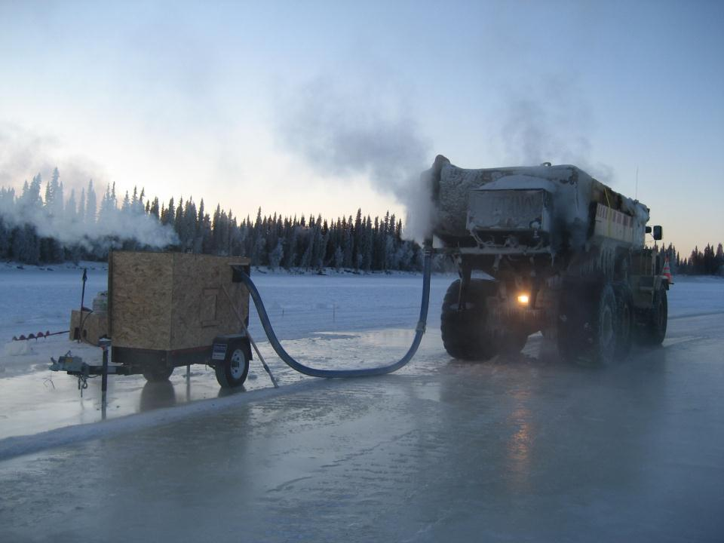
4.12.2 Winter Construction
Permit coverage is not required for the construction of ice roads or the placement of sand or gravel on frozen tundra with no excavation or potential to pollute waters of the U.S.

Slide 38
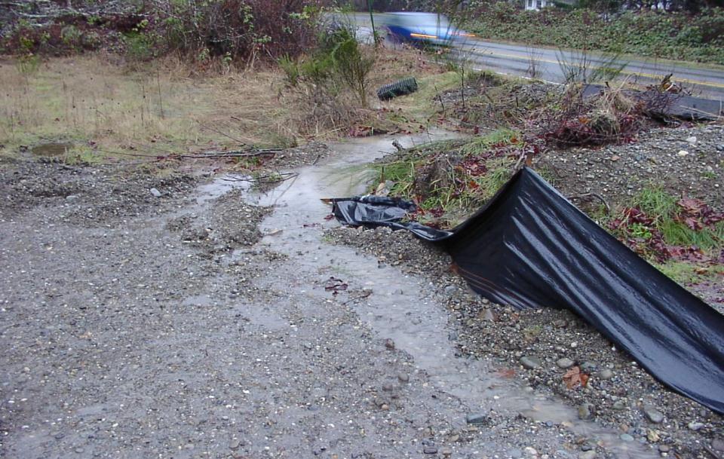
Maintain BMPs
2021 CGP 4.13
All BMP’S Have Designed Performance Goals & Standards
All BMPs Should Have the Performance Goals Detailed in the SWPPP
Notes:
BMPs must be continually maintained – especially after rain events

Slide 39
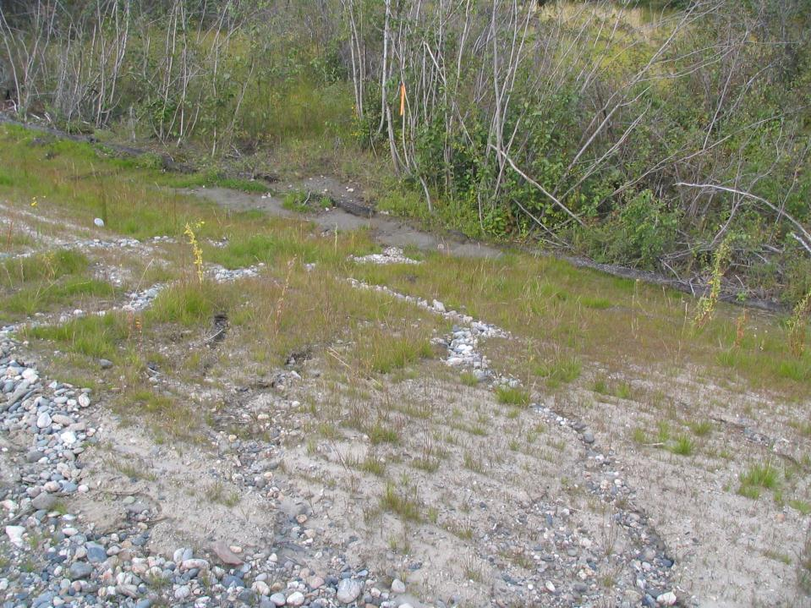
2021 CGP 4.13
4.13.1 A permittee must maintain all control measures, good housekeeping measures, and other protective measures in effective operating condition.

Slide 40
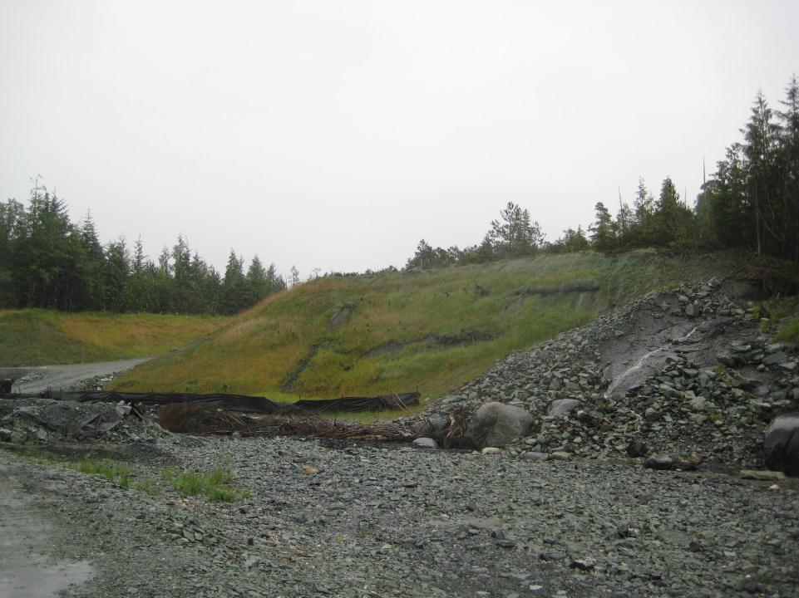
2021 CGP 4.13.1
If site inspections required by Part 6.0 identify control measures, good housekeeping measures, or other protective measures that are not operating effectively, the permittee must implement corrective actions in accordance with Part 8.0.
Ketchikan

Slide 41
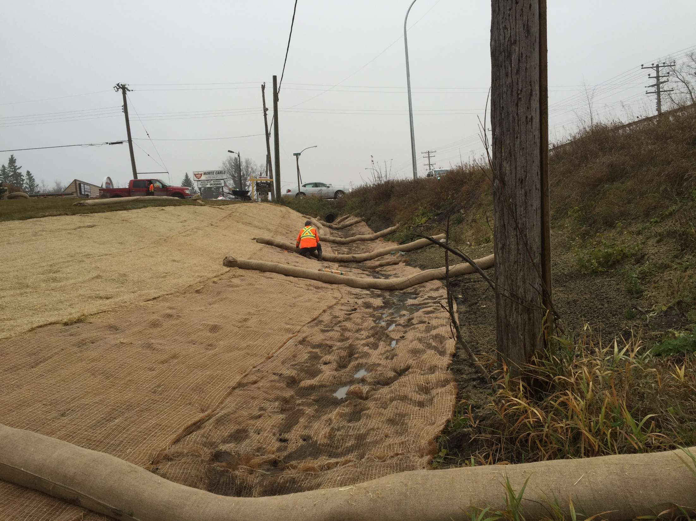
4.13.2 If existing control measures need to be modified or if additional control measures are necessary for any reason, the permittee must complete any corrective action in accordance with Part 8.2.
2021 CGP 4.13

Slide 42
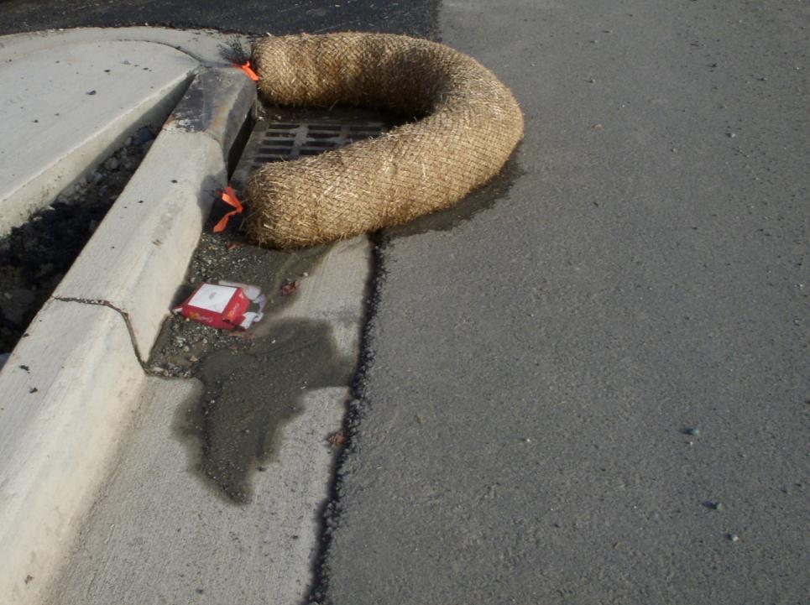
Anchorage
2021 CGP 4.13
4.13.3 A permittee must remove sediment from silt fences, check dams, berms or other controls before the accumulated sediment reaches:
4.13.3.1 One-third (⅓) the distance up the above-ground height (or it reaches a lower height based on manufacturer’s specifications) for silt fences;
4.13.3.2 One-half (½) the distance up the above-ground height (or it reaches a lower height based on manufacturer’s specifications or BMP guidance manuals) for storm water inlets, check dams, berms, or other control measure; or
4.13.3.3 For sediment traps or sediment ponds, the permittee must remove accumulated sediment when the design capacity has been reduced by fifty (50%) percent.

Slide 43
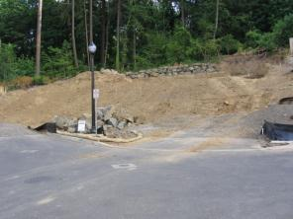


MAINTAIN BMPs
All BMPs require maintenance
Proper installation is only the first step
Inspect on a regular basis and after every discharge
Designate a person to inspect E & S controls
Notes:
All erosion and sediment control BMPs require regular maintenance to function. Proper installation alone is no guarantee of success. They should be inspected on a regular basis and after every storm event. Frequent occurrences include storm drain inlets becoming clogged, silt fence overwhelmed by runoff and sediment after a storm, sediment traps filling in and stabilized construction entrances sinking into the mud. These devices are useless in poor condition. We highly recommend designating someone to visually inspect E&S controls every day, reporting back to the construction manager with recommendations for maintenance or replacement.

Slide 44

Maintenance of Controls
Summarize routine maintenance of BMPs.
Include schedules (daily, weekly, etc.) as well as who is responsible.
Detail maintenance procedures for individual BMPs.
All maintenance activities must be documented.
Use corrective action log to describe all maintenance.
Notes:
For more on this topic, see SWPPP Guide, Chapters 4 and 5 and the suggestions on the Sample Inspection Report in Appendix B.

Slide 45

BMP’s Need More Than “On The Fly” Maintenance

Slide 46

Some BMPs in Certain Situations are Harder to Maintain Than Others

Slide 47

Timely Monitoring of BMPs is Required and prudent
Responsible Person (AK-CESCL) Must Inspect & Record BMP Performance
BMP Performance Must be Inspected per all Permit Conditions
Schedule must be in the SWPPP

Slide 48

BMP Inspections
Qualified Inspectors Must Fill Out Inspection Checklists/Reports
You Must Record BMP Maintenance
You Must Record any Sampling Data of Stormwater Discharge

Slide 49

How do you do what you do?
Are your means and methods compliant with all permit conditions?
Notes:
Ask your self with regards to all tasks associated with your project.

Slide 50

Debris Bins
Covered Soils
Inlet Protection
Gravel Entrance
Driveway Perimeter Control
Clean Streets
Notes:
Clean & Tidy

Slide 51

Debris Free Zone:
Clean Access for Clients & Crew

Slide 52


Innovative thinking, Risk Management
Notes:
Place Matting Materials Down Where People Walk

Slide 53

Temporary “Winter Over” Erosion Control
Site Outlet
Pre-Load Pile
Wattles
Jute Lined
V- Ditch
Pipe Drain

Slide 54

Stockpile Covered
Stockpile Silt Fence
  Reinforced for Flow (Straw Bales)
Lot Grading Perimeter Silt Fence
Buffer Zone
Wire Backed Silt Fence at Site Perimeter

Slide 55




Notes:
Step by step implementation

Slide 56

Sediment Controls must be removed
30 days after final site stabilization
Notes:
Someone has to remove the BMP’s for permit compliance.

Slide 57

Be on the lookout for
Cost Saving Opportunities
Cutting Edge
BMP Removal
Strategies
Free Acquisition
Of Materials

Slide 58

Scheduling
Stabilized Site
BMP
WA C-162
OR EP-1
Bonneville Dam
Notes:
Scheduling and manage the project are the best BMP’s for construction activities.

Slide 59










MANAGE THE PROJECT
Notes:
The approved Sediment and Stormwater plans must be kept on site, accessible, and must be referred to frequently. The plan should be strictly adhered to with particular attention paid to the sequence of construction. Any deviations need to be approved by the review agency. Certain changes require formal revisions to the Sediment and Stormwater plans. Coordinate with utilities and subcontractors to minimize conflicts and impacts on erosion and sediment controls. Project managers should have equipment and materials available for stabilization, dust control, street sweeping and BMP maintenance. For example, ordering additional stone will permit regular maintenance of the stabilized construction entrance without having to wait for availability. An open dialog should be maintained with the project owner, engineer, E&S control material suppliers, inspector and delegated agency representative. It is beneficial to include erosion and sediment control aspects of the project in any progress meetings.

Slide 60

Doing It Right Won’t Kill You !
58

