Slide 1


8. SWPPP Control Measures:
Sediment Controls
Minimum measures
Inspecting for compliance
Recognizing deficiencies
January 2022

Slide 2
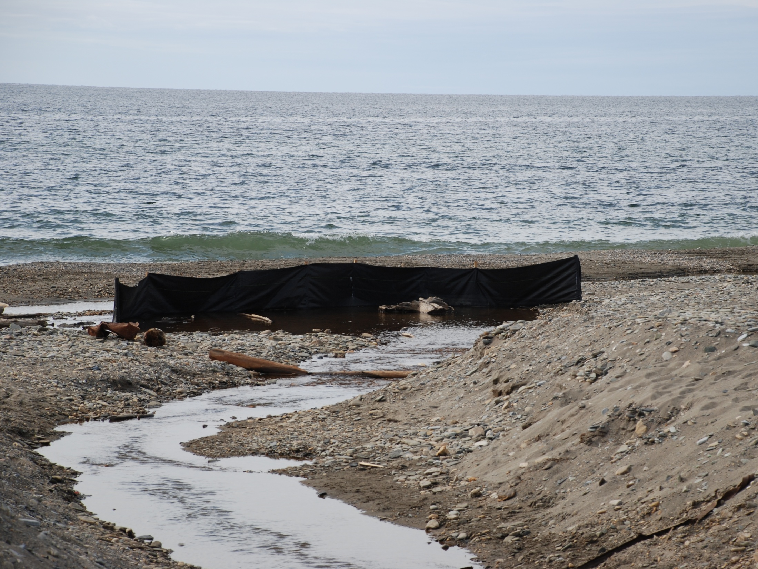
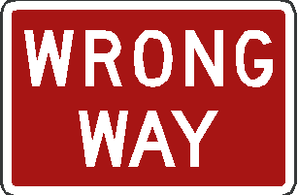
Sediment Controls
Behold: The worlds most effective silt fence
Nome
Notes:
What exactly is this silt fence doing, comment on the repeated misuse of silt fence in the construction industry. Open the discussion about how sediment controls are trying to prevent sediment from getting into surface waters, the sediment controls should not be in the waters.

Slide 3

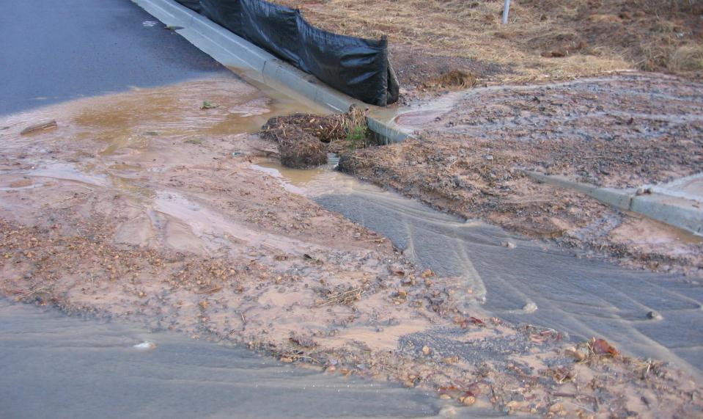
Storm Drain Inlet Protection Measures
2021 CGP 4.3.1
A permittee must install appropriate protection measures to minimize the discharge of sediment prior to entry into the inlet
Notes:
Do not spend a lot of time working on drain inlets without protecting it properly

Slide 4
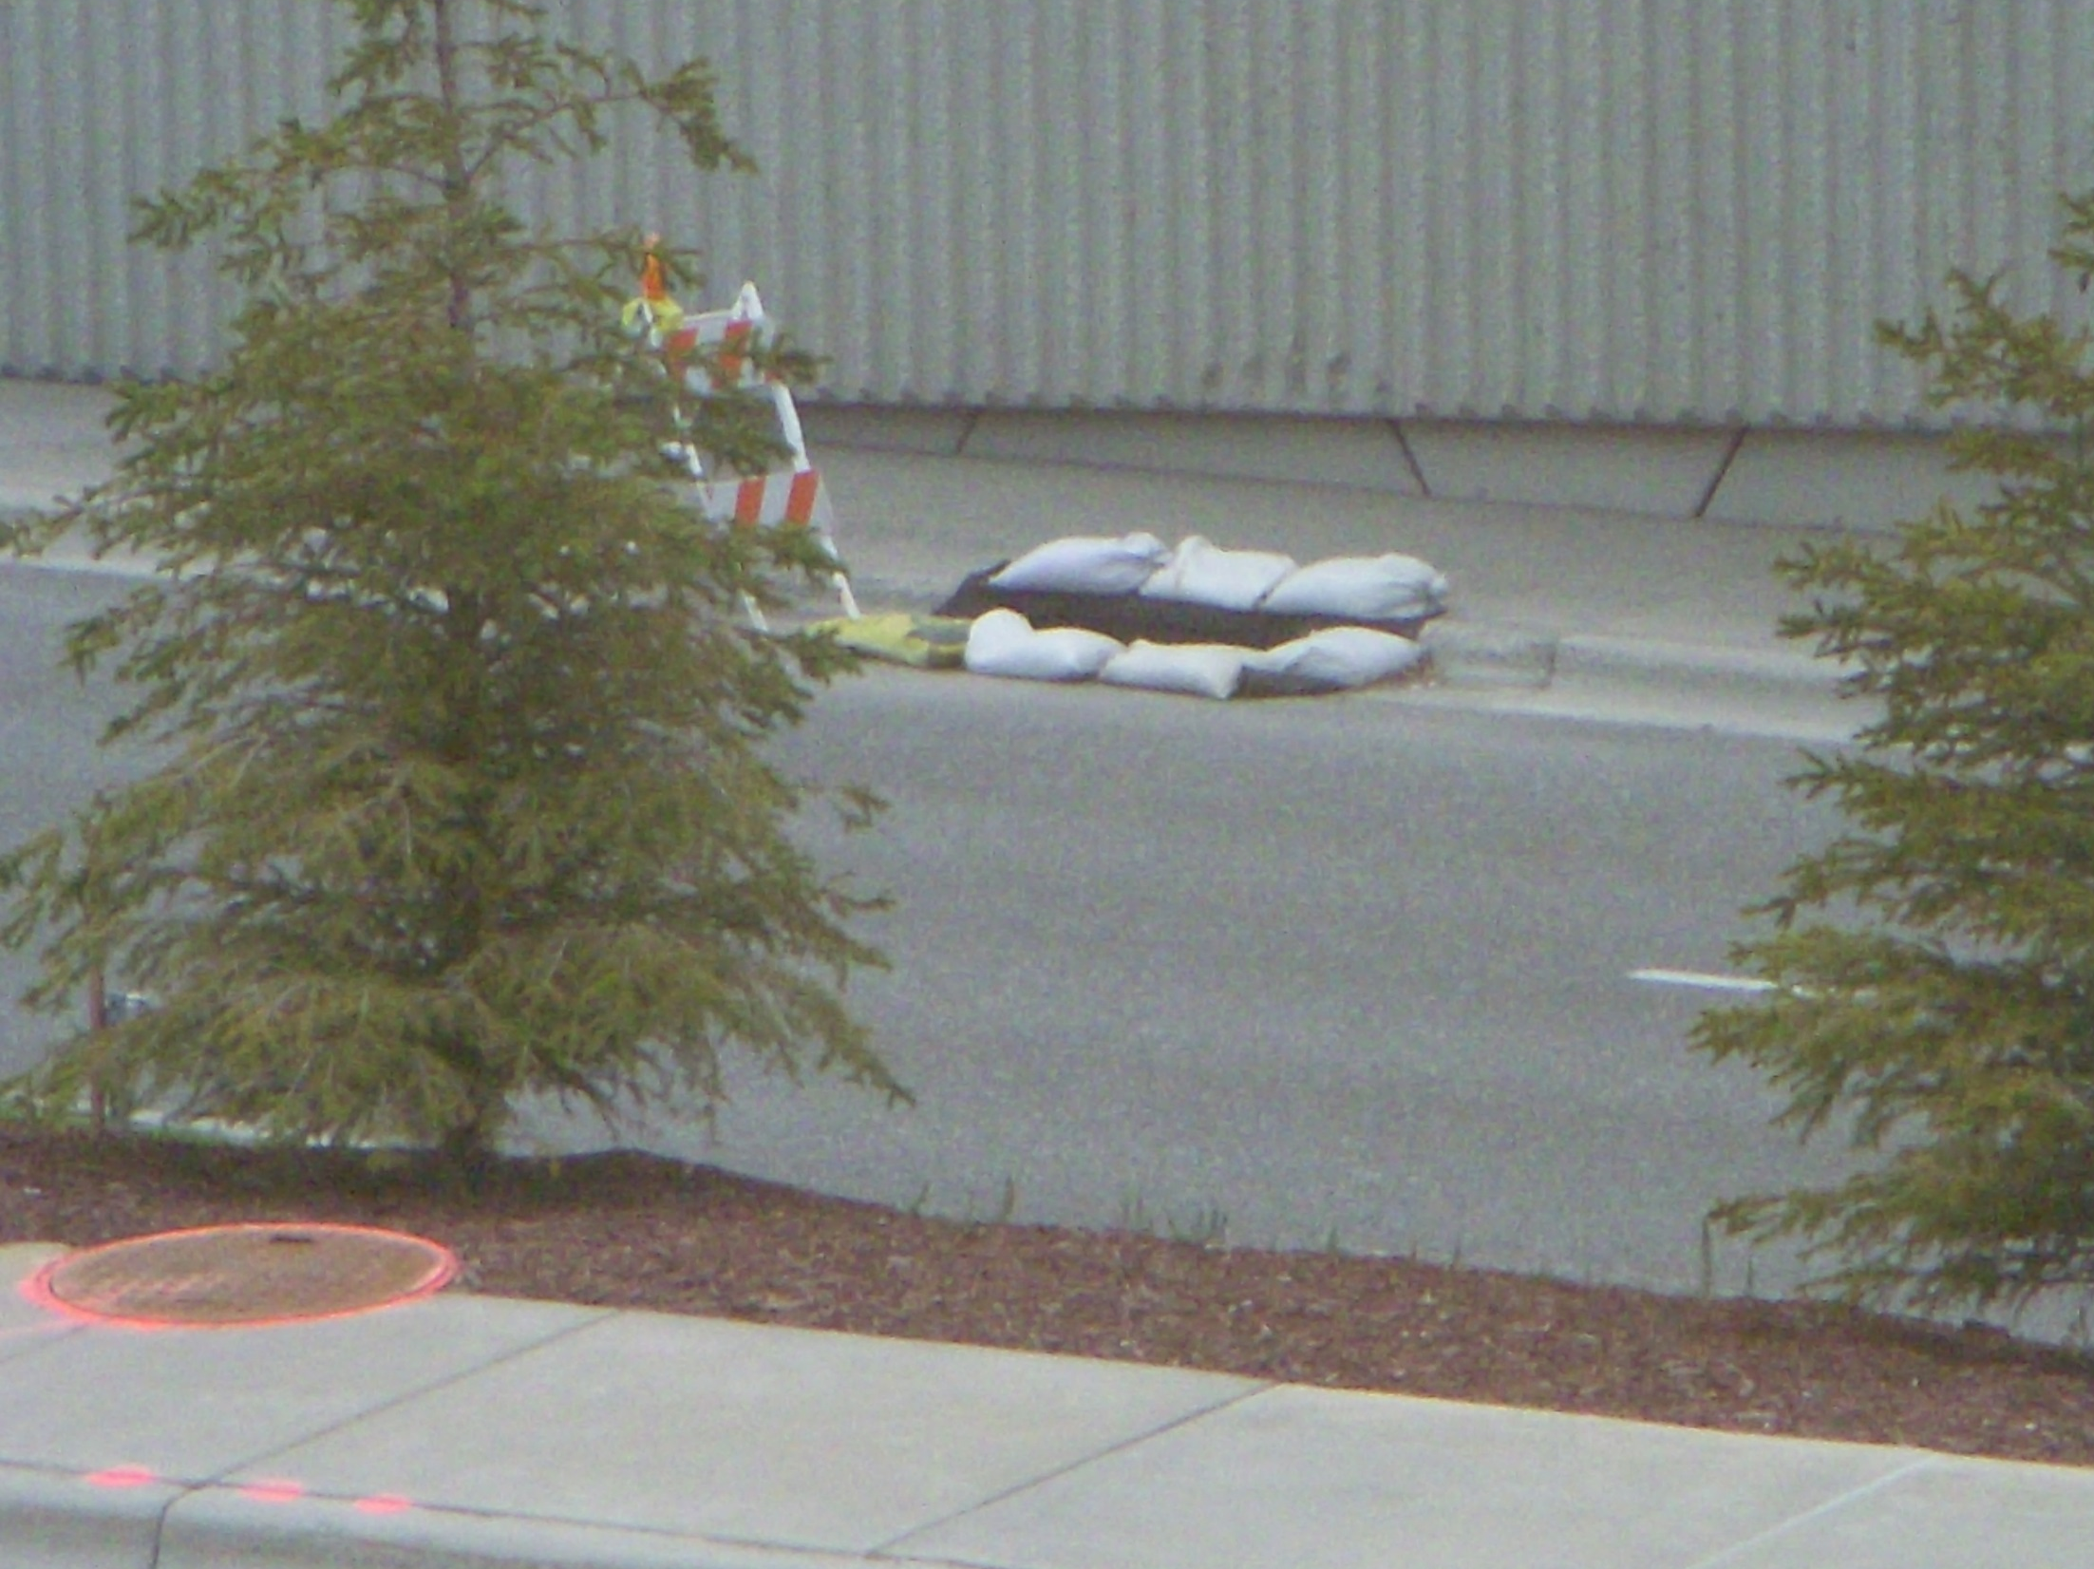
Will traffic impact your BMP?
Will your BMP divert flow somewhere else?
Is there a detail for this that assists an inspector?
ANC
Notes:
Many times inlet protection can get in the way of traffic or be destroyed by traffic. An inspector must pay attention to inlet protection that diverts flows somewhere else like this one as the increased flows to other areas may cause problems. The diversion would be created because the BMP will bypass the flow around the inlet to the next one down gradient.

Slide 5
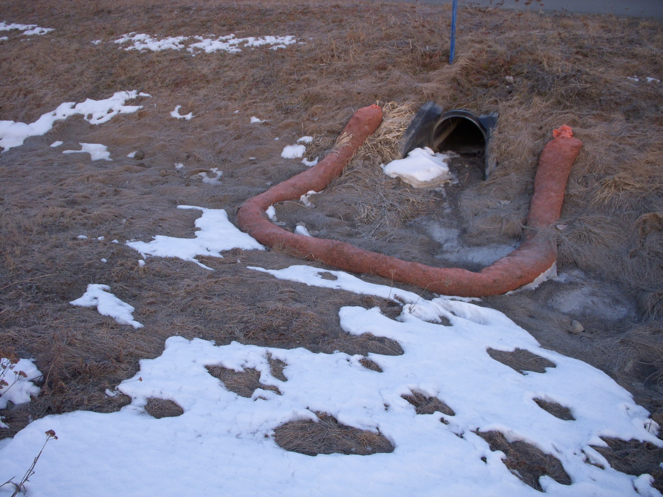
Protect culverts from sediment deposition
Anchorage

Slide 6
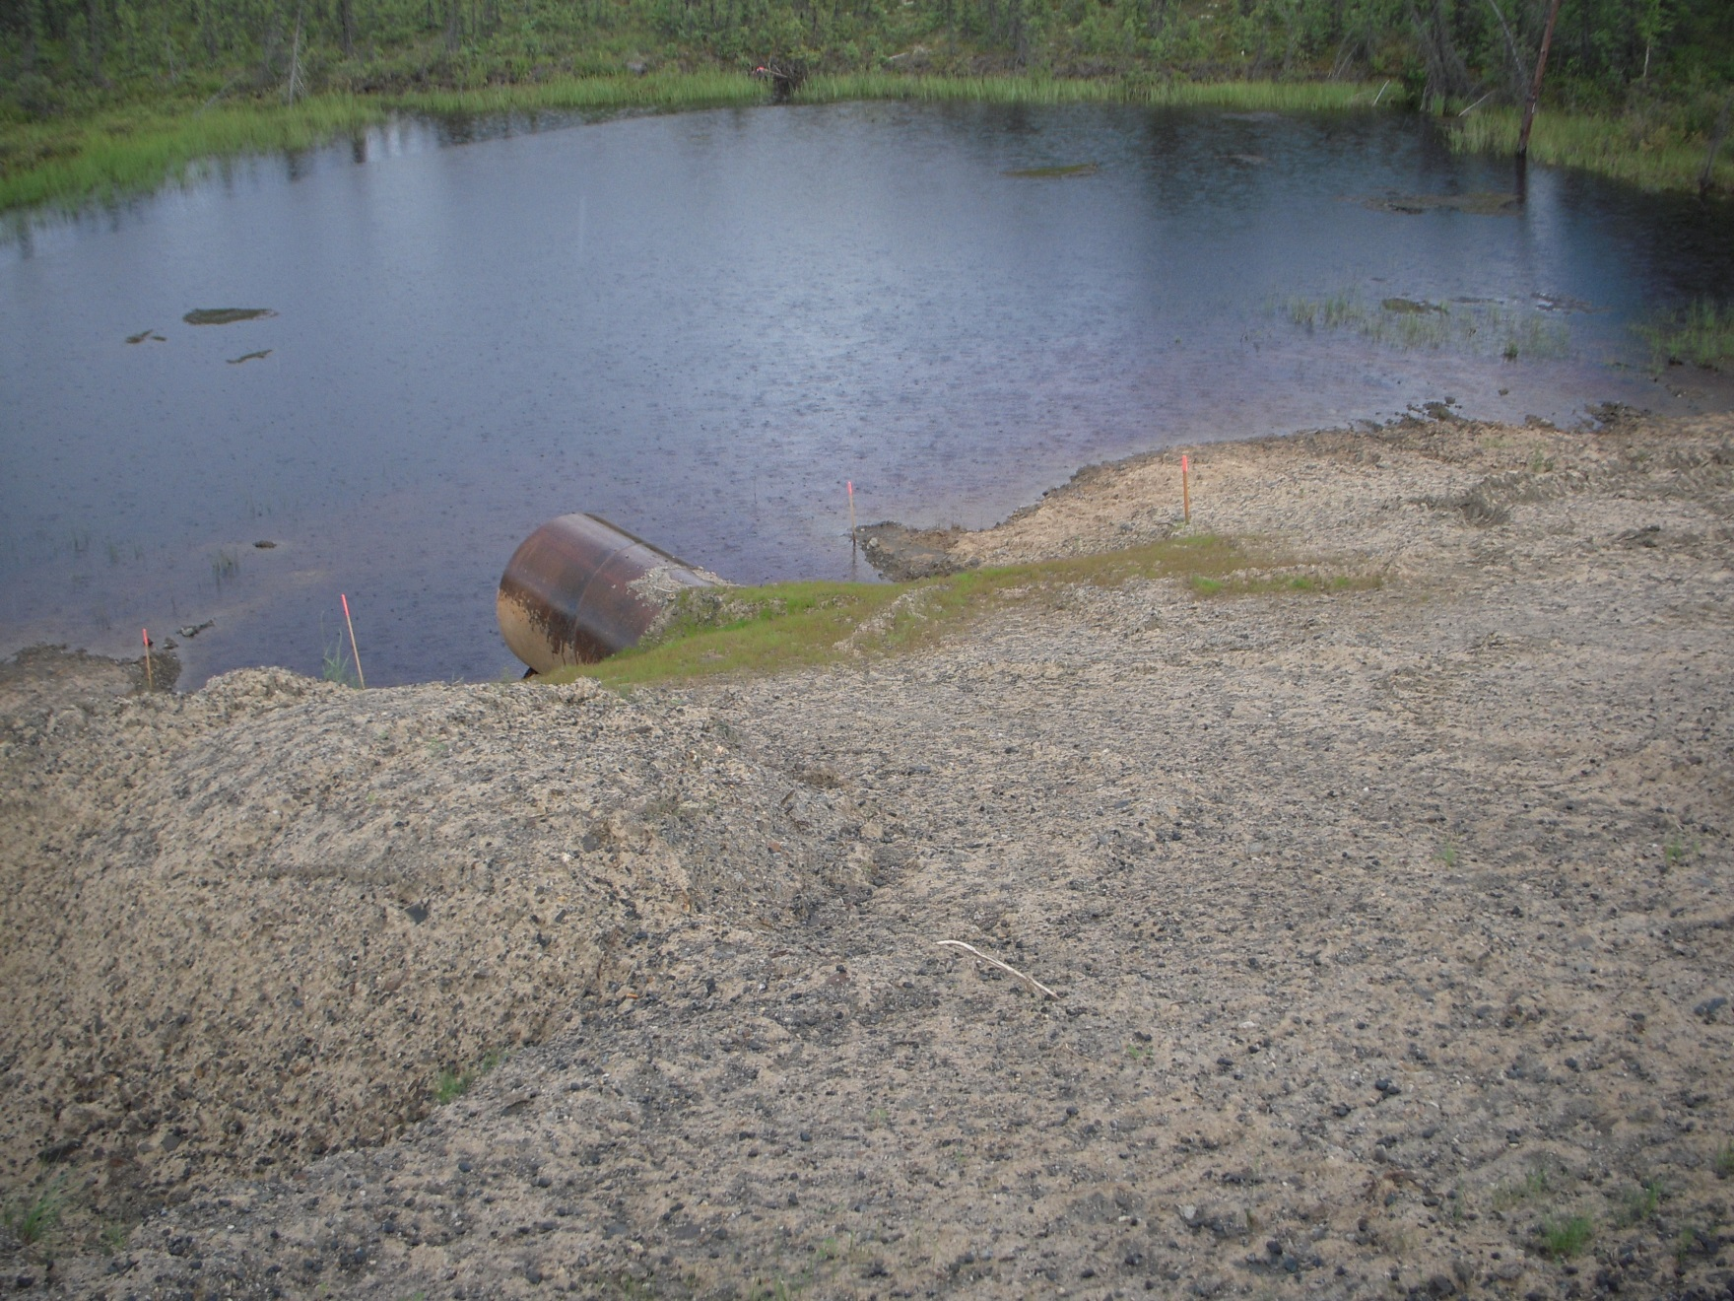
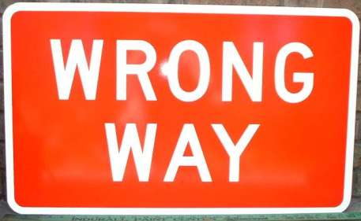
Water Body Protection Measures
2021 CGP 4.3.2
No perimeter protection measures in place
-Some mulch, should be thicker
Notes:
There is no BMP between the construction site and the receiving waters.

Slide 7
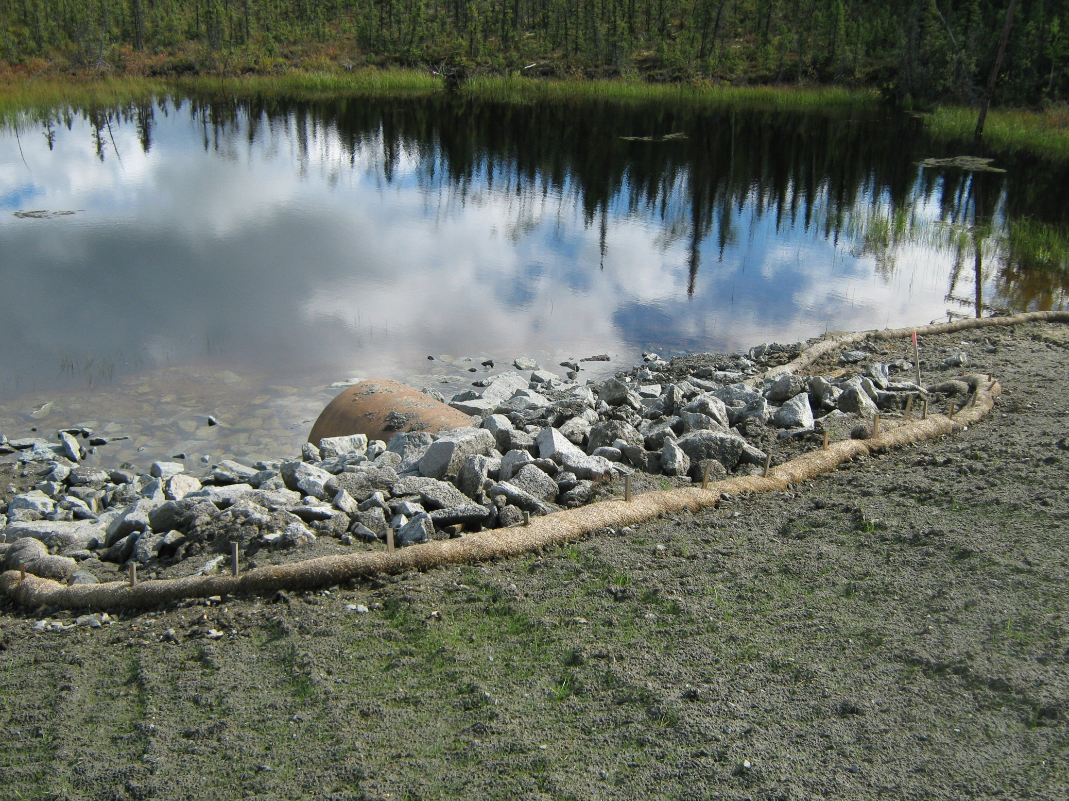
Water Body Protection Measures
2021 CGP 4.3.2
A permittee must install appropriate protection measures to minimize the discharge of sediment prior to entry into the water body for water bodies located on site or immediately downstream of the site.
Tok
Notes:
Outlet protection is in and the wattle is the waterbody protection measure mulch and seed on the soils.

Slide 8
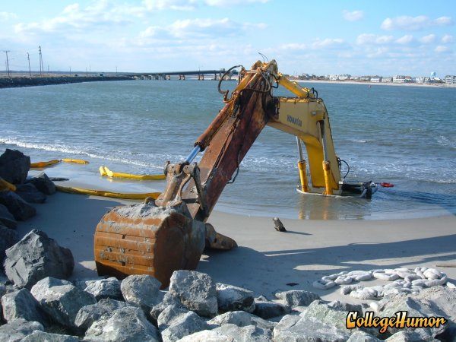

Shoreline Protection?
Notes:
This is only for a little humor, if an instructor has no humor or desire to inject any levity to the class delete it or ignore it.

Slide 9
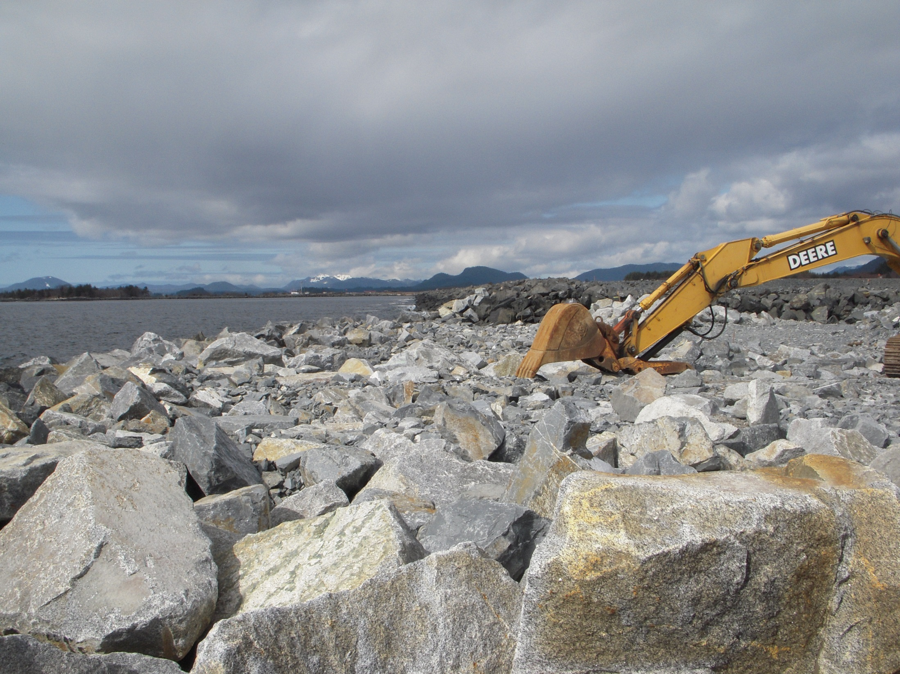
Aggregate Gradation for Stabilization
Sitka
Notes:
Interlocking gravel is great stabilization. Depending on the forces it will be exposed to you need to use larger rock. This is true for all shear stress lining, ditches, overflows, outlets etc.

Slide 10
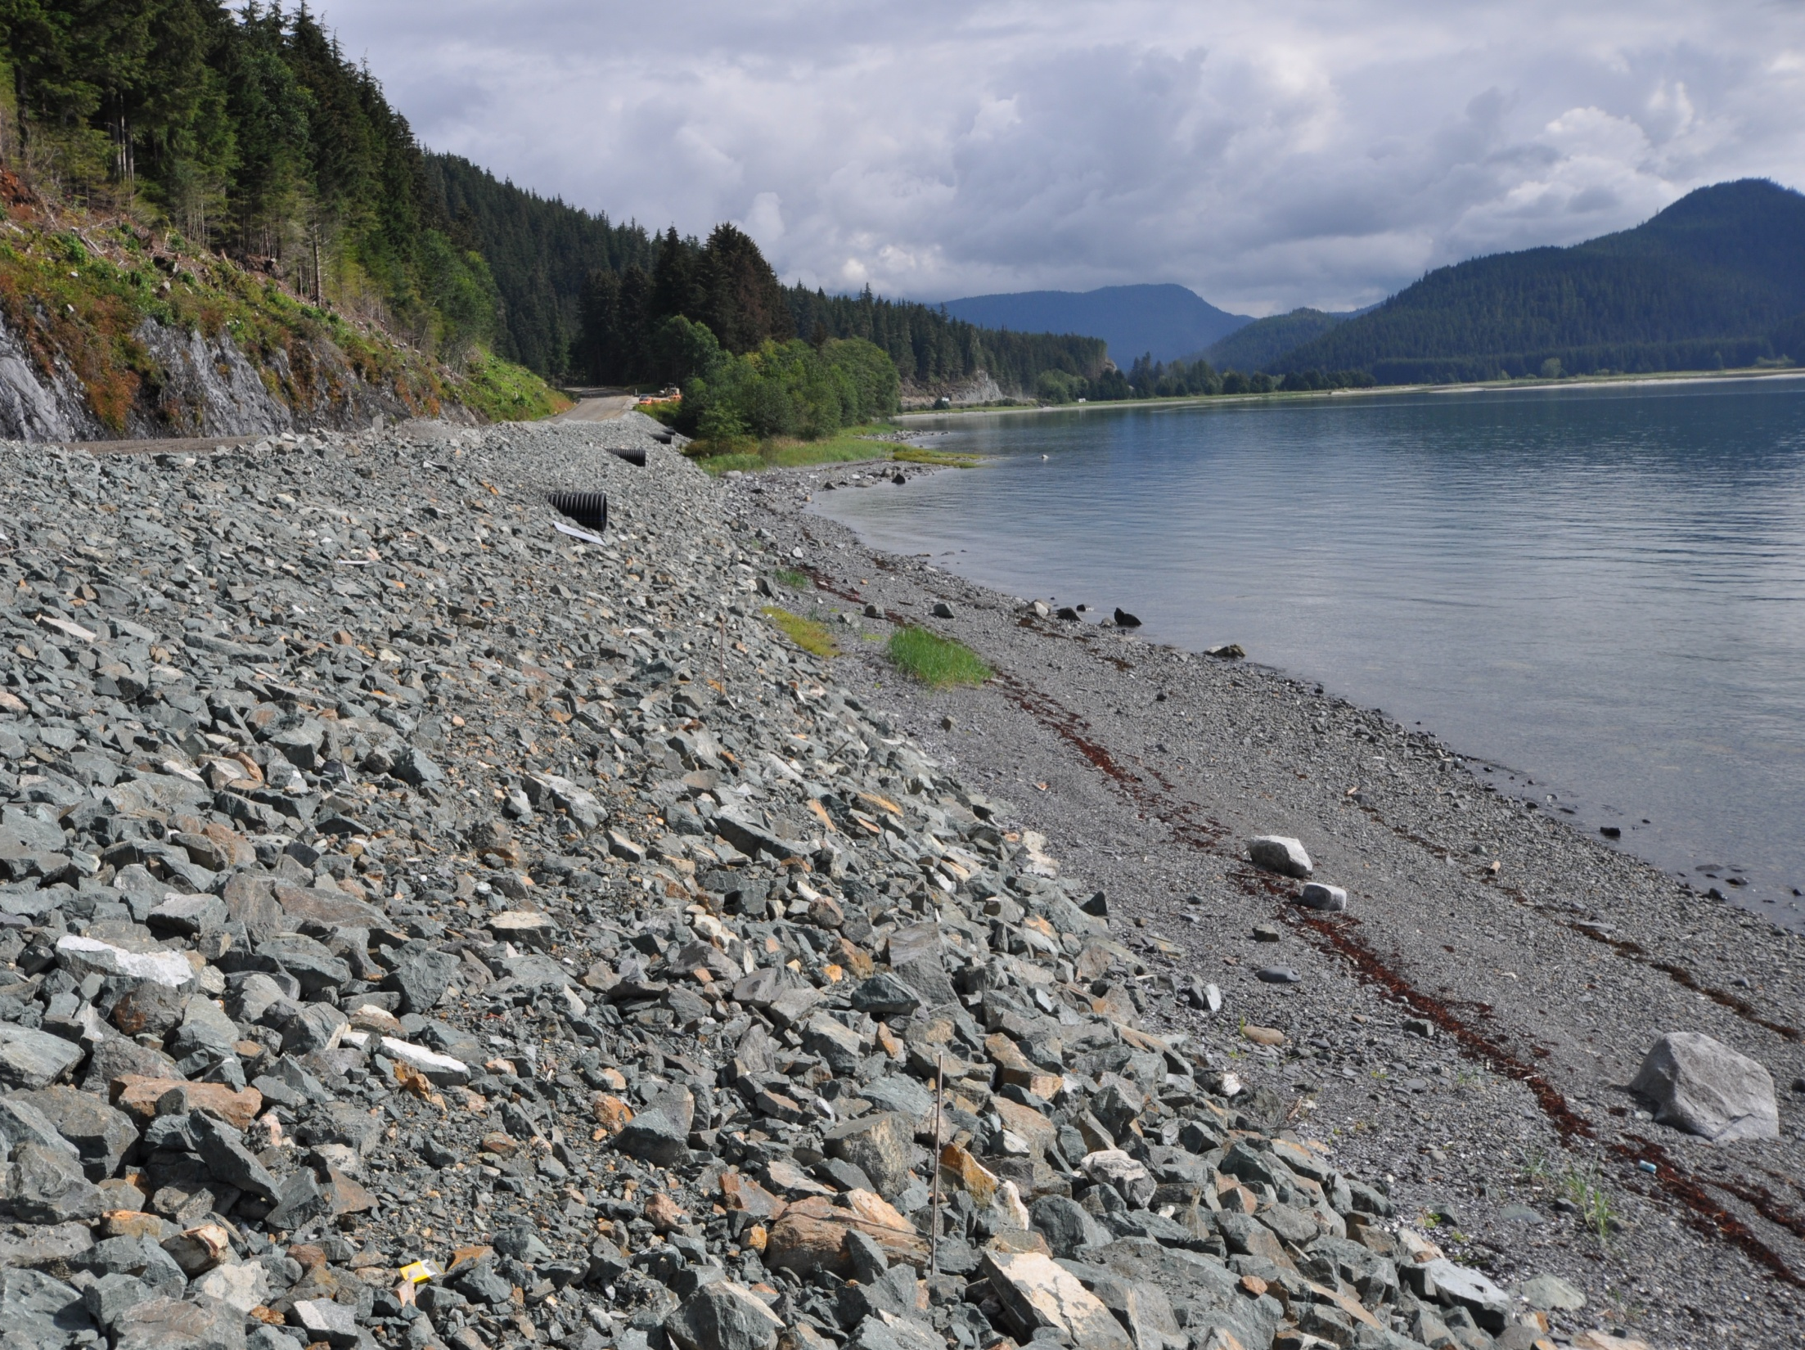
How Should We do Perimeter Control Here?
Glacier Highway
Notes:
Using the finished rock material to create a sediment control berm as the slope is constructed.

Slide 11
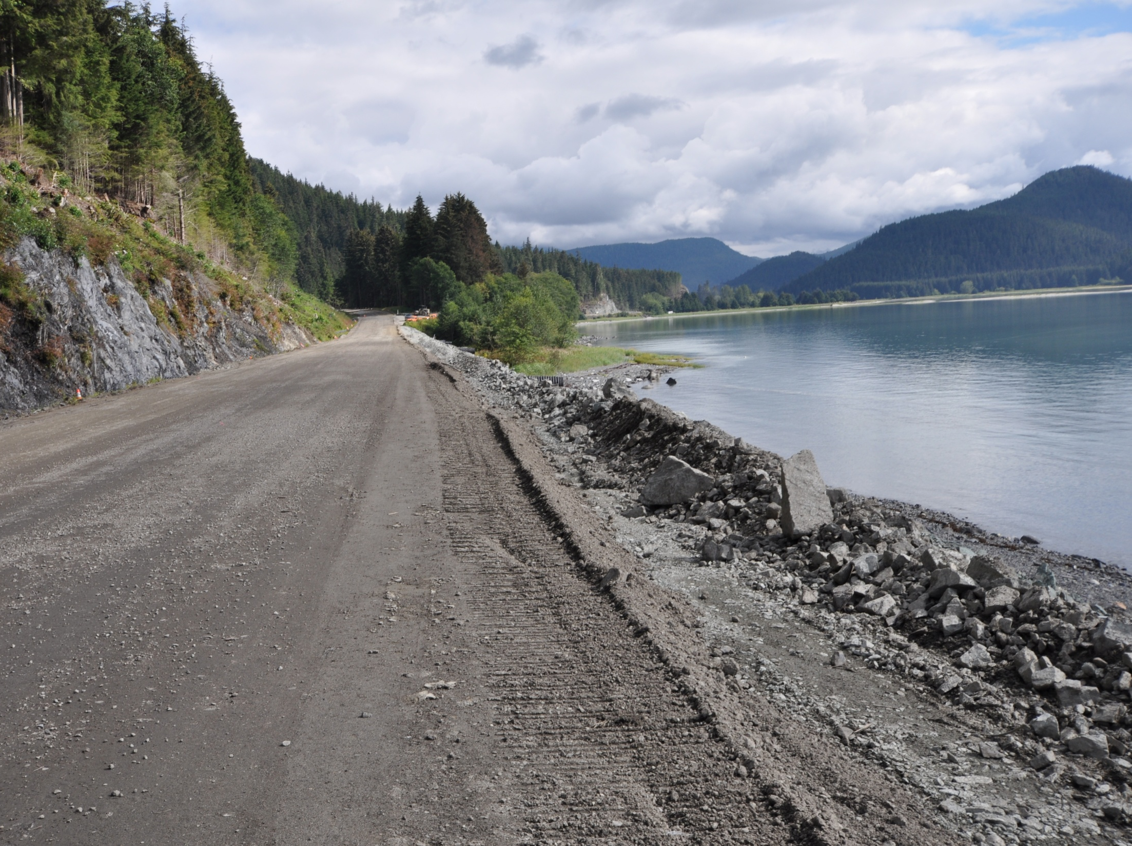
Glacier Highway
Notes:
Note the height of the berm will detain sediment washed off the roadway

Slide 12
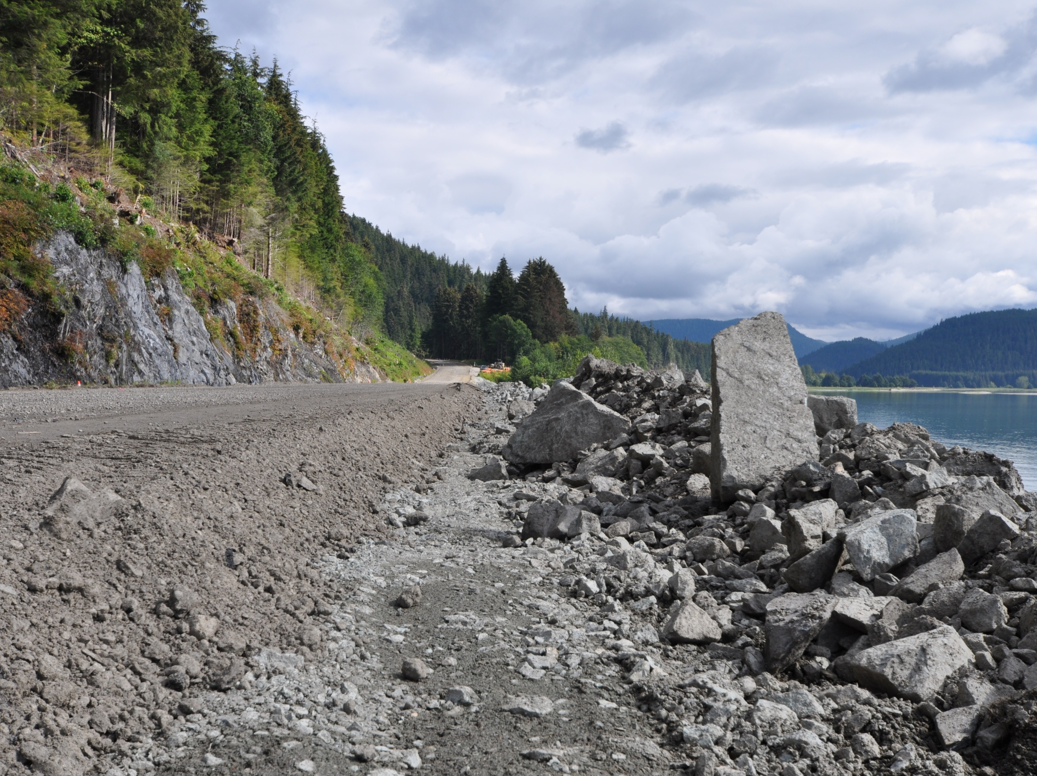
Perimeter Controls On the Cheap and Easy
Glacier Highway
Notes:
Note the big rock is the same in the previous slide to show scale and height

Slide 13
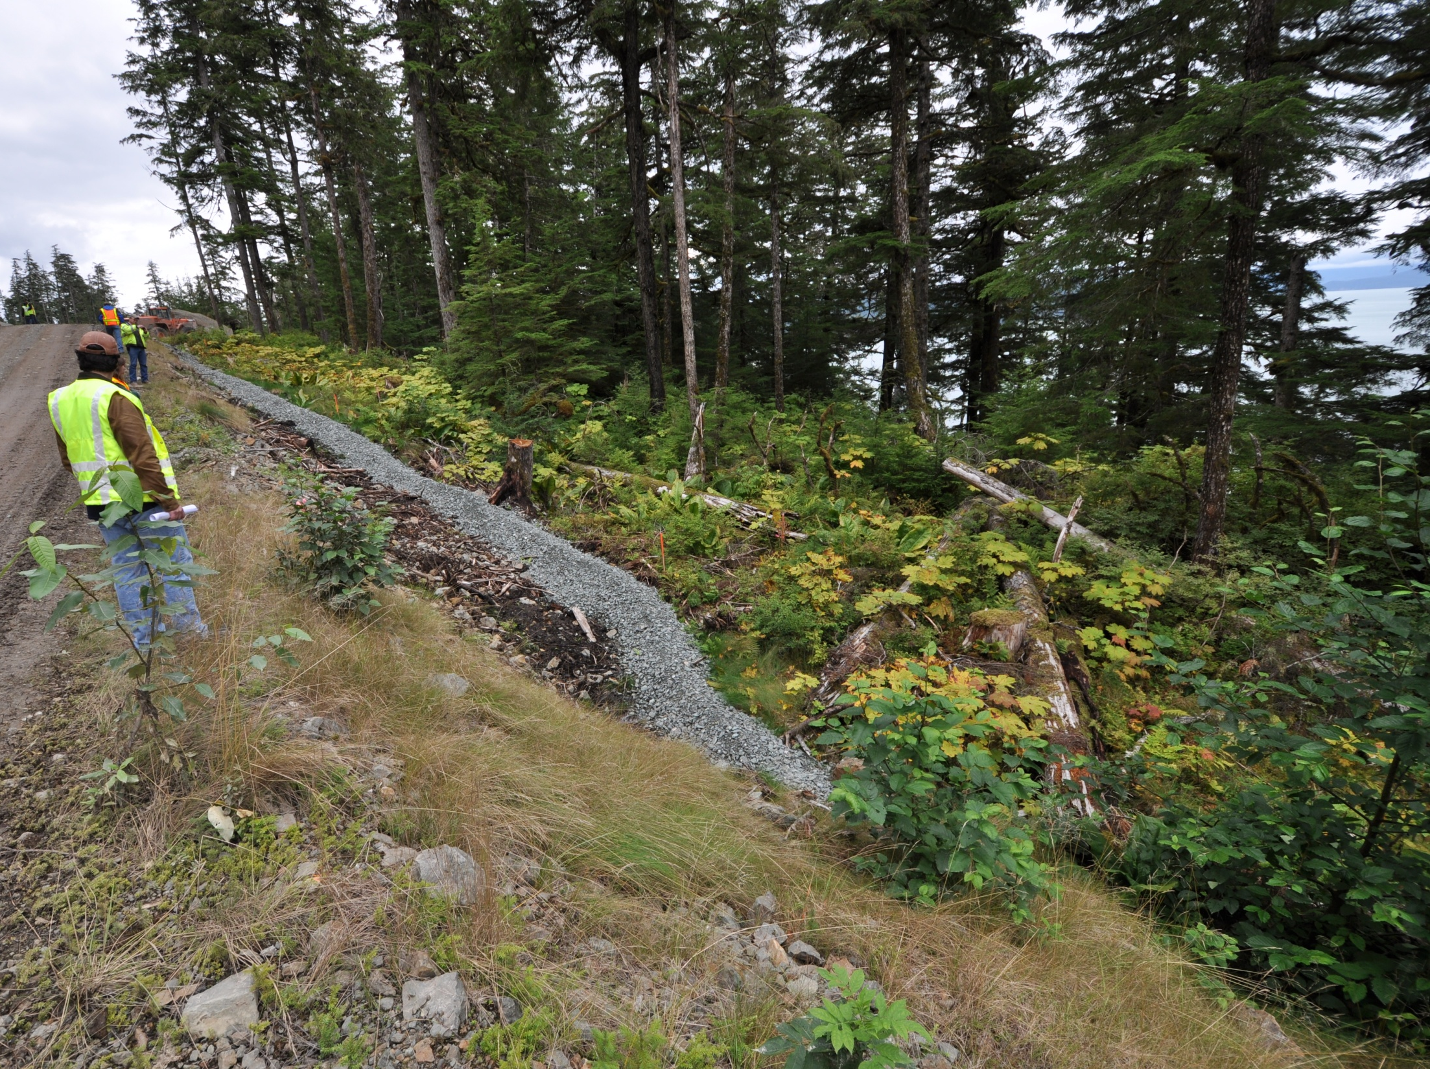
Gravel Berm Perimeter Control
Glacier HWY Juneau
Notes:
This is a gravel filter berm that will be the perimeter control and simply become part of the fill.

Slide 14
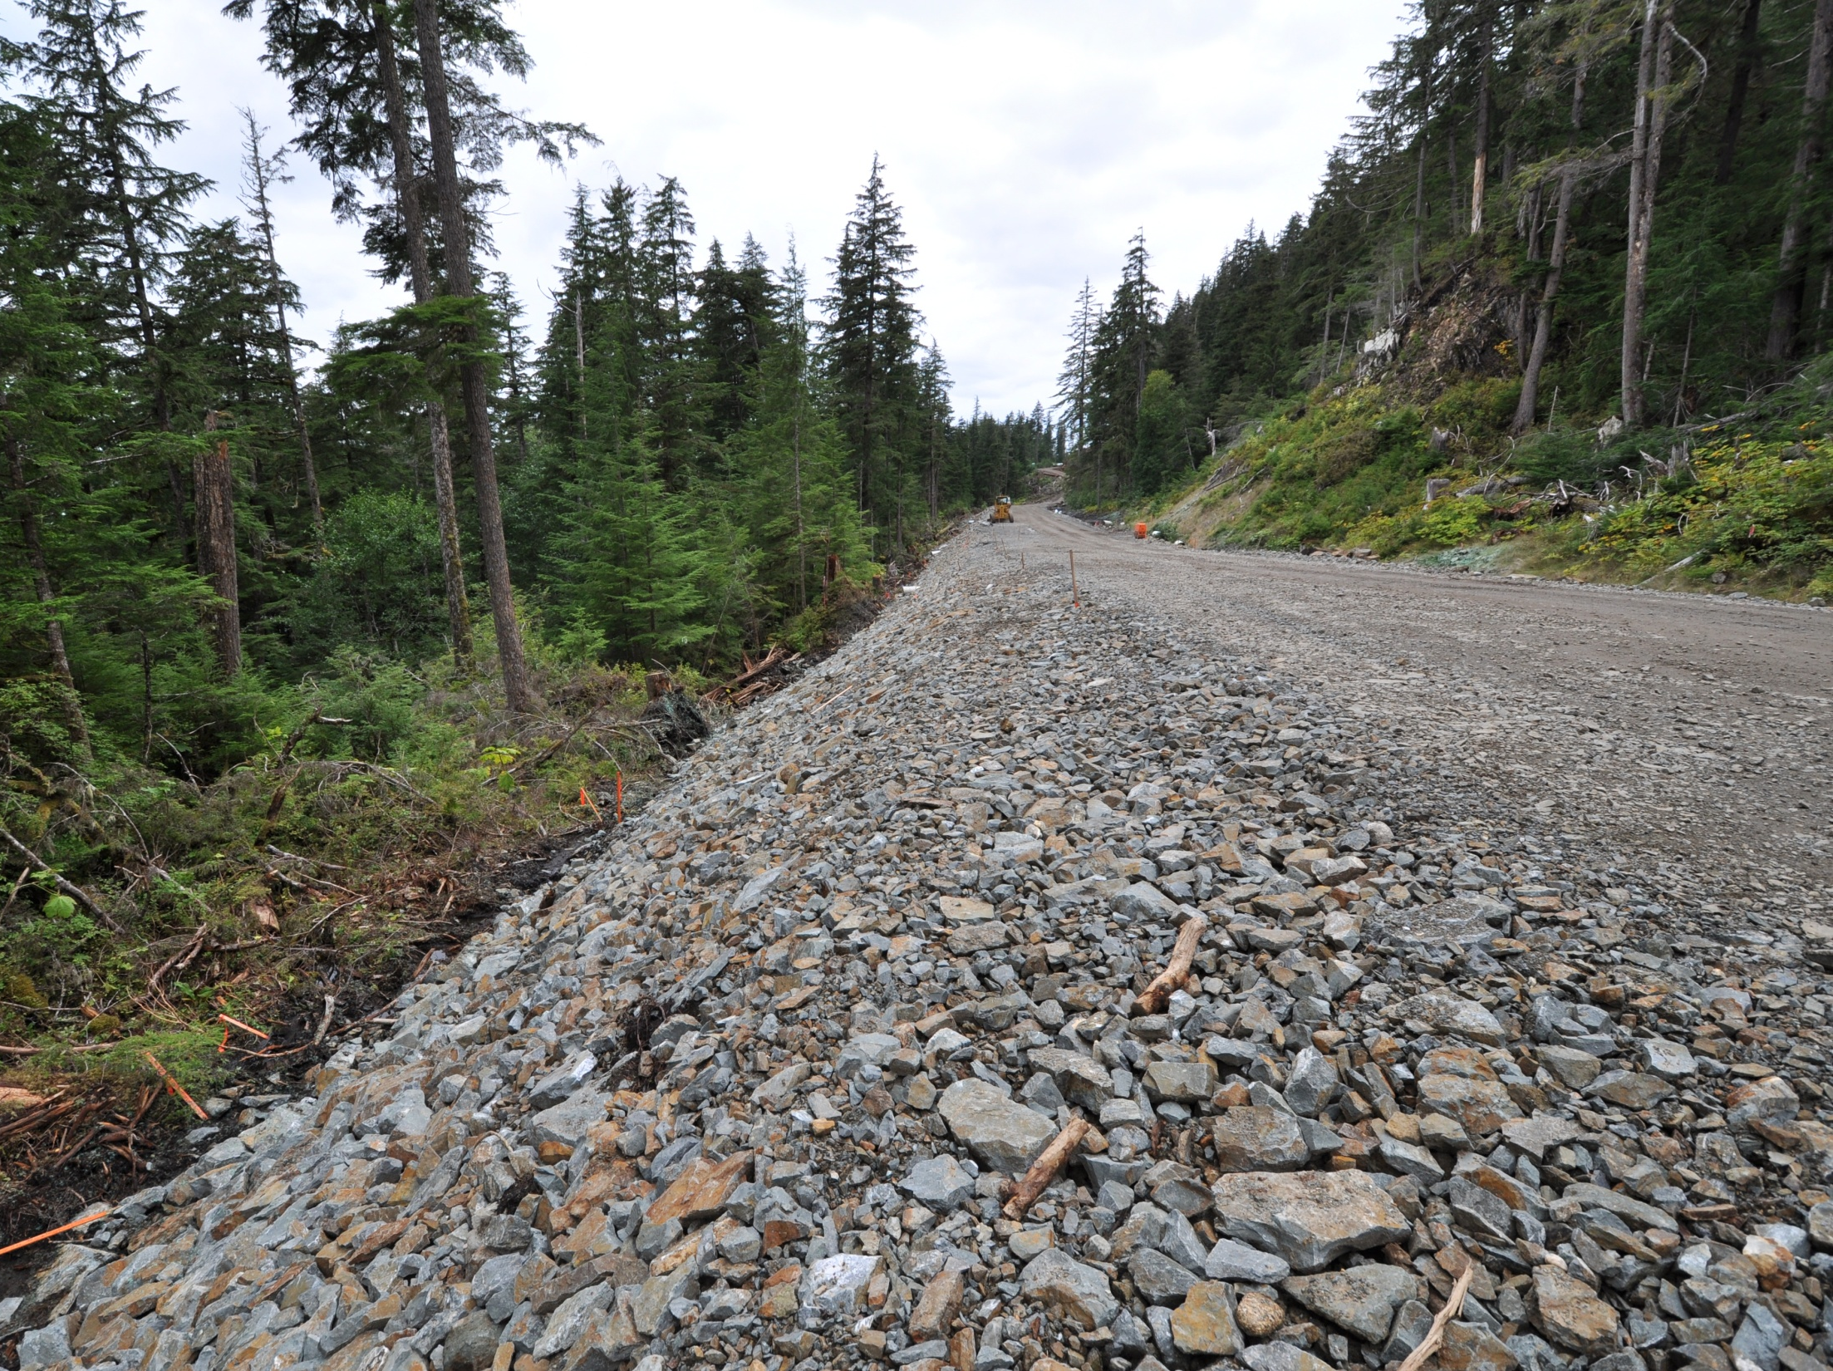
Glacier HWY Juneau
Notes:
With the fill complete the gravel filter berm is simply part of the fill.

Slide 15
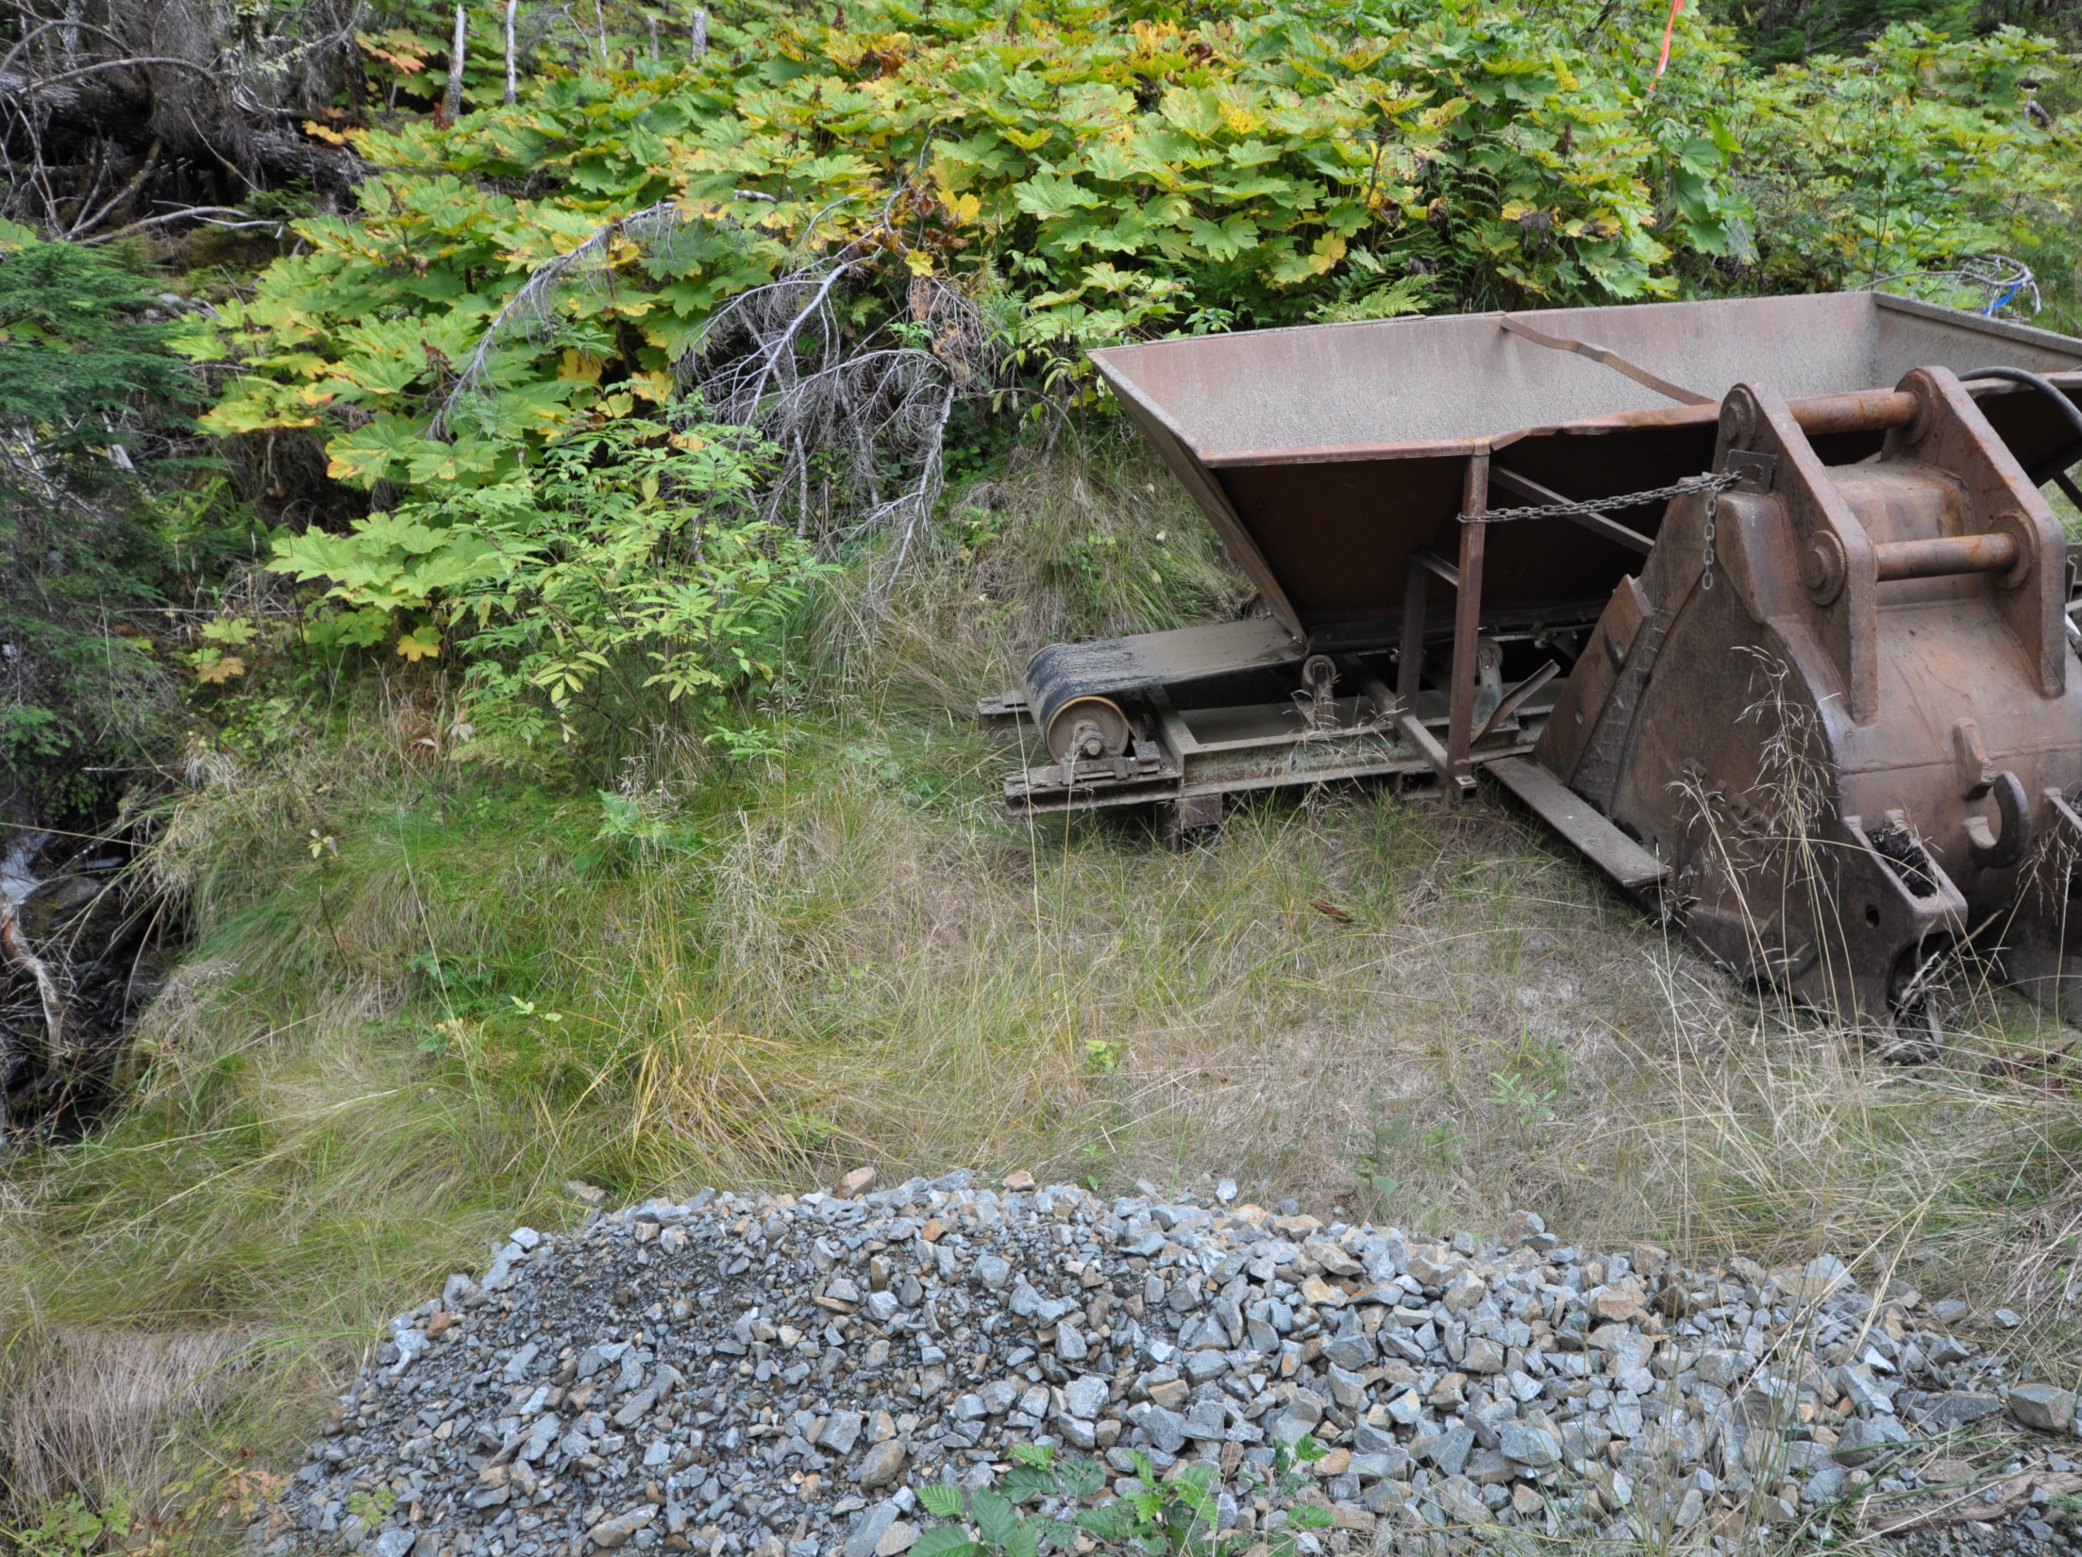
Introducing:
The All NEW!
BERMANATOR
Notes:
This is a unique invention from the field. Nicknamed the bermanator.

Slide 16
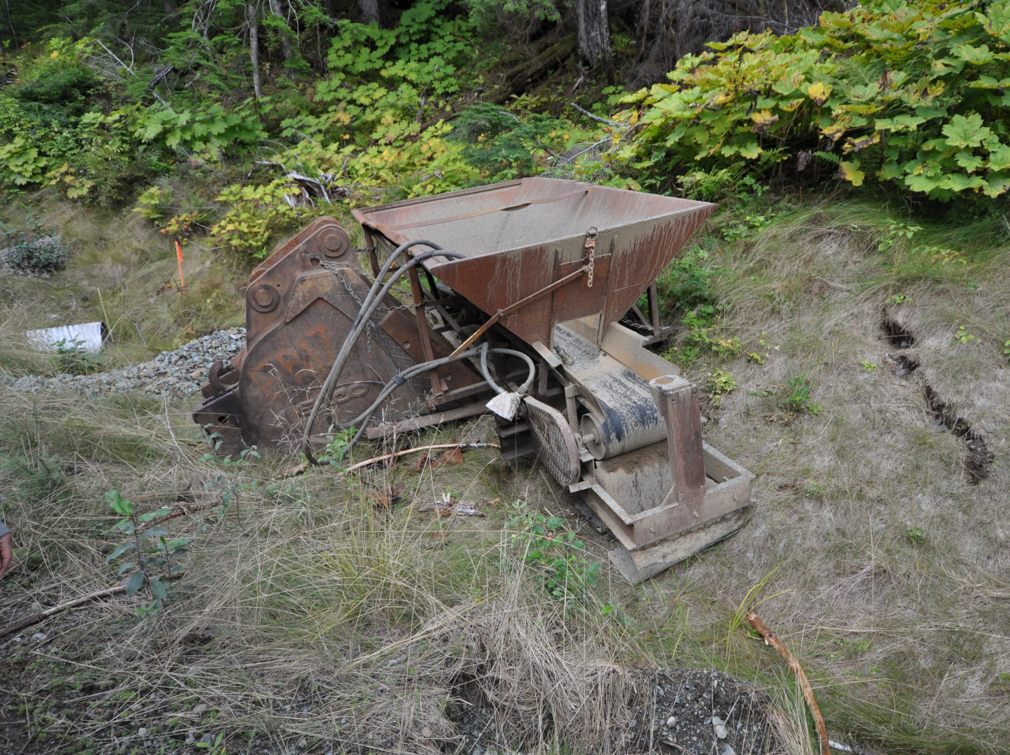
Notes:
A conveyer to build the berm with an excavator.

Slide 17
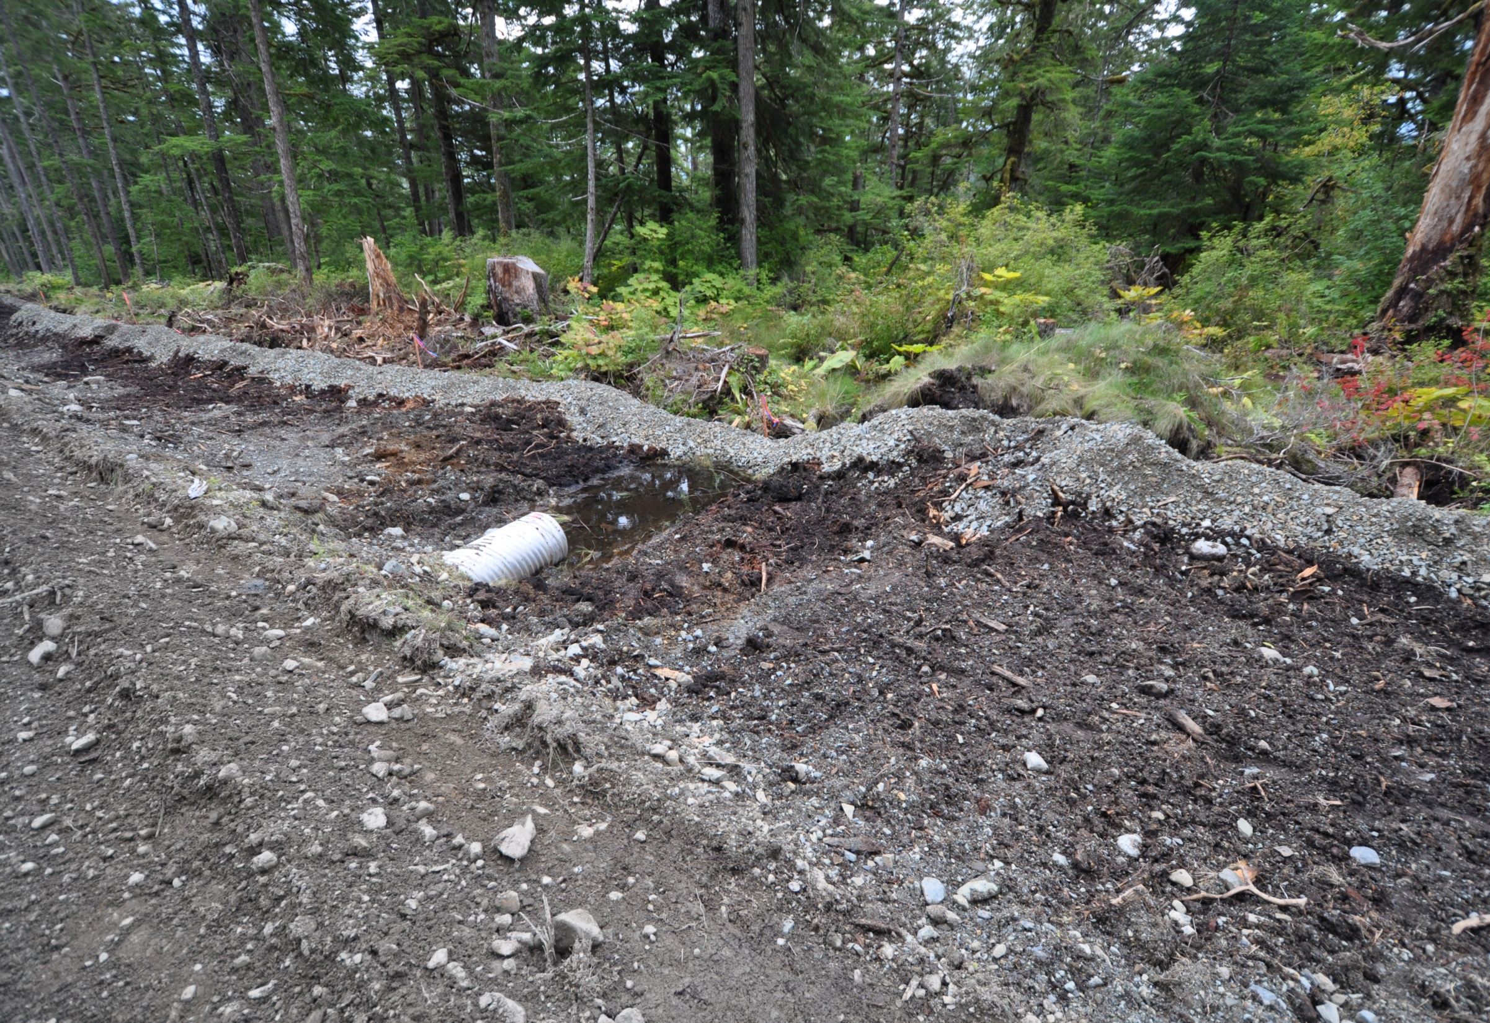
Glacier HWY Juneau
Notes:
The perimeter controls do not go through the receiving waters but should go around them.

Slide 18
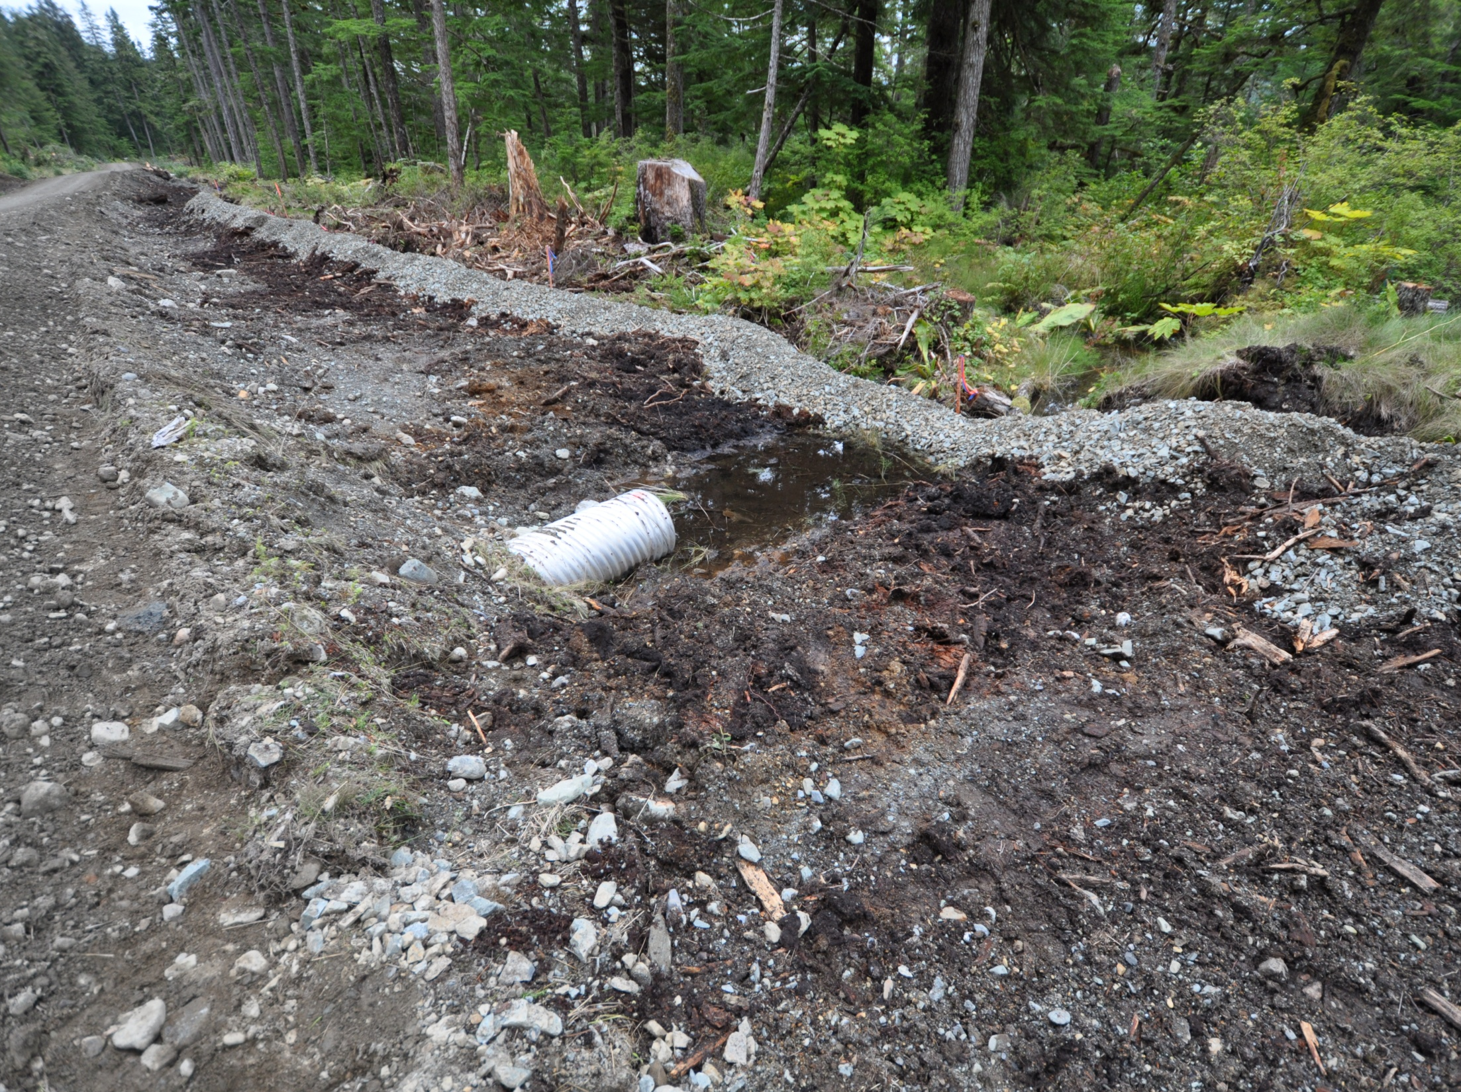
Use riprap that is 4” or greater
Install fabric to prevent soil erosion beneath the riprap
Stabilize all disturbed areas immediately after work is complete
Inspect the outlet after a heavy rain event
Glacier HWY Juneau

Slide 19
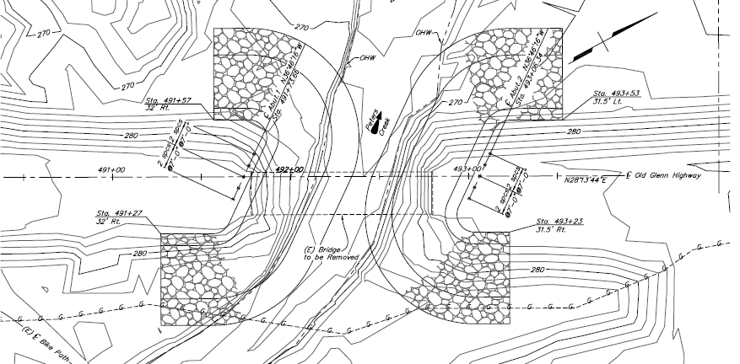

Prior to embankment fill:
1- Install Perimeter berm at OHW
2- Place 4 “ gravel filter layer on berm
Upon completion of the approach fill:
1- Place geotextile fabric
2- Place rip rap on slopes
See detail Plan sheet xxxxx
Describe the sequence and timing of activities that disturb soils and of BMP implementation and removal. Phase earth disturbing activities to minimize un-stabilized areas, and to achieve temporary or final stabilization quickly.
Notes:
An example of using the same idea for a water crossing perimeter control and embankment stabilization. Bern height may vary depending on size of embankment fill

Slide 20

Example DOT&PF BMP
8oz Geotextile filter fabric
Berm 4’’- 8’’ Varies
Fill
area
Washed
Pea Gravel
Riprap
Existing Grade
OHW
No published BMP manual was used for this design.
Designed by Danny Dirt PE, AK-CESCL #007

Slide 21
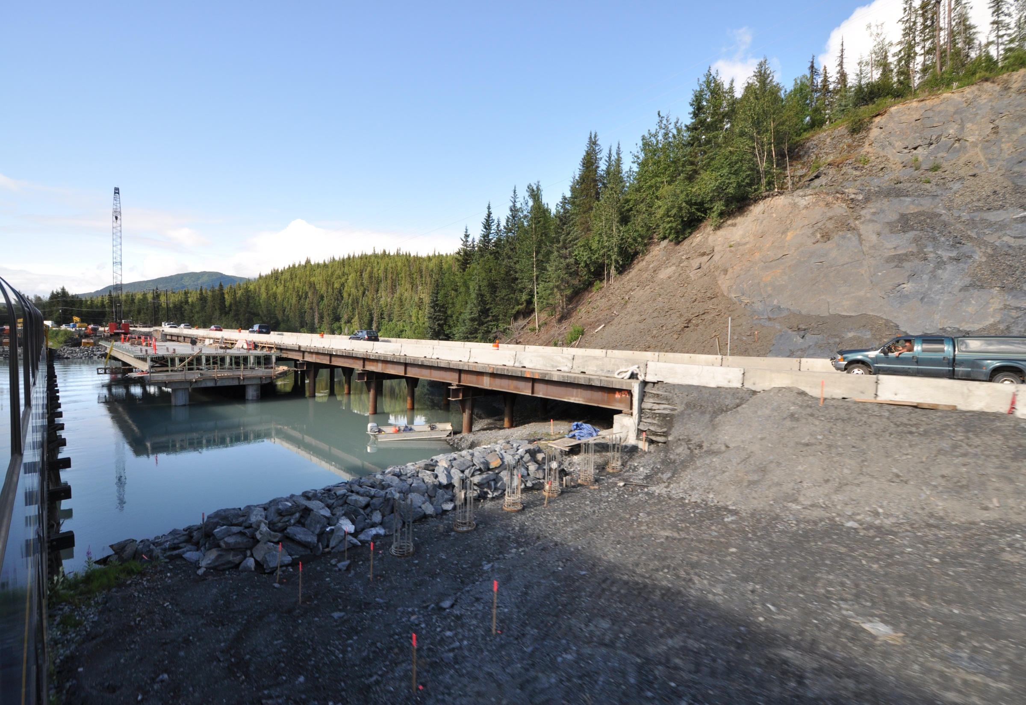
Perimeter Control
Notes:
Bridge decks and temporary crossings always present challenges to perimeter sediment controls.

Slide 22
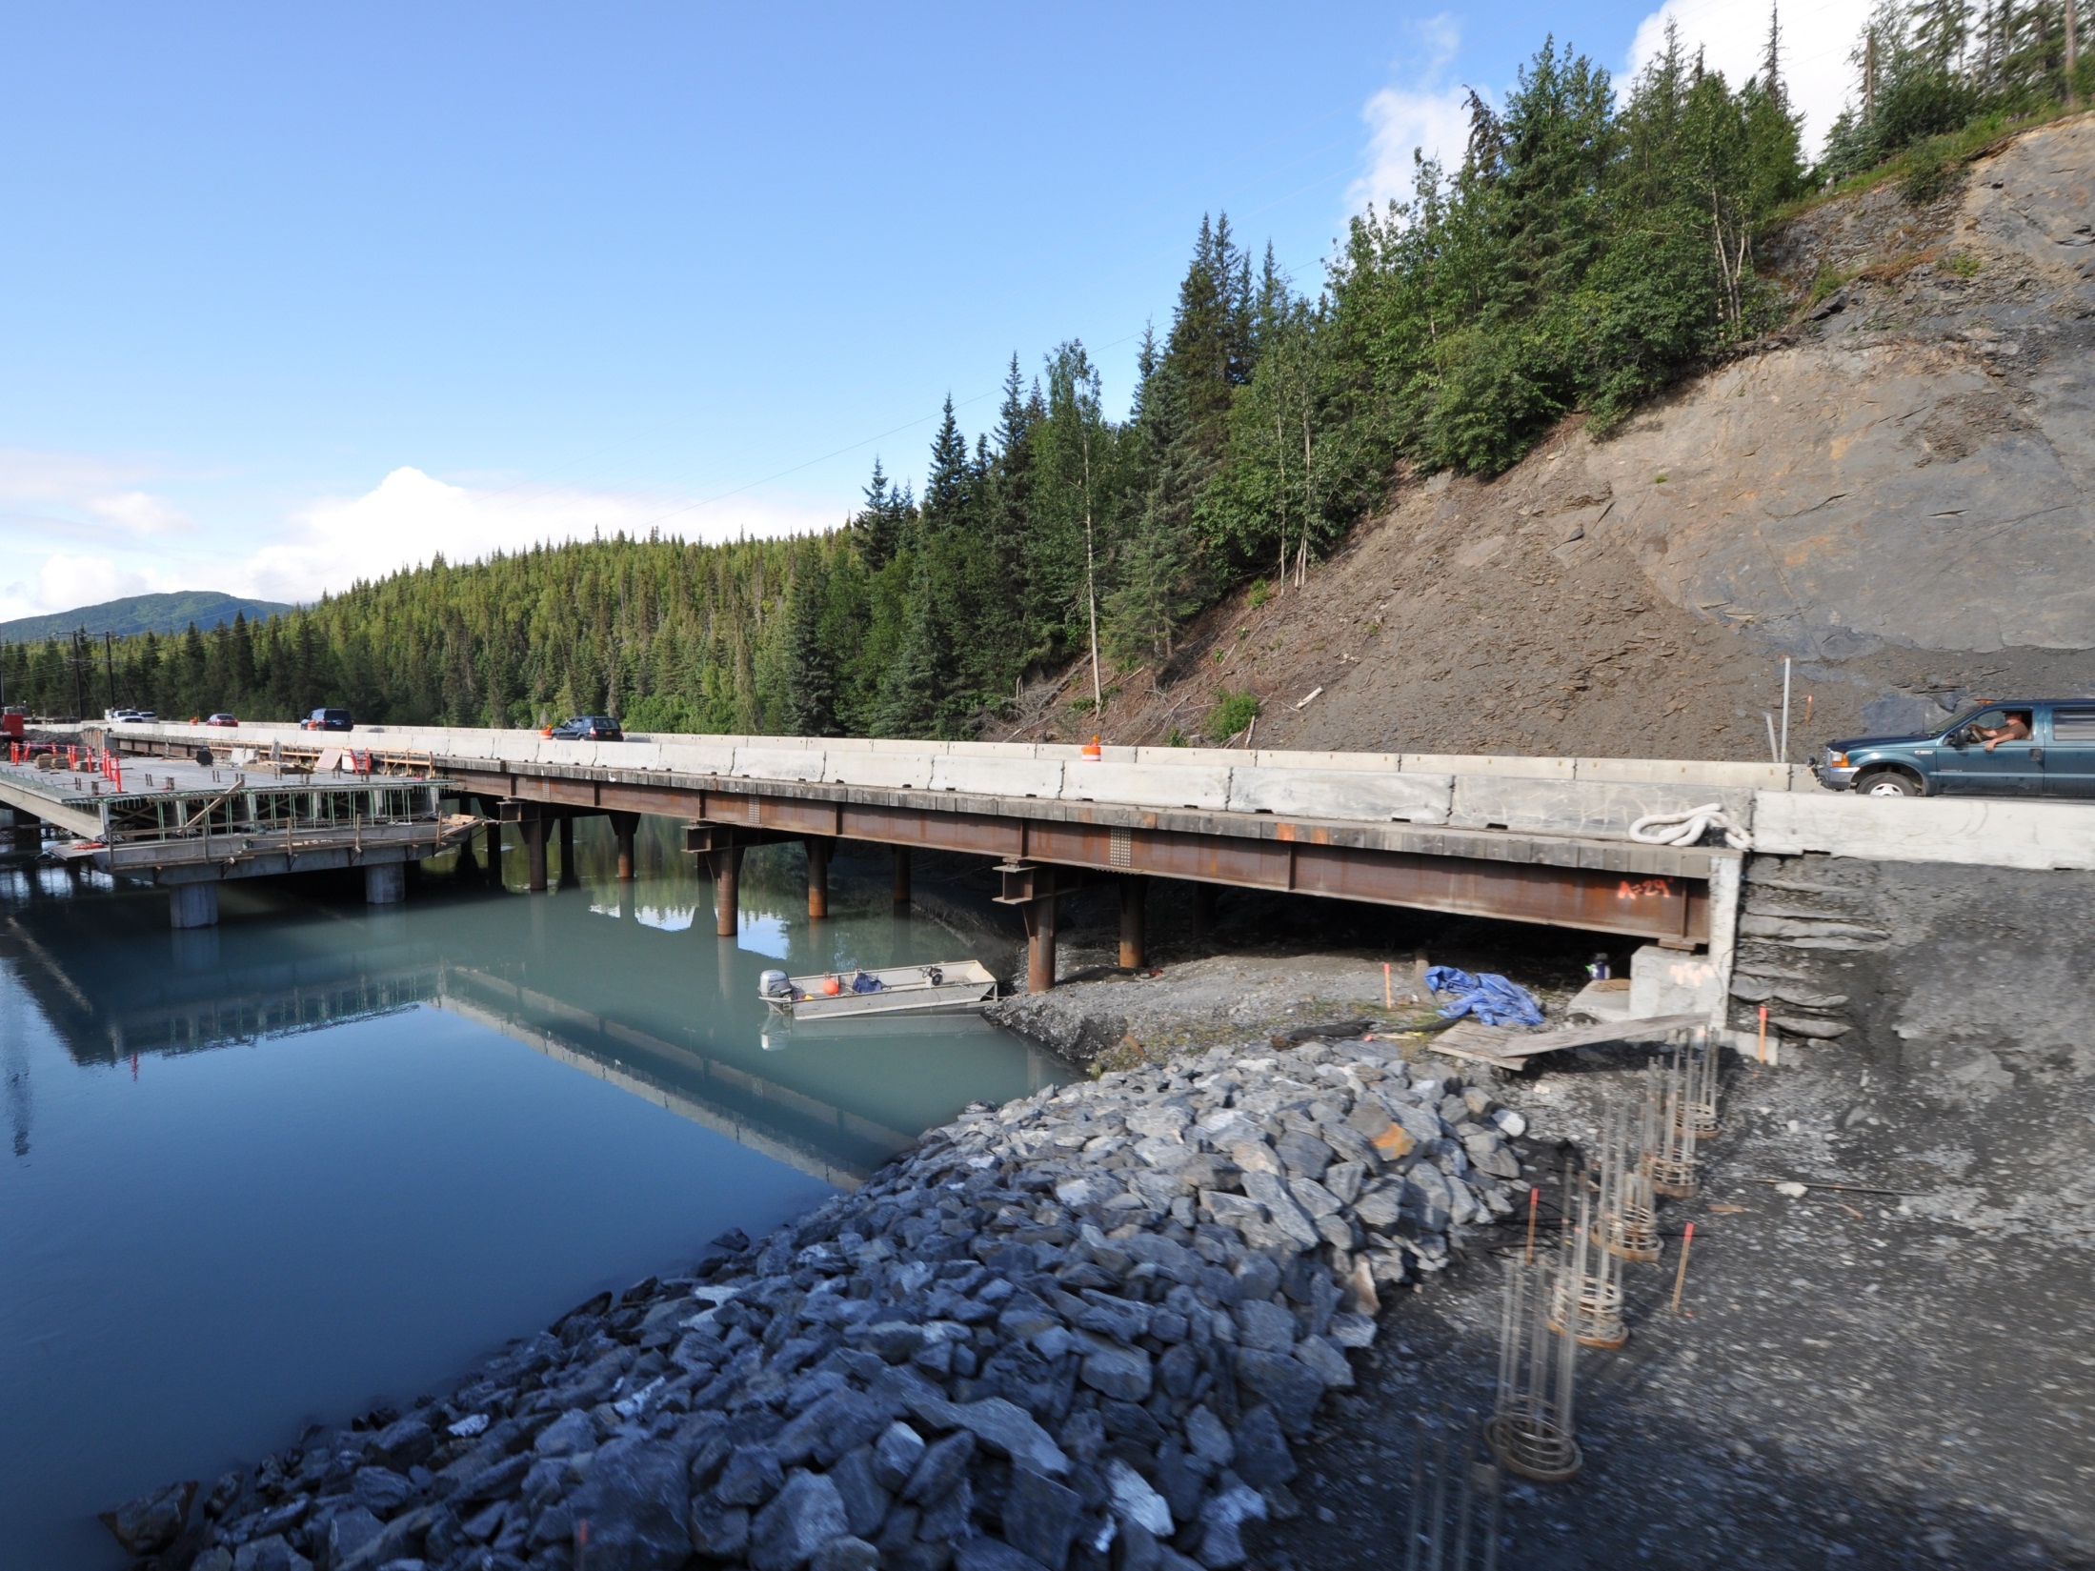
Gravel Filter Berm &
Embankment Stabilization
Notes:
Here a gravel filter berm is also acting as final stabilization.

Slide 23
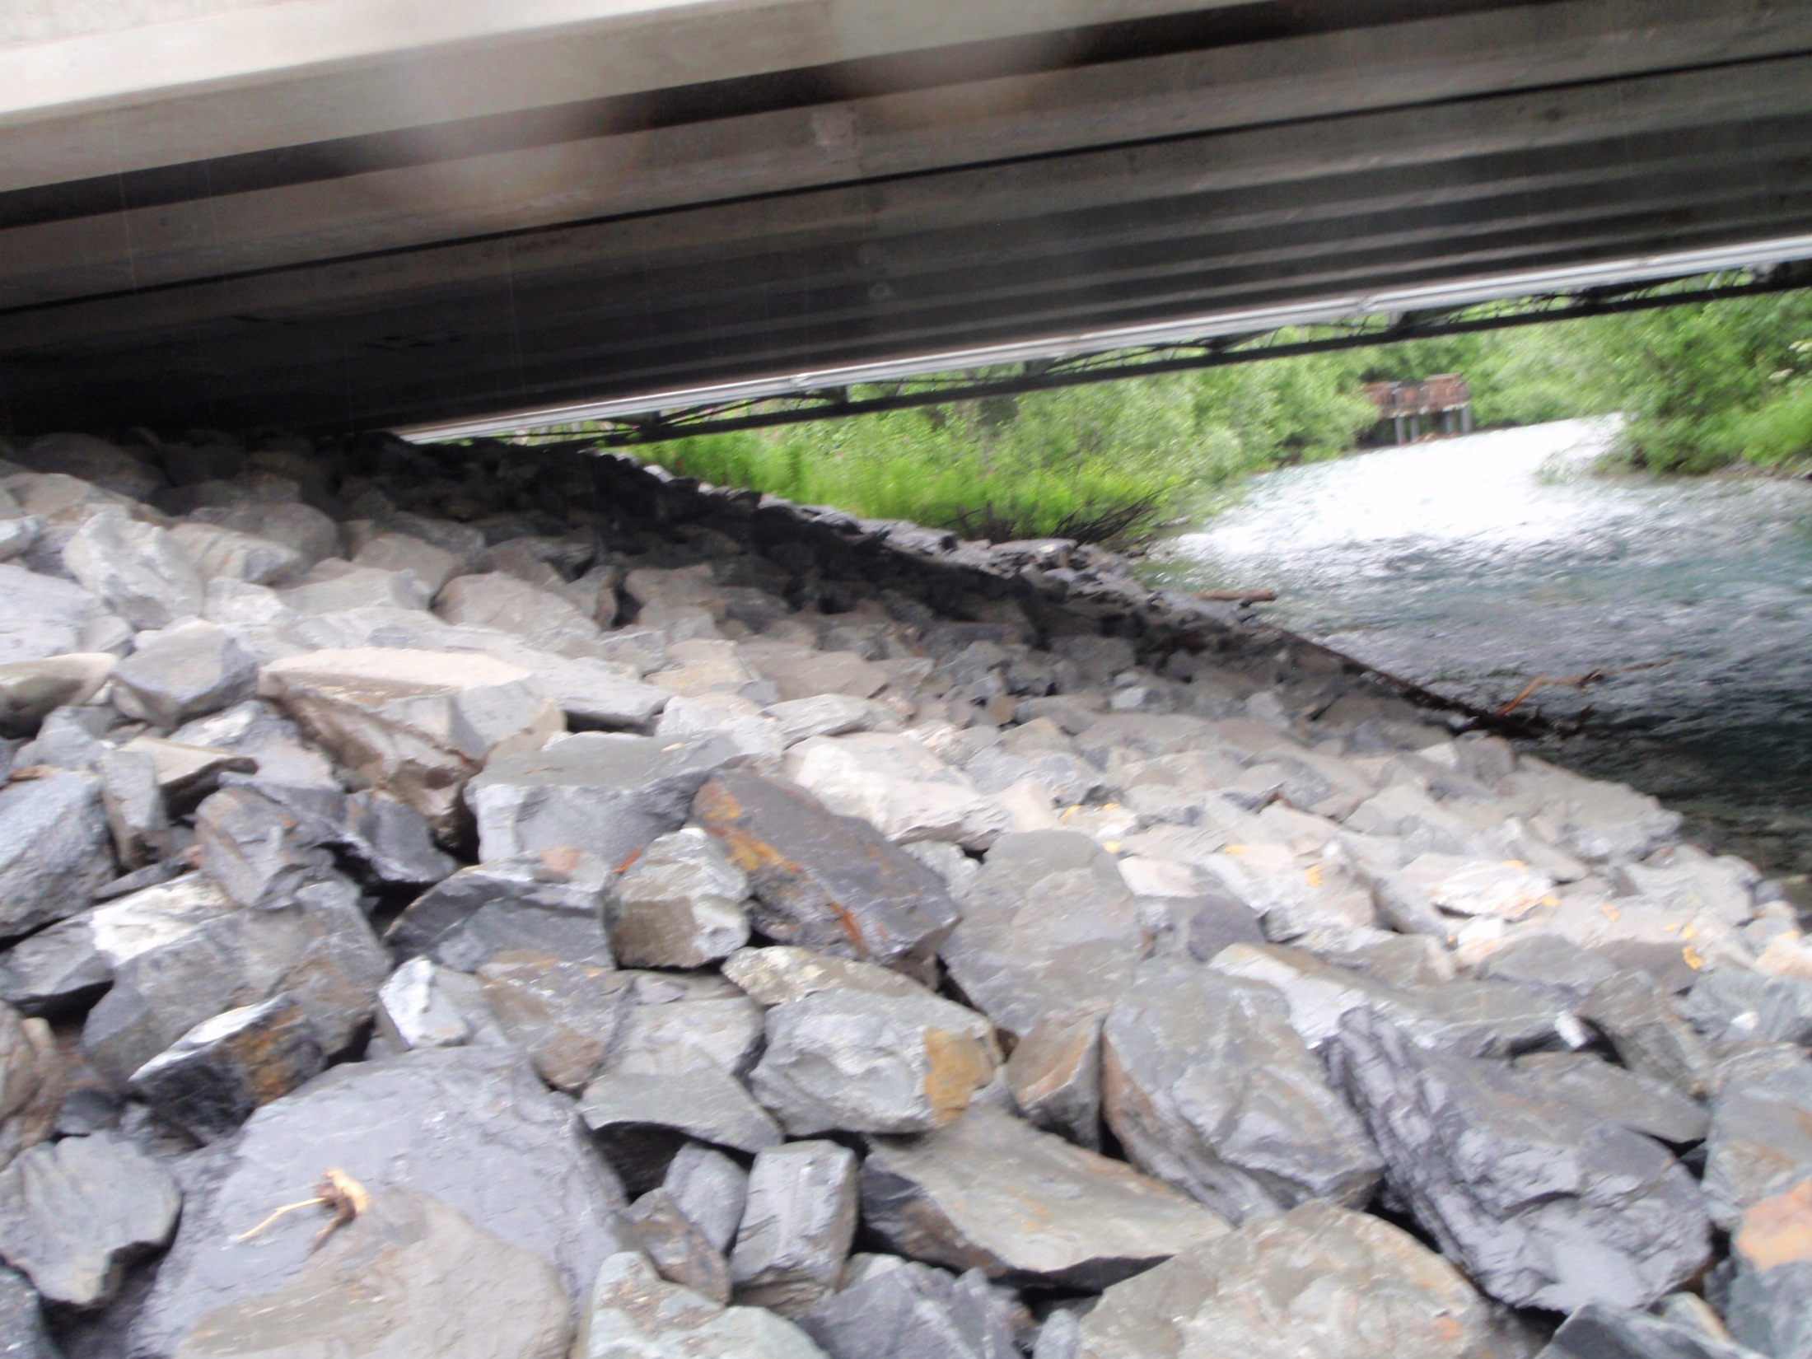
Notes:
When the girders are set the stabilization is complete.

Slide 24
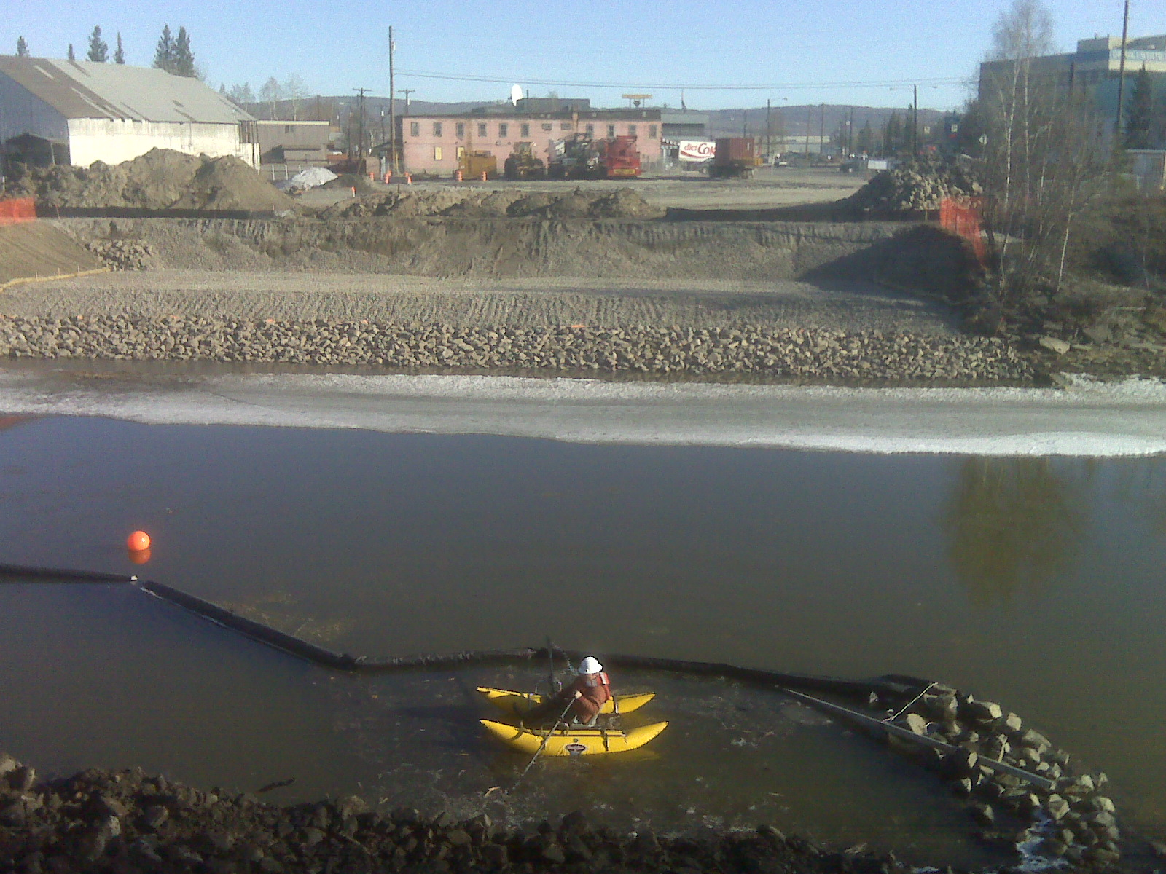
Different Risks = Different Stabilization Measures
Fairbanks
Notes:
The different slopes, proximity to the water, schedules for the next phase should drive the decisions about the rock size to stabilize the areas.

Slide 25
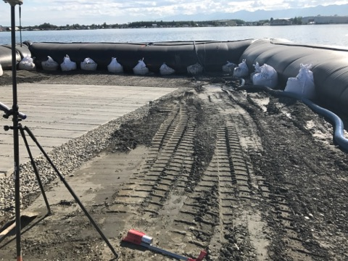
In Water Controls
2021 CGP 4.3.3
Lake Hood
Notes:
Provide a place for the eroded material to collect on your property.
Remove sediment from the stormwater.

Slide 26
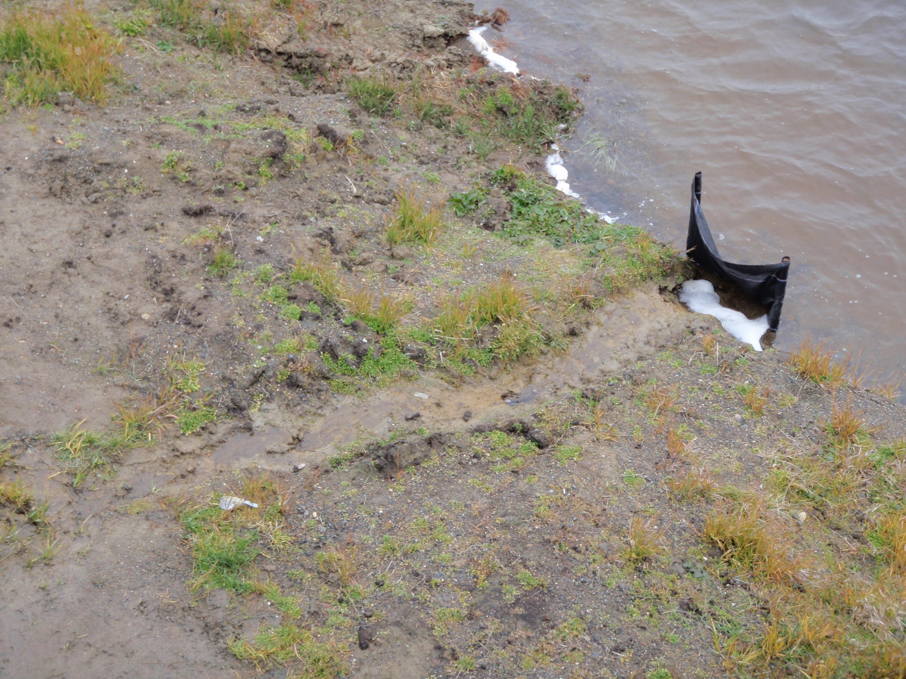


Pity the BMP’s on the edge of the earth
Receiving Water
BMP?
Site Discharge
Barrow
Notes:
Make a little fun of silt fence, then introduce alternative method with the wattle

Slide 27
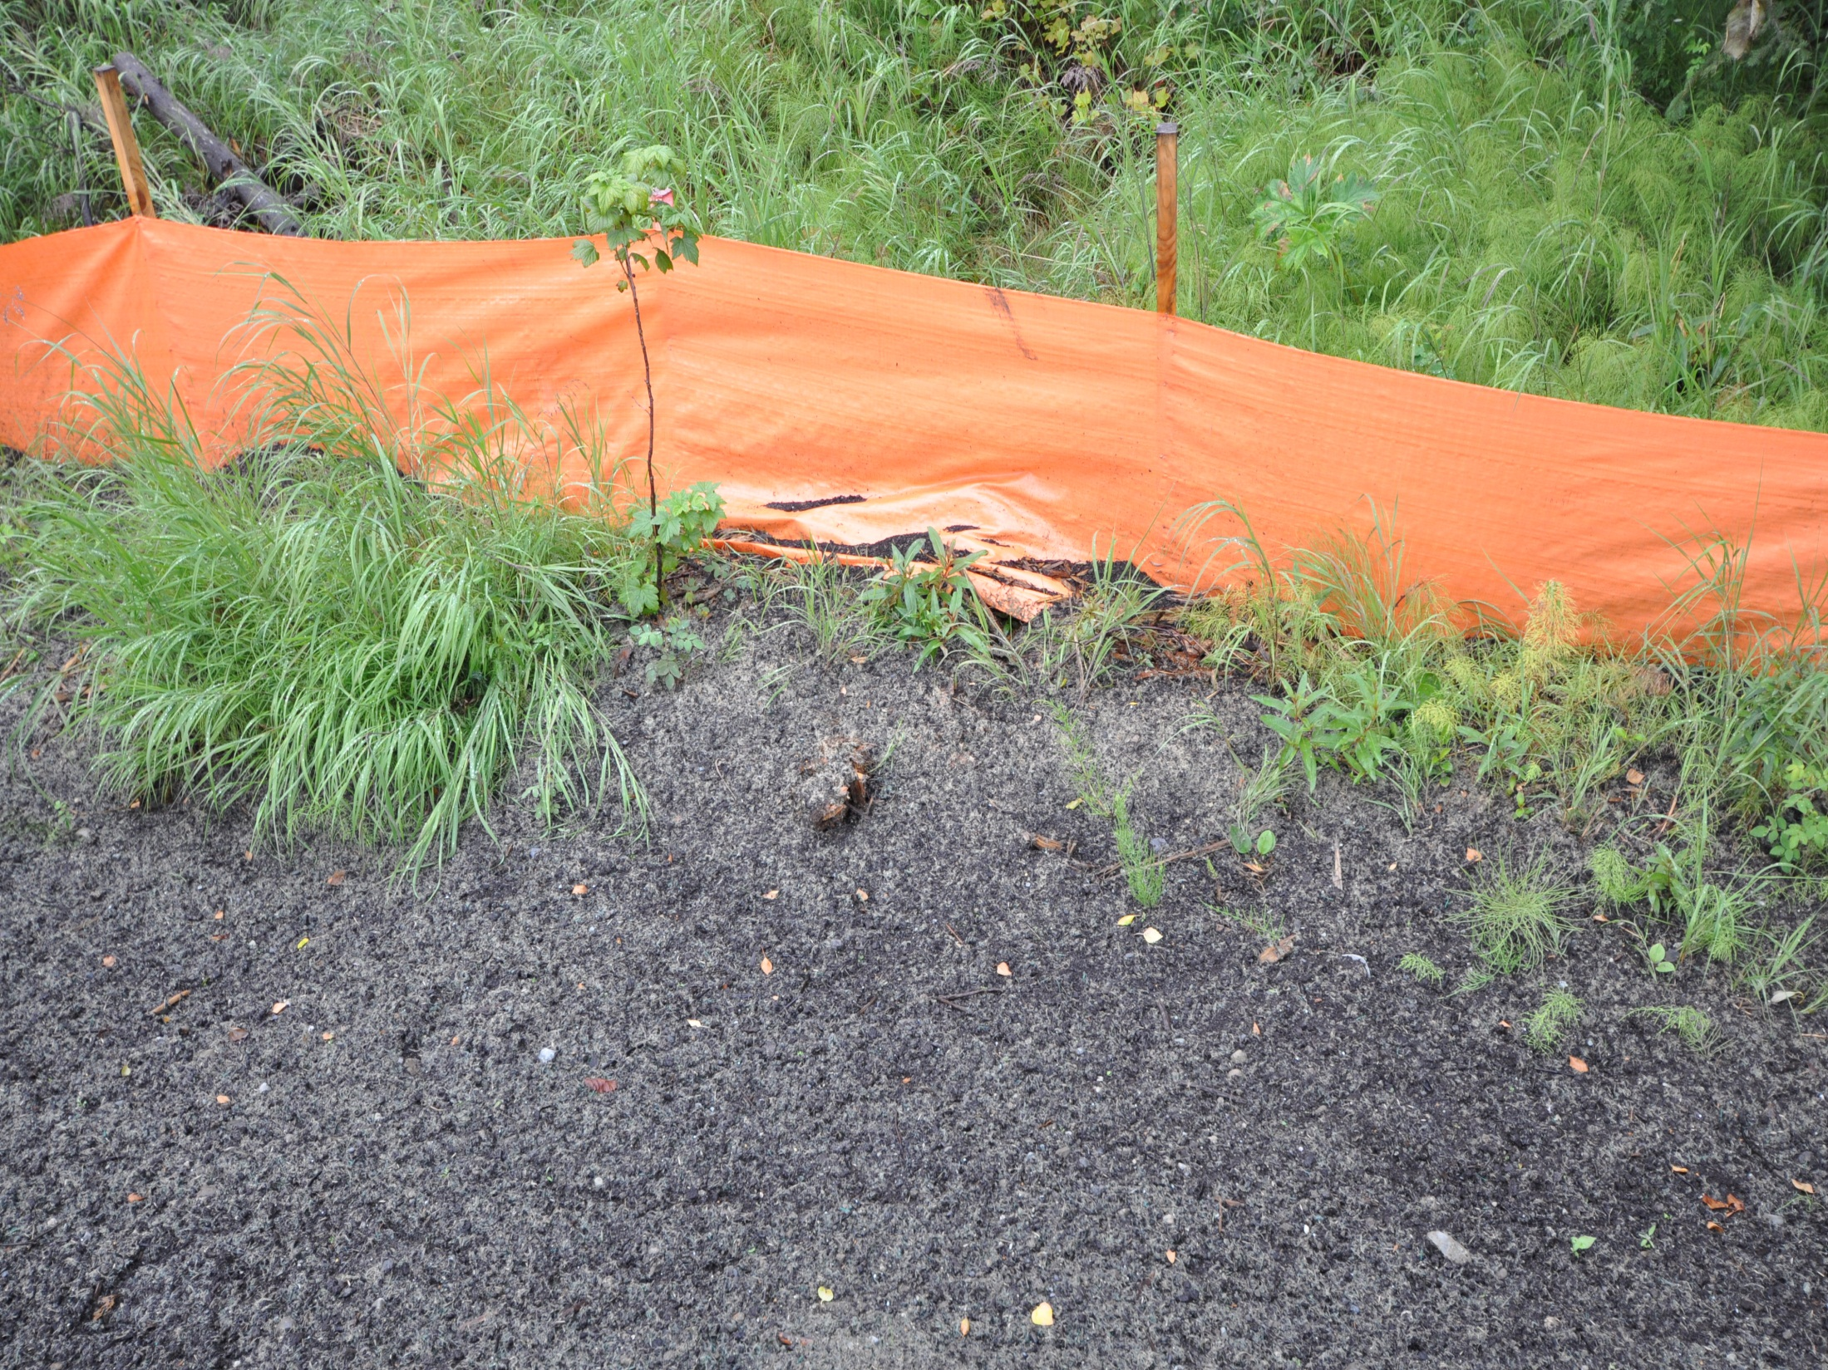
Was it inspected?
Do we know how to inspect?
Anchorage
Notes:
Improper installation when found in the field begs two questions, are we inspecting? Are we qualified to do inspections?

Slide 28
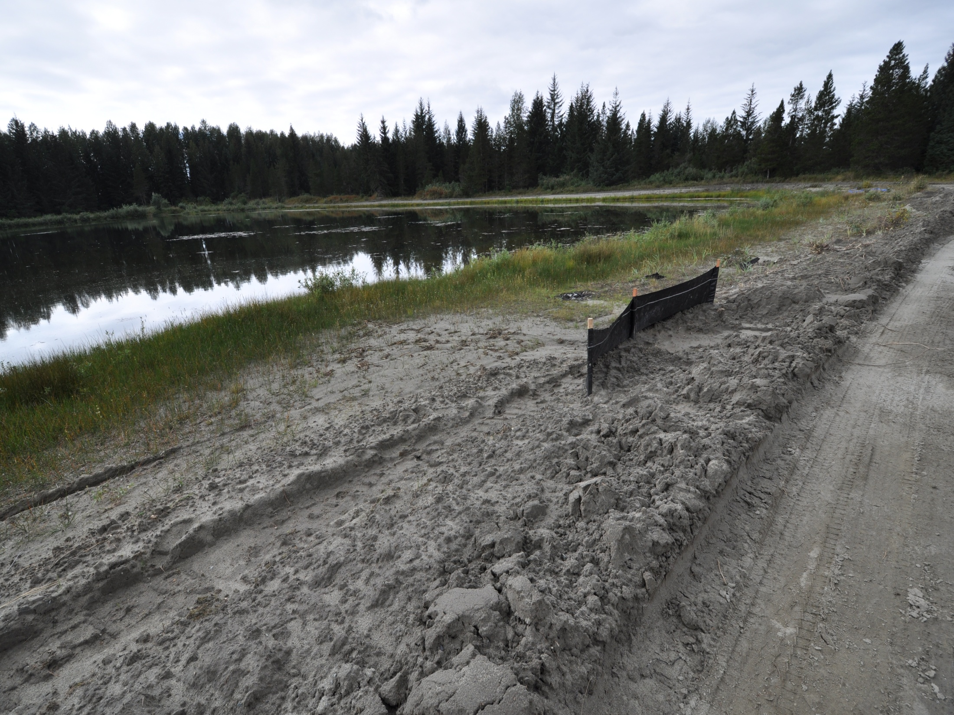
28
Gustavus
Notes:
Note sediment deposition past the silt fence, what is the purpose of the silt fence. Where should the fence be?

Slide 29
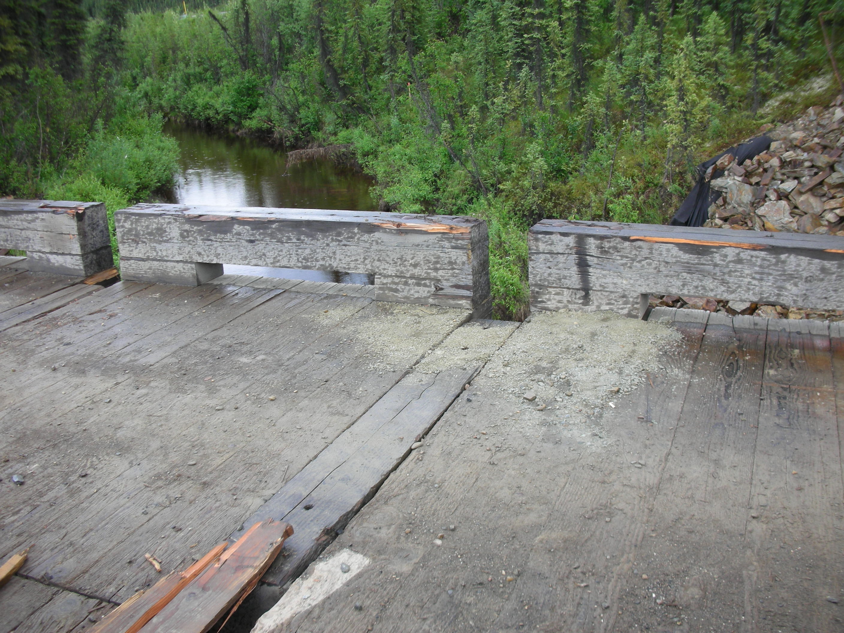
Specialty Perimeter Sediment Controls
Temporary Crossings
Bridge Decks

Slide 30
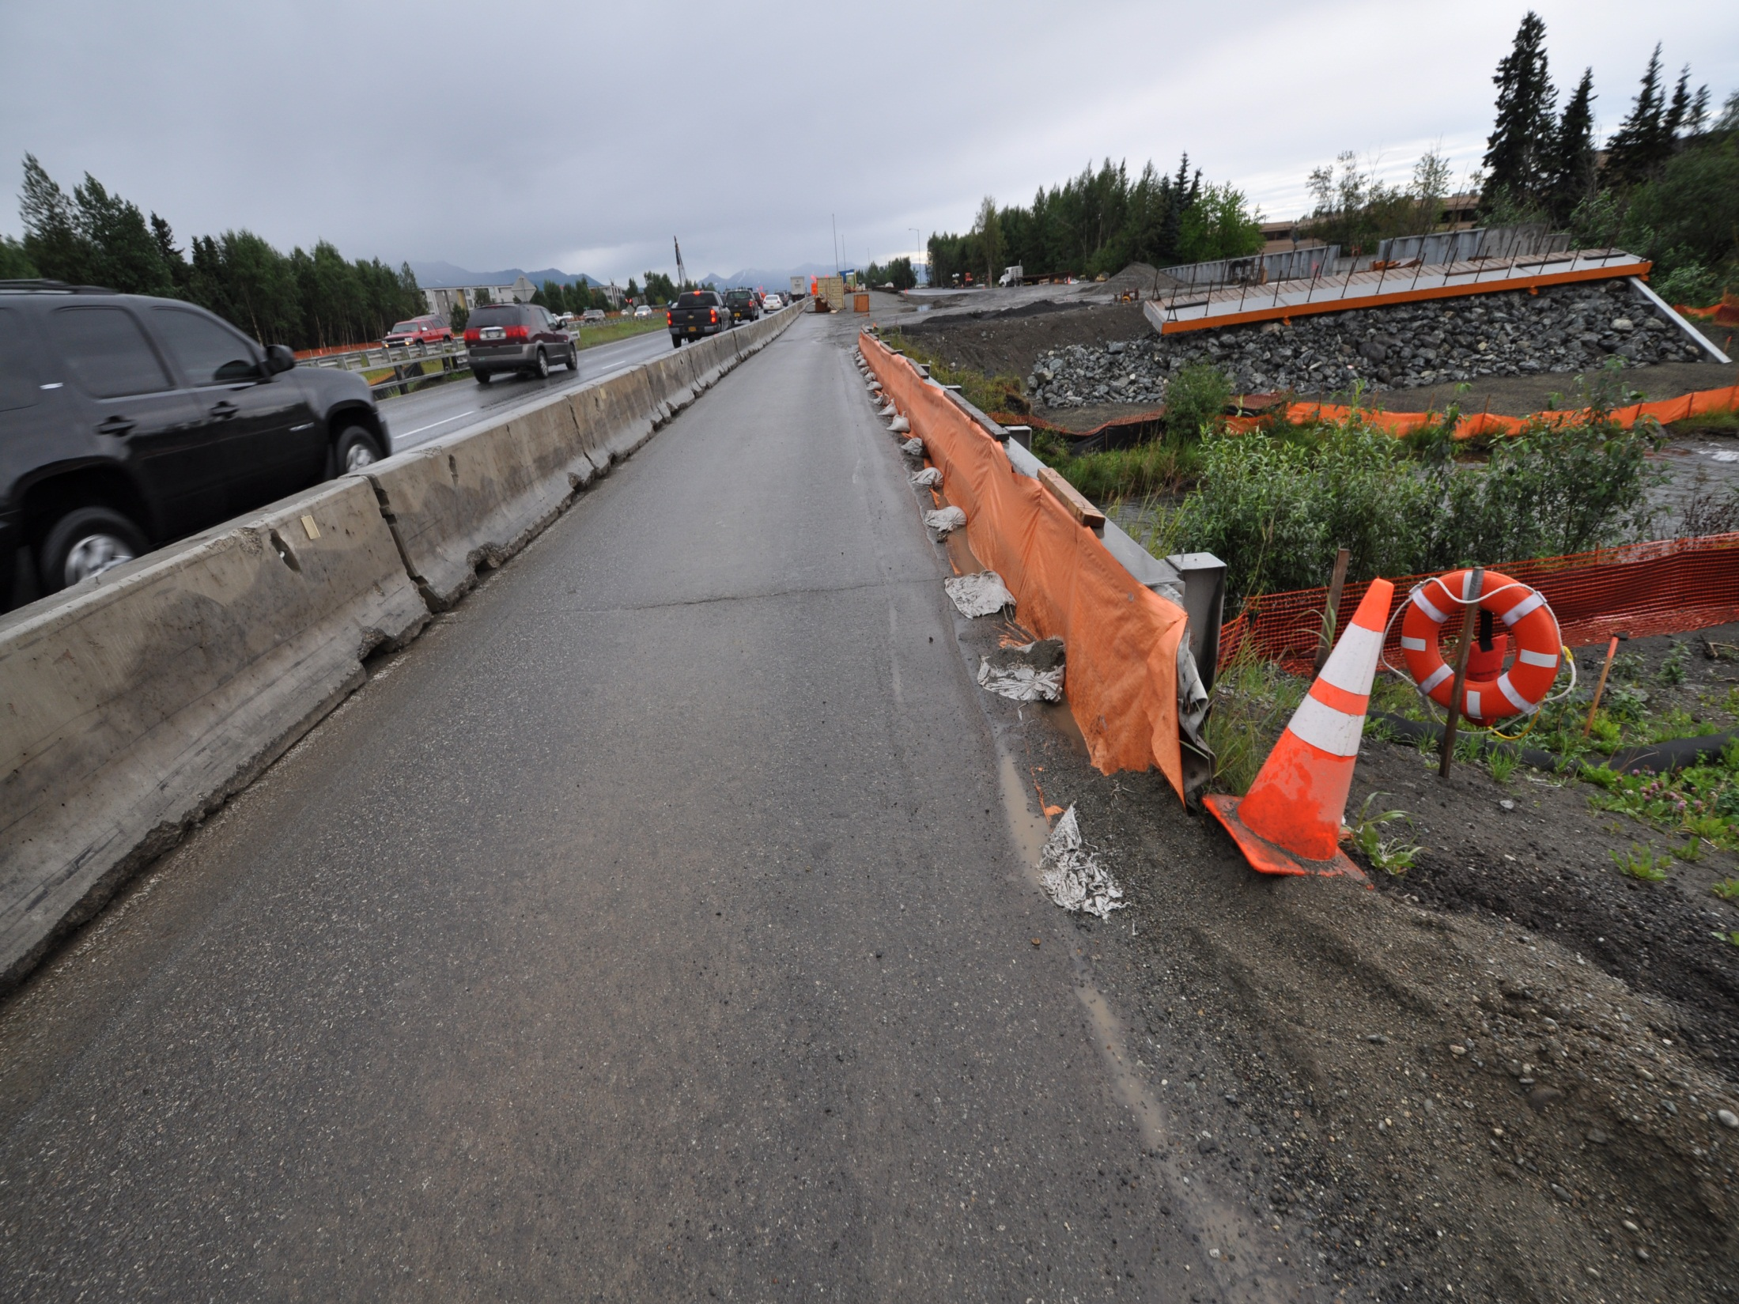
Perimeter Control?
Notes:
This is bridge crossing and the silt fence is simply a flap on the asphalt and some sand bags to try to hold it down. Construction traffic is breaking the bags and the effectiveness was never really there. This situation comes up a lot, if the sediment control is not tightly sealed to the surface flow will simply go under it. In this case right into the creek.

Slide 31
Notes:
Directing flow off a bridge crossing situation to the surrounding area is usually the preferred method for dealing with these perimeter control situations.

Slide 32
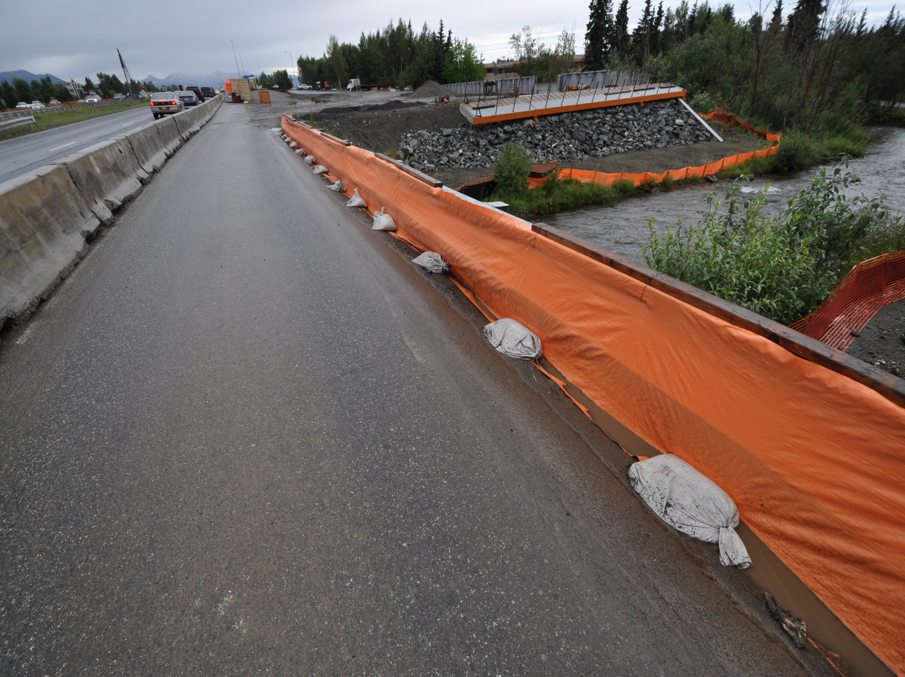
8oz Drainage Filter Fabric
Weep Holes (Maybe)
2x6 lumber or larger
Adhesive / Sealant
Simple Solutions
Notes:
This is only one idea for dealing with this situation. No matter what a project chooses to use it must be in contact with the asphalt to prevent water from getting under the installation.

Slide 33
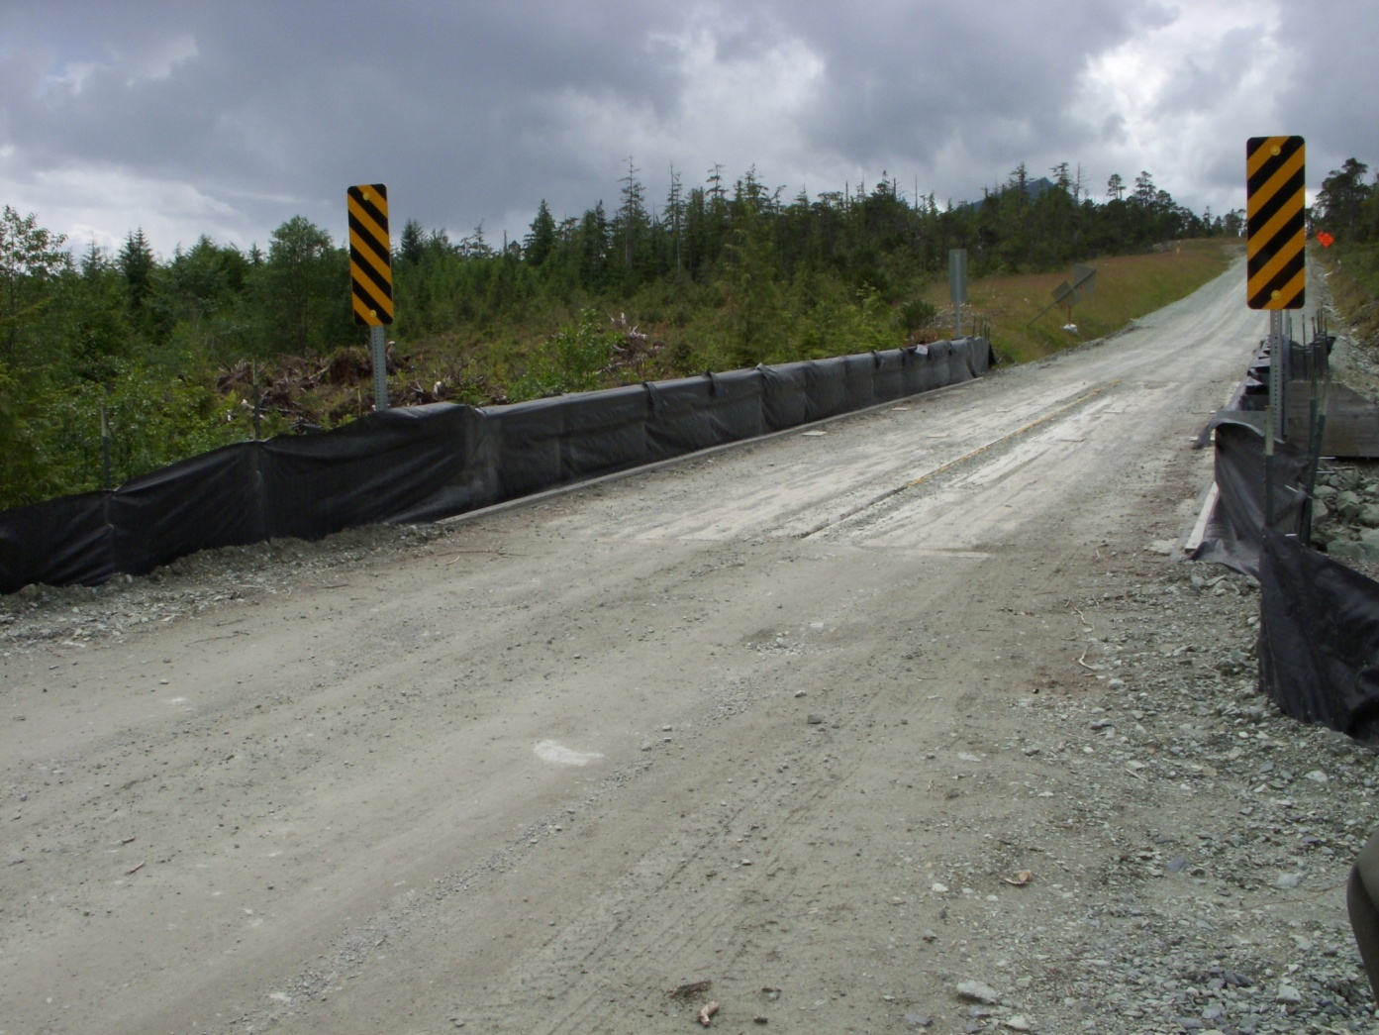
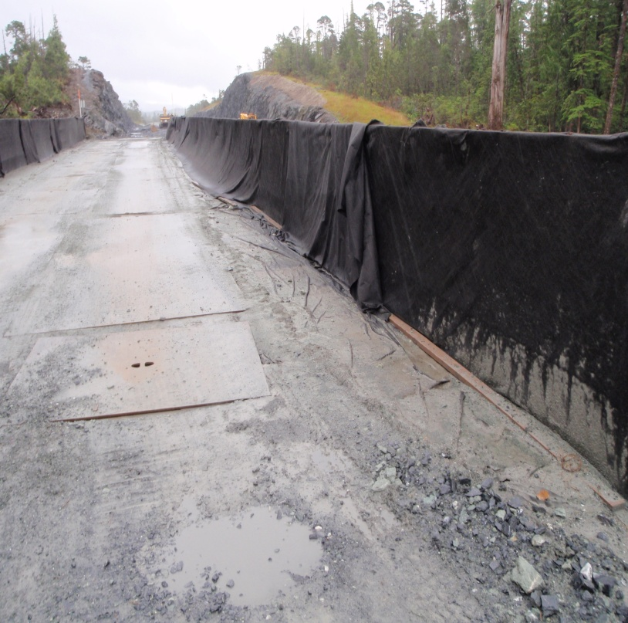
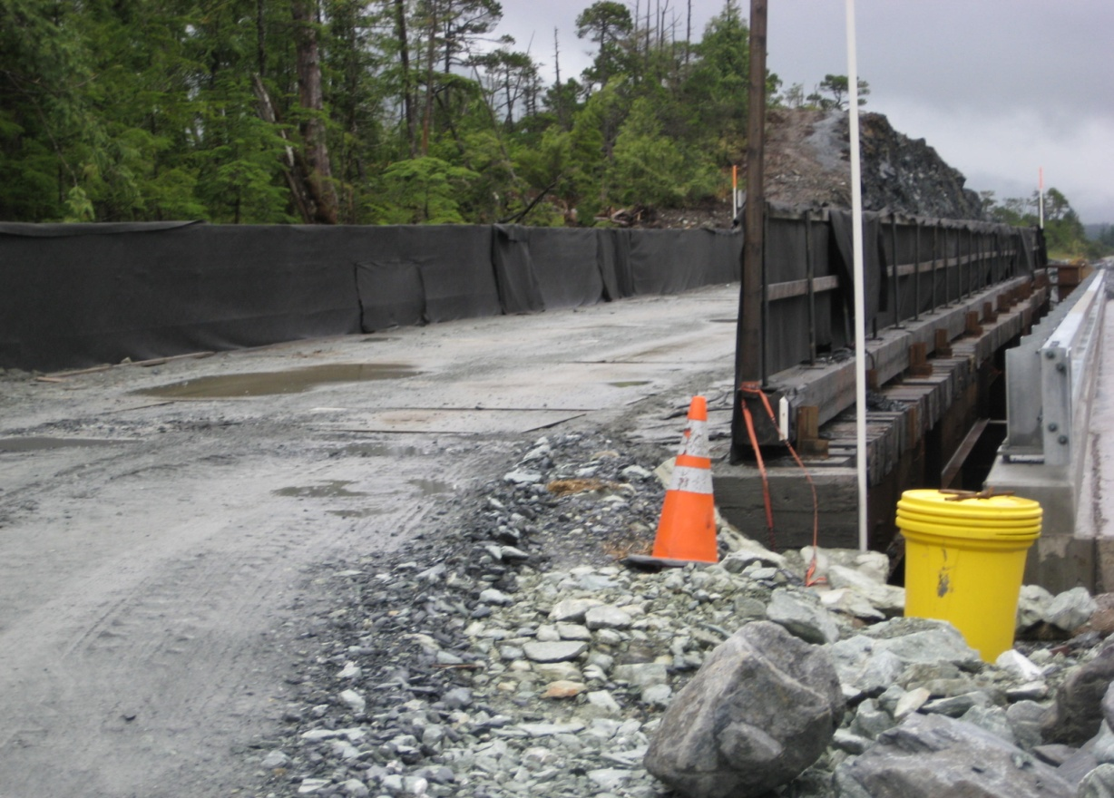
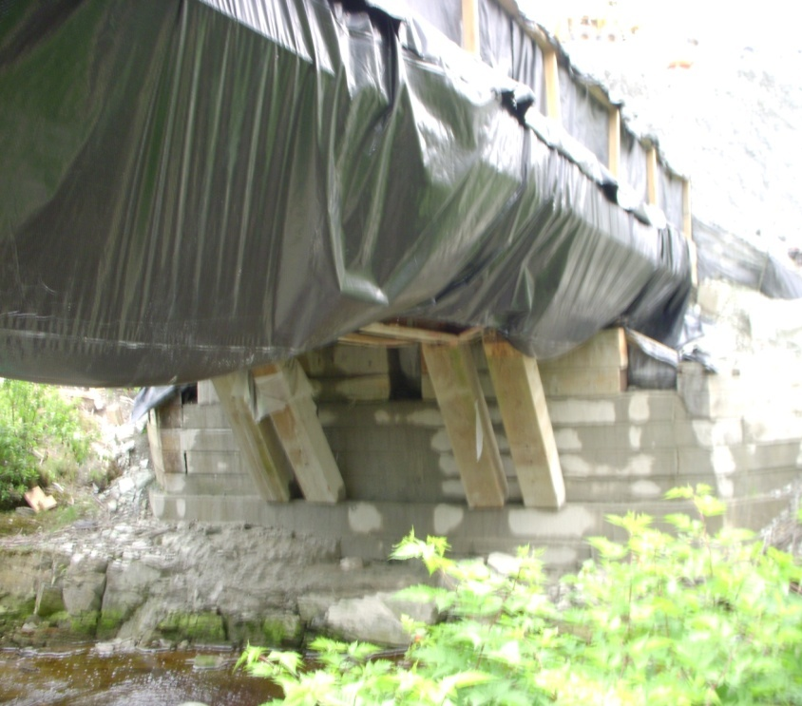
Bridge Deck Perimeter Control
Ketchikan
Notes:
These are different examples of bridge deck perimeter controls, note the steel plate preventing the wear on the geotextile.

Slide 34
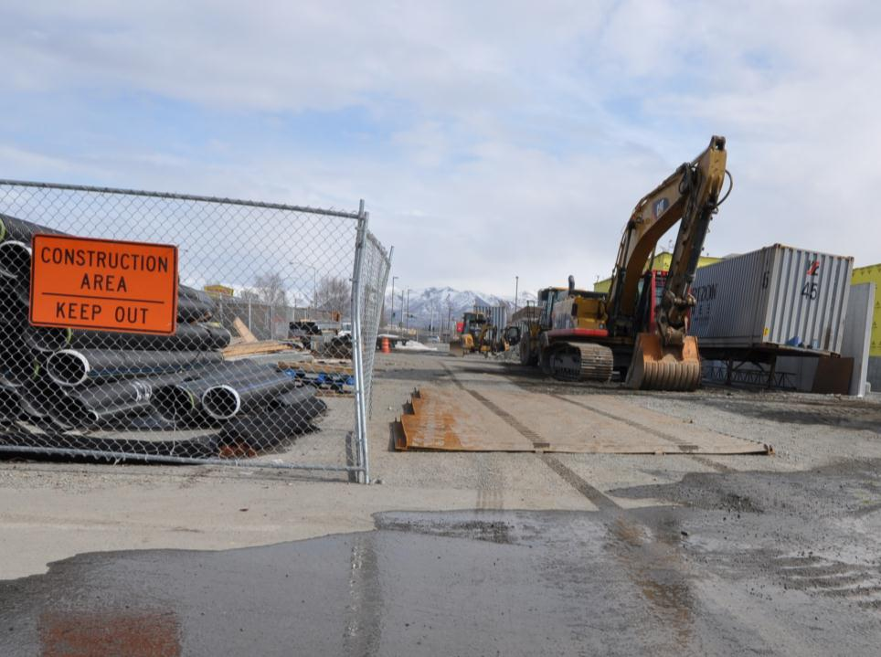
Stabilized Construction Vehicle Access & Exit Points
2021 CGP 4.3.4
Rattle
Racks
A permittee must establish construction vehicle access and exit points and they must be stabilized.
Anchorage
Notes:
Trackout is extremely dirty when rain washes it off – Regulators will be looking at this very frequently – perhaps the most public construction erosion control problem there is.

Slide 35
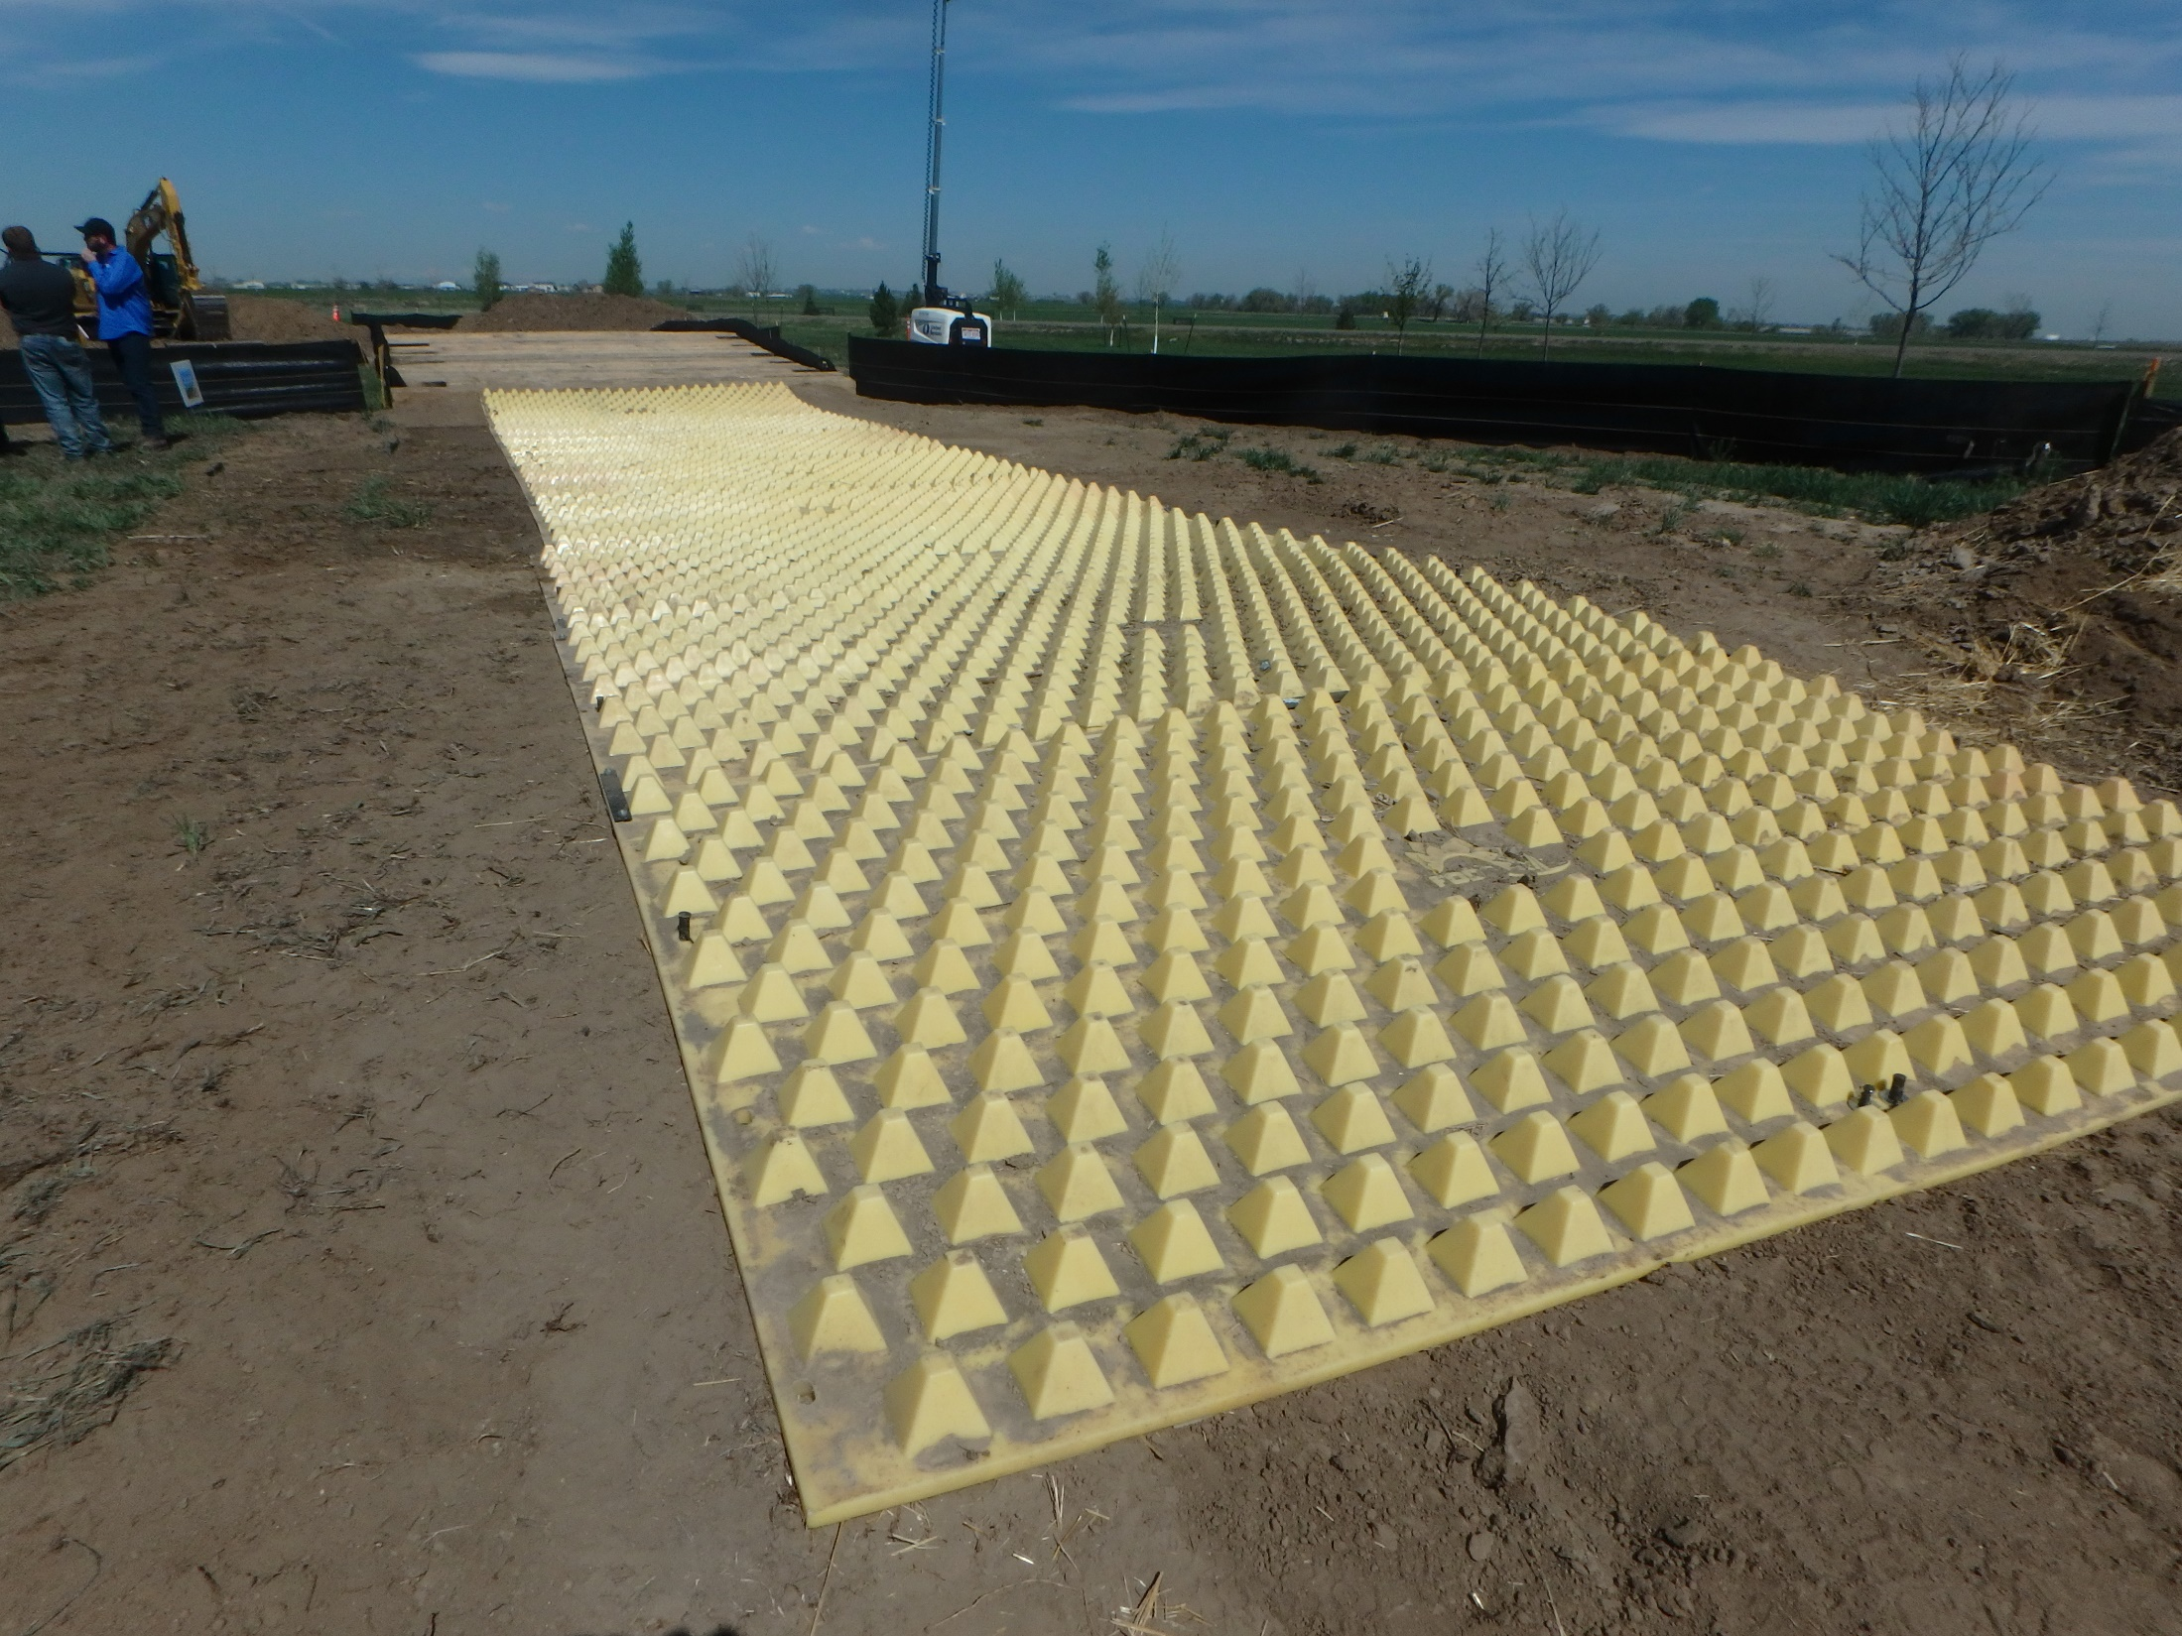
Stabilized Construction Vehicle Access & Exit Points
35

Slide 36
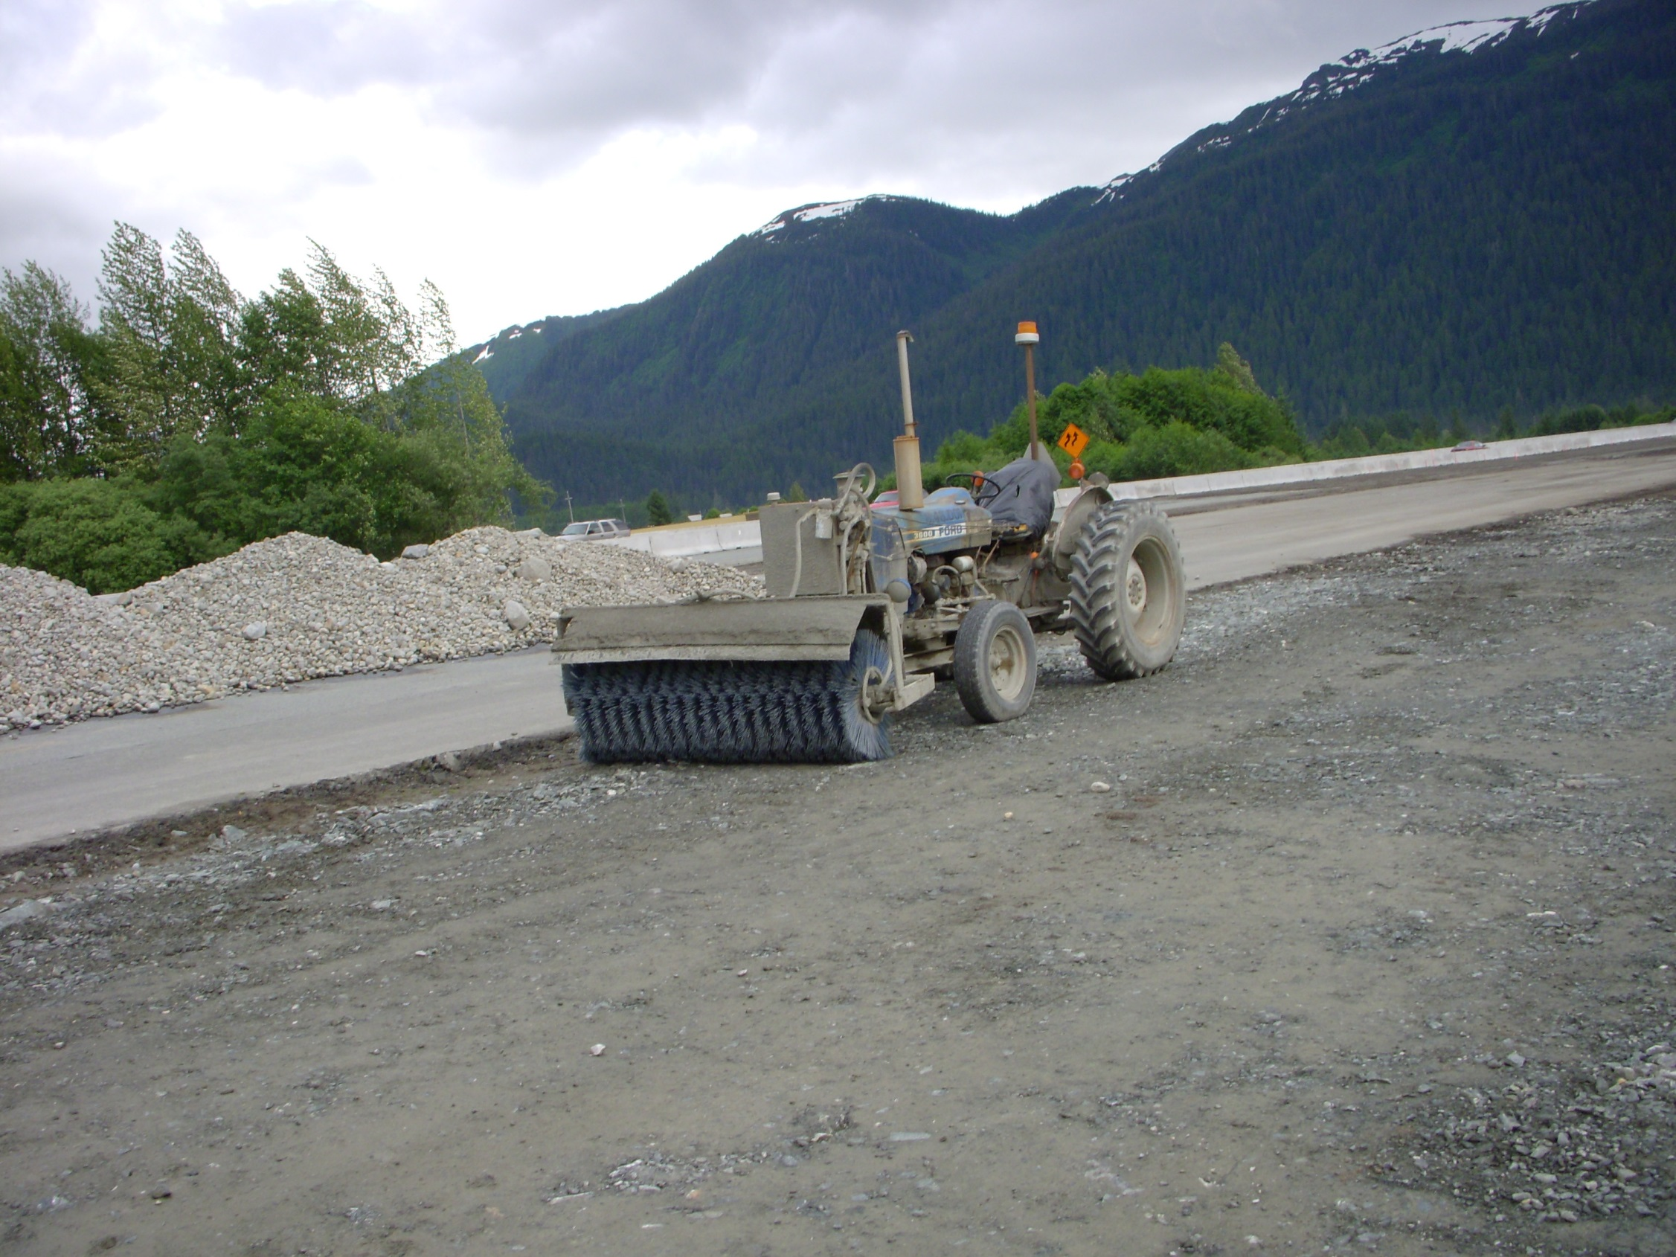

2021 CGP 4.3.5
Juneau
Notes:
This means more than just cleaning up the track out. “Prevent” is the key word.

Slide 37
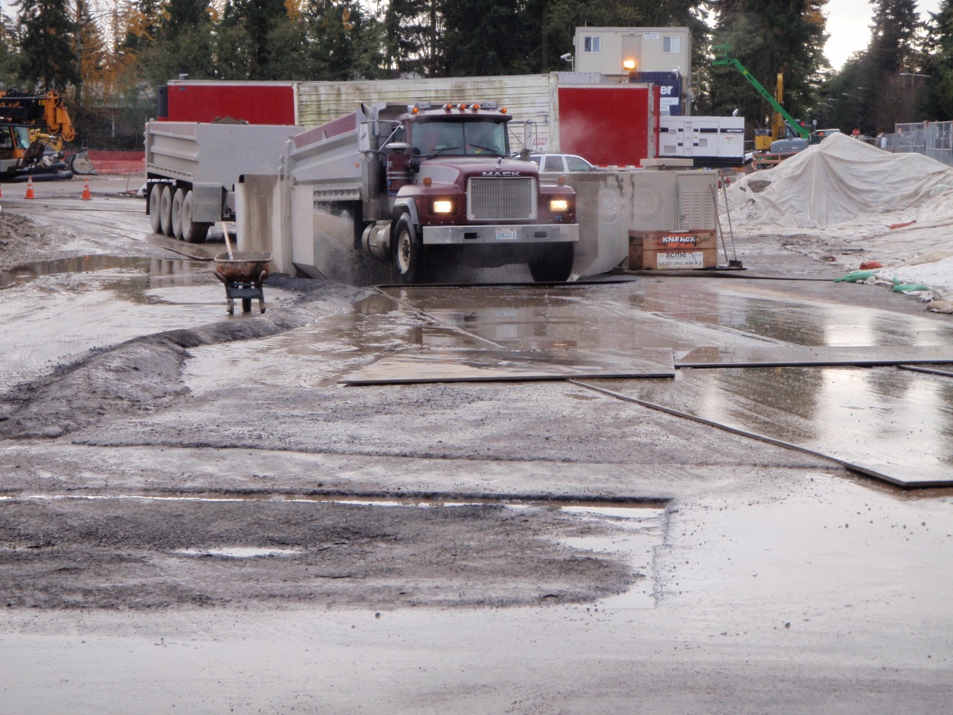
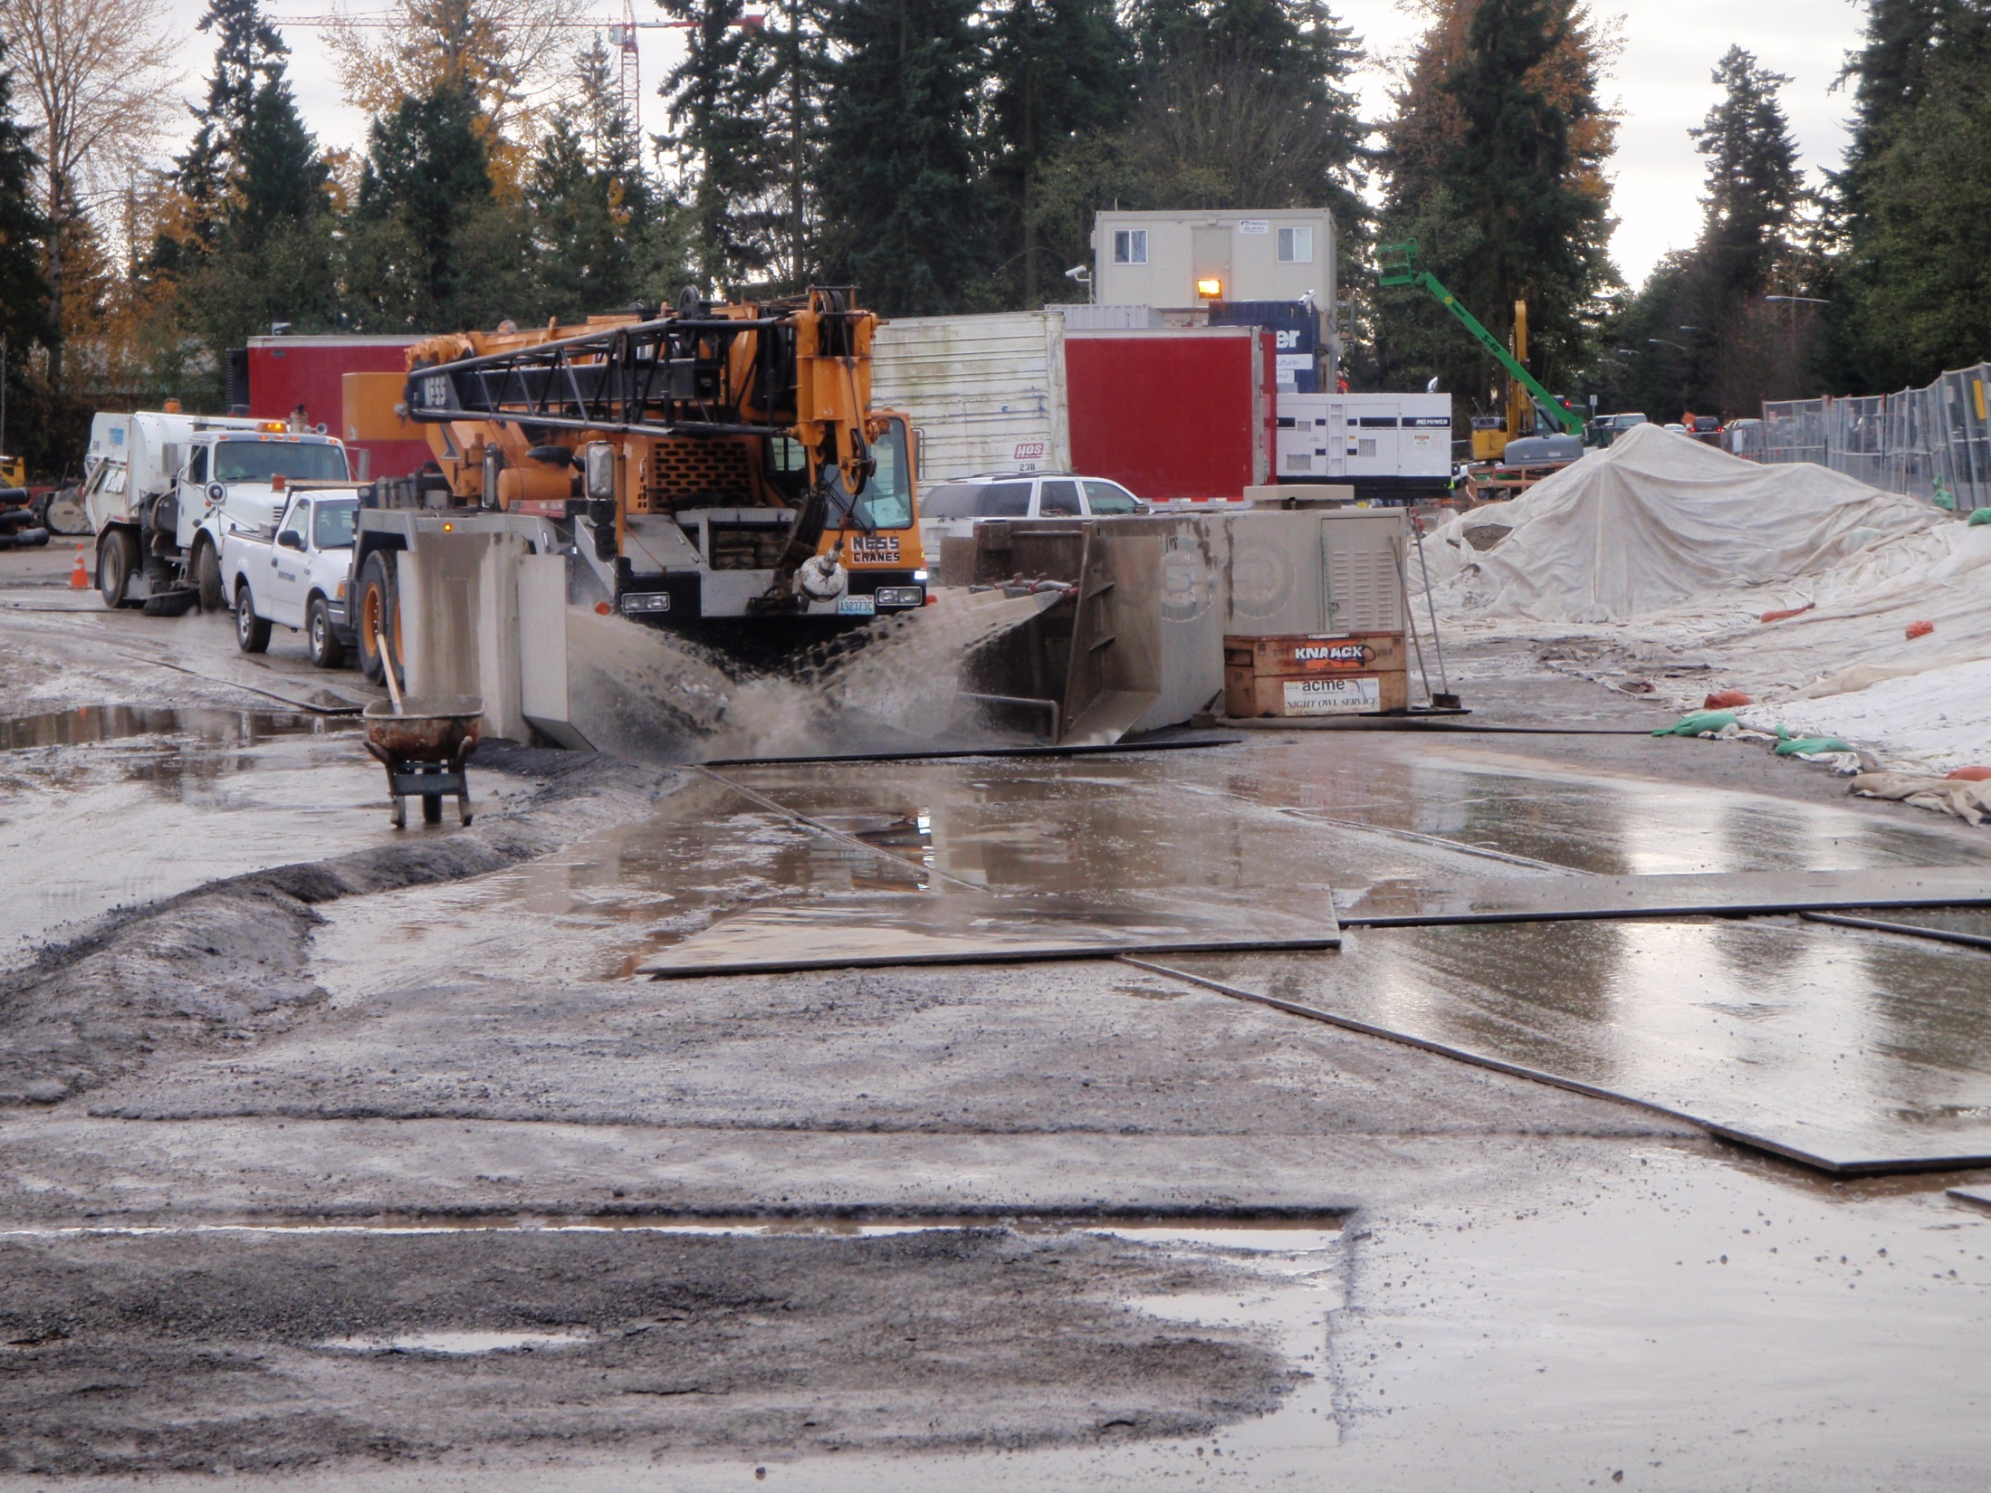
Automated Wheel Wash
Notes:
Street sweeping can be very expensive on projects that involve a lot of export. If traffic must enter the site and drive through dirt and mud there will be trackout, a wheel wash may be necessary to prevent the trackout. Most commercial washes usually need extra capacity in the reservoir and a flocculent to get desired results.

Slide 38
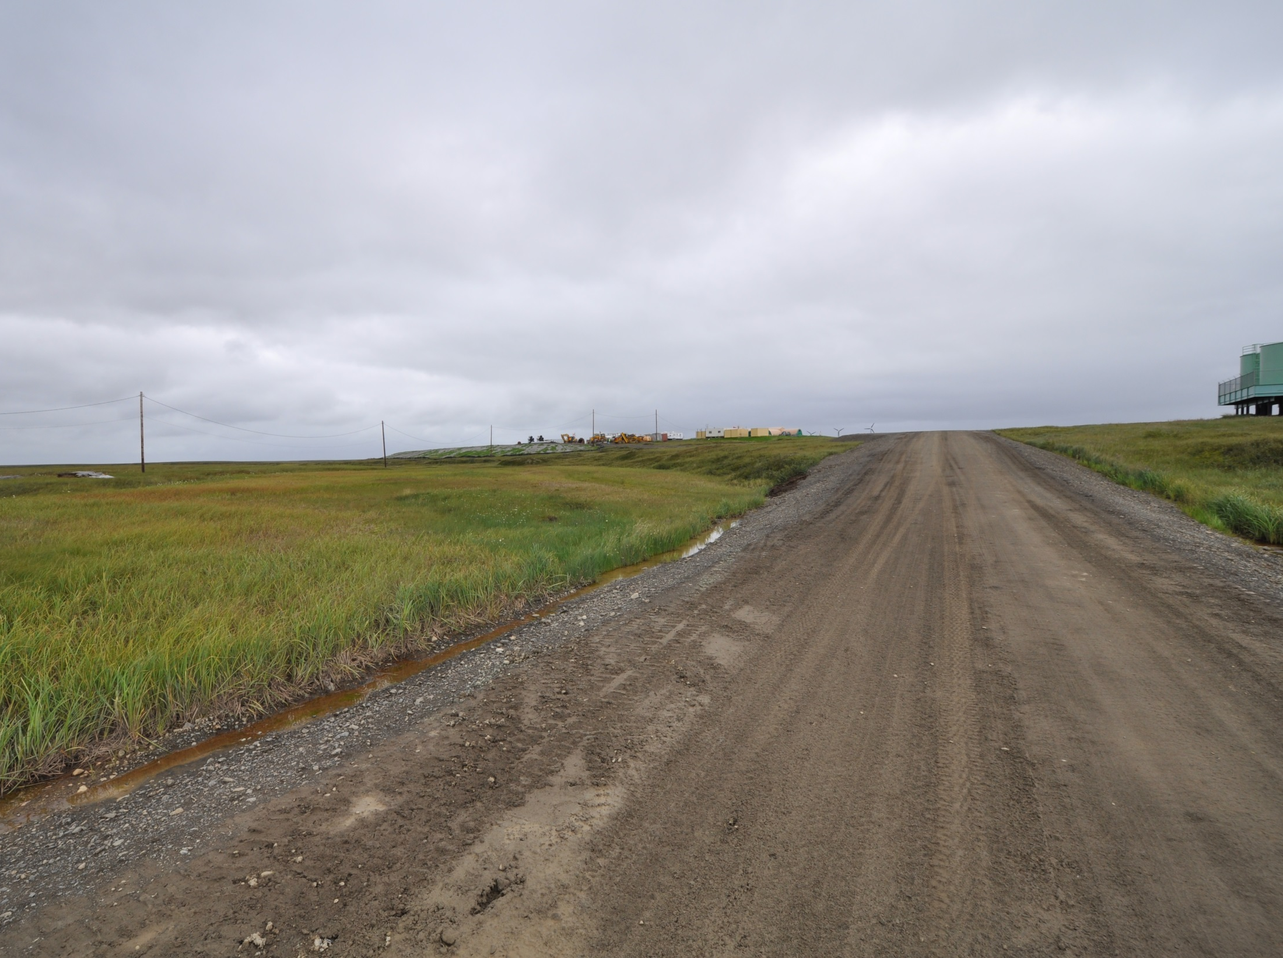
Stabilized Construction Vehicle Access and Exit Points
Is tracking out onto a dirt road really track-out?
If sediment escapes the construction site, off site accumulations of sediment must be removed at a frequency sufficient to minimize off-site impacts.
2021 CGP 4.3.4
Kongiganak
Notes:
Note the heavy equipment at the project, this is a haul road from the barge landing being used for the aggregate import. Does the trackout need to be cleaned up to “minimize” off-site impacts? If washed into the roadside ditch where will it go? Does the ditch discharge into a water of the US?

Slide 39
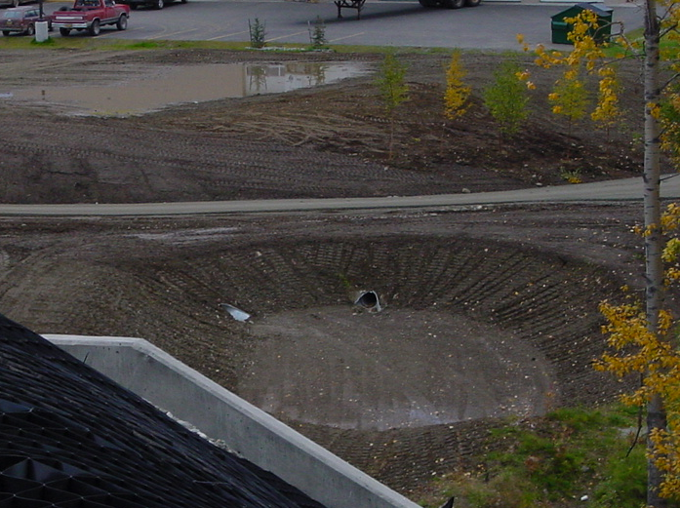
2021 CGP 4.3.9
Sediment Basins
4.3.9.1 For common drainage locations that serve an area with 10 or more acres disturbed at one time, a temporary (or permanent) sediment basin that provides storage for a calculated volume of runoff from the drainage area from a 2-year, 24-hour storm, or equivalent sediment control measures, must be installed, maintained, and used where practicable until final stabilization of the site. 10 acres of contributing drainage requires a sediment basin
4.3.9.1.1 Where no such calculation has been performed, a temporary (or permanent) sediment basin providing 3,600 cubic feet of storage per acre drained, or equivalent sediment control measures, must be installed and used where practicable until final stabilization of the site.
Wasilla
Notes:
10 acres of disturbed area at a time contributing to a single discharge point.

Slide 40
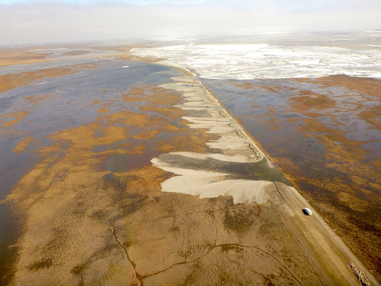
2021 CGP 4.3.9.4
Note: No installation of sediment basins should be installed in permafrost areas.

Slide 41
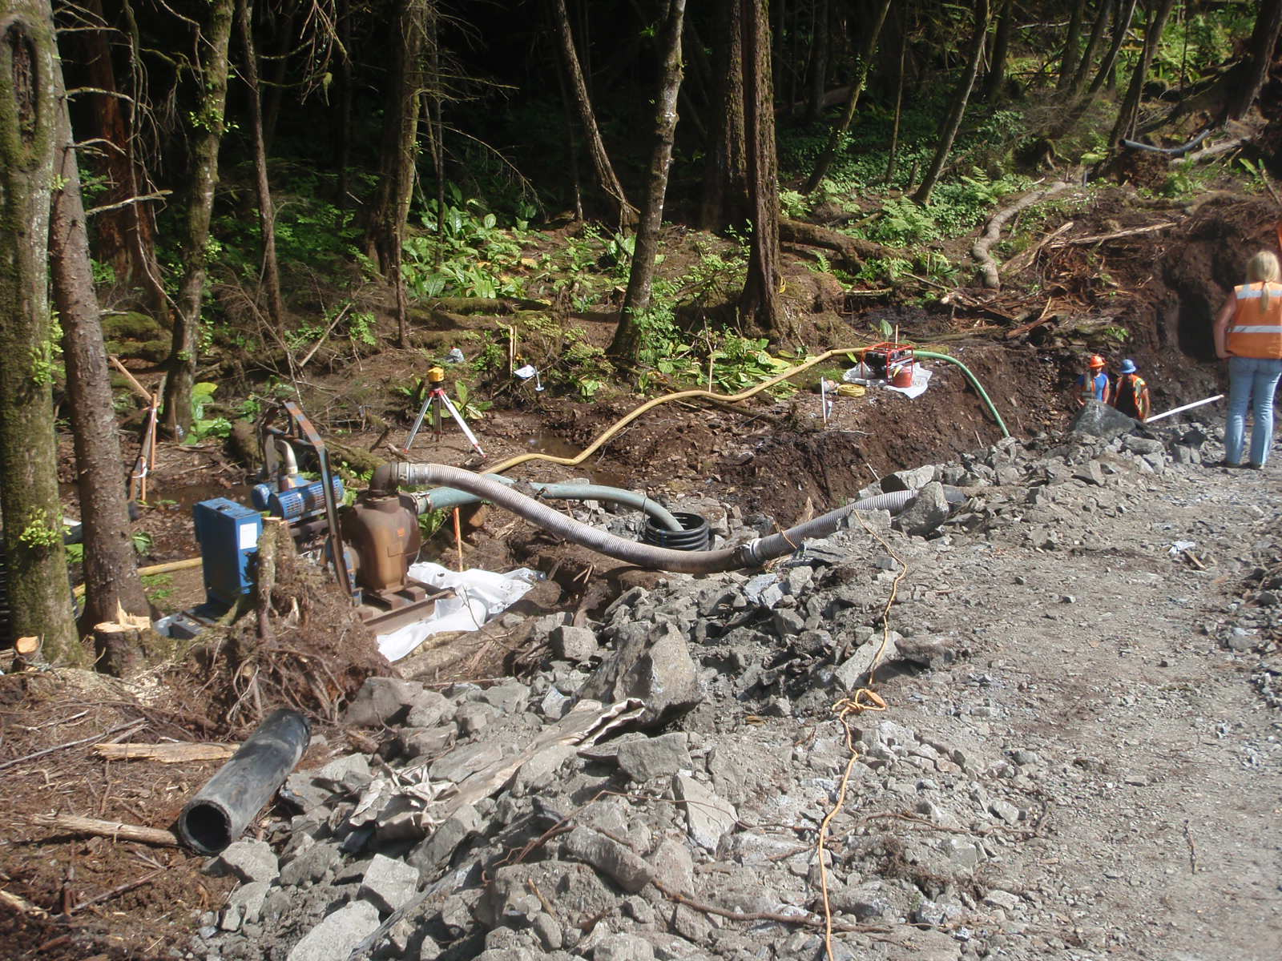
Control Dewatering
Plan the dewatering activity
  Have an approved method
  File NOI for DEC permit if necessary
  Involve the approval agency
  Monitor dewatering operations
Notes:
The DEC permit we are talking about here is the excavation dewatering permit, not the CGP.

Slide 42
ADEC Dewatering Permit
AKG002000
Dewatering discharges eligible for coverage under this general permit consist of water pumped from excavation areas through the use of temporary dewatering wells or submersible pumps to lower the water table to support a construction activity. The dewatering of accumulated groundwater and storm water that accumulates within an excavation area is an authorized discharge under the permit. The permit does provide discharge authorization for dewatering conducted within 1,500 feet of a permit defined “DEC-identified contaminated site” although special permit conditions apply and additional requirements may be added in the discharge authorization. The special conditions will provide assurance that the dewatering activities does not pull contamination from known contaminated sites. See
http://dec.alaska.gov/water/wnpspc/stormwater/edhsgp.html

Slide 43
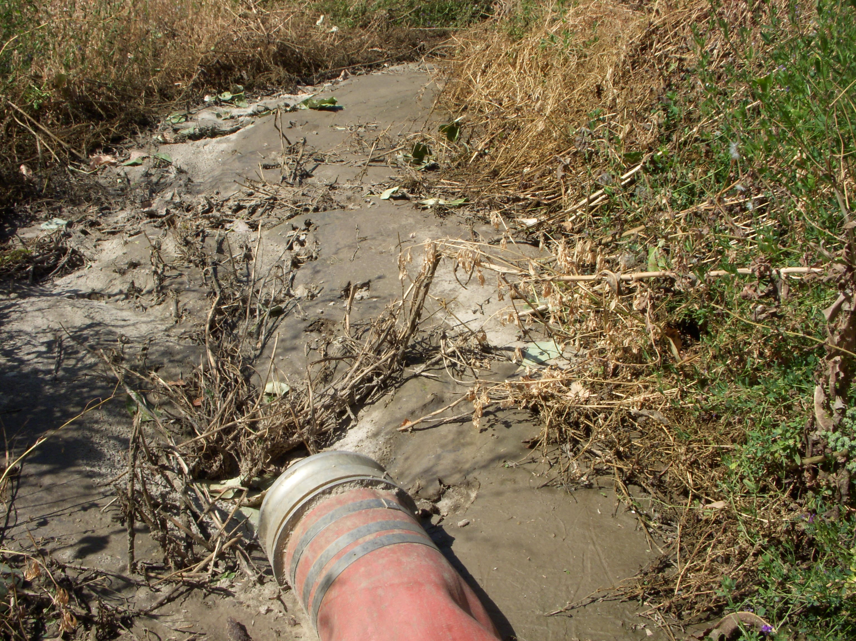
Dewatering Notice Requirements
Submit an NOI and a certified BMP Plan to receive discharge authorization, IF
  1. You have excavation dewatering activities located within 1,500 feet of a permit defined “DEC-identified contaminated site,” or
  2. You have excavation dewatering activities located within 1,500 feet of a “contaminated groundwater plume” identified by Contaminated Sites, or
  You have excavation dewatering discharge to waters of the U.S. not
  covered by the Construction General Permit
IF answers to 1, 2, and 3 is No then no NOI Submittal is required. Projects not requiring an NOI still must comply with the conditions of the Excavation Dewatering General Permit. Dewatering discharge to the land is authorized in accordance to Part 4.0, Control Measures; Part 5.0, Monitoring Requirements; and Part 6.0, Reporting and Recordkeeping of the Excavation Dewatering General Permit.

Slide 44
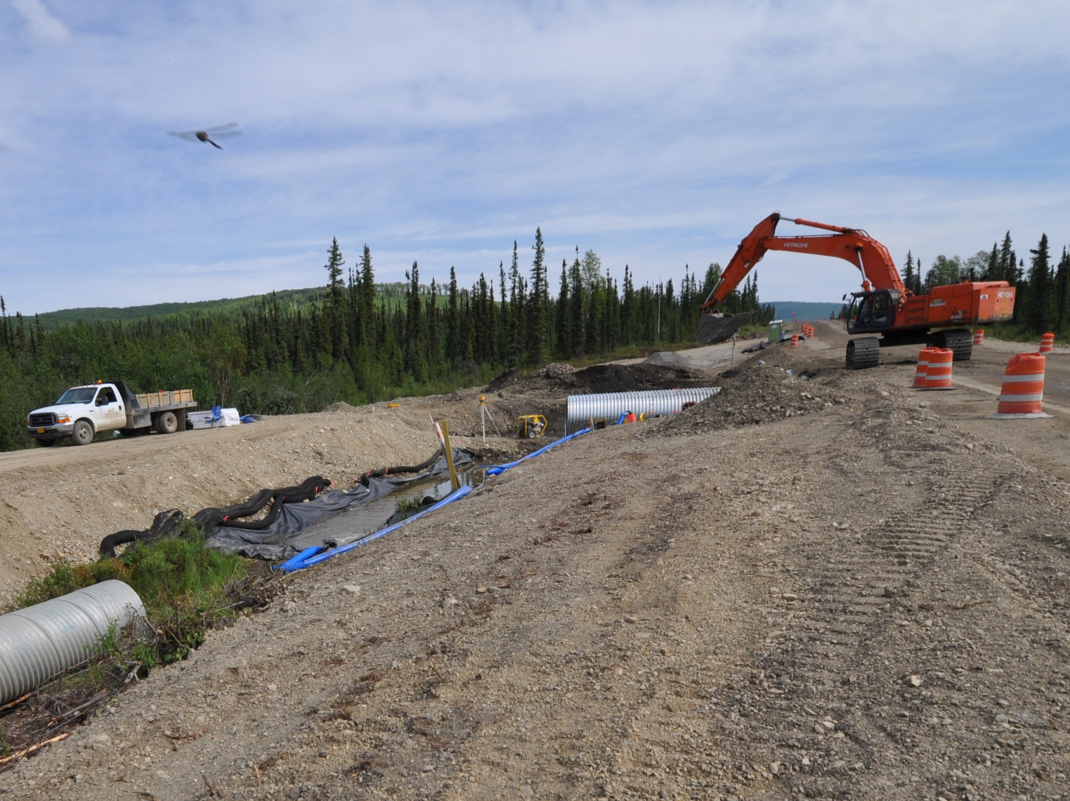
What is Dewatering?
Dewatering may be difficult
But it’s not impossible!
Notes:
Dewatering is when we pump from a constructed excavation.

Slide 45
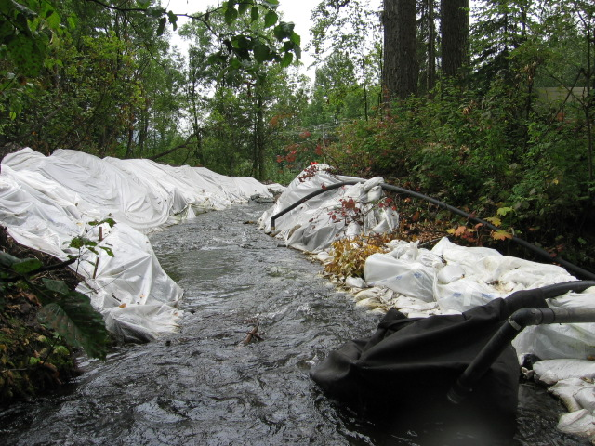
Diversion
Notes:
Diversions may be constructed and stabilized and not involve any dewatering.

Slide 46
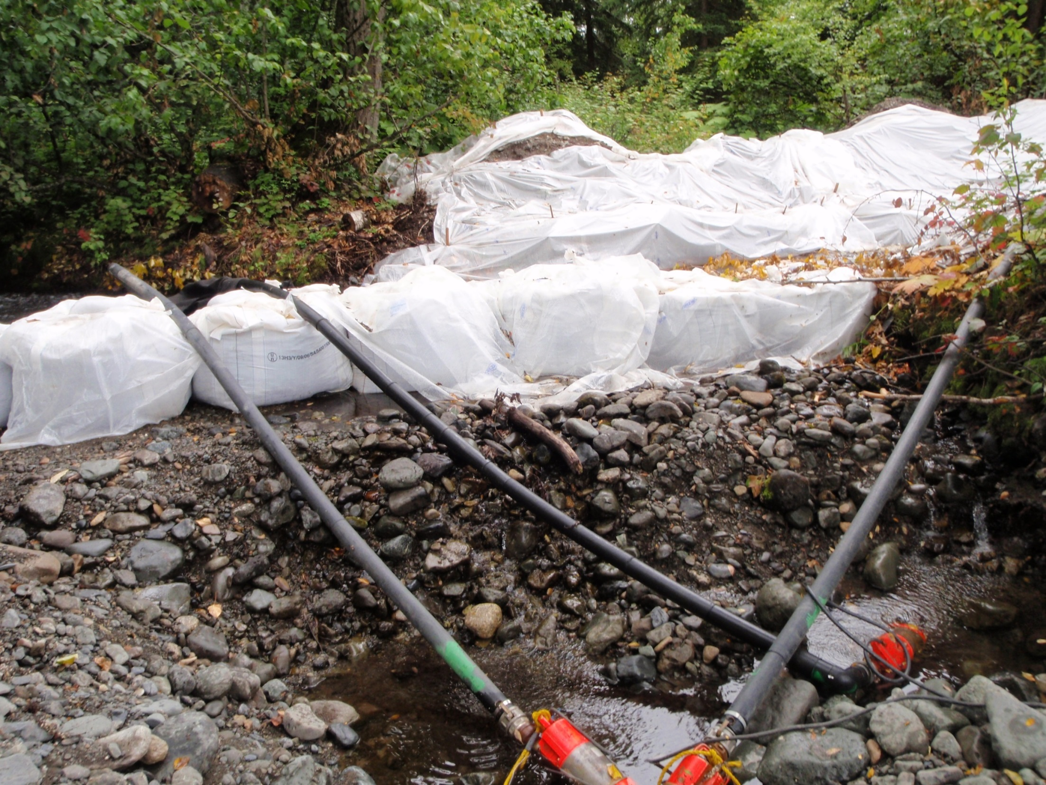
Pumped Diversion
Notes:
Diversions can be pumped and not involve dewatering. This is simply putting the water that drains through the creek bottom cobble back in to the constructed diversion.

Slide 47
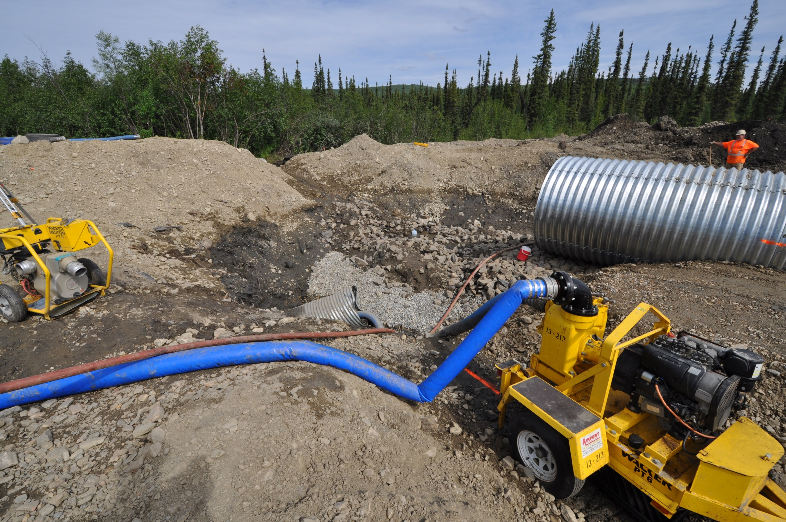
Curb Appeal?
Notes:
This is pumping from the excavation, this is excavation dewatering, note there is no perimeter control between the disturbed construction site and the flow.

Slide 48
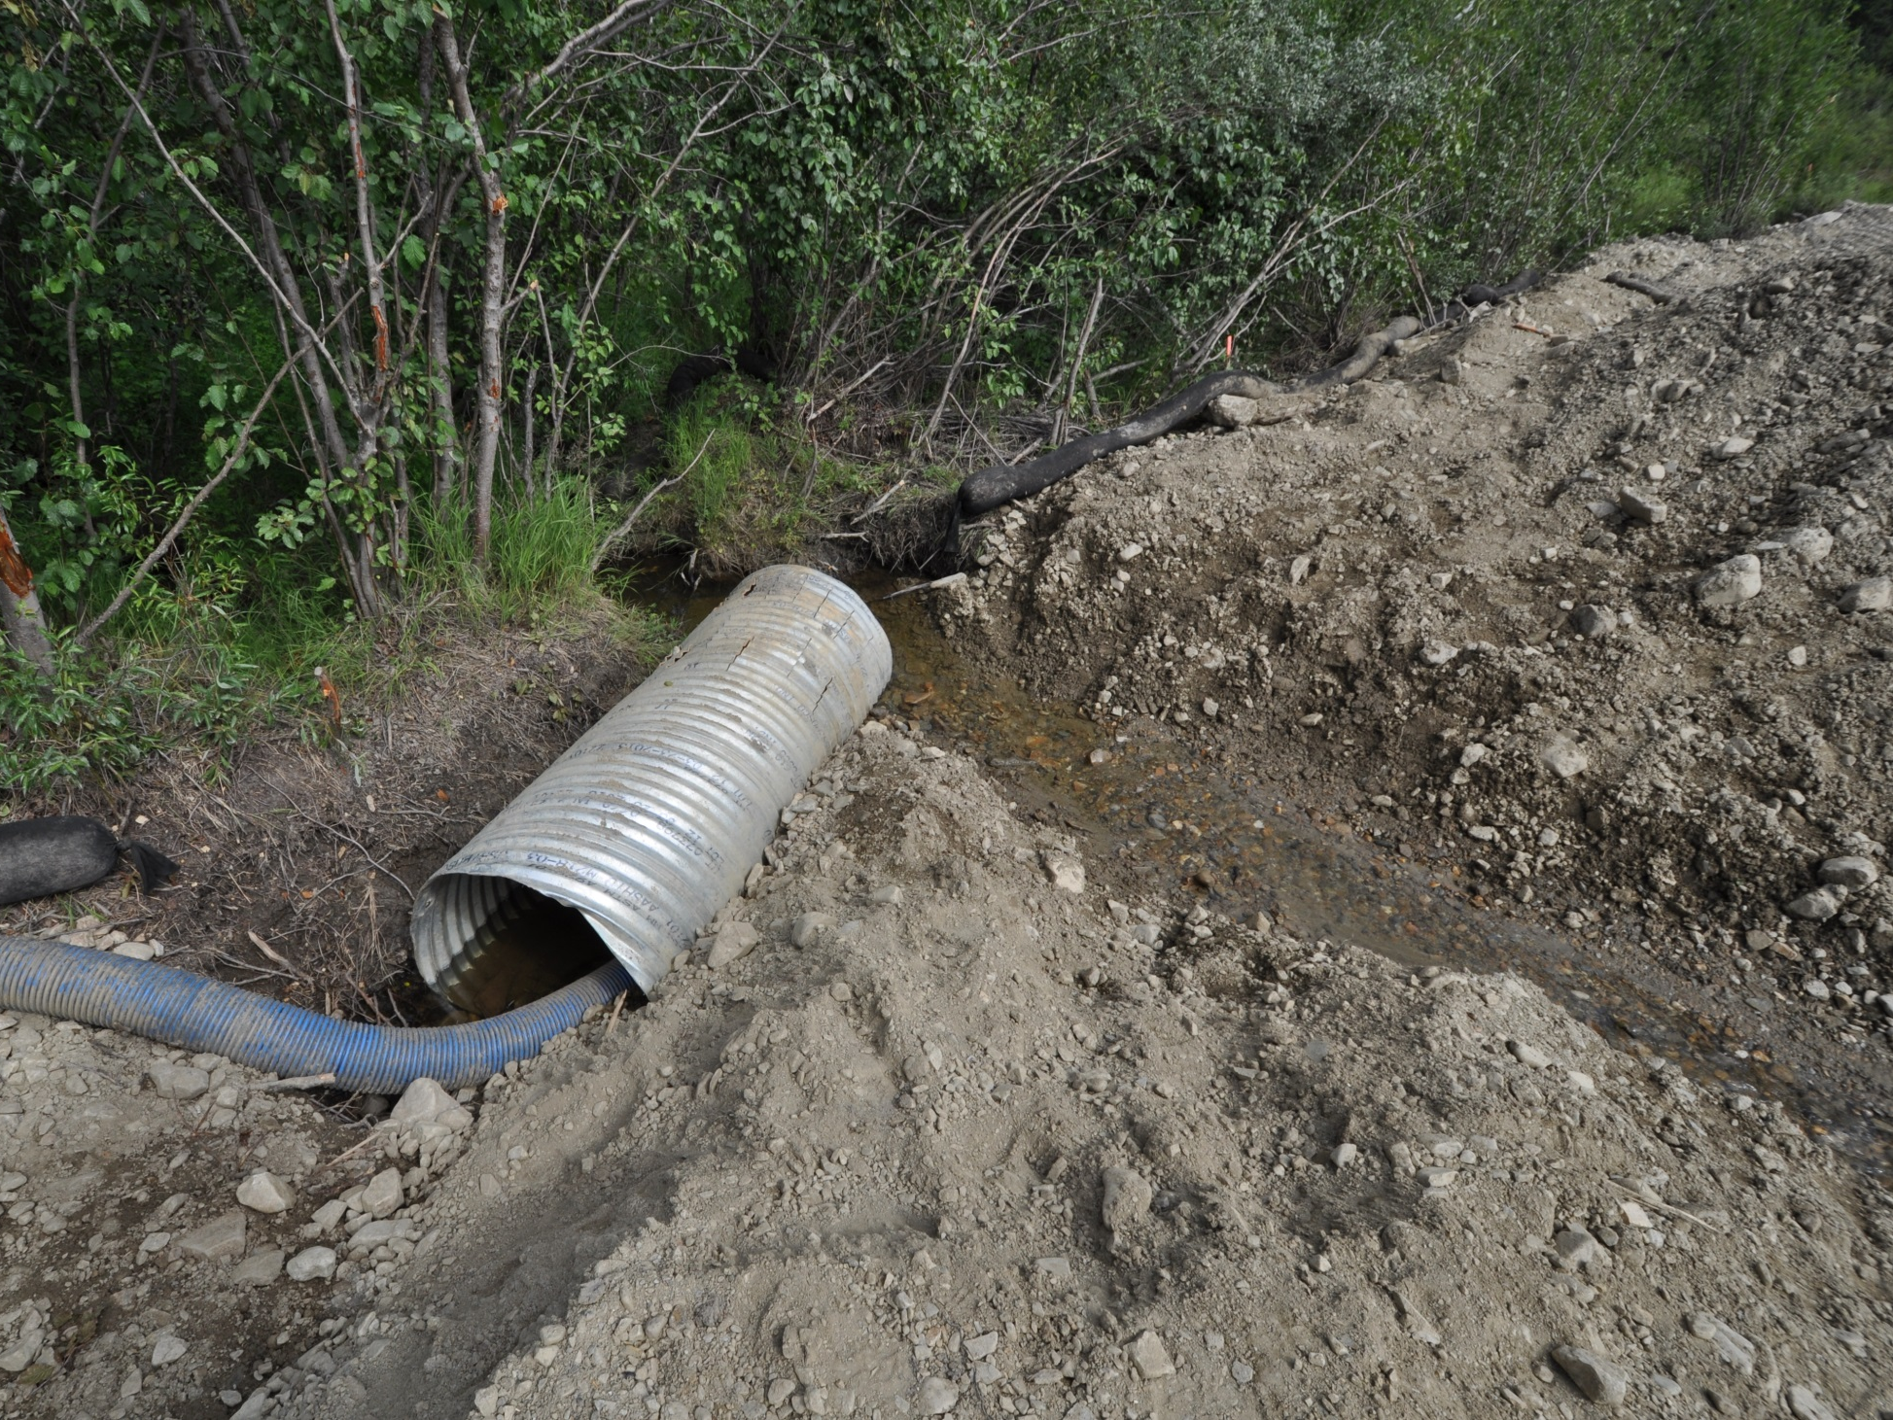
Diversion would intake here
We build it
We stabilize it
Notes:
This intake location could be a diversion.

Slide 49

This is Excavation Dewatering
Not a Diversion
Pump is drawing from the excavated area.
Flow is over constructed area
Notes:
This is the upstream view. This water is running into the project from offsite.

Slide 50

Consider the permit minimum measures
Dewatering
Soils Stabilization
Waterbody Protection Measures
Down Gradient Sediment Control
Notes:
When inspecting always keep in mind the minimum measures we have gone over throughout the day.

Slide 51

Have a Plan!
Write it down!
Modify if needed!

Slide 52

This plan must have
a lot of updates!
Sitka
Notes:
Sometimes you tell when things just don’t seem to be working out. There are 5 pumps in this picture.

Slide 53

4.6 2021 CGP
4.6 Treatment Chemicals
Requires:
Manufacturer MSDS Sheets
Trained employees
Site specific soil testing for treatability

Slide 54


What are the chemicals you will use?
Include documentation:
MSDS Sheets
EPA approval for water use
Approval from CA, MN, OR, WA, WI for construction or AG
Non Toxic certification
Identify Operators & Training
Polyacrylamide
Chitosan
The SWPPP must:
Describe what chemicals will be used, including information required by CGP Section 4.6.2.3 Document the training for employees using treatment chemicals.

Slide 55

    Treatment chemical use procedures
Handling & Storage - Dose Rate - Mixing Requirements
The SWPPP must:
Describe training for employees using treatment chemicals at the site. Document this training in SWPPP appendices.

Slide 56

2021 CGP APP C
Treatment Chemicals
For the purposes of this permit, means polymers, flocculants, or other chemicals used to reduce turbidity in storm water. Tackifiers and soil stabilizers (binders) are not considered treatment chemicals.

Slide 57


    Project site conditions
Jar testing for treatability & dose rate
Mixing
Plan for sediment retention
The SWPPP must:
Describe how proposed chemicals are suitable for use at the site.

Slide 58


    Application of treatment chemicals
How will it be used?
Petersburg
The SWPPP must:
Briefly describe treatment chemical application procedures to be used.

Slide 59

  Active Treatment System information (CGP 4.6.7)
If the permittee plans to use cationic treatment chemicals or an active treatment system (as defined in Appendix C) they must submit a request to the Department fourteen (14) calendar days in advance of proposed usage.
Notes:
The instructor could say that the Web site link is in the handout

Slide 60

2021 CGP 4.6.5
Application of Treatment Chemicals
Application of treatment chemicals through the use of manufactured products (e.g., gel bars, gel logs, floc blocks, etc.) must be used in combination with adequate ditch check dams, sediment traps, sediment basins, or physical control measure designed to settle out chemically treated storm water and minimize the presence of treatment chemicals before discharges reach waters of the U.S.
Notes:
This is to ensure we do not discharge sediment or chemical with the storm water.

Slide 61
9. Good Housekeeping
Washing & Washout
Fueling & Maintenance
Fertilizer / Pesticides
Spill Prevention
Waste Handling

Slide 62

2021 CGP 4.8
Good Housekeeping
A permittee must design, install, implement, and maintain effective good housekeeping measures to prevent and/or minimize the discharge of pollutants. A permittee must include appropriate measures for any of the following activities that are used at the site.

Slide 63

    Washing of equipment and vehicles (CGP 4.8.1)
Prevent pollution to receiving areas
Wash water must be controlled
No detergent, soap or solvent
Notes:
Discharge of solvent, soap, and detergents is prohibited. Oil and grease must be addressed as well.

Slide 64

    Washout of applicators/containers used for paint, concrete, and other materials (4.8.4)
What will be washed?
Where will it be washed?
How will the discharge of pollutants be minimized?
Cap
Liner
Concrete
Basin
Notes:
The reinforced plastic is being held on the dirt berm with more dirt. While not the most attractive this will work well. It could be improved by holding down the liner at the outside toe of the berm.

Slide 65

Document the good things that you notice
Washout into steel “eco pan”
Clean entrance
No trackout
Juneau
Notes:
Example of “eco pan” being used for concrete washout, clean entrance and streets. It’s important to reinforce good things. Noting positive observations is a good practice. Using safety meetings etc. as a way to let the crews know when there are good things in the field also will help in the overall site management.

Slide 66

4.8.2 Fueling and Maintenance Areas
Designate areas to be used for fueling and/or maintenance of equipment and vehicles
Taylor Hwy

Slide 67


4.8.2.4.3
Use drip pans or absorbents under or around leaky equipment and vehicles
Juneau

Slide 68

Clean
Contained
Compliant

Slide 69

4.8.3 Staging and Material Storage Areas
Designate areas that:
Minimize the exposure to precipitation and storm water and vandalism for all chemicals, treatment chemicals, liquid products, petroleum products, and other materials that have the potential to pose a threat to human health or the environment.
Goodnews Bay

Slide 70



    Fertilizer or Pesticide use (CGP 4.8.5)
What will be used?
Where will it be used? + storage
When & how will it be used?
Follow the SWPPP & label requirements, minimize loss to runoff.
Notes:
Products that could cause pollution in runoff must be stored and used in a manner that follows all regulations and does not pollute or harm the environment.

Slide 71

4.8.6 Storage, Handling, & Disposal
of Construction Waste
Provide for storage areas
Store Hazardous / toxic wastes in appropriate containers
Ft. Richardson

Slide 72


  Construction and Waste Materials (4.8.6)
The SWPPP must:
Describe in general terms the type of construction and waste materials expected to be stored at the site, with updates as appropriate, and describe the measures for handling and disposal of all wastes generated at the site, including clearing and demolition debris or other waste soils removed from the site, construction and domestic waste, hazardous or toxic waste, and sanitary waste.

Slide 73

  Spill notification (CGP 4.9)
Be aware of spill reporting requirements in the SWPPP, SPCC, HMCP & DEC regulations.

Slide 74

Secure from tipping
Stabilize surrounding areas
Provide clean service truck access
Juneau

Slide 75

Any final questions?

Slide 76



Slide 77

Evaluations help us improve AK-CESCL
Please take your time &
Include any comments

Slide 78



