Slide 1
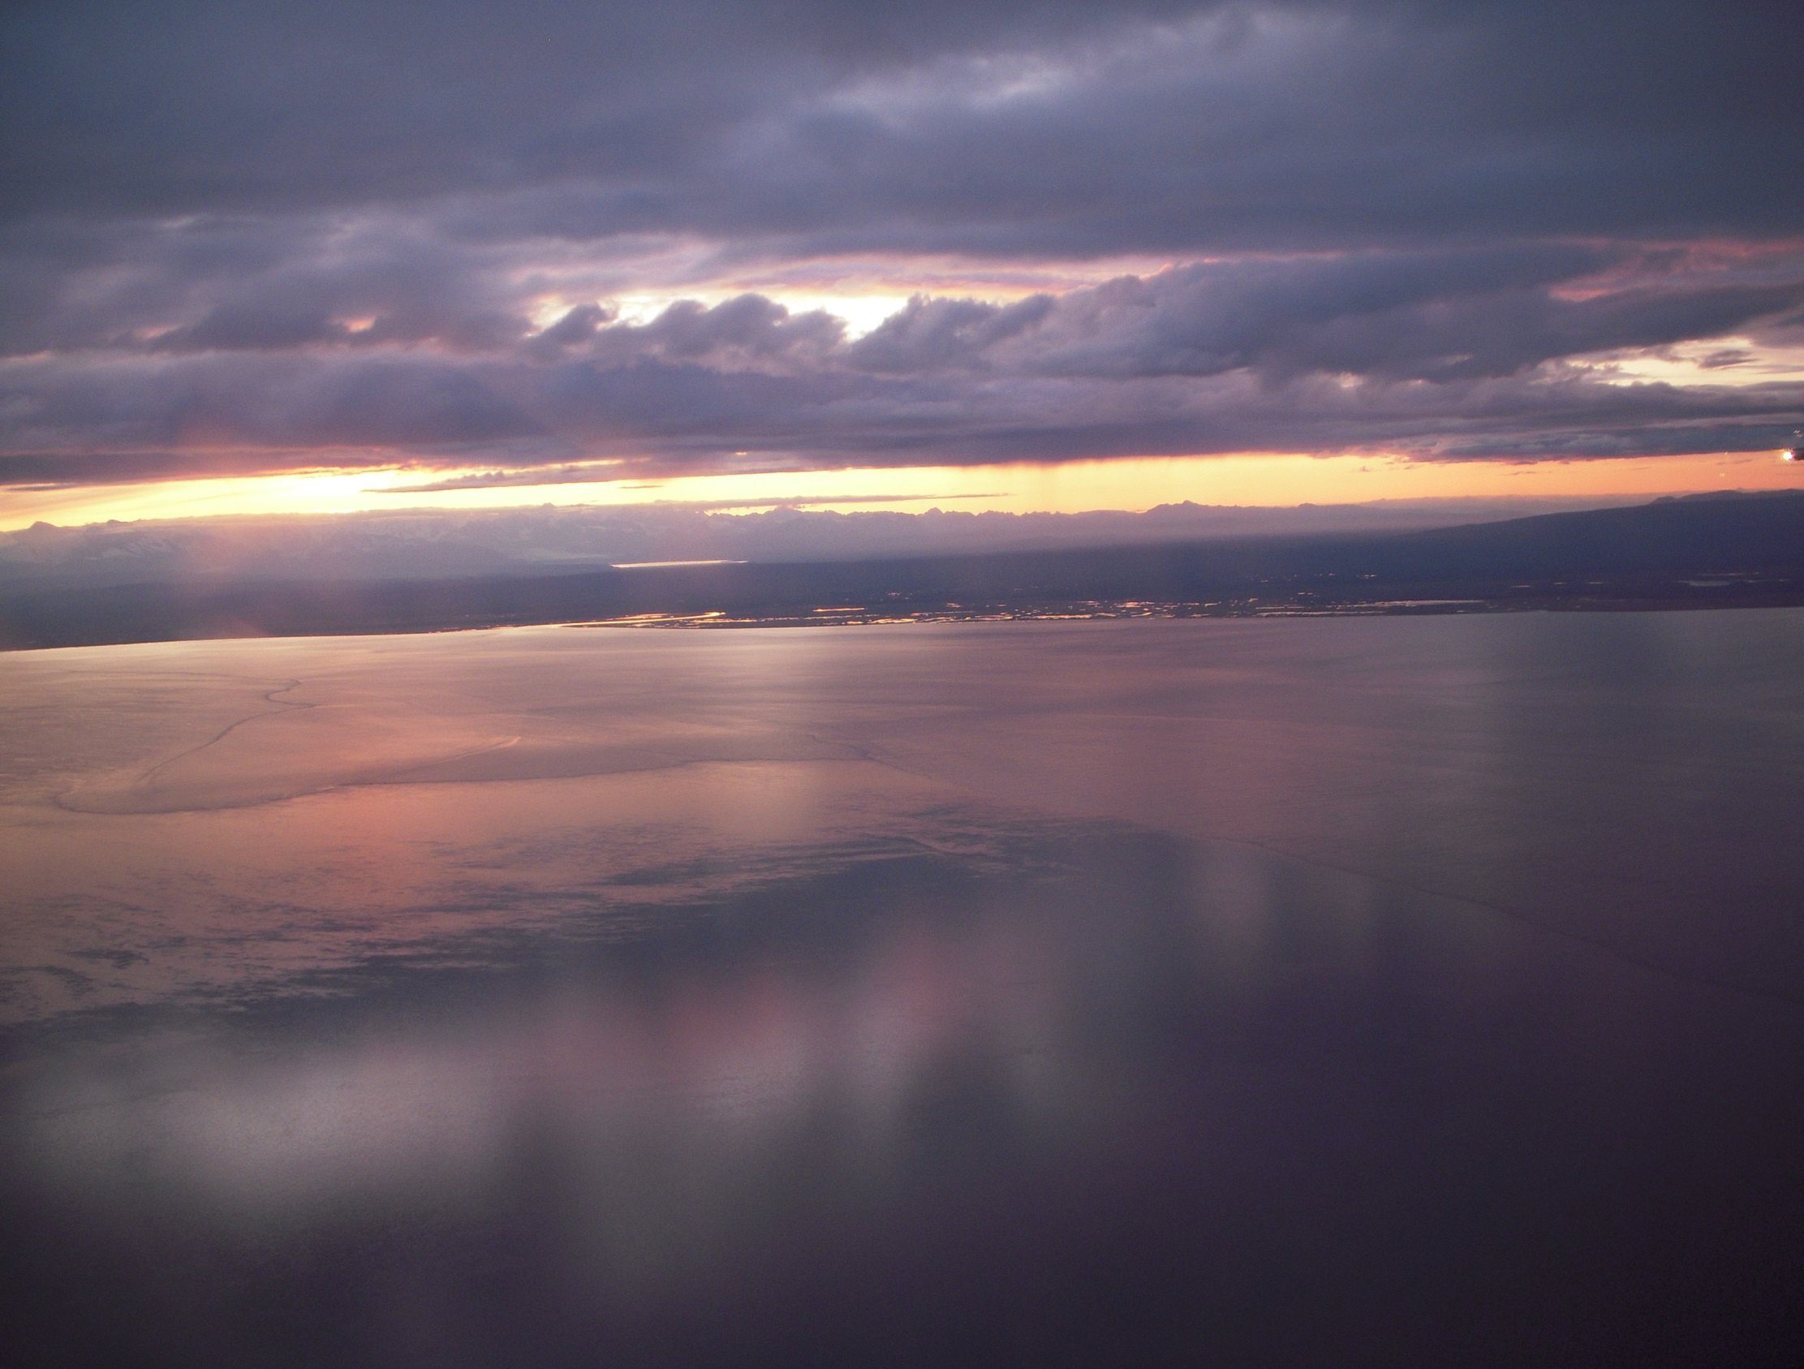
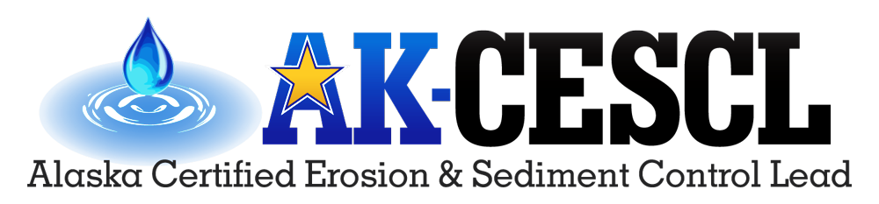
7. SWPPP Control Measures:
Erosion Control
Minimum measures
Inspecting for compliance
Recognizing deficiencies
January 2022

Slide 2
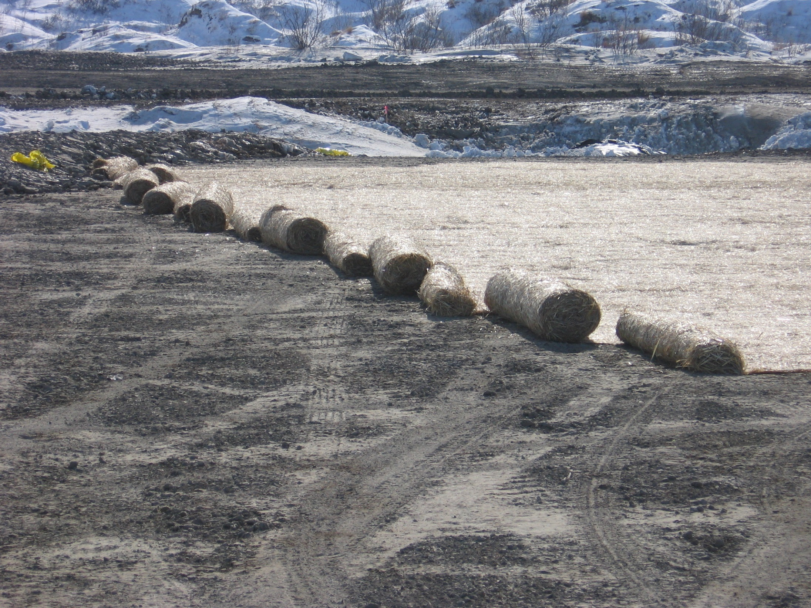
Erosion Prevention
Source Control
  Prevents raindrop erosion
  Conveys flows without scour
  Reduces risk
Kotzebue
Notes:
Preventing problems is much easier and cheaper than fixing problems. Many erosion control methods can actually help to finish a project.

Slide 3
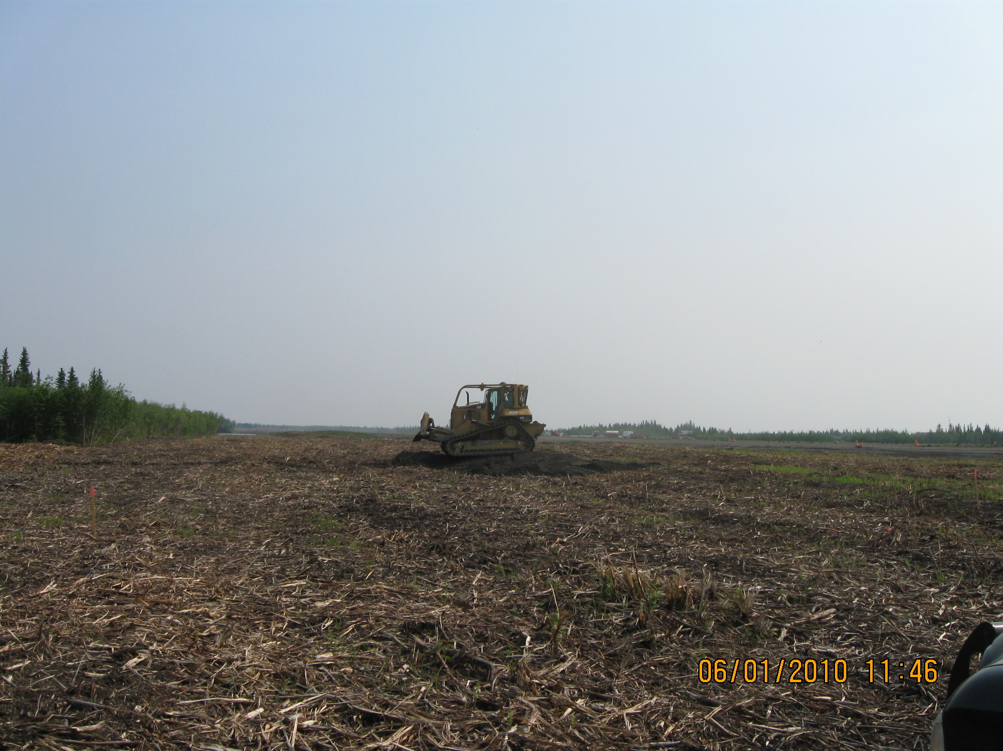

4.2.2 Minimize the Amount of Soil Exposed during Construction Activity
Preserve Vegetation
Mulch
Fort Yukon

Slide 4
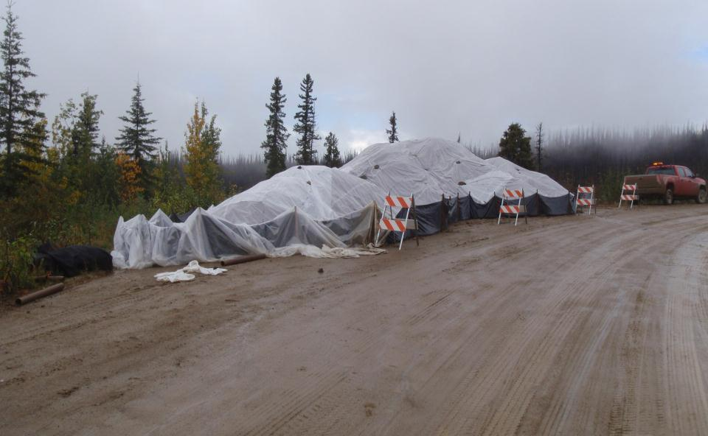
Preserve Topsoil
Unless infeasible, preserve areas of native topsoil onsite (CGP)
  Helps provide a growing medium for vegetative stabilization measures
  Better vegetative stabilization reduces erosion rates and increases infiltrative capacity
Topsoil can be preserved by
  Stockpiling topsoil in a manner that will maximize its use in reclamation
  Or by limiting disturbance and removal of the topsoil.

Slide 5
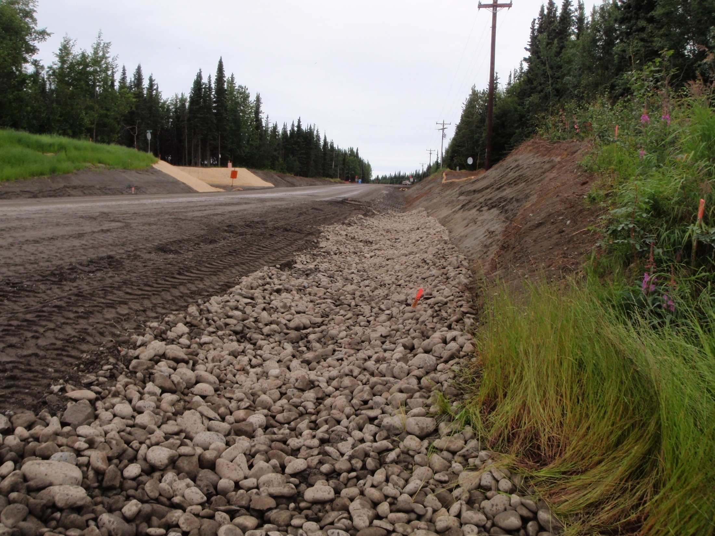
4.2.2.2 Sequence or phase construction activities to minimize the extent and duration of exposed soils.
2021 AGCP 4.2.2.2
Soldotna
Notes:
Point out how the slopes are being finished as they go. And the ditches are being completed with the stone as the project progresses. This is a great example of turning liabilities into assets. Finishing as you go. The most productive and profitable ways to reduce risk are to complete areas of the project and get paid. Take areas out of sediment production.

Slide 6
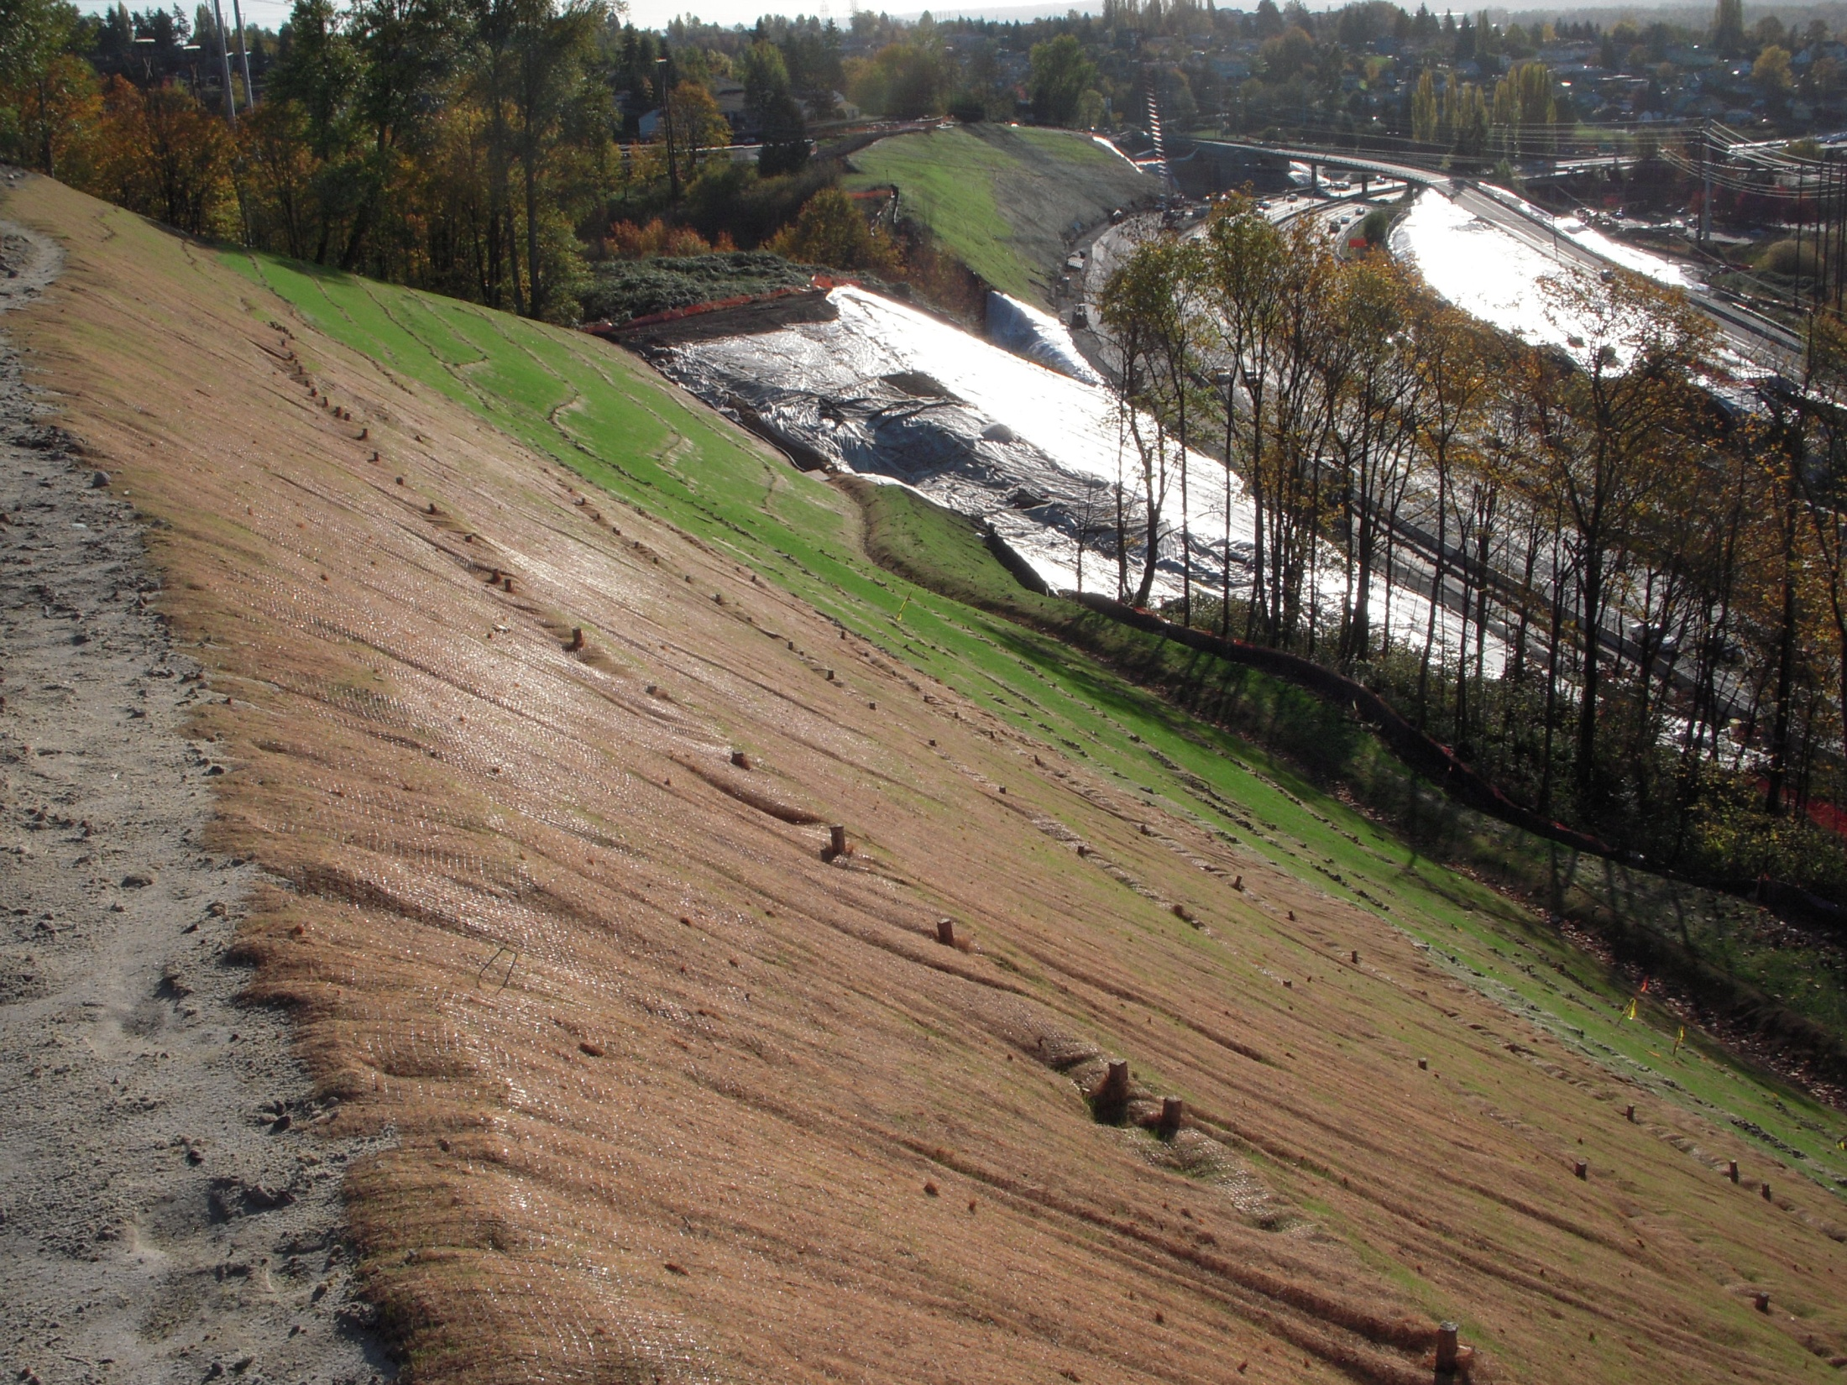

Seeding
Plastic
Wattles
Silt Fence
Preserve
Vegetation
RECP’s
Channel
Lining
What-Where-When?
Notes:
The next few slides show a good stabilization plan being executed on a project. The cut is being stabilized on the way down and the fill slopes are being stabilized on the way up.

Slide 7
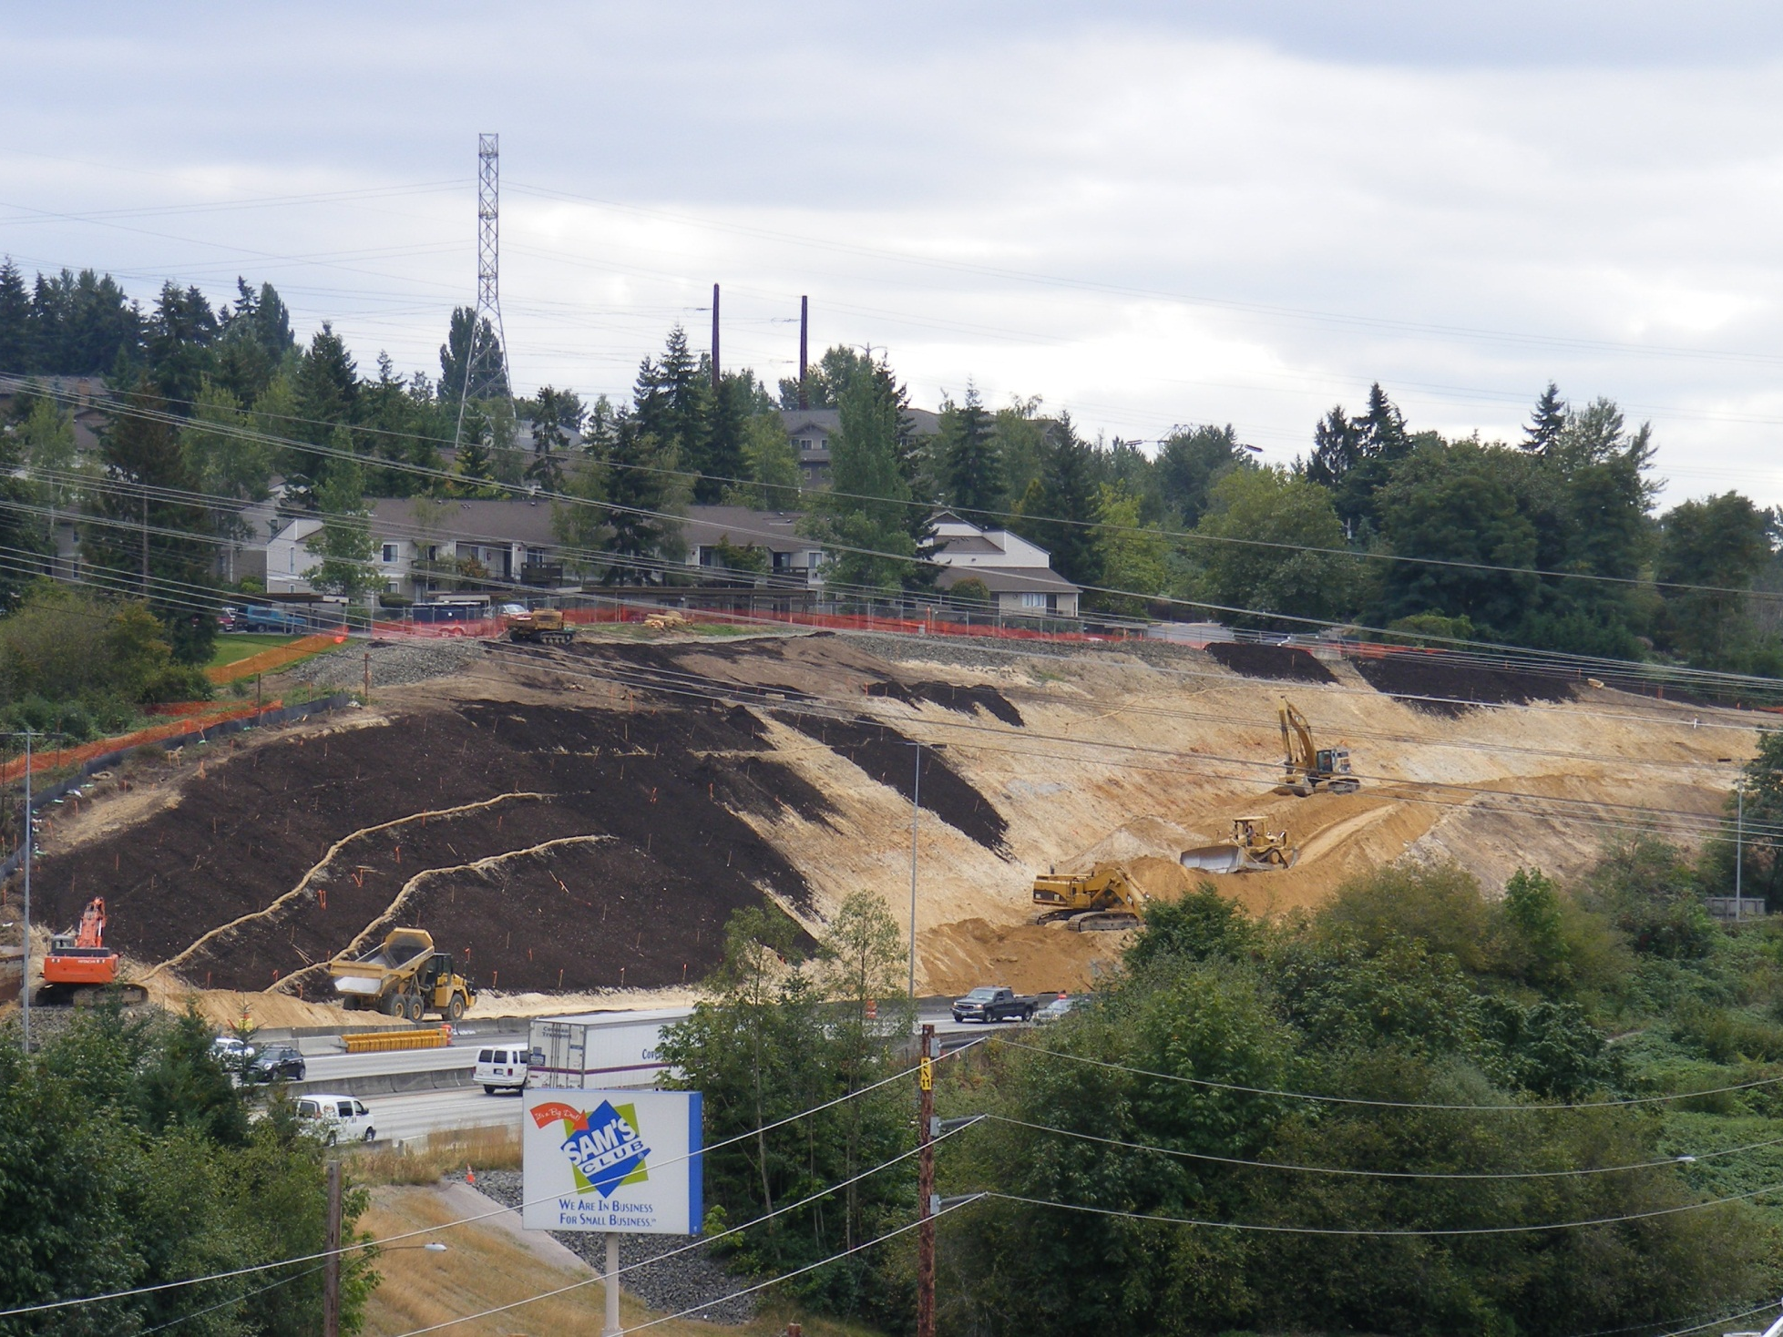
Finish as you go
Turn Liabilities into Assets
Manage Risk
Notes:
Finish slopes are 1.5:1.
Slopes were stabilized as we proceeded. Subgrades were roughened. Straw wattles were countersunk and staked. 8” coarse compost blanket was applied throughout. Backsloping and vegetation retention continued as possible.
Note that permanent and temporary stabilization measures were integrated through design.
At this point in the excavation, the stormwater drainage shifted to the south.
We installed double silt fencing around sensitive area.

Slide 8
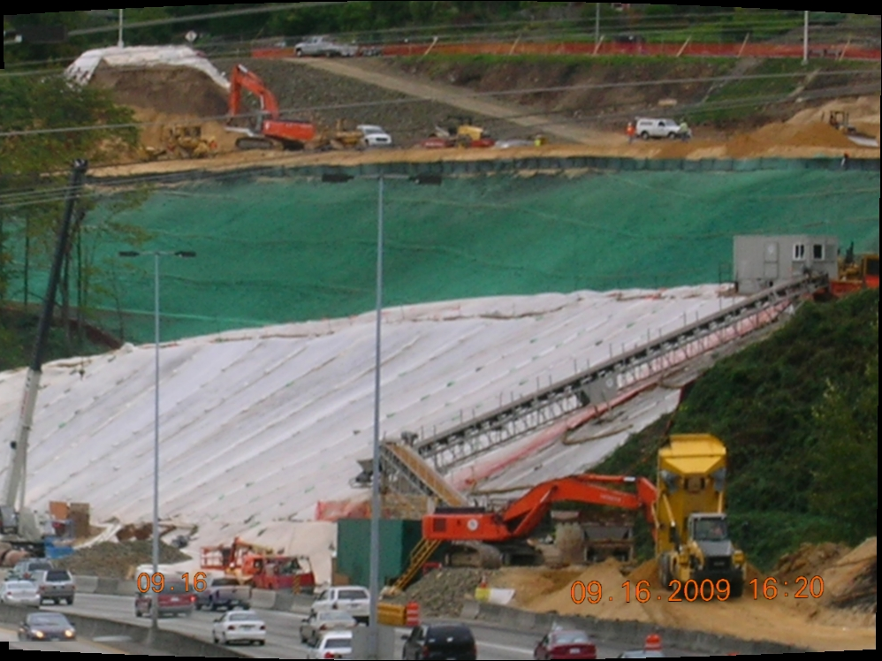
Detail the planned process
Notes:
The slope was stabilized as the fill was constructed.
We staked straw wattles, then spread coarse compost blanket, then hydromulched and seeded, before fill was completed.
PAM was applied on the fill slopes.

Slide 9
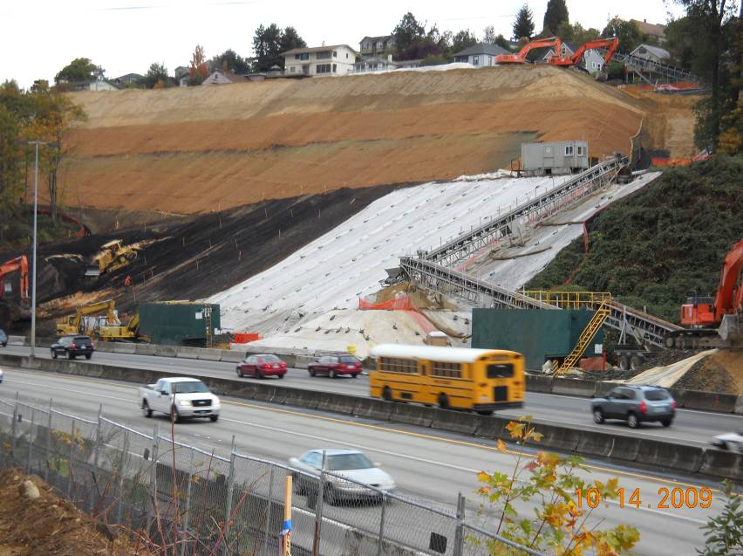
Phase the Process
Notes:
The lower slopes of the reinforced fill in the distance have been covered with coir matting, also before the fill is completed.
Note dedicated Baker tanks to manage runoff.

Slide 10
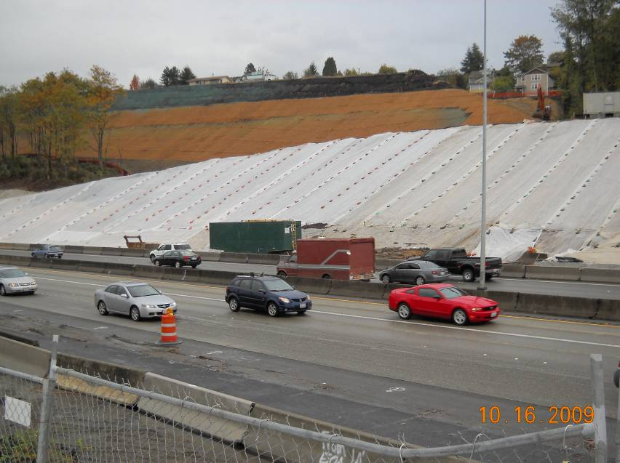
Work the Plan
Notes:
The newer slopes at top have been composted, but have not yet received coir matting.
The project has applied 200-330 cubic yards of compost to date.
Plastic was used over slopes that were not finish graded.

Slide 11
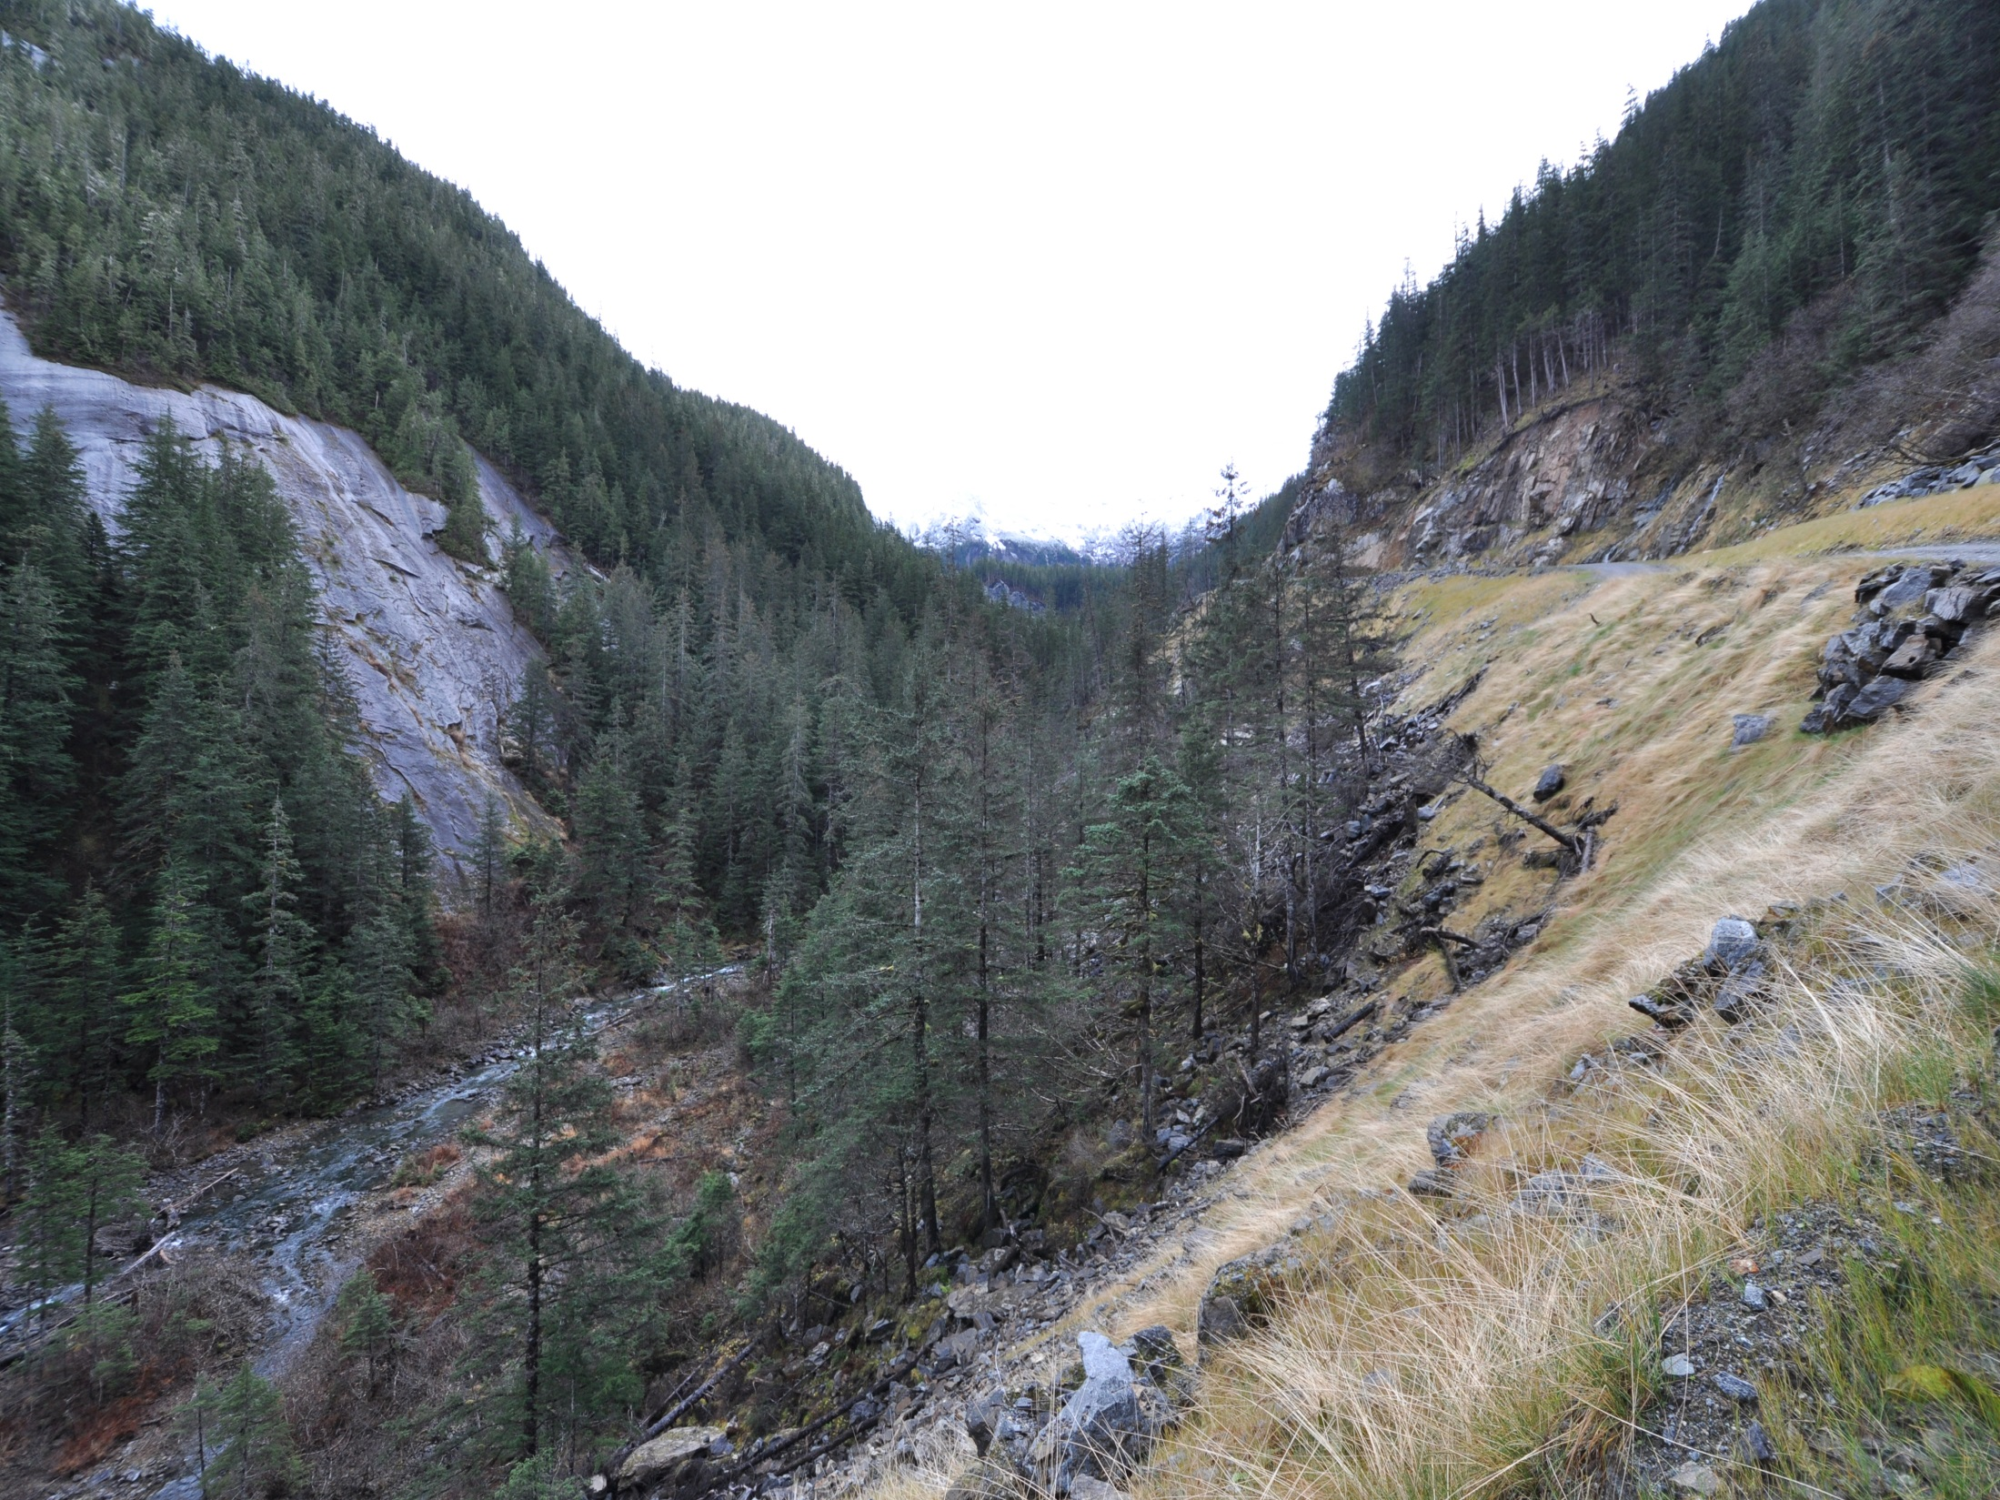
4.2.3 Maintain
Natural Buffer Areas
The buffer must be a minimum of twenty-five (25) feet wide
Stream Crossings
Adjacent US waters
Notes:
Permit requires buffers where feasible along and adjacent to waters of the US. Buffers can also be perimeter controls for sediment control.

Slide 12
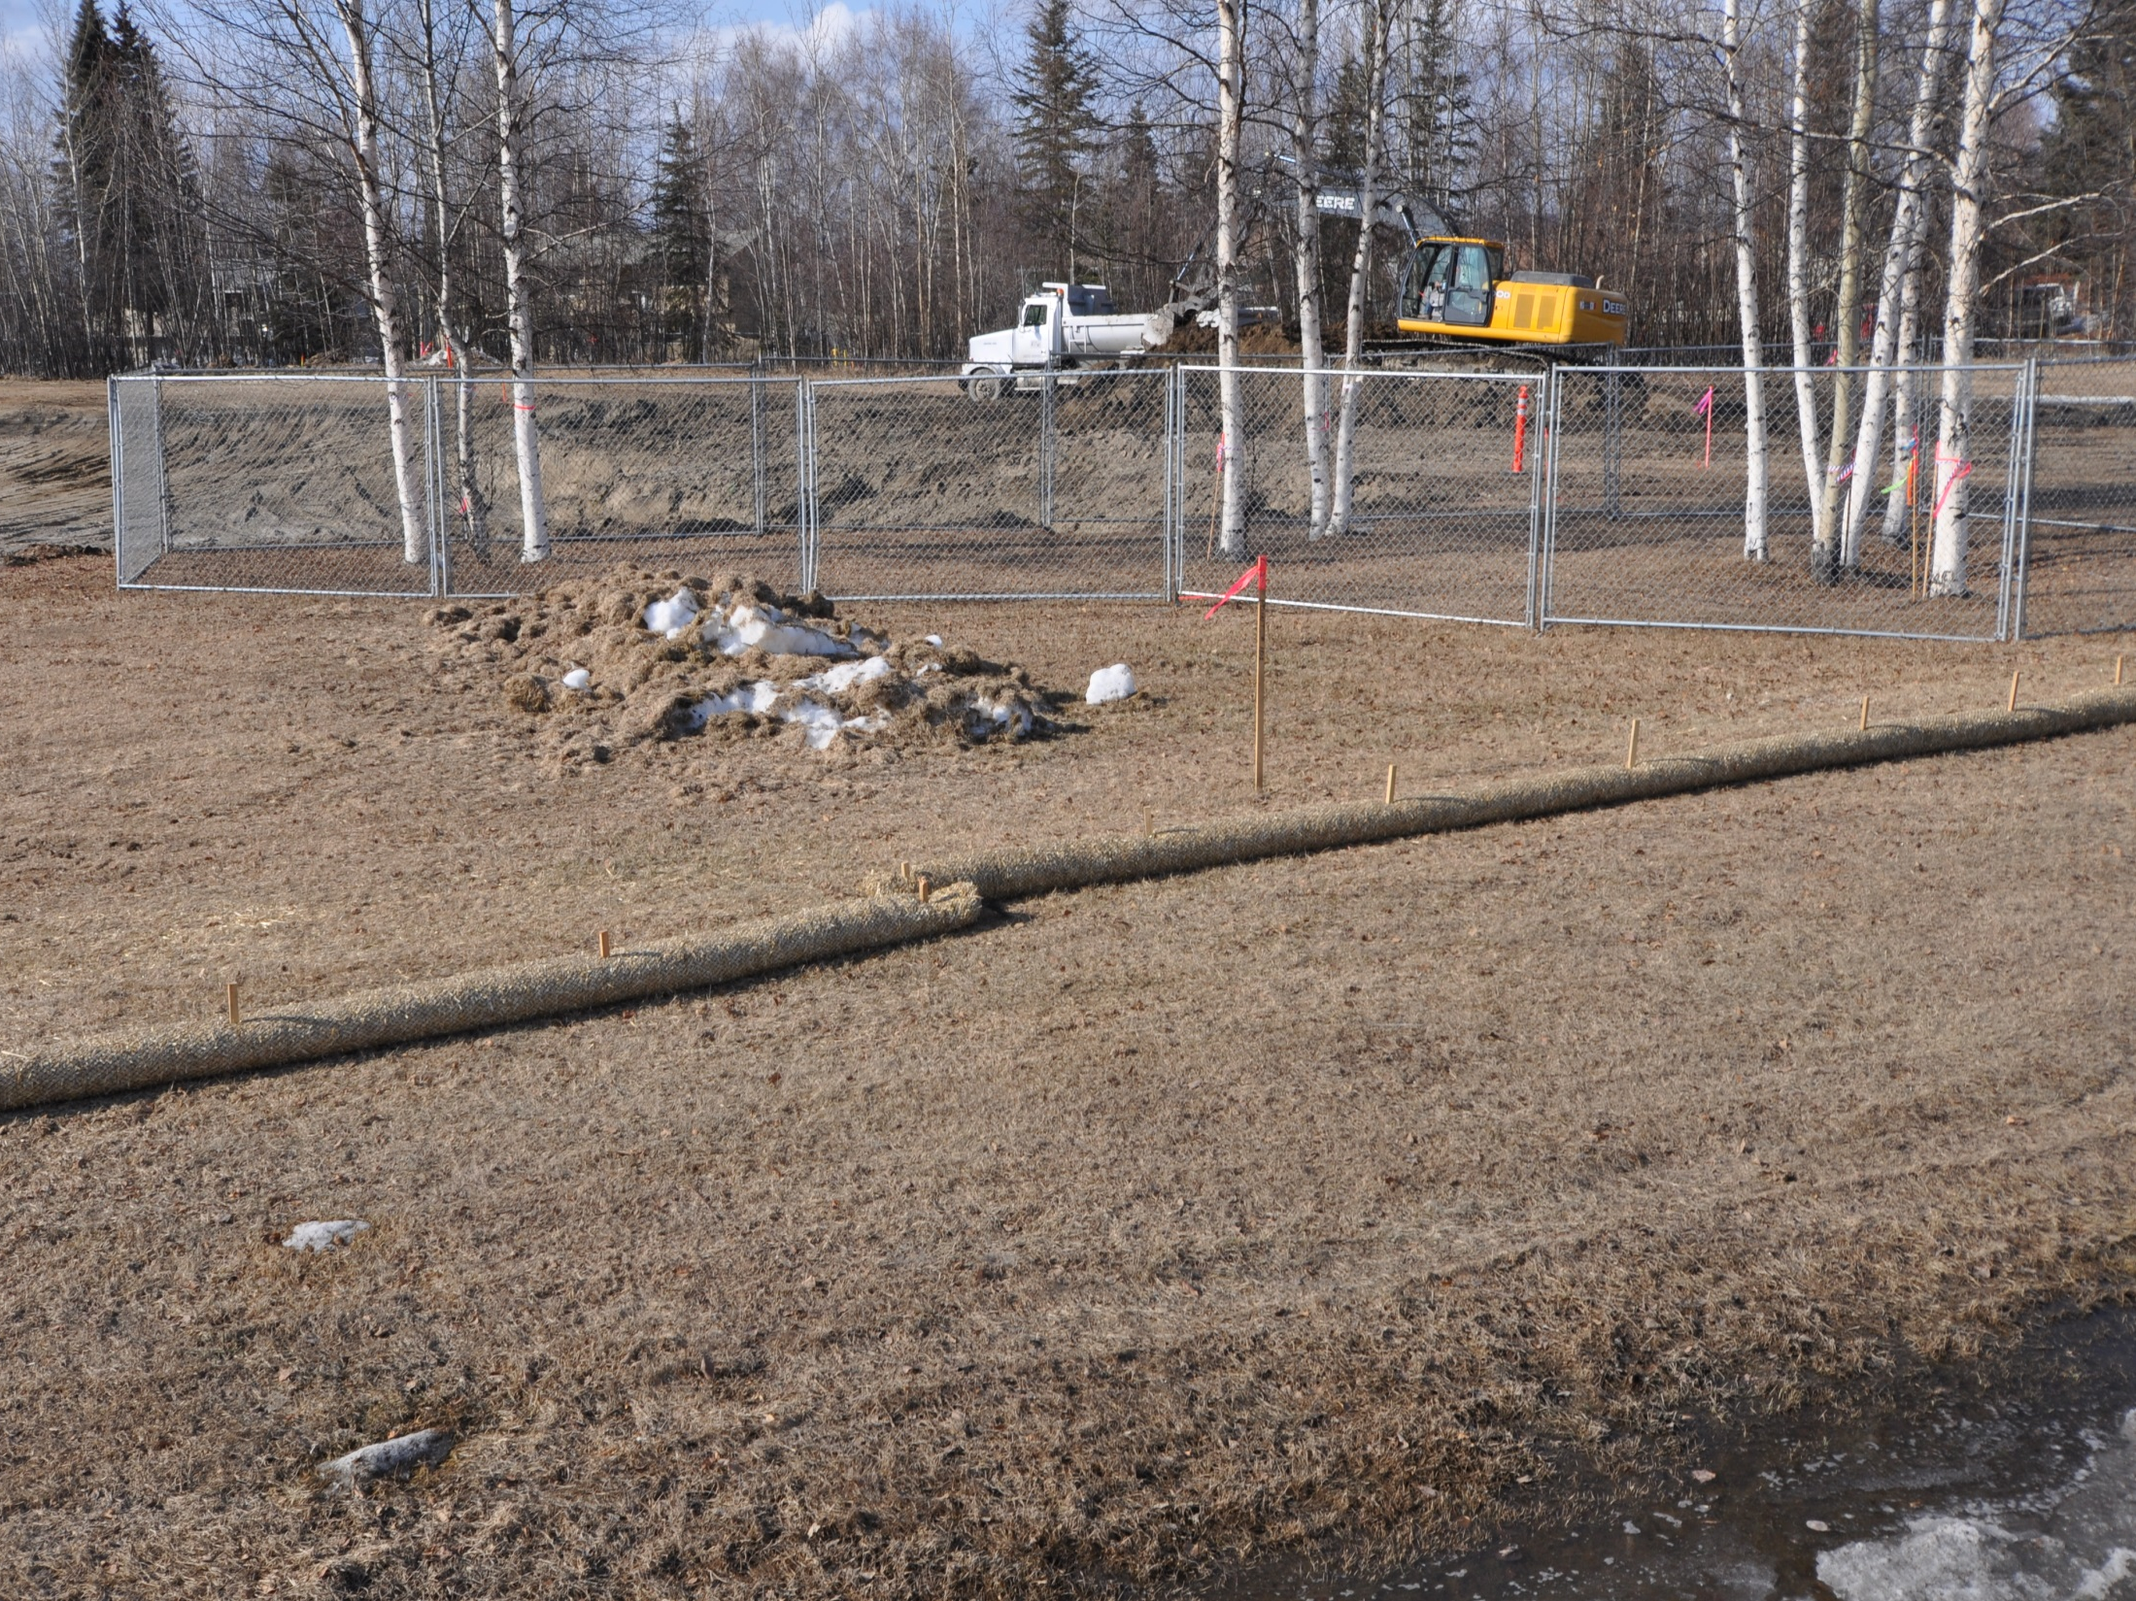
Mark Clearing Limits
Reduce exposed areas
Less area to inspect, repair & stabilize
Preserve vegetation
Reduce risks
Fairbanks

Slide 13
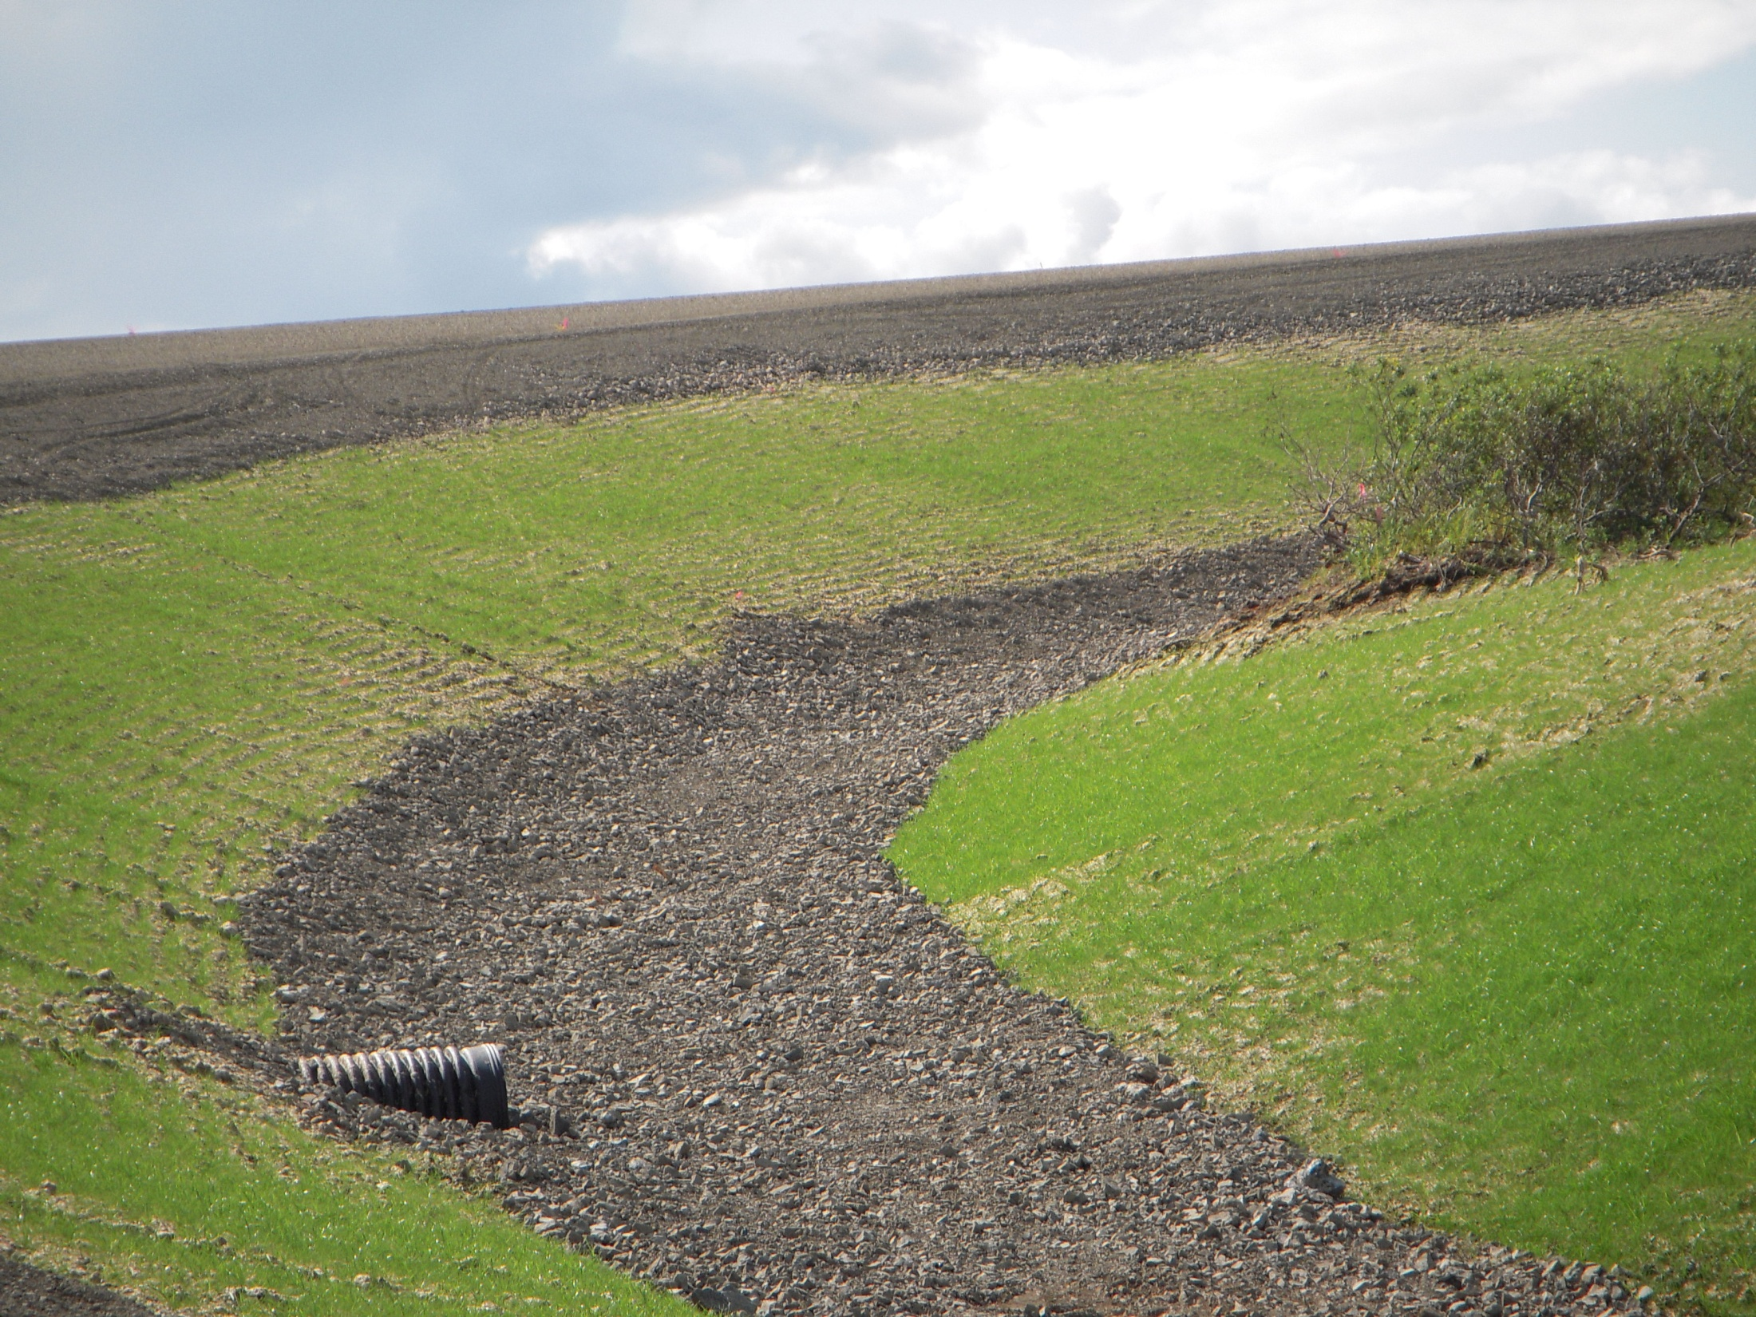
4.2.5 Control Stormwater Discharges & Flow Rates
How will the Conveyance change during construction?
Goodnews Bay

Slide 14
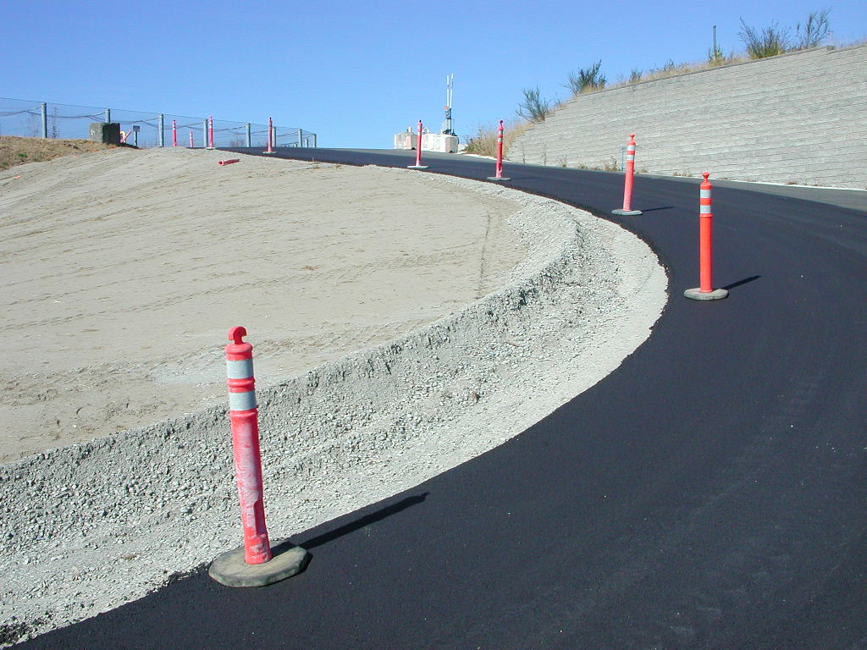
Run-On Controls
2021 CGP 4.2.5.1
A Permittee Must:
Divert storm water around the site so that it does not flow onto the project site and cause erosion of exposed soils; (diverting storm water around the site can be effective measure as long as it does not cause flooding and/or erosion offsite);
Sea-Tac
Notes:
The future shoulder gravel is being used as a temporary berm to prevent the clean water from the road way washing out the slope.

Slide 15
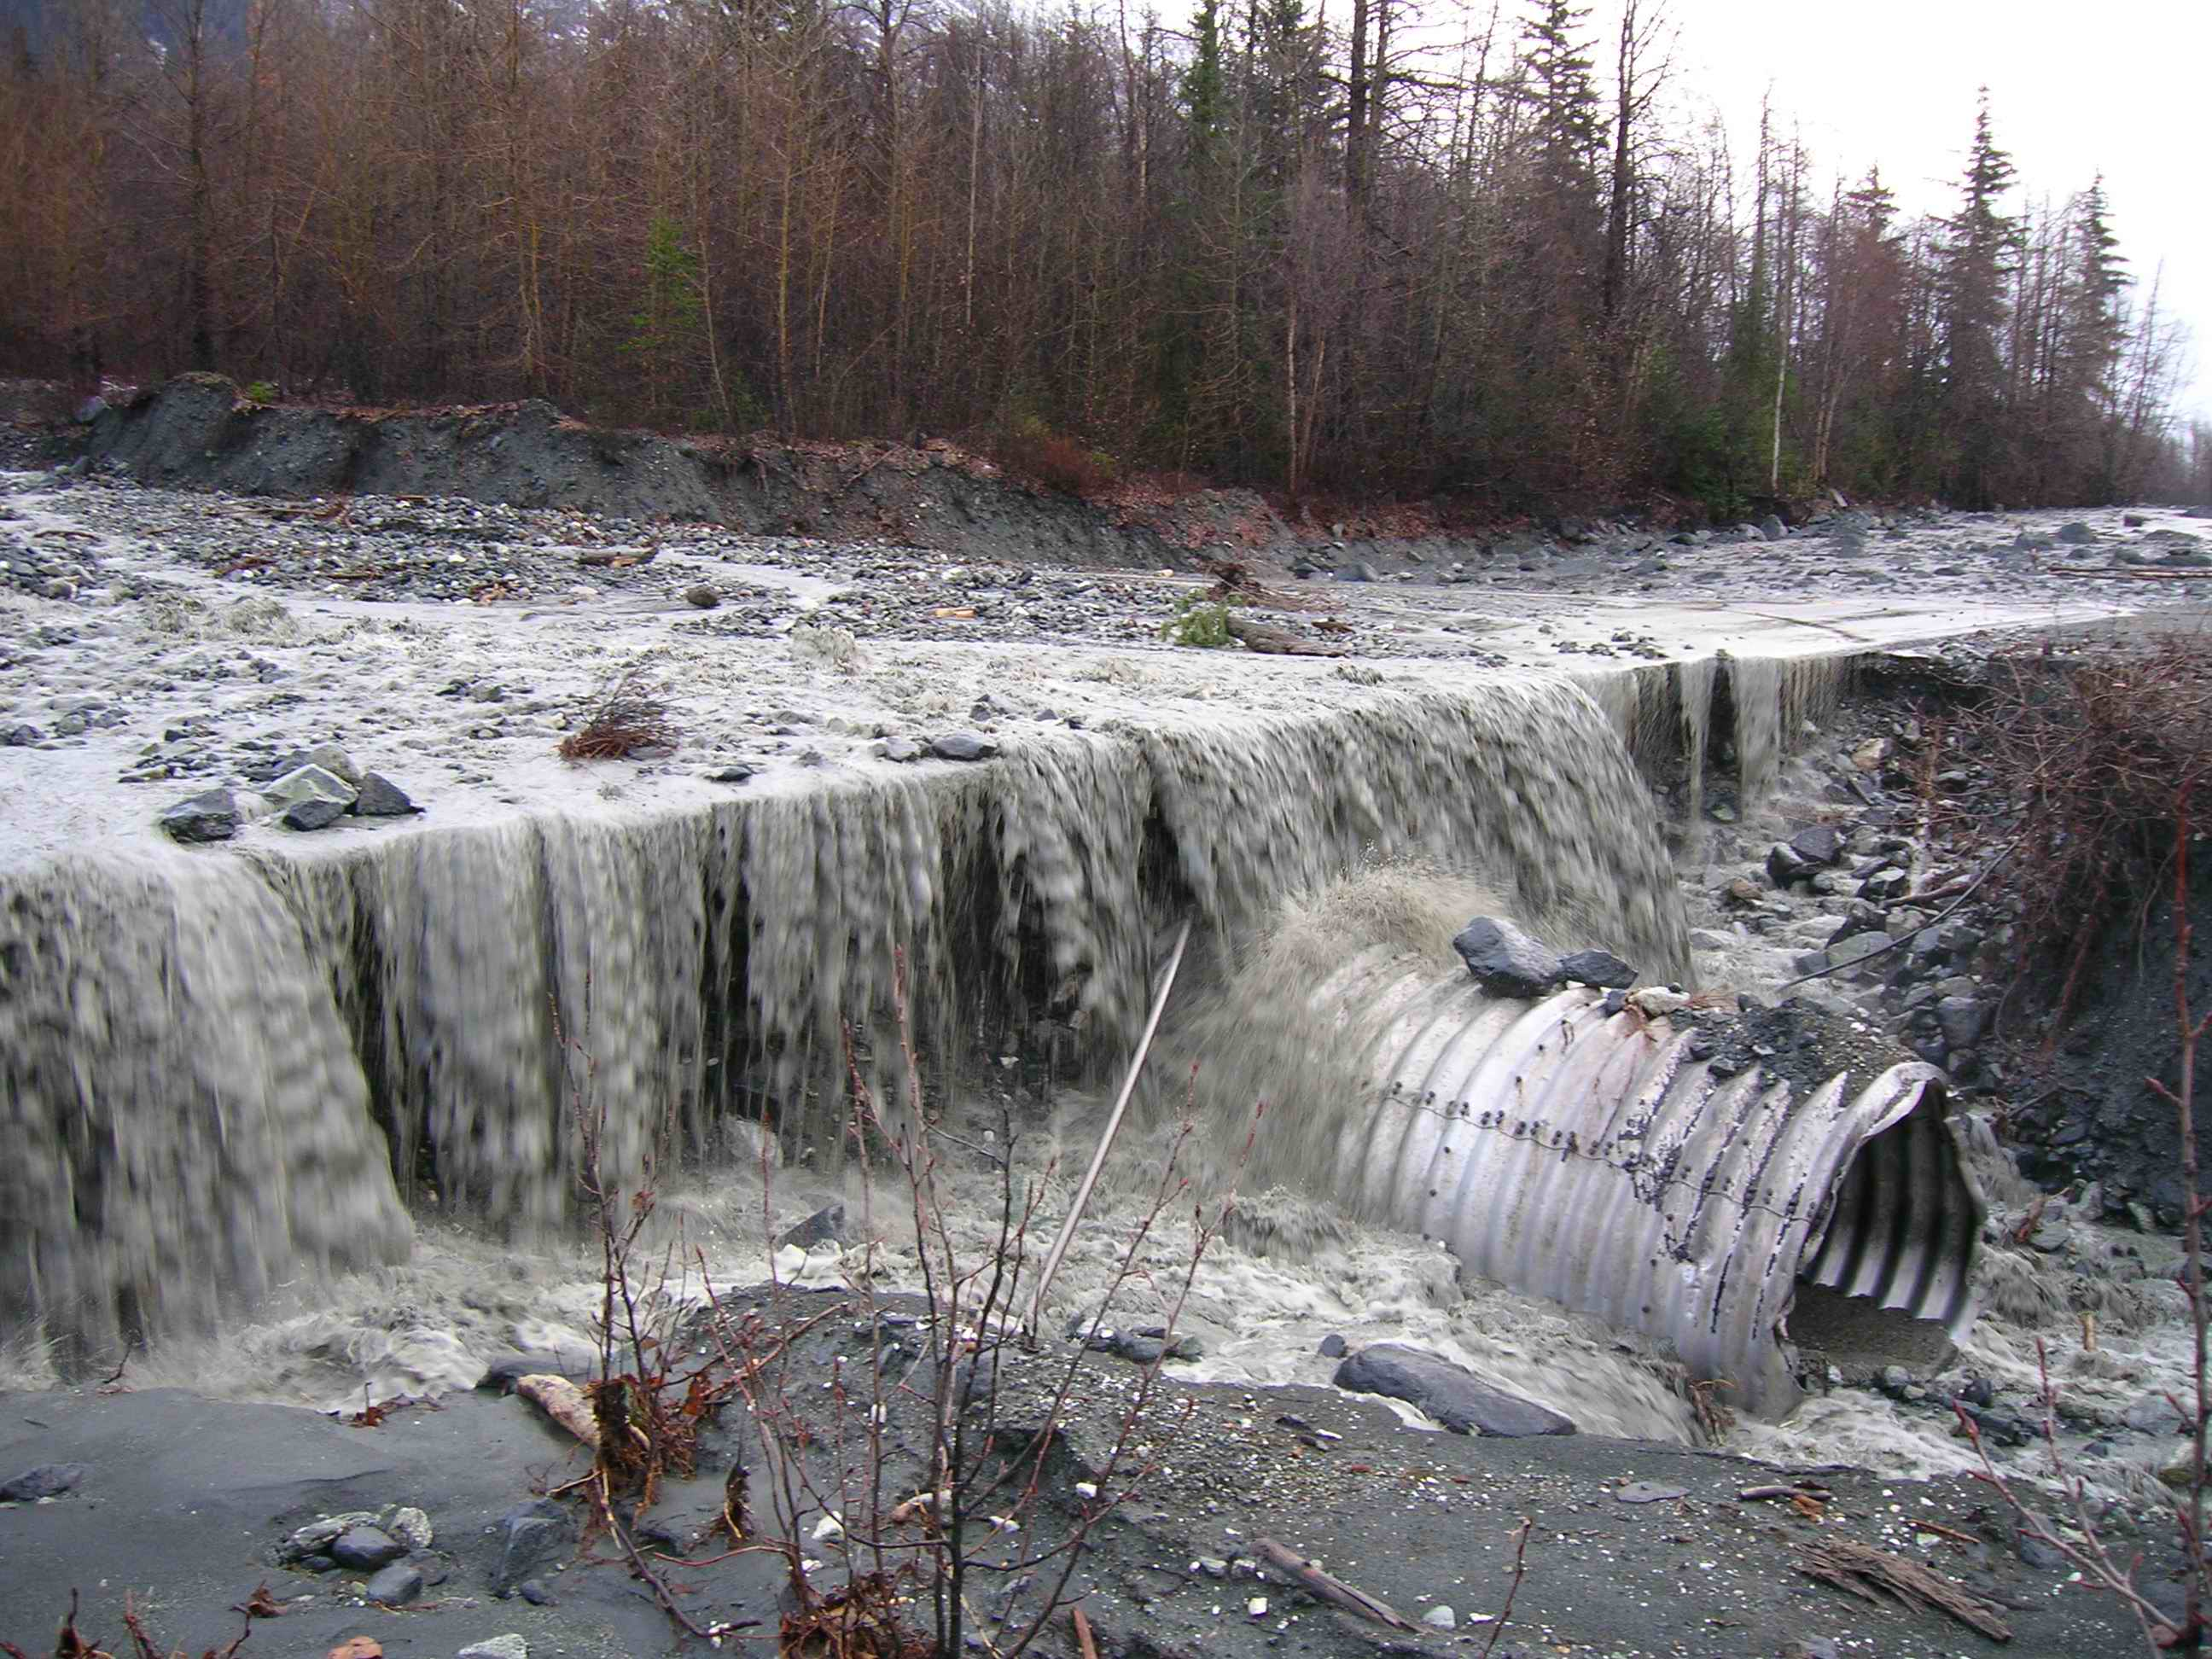
2021 CGP 4.2.5.2
Slow down or contain storm water that may collect and concentrate within a site and cause erosion of exposed soils.

Slide 16
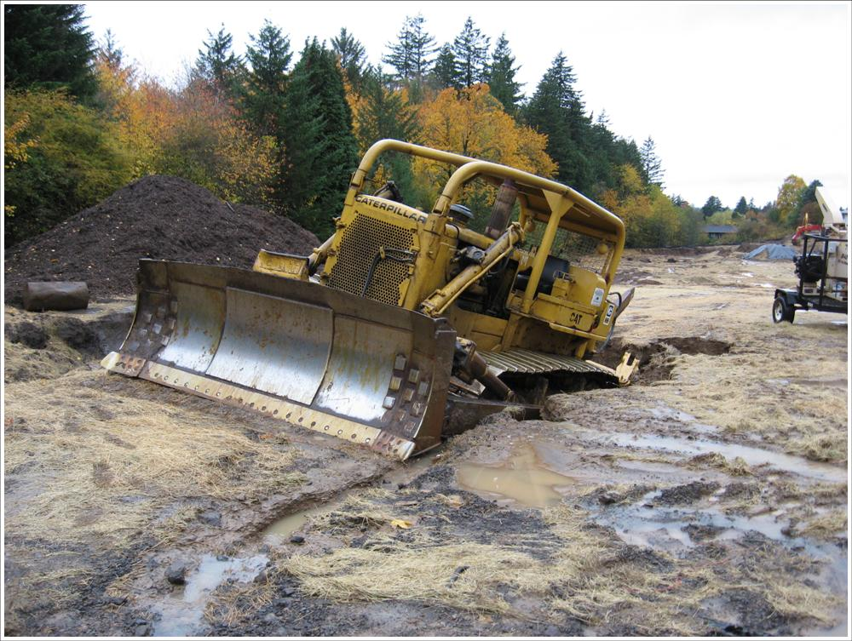
2021 CGP 4.2.5.4
Place velocity dissipation devices along the length of any conveyance channel (of erodible materials) to provide a non-erosive flow velocity.
Notes:
Dozers do not make good check dams.

Slide 17
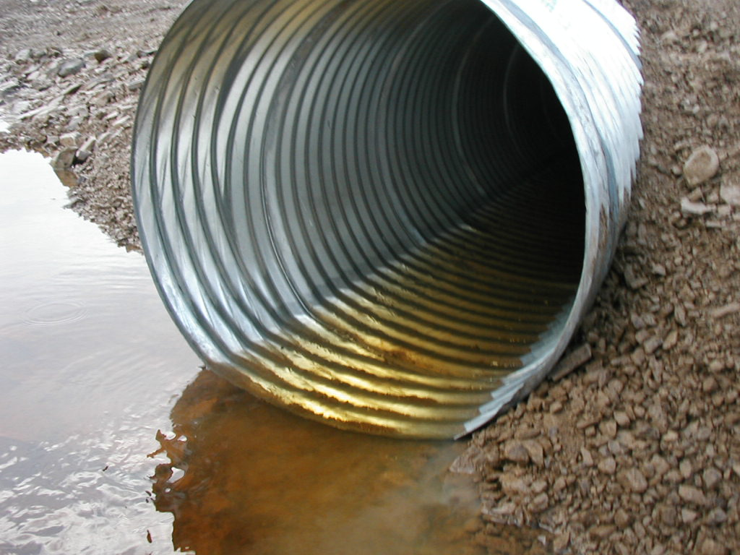
2021 CGP 4.2.5.4
Place velocity dissipation devices where discharges from a conveyance channel or structure join a water course to prevent erosion and protect the channel, embankment, outlet, adjacent slopes and downstream waters.
Grayling
Notes:
Ask the class what should be done in this picture. Refer to grading logs, where this water goes, does it infiltrate? Does it discharge from the site?

Slide 18
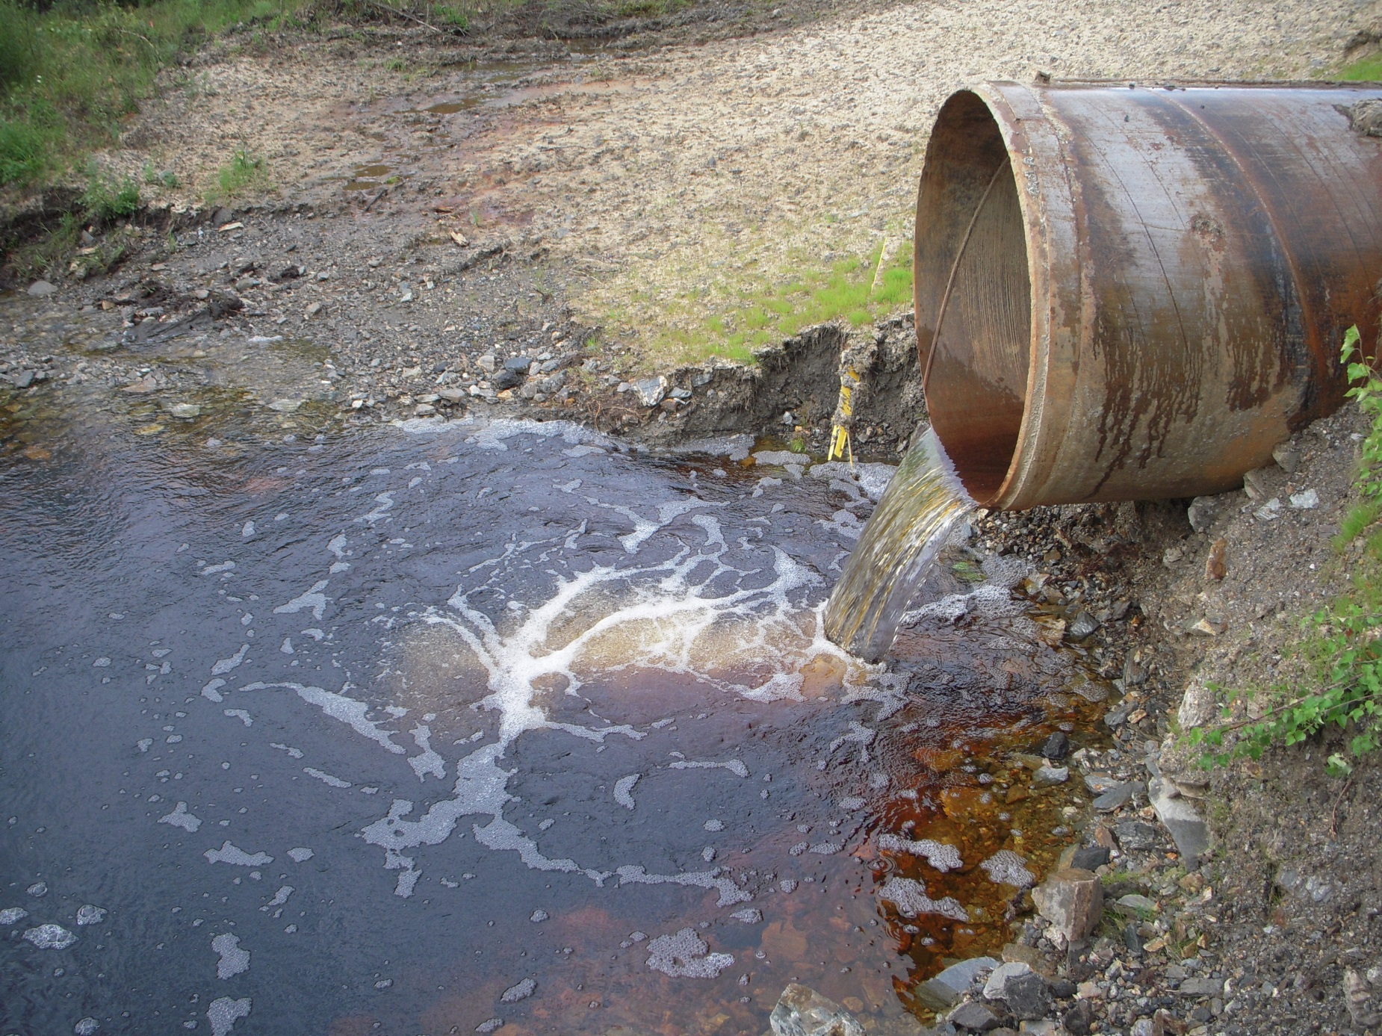
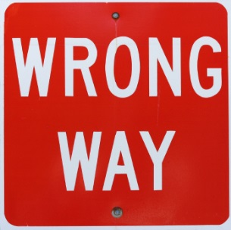
Notes:
Before culverts have any flow the outlets need to be stabilized. Note the attempt a seeding that will need to be done again due to erosion.

Slide 19
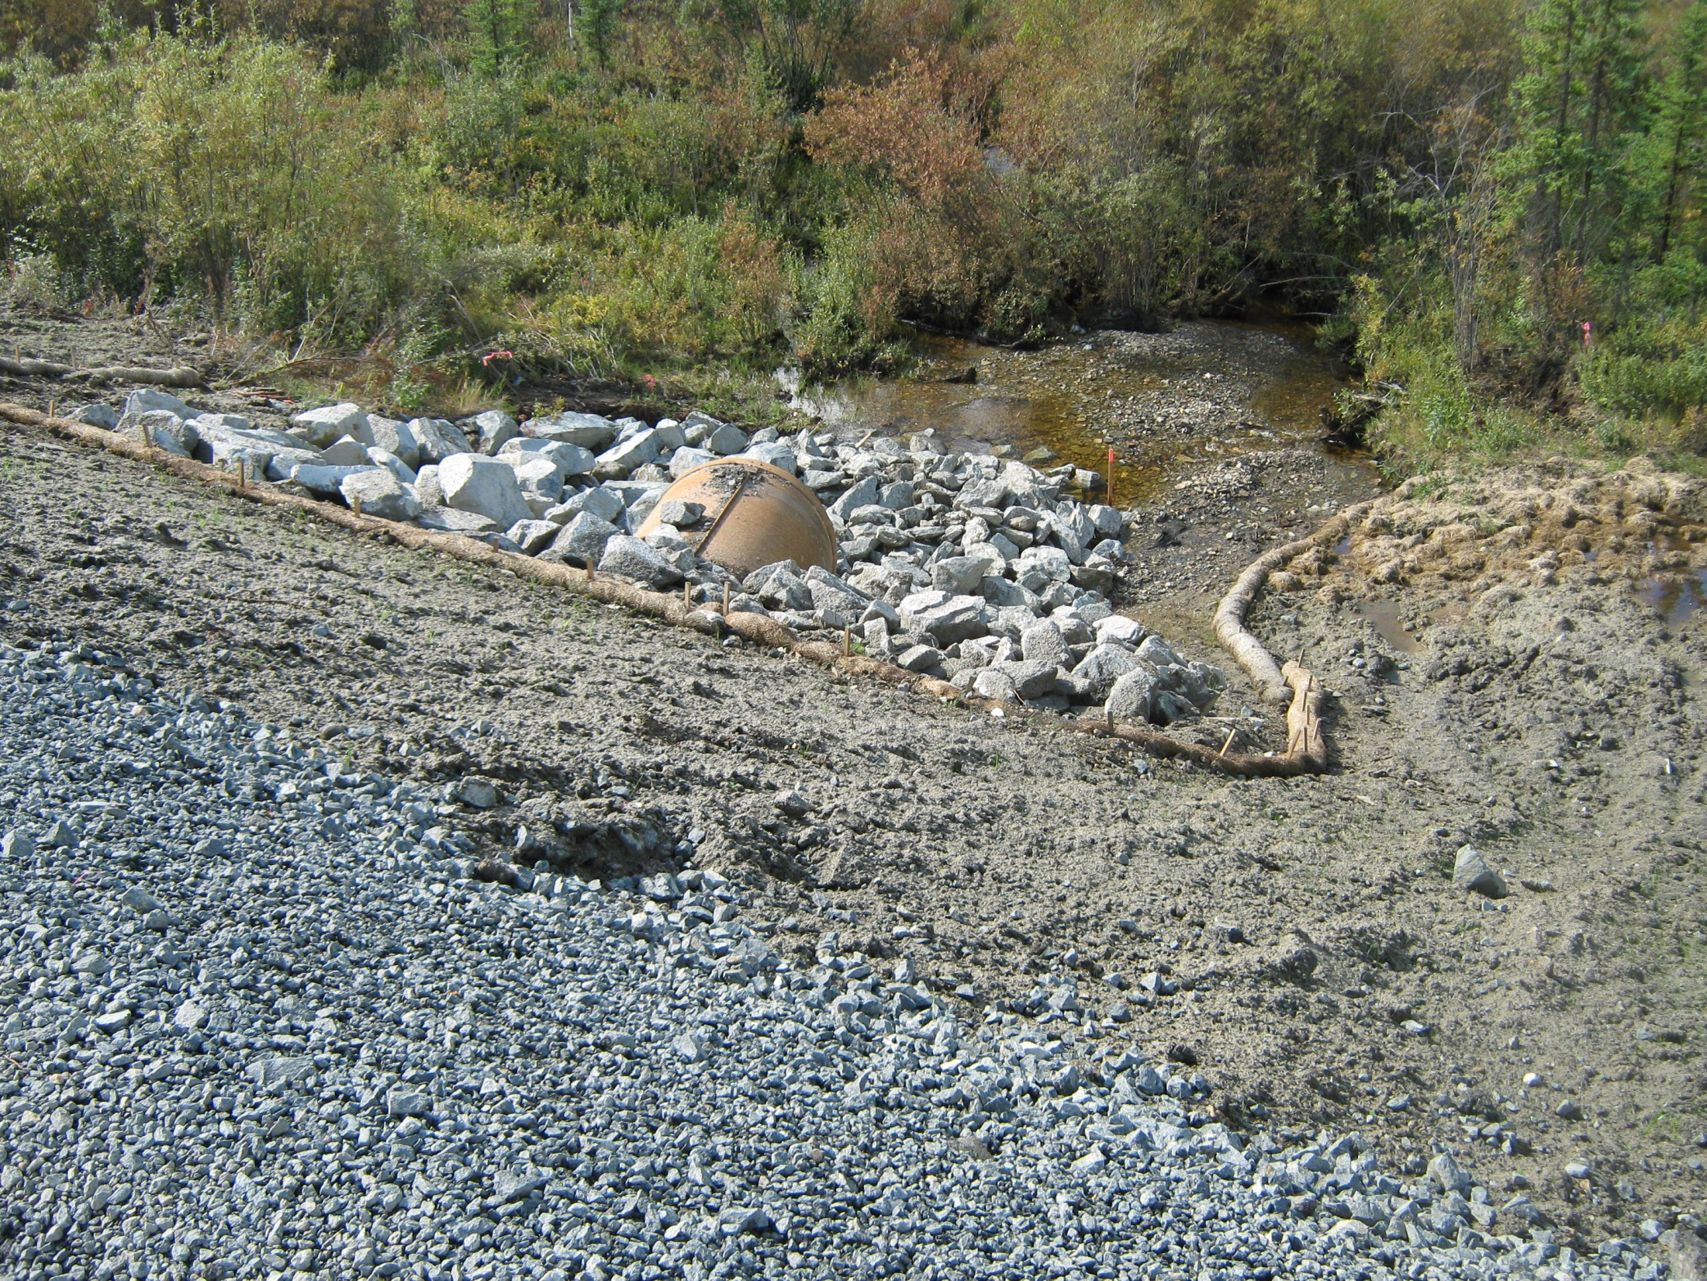
Notes:
Same outlet with stabilization, could we have done this earlier?

Slide 20
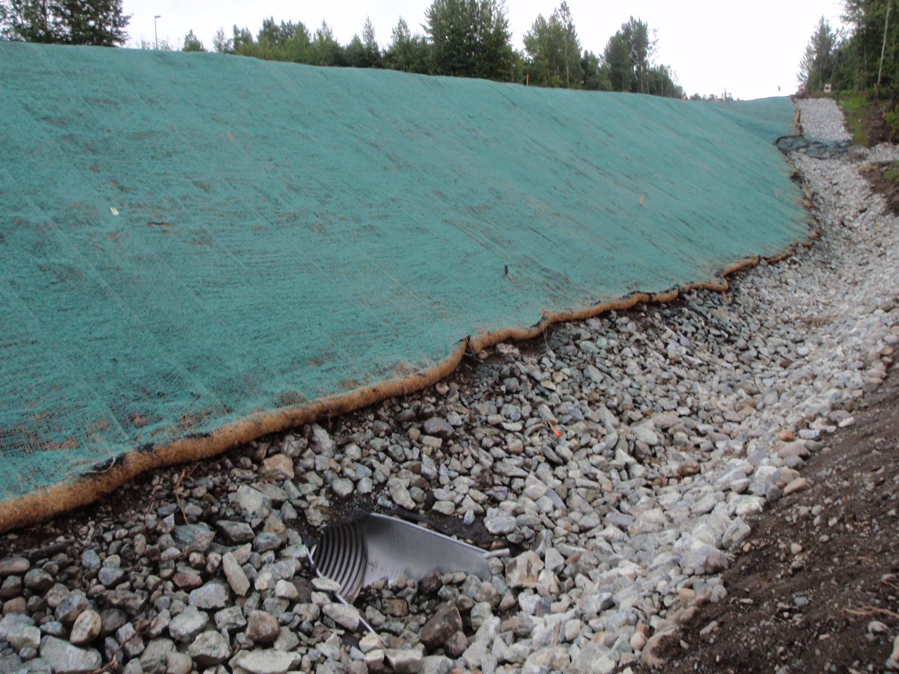
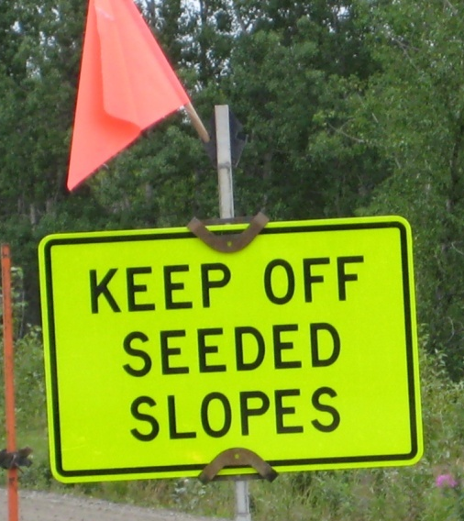
2021 CGP 4.2.6
Protect Steep Slopes
Raindrop
Protection
Conveyance
Four Wheeler
Deterrence
Perimeter Control
Eagle River

Slide 21
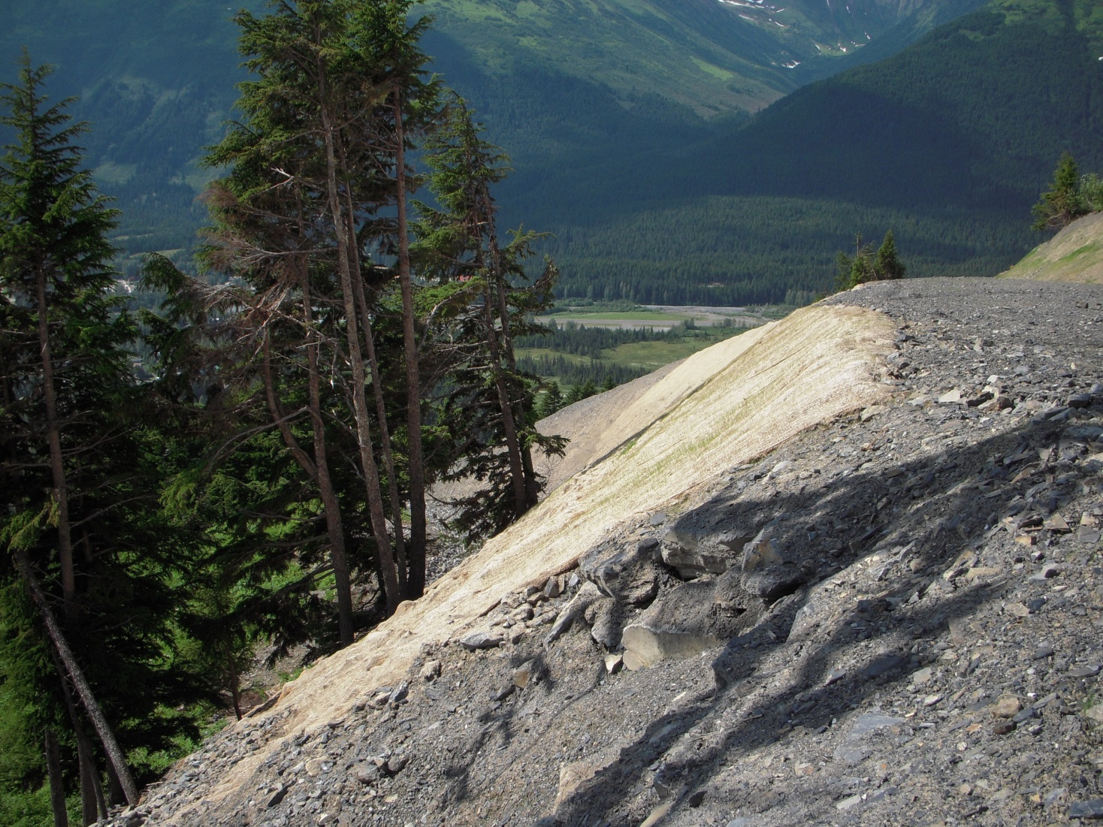
Alyeska
Notes:
The steeper and longer the slope the more erosion potential. Discuss what kind of rock is considered stable. The steeper the slope and the more severe the climate it will be exposed to the larger the rock will need to be to make it stable. Consider the shear stress that the rock will be exposed to. Notice areas that are failing to learn what does not work. At some point the slope steepness will allow gravity to simply cause erosion.

Slide 22
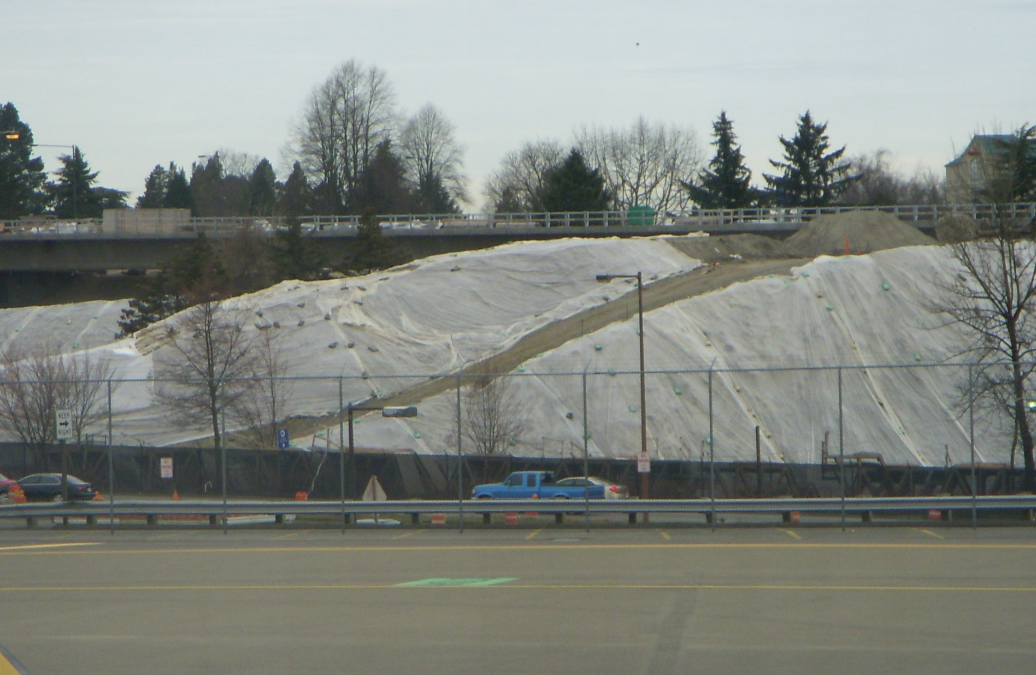
Stockpiles
2021 CGP 4.3.7
A permitee must stabilize or cover stockpiles, protect with sediment control measures. Locate stockpiles away from water inlets, water bodies, and conveyance channels. Install a sediment control measure along all downgradient perimeter areas.
Sea-Tac
Notes:
Sandbags must be placed about every 10 feet to keep it from blowing away & watch out for seams so that water does not get underneath them.
Install downgradient sediment control.

Slide 23
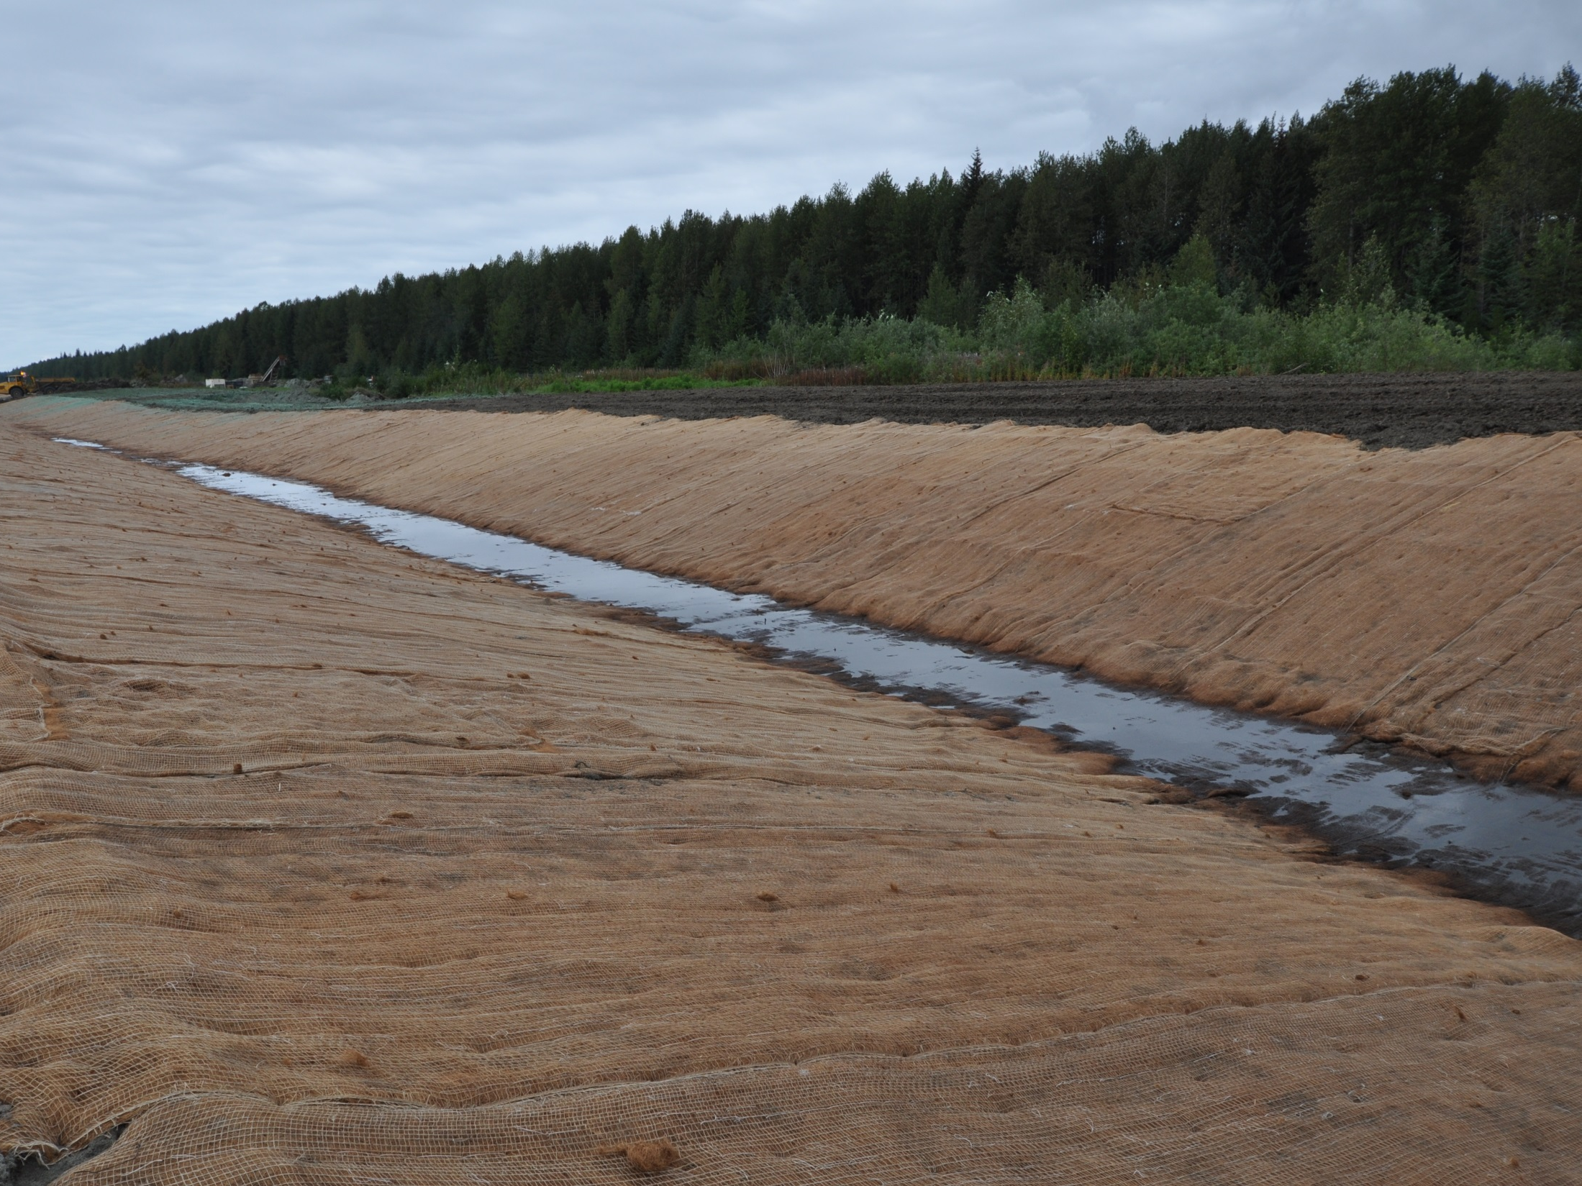
Part 4.5 2021 CGP
4.5 Soil Stabilization
Minimum Requirements for Soil Stabilization
Temporary Stabilization
Final Stabilization
Stabilization Requirements for Terminating Permit Coverage
Gustavus

Slide 24
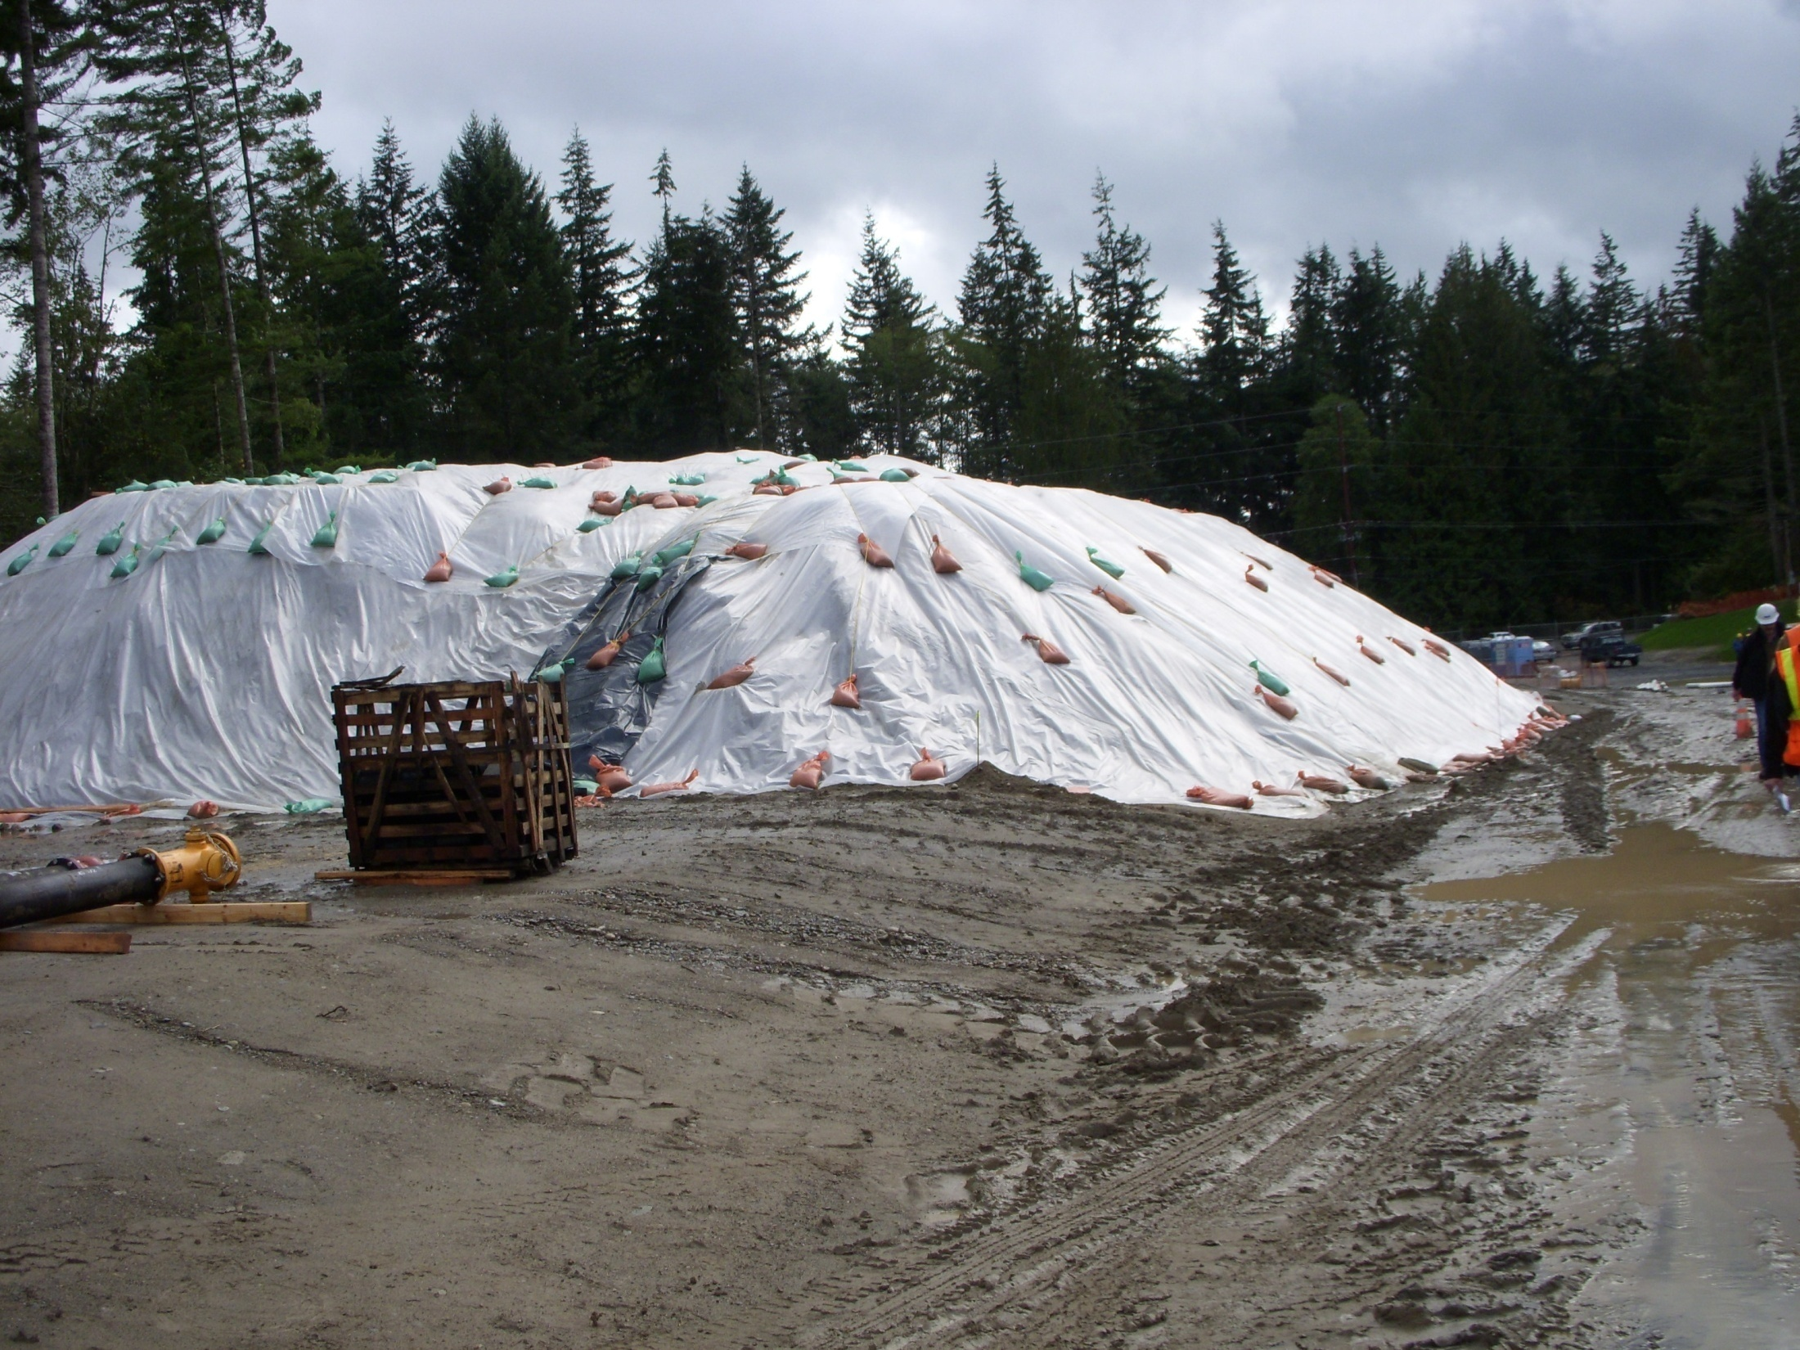
2021 CGP Pg. 38
5.3.6.3 The general sequence of the stabilization practices that will be used to achieve temporary or final stabilization on exposed portions of the site as required
Notes:
The permit requires that this information be included in the SWPPP.

Slide 25
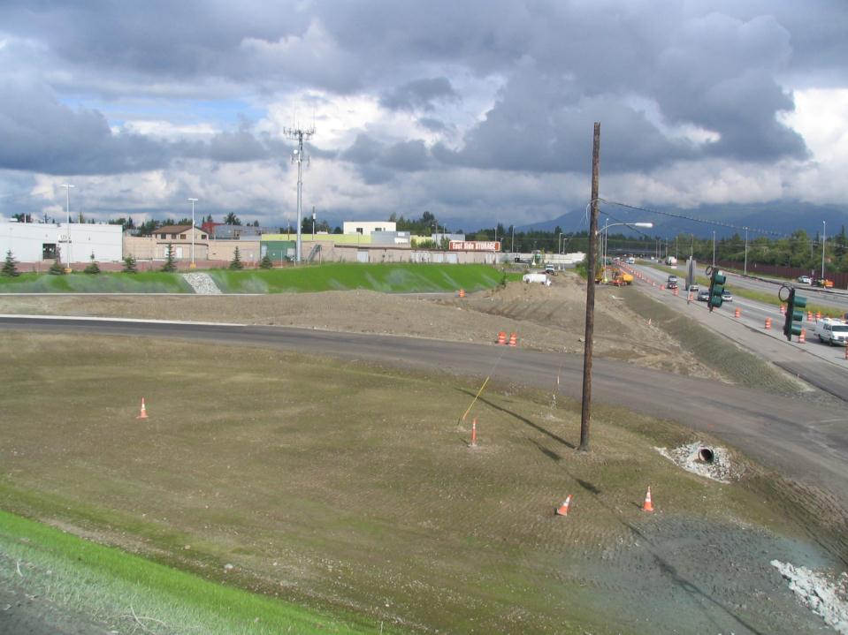
2021 CGP 4.5.1
Erosion Control & Stabilization:
Minimum Requirements for Soil Stabilization
A permittee must consider the selection and implementation of control measures and the sequence of project construction as they apply to the project site.
Anchorage

Slide 26
2021 CGP 4.5
Erosion Control & Stabilization:
Stabilization of disturbed areas must be initiated immediately whenever any clearing, grading, excavating, or other earth disturbing activities have permanently ceased on any portion of the site or temporarily ceased on any portion of the site
Anchorage

Slide 27
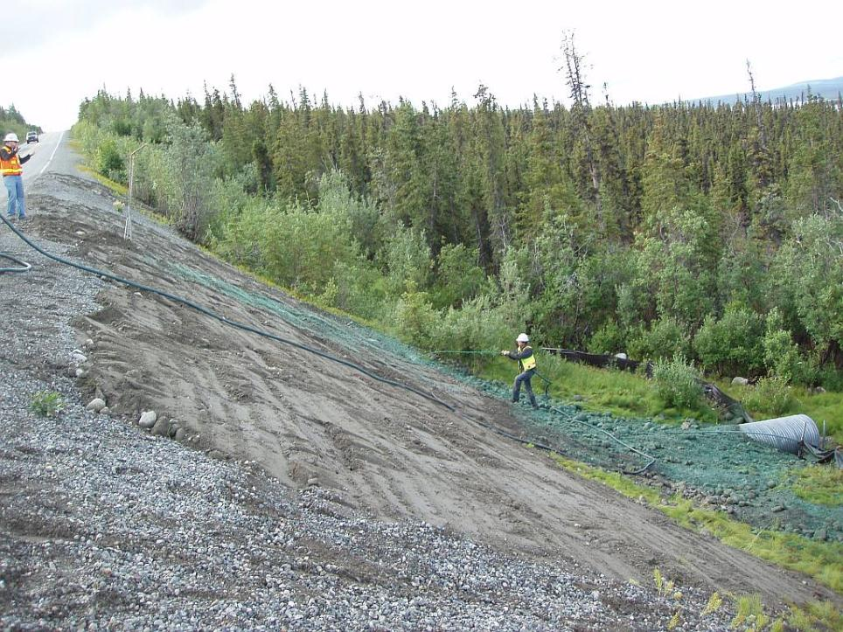
Initiate Stabilization
Immediately….
Where mean annual precipitation is :
>40 inches within 7 days
<40 inches within 14 days

Slide 28
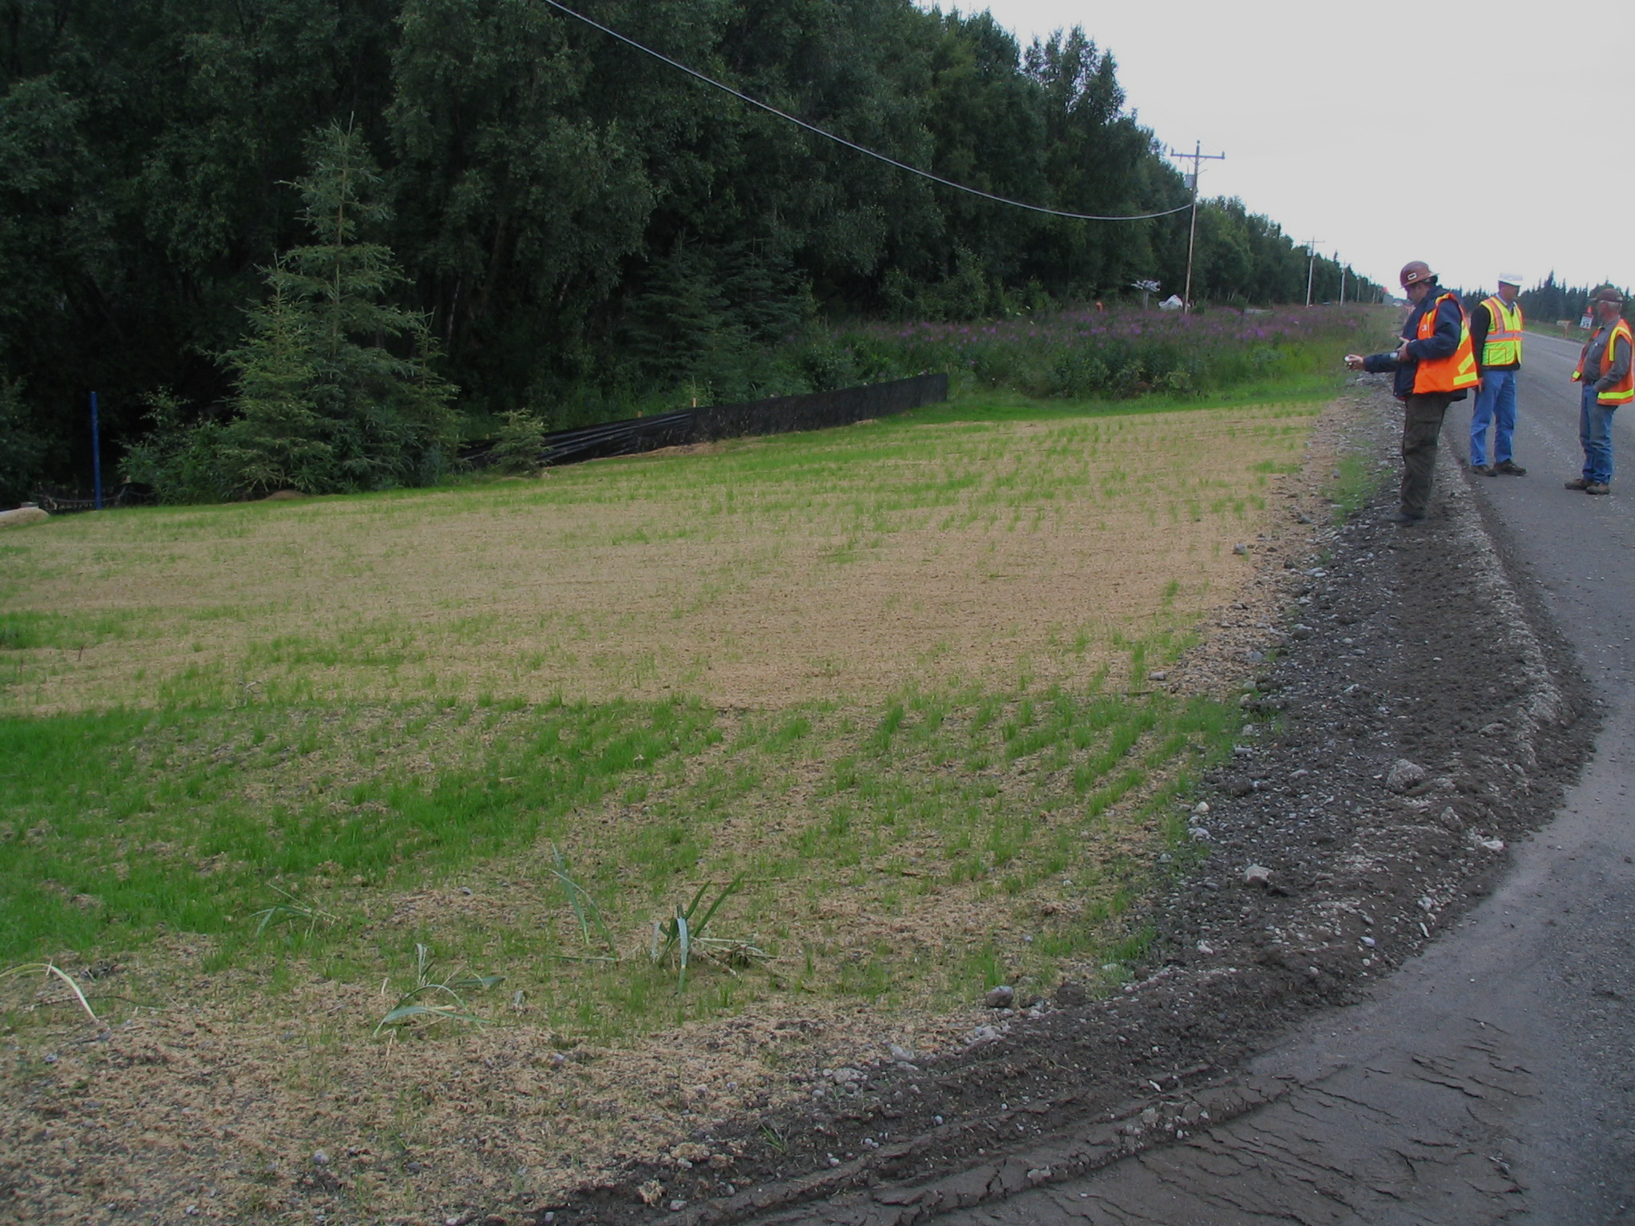
Deadline to Complete Temporary Stabilization Activities
(Part 4.5.1.2)
The following are required to be completed as soon as practicable, but no later than 14 calendar days after initiation of soil stabilization measures for
Vegetative stabilization, all activities necessary to initially seed or plant the area to be stabilized; and/or
Non-vegetative stabilization, the installation or application of all such non-vegetative measures.

Slide 29
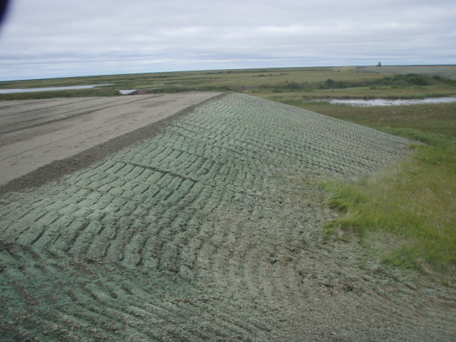
Deadline to Complete Final Stabilization Activities
The permittee must within 7 calendar days of initiating final stabilization complete or continue maintenance for the following on any portion of the site that has reached final grading and for areas where clearing, grading, excavating, or other earth disturbing activities have permanently ceased:
All soil conditioning, seeding, watering, mulching, and any other required activities for the establishment of vegetative cover;
The installation or application of all such measures for vegetative cover; and/or
The placement of non-vegetative final stabilization measures.
Tuntutuliak
Notes:
The 14 calendar days is for the whole state. It does not mater the location of the project or the amount of precipitation.

Slide 30
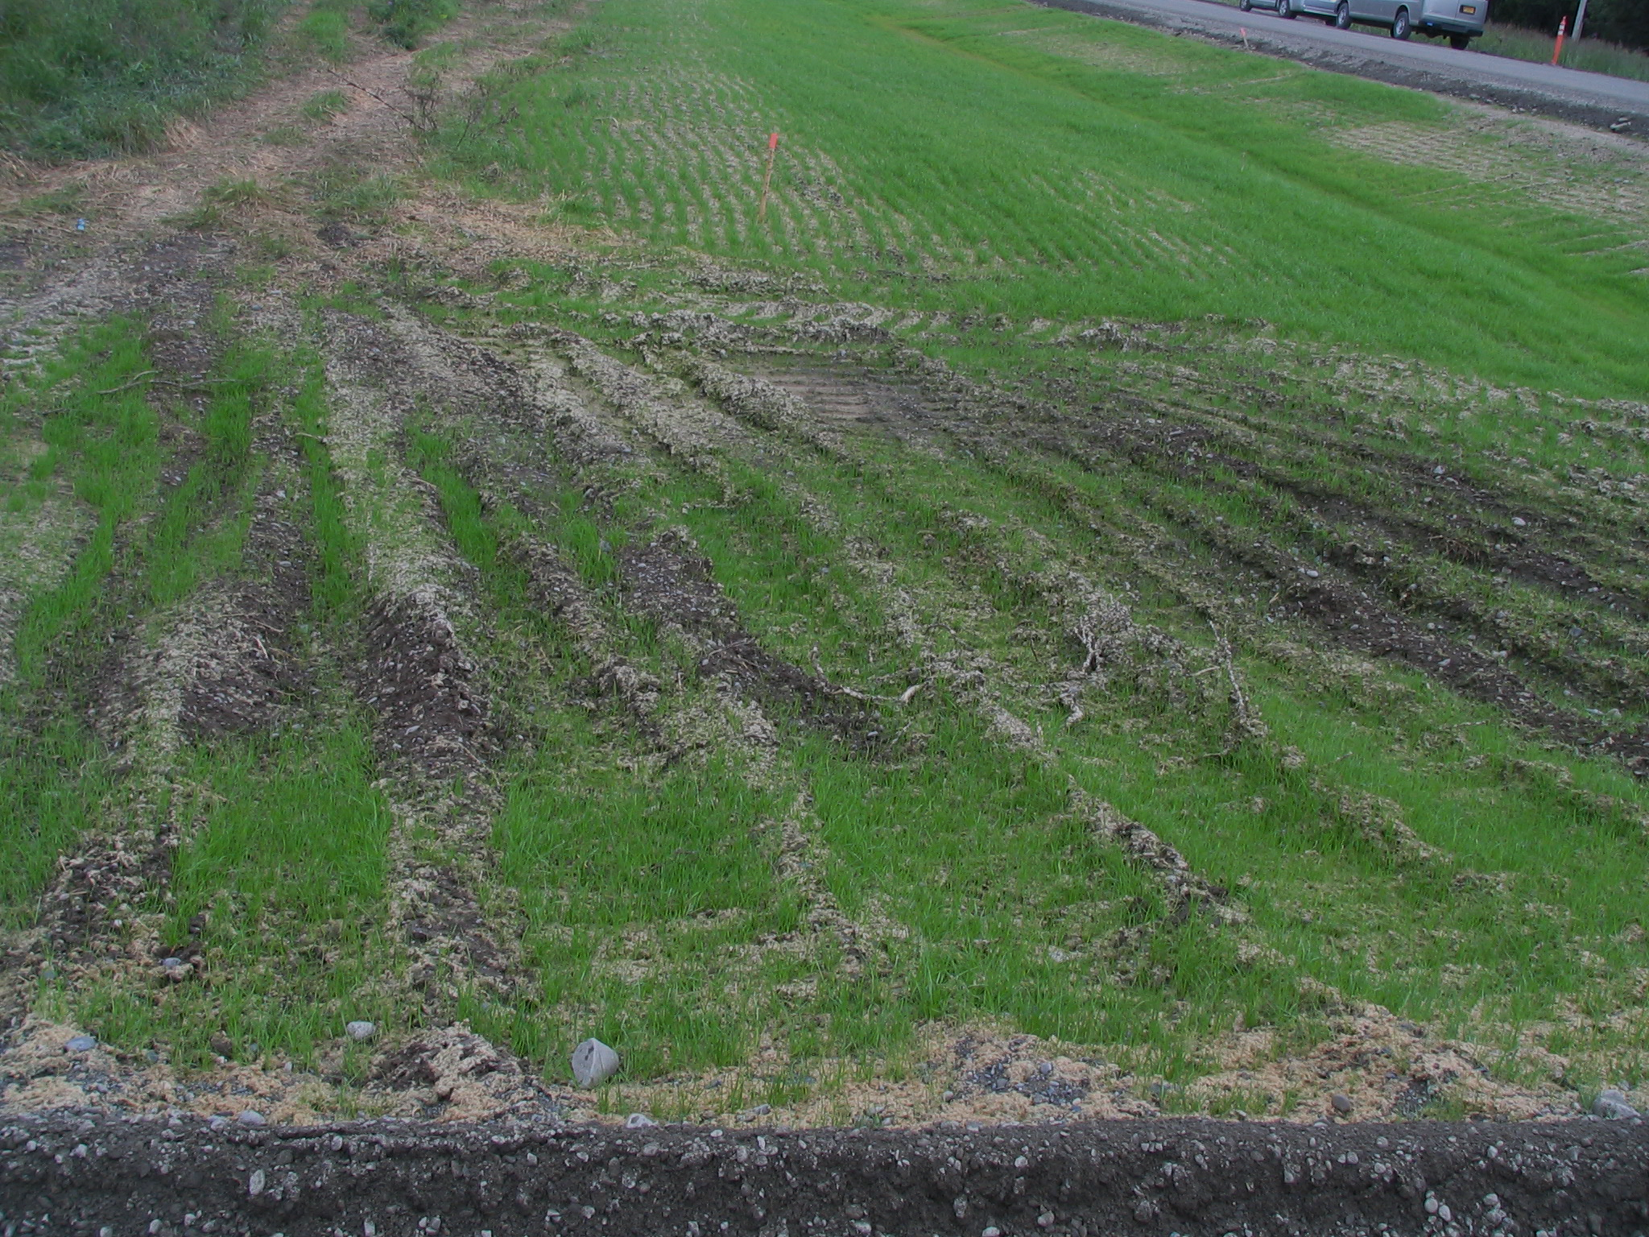
Exceptions to the Deadlines for Initiating and Completing Stabilization (Part 4.5.1.3)
Projects in Arid or Semi-Arid, or Drought Stricken Areas
Deadlines for projects that are affected by circumstances beyond the control of the permittee that delay the initiation and/or completion of vegetative stabilization
Notes:
Read through the permit with the class.

Slide 31
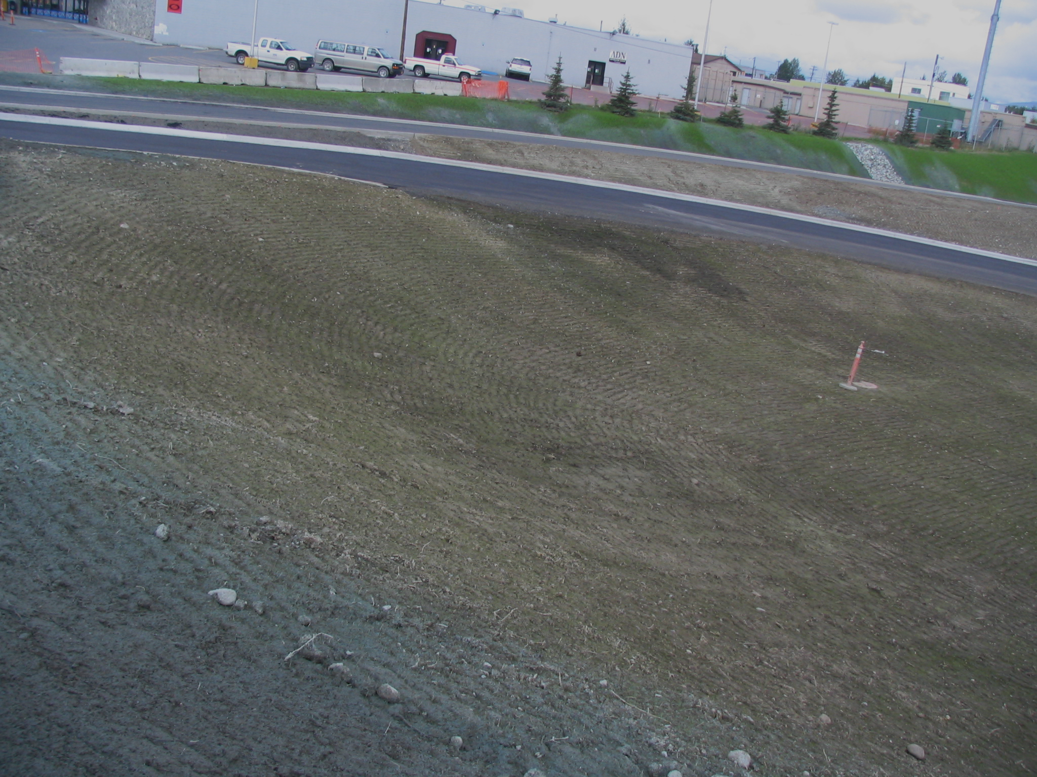
Minimum Requirements for Soil Stabilization
(Follow Along in the Permit -- Part 4.5)
Deadline to Initiate Stabilization
Deadline to Complete Temporary Stabilization Activities
Exceptions to the Deadlines for Initiating and Completing Stabilization
Deadline to complete Final Stabilization Activities
Stabilization Requirements for Terminating Permit Authorization

Slide 32
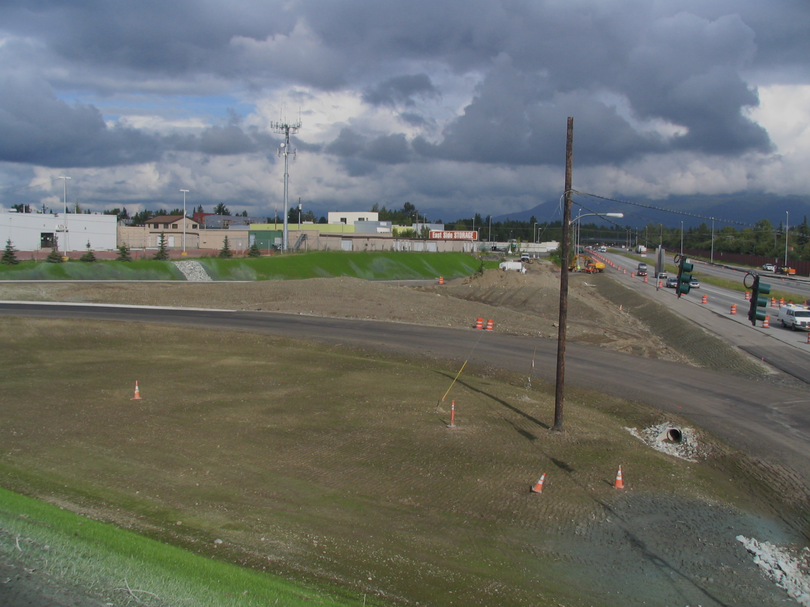
Stabilization Requirements for Terminating Permit Authorization
(Part 4.5.2)
To terminate authorization under this permit, final stabilization (as defined in Appendix C of the CGP), must be achieved on all portions of the site for which a permittee is responsible and all ground disturbing construction activity or use of related support activities must be completed.
Anchorage

Slide 33
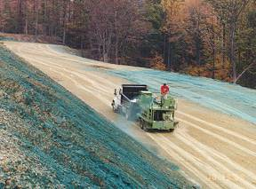
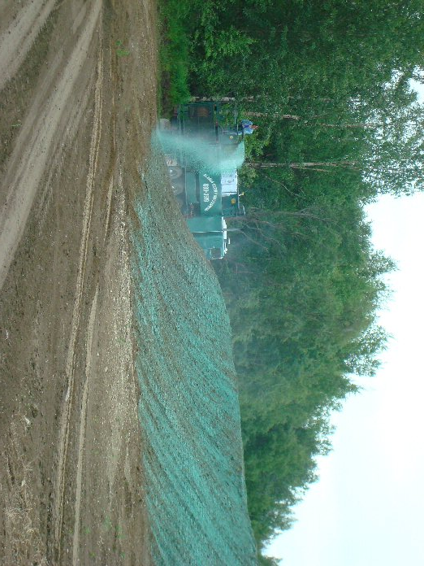
Hydroseeding
The process of combining seed, mulch, fertilizer and soil amendments with water to mix in a Hydro seeder tank to form a thick slurry.
This slurry is applied with pressure to the surface for seed germination and turf development.

Slide 34
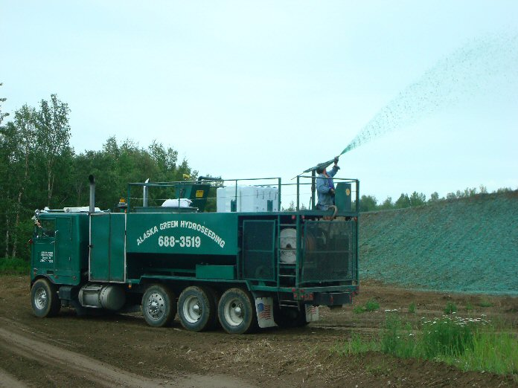
Hydroseeding
Advantages:
Cost effective less labor intensive
Vegetation Quality is better
Micro environment for seed germination and high-water retention
More coverage in less time
Erosion Control
It can also be applied as:
  A stand alone process – seed and emulsion
  Mixed with Hydraulic Mulch
  Mixed with Soil Binders
  Applied prior to application of Straw Mulch
  Applied prior to application of Rolled Erosion Control Products
  Applied prior to application of Wood Mulch

Slide 35
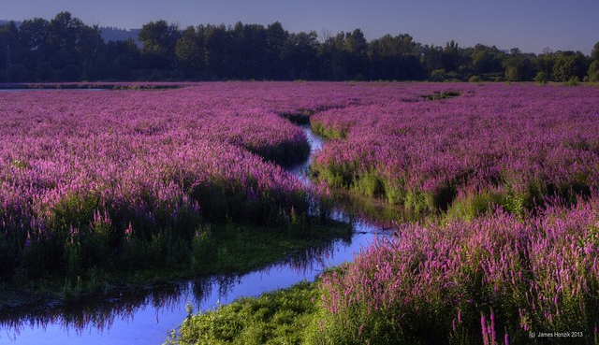
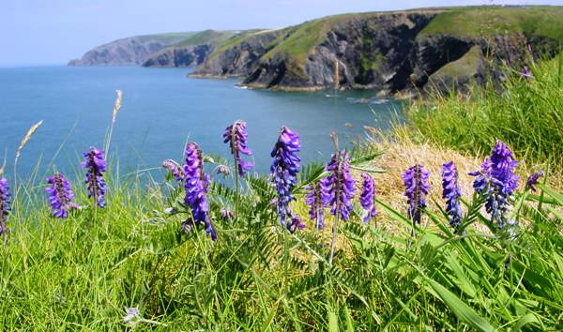
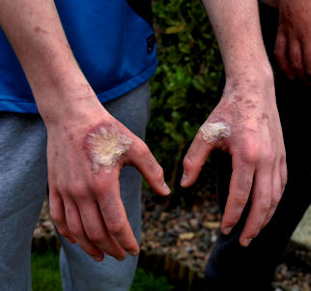
Invasive Species
USDA defines an invasive plant as a species that is non-native or alien to the ecosystem.
  Noxious Weed: An invasive plant species so aggressive that legal action has been taken to prevent their introduction and spread
  Can be terrestrial or Aquatic
  Invasive species can be plants, insects, animals, fungi, or bacteria.
  In Alaska. invasive plants are the most common problem for projects.
  Easily spread by recreational and industrial equipment, wind, water, animals, floatplanes, and imported goods.
Vicia Cracca – Tufted Vetch found at most construction sites throughout AK

Slide 36
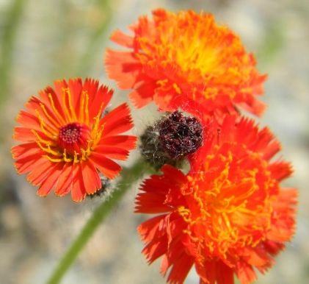
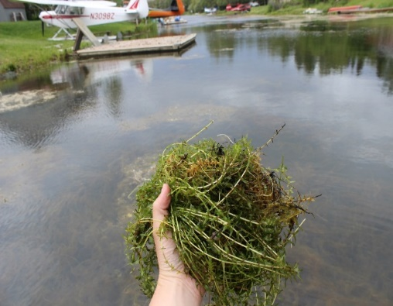
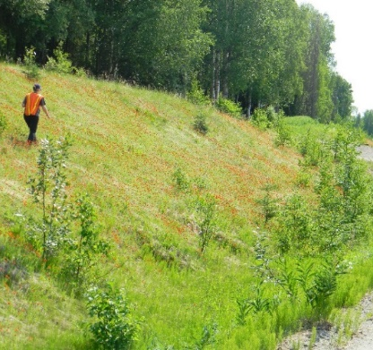
Impacts of Invasive Species
Cost Alaskan agencies , non-profits and private land managers 29 million from 2007-2011 to manage invasive species.
Invasive species adversely affect biodiversity and can lead to the extirpation or even extinction of native species, can alter fire cycles, and (non-plant species) can cause or spread diseases
Can devastate industries, including fisheries, agriculture, and recreation.
Can destabilize soil and alters hydrology and water quality of stream, rivers, lakes, and wetlands.

Slide 37

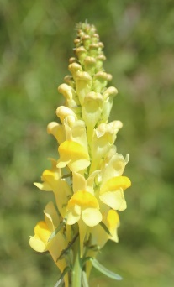
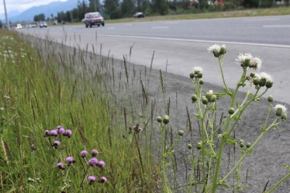
Manage Invasive Species at Work Sites
Identify noxious and other invasive species of concern at the project site.
  There is an ID app (Alaska Weeds ID), a website (https://accs.uaa.alaska.edu/invasive-species/non-native-plants/ ), and groups that can help (AKISP and local CWMAs and SWCDs).
Report any invasive species: 1-877-INVASIV
Contact DNR Division of Agriculture Plant Materials Center in Palmer for proper management and disposal.
Use Alaskan-certified material that is weed-free.
Prevent the spread of invasive plants during construction by not washing vehicles & equipment between sites, using certified weed-free gravel and BMPs.
Promote growth of native species.
Monitor site.
907-745-8721
Notes:
Imported topsoil or compost obtained from outside the project limits. Both are typically used for highway planting projects rather than for erosion control work. Be careful about invasive species.
Prioritize: Where invasive species are present on a site thin and burn to help control invasive before work begins.
Don’t transfer seeds of many invasive species are easily carried by vehicles.

Slide 38
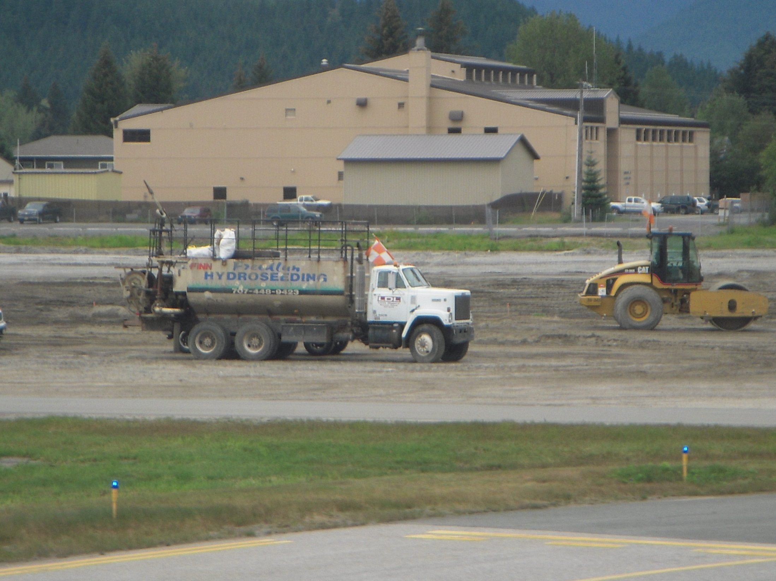
As an Inspector:
Do the Grading Logs Document Compliance
With the Stabilization Requirements?
JNU

Slide 39
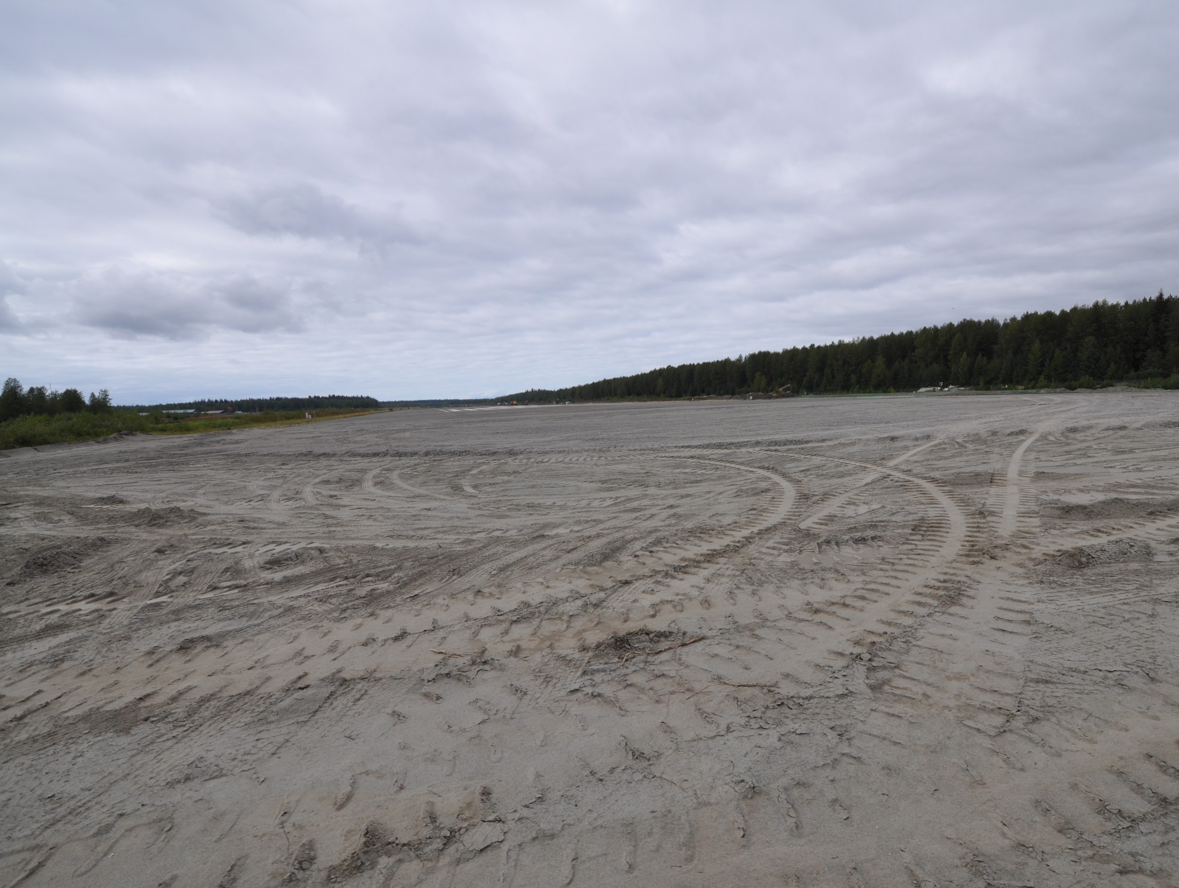
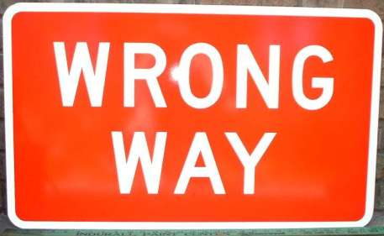
Large bare areas for long periods of time
increases the potential for erosion.
Exposure to Risk = Extent & Duration of Exposed Soils

Slide 40
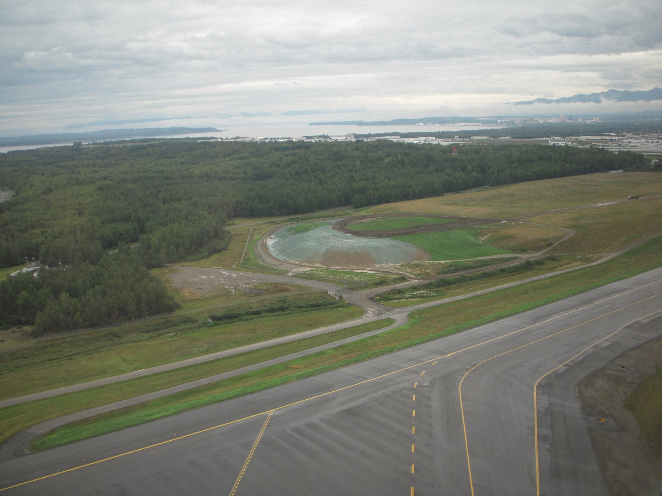
Stabilization: Finish as you go!
ANC
Notes:
Finish as you go, turn your liabilities into assestts. Turn a maintenance cost into an invoice item.

Slide 41
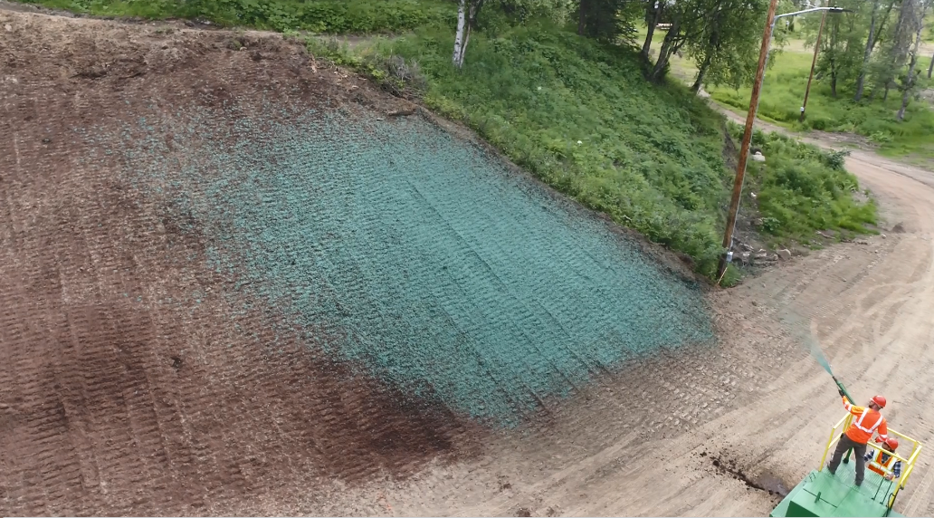

Tackifiers and Binders
Tackifiers are used as a tie/stick down for:
  Soil, Compost, Seed, & or Mulch.
  Many types:
  Guar, Hydraulic Mulch, Hydraulic Matrix, Bonded Fiber Matrix, Mechanically Bonded Fiber Matrix, PAM

Slide 42

Temporary Stabilization
“Balance the scales”
Time
Schedule
Plant Growth
Longevity
Strength
Climate
Winter over & breakup
During revegetation
Pauses in Construction Activity
Notes:
When planning for stabilization you need a temporary measure that will last long enough for the permanent vegetation to grow in. Depending on the length of time and the strength necessary to resist the erosion during the grow in process the choice for the temporary measures will vary.

Slide 43

Pop Quiz: Which Lasts Longer?
Which product is right for the job?
Paper Hydromulch with Tackifier
Jute Netting
Tackifier
Turf Reinforcement Mat TRM
Straw Blanket RECP
Bonded Fiber Matrix (BFM)
Wood Fiber Hydromulch with Tackifier
Coconut Blanket RECP
*ECTC website for more info

Slide 44

Compost Blanket

Slide 45

Compost Certification
Temperature to kill weed seed
Notes:
Some compost can contain weed seeds.

Slide 46



Concrete Cloth
Notes:
Concrete cloth is flexible and can harden under water or with salt water

Slide 47

Biotic Soil Amendments BSAs
Petersburg
Notes:
BSA’s are hydraulically applied and assist in revegetation. They add beneficial bacteria, fungi, and microbes along a food source to build a healthy soil much faster that mother nature.

Slide 48



Dillingham, AK
Pop. 2,143

Slide 49

Poor Soils
Low Organics
Low Fertility
Topsoil alternative
Dillingham

Slide 50

Surface Prep
Biotic Soil Amendments
Phase Stabilization
Finish as you go!
Dillingham

Slide 51

Erosion Control: Bonded Fiber Matrix
Dillingham
Notes:
Surface prep, biotic soil amendments, erosion control BFM.

Slide 52

Growing grass takes time.
Plan for:
Germination, water schedule, and expression and establishment.
Dillingham
Notes:
Later in the same season.

Slide 53

Plan & schedule for Termination!
Faster Establishment
Project Closeout
Permit termination
No Maintenance
Dillingham
Notes:
Same project same season before winter. Note the base rock is now place on the top of embankment

Slide 54

Kenai Riverbank Stabilization

Slide 55

Turf Reinforcement Mat( TRM)
  Infill with Biotic Soil Media
  Stabilize with erosion control
Shoreline armor.

Slide 56

Turf Reinforcement Mat( TRM)
  Infill with Biotic Soil Media
  Stabilize with erosion control
Shoreline armor.

Slide 57

Be prepared for breakup!

Slide 58

Notes:
Note the riverbank with stabilization is not eroding like the adjacent property.

Slide 59

Permanent Stabilization
Prevents Raindrop Erosion – Stabilizes Flow Paths
Permanent Landscaping
Concrete / Asphalt
Rock-Quarry Spalls-Rip Rap
Arid & semi-arid areas:
3 years to 70%
Eagle River
Notes:
Refer to the permit definitions.

Slide 60

Preparing for Winter Shutdown
Notes:
Winter will be coming, we need to plan for winter stabilization

Slide 61

Stabilization:
Waste, overburden
Cut slopes
Material source roads
Dalton Highway
Notes:
What areas will need stabilization, how soon can we get it done?

Slide 62

Dealing With Break Up
*Minimize exposed soils before freeze up.
Notes:
Preparing for thaw begins before freeze up.

Slide 63

Questions?

