Slide 1
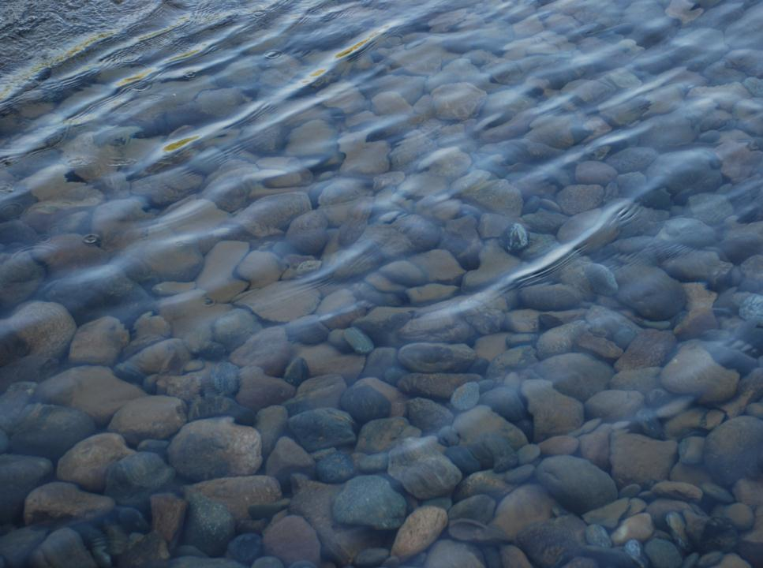

CGP Requirements
Sediment Control Measures
CGP Part 4.0 Pg. 22
January 2026

Slide 2
CGP Requirements
Goal of this section:
Become familiar with the types of sediment control measures that are required by the CGP
  Protect drain inlets and water bodies
  Down-slope sediment controls
  Stabilize vehicle access and exit points, dust control
  Soil stockpiles
  Sediment basins
  Dewatering
  Soil stabilization
  Treatment chemicals
Learn the names and functions of common sediment control BMPs

Slide 3
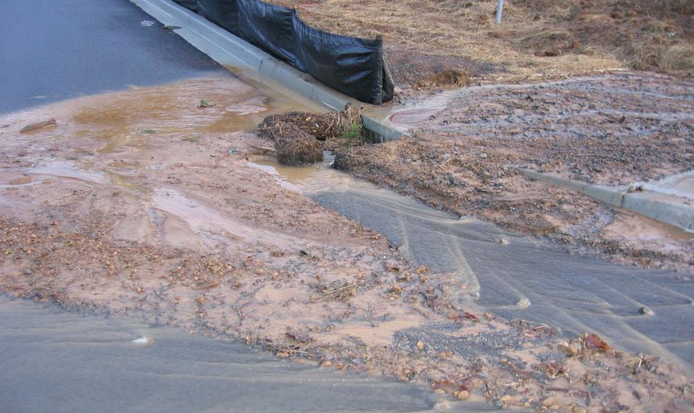
Storm Drain Inlet Protection Measures
CGP Part 4.3.1 Pg. 25
A permittee must install appropriate protection measures to minimize the discharge of sediment prior to entry into the inlets located on site or immediately downstream of the site.
Notes:
Do not spend a lot of time working on drain inlets without protecting it properly

Slide 4
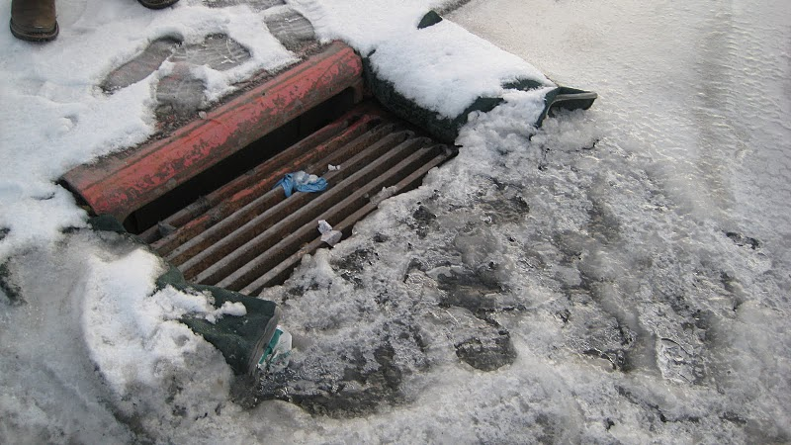
Inlet Protection vs.
Plow Destruction
Notes:
Mention that ice may back up and cause safety issues

Slide 5
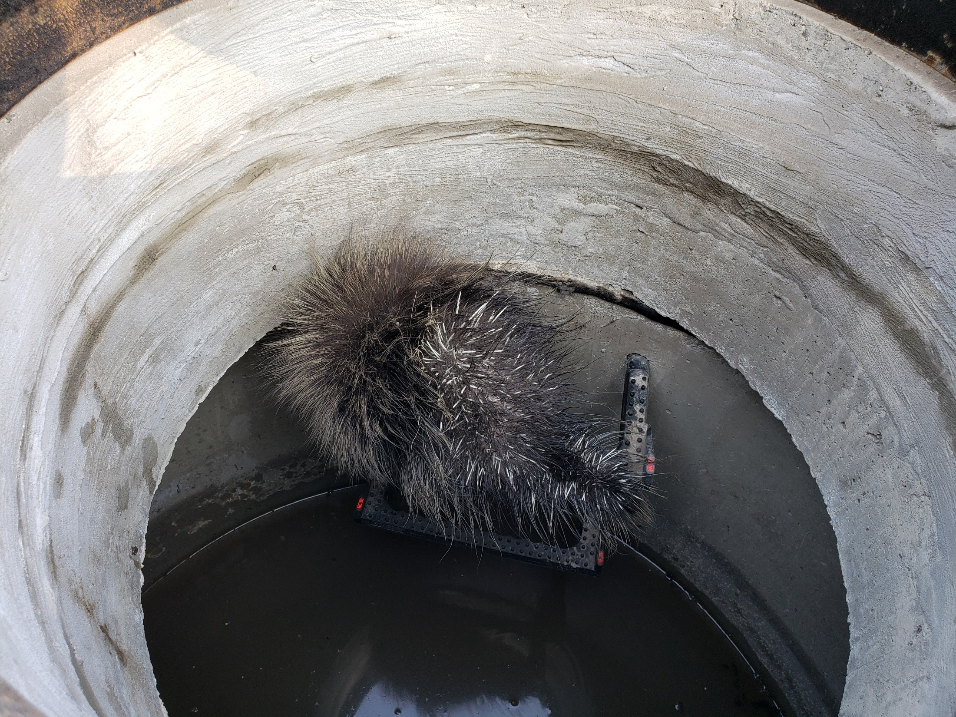
Habitat Protection?

Slide 6
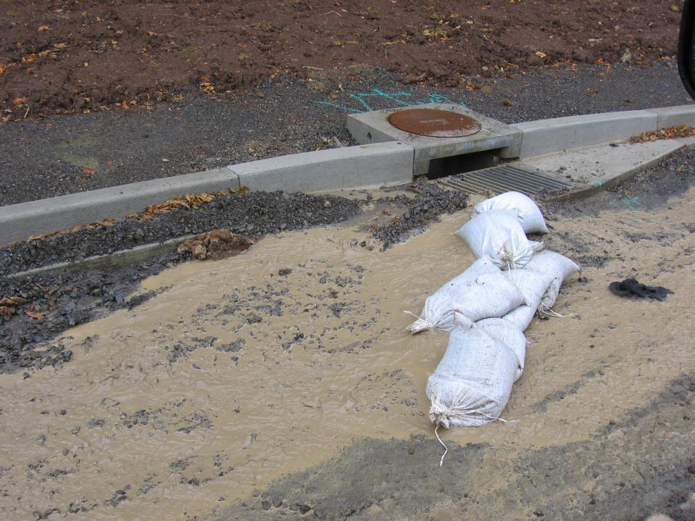
Where’s the Best in this management practice?
Notes:
Here dirty water is being directed into the drain.

Slide 7
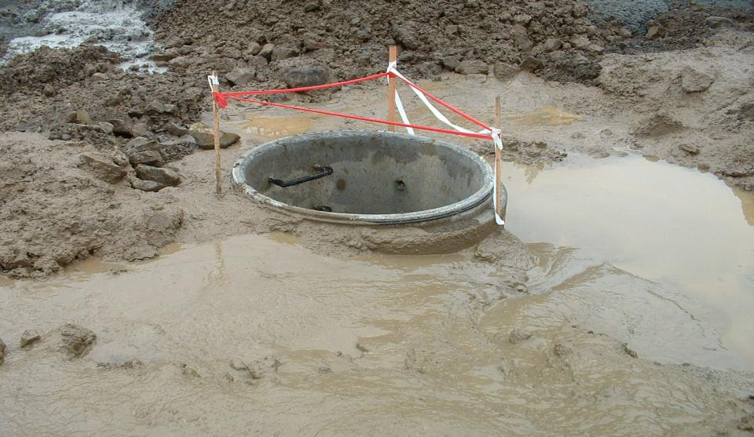
This is No Place for Sediment to Collect - $$$$$$

Slide 8
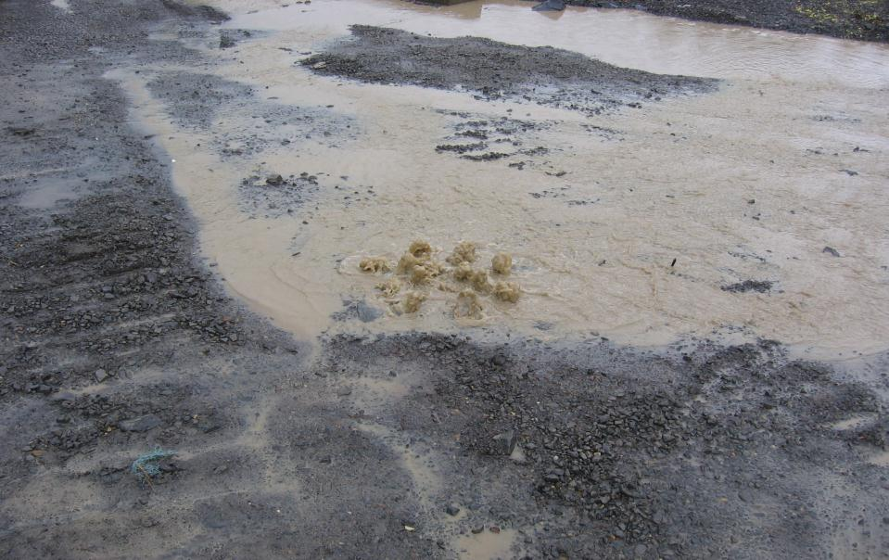
What’s in this Storm System?
Who’s Cleaning it Out?

Slide 9
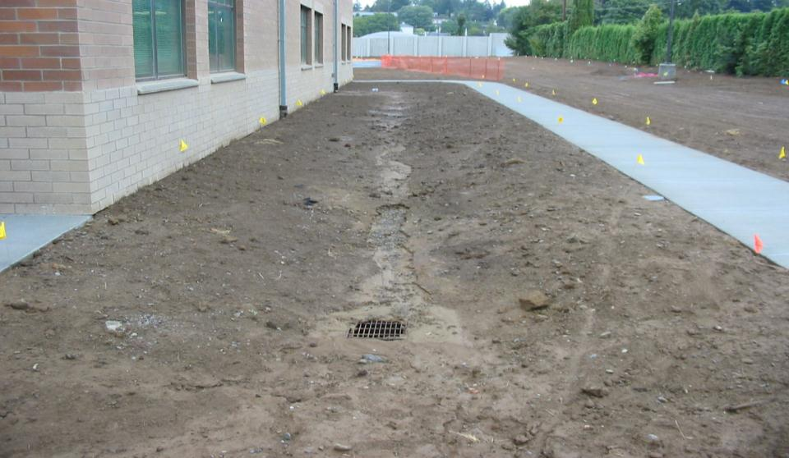
Protect Inlets Until Final Site Stabilization is Completed!
Notes:
Note the cause of the problem is the connection to the down spout

Slide 10
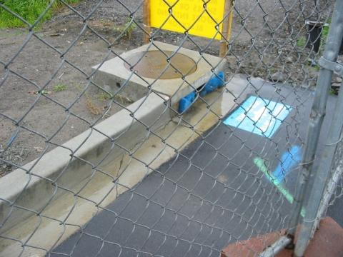
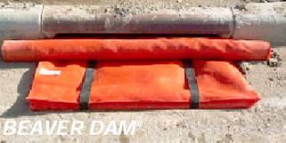
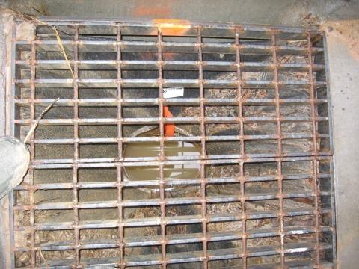
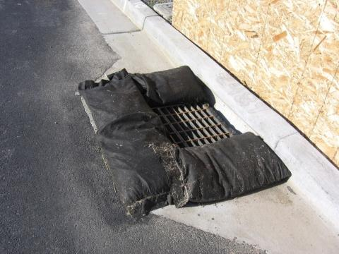
Inlet Protection

Slide 11
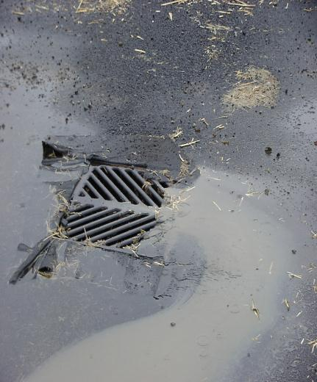
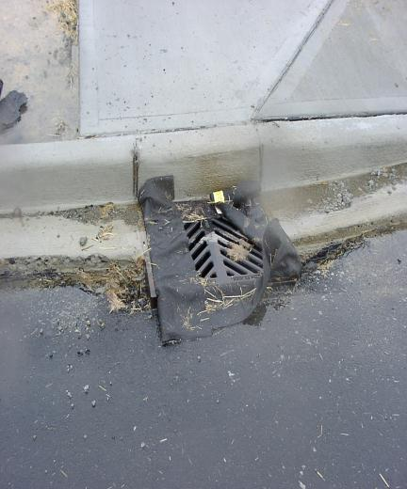
Catch Basin Inserts

Slide 12
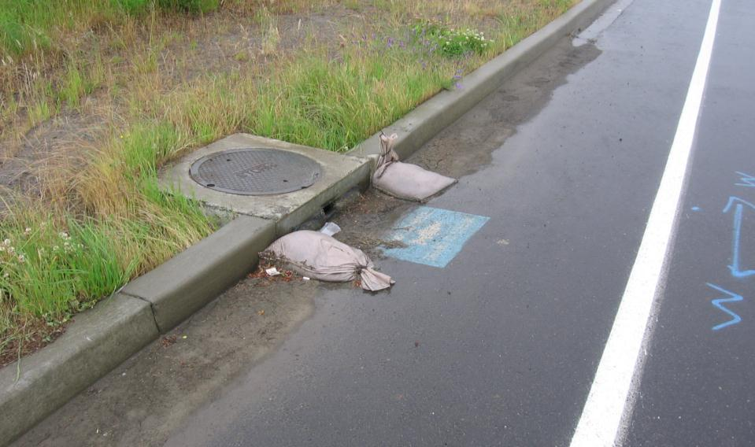
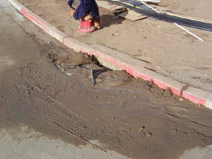
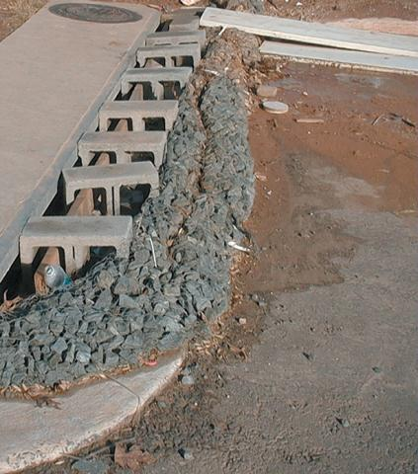
Maintenance Issues

Slide 13
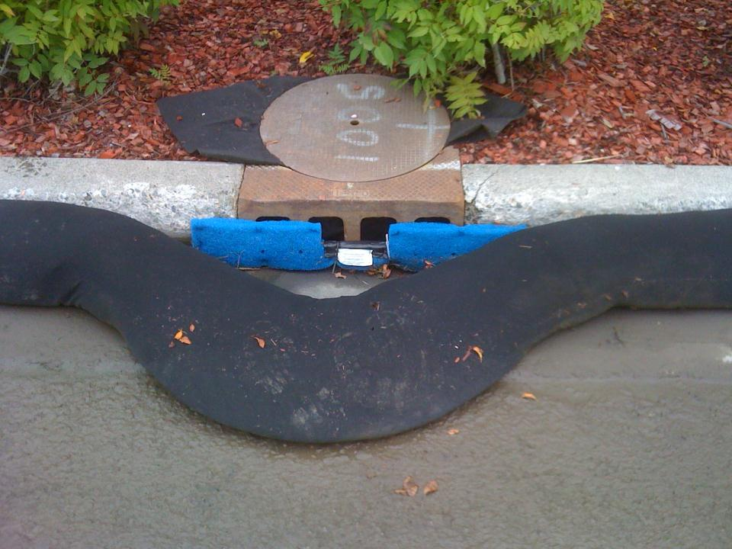
Will Traffic Destroy Your Efforts?
Midtown Anchorage

Slide 14
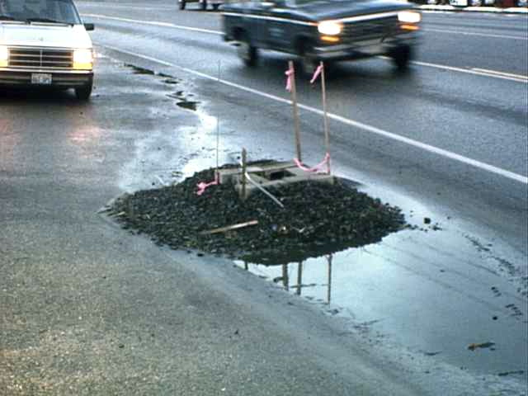
Will Your Efforts Destroy Traffic ?
Photo Courtesy David Jenkins
Notes:
This detail still exists!

Slide 15
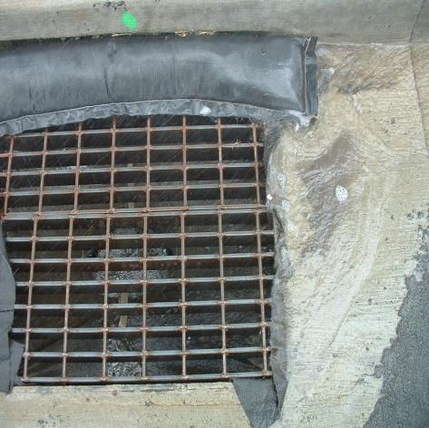
Storm Drain Inlet Protection
Keeps coarse sediment out of drainage systems
Above ground methods: silt fence, Exert, Dandy Bag
Below ground: catch basin filter
BMP
WA C-220
OR SC-8
DOT&PF – 25.00, 26.00, 27.00, 28.00
Notes:
Catch Basin insert with a curb inlet barrier. What kind of traffic will it need to withstand?

Slide 16
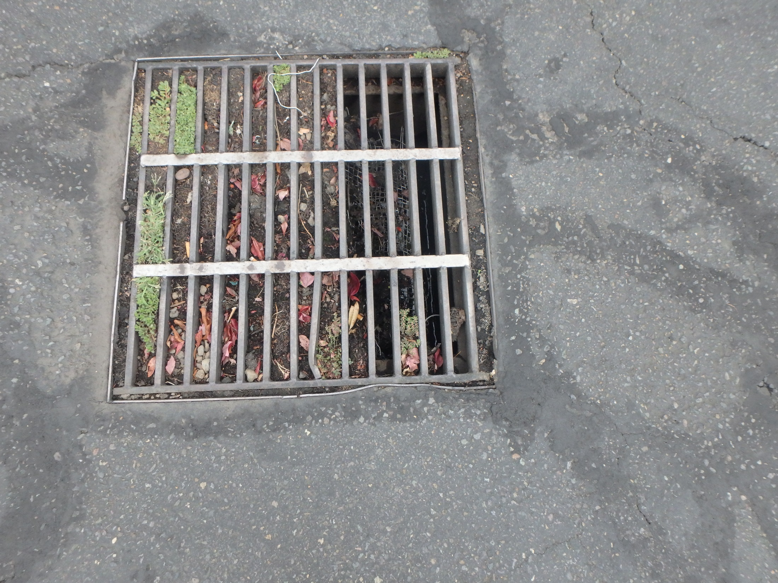
Make sure to remove them!

Slide 17
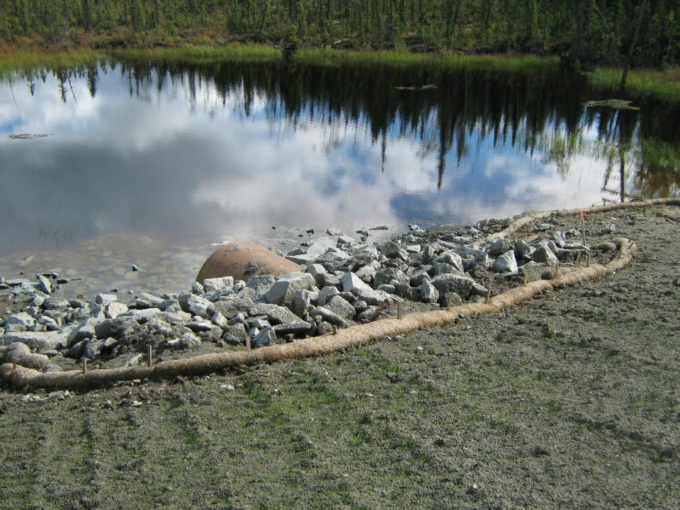
Water Body Protection Measures
CGP Part 4.3.2 Pg. 25
A permittee must install appropriate protection measures to minimize the discharge of sediment prior to entry into the water body for water bodies located on site or immediately downstream of the site.
Tok

Slide 18
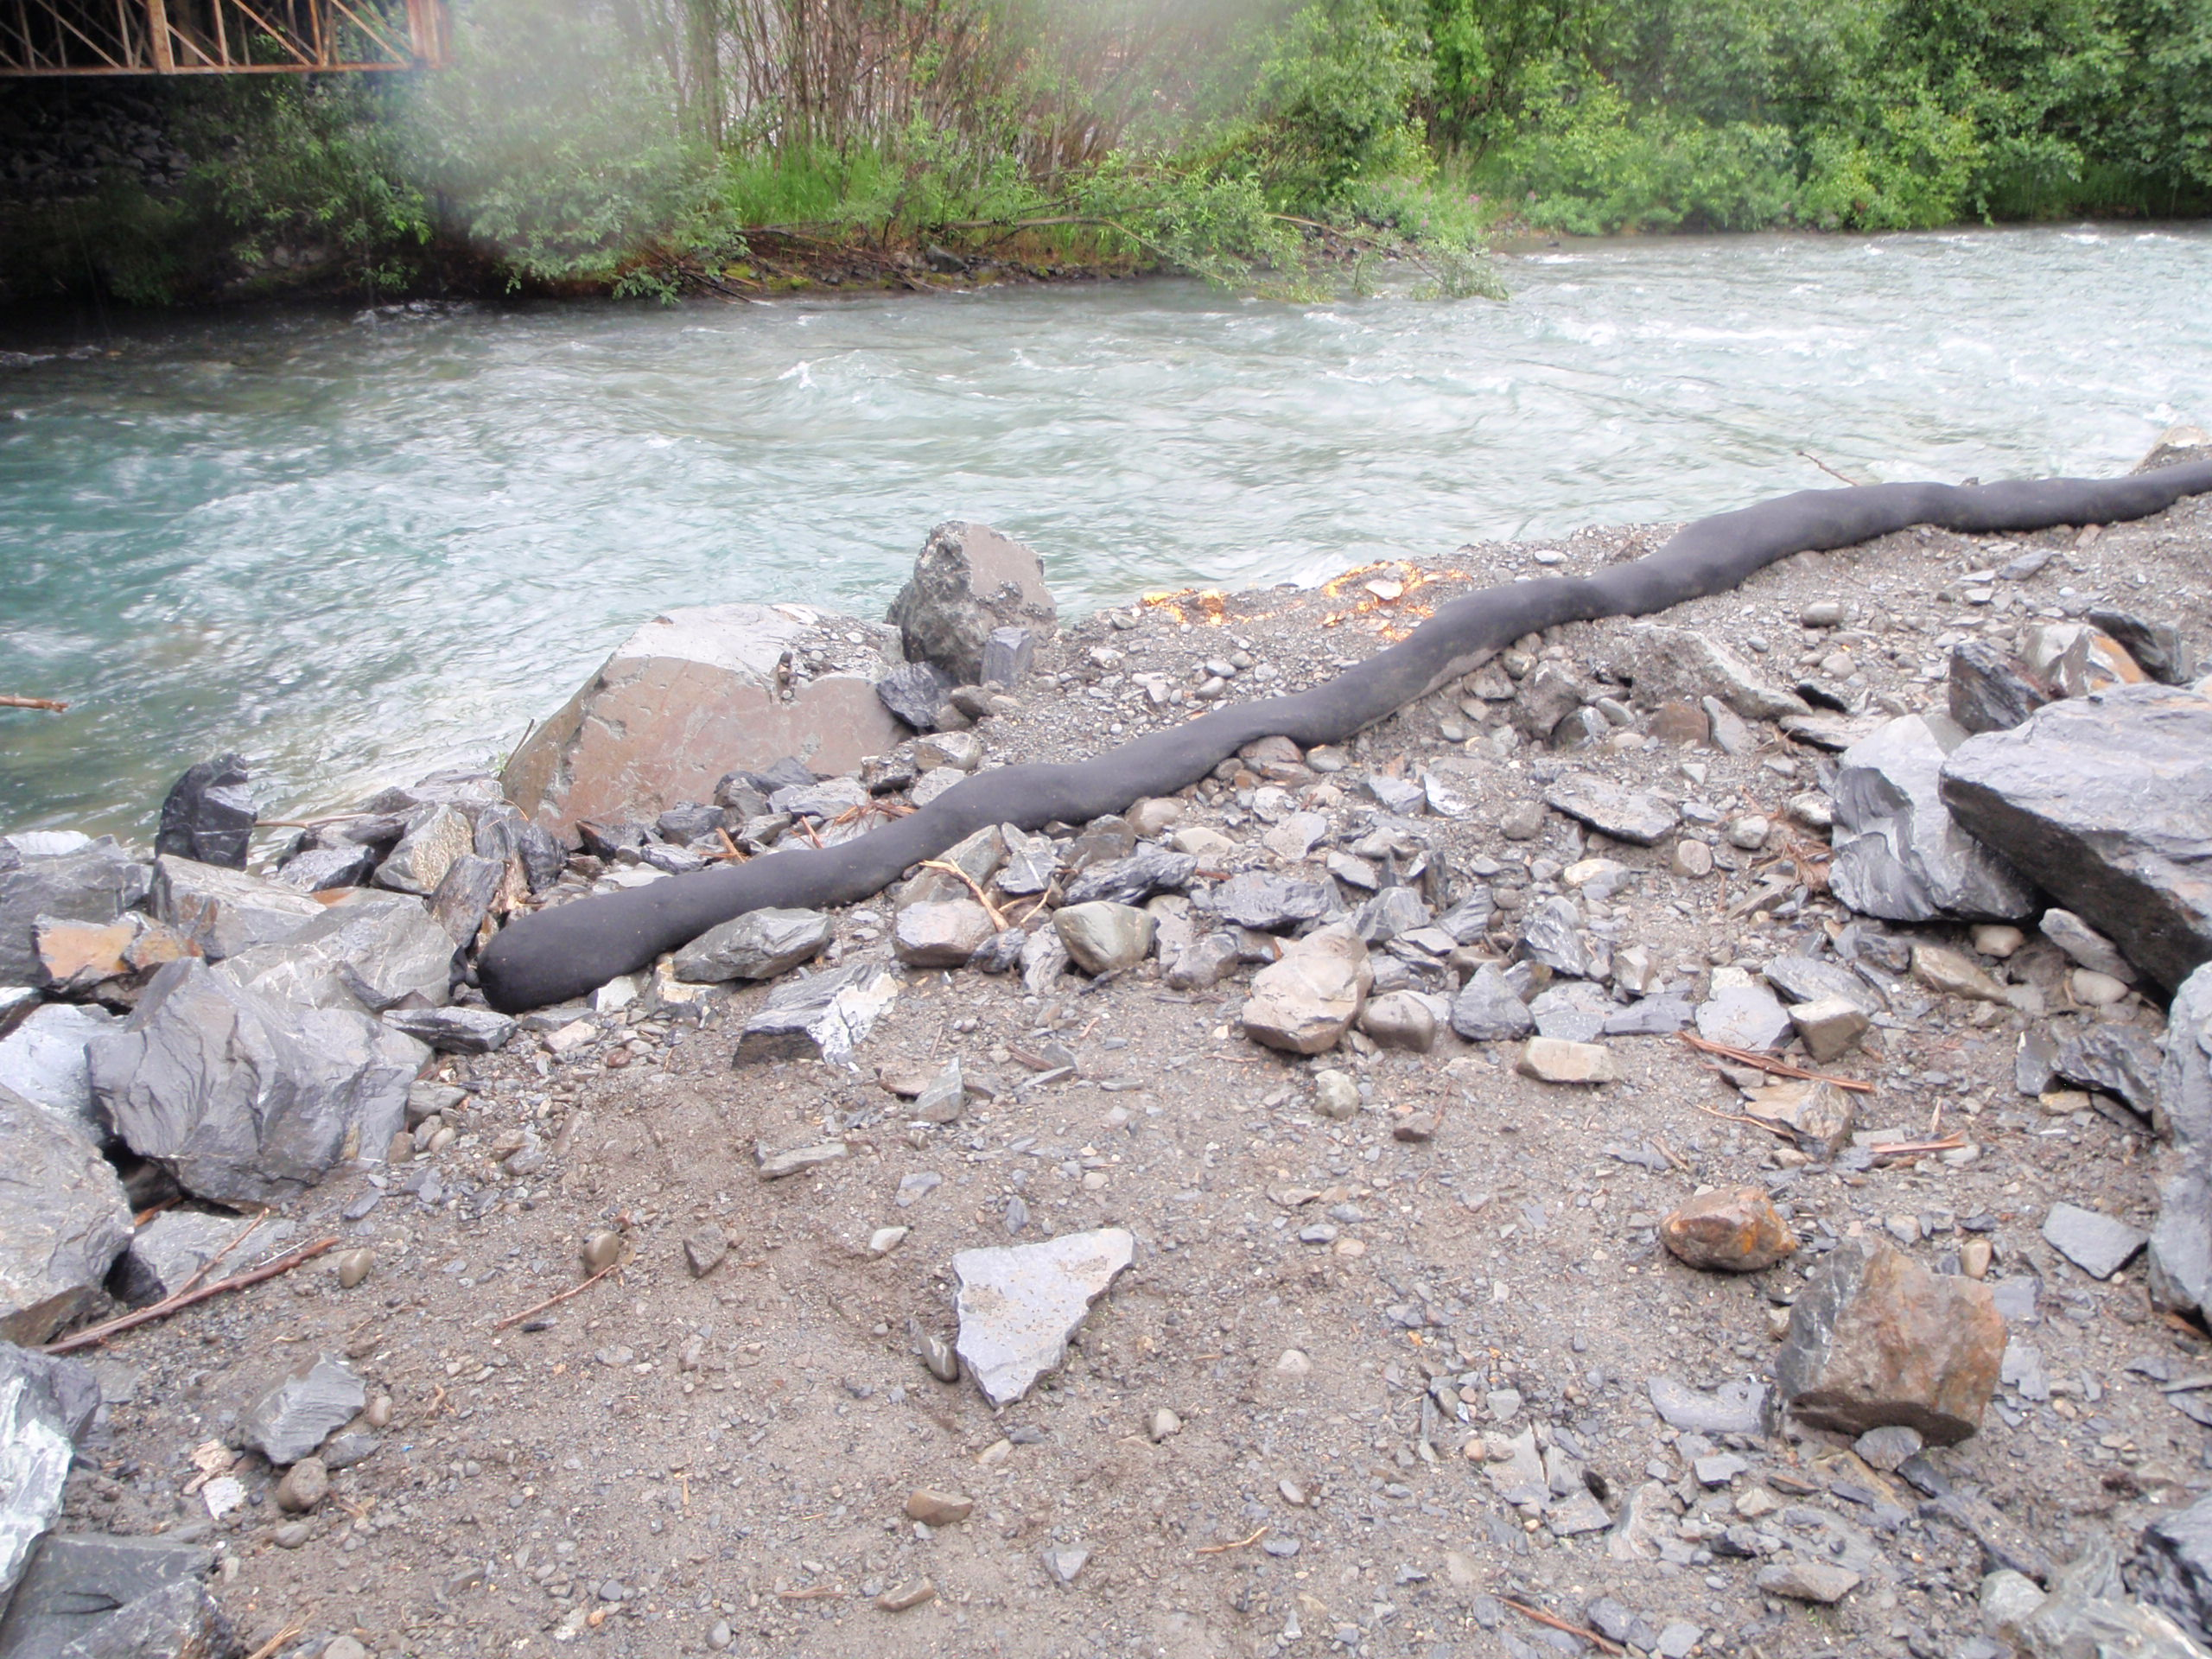
Compost Wattle
Eye Candy for Fish & Game

Slide 19
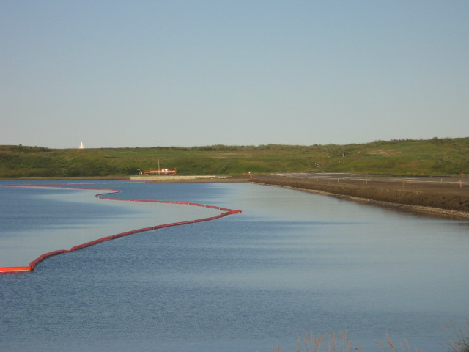
Turbidity Curtain / Oil Boom
Where intrusion into a watercourse is necessary
Tidal and non-tidal uses
Maximum flow velocity of 5 feet per second
Locate parallel to flow, not across a channel
BMP
DOT&PF 19.00
OR RC-10
Kotzebue

Slide 20
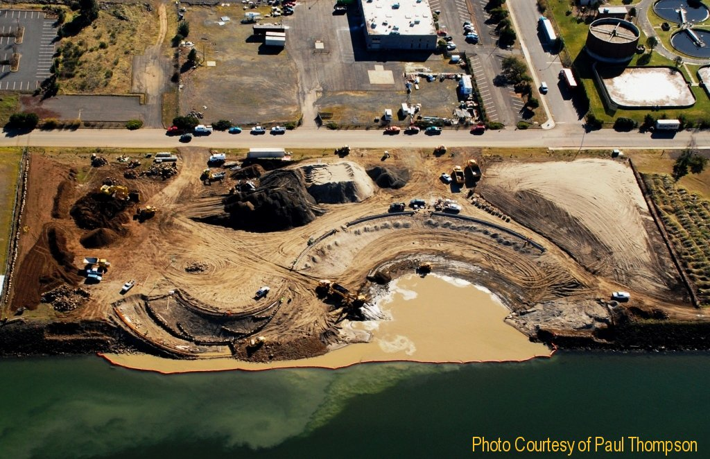
Columbia River

Slide 21
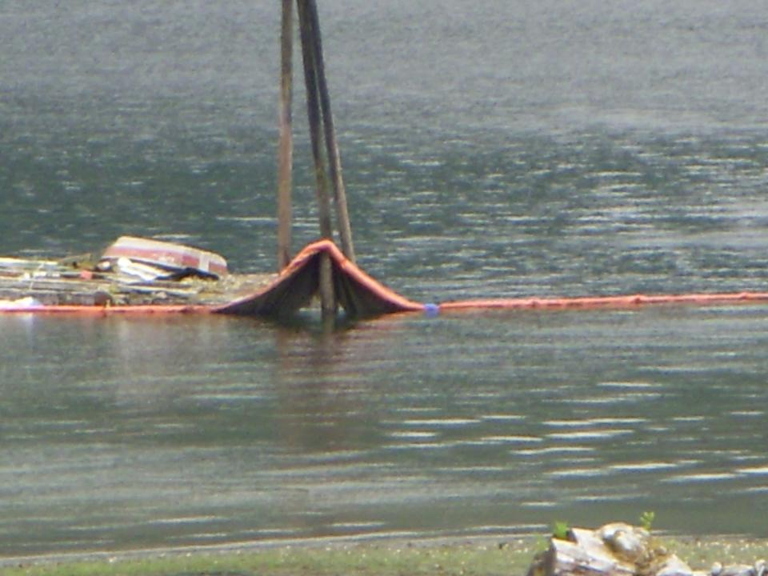
Tidal Influences
make maintenance difficult
Turbidity / Silt Curtain
Ketchikan
Notes:
This measure by itself may not meet ADEC or NMFS requirements.

Slide 22
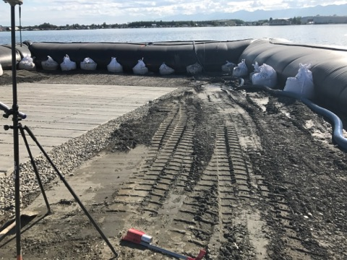
In Water Controls
CGP Part 4.3.3 Pg. 25
2021 ACGP 4.3.3
Lake Hood
Notes:
Provide a place for the eroded material to collect on your property.
Remove sediment from the stormwater.

Slide 23
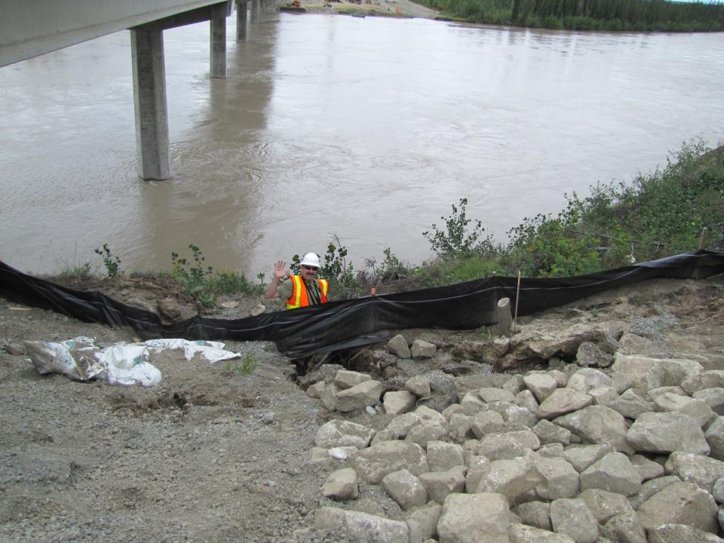
CGP Part 4.3.3 Pg. 25
A permittee must establish and use down-slope sediment controls where storm water will be discharged from disturbed areas of the site.
Tok
Notes:
Slope now needs repair

Slide 24
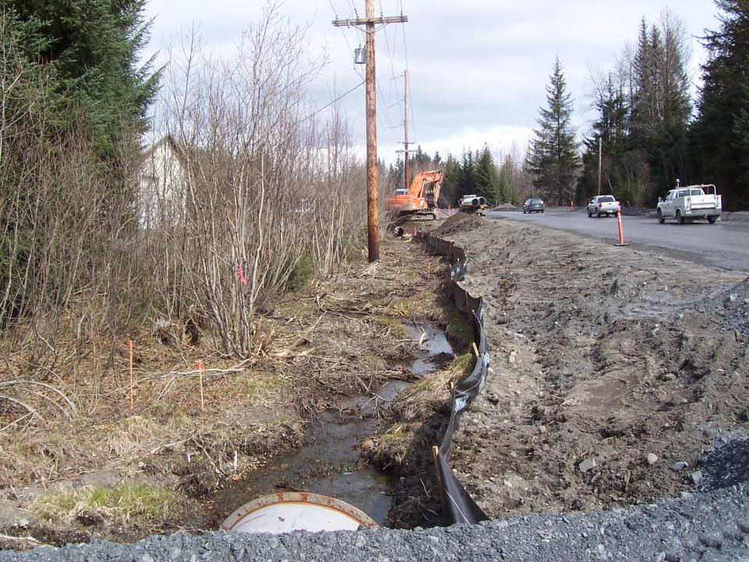
Install Sediment Controls
Sediment Controls are BMPs Installed to Prevent Sediment from Leaving Your Site
Most Sediment Control Devices are Used to Pond/Collect Sediments (Not Filtration)
Without Application of Erosion Control BMPs Stormwater Runoff Cannot Be Properly Controlled Downslope
Erosion Control BMPs Prevent Soil Erosion at its Source – First Line of Defense

Slide 25
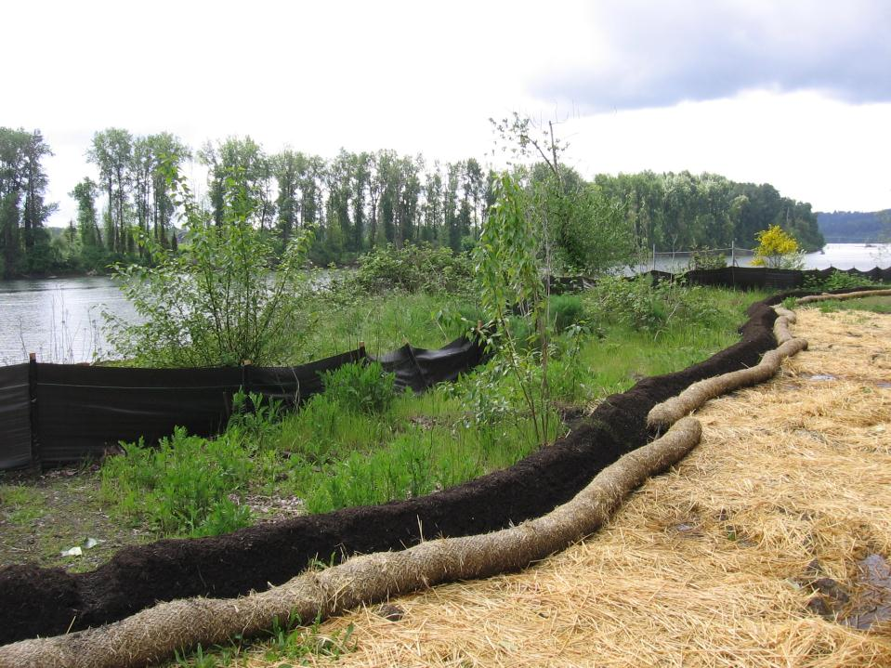
Down-Slope Sediment Controls
CGP Part 4.3.3 Pg. 25
Silt Fence
Vegetated Buffer
Compost Berm
Straw Wattle

Slide 26
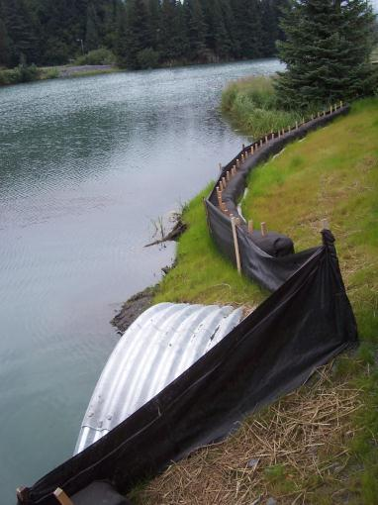
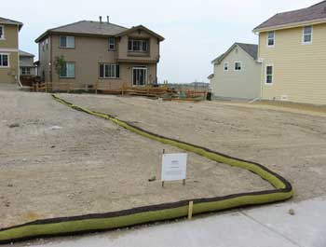
Perimeter Sediment Controls
Silt Fence and Geotextile Bales
Compost Sock
Notes:
Small areas need sediment controls too.

Slide 27
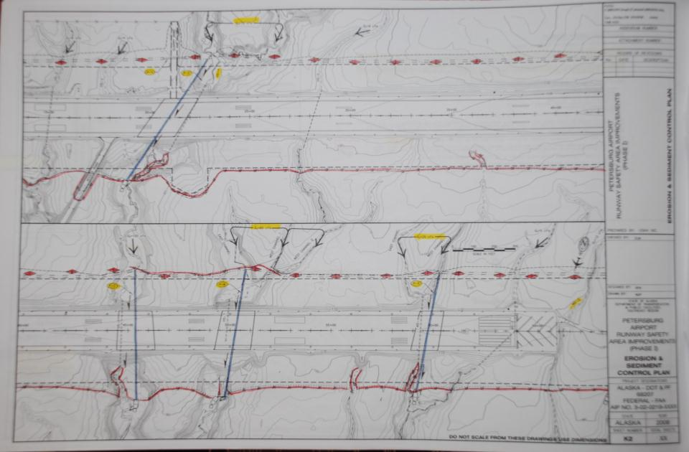
Sediment controls tight to the work area. Good, Bad, Both?

Slide 28
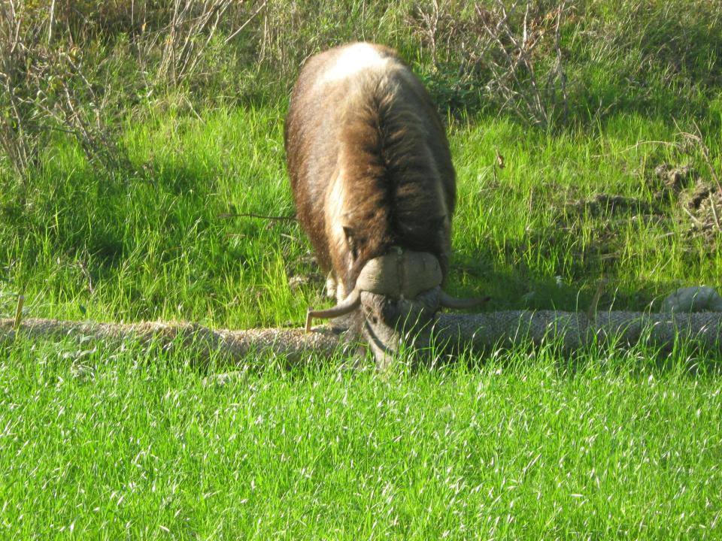
Tasty BMP’s

Slide 29
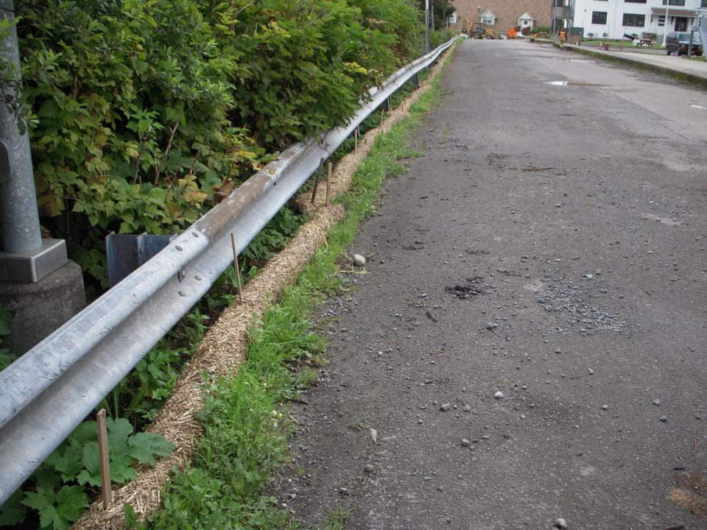
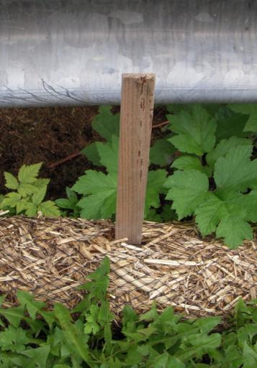
Installation Specs
Stake Size / spec
Spacing / spec
Trenched in?
Sitka

Slide 30
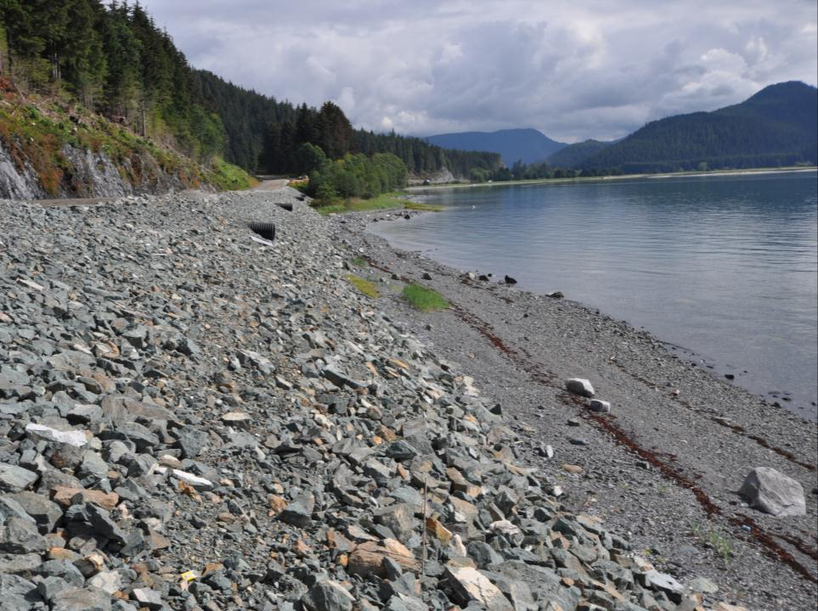
How should we do Perimeter Control
at this site?
Glacier Highway
Notes:
Using the finished rock material to create a sediment control berm as the slope is constructed.

Slide 31
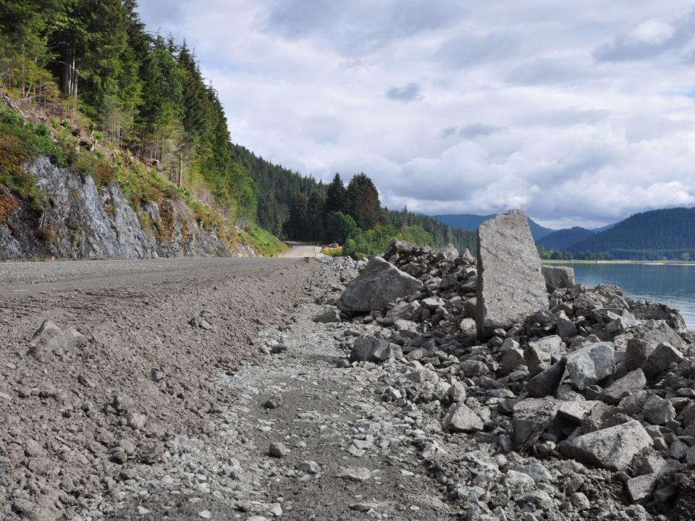
Perimeter Control can be done on the cheap and easy
Glacier Highway
Notes:
Note the big rock is the same in the previous slide to show scale and height

Slide 32
Insert Video Perimeter Sediment Controls

Slide 33
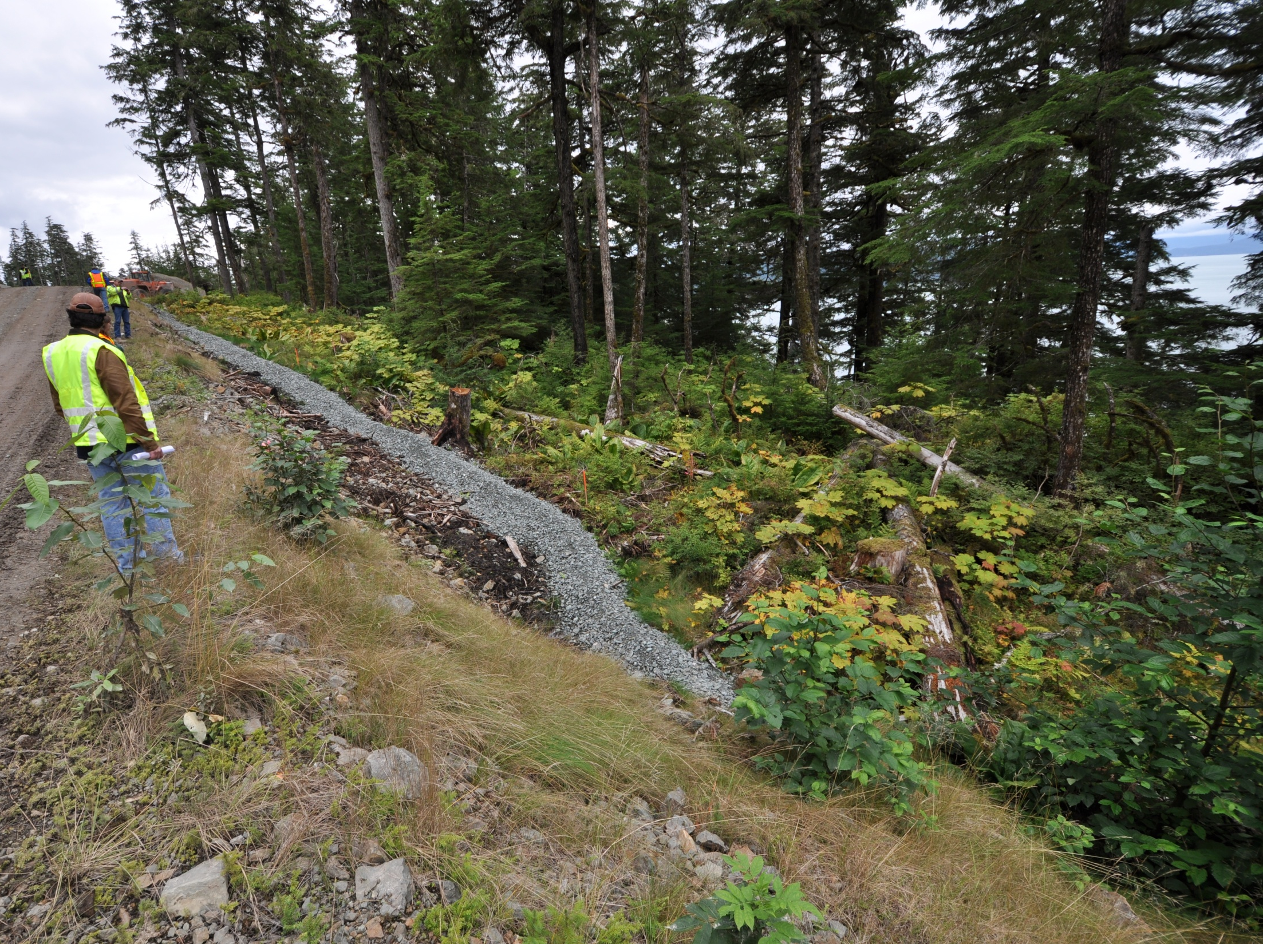
Gravel Berm Perimeter Control
Glacier HWY Juneau

Slide 34
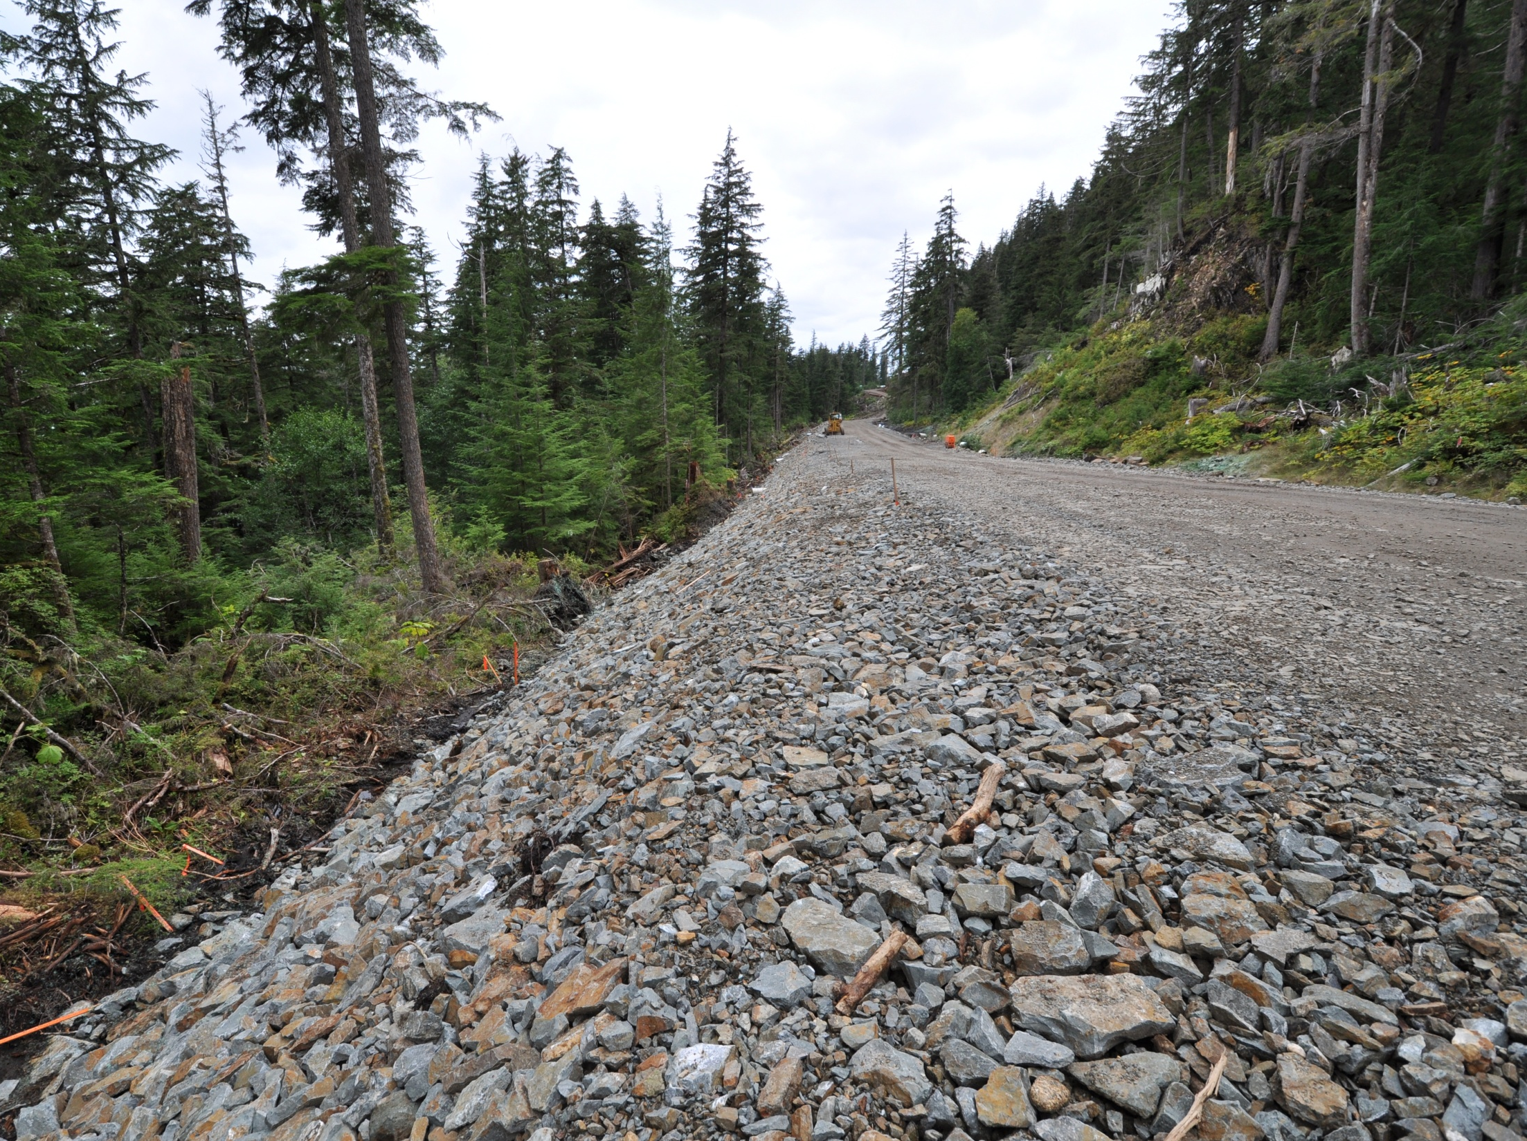
Glacier HWY Juneau

Slide 35
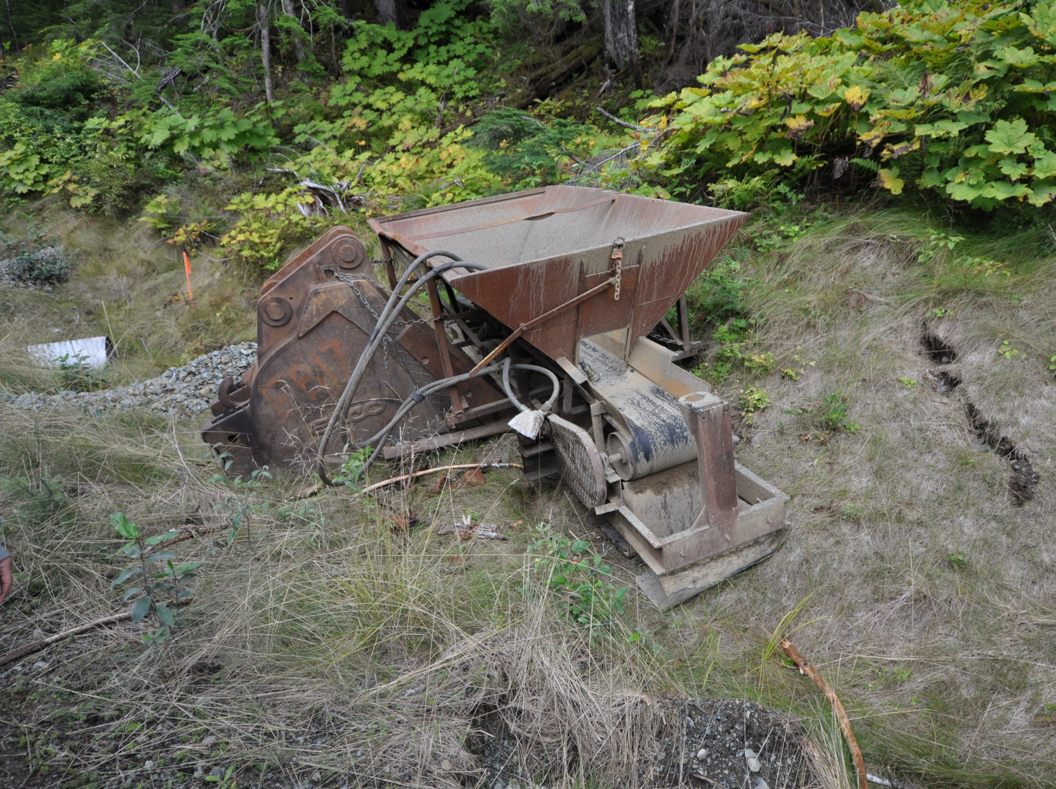
BERMANATOR

Slide 36
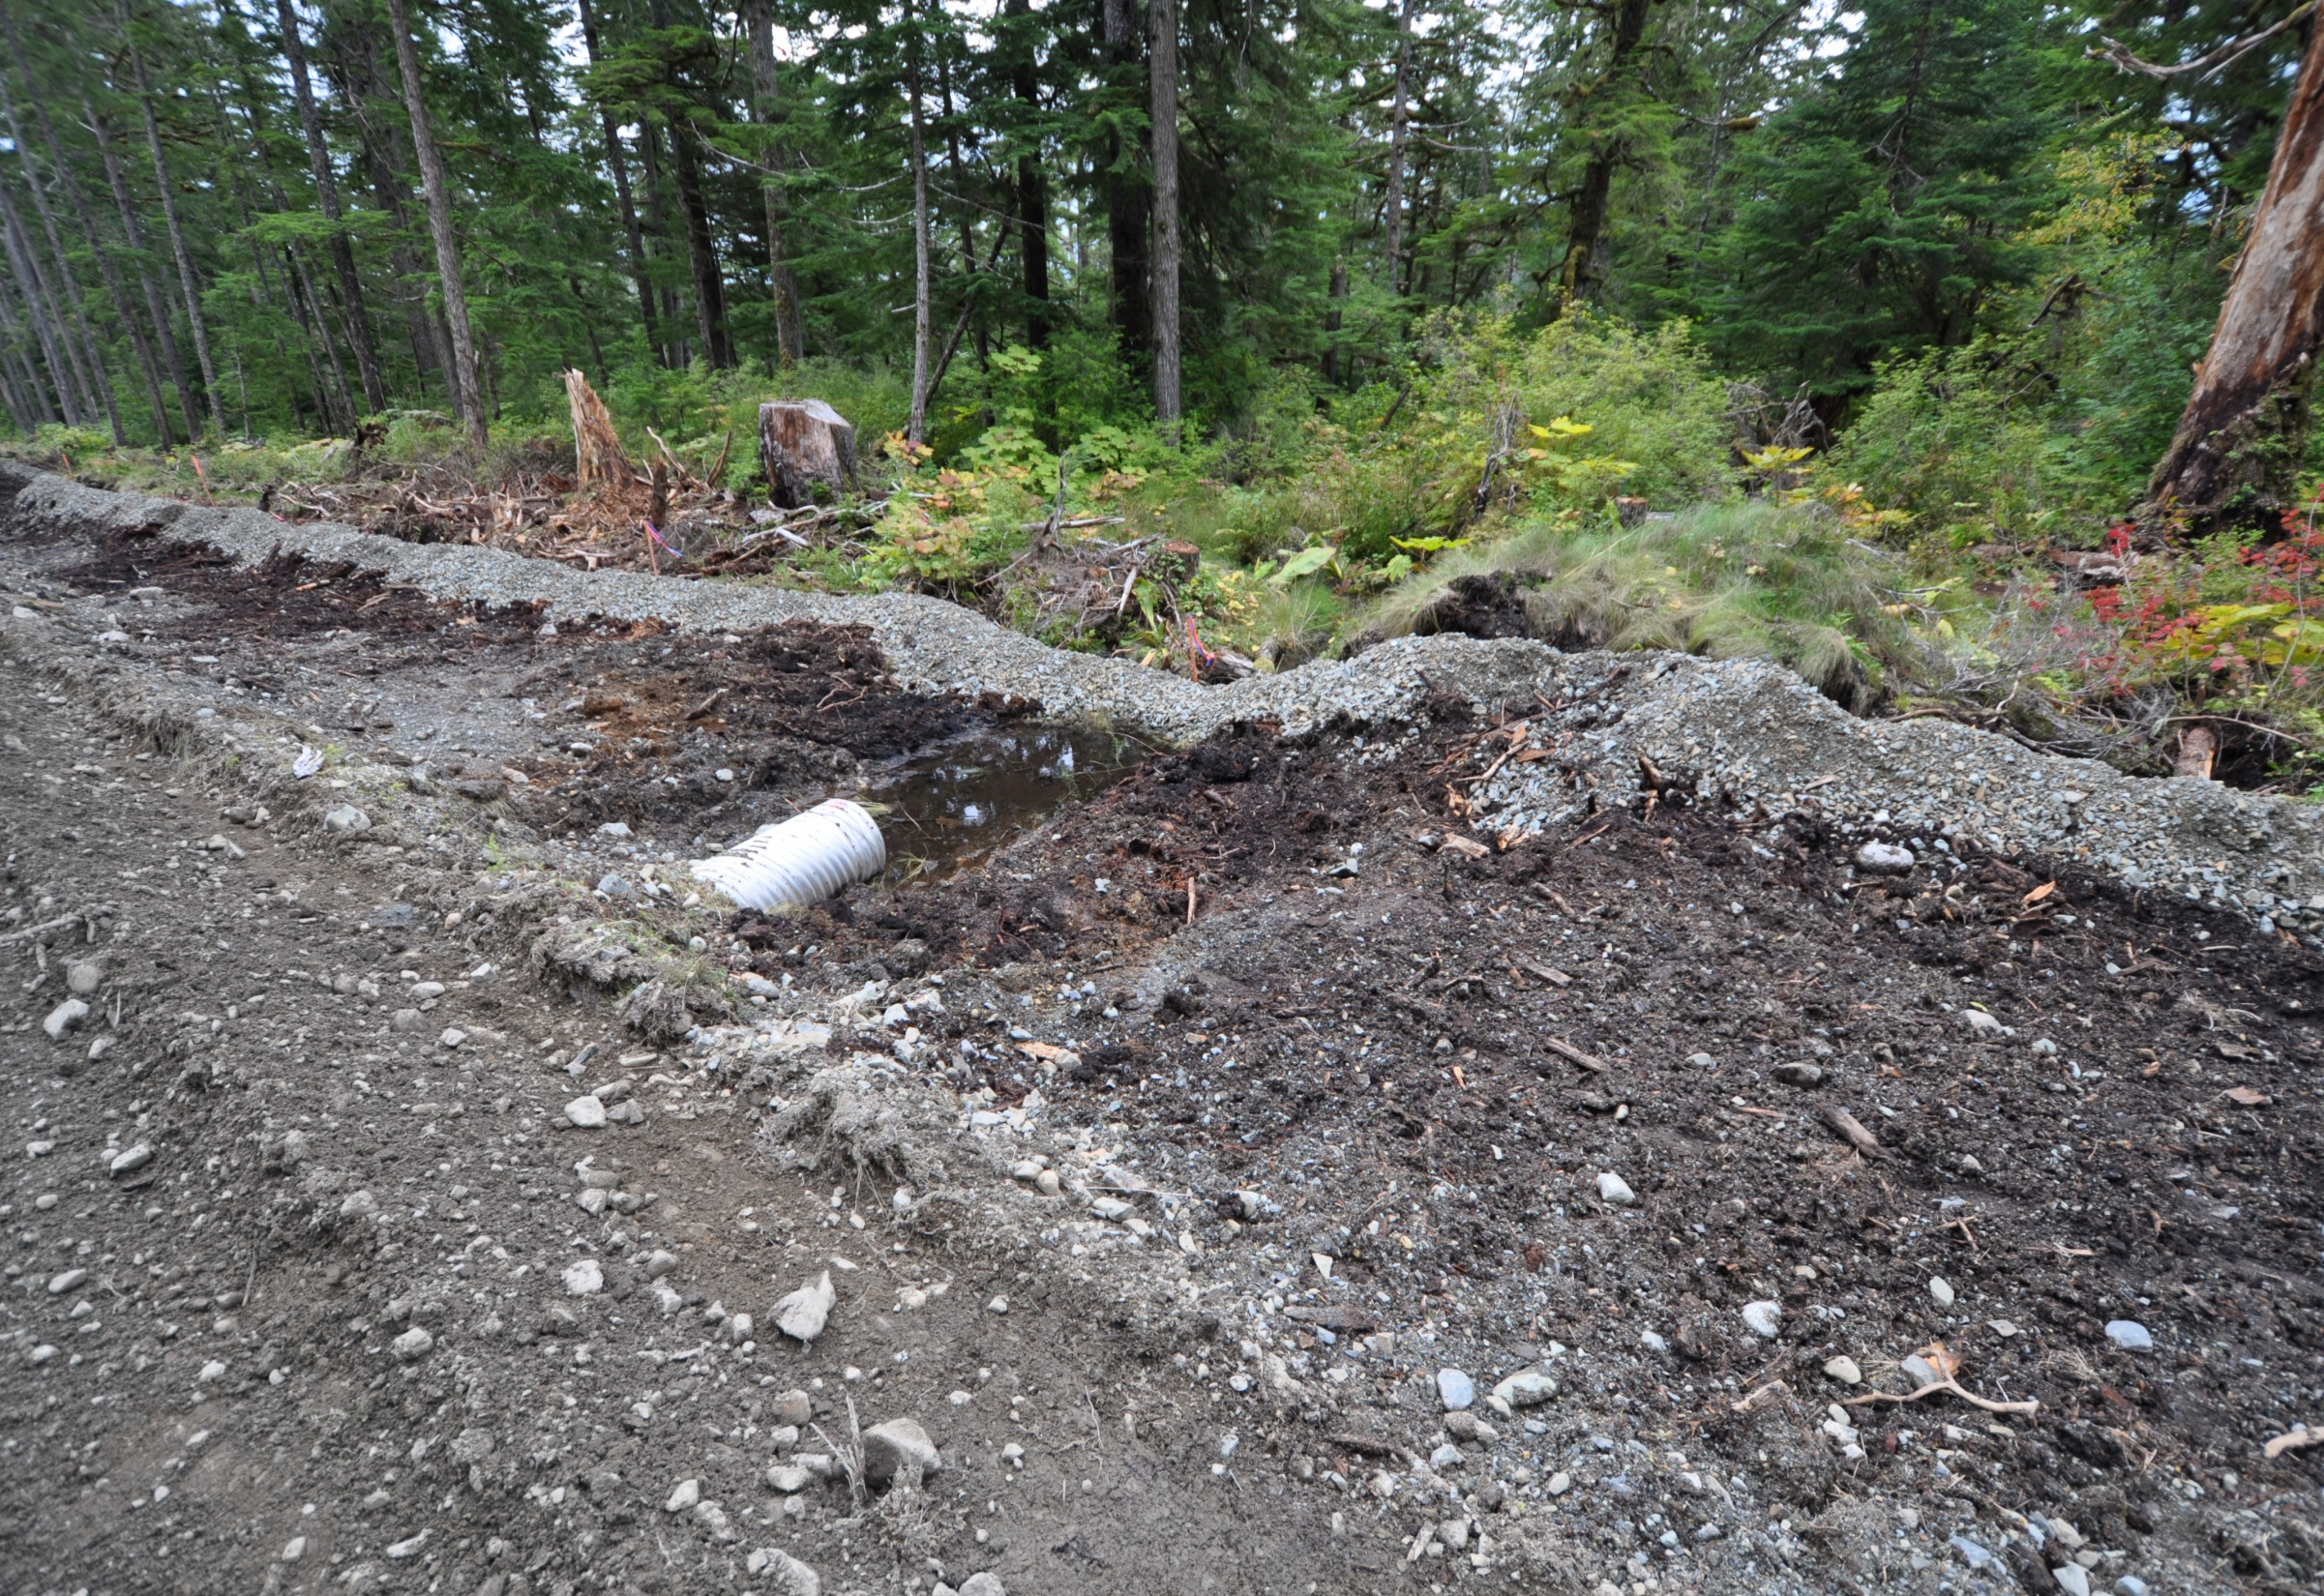
Glacier HWY Juneau

Slide 37
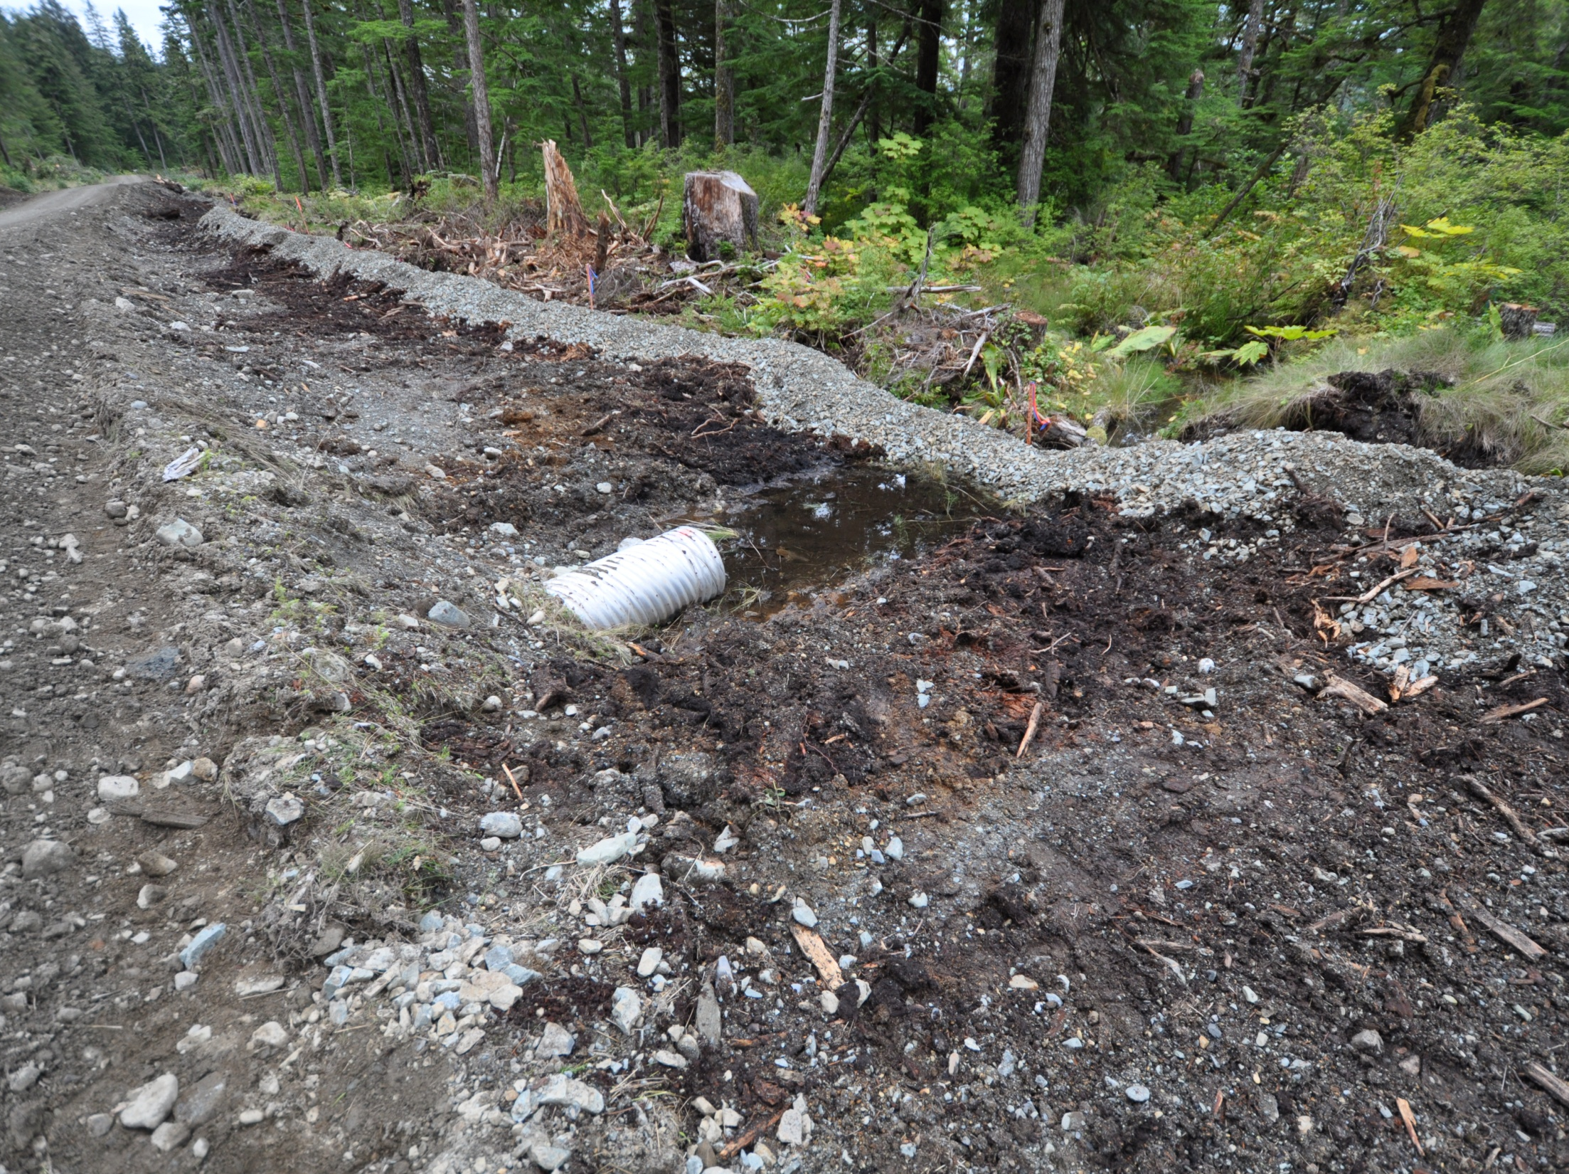
Use riprap that is 4” or greater
Install fabric to prevent soil erosion beneath the riprap
Stabilize all disturbed areas immediately after work is complete
Inspect the outlet after a heavy rain event
Glacier HWY Juneau

Slide 38
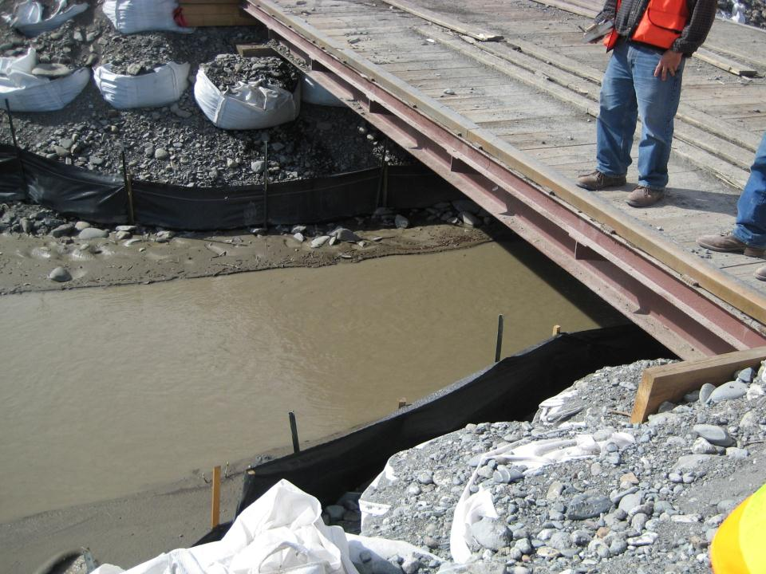
Temporary Crossings
create unique challenges.
Glenn HWY @ Hicks Cr.

Slide 39
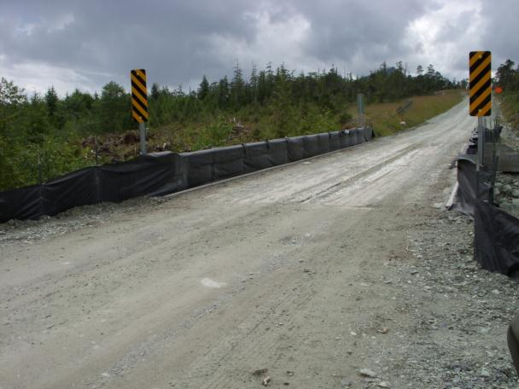
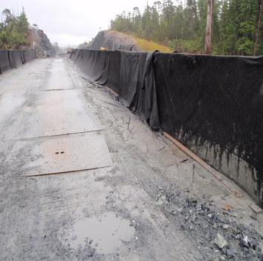
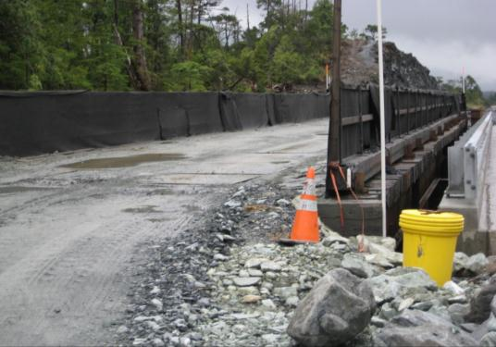
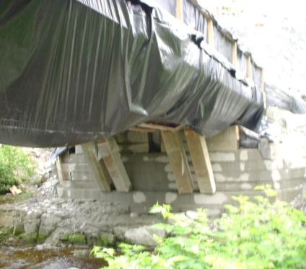
Bridge Deck Perimeter Control
Ketchikan

Slide 40
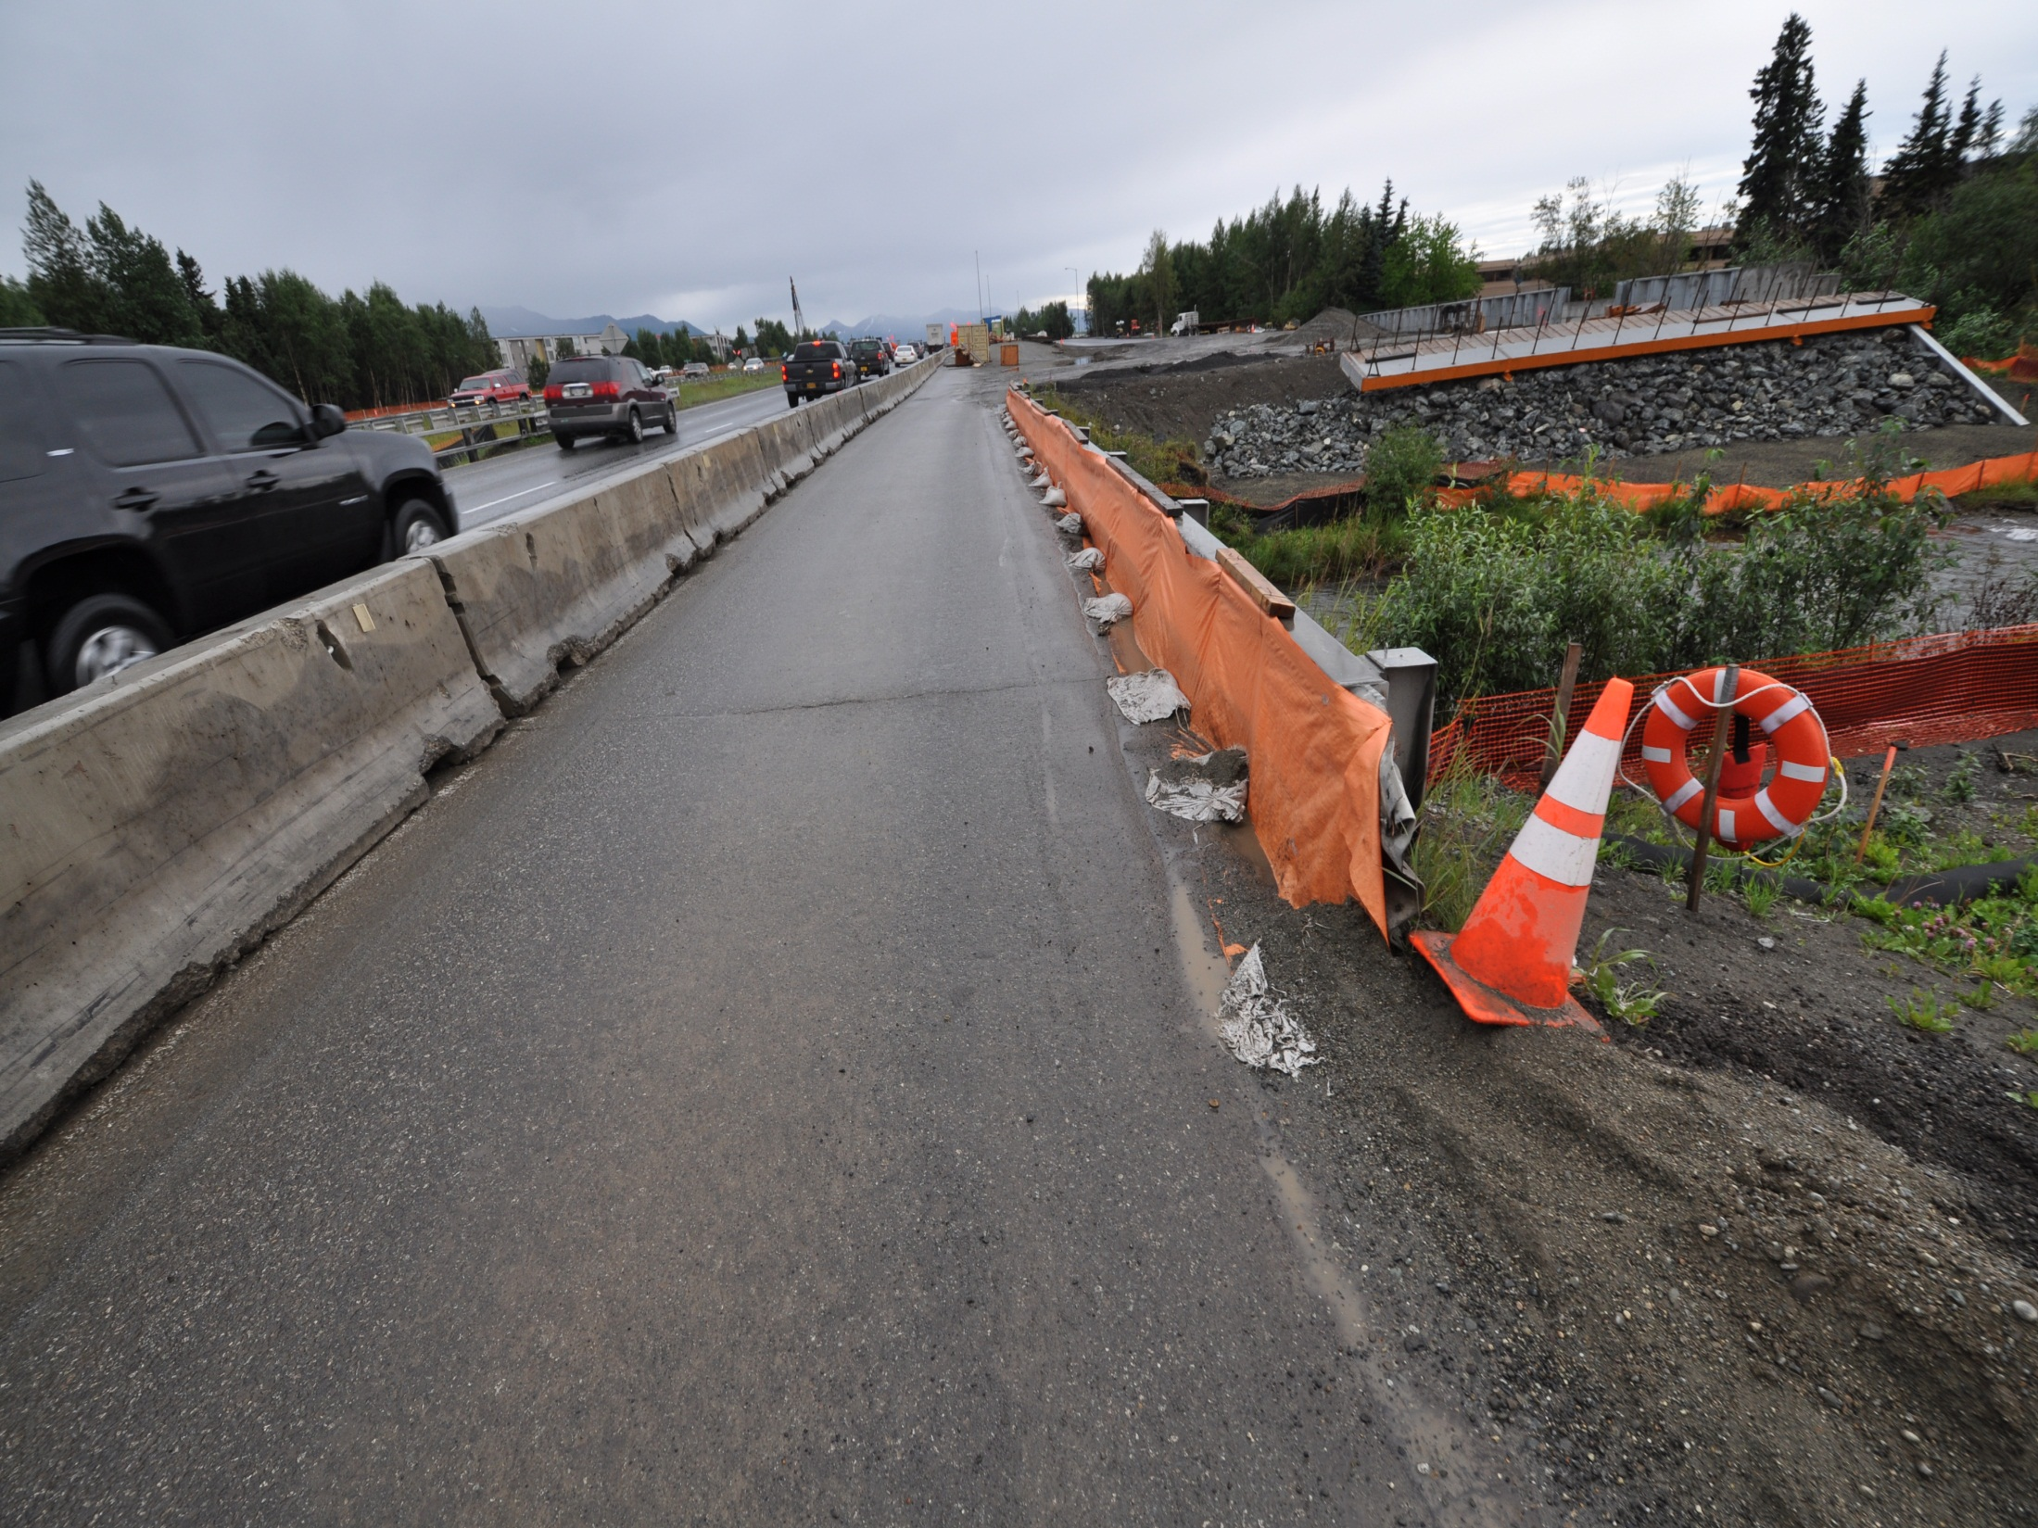
Perimeter Control?

Slide 41
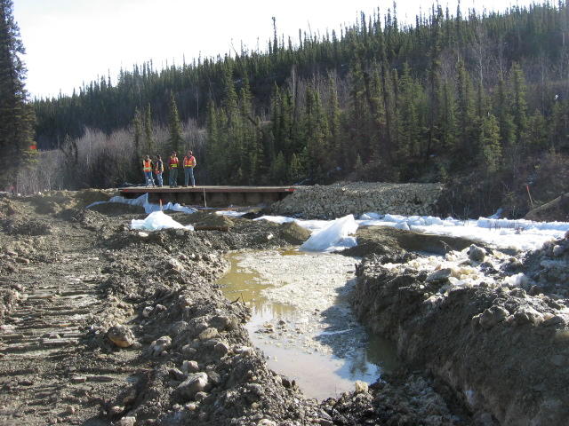
Break Up

Slide 42

Ice Pass Thru & Scour

Slide 43

ALL DISTURBED AREAS (EVEN SMALL AREAS)
MUST HAVE SEDIMENT CONTROLS INSTALLED
Taylor Hwy
Notes:
All runoff from construction activity must pass through a sediment control BMP.

Slide 44




SILT FENCE
Must meet specifications
Sheet flow only
Trench into ground
Pull tight and place ends up slope
Wrap end stakes of adjoining sections
Reinforced and super silt fence
Courtesy DNREC
Notes:
The purpose of silt fence is to temporarily pond sediment laden stormwater to allow settling to occur before runoff passes through the fabric. Silt fence is only effective when used in accordance with the maximum slope length and fence length standards in the E&S Handbook. It is designed to filter sheet flow and should not be subjected to concentrated flows. Due to its availability and relatively low cost, silt fence is frequently used in situations for which it was not designed. The Handbook also contains specifications for the geotextile fabric. Stakes must be 2” hardwood with a reinforcing strip over the fabric. Steel stakes may also be used. The most important installation requirement is trenching and embedding the fabric 8” into the ground. Be sure to drive stakes 16” into the ground, pull the fence tight and place the ends up slope to contain runoff. When two sections adjoin each other the stakes must be twisted and overlapped by six inches, then the fabric stapled to the stake. Reinforced and super silt fence standards and specifications are also contained in the E&S Handbook. The maximum slope length and fence length are significantly greater for these devices.

Slide 45
Insert Video Silt Fence Installation

Slide 46

Behold: The world's most effective silt fence
Nome
Notes:
What exactly is this silt fence doing, comment on the repeated misuse of silt fence in the construction industry.

Slide 47

Silt Fence Installed on Contour
Notes:
The strength is in the length. Create places for deposition to occur.

Slide 48

Silt Fence
Used down slope of disturbed areas
Captures water and sediment
Contains site soils
At grade pond
BMP
WA C-233
OR SC-1
DOT&PF 20.00
Ft. Yukon

Slide 49

Silt Fences Should Not Be
Used for Concentrated Flows
Notes:
Note erosion around the right side as concentrated flows are diverted and forced to a weak point. Instead armor the culvert discharge point and disperse the flow into the receiving area.

Slide 50

Silt Fences are Not For V-Shaped Channels

Slide 51

Silt Fence Sedimentation
Evidence of
Ponding
Sedimentation Behind Silt Fences is Evidence of Proper Siltation
Without Sedimentation Water is Perhaps Flowing Underneath or is Going Someplace Else
When Sediment Accumulates up to 1/3 the Height of the Fence – Clean Out
Notes:
Note Scum Line

Slide 52

Wire Backed Silt Fence
Sand Bag Toe & J Hooks
Ketchikan
Notes:
Sandbags have been used to secure the toe
J Hooks used to slow velocity due to off contour installation.

Slide 53


Sediment control measures must be constructed as one of the first steps in grading. These control measures must be functional before other land disturbing activities take place.
Muskeg Installation
Petersburg
Notes:
They used a chain saw to cut out cubes then replaced the cubes to install the silt fence. So easy a monkey can do it. ( I hope you get a laugh out of the class) Remember it’s all in the delivery.

Slide 54


Maintenance
CGP Part 4.13 Pg. 35
Fairbanks
Notes:
Wire backed Silt fence damage repaired with spray glue and patch

Slide 55

Frozen Ground
Installation
Photo Courtesy Michael Travis
Notes:
Sandbags used for the toe installation. This fence may be a maintenance nightmare, stapled to posts and loose fabric. Note the melting soil ooze.

Slide 56

Silt Fence
Notes:
Air Fence

Slide 57

Compaction of Backfill is Critical
Good Compaction of Backfill is the Most Crucial Element of Proper Installment as it Prevents Saturation & Piping Underneath
Trenches Must Also Be First Cleaned of Debris to Help Avoid Blowouts

Slide 58

Was it inspected?
Do we know how to inspect?

Slide 59

Silt Fence Fabrics Differ Greatly
BMP
WA C-233
OR SC-1
AK 18
If you can see through it
what can get through it?

Slide 60

Longevity
Break Up Survival

Slide 61


Slide 62

Notes:
See SWPPP Guide, Chapter 4, ESC Principle 7 for more information.

Slide 63



Pity the BMP’s on the edge of the earth
Receiving Water
BMP?
Site Discharge
Barrow
Notes:
Make a little fun of silt fence, then introduce alternative method with the wattle

Slide 64


Compost Berm
Perimeter Control
Slope length reduction
Soil Amendments

Slide 65

Down Slope Sediment Controls
Silt Fence
Straw Bale Barrier
Seeding
Temporary BMP’s
Must be removed
Notes:
While we are on straw bales.. How will his be removed? What is its effectiveness? When should it be removed?

Slide 66

Vegetated Strip
BMP
WA C-234
OR EP-2
DOT&PF 38.00
Reduce the transport of coarse sediment
Reduce the runoff velocities of overland flow
Huslia
Notes:
How soon can you put a perimeter of grass around your site? The benefits far outweigh the costs.

Slide 67




Frozen Arctic Perimeter Controls
Snow Berms
Kotzebue
Notes:
Snow berm is built about 6 feet high for winter perimeter control

Slide 68

Stabilized Construction Vehicle Access & Exit Points
CGP Part 4.3.4 Pg. 26
Rattle Racks
A permittee must establish construction vehicle access and exit points and they must be stabilized.
Anchorage
Notes:
Trackout is extremely dirty when rain washes it off – Regulators will be looking at this very frequently – perhaps the most public construction erosion control problem there is.

Slide 69

Stabilized Construction Vehicle Access & Exit Points

Slide 70





Establish stabilized transitions to roadways &
construction exits
Notes:
Video Clip “AK Rumble Strip”

Slide 71

CGP Part 4.3.4 Pg. 26
If sediment escapes the construction site, off-site accumulations of sediment must be removed at a frequency sufficient to minimize off-site impacts.
Notes:
Juneau

Slide 72

A permittee must provide an effective way of removing sediment from wheels to prevent trackout.
Anchorage
Notes:
You can’t remind people enough about housekeeping.

Slide 73

CGP Part 4.353 Pg. 26
Vehicle Track-Out
Where sediment has been tracked-out from a site onto paved roads, sidewalks, or other paved areas outside of the site, remove the deposited sediment by the end of the same business day in which the track-out occurs or by the end of the next business day if track-out occurs on a non-business day.

Slide 74

Keep the Rubber on the Rock!
*Hint Use Clean Rock
Notes:
Believe it or not this is rock that showed up for use as a construction exit.

Slide 75

USE CLEAN ANGULAR ROCK & MAINTAIN
FOR EFFECTIVE PERFORMANCE
Notes:
Wash rock before usage – place materials underneath to keep mud & dust from creeping up

Slide 76

OVER-EX FOR ROCK & PLACE
SEPARATION FABRIC
Notes:
Can I just bury this when I’m done?

Slide 77

Notes:
Smaller sites may need to adjust the size of the entrance. Did we skimp on the fabric here?

Slide 78

Construction Road & Parking Area Stabilization
BMP
WA C-107
OR SC-10
AK - 21
Notes:
Don’t let unnecessary tires on the dirt.

Slide 79

Parking of Vehicles
Willy - Nilly Does Not Help

Slide 80


Uncontrolled Construction Access are Major Sources for Stormwater Pollution

Slide 81



Mud Mats
Eagle

Slide 82

SINGLE FAMILY RESIDENCE
Individual Construction Entrance
Notes:
All subcontractors should keep vehicles on the rock.
Do we need to straw the bare soils?

Slide 83

LARGER SITES WITH MORE TRAFFIC
NEED LARGER & LONGER ENTRANCES
PERFORMANCE GOALS:
No off site tracking to adjoining streets!

Slide 84




Inspection / Corrective Action
Notes:
Like any BMP construction entrances need maintenance.

Slide 85

Clean Site
Safe Site
Productive Site

Slide 86


Modified Rumble Construction Entrance
Ingenuity in action
Fairbanks

Slide 87

Clean Up As You Go!
Public Roads Must Be Kept Clean
Dirt Must Be Disposed of in Areas With Sediment Controls
Staining vs. Tracking
Rock Entrances Need to Be Maintained
Good Housekeeping
Notes:
Clean up as you go.

Slide 88


Everyone has a role to play

Slide 89

Be Prepared to Clean up any tracking
Juneau

Slide 90

Describe the corrective action
Notes:
If the tracking is within my project limits is this ok? Answer no, when this washes into a storm system or the receiving environment we will be in violation.

Slide 91

Dust Generation
CGP Part 4.3.6 Pg. 26
A permittee must minimize the generation of dust through the application of water or other dust suppression techniques and prior to vehicle exit.

Slide 92

Wind Erosion
Temporary Irrigation
Compaction

Slide 93

Dust Generation &
Track–Out from Vehicles
CGP Part 4.3.6 Pg. 25
Dust & Mud are Cousins
Dust Becomes Stormwater Pollution During Rain Events

Slide 94

Plan Ahead for Dust Control!
Water Should Be Applied Prior to Construction Activity
Dust Suppressants Cannot Handle Heavy Equipment Traffic
Surfactants Can Increases Moisture Penetration
Minto

Slide 95

DUST CONTROL
Employee & Public Health Concerns
Notes:
Dust control is also required for compliance with the CLEAN AIR ACT.

Slide 96

Equipment Operation for Dust Control
Keep Loader Close to Truck When Emptying
Mix Water & or Surfactants With Clay/Silt Soils
Avoid Construction Activity During High Winds
Barrow

Slide 97


Drive Slowly & Cover Loads With Tarps

Slide 98

Demolition Dust Control
Apply Water to Demolition Debris
Make Sure that Water Does Not Become A Stormwater Pollutant

Slide 99

Perimeter Wind Barriers
In Areas Wind Barriers May Sometimes Be More Appropriate Than Silt Fences
Use Wind Barriers to Help Protect Bare Soils from Blowing Away

Slide 100

Stockpiles
CGP Part 4.3.7 Pg. 26
A permittee must stabilize or cover stockpiles, protect with sediment trapping measures, and where possible, locate stockpiles away from drain inlets, water bodies, and conveyance channels.
Install sediment control measures along all downgradient perimeter areas Sea-Tac
Notes:
Sandbags must be placed every 10 feet to keep it from blowing away & watch out for seams so that water does not get underneath them.

Slide 101

Stockpiles
Keep Stockpiles From Impacting Stormwater
Cover Stockpiles
Provide sediment controls
Taylor Hwy

Slide 102

How Much Maintenance Do You Want to Do?

Slide 103

Plastic Covering
Immediate, short-term erosion protection to slopes and disturbed areas.
Cut and fill slopes and stockpiles.
Over newly-seeded areas
Install water collection measures at the base of the slope
Don’t mix clean runoff from plastic with dirty runoff
Other uses for plastic include:
  Temporary ditch liner
  Pond liner in temporary sediment pond;
  Liner for bermed temporary fuel storage area
  Emergency slope protection during heavy rains
Source Control BMPs
BMP
WA C123
OR NS-9
DOT&PF – 12.00
Notes:
Can be maintenance intensive. Protect from blowing away.

Slide 104

Photo Courtesy David Jenkins
Notes:
Where will the increased energy and flow go? Porta potty location if it tips over?

Slide 105

Plastic Cover
Sandbags on 10’ Centers
String “Net” Connections
WA BMP C-123

Slide 106

Authorized Non-Storm Water Discharges
A permittee must minimize any non-storm water discharge
authorized by this permit.
CGP Part 4.3.8 Pg. 26

Slide 107

Non-Stormwater Discharges
Identify pollution prevention measures to ensure that pollutants are not introduced to these discharges and carried to nearby waterbodies.
Water line flushing
Dust Control
Vehicle wash water without detergent
North Pole

Slide 108

CGP Part 4.3.9 Pg. 26
Sediment Basins
10 acres of contributing drainage requires a sediment basin
Volume must equal 2yr 24hr storm event
Note: No installation of sediment basins should be installed in permafrost areas.
Wasilla

Slide 109

Sediment Basins
Stormwater Runoff Shall Be Controlled
Stormwater May Require Onsite Detention, Sediment Pond/Trap, Before Discharge Offsite
Site Area - 10 or more acres
Must provide storage for a 2-year, 24-hour store
Notes:
These are some “rules of thumb” for design guidelines. Use this slide to reinforce how hard it is to control sediment with a pond.Oregon, Damage to highway near Mt. Hood Meadows 11-06

Slide 110

Runoff Conveyance and Treatment BMPs
Temporary Sediment Pond
Contributing drainage area is 10 acres or more
Removes coarse sediments only
BMP
WA C-241
OR SC-9
Notes:
Pond with gravel filter weir.

Slide 111


Runoff Conveyance and Treatment BMPs
Sediment Trap
Small temporary ponding area with a gravel outlet
Used to collect and store sediment
Drainage area is less than 10 acres
Design life of approximately 6 months
Removes coarse sediments only!
BMP
WA C-240
OR SC-9
Juneau

Slide 112

Sediment Basin Limitations
Sediment Pond/Traps Cannot Filter Out Fine Sediments
Stormwater Discharges from Sediment Pond/Trap Can be Pumped Back Onsite for Increased Treatment
Remember that Sediment Ponds May be Designed for Post Construction Landscaped Areas – Not for Construction Activities

Slide 113

Key Points
Runoff from Disturbed Areas:
Must pass through sediment pond or other sediment removal BMP before discharge
Runoff from Stabilized Areas:
May be discharged off site without sediment control BMPs but must adhere to Flow Controls
Design Criteria:
Volume ~ Acreage
Land Use ~ Precipitation
Notes:
Were the sediment controls on your project designed to handle the flows?
What was the land use practice modeled for volume? What was the design storm event?

Slide 114

Ketchikan
Notes:
Channel Lining Silt Fence Baffles
Note the elevation of the baffles relative to the desired flow line. The outlet of this pond is to high or the silt fence is too low or the flow rate is too great. This is why it’s so important to “watch the water”

Slide 115

Silt Fence
Sediment Bag
Baffles
Outlet
Inlet
Ketchikan
Notes:
Note deposition in the fore bay. Long flow length, Geotextile filter bag, Perimeter silt fence, existing vegetation, elevation of outlet and top of silt fence baffles.

Slide 116
Control Measures
Dewatering
CGP Part 4.4 Pg. 27
* Other Control Measures May Be Used
Notes:
1.4.2 deals with what is permitted. 4.3.2 is an almost all inclusive list of what is an “appropriate” control measure.

Slide 117

Excavation dewatering that may adversely impact a local drinking water well, a DEC-identified contaminated site or groundwater plume, or waters of the U.S., may be required to obtain the DEC General Permit for Excavation Dewatering permit.
CGP Part 4.4.1 Pg. 27

Slide 118

What is Dewatering?
Dewatering may be difficult
But it’s not impossible!
Notes:
Dewatering is when we pump from a constructed excavation.

Slide 119

Diversion
Notes:
Diversions may be constructed and stabilized and not involve any dewatering.

Slide 120

Pumped Diversion
Notes:
Diversions can be pumped and not involve dewatering. This is simply putting the water that drains through the creek bottom cobble back in to the constructed diversion.

Slide 121


Curb Appeal?
Notes:
This is pumping from the excavation, this is excavation dewatering, note there is no perimeter control between the disturbed construction site and the flow.

Slide 122

Diversion would intake here
We build it
We stabilize it
Notes:
This intake location could be a diversion.

Slide 123

This is Excavation Dewatering
Not a Diversion
Pump is drawing from the excavated area.
Flow is over constructed area
Notes:
This is the upstream view. This water is running into the project from offsite.

Slide 124

Consider the permit minimum measures
Dewatering
Soils Stabilization
Waterbody Protection Measures
Down Gradient Sediment Control
Notes:
When inspecting always keep in mind the minimum measures we have gone over throughout the day.

Slide 125

CGP Part 4.4.2 Pg. 27
Appropriate control measures include, but are not limited to, sediment basins or traps, dewatering tanks, weir tanks, or filtration systems designed to remove sediment.

Slide 126

Control Dewatering
Plan the dewatering activity
  Have an approved method
  File NOI for DEC permit if necessary
  Involve the approval agency
  Monitor dewatering operations

Slide 127

Have a Plan!

Slide 128

Control Dewatering
Trench/Foundation Dewatering Shall Be Infiltrated, Conveyed, or Controlled Onsite by Proper BMPs
Clean Well Water Can Be Discharged into Surface Waters if it Does Not Cause Increased Flows or Erosion

Slide 129



Making Clean Water Dirty
Courtesy DNREC

Slide 130

Dewatering Well
Notes:
STORY SLIDE: Note clean water near well standpipe

Slide 131


Dispersal & Infiltration
Notes:
All trench & foundation watering shall be properly infiltrated on site – a good reason to keep a natural vegetated area for filtering water

Slide 132

Foundation Dewatering & High pH

Slide 133

IS THIS WORKING?
Bag 3
Bag 1
Bag 2
Hay Bale Dam
Notes:
Bags are limited to the filter fabric apparent opening size, “the pore space”
When they clog the can explode and discharge all the captured sediment.

Slide 134

Juneau

Slide 135

Sediment Bag

Slide 136





Notes:
Different ways to us filter bags to augment your sediment controls.
Keep in mind the eventual bag removal.

Slide 137

Notes:
Filter bag attached to culvert for sediment collection.

Slide 138



Invasive Species
USDA defines an invasive plant as a species that is non-native or alien to the ecosystem.
  Noxious Weed: An invasive plant species so aggressive that legal action has been taken to prevent their introduction and spread
  Can be terrestrial or Aquatic
  Invasive species can be plants, insects, animals, fungi, or bacteria.
  In Alaska. invasive plants are the most common problem for projects.
  Easily spread by recreational and industrial equipment, wind, water, animals, floatplanes, and imported goods.
Vicia Cracca – Tufted Vetch found at most construction sites throughout AK

Slide 139



Impacts of Invasive Species
Cost Alaskan agencies , non-profits and private land managers 29 million from 2007-2011 to manage invasive species.
Invasive species adversely affect biodiversity and can lead to the extirpation or even extinction of native species, can alter fire cycles, and (non-plant species) can cause or spread diseases
Can devastate industries, including fisheries, agriculture, and recreation.
Can destabilize soil and alters hydrology and water quality of stream, rivers, lakes, and wetlands.

Slide 140



Manage Invasive Species at Work Sites
Identify noxious and other invasive species of concern at the project site.
  There is an ID app (Alaska Weeds ID), a website (https://accs.uaa.alaska.edu/invasive-species/non-native-plants/ ), and groups that can help (AKISP and local CWMAs and SWCDs).
Report any invasive species: 1-877-INVASIV
Contact DNR Division of Agriculture Plant Materials Center in Palmer for proper management and disposal.
Use Alaskan-certified material that is weed-free.
Prevent the spread of invasive plants during construction by not washing vehicles & equipment between sites, using certified weed-free gravel and BMPs.
Promote growth of native species.
Monitor site.
907-745-8721
Notes:
Imported topsoil or compost obtained from outside the project limits. Both are typically used for highway planting projects rather than for erosion control work. Be careful about invasive species.
Prioritize: Where invasive species are present on a site thin and burn to help control invasive before work begins.
Don’t transfer seeds of many invasive species are easily carried by vehicles.

Slide 141
CGP Part 4.6 Pg. 30
Treatment Chemicals
Requires:
Manufacturer MSDS Sheets
Trained employees
Site specific soil testing for treatability

Slide 142

CGP Part 4.6 Pg. 30
Application of Treatment Chemicals
The application of treatment chemicals shall be in combination with appropriate physical control measures (e.g., rolled erosion control products, ditch check dams,
sediment basins, sediment bags, filtration, etc.) to ensure effectiveness of the treatment chemical.

Slide 143



Additional PAM Applications
Courtesy DNREC

Slide 144
Flocculation
Chemicals flocculate suspended sediment by binding to several soil particles forming a larger aggregate or floc

Slide 145
Flocculation
The large flocs then settle out of suspension or are filtered.

Slide 146


    Project Site Conditions
Jar testing for treatability & dose rate
Mixing
Plan for sediment retention
Notes:
Jars left to right go from sand to clay. Dose rate for sand is less, but you need to remove the sand prior to chemical treatment (filter, settle).

Slide 147

Bench Testing
Chemicals & Dose Rates
Notes:
Bench scale testing is critical for proper chemical and dose rate selection

Slide 148




1 Drop 2 Drops Control
1 Drop 2 Drops Control
1
2
1 Drop 2 Drops Control
1 Drop 2 Drops Control
3
4
Notes:
Note elapsed time and the suspended solids that will settle by gravity if given enough time.

Slide 149

1 Drop
2 Drops
Notes:
2 drops makes little difference to water quality but created larger flocs, how will this affect our CTS efficiency? Always use the lowest dose rate that will cause flocculation.

Slide 150


Simple pH
Remediation System
CO2 Injection
Notes:
Some chemical flocculants performance is limited by pH. Some regulations control pH parameters in discharge. State water quality standards and the CGP.

Slide 151

pH
Adjustment
Remediation
Controller
Notes:
pH remediation controller reads influent & effluent to regulate the CO2 gas injection.

Slide 152


CO2 Injection
pH Sample Line
Notes:
Two bubblers are locater in the mixing pipe. The results are measured after the settling tank and filters prior to discharge.

Slide 153

Floating Suction for Shore-Side Pump
8-inch PVC pipe float
90⁰ Elbow
Suction hose
To pump

Slide 154
Floating Suction for Shore-Side Pump
8” PVC floatation pipe
Top View
Suction pipe
To pump
2”x 4” braces
Suction pipe
To pump
Water level
8” PVC Floatation pipe
Side View
Submerged suction

Slide 155

Floating Barrel Surface Suction

Slide 156

Example of Passive Dosing CTS
Dewatering
Discharge
12” corrugated pipe w/
solid flocculant inside
Stabilized outlet
Rock baffle
Notes:
Pumped water dissolves the flocculant, either in socks or solid blocks, as it passes over it. The pipe both mixes and protects the flocculant from drying. The number of socks or blocks is adjusted to achieve acceptable performance.

Slide 157



Effect of Flocculant
Pumping with no flocculant
12:03
Flocculant pump turned on
12:14
Clear water from bag
12:26
Notes:
Note how the bag inflates once flocculation is started. This is because the flocs clog the pores, so the bags need replacing more frequently.

Slide 158

If the permittee plans to use cationic treatment chemicals or an active treatment system (as defined in Appendix C) they must submit a request fourteen days in advance of proposed usage.
CGP Part 4.6.7 Pg. 31

Slide 159

Petersburg, Alaska Runway Safety Area
A Case study in Passive Treatment
Notes:
Note discharge was to land.

Slide 160
Notes:
PAM applied to road surface to bind fine sediment on the haul road

Slide 161

Dry application of PAM
Notes:
Using a fertilizer spreader to distribute the PAM

Slide 162


Slide 163

PAM on haul road surface
Notes:
View of the application rate of the granule PAM

Slide 164

Haul Road Sediment Trap
Notes:
Must provide sediment retention for all treated sediments. This filter fabric trap collects the runoff from the haul road that has been treated with PAM and retains the sediments.

Slide 165

Dewatering Source
Notes:
Pump intake in the excavation area
165

Slide 166

Dispersal System
Notes:
Dispersal system can use one chitosan sock or up to four depending on the influent turbidity and the required dose rate.
166

Slide 167

Wire Backed Perimeter Silt Fence
Notes:
Provide for sediment retention in the project area
167

Slide 168

No Chitosan
Notes:
168

Slide 169

With Chitosan
Notes:
169

Slide 170

Notes:
Added the filter fabric sediment retention for sediment capture
170

Slide 171

Sediment Trap
Notes:
171

Slide 172

Intake Weir Pond Perimeter
Notes:
172

