Slide 1
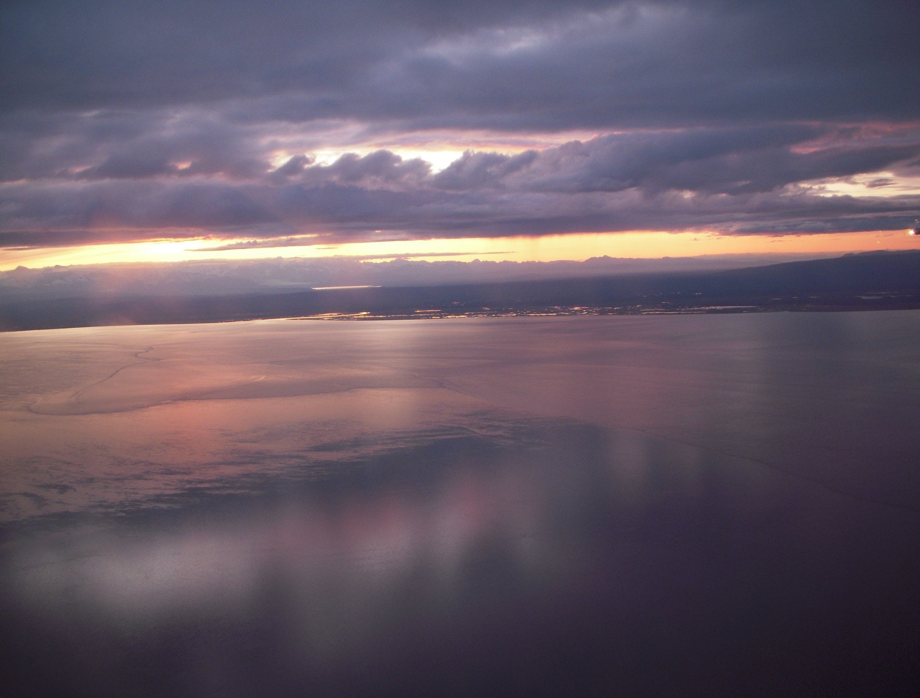

6. SWPPP Basics for Inspectors
What information is required?
How does the SWPPP document compliance?
What are the inspector’s responsibilities?
January 2022

Slide 2
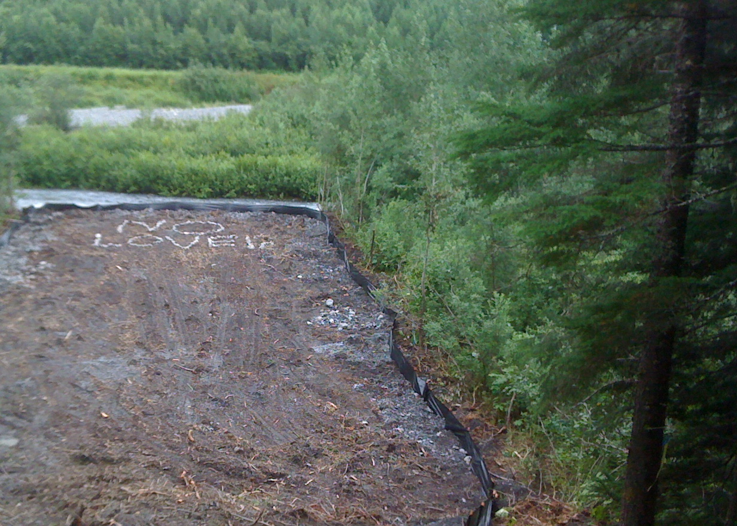
SWPPP Review
SWPPP Basics
SWPPP Goals
Amendments & Updating
Common Problems

Slide 3
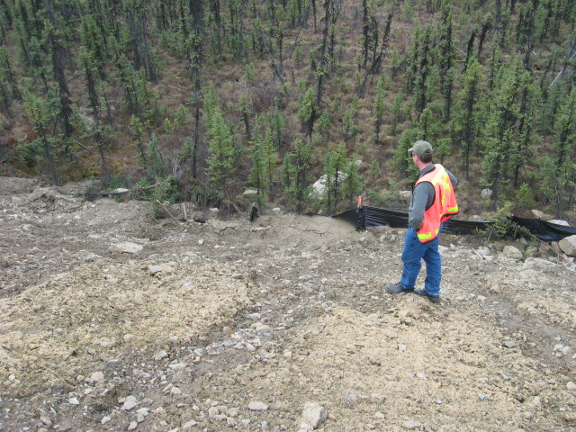
Inspector SWPPP duties
Are we following the plan?
Do any BMPs need maintenance?
  Have you reviewed the BMP details and specs?
Should any BMPs be replaced?
Are additional BMPs necessary?
Notes:
Remind every one that as an inspector they are assessing the SWPPP implementation and performance.

Slide 4

A Strong SWPPP Needs Strong Bones!
Consider that the SWPPP needs to provide the rationale for the decisions that were made.
Design
Schedule
BMPs
Can you defend your research & decisions?

Slide 5
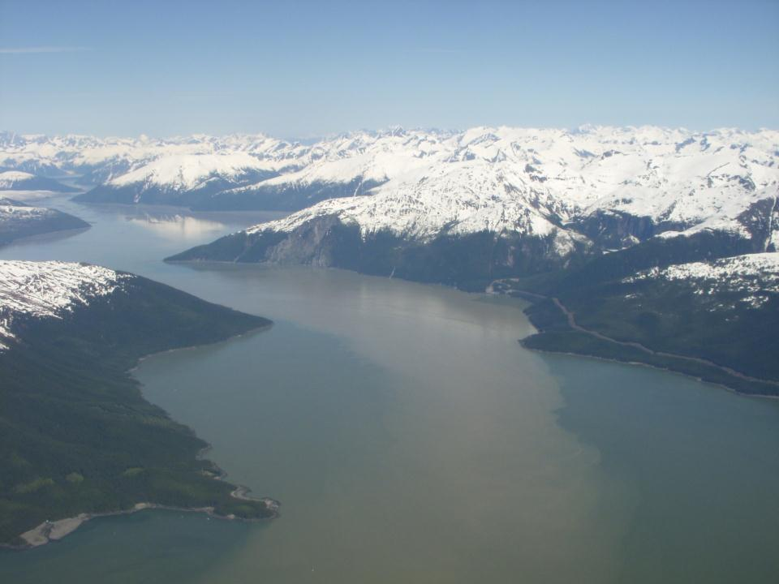

2021 CGP 3.1
Attainment of Water Quality Standards
3.1 Requirements for all Projects
A permittee must select, install, implement, and maintain control measures (described in Part 4.0) at the construction site to minimize the discharge of pollutants as necessary to meet WQS’s (18 AAC 70).

Slide 6

Section 1 – General Information
Insert Company or Organization Name
Insert Name
Insert Address
Insert City, State, Zip Code
Insert Telephone Number
Insert Fax/Email
Insert Area of Control
1.0 Permittee
1.1 Operator(s)/Contractor(s)
1.2 Subcontractors
SWPPP Template
CGP Section
2021 CGP 5.3
Notes:
Point out that we are citing two documents, the ADEC SWPPP Template and the CGP.

Slide 7
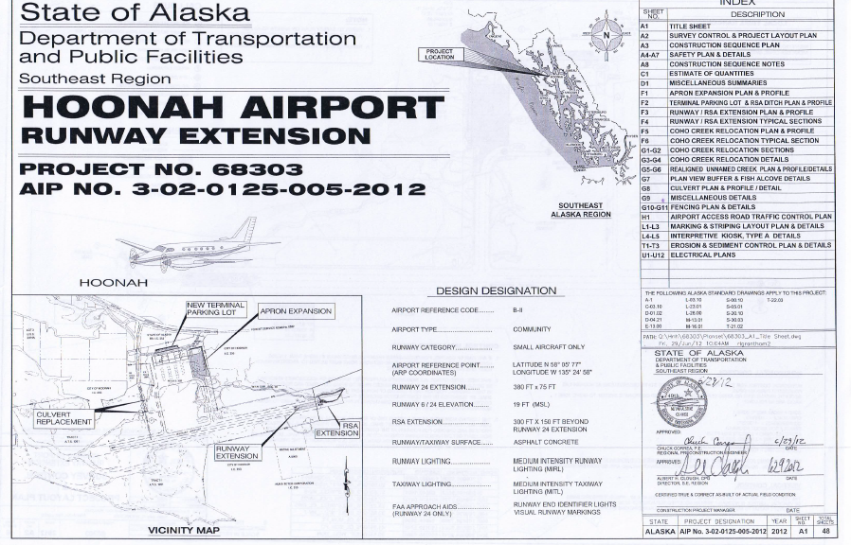

Project Information Section 3.0
Project / Site Name:
Project Street / Location:
City: State: Zip code:
Borough or Subdivision:
Latitude / Longitude:
Hoonah Airport Runway Extension
Airport Road
Hoonah Alaska 99829
None
N 58° 05’ 77” W 135° 24’ 58”
LATITUDE 58.10472
LONGITUDE -135.41611

Slide 8
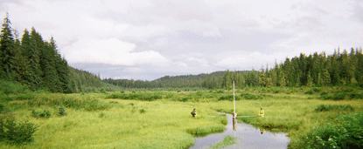
3.2 Project Site Specific Conditions
CGP 5.3.3 Project Site-Specific Conditions
Briefly describe the existing site-specific conditions, including:
5.3.3.1 The mean annual precipitation based on the nearest appropriate weather station;
5.3.3.2 Site conditions such as soils, topography, drainage patterns, approximate growing season, and vegetation; and
5.3.3.3 Receiving waters, such as impaired waters or waters listed in the Alaska Department of Fish &Game (ADF&G) Anadromous Waters Catalog.

Slide 9
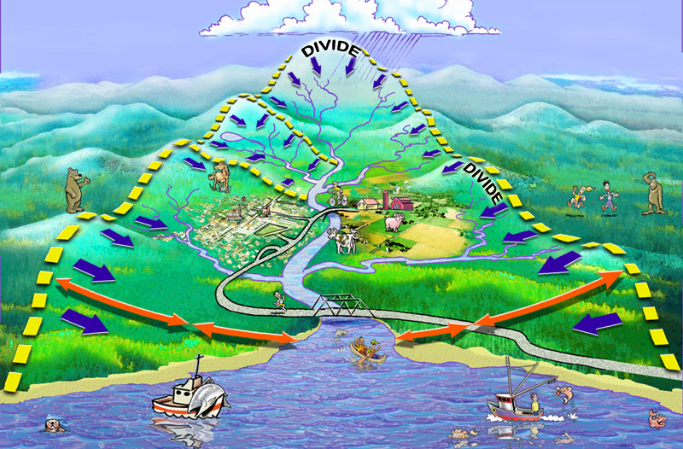
Exactly how does water move through the site?
Run On
Conveyance
Concentration
Discharge
How might the movement of water change during construction?

Slide 10
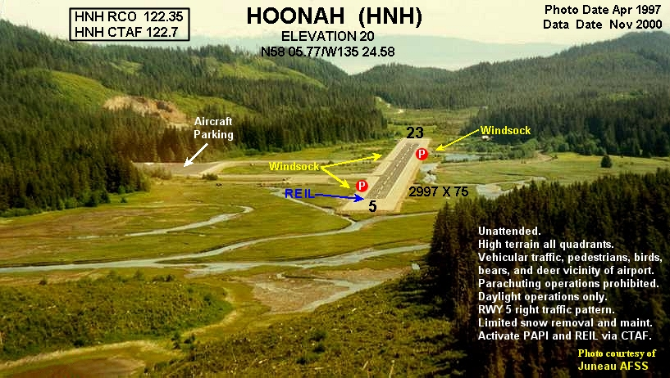
4.0 Nature of Construction Activity
CGP 5.3.4.1 The function of the project (e.g., low density residential, shopping mall, subdivision, airport, highway, etc.);

Slide 11
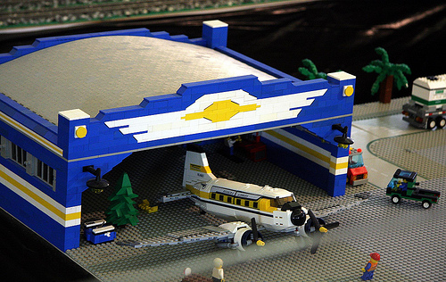
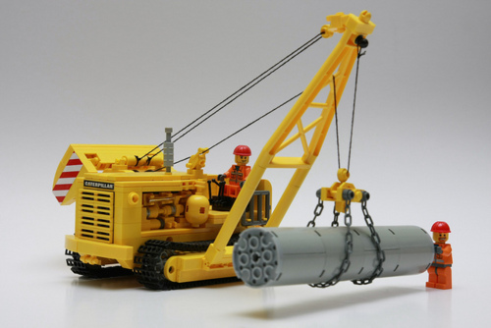
It’s an Airport
What are we doing?
  Replacing Culverts / Mitigation
  Extending the Runway Safety Area
  Expanding the Apron & Parking Areas
Notes:
The SWPPP needs to state what we are doing

Slide 12
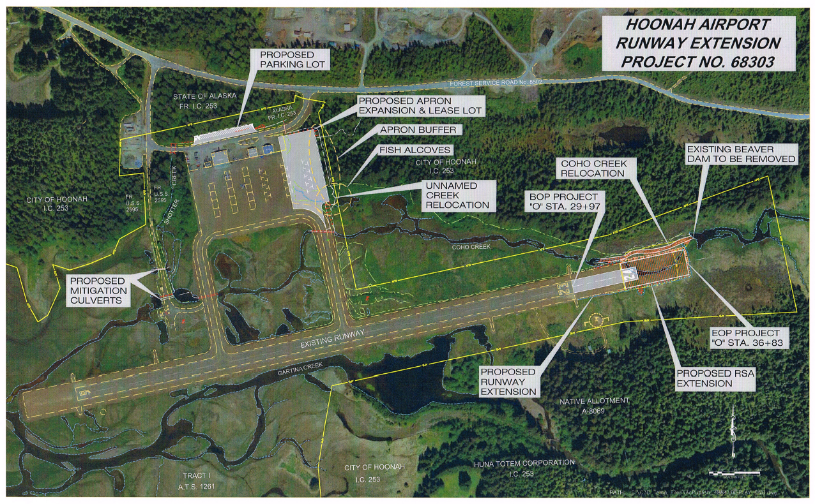
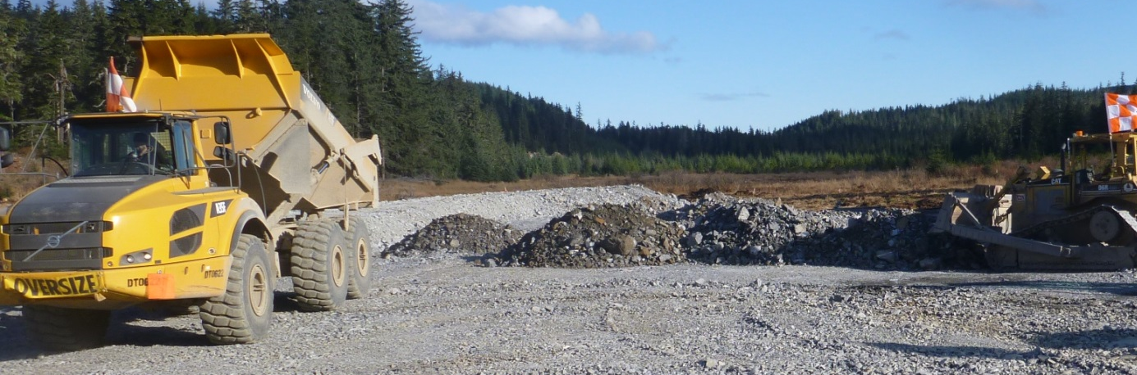
4.1 Scope of Work
Describe where and how you are going to do what you’re going to do!
Culvert Replacement
Creek Realignment
Runway Safety Area
Apron Expansion
Parking Expansion
Hoonah
Notes:
The tasks and locations are on the map, knowing how the work will be done is critical for a AK-CESCL. The picture is of the fill at the end of the runway going in.

Slide 13
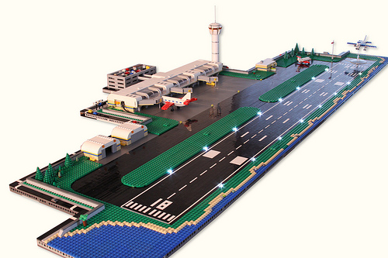
4.2 Project Function (5.3.4.1)
Why are we doing it?
  Improved safety
  Improved use, humans & fish

Slide 14
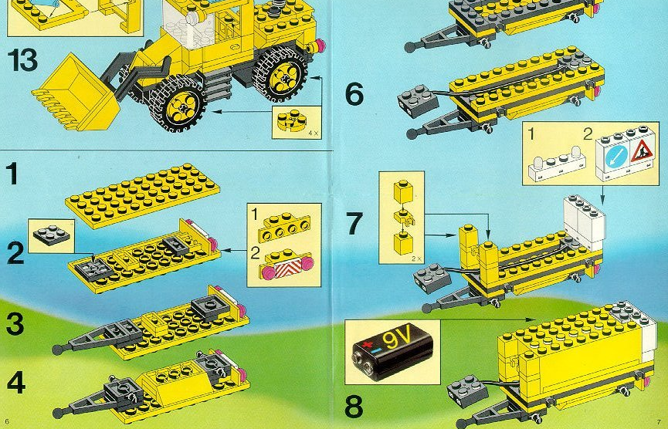
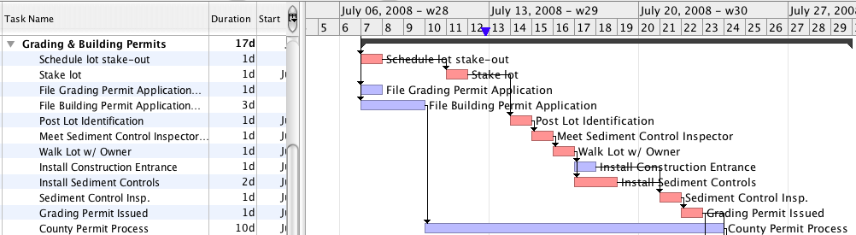
Schedule - Sequence - Critical Path
Sequence and Timing of Soil-disturbing Activities
“Prior To & Upon Completion Of ”
Phasing
Contractor Involvement
Opportunities
Liability - Assets
It’s A Step By Step Process.
Notes:
Note that for most items on a critical path there are prior to and upon completion elements, BMP’s, that can be implemented. Look for the opportunity to turn areas of the project that will be liabilities into assets, like soils that will be exposed for long periods, or conveyances that could start flowing water and implement BMPs or complete the project elements earlier to reduce risk and even make an asset for the project.

Slide 15
The intended sequence and timing of activities that disturb soils at the site;
2021 CGP Pg. 37

Slide 16
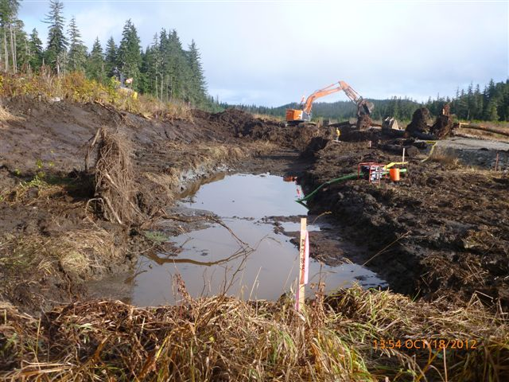
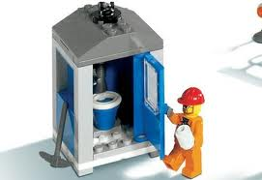
Identification of all potential pollutant sources
Potential sources of sediment to storm water runoff:
Disturbed soils
Material stockpiles
Waste disposal areas
Potential pollutants and sources, other than sediment, to storm water runoff:
Fuel, Oil, Grease
Paint, Solvent
Fertilizers
And ???

Slide 17
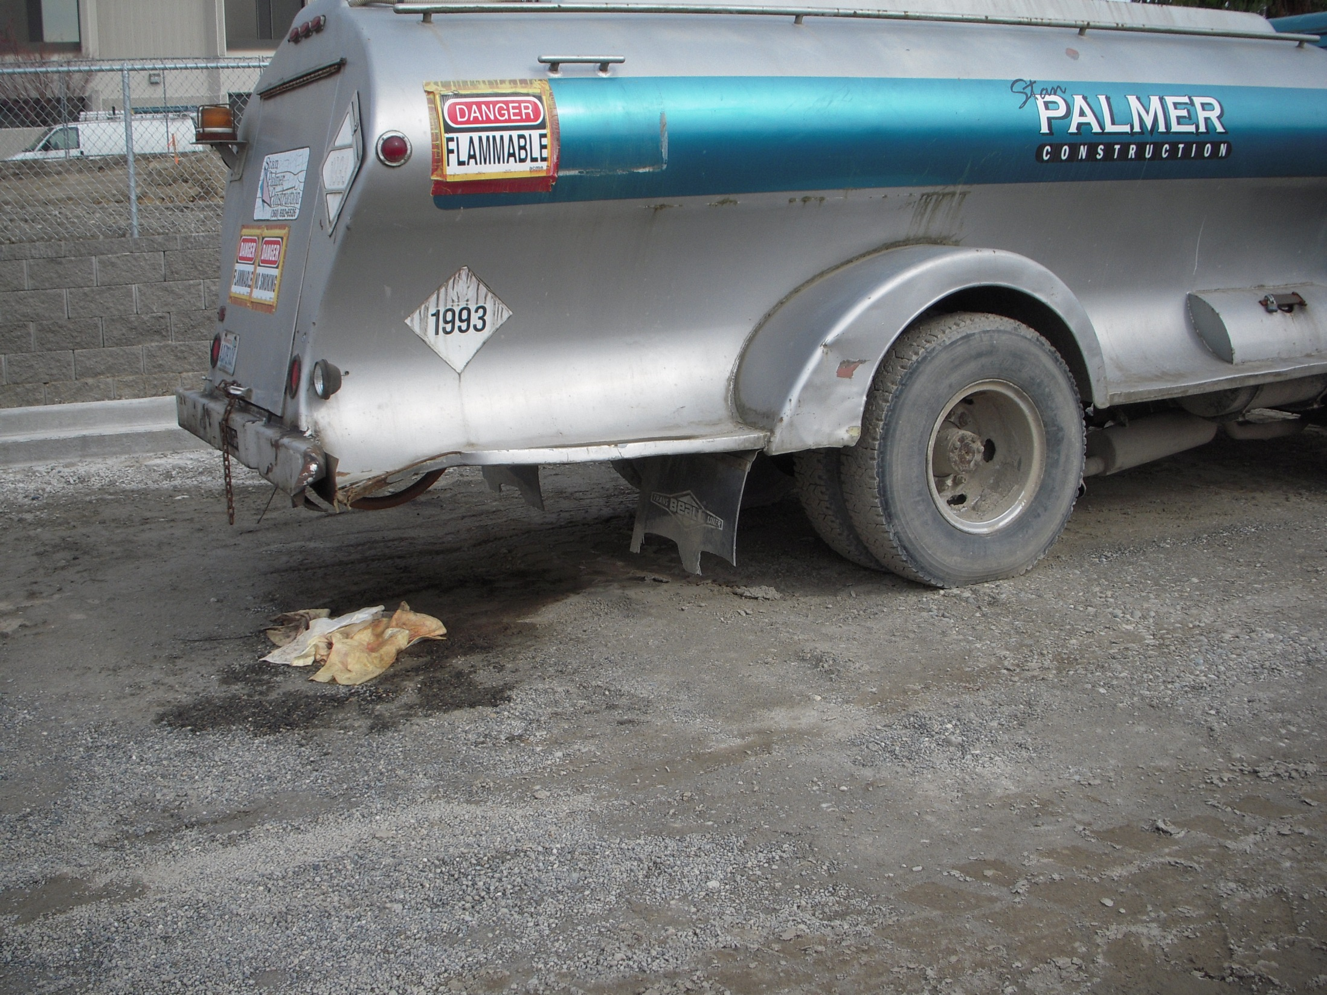
As an Inspector
Do you find things that are not listed in the SWPPP?
Does the SWPPP prevent pollution?
Notes:
Discuss what needs to be changed, do we need a SWPPP amendment for the fuel on site? What documentation needs to happen for the spill and response?

Slide 18
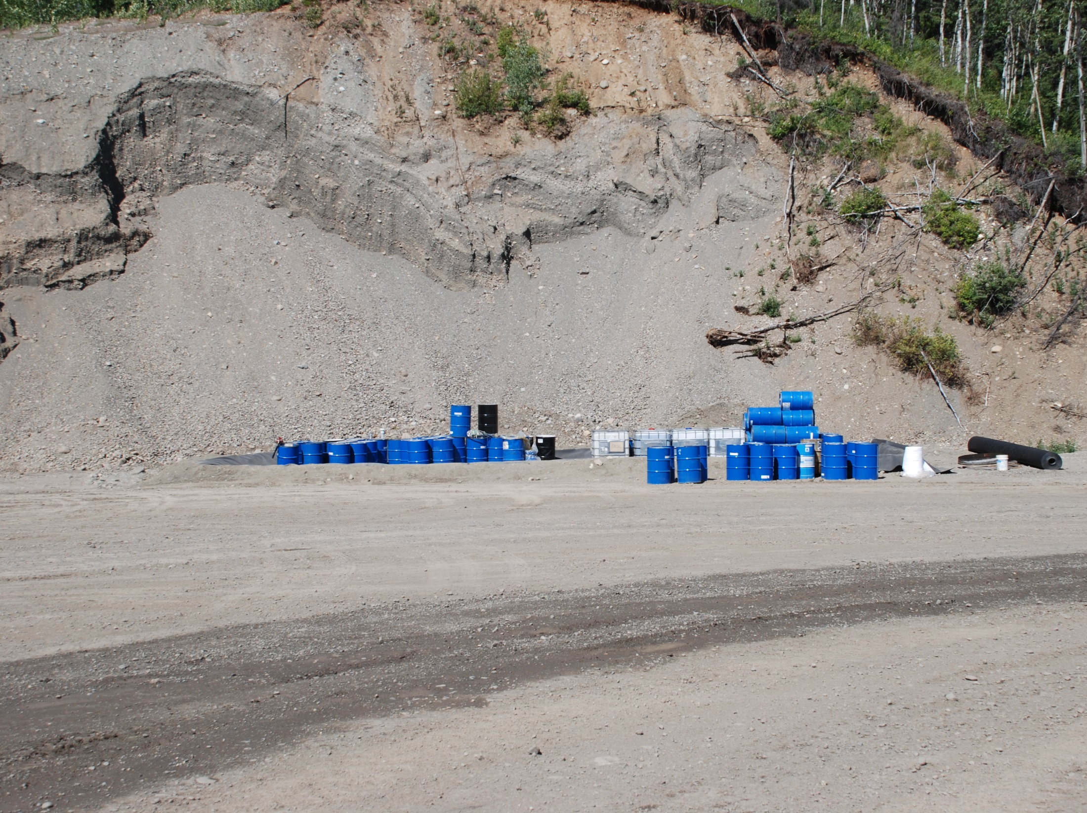
Identification of all potential sources of pollutants that may reasonably be expected to affect the quality of the storm water discharges from the site.
2021 CGP 5.3.4.5 Pg. 37

Slide 19
5.0 Site Maps (CGP 5.3.5)
Instructions: The SWPPP must include a legible site map (or set of maps for large projects) showing the entire site and identifying the following site-specific information: North arrow & Bar Scale (NEW) Property boundaries Locations where earth-disturbing activities will occur, noting phasing Location of areas that will not be disturbed and natural features to be preserved Direction of storm water flow and approximate slopes anticipated after grading activities Locations where control measures will be or have been installed Locations where exposed soils will be or have been stabilized Locations where post-construction storm water controls will be or have been installed Locations of support activities Locations where authorized non-storm water will be used Locations of all waters of the U.S. on-site and within 2,500 feet of the site boundary Locations where storm water discharges to waters of the U.S. or an MS4 Sampling point(s), if applicable Areas where final stabilization has been accomplished Staging and material storage areas (construction materials, hazardous materials, fuels, etc.) Dumpsters Porta-potties Concrete, paint, or stucco washout areas Stabilized construction exits Location of existing public water system (PWS) drinking water protection areas (DWPA)
Notes:
Grading log is not enough to show al the areas of disturbance, stabilization, and preservation. The site maps need to show these areas.

Slide 20
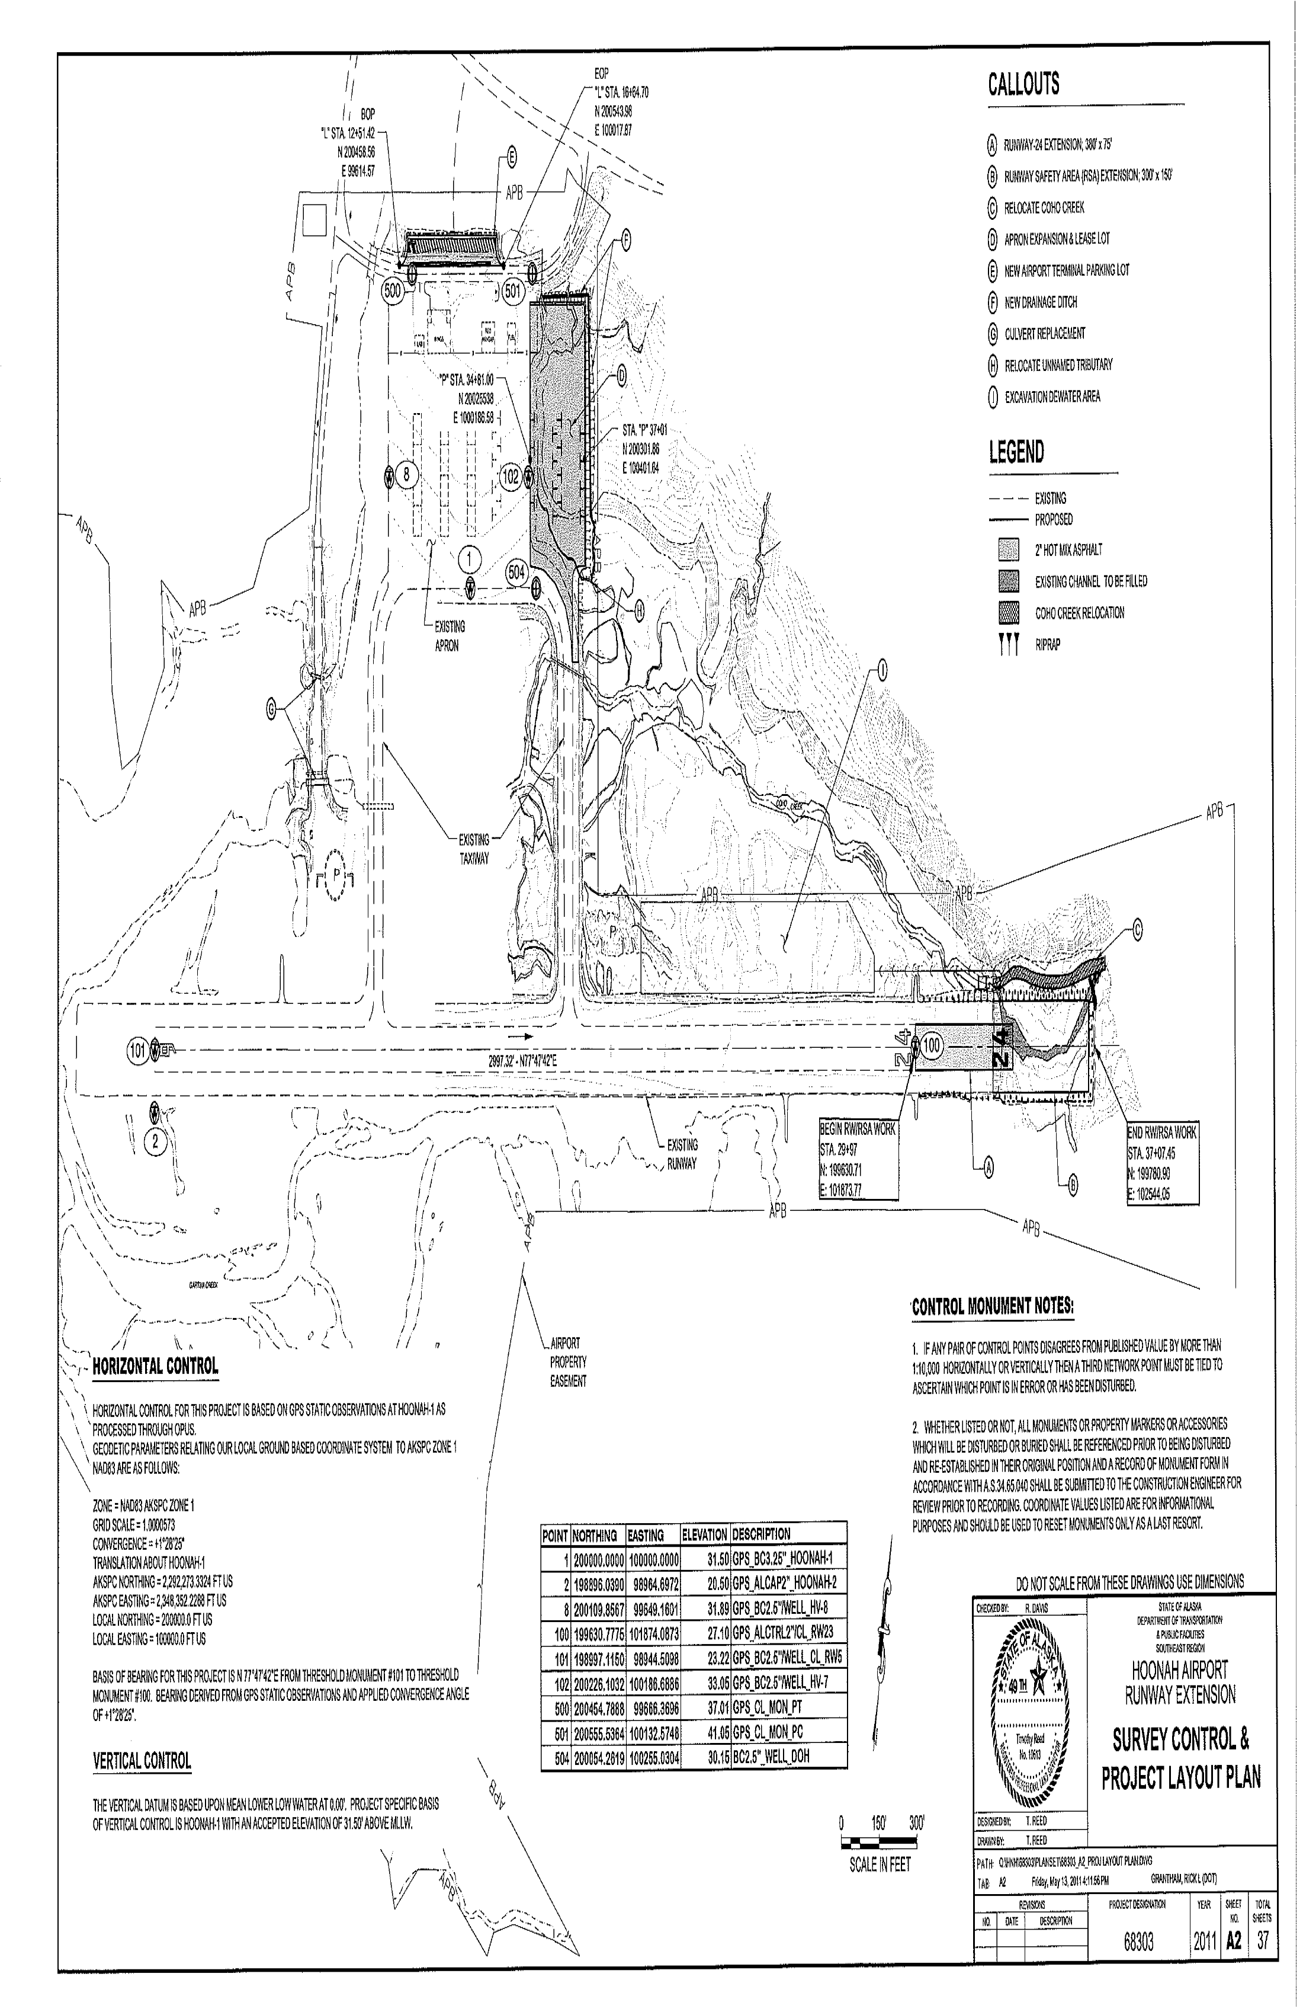
2021 CGP 5.3.5
Site Map(s)
The SWPPP must contain a legible site map identifying:
Boundaries of the property where construction activities will occur;
Locations where earth-disturbing activities will occur, noting phasing.
Location of areas that will not be disturbed & features to be preserved
Hoonah

Slide 21
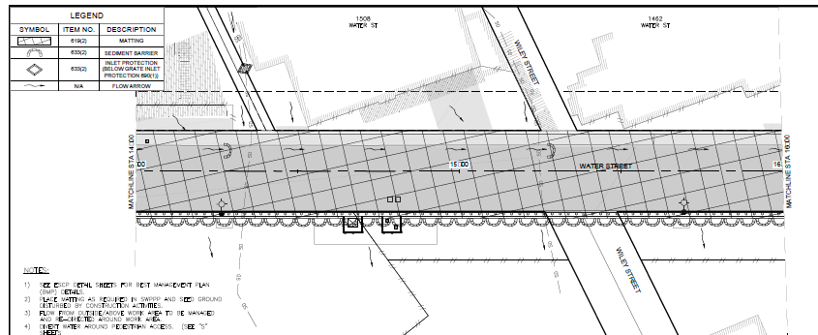
Site Maps Include:
2021 CGP 5.3.5
5.3.5.8 Direction(s) of storm water flow & slopes after grading;
5.3.5.9 Locations where control measures will be or have been installed;
5.3.5.10 Locations where soils will be stabilized or have been stabilized;
5.3.5.11 Locations where post-construction storm water controls will be or have been installed;

Slide 22
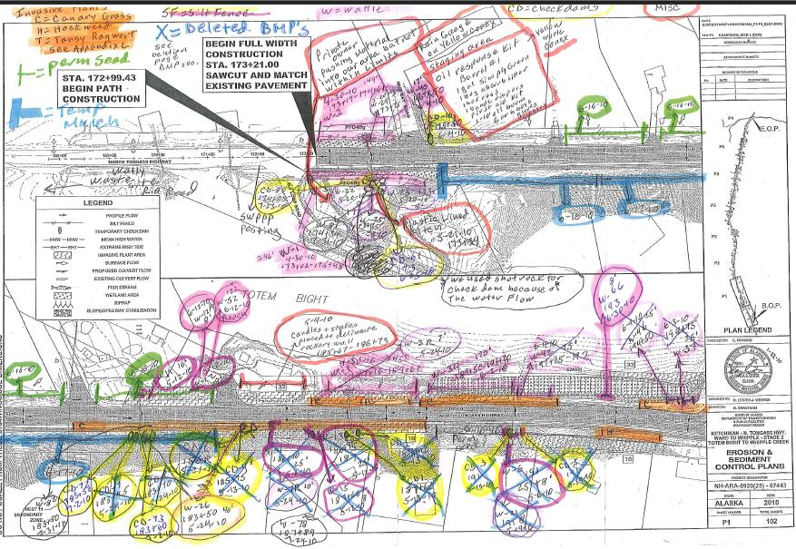
Site map markup

Slide 23
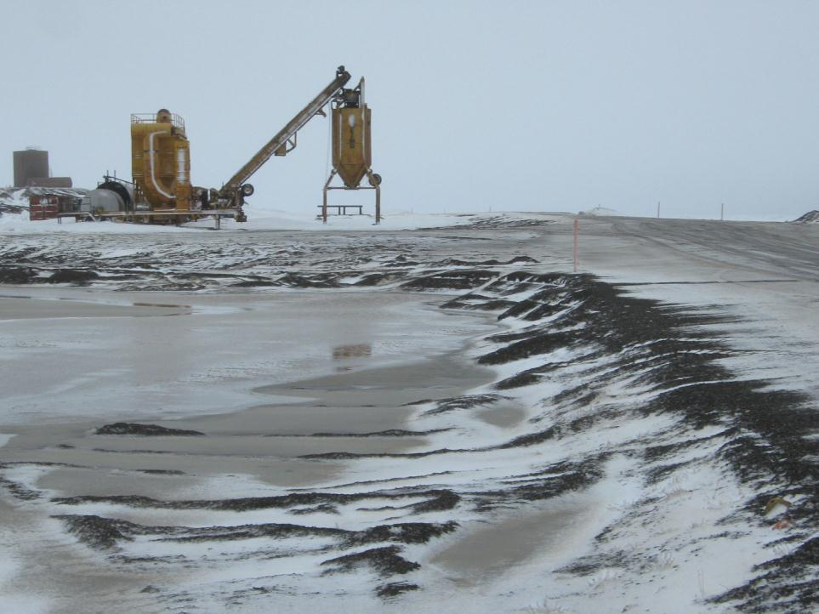
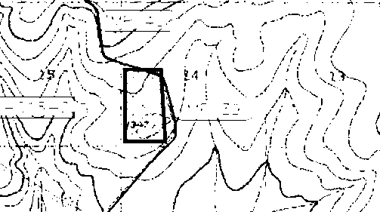
Locations of support activities.
2021 CGP 5.3.5.12
Batch Plant

Slide 24
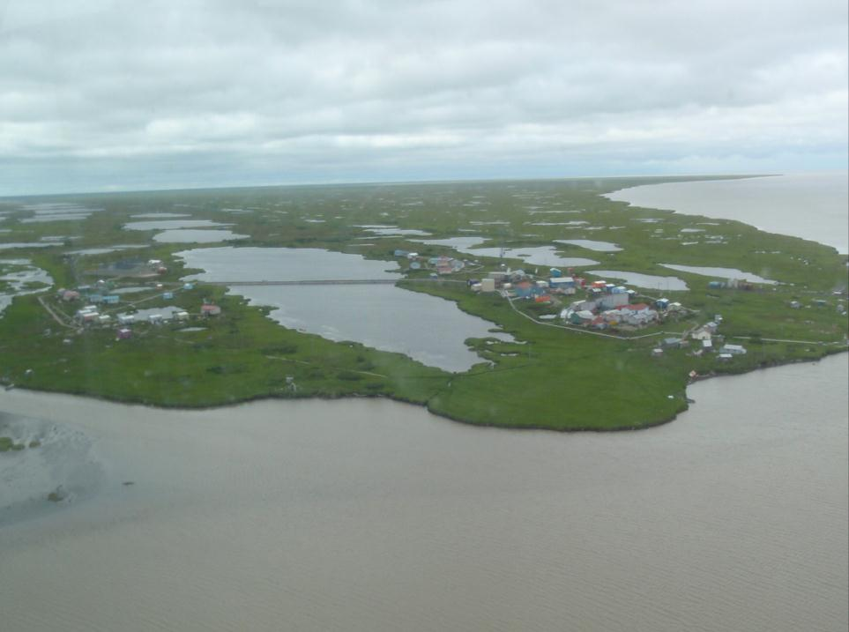
Locations of all waters of the U.S. (including wetland areas
> 10,000sf) on the site & located within 2,500 feet of the site boundary that may be affected by discharges from the site.
2021 CGP 5.3.5.14
Your Next Job
Notes:
Sam can you identify this village?

Slide 25
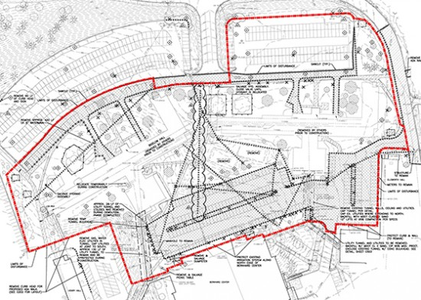
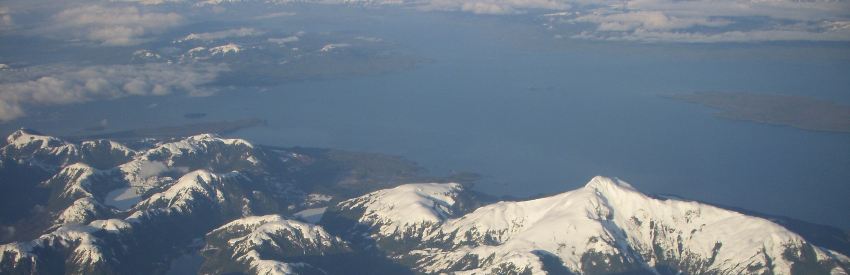
5.3.5.15 Projects near a Public Water System (PWS)
Where projects intersect a PWS drinking water protection area (DWPA) the
site map must contain this information
Springs;
Wells; or
Surface water intakes.
4.10.1 Where the project intersects a PWS drinking water protection area (DWPA) (see Part 5.3.5.15), notify the PWS contact.
Notes:
The DEC has the Web Map Basic Instructions located on the CGP webpage.

Slide 26
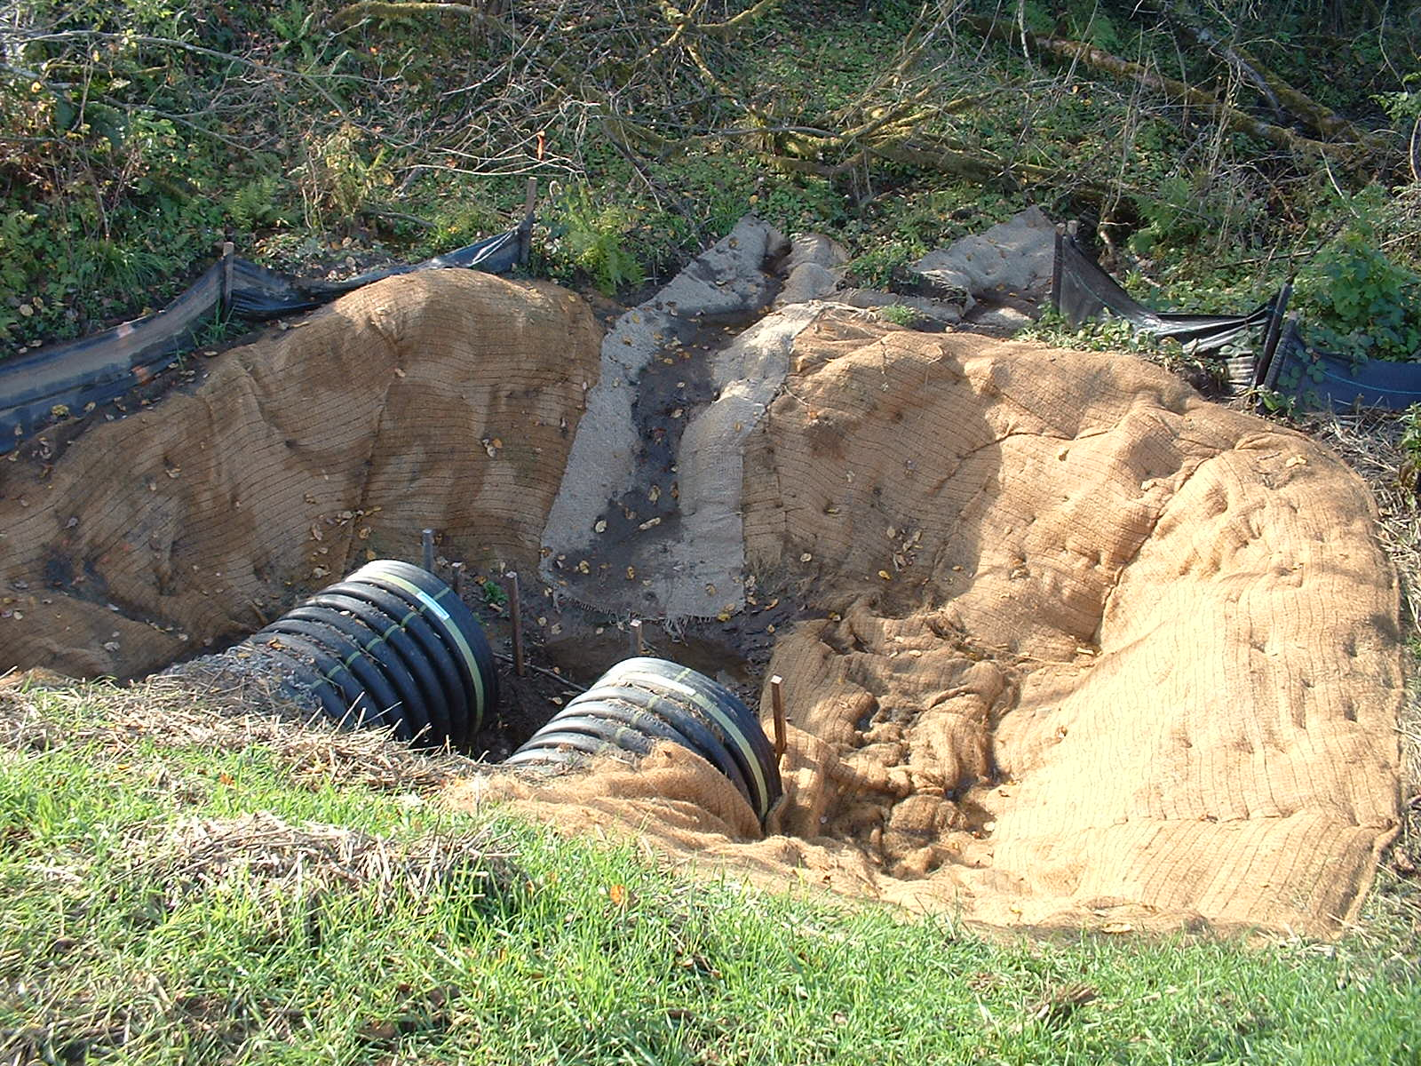
2021 CGP 5.3.5.16
Locations where storm water discharges to waters of the U.S. (wetlands, or an MS4)

Slide 27
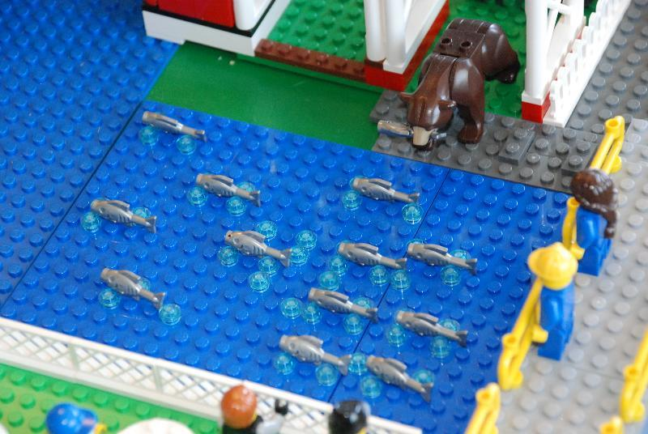
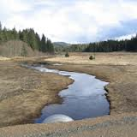
2021 CGP Pg. 37
5.3.3.3 Receiving waters, such as impaired waters or waters listed in the Alaska Department of Fish &Game (ADF&G) Anadromous Waters Catalog.

Slide 28
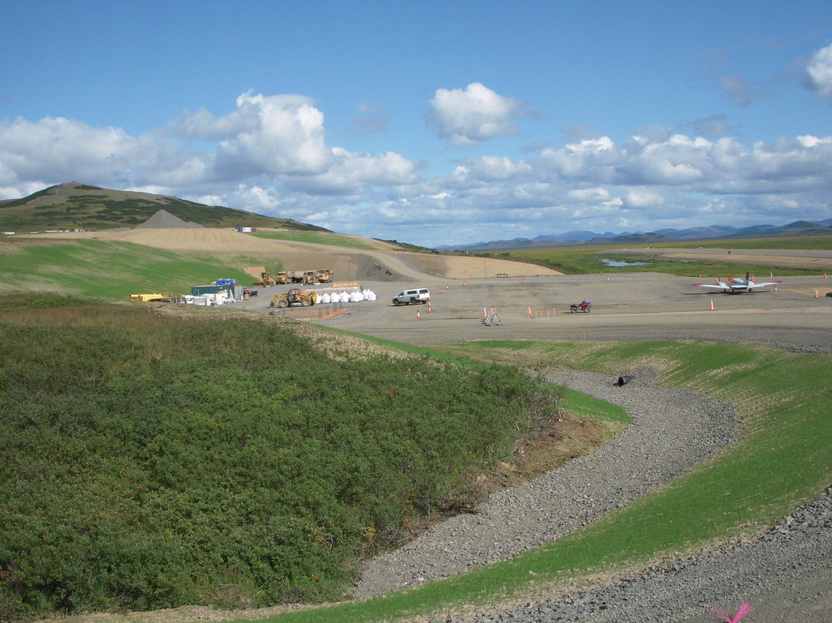
Areas where final stabilization has been accomplished and no further permit requirements apply.
2021 CGP 5.3.5.18
Who will keep up the site maps?
Record your way to NOT!
Goodnews Bay
Notes:
Ask if the seeded areas have achieved final stabilization, how about the ditch with rock lining? Should the site maps be updated?

Slide 29
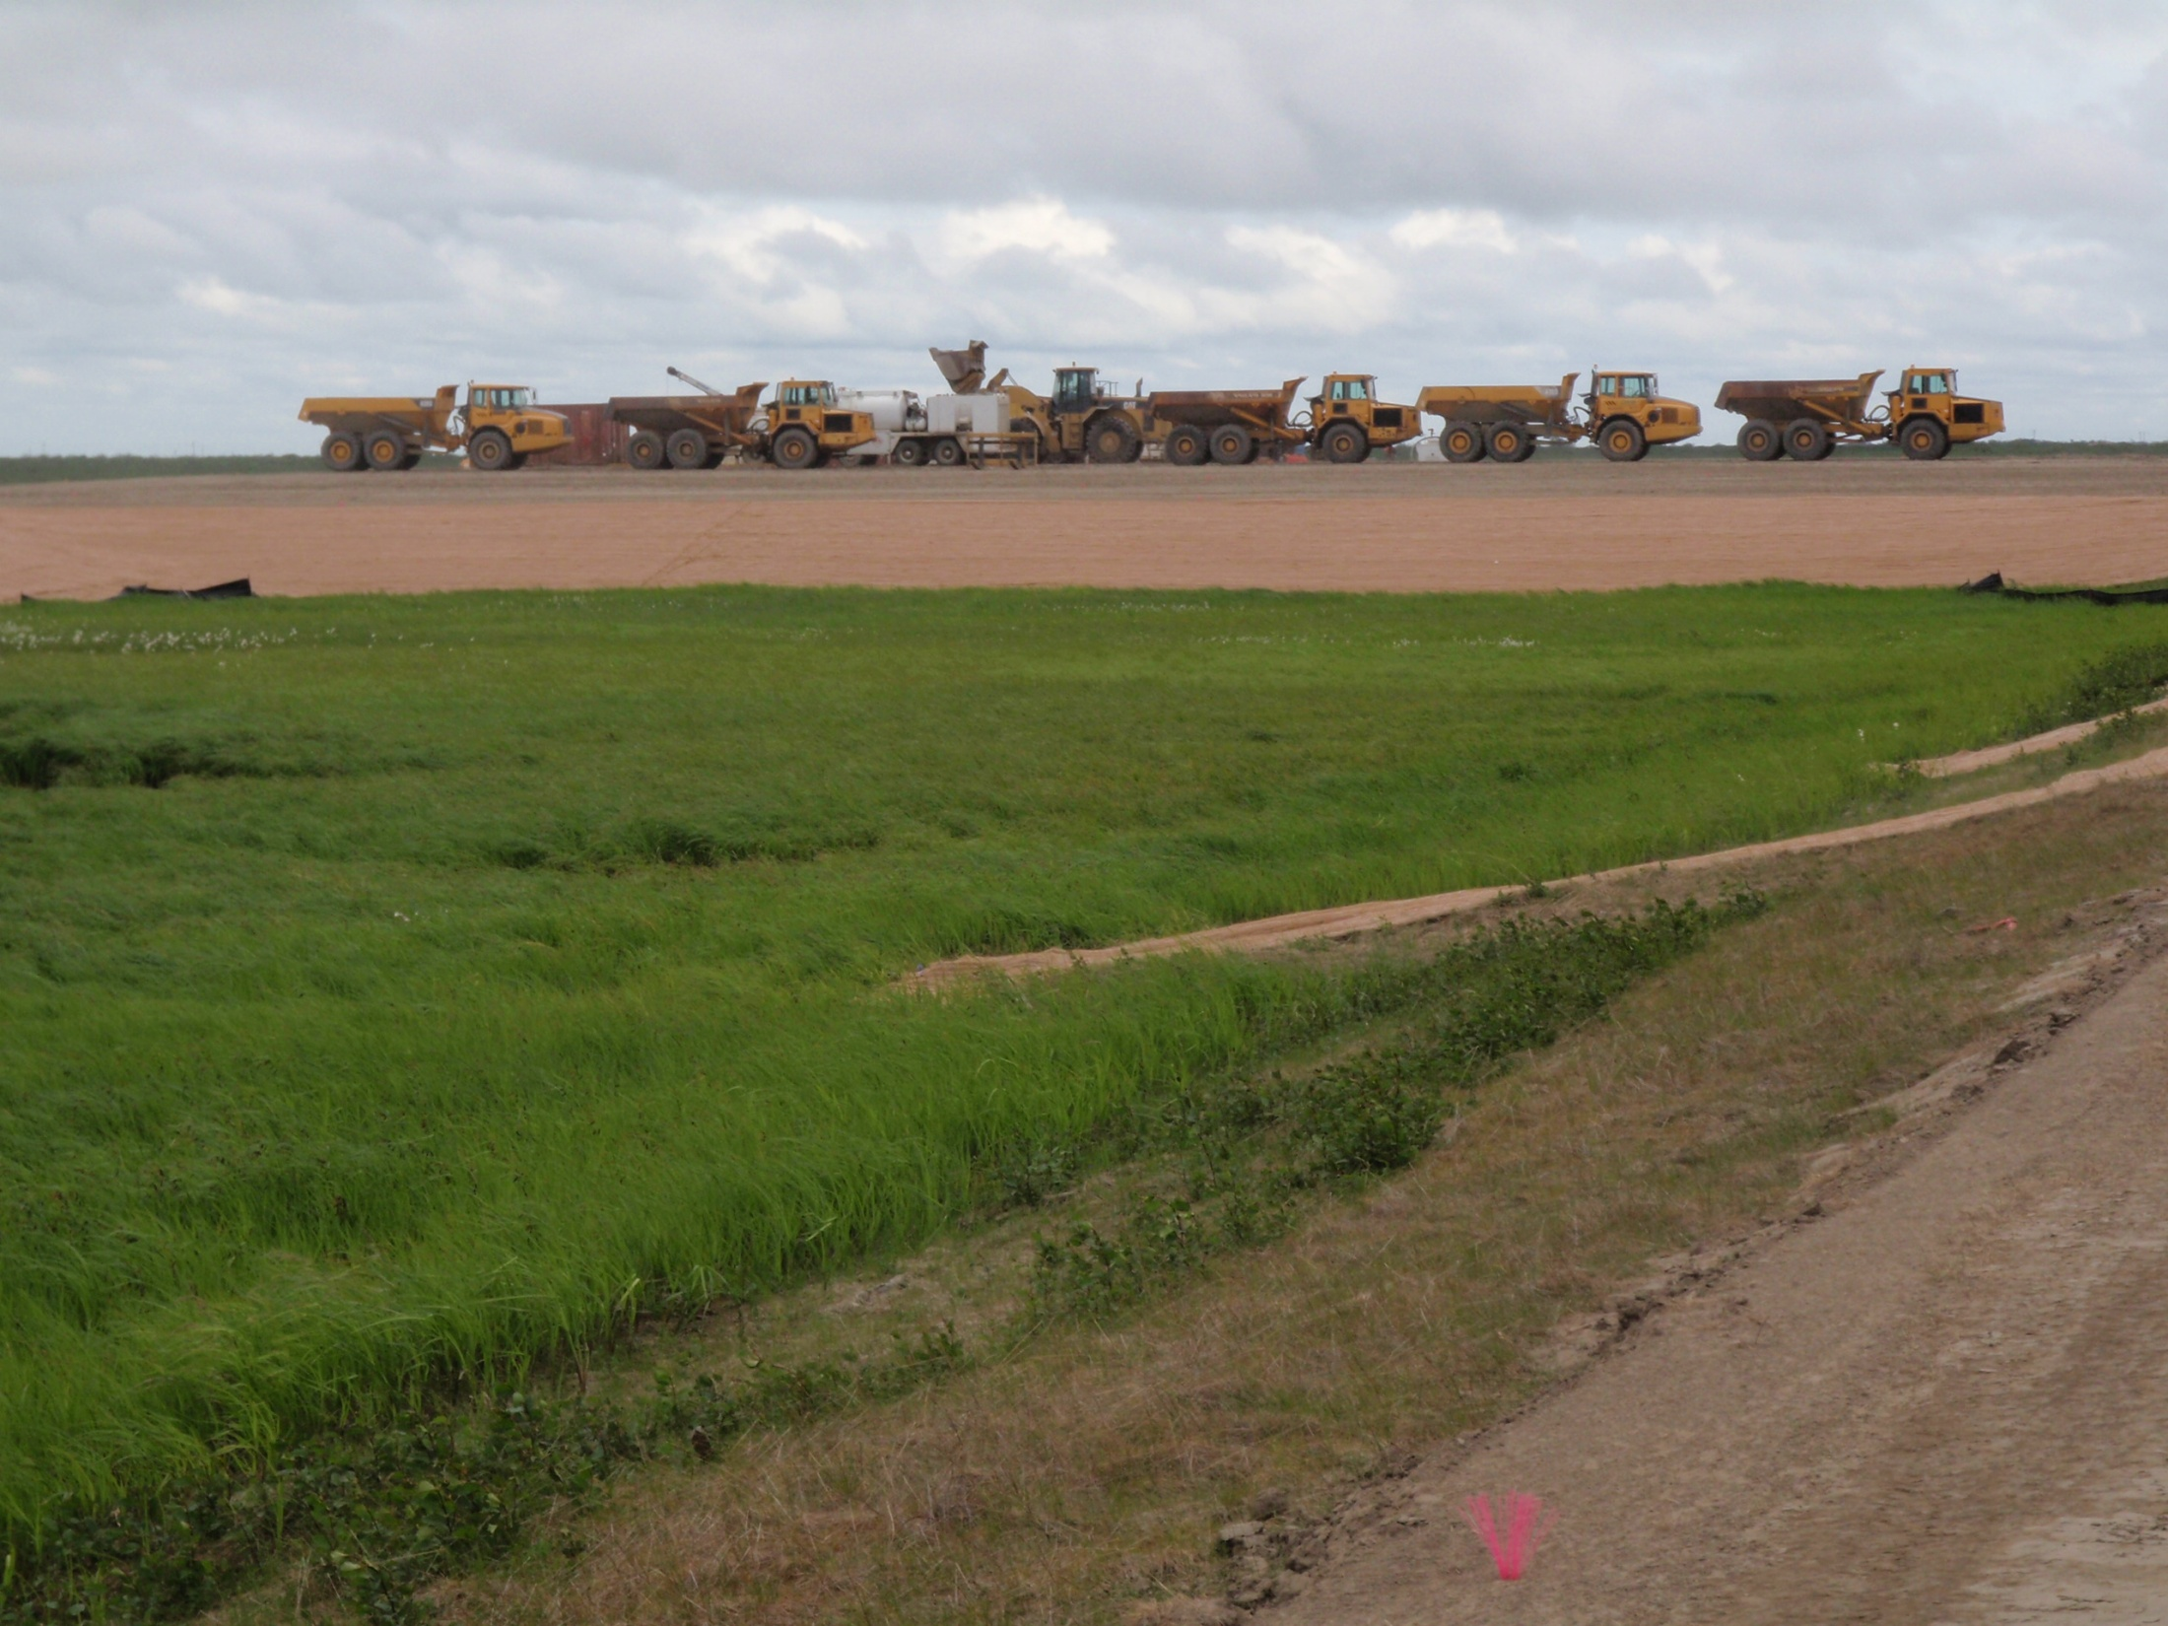
2021 CGP 5.3.6
5.3.6 Control Measures
The SWPPP must document the following:
The type of control, required maintenance & location.
The sequence during construction when it will be installed, operational, & any manufacturer’s specifications.
Alakanuk
Notes:
Reminder: there is no guess work or opinion involved. The site is either following the plans and specs or it is not. This SWPPP requirement when followed will make the inspectors job pretty black and white, documenting compliance becomes much simpler.

Slide 30
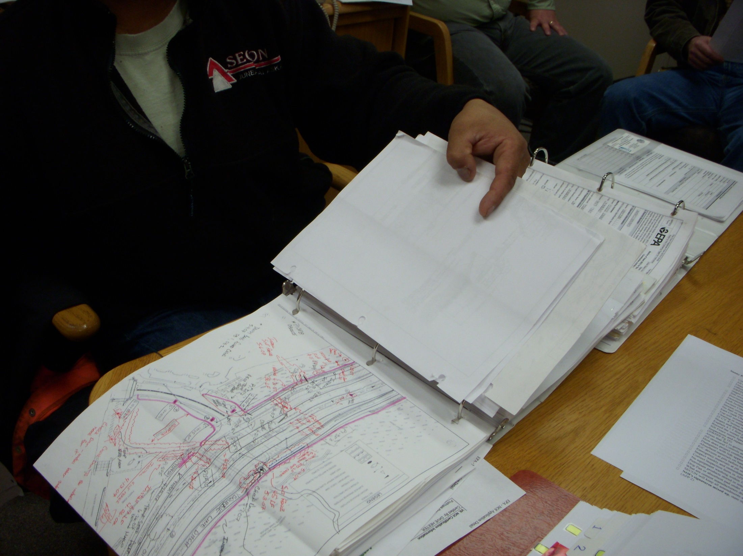
What's on the plan is in the field.
What’s in the field is on the plan!

Slide 31
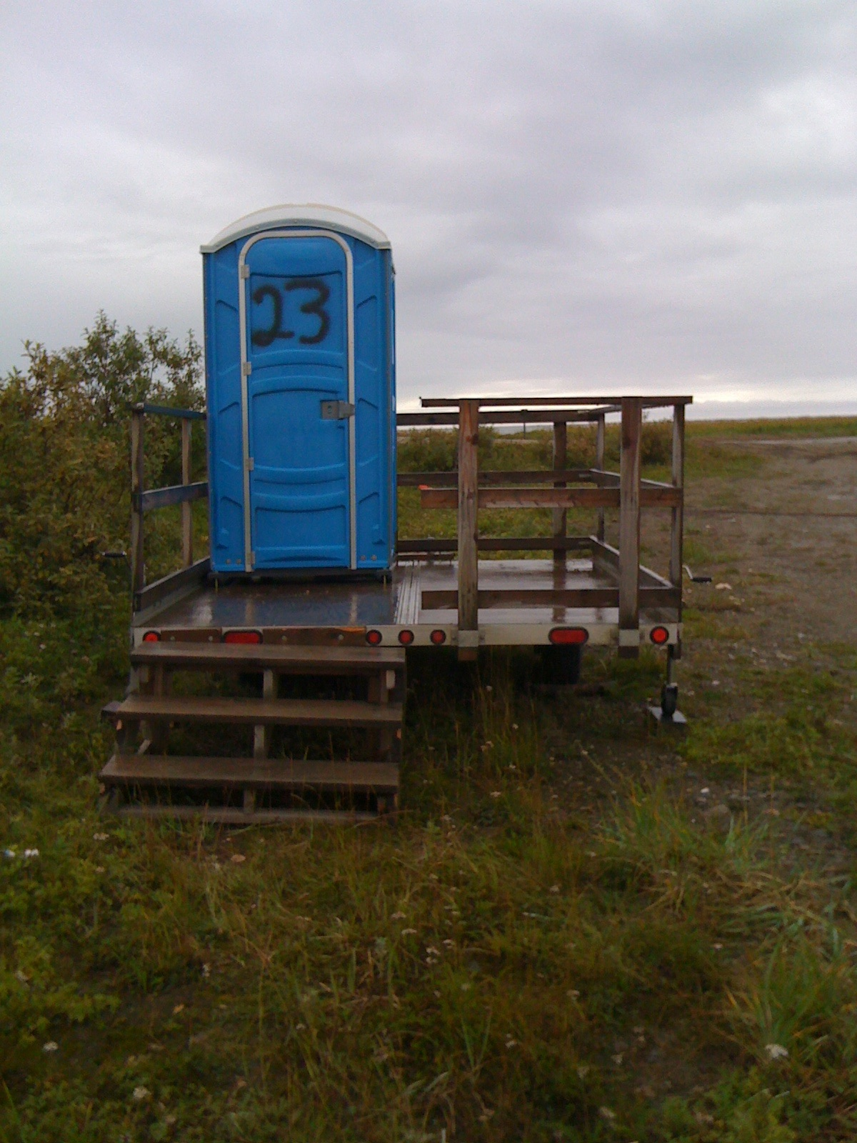
Update the site map as the site changes & BMP’s or facilities move

Slide 32
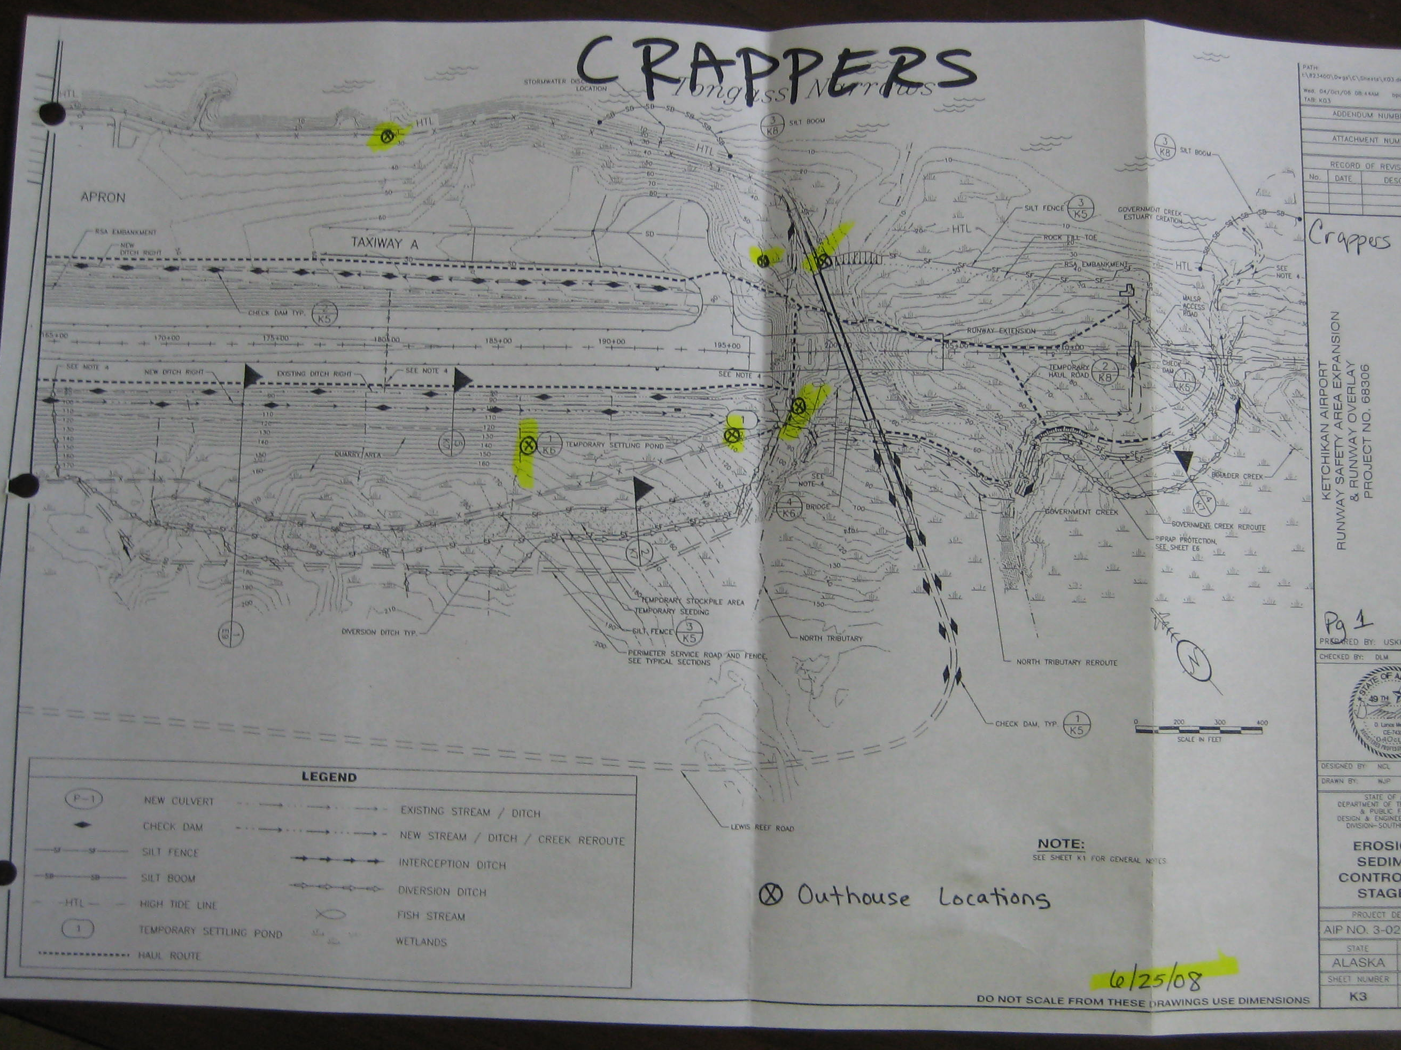
Politically Correct? Maybe….
Compliant, Probably!

Slide 33
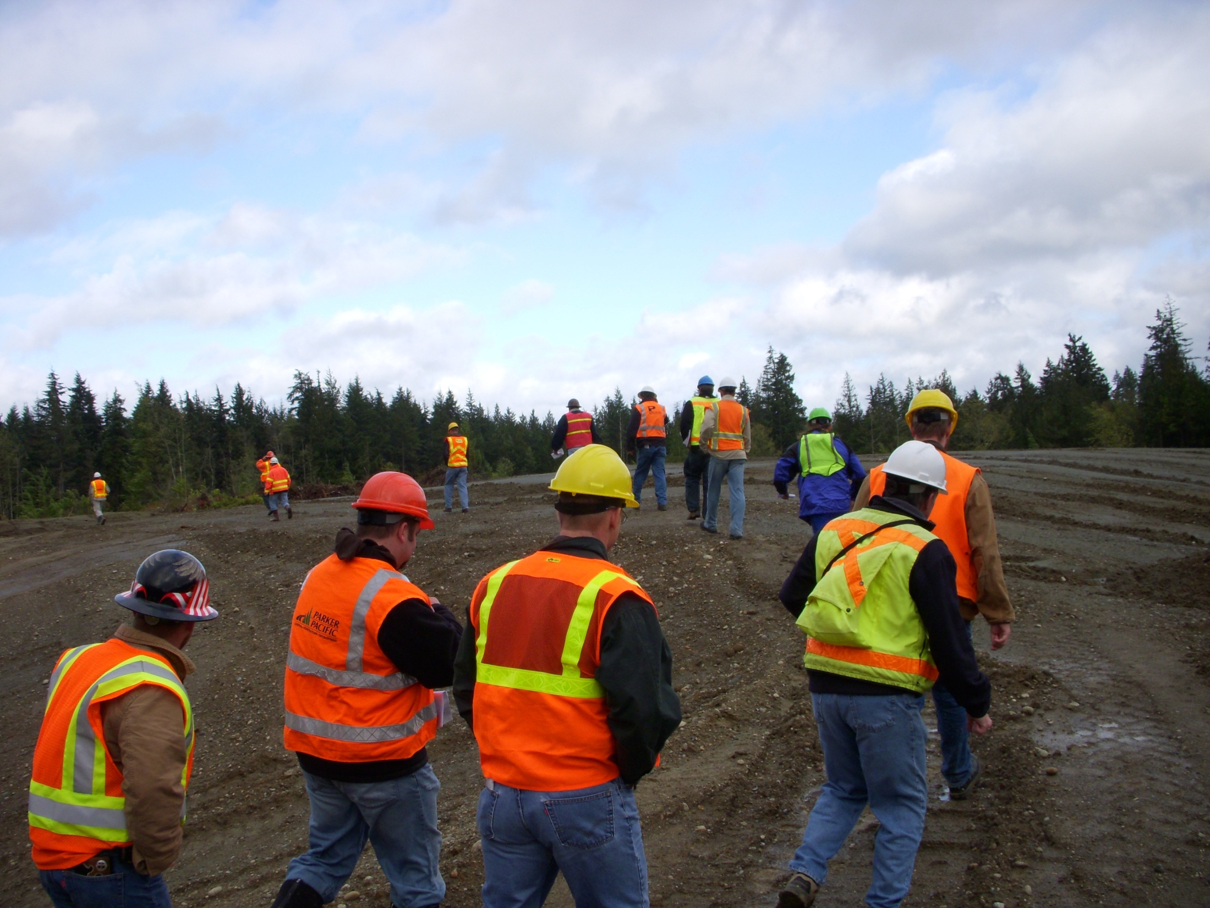

DOT&PF specification 641-1.05 SIGNATURE CERTIFICATION REQUIREMENTS & DELEGATIONS.
3. Subcontractor Certification. Subcontractors must certify that they have read and will abide by the CGP & conditions of the project SWPPP.
*Subcontractors marching in line

Slide 34
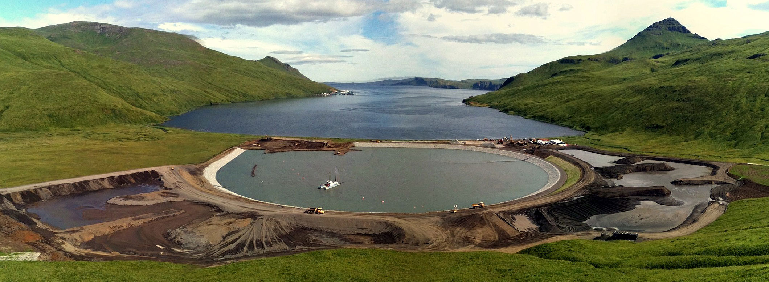
SWPPP Summary
Akutan

