Slide 1
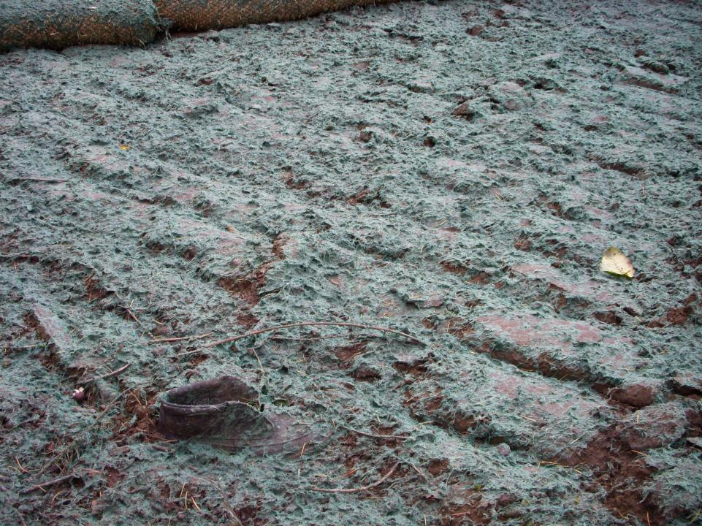
SWPPP INTRODUCTION
For the Boots on the Ground
January 2022

Slide 2
SWPPP Introduction
Goals of this section:
Be able to describe the purpose of a SWPPP;
Name the parts of a SWPPP; and
Know what makes a good SWPPP.

Slide 3
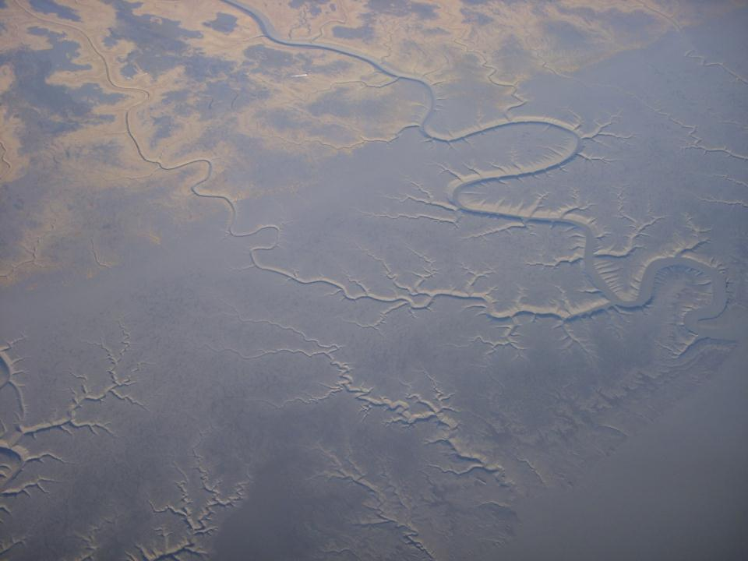

What Elements Are Required in a SWPPP?
First and foremost, your SWPPP must be developed and implemented consistent with all permits.
• Cover/title page
• Project and SWPPP contact information
• Site and activity description, including a site map
• Identification of potential pollutant sources
• Description of controls to reduce pollutants
• Maintenance/inspection procedures
• Records of inspections & maintenance of BMPs
• SWPPP amendments
• SWPPP certification

Slide 4
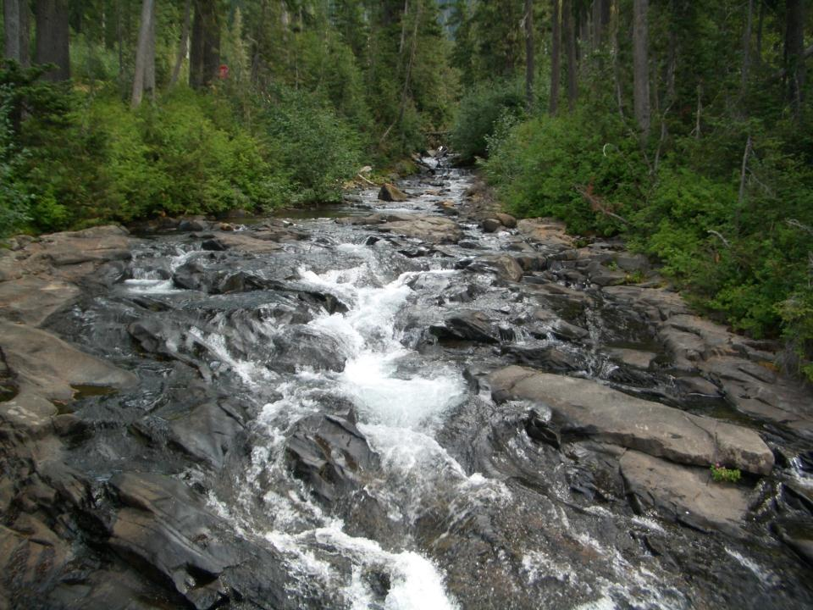
What is an Adequate Stormwater Pollution Prevention Plan?
Site Conditions
Schedule
Design
Protects Water Quality
Notes:
Must satisfy plan approval authority that all pollution sources will be controlled.
Incorporate the existing conditions, construction schedule, & finished design elements to protect water quality

Slide 5
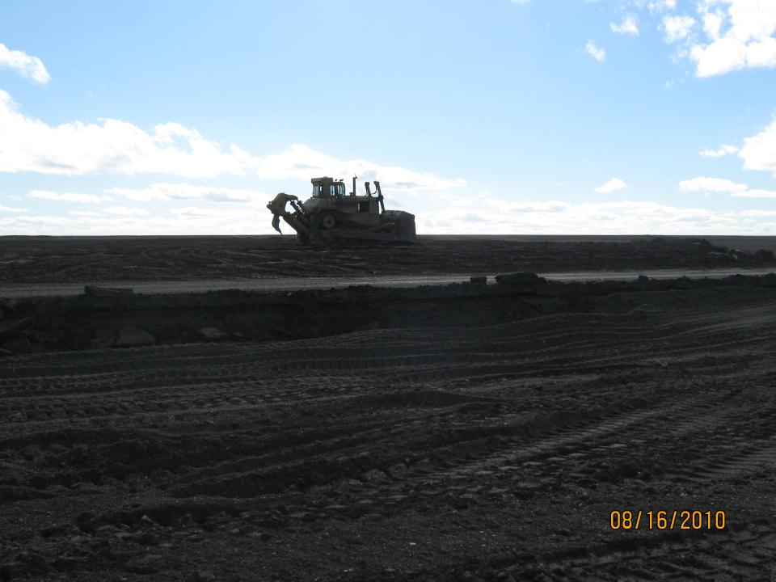
Managing Construction Site Runoff
is Not an Easy Task….
Budgets are tight, environmental protection
is often underestimated along with other
“unaccounted for” variables
The market is looking for a “one step solution”
answer and it does not exist
Enforcement is perceived as random and often
unevenly distributed regionally

Slide 6
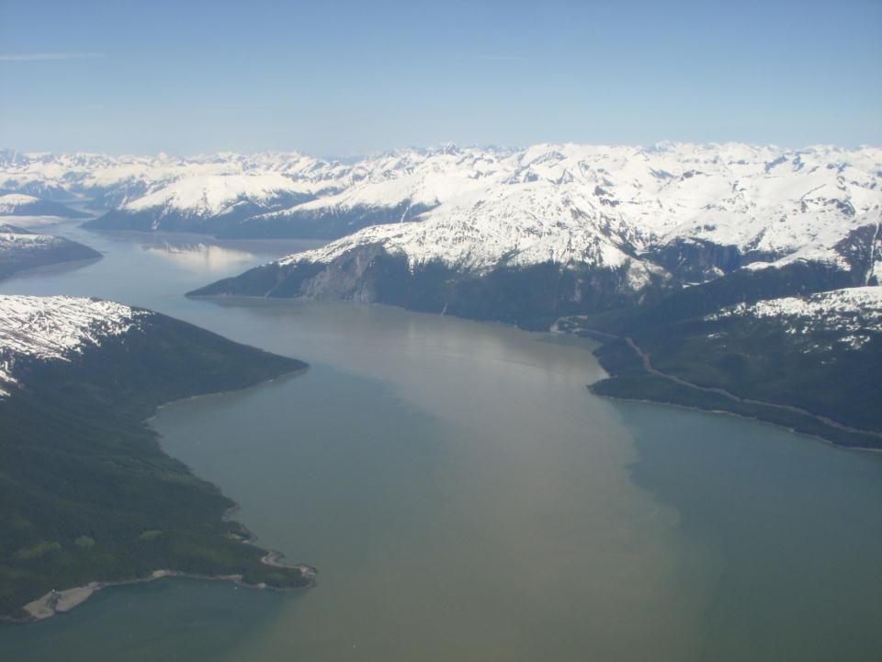

Attainment of Water Quality Standards
CGP Part 3.1 Pg. 20
Requirements for all Projects
A permittee must select, install, implement, and maintain control measures (described in Part 4.0) at the construction site to minimize the discharge of pollutants as necessary to meet WQS’s (18 AAC 70).

Slide 7
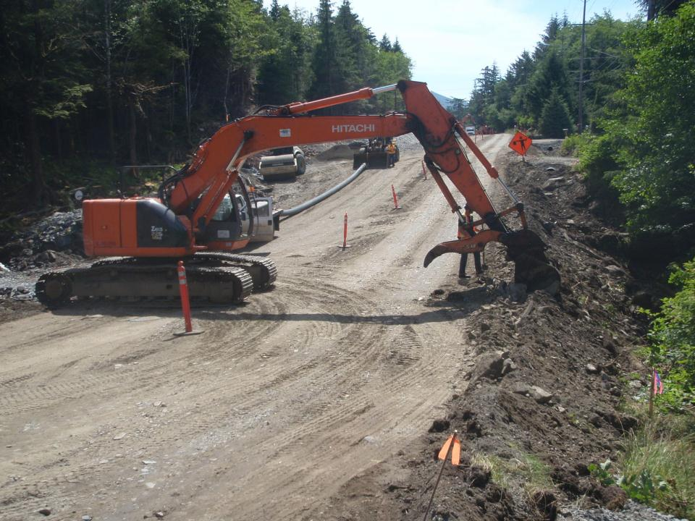
The Purpose of the SWPPP is to:
Describe BMP’s to minimize erosion and sediment discharge.
Identify, reduce, or prevent the pollution of stormwater.
Prevent violations of water quality standards.
Identify, and assign maintenance responsibilities for BMP’s.

Slide 8
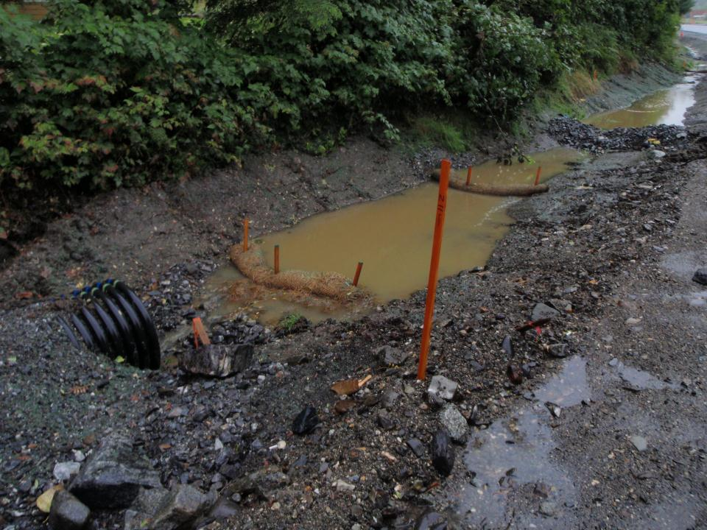
The Key to a Successful SWPPP is…..
Site Specific:
Assessment & Analysis
BMP Selection
Understanding & Implementation
Inspections & Documentation
Adaptive Management
Ketchikan

Slide 9
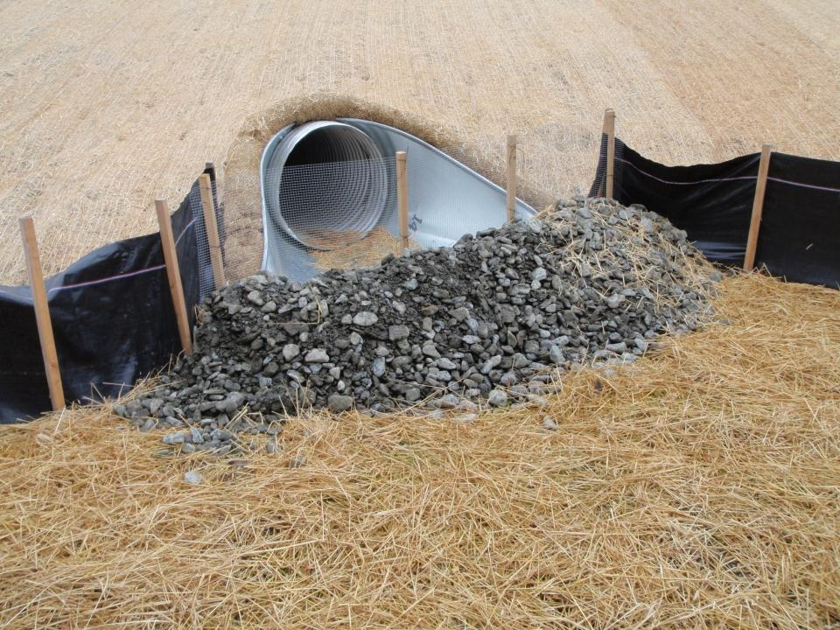
Seeding
Straw Blanket
Wattle
Gravel Filter Berm
Silt Fence
Straw Mulch
What-Where-When?
Soldotna
Notes:
K-Beach Kenai

Slide 10
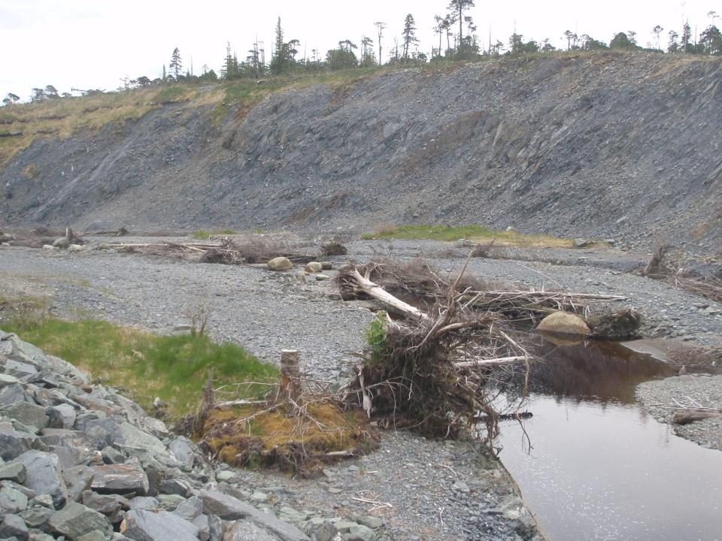
Basics of a SWPPP
Narrative
Existing Site Conditions
Construction Schedule
Rainfall Data
Pollution Prevention Strategies & Responses
Drawings and Notes
Where & When BMPs Installed
BMP Performance Goals
Maintenance Procedures & Standards
Notes:
Must satisfy plan approval authority that all pollution sources will be controlled.

Slide 11
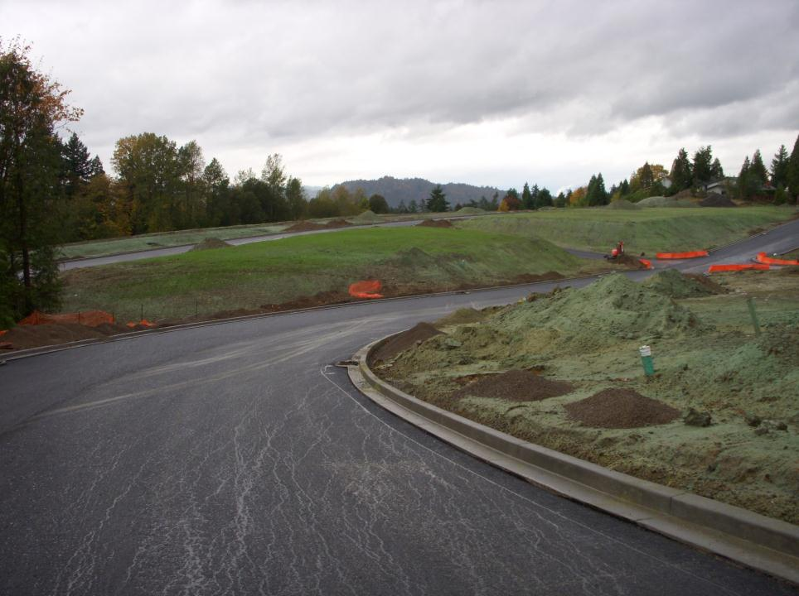
SWPPP Objectives:
• Stabilize the site as soon as possible
• Protect slopes and channels
• Reduce impervious surfaces
• Promote infiltration
• Control the perimeter of your site
• Protect receiving waters adjacent to your site
• Follow pollution prevention measures
• Minimize the area and duration of exposed soils
Notes:
How do we describe this stage of construction in the SWPPP? Subdivision, Longview WA

Slide 12
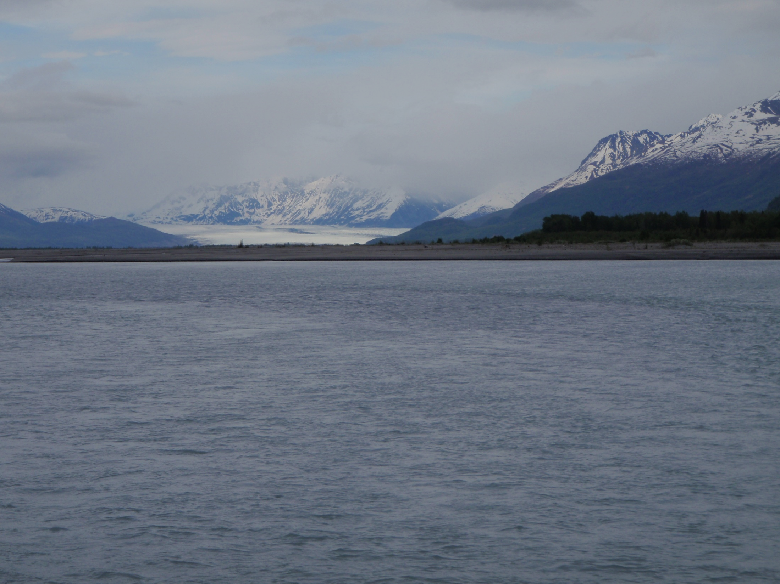
Storm Water Contact(s)
CGP Part 5.3.2 Pg. 36
Identify the following qualified person(s) responsible for the following (Note: A small project may have all one person):
Storm Water Lead;
Updating the SWPPP according to Part 5.9;
Conducting inspections according to Part 6.0;
Conducting monitoring (if applicable) according to Part 7.0; and
Operating an Active Treatment System (if applicable) according to Part 4.6.7.

Slide 13
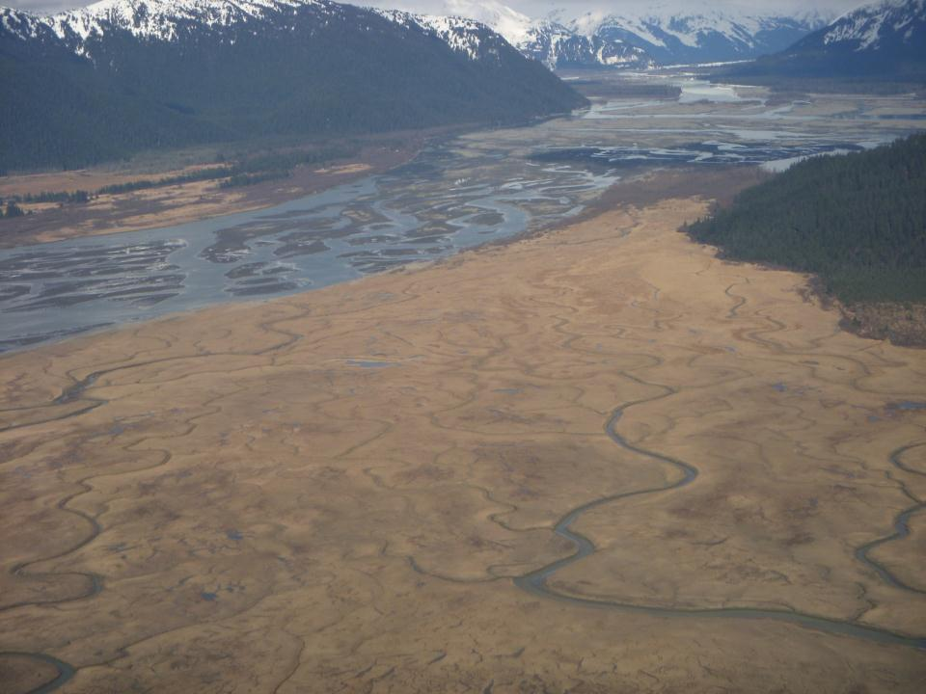

Contact Information
Responsible Parties
CGP Part 5.3.1 Pg. 36
Permittee
At a minimum, the SWPPP must:
Identify the permittee for the site and any subcontractors that may work on the site, including the areas where the subcontractors are expected to conduct activities covered by this permit.
Notes:
The SWPPP should give the CESCL the information regarding chain of command. See SWPPP Guide, Chapter 2.B. and your construction general permit for the definition of operator.

Slide 14
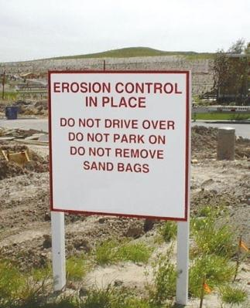
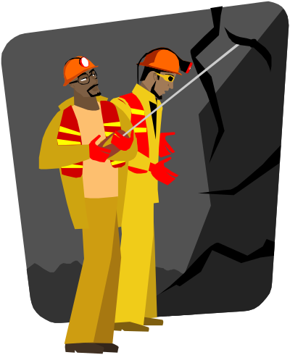
CGP Part 5.3.2 Pg. 36
Exactly who is considered an operator is largely controlled by how the owner of the project chooses to structure the contracts with the contractors hired to design and/or build the project.
The SWPPP must communicate
to everyone on the project!
Subcontractors must be trained on appropriate BMPs and requirements in the SWPPP and should not disturb or remove BMPs. Some contractors will include specific penalties in subcontractor agreements to ensure subcontractors do not damage or remove BMPs.

Slide 15
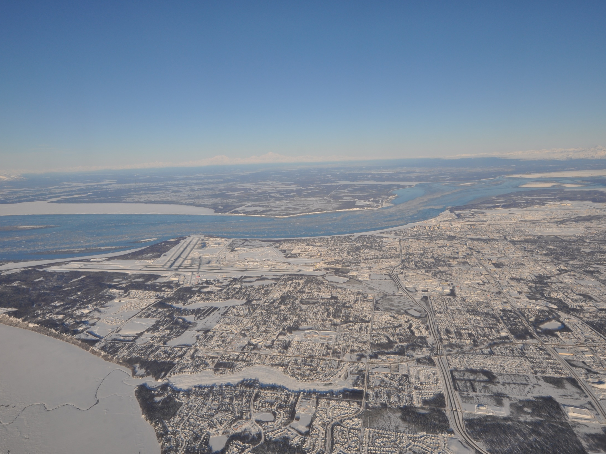
Project Site-Specific Conditions
CGP Part 5.3.3 Pg. 37
Briefly describe the existing site-specific conditions, including:
Precipitation based on nearest weather station
Site Conditions – soils, topography, drainage, vegetation, etc.
Receiving waters

Slide 16
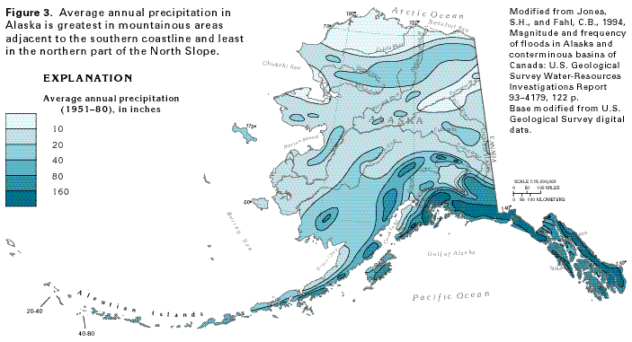
The mean annual precipitation based on the nearest appropriate weather station;
CGP Part 5.3.3.1 Pg. 37
This is close but we can do better!

Slide 17
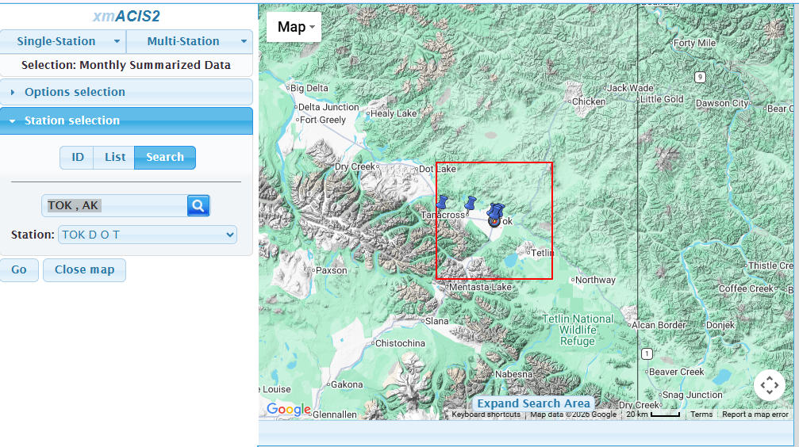

Slide 18
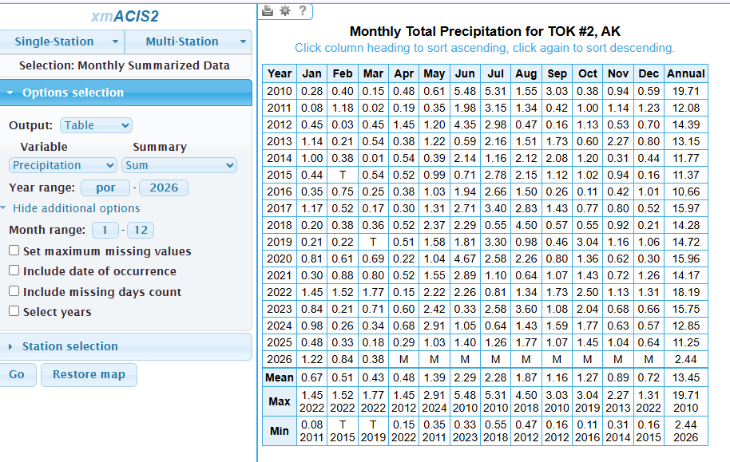
xmacis.rcc-acis.org

Slide 19
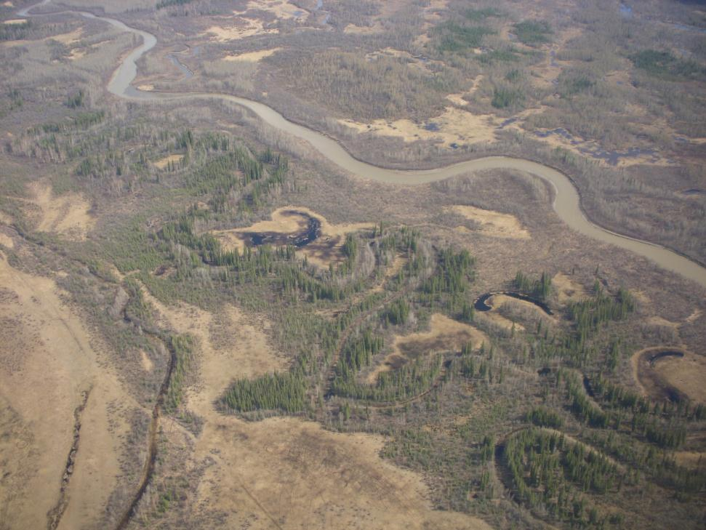
Site Conditions
Soils, Slopes, Vegetation, & Current Drainage Patterns
CGP Part 5.3.3.2 Pg. 37
Describe the existing soil conditions including soil types, slopes and slope lengths, drainage patterns, and other topographic features that might affect erosion and sediment control.
Note any historic site contamination evident from existing site features and known past usage of the site.
Include this information on your site maps.
Notes:
Included on your site maps (See SWPPP Guide, Chapter 3.C.).
For more information, see SWPPP Guide, Chapter 3.A. for more information.

Slide 20
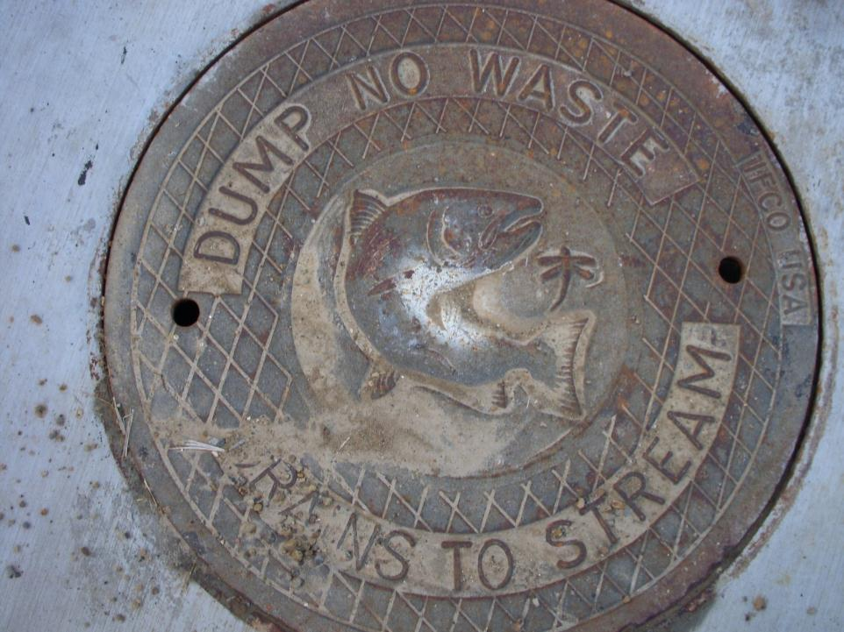
Identify Receiving Waters,
Storm Drains &
Conveyances
Notes:
Know where your water goes

Slide 21
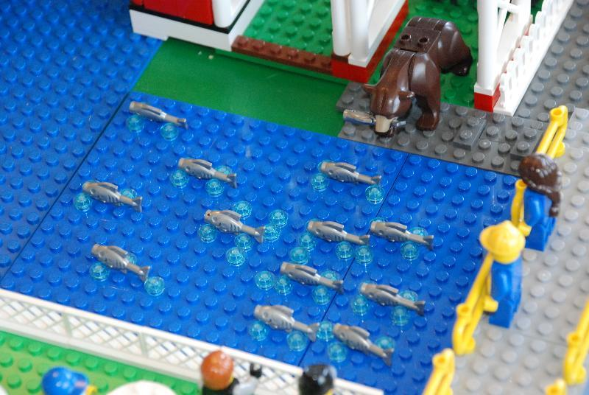
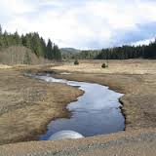
CGP Part 5.3.3.3 Pg. 37
Receiving waters, such as impaired waters or waters listed in the Alaska Department of Fish & Game (ADF&G) Anadromous Waters Catalog.

Slide 22
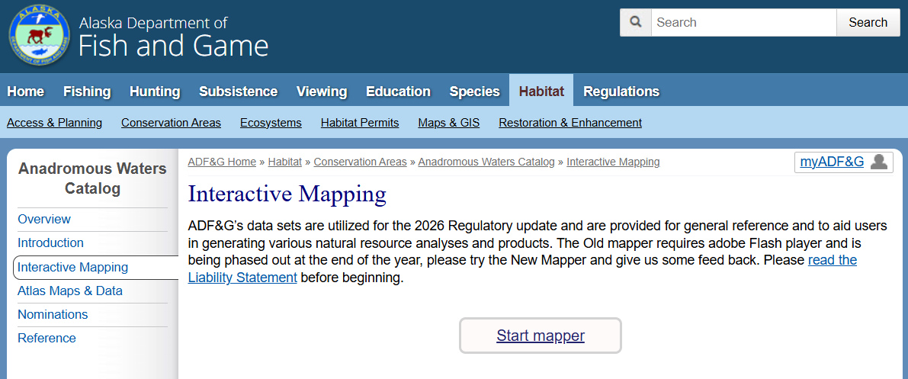
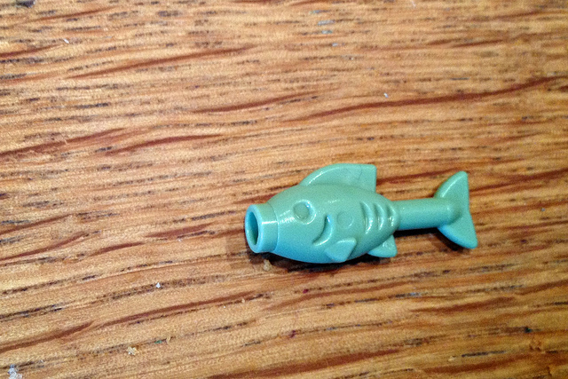
www.adfg.alaska.gov/sf/SARR/AWC/index.cfm?adfg=maps.interactive

Slide 23

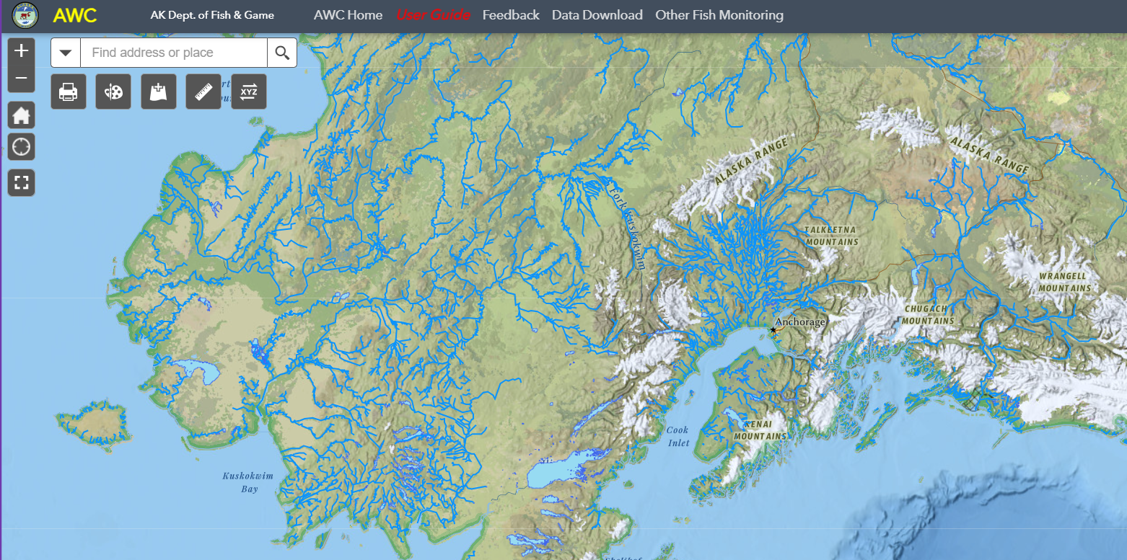
Click your Project area.
Use the Zoom feature to find your Project.

Slide 24
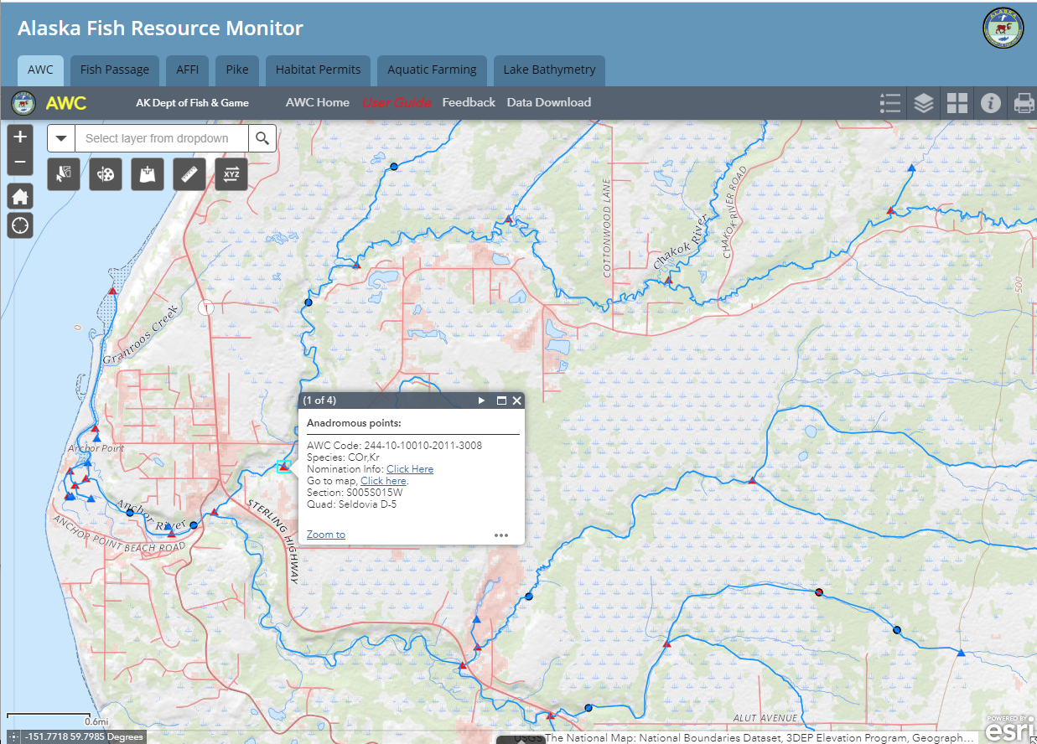


Slide 25
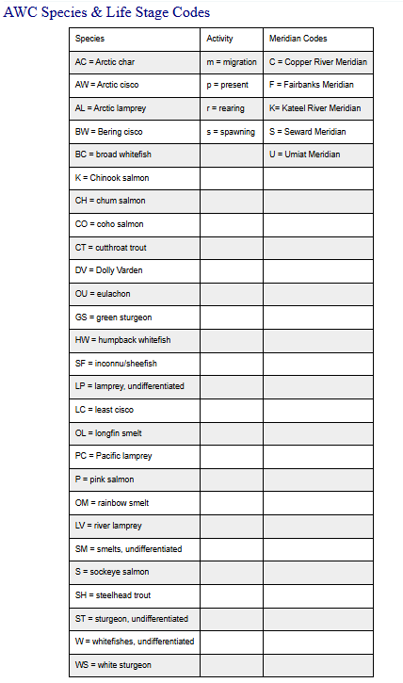



Slide 26
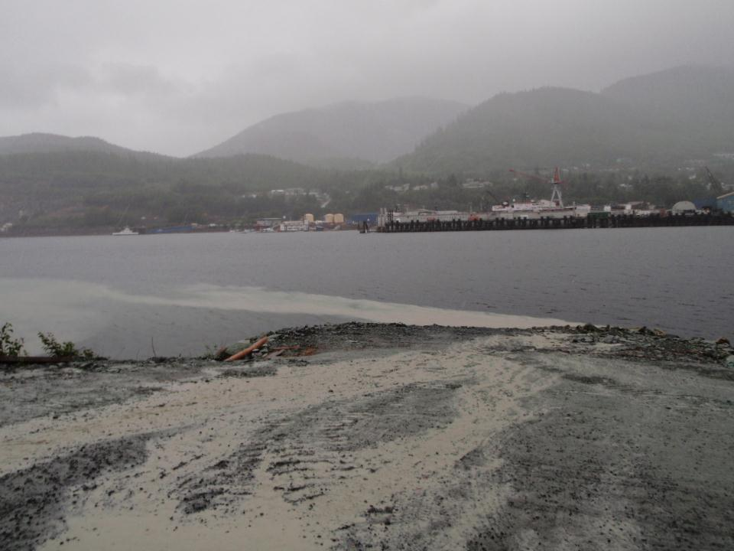
Identify Approaches to Protect Natural Resources
Protect Nearby Waters
Use a combination of techniques, including temporary fencing, signage, and educating staff and subcontractors.
Gravina Island

Slide 27
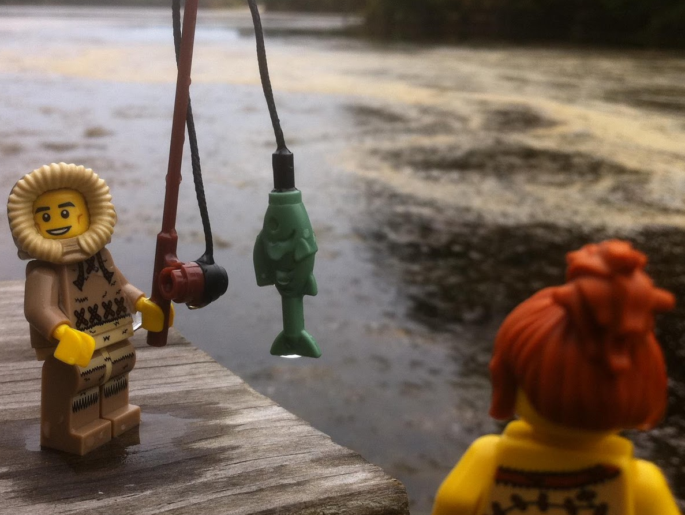
In Water Work Conditions?
Environmental Commitments?
Windows for permitted work?
Timing Prohibition's?

Slide 28
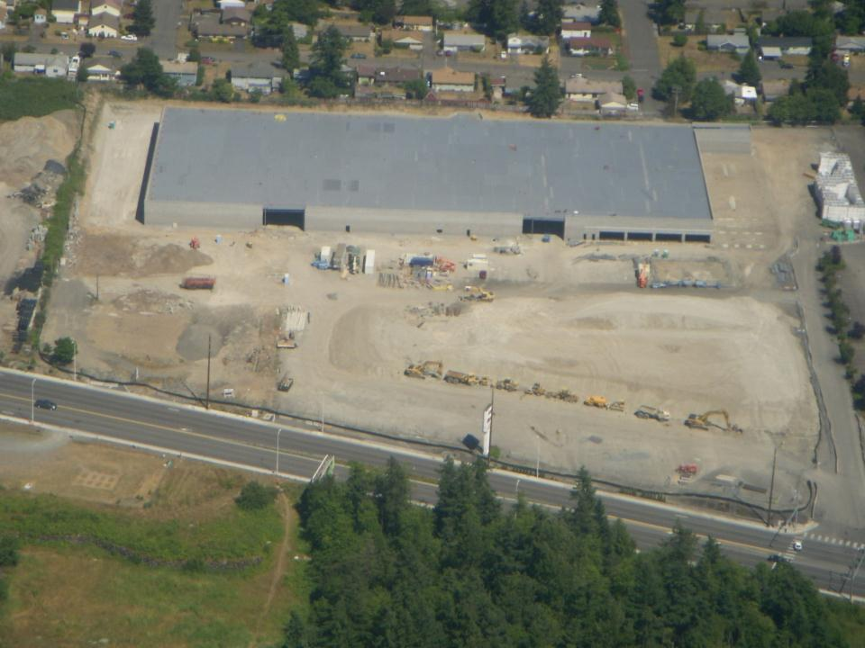
Nature of Construction Activity
CGP Part 5.3.4 Pg. 37
• Project type or function
• Sequence and timing of activities that will disturb soils at the site
• Size of the property including support activities and disturbance in acres
• General location map with construction site location and
any nearby waters or wetlands within 1 mile
• Other potential sources of pollution, asphalt, concrete, stucco, paint etc.

Slide 29
Insert Video LID Part 1

Slide 30
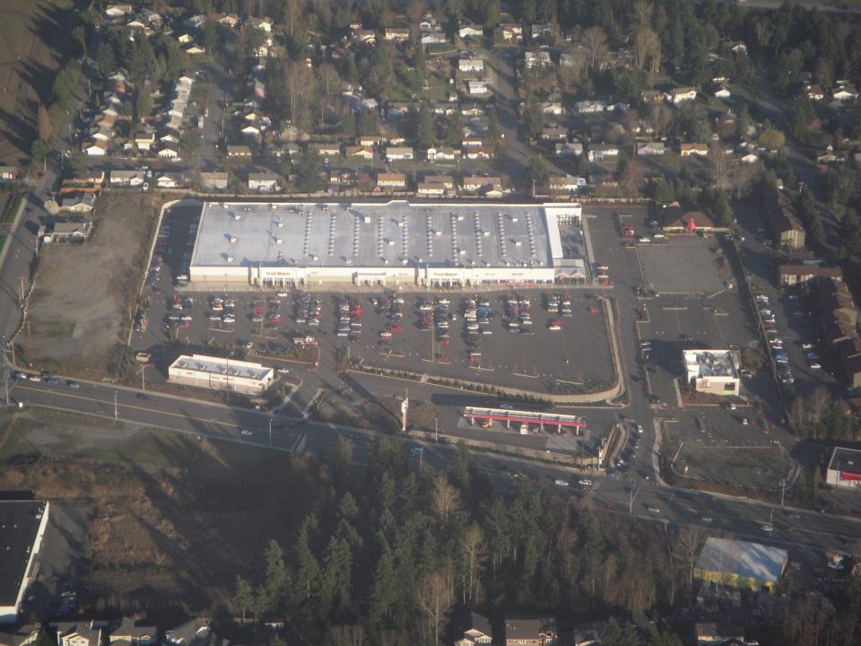
Will the discharge points
change during construction?

Slide 31
Insert Video LID Phasing and Scheduling

Slide 32
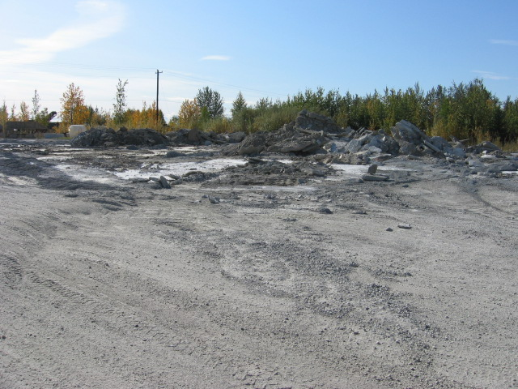
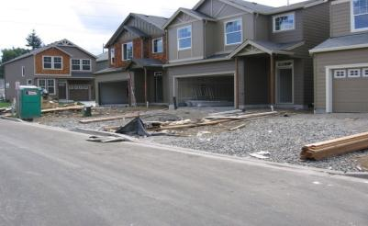
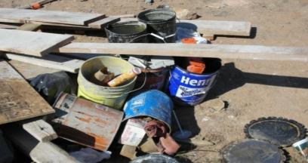
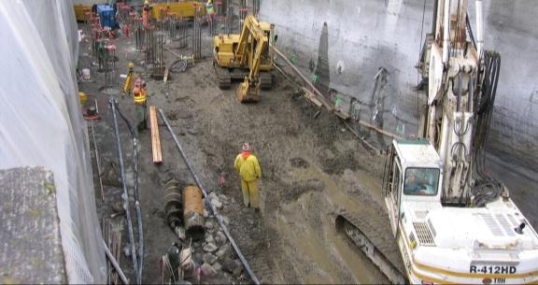
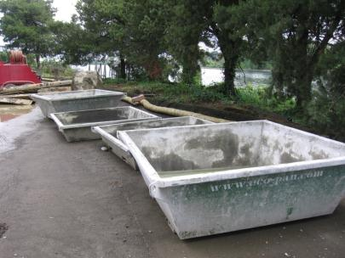
Identify Pollutants
& Pollution Sources
What is likely to be on site?
How might it pollute?
Be as specific as possible in your SWPPP about the BMPs you will use to address them.

Slide 33
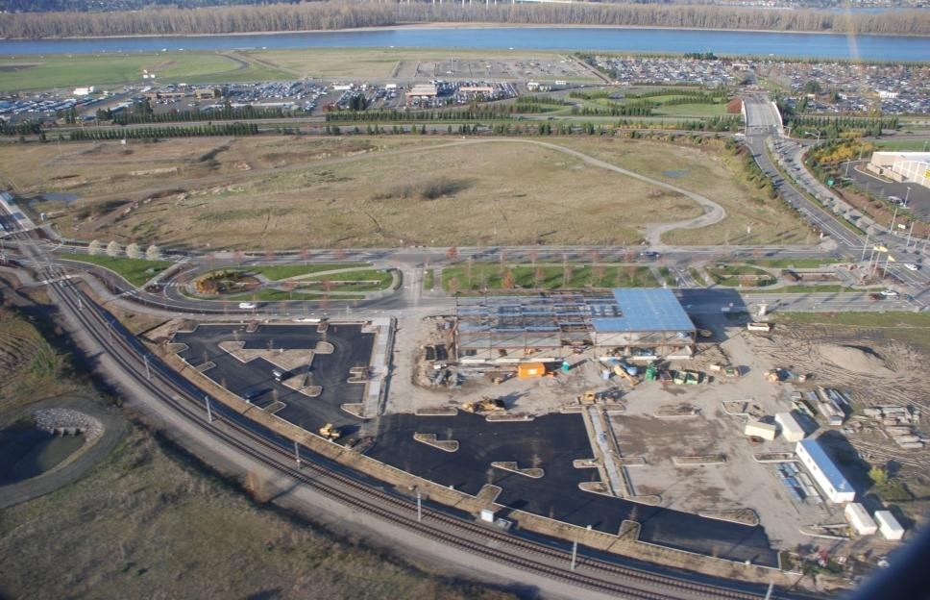
Incorporate sediment and erosion controls to protect permanent stormwater controls as they are constructed.
Notes:
Such as wet ponds, swales, and bioretention cells. The construction site will drain into constructed storm systems. The planting strip behind the project is a stormwater treatment facility the hole to the left has outlets that drain into the Columbia river in the background.

Slide 34
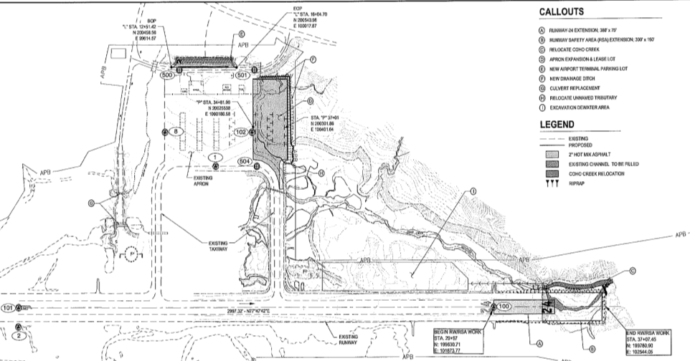
CGP Part 5.3.5 Pg. 37
Site Map(s)
The SWPPP must contain a legible site map (or set of maps for large projects) showing the entire site and identifying the following site-specific information:
Hoonah

Slide 35
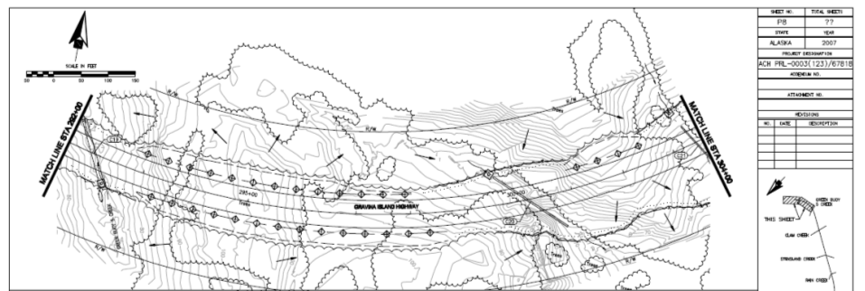
Use or create a topographic drawing that details:
North Arrow and bar scale;
Boundaries of the property where construction will occur;
Locations where earth-disturbing activities will occur, noting phasing;
Location of areas that will not be disturbed and features to be preserved;
Location of all storm water conveyances including ditches, pipes, and swales;
Locations of storm water inlets and outfalls, with a unique code for each;

Slide 36
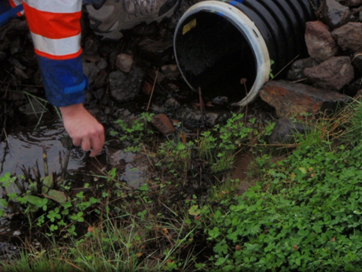
Monitoring Plan Only
Sampling Points
CGP Part 5.3.5.18 Pg. 37
A permittee subject to the requirements of Parts 3.2 must include the location(s) of the storm water discharge sampling point(s). For a linear project, indicate which sampling points are considered substantially identical in accordance with Part 7.3.5*.
*Representative Discharge Point for a Linear Project.
Notes:
in accordance with Part 7.3.5;

Slide 37
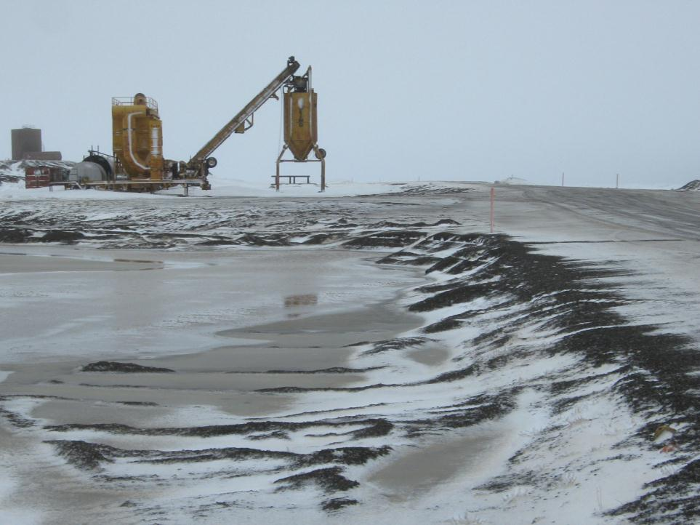
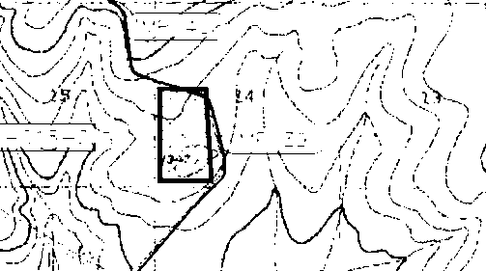
Locations of support activities.
CGP Part 5.3.5.13 Pg. 37
Batch Plant

Slide 38
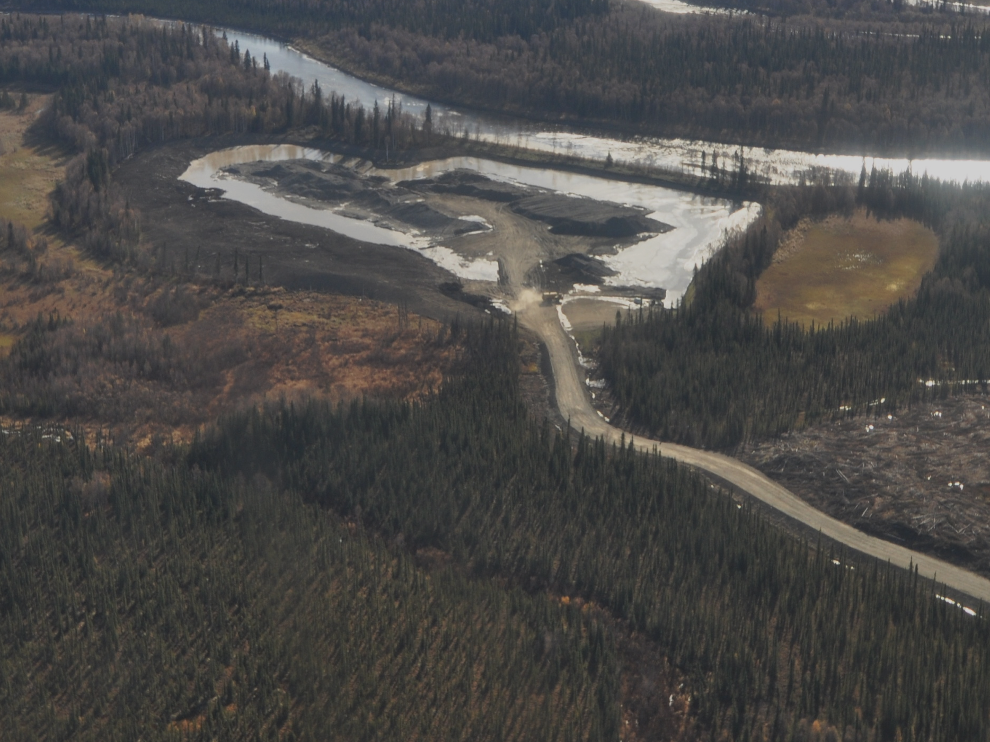
Locations of support activities
CGP Part 5.3.5.13 Pg. 37
The SWPPP must describe and identify the location of any storm water discharge associated with support activities.
CGP Part 1.4.2.3 Pg. 10
Storm water discharges from support activities (such as concrete or asphalt batch plants, equipment staging yards, material storage areas, excavated material disposal areas, borrow areas) (as defined in Appendix C), whether on-site, adjacent to, or offsite, provided the following:

Slide 39
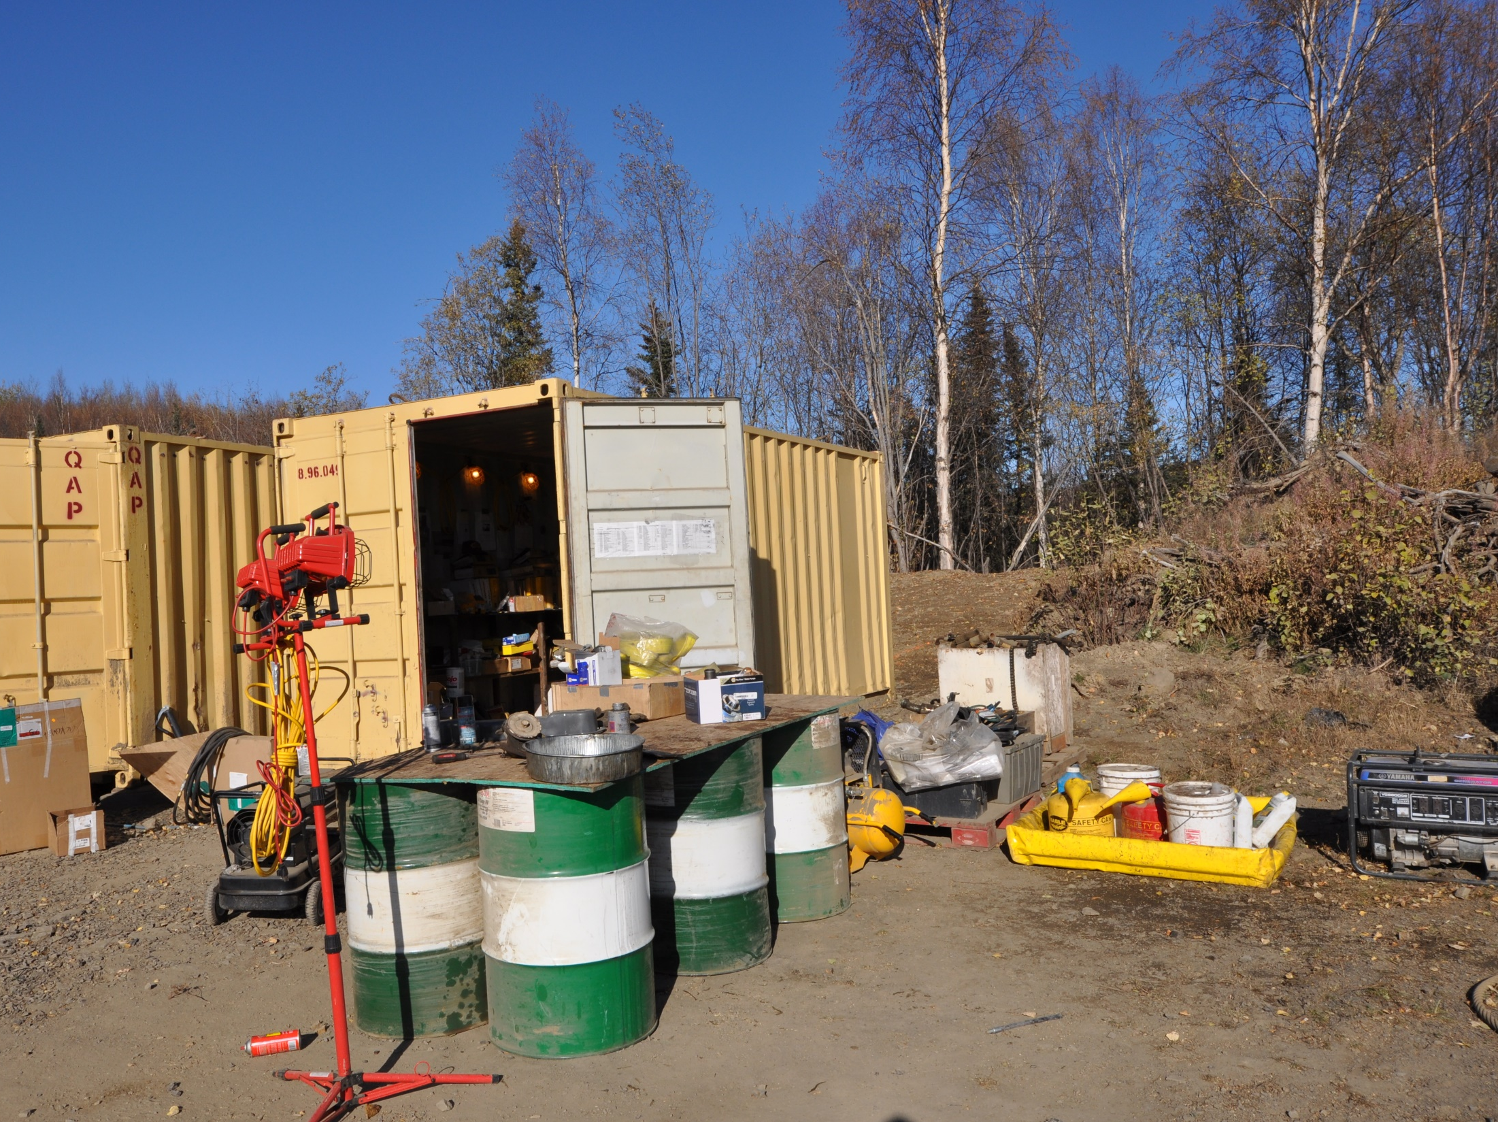
The support activity is directly related to the construction site required to have permit authorization for discharges of storm water associated with construction activity under this permit:
CGP Part 1.4.2.3.1 Pg. 10

Slide 40
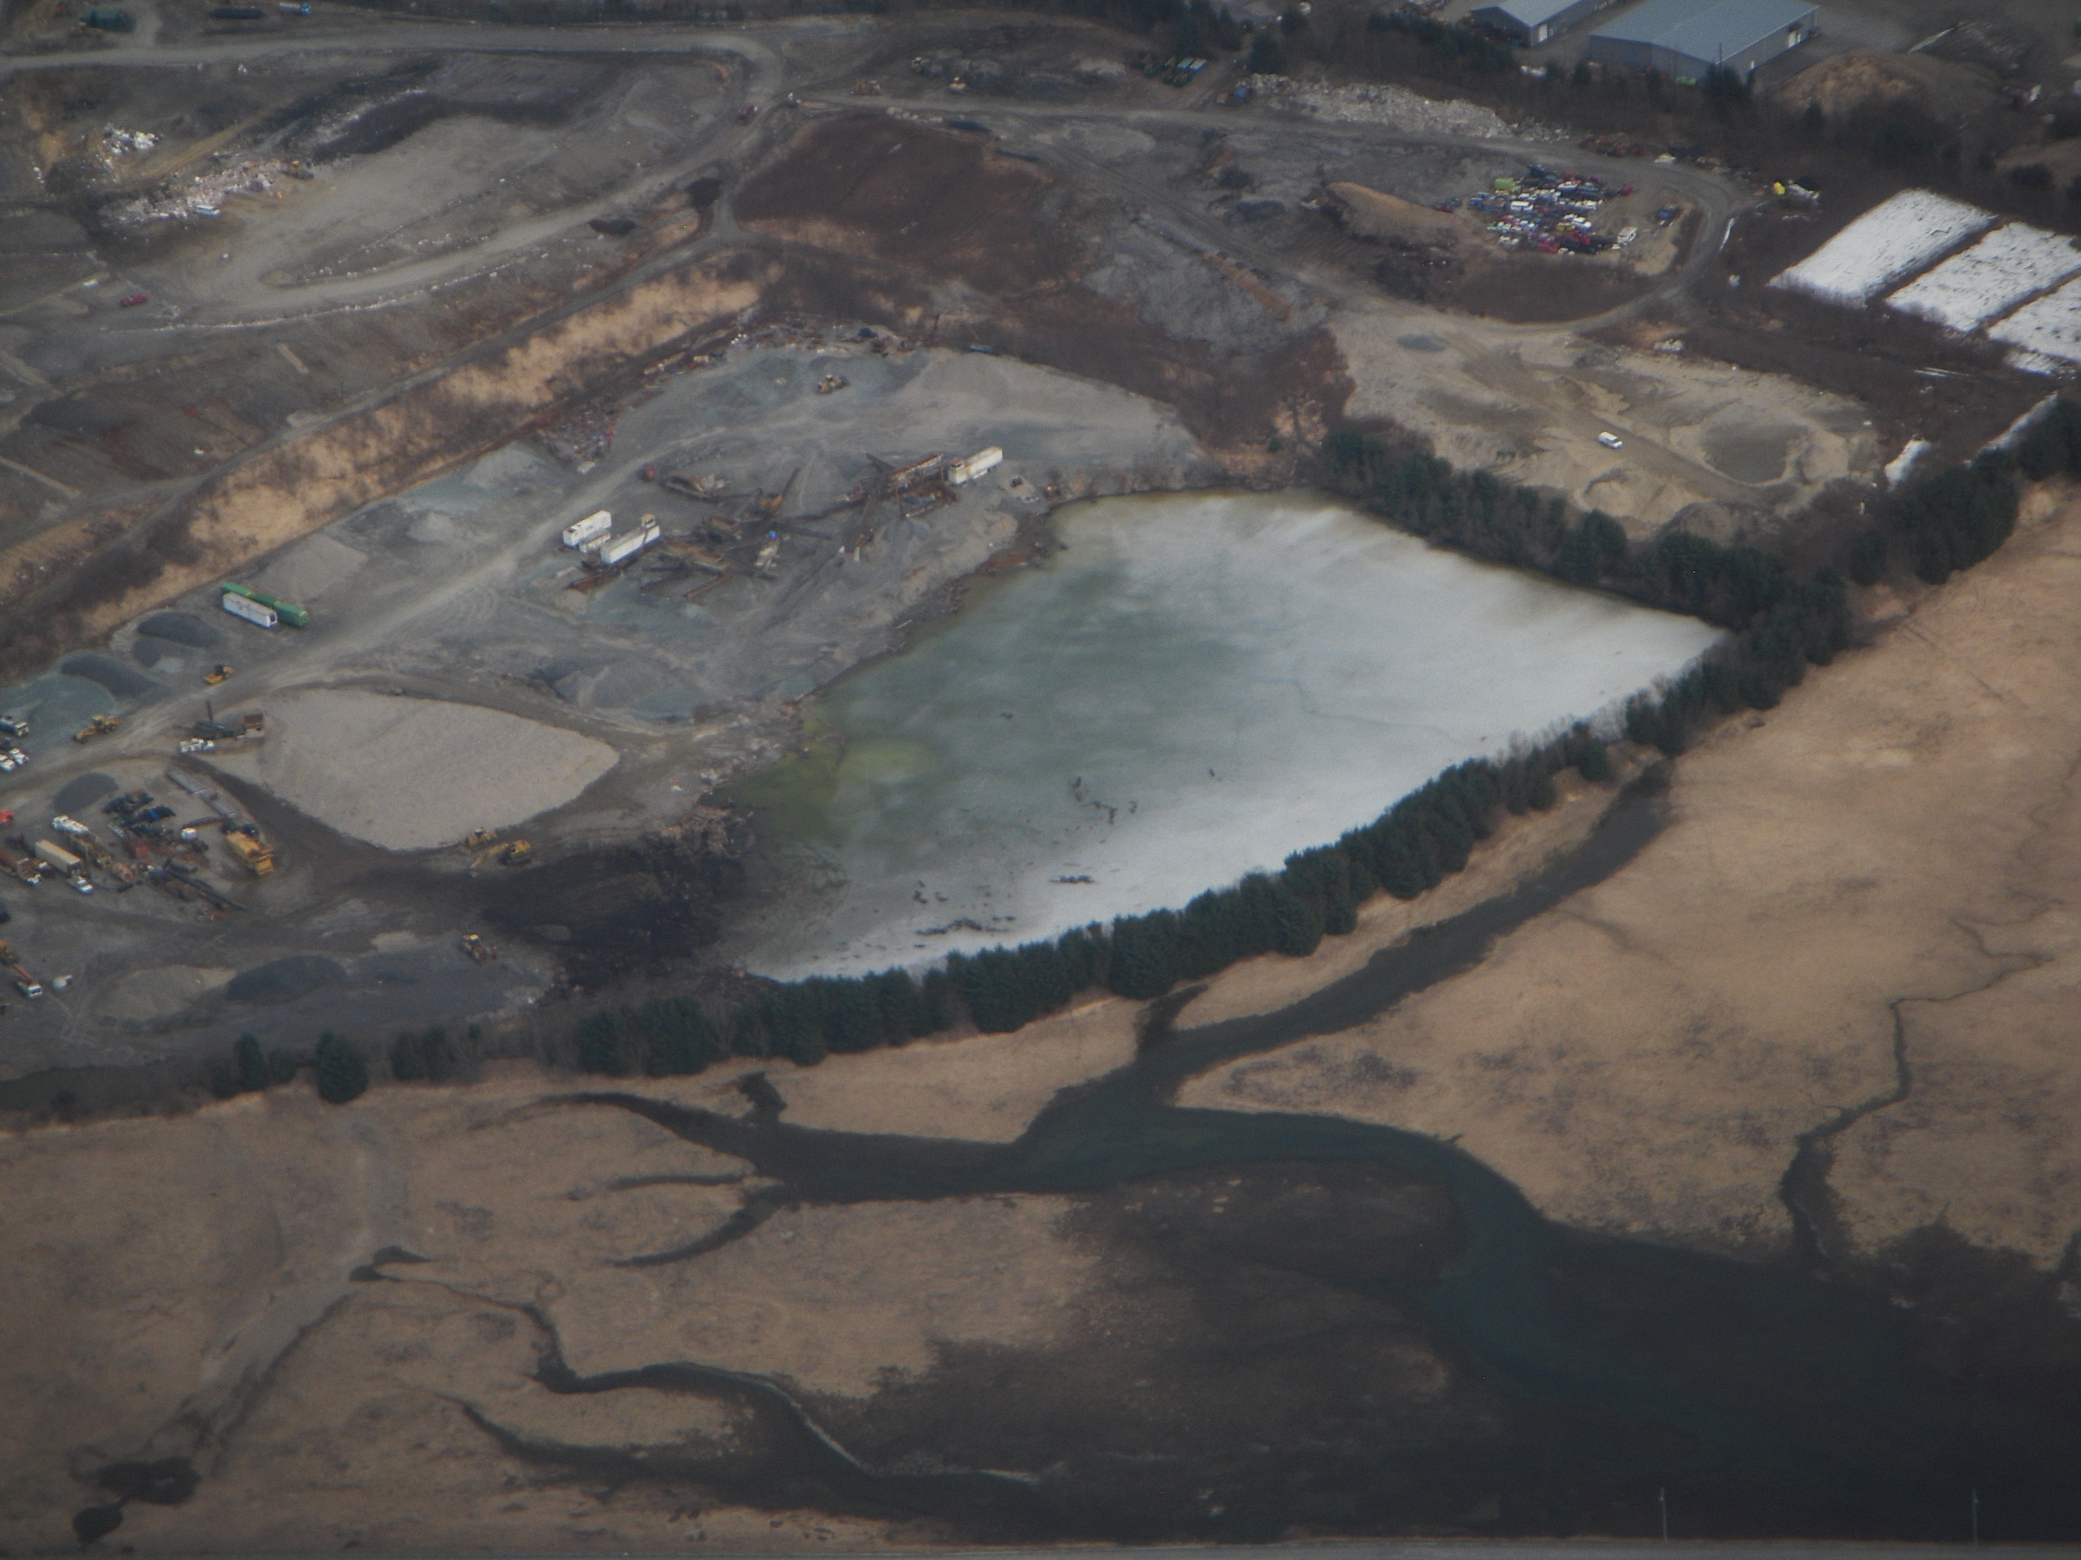
Locations of support activities
CGP Part 1.4.2.3.2 Pg. 10
The support activity is not a commercial operation serving multiple unrelated construction projects by different permittees;
The support activity does not operate beyond the completion of the construction activity at the project it supports; and
CGP Part 1.4.2.3.3 Pg. 10

Slide 41
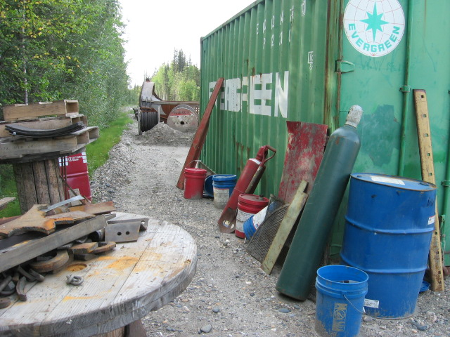
Appropriate control measures are identified in the Storm Water Pollution Prevention Plan (SWPPP) and pollutant discharges are minimized in compliance with Parts 3.0 and 4.0 of the permit.
CGP Part 1.4.2.3.4 Pg. 10

Slide 42
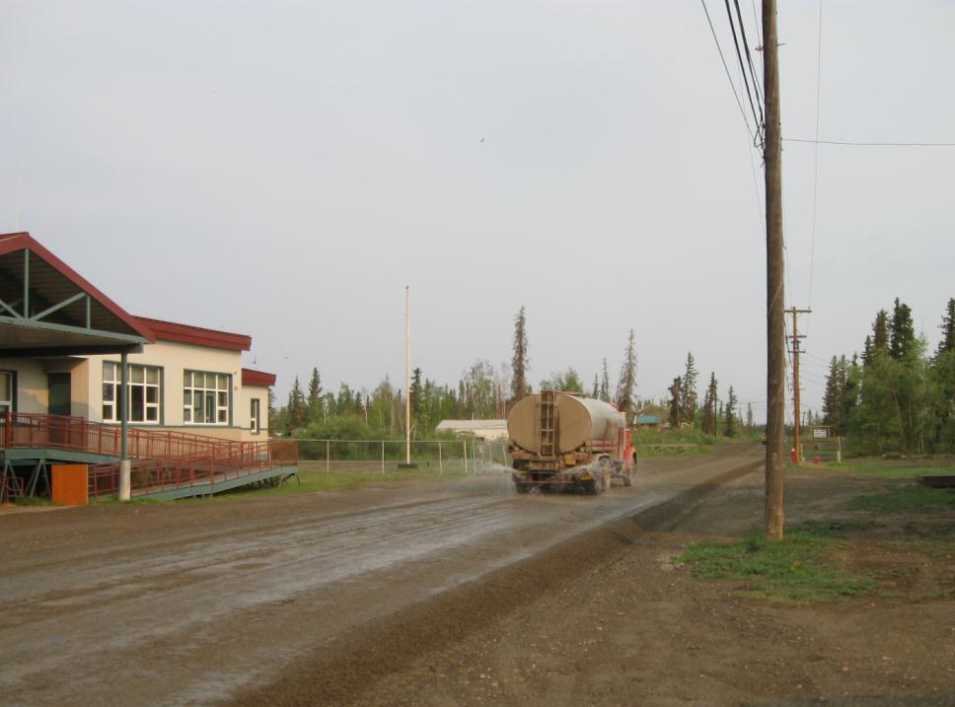
Locations where authorized non-storm water will be used, including the types that will be used on-site.
CGP Part 5.3.5.14 Pg. 37
Fort Yukon

Slide 43
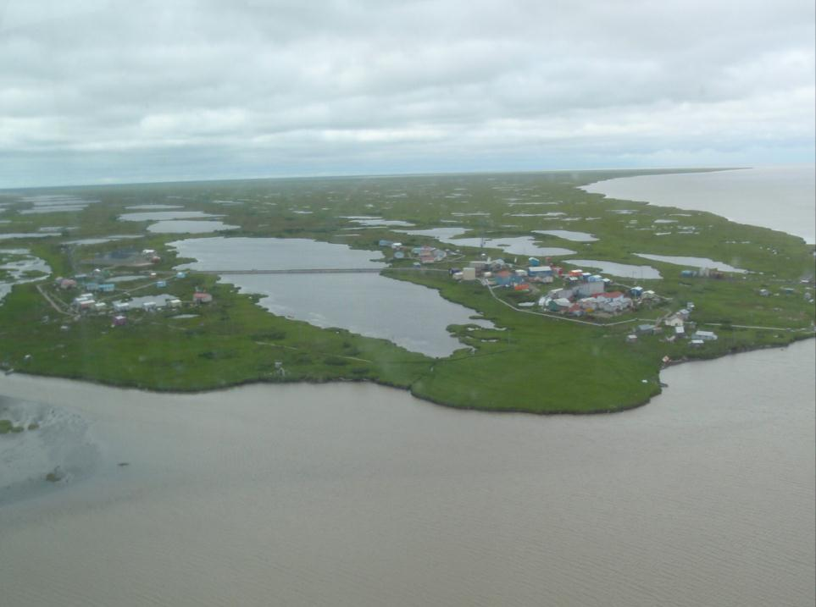
Locations of all waters of the U.S. (including significant wetland areas > 10,000sf) on the site & located within 2,500 feet of the site boundary that may be affected by discharges from the site.
CGP Part 5.3.5.15 Pg. 38
Your Next Job
Notes:
Sam can you identify this village?

Slide 44
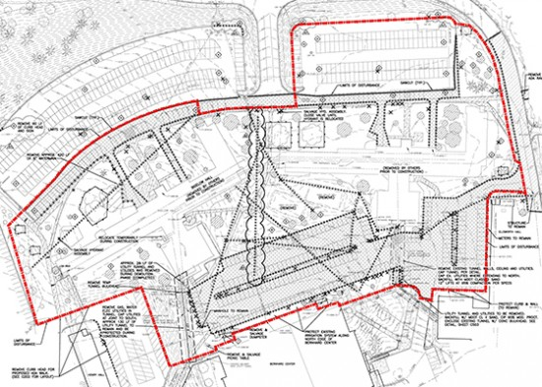
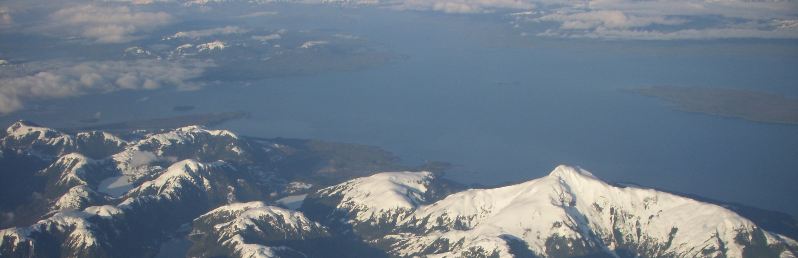
Projects near a Public Water System (PWS)
CGP Part 5.3.5.16 Pg. 38
Locations of existing PWS drinking water protection areas (DWPA) for PWS sources that intersect the boundary of the proposed project/permit area. The
site map must contain this information
Springs;
Wells; or
Surface water intakes.
CGP Part 4.10 Pg. 34
Where the project intersects a PWS drinking water protection area (DWPA) (see Part 5.3.5.16), notify the PWS contact.
Notes:
The DEC has the Web Map Basic Instructions located on the CGP webpage.

Slide 45


The DWPA can be found using the DEC interactive web map located at
http://dec.alaska.gov/das/GIS/apps

Slide 46

CGP Part 5.3.5.17 Pg. 38
Locations where storm water discharges to waters of the U.S. (wetlands, or an MS4)

Slide 47

Areas where final stabilization has been accomplished and no further permit requirements apply.
CGP Part 5.3.5.19 Pg. 38
Goodnews
Notes:
Ask if the seeded areas have achieved final stabilization, how about the ditch with rock lining?

Slide 48

Control Measures to Reduce Pollutant Discharges
CGP Part 5.3.6 Pg. 38
The type of control, required maintenance & location.
The sequence during construction when it will be installed, operational, & any manufacturer’s specifications.

Slide 49

SWPPP must describe & document control measures
CGP Part 5.3.6.3 Pg. 38
Sequencing
The general sequence of the stabilization practices that will be used to achieve temporary or final stabilization on exposed portions of the site as required in Part 4.5.

Slide 50

SWPPP must describe & document control measures
CGP Part 5.3.6.4 Pg. 38
Treatment Chemicals
The type of treatment chemicals used on the site and a description of the general location of their use at the site, in accordance with Part 4.6.

Slide 51

SWPPP must describe & document control measures
CGP Part 5.3.6.6 Pg. 38
The good housekeeping measures that will be used at the site, if any, in accordance with Part 4.8.

Slide 52

SWPPP must describe & document control measures
CGP Part 5.3.6.7 Pg. 38
A description of spill prevention and response measures that will be used at the site, in accordance with Part 4.9. The permittee may reference the existence of other plans for Spill Prevention and Control and Countermeasure (SPCC) for the project, provided that a copy of the other plan(s) is kept with the SWPPP.

Slide 53

SWPPP must describe & document control measures
CGP Part 5.3.6.8 Pg. 38
A description of all permanent storm water management controls that will be installed at the site, including their location, in accordance with Part 4.11.

Slide 54

SWPPP must describe & document control measures
CGP Part 5.3.6.9 Pg. 38
Winter Shutdown
For projects that expect a winter shutdown, SWPPP must provide a description of the following:
Anticipated dates of freeze-up and spring thaw.
The methods to address winter considerations.

Slide 55
SWPPP must describe & document control measures
CGP Part 5.3.6.10 Pg. 39
A description of maintenance procedures for control measures in accordance with Part 4.13.
Goodnews

Slide 56

Develop Site Maps
Include: Planned construction activities and stormwater practices for all stages of construction, protected areas, natural features, slopes, erodible soils, nearby waterbodies, permanent stormwater controls, etc.
Your SWPPP and site maps must reflect changes at your site.
Notes:
Discuss the SWPPP change and how it goes against the Army corps permit requirement

Slide 57

Use Site Maps to Track Progress
• Portable toilets
• Material storage areas
• Vehicle and equipment fueling and maintenance areas
• Concrete washouts
• Paint and stucco washouts
• Dumpsters or other trash and debris containers
• Spill kits
• Stockpiles
• Any other non-stormwater management BMPs
• Any temporarily removed structural BMPs
• Any changes to the structural BMPs
Notes:
If a marked-up site map is too full to be easily read, you should date and fold it, put it in the SWPPP for documentation, and start a
new one. Construction sites are dynamic. As conditions change at the construction site, such as the locations of BMPs, your SWPPP must reflect
those changes.

Slide 58

Update the site map as the site changes & BMP’s or facilities move

Slide 59

SWPPP must describe & document:
CGP Part 5.3.6.11 Pg. 39
A description of the training relevant to the construction activity and control measures used at the site.

Slide 60

Construction and Waste Materials
The SWPPP must:
CGP Part 5.3.7 Pg. 39
Describe the type of construction and waste materials expected to be stored at the site with updates as appropriate and describe the measures for the handling and disposal of all wastes generated at the site.
clearing and demolition debris
waste soils removed from the site
construction and domestic waste
hazardous or toxic waste
sanitary waste
Kodiak

Slide 61

CGP Part 5.3.8 Pg. 39
Locations of Other Industrial Storm Water Discharges
The SWPPP must describe and identify the location of any storm water discharge associated with support activities.
Including storm water discharges from dedicated asphalt and concrete plants that are covered by this permit.
Tok

Slide 62

Non-Storm Water Discharges
CGP Part 5.3.9 Pg. 39
The SWPPP must identify all authorized sources of non-storm water discharges.
The SWPPP must describe the good housekeeping measures used to control or reduce non-storm water discharges.
Barrow

Slide 63

CGP Part 5.1.2.4 Pg. 36
CERTIFICATION AND NOTIFICATION
“I certify under penalty of law that this document and all attachments were prepared under my direction or supervision in accordance with a system designed to assure that qualified personnel properly gathered and evaluated the information submitted. Based on my inquiry of the person or persons who manage the system, or those persons directly responsible for gathering the information, the information submitted is, to the best of my knowledge and belief, true, accurate, and complete. I am aware that there are significant penalties for submitting false information, including the possibility of fine and imprisonment for knowing violations.”
The SWPPP must be signed and certified by the construction operator(s).
Attach a copy of the NOI and permit authorization letter.

Slide 64


Personnel Qualifications in the SWPPP
Example DOT&PF requirement:
Include in the SWPPP copies of the AK-CESCL cards or certificates for the Superintendent and SWPPP Manager, and for any acting Superintendent and acting SWPPP Managers. If the Superintendent or SWPPP Manager is replaced permanently or temporarily, by an acting Superintendent or acting SWPPP Manager; record in the SWPPP the names of the replacement personnel, the date of the replacement, and for temporary personnel their beginning and ending dates.
AK DOT Form 25D-127

Slide 65




CGP Part 5.10 Pg. 42
Main Entrance Signage
Permit Authorization Number assigned NOI
Operator Contact Name
Operator Contact Phone Number
SWPPP Location or the name and phone number of the contact person
Notes:
Include all posting materials in the SWPPP. Have copies available to replace any damaged, even faded doccuments.

Slide 66

Every site is different
Every SWPPP is unique
Practices will vary
Ketchikan

Slide 67


SWPPP APPENDICES
* DOT SWPPP
Appendices vary
A. Site Maps and Drawings
B. BMP Details
C. Project Schedule
D. Supporting Documentation:
    TMDLs
    Endangered Species
    Other Permits or Requirements
E. Delegation of Authority, Subcontractor Certifications
F. Permit Conditions:
    Copy of Signed Notice of Intent
    Confirmation of Delivery of NOI to ADEC
    Copy of Letter from ADEC Authorizing Coverage, with ADEC NOI Tracking Number
    Copy of Most Recent ADEC CGP
G. Grading and Stabilization Records
H. Monitoring Plan (If Applicable) and Reports
I. Training Records
J. Corrective Action Log
K. Inspection Records

Slide 68

When using the DEC SWPPP template:
• Control Measures:
Add a subsection to describe dedicated asphalt plants and/or dedicated concrete plants, give their locations and identify the BMPs that will be used to minimize pollutants from them. If there are no dedicated asphalt or concrete plants, then state that in the SWPPP.
Sea-Tac

Slide 69

Proper BMP Specification, Application, Installation & Maintenance are Critical
The Right Thing
In The Right Place
At The Right Time
Notes:
The right thing in the right place at the right time.

Slide 70


Slide 71

What is a BMP?
Schedule of activities - Prohibitions of practices
Physical structures - Construction procedures
Other management practices to reduce pollution

Slide 72

Design BMPs
Minimize disturbance (foot print) of project.
Maximize integration of existing land contours.
Minimize length and gradient of slopes.
Account for both onsite and offsite stormwater during construction.
Notes:
Engage the class and encourage discussion.

Slide 73

Procedural BMPs
Time major soil disturbance for dry season
Complete project in phases
Integrate erosion control and construction schedules (they don’t have to conflict)
Notes:
Read slide.
Engage the class and encourage discussion.

Slide 74

Physical BMPs
Implementation of erosion & sediment control practices in the field.
Must be a supplement to and not a replacement for design & procedural BMPs.
Notes:
Read slide.
Section’s on SWPPP contains numerous BMPs that will be discussed in greater detail.

Slide 75

General Principles
Retain duff layer, tundra, native topsoil & vegetation
Source control: preventing erosion is easier and cheaper than managing sediment
Divert run-on / runoff
Creativity is a BMP
Notes:
Its important to control the water coming onto your project. Don’t let clean run-on water become dirty run off water from your project.

Slide 76


BMP’s and your SWPPP should consider designs
to exceed your sites conditions.
Notes:
Like anything, you can’t do it twice for less than doing it right the first time.

Slide 77


Much Cheaper to start with
the right BMP first
BMP’s should meet & exceed designed performance
goals or outlast the strongest, longest storm
Notes:
Plan ahead to avoid failures, use the information you have for risk management.

Slide 78

Two Main Categories of BMPs in Stormwater & Erosion Control Manuals
Source Control BMPs
- Prevent the Problem
Runoff Conveyance & Treatment BMPs
  -Control Flows On & Around Your Site
  -Treat the Problem

Slide 79

Erosion Control (keeping the dirt in place) &
Minimizing the Impact of Construction
Minimize disturbed area and protect natural features and soil
Phase construction activity
Control stormwater flowing onto and through the project
Stabilize soils promptly
Protect slopes
Sediment Controls (the second line of defense)
Protect storm drain inlets
Establish perimeter controls
Retain sediment on-site and control dewatering practices
Establish stabilized construction exits
Inspect and maintain controls

Slide 80





Guidance Differs from Place to Place & Contracting Agency
Check With Your Local Agency & Owner
Notes:
Details and instructions for BMP use etc. There are other manuals that have good details for BMP’s. When in another jurisdiction always use the local manual first then go outside for necessary BMP details and specifications. Note that the WA and OR BMPs may have regulatory elements that do not apply to Alaska.

Slide 81
Alaska Storm Water Guidance
ADEC Storm Water Guide
  Program procedures
  http://www.dec.state.ak.us/water/wnpspc/stormwater/Guidance.html
DOT&PF Alaska Storm Water Pollution Prevention Guide
  Best Management Practices
  Department-Specific Requirements
  http://www.dot.state.ak.us/stwddes/desenviron/resources/stormwater.shtml
AK-CESCL
  Videos & training documents
  ak-cescl.com

Slide 82

Most Used BMPs for Construction Sites Include:
Minimizing Soil Disturbance
Preserving Natural Vegetation
Good Housekeeping
Mulch/Seeding
Stockpile Covers
Silt Fence
Inlet Protection
Check Dams
Stabilized Rock Construction Entrances
Sediment Traps

Slide 83

BMPs may Require an Engineer
Gradient Terraces
Interceptor Swales or Dikes
Orifice/Dams
Grass Lined Channel
Pipe Slope Drains
Subsurface Drains
Level Spreaders
Outlet Protection
Gravel Filter Berm
Sediment Traps & Ponds
Chemical Treatment
Filtration
Notes:
Note picture. If this over flows where does it go? Could this be a hazard to the home directly downhill? Could infiltration of water in this area put down gradient structures at risk? Whose responsible for this if something happens?

Slide 84

Stormwater Design Engineering Considerations
Identify Areas for Stormwater Infiltration
Identify Area for Stormwater Collection
Identify Construction Access
Identify Lay-Down Areas for Materials
Plan Contours to Eliminate Long and/or Steep Slopes
Notes:
The picture is of a parking lot with stormwater infiltration and storage area. All asphalt drains into the center area. This is in north Idaho. There will be increased focus on “greener” design elements in all construction.

Slide 85

All Sites Require Multiple BMP’s
Compost Sock
Creek
Coir Blanket
Silt Fence
Coir Logs
Jute Netting
Seeding
The trick is…
Gravel Access
The right BMP,
in the right place, at the right time!

Slide 86

USACE Bonneville Dam Fish Bypass
BMPs During Construction
BFM Spray Truck
Stockpile
Silt Fence
Rip Rap
Columbia River

Slide 87

Silt Fence
Slash Berm
J Hook Sand Bags
Rock Berm

Slide 88

Stockpile Covered & Contained
Dump Truck on Gravel
Street Kept Clean
CGP Part 4.3.7 Pg. 26
Notes:
Re cover pile when not working, Laborer with a broom & shovel.
The large export of this job made the stabilized entrance difficult to maintain. In retrospect it would have been cheaper to pave the access.

Slide 89

Gravel Road
Wattles
Seeding
Stockpiles Covered
Tree Protection
The Right BMP in the Right Place at the Right Time Takes Planning

Slide 90


Plan Implementation / Task Execution
Notes:
Bypass creek to install outlet protection.
With any plan its only as good as it’s implementation and execution.
Now that we have a plan let’s do it!

Slide 91

Coconut Blanket
Hand Strewn Straw
Coconut & Straw Blanket
Straw Wattle
Creek Culvert Outlet
Energy Dissipation
Notes:
Work completed in one day including the creek bypass.

Slide 92

Seeding
Plastic
Wattles
Silt Fence
Preserve
Vegetation
RECP’s
Channel
Lining
What-Where-When?
Notes:
The next few slides show a good stabilization plan being executed on a project. The cut is being stabilized on the way down and the fill slopes are being stabilized on the way up.

Slide 93

Finish as you go
Turn Liabilities into Assets
Manage Risk
Notes:
Finish slopes are 1.5:1.
Slopes were stabilized as we proceeded. Subgrades were roughened. Straw wattles were countersunk and staked. 8” coarse compost blanket was applied throughout. Backsloping and vegetation retention continued as possible.
Note that permanent and temporary stabilization measures were integrated through design.
At this point in the excavation, the stormwater drainage shifted to the south.
We installed double silt fencing around sensitive area.

Slide 94

Detail the planned process
Notes:
The slope was stabilized as the fill was constructed.
We staked straw wattles, then spread coarse compost blanket, then hydromulched and seeded, before fill was completed.
PAM was applied on the fill slopes.

Slide 95

Phase the Process
Notes:
The lower slopes of the reinforced fill in the distance have been covered with coir matting, also before the fill is completed.
Note dedicated Baker tanks to manage runoff.

Slide 96


Plan Ahead
Avoid preparing for spring runoff the hard way!

Slide 97

Storm Water Lead & Training of Employees
CGP Part 4.14 Pg. 35
A permittee must ensure that employees and subcontractors receive adequate training to ensure proper installation, maintenance, and removal of the control measures described in the SWPPP for the project.

Slide 98


DOT&PF specification 641-1.05 SIGNATURE CERTIFICATION REQUIREMENTS & DELEGATIONS.
Subcontractor Certification
Subcontractors must certify that they have read and will abide by the CGP & conditions of the project SWPPP.
*Subcontractors marching in line

Slide 99

“Questions”

