Slide 1


4. Risk Management
A different way of thinking about
Erosion prevention & Sediment control
January 2022

Slide 2
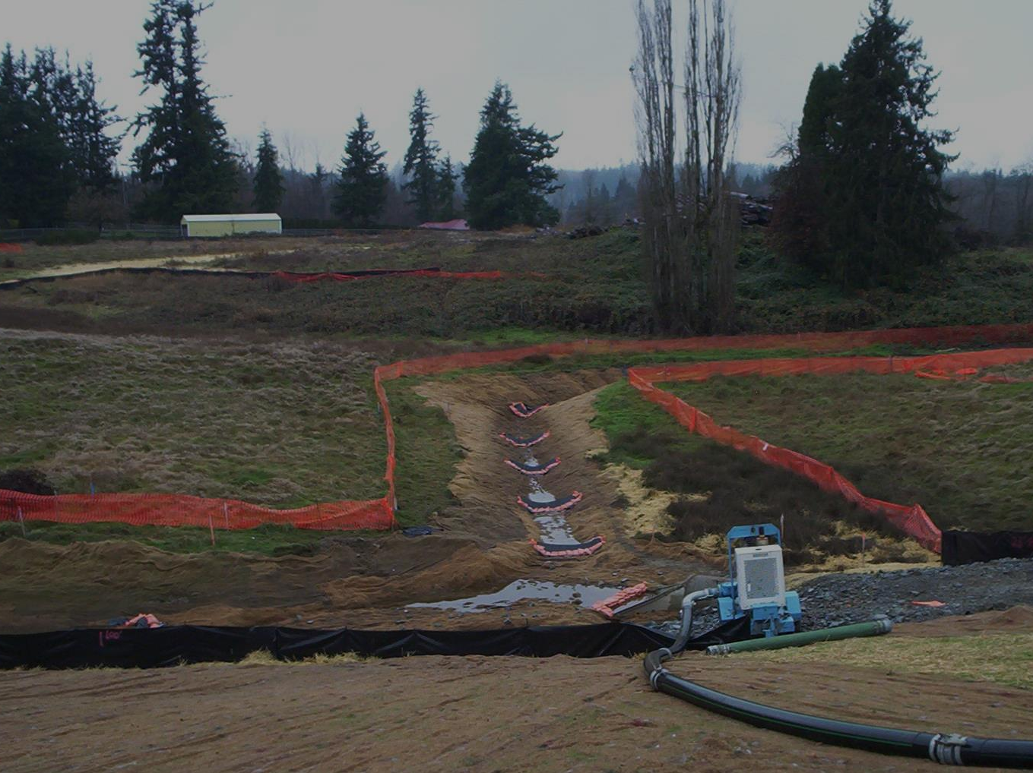
A Strategic Approach to Erosion Control Planning
1. Assessing risks of erosion & sedimentation
2. Managing risks through
  Planning: SWPPP
  BMP implementation: Work the plan.
  Inspection: Did we do it? Is it working?
  Adaptive Management – Make it work!

Slide 3
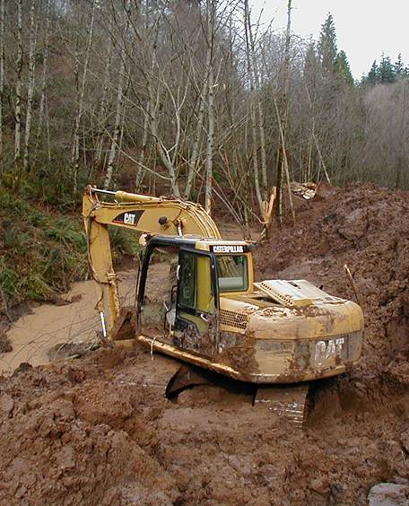
What is Risk?
RISK definitions:
Potential negative impact to an asset that may arise from some present process or future event
Probability of a known loss
Product of onsite hazard & consequences
Notes:
What are some examples of risk that affect construction sites?
Rain storm forecast for the same day that project clears large area of vegetation –increasing risk of erosion and sediment runoff.
Skip permit required site -inspections to save time and money increasing risk of liability if Agency inspects compliance with the permit.
Skip installation of BMP called for in SWPPP to save money increasing risk of liability of rain storm causing sediment runoff
Ask audience if they can think of other Risks a construction site deals with.

Slide 4
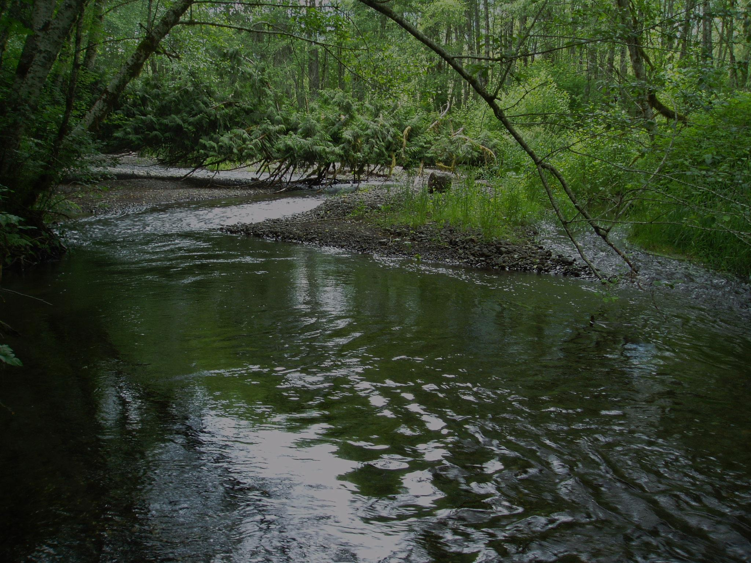
Erosion Control is all about Risk…
Erosion Risk Factors:
Rainfall: Timing, Intensity & Duration
Soils: Texture & Cohesion
Vegetation
Topography: Slope Steepness & Length, basin area, exposure
Proximity to off-site resources: natural resources, the neighbor’s yard
Notes:
Erosion risk factors:
Rainfall: timing, intensity, duration
Soils: texture, cohesion
Topography: slope steepness and length, basin area, exposure
Proximity to off-site resources: natural resources, the neighbor’s yard
Note that the first 3 relate to on-site hazards, 4th relates to off-site consequences
Erosion/sedimentation consequences:
On-site damage
Impacts to off-site resources: riparian area, water quality, stream channel integrity, aquatic habitat, community watershed issues (ie, flooding)
Public perception and goodwill
Legal consequences

Slide 5
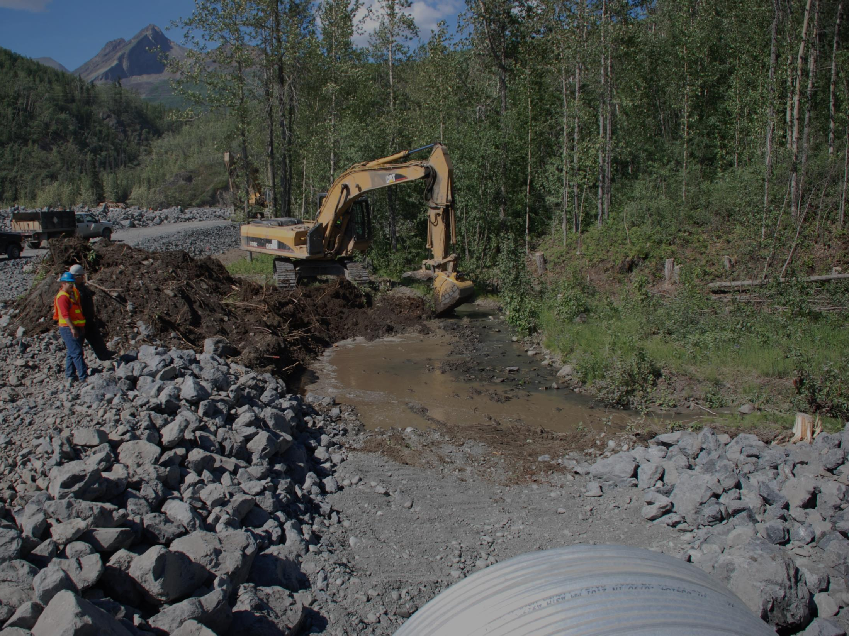
….and Consequences
Onsite Damage
Public Perception & Goodwill
Legal Consequences
Impacts to Offsite Resources:
  riparian area
  water quality
  stream channel integrity
  aquatic habitat
  community watershed issues (i.e. ,flooding)
Notes:
On-site damage, Takes time and costs money to fix.
Impacts to off-site resources: riparian area, water quality, stream channel integrity, aquatic habitat, community watershed issues (ie, flooding)
Public perception and goodwill
Legal consequences: Contractor skipped doing permit required onsite inspections. They were inspected by Permitting agency, ended up paying $18,000 fine for not doing inspections and documenting them in SWPPP. The Contractor took a risk and paid a fine.

Slide 6
What If I Don’t Comply?
Civil penalties
  EPA: $52,414 per day/per violation
  DEC Monetary fines
Stop Work Orders
  Requires formal notice from Permitting authority
Criminal Sanctions
  If violation knowing & willful, criminal penalties up to $10,000 and possible jail time
Citizen Suits
  Permit noncompliance is violation of Clean Water Act
  Citizens can use SWPPPs, inspection reports, log entries, and DMRs to sue you
Notes:
Keep in mind that with increased oversight or enforcement will come extra paperwork and legal fees. These costs often exceed the fines.

Slide 7
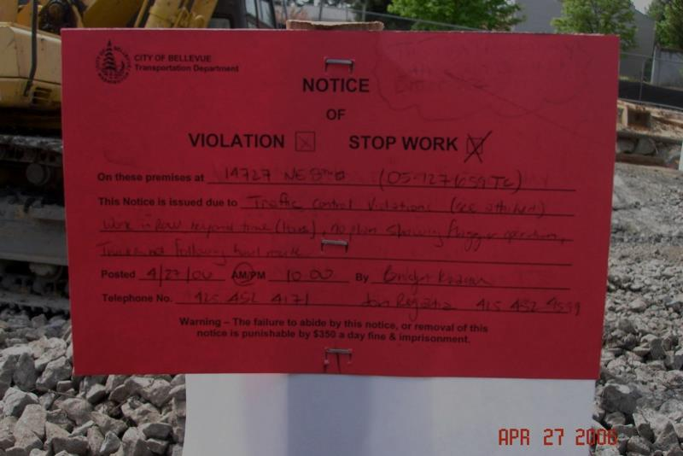
Risk Calculation
Uncertain in 1 event, Certain over Multiple Events
There may or may not be a big storm this week – but over time there will be a big storm
Proportional to expected losses from an event and to probability of event
The harsher the loss and the more likely the event, the greater we count the overall risk
To calculate risk:
Consider probability of negative event
Consider consequences of that event
Notes:
The classic probability of a negative event is the forecast of a rain storm. If the weatherperson is correct in their forecast of a large storm event in your area what’s going to be the impact to your project.
Ask audience if they can think of other negative events and their probabilities and the consequences of that event.

Slide 8
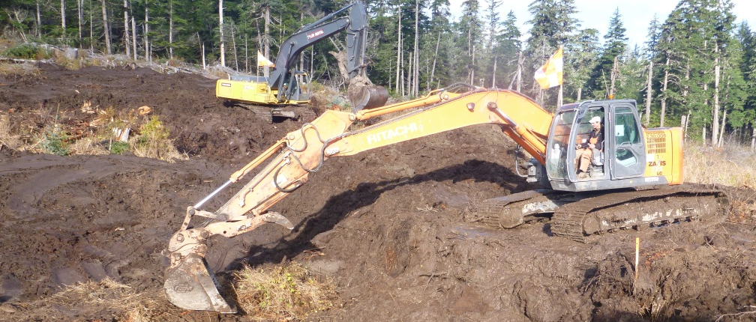
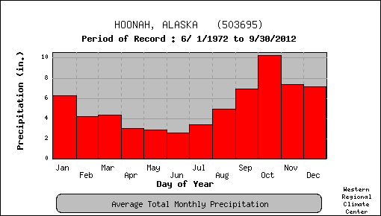
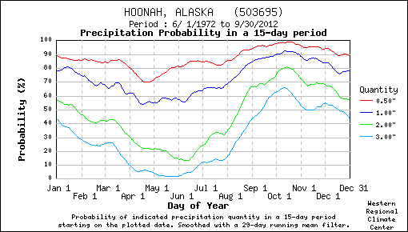
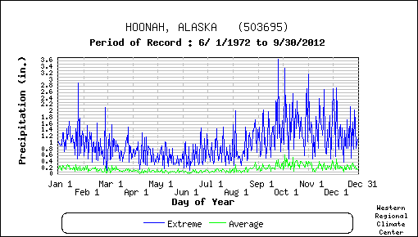
Risk Issues
Measuring Risk is Often Difficult
Assess Probability by the Frequency of Past Similar Events
Rare Events are Hard to Estimate
Notes:
Precipitation records provide basis for predicting future events, even to the point of assigning probabilities
Extreme precipitation events are not as predictable- they are irregularly distributed over time, and the coming year may bring below average, average, or record-breaking events.
These graphs could be risk management curves. What must we do when we move out of optimum?
In Figure in lower left labeled “Precipitation Probability in a 15-day period.” In June there is less than a 20% probability of a 2.0 inch rainfall in a fifteen day period. Whereas in September there is nearly a 70% probability of a 2.0 inch rainfall in a fifteen day period. Which month has a higher risk of rainfall and therefore a higher risk sediment runoff?

Slide 9
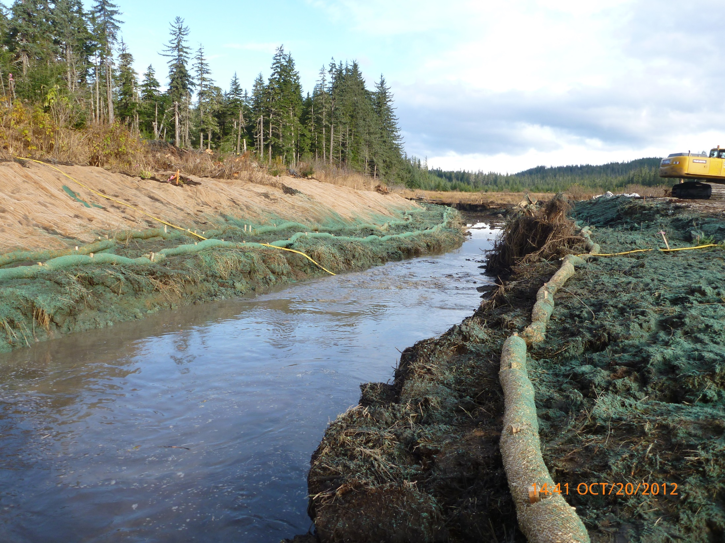
To Assess Risk :
Identify -
Sources of Harm & their Erosion Risk Factors
Likelihood that Harm Will Occur
  Precipitation Patterns
  Site Conditions
The Consequences if Harm Does Occur
  Site repairs
  Legal Penalties
  Off-site Repair/Mitigation
Hoonah
Notes:
Taking these steps will direct resources to the highest priority risks- those with the greatest likelihood of occurrence and the greatest consequences if they do occur.

Slide 10
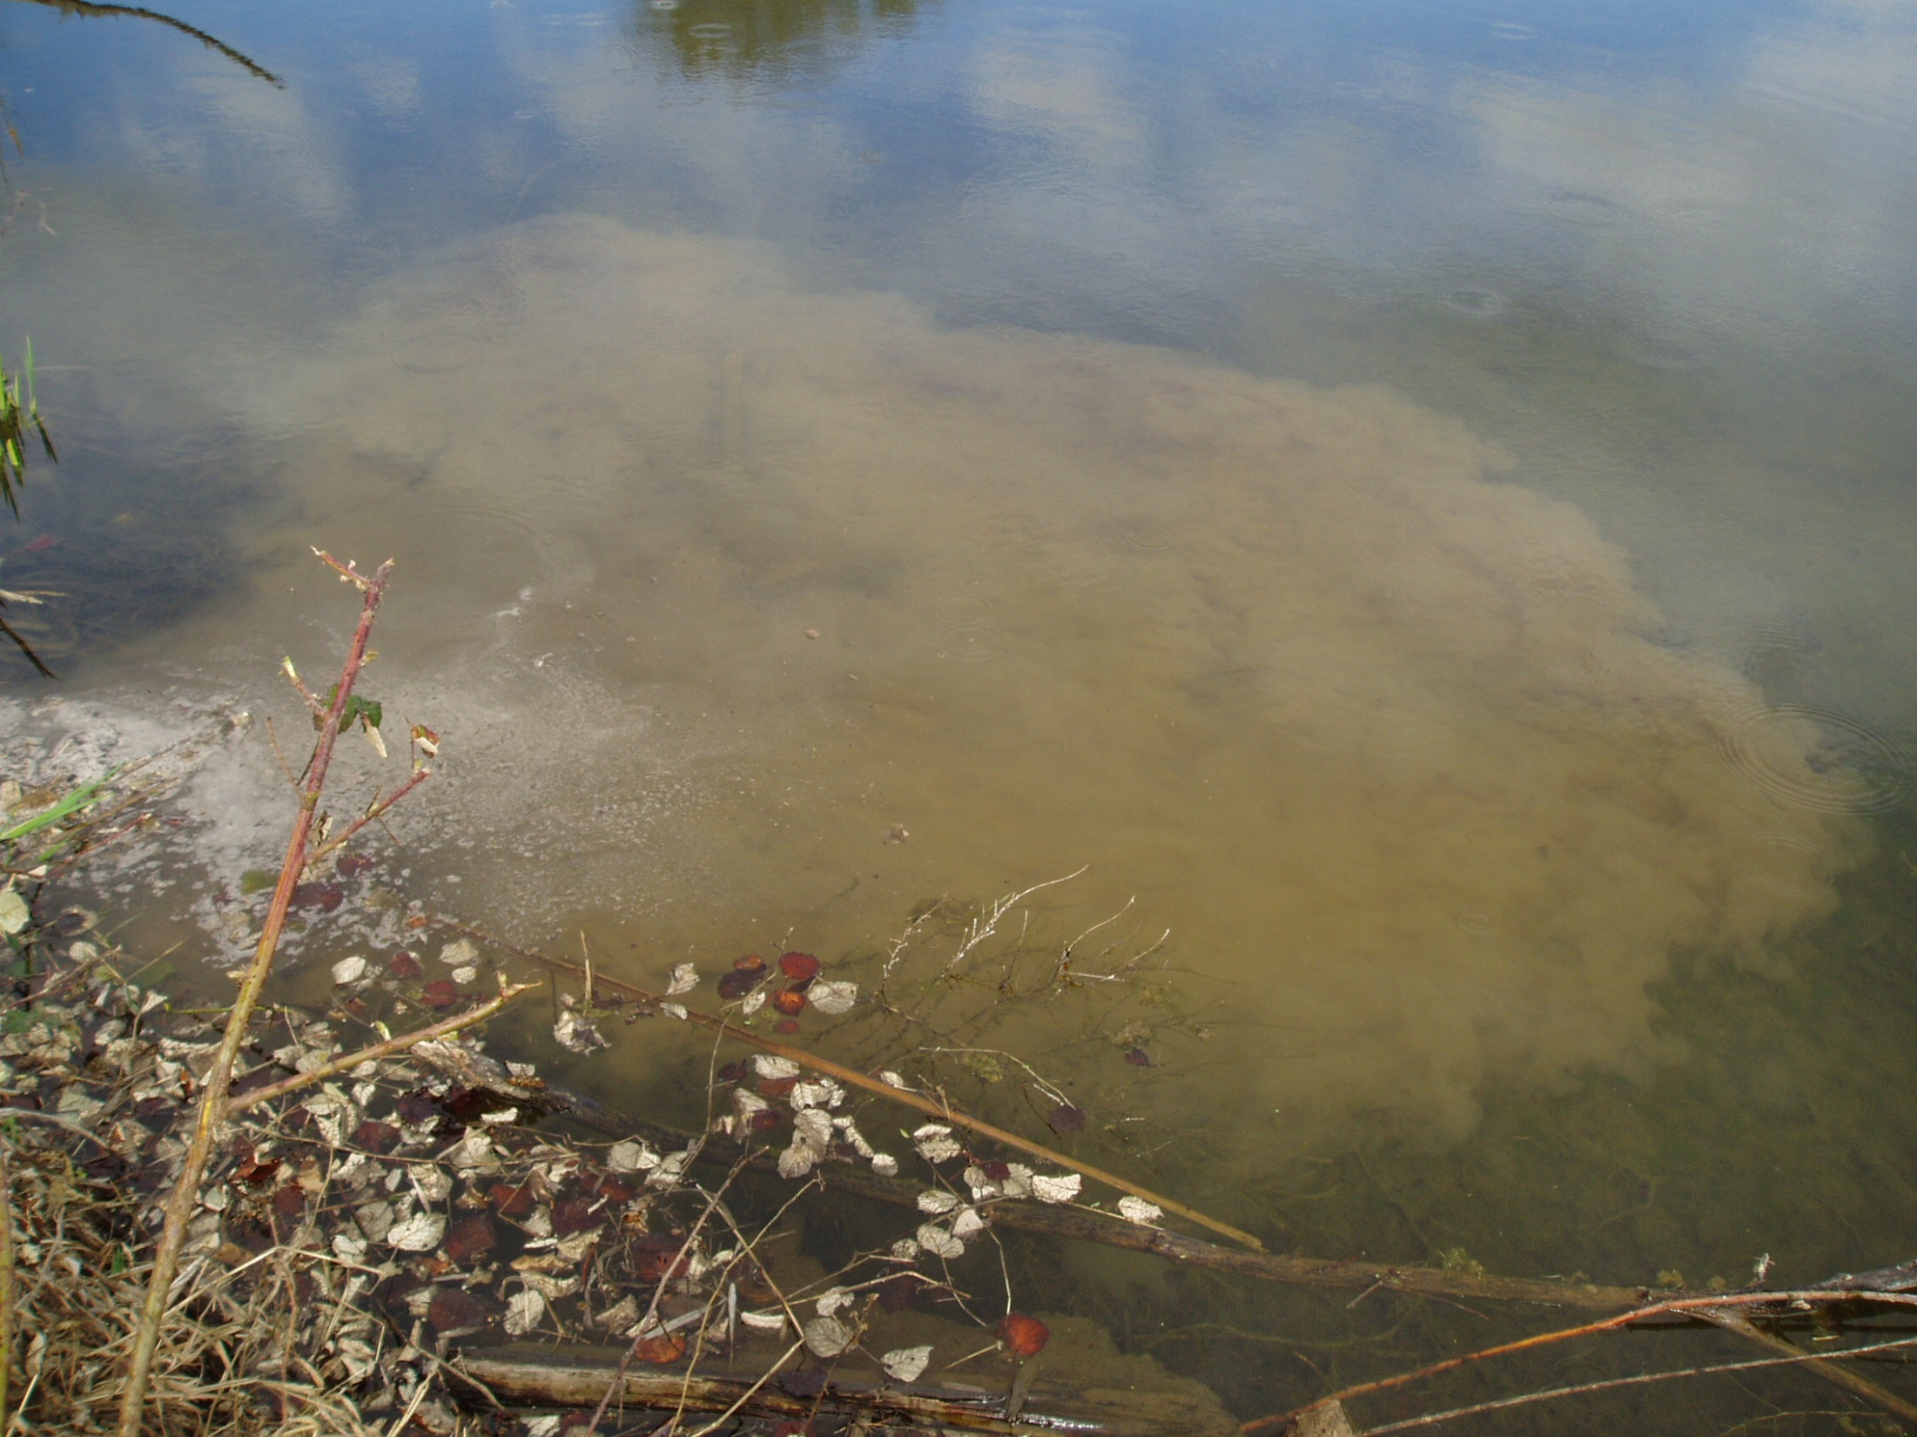
Mitigation of Risk
  Strategies Include:
  Avoid the risk
  Transfer risk to another party
  Design and/or schedule to avoid/reduce risk
  Reduce negative effect of the risk
  Accept consequences of the risk
Notes:
Note: The transfer risk option is always used in construction contracting. In Construction Hold Harmless and Indemnification clauses are common for contracts however they will not mean much with regard to enforcement actions for permit noncompliance. The signatory to the NOI is always holding the “Bag of Risk”

Slide 11
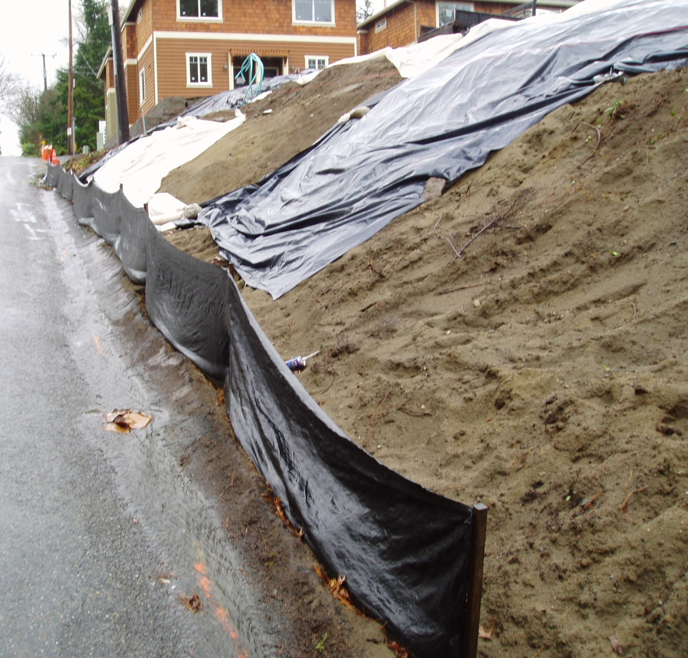

Managing Risk
1. Identify Sources of Potential Harm
Notes:
Where on site are the risks of erosion…and consequences from erosion or sedimentation…the greatest? The risk is the bare soil, what have we done to manage the risk? Some half way done plastic. What are we doing if we do have some erosion? Some silt fence that will simply direct the flow to the curb gutter and make the clean flow dirty. When we look at our sites with a critical eye like this it is pretty clear where the risks are and whether our responses are adequate.

Slide 12
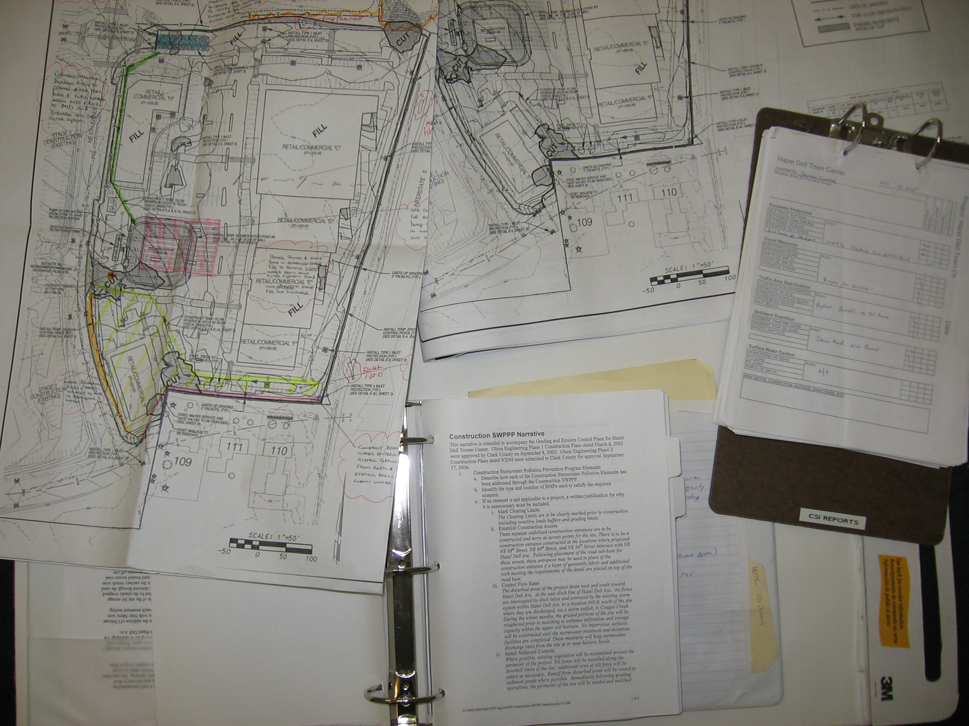
Managing Risk
Identify Sources of Potential Harm
Develop Strategies to Manage Risk
Notes:
The SWPPP is all about identifying risks and then crafting strategies to address them. A good SWPPP provides a narrative that details why the BMPs that have been selected are the best BMPs for the project, site conditions, schedule etc.

Slide 13
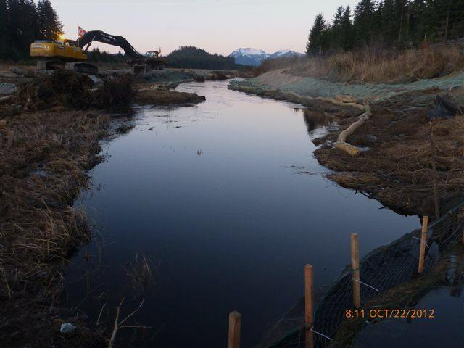
Managing Risk
Identify Sources of Potential Harm
Develop Strategies to Manage Risk
Implement Plans to Reduce or Eliminate Risk
Hoonah
Notes:
Implement the SWPPP to reduce/eliminate the risks of erosion/sedimentation. Having a good plan won’t do anything if it’s not implemented.
A few slides ago we saw the figure on precipitation probability.
Identify Sources of Potential Harm -- In June there is less than a 20% probability of a 2.0 inch rainfall in a fifteen day period. Whereas in September there is nearly a 70% probability of a 2.0 inch rainfall in a fifteen day period.
Develop Strategies to Manage Risk -- Plan to expose erosive soils in June and July.
Implement Plans to Reduce or Eliminate Risk -- Spread mulch and grass seed in July and August and don’t wait until September or October.
Ask audience for some other examples of identify risk, develop strategy, and implement plans.

Slide 14
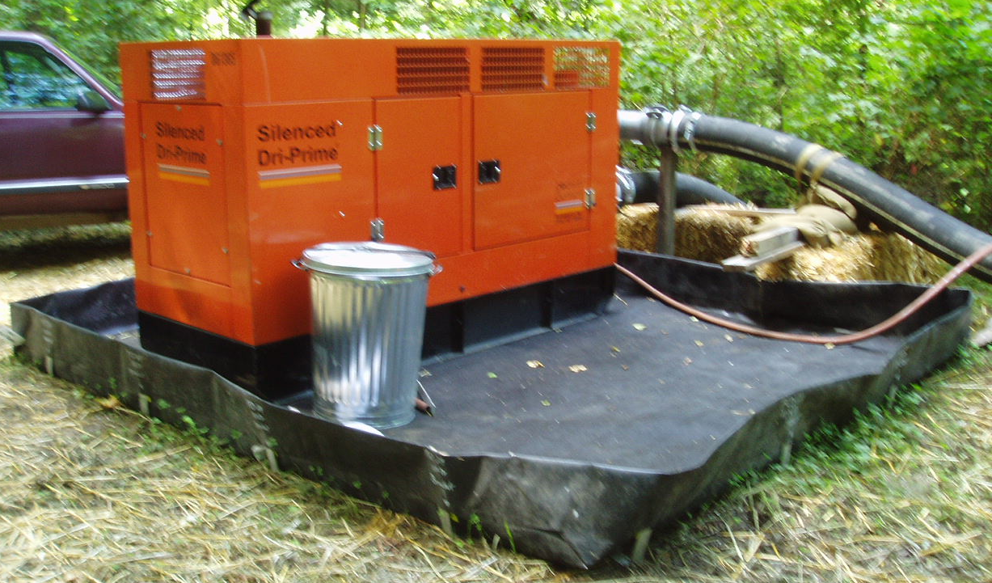
Risk Responses
Risk Avoidance:
Not performing an activity that could carry risk
Eliminate risk - but this also eliminates potential gain
Risk reduction - take action to reduce the severity of the loss

Slide 15
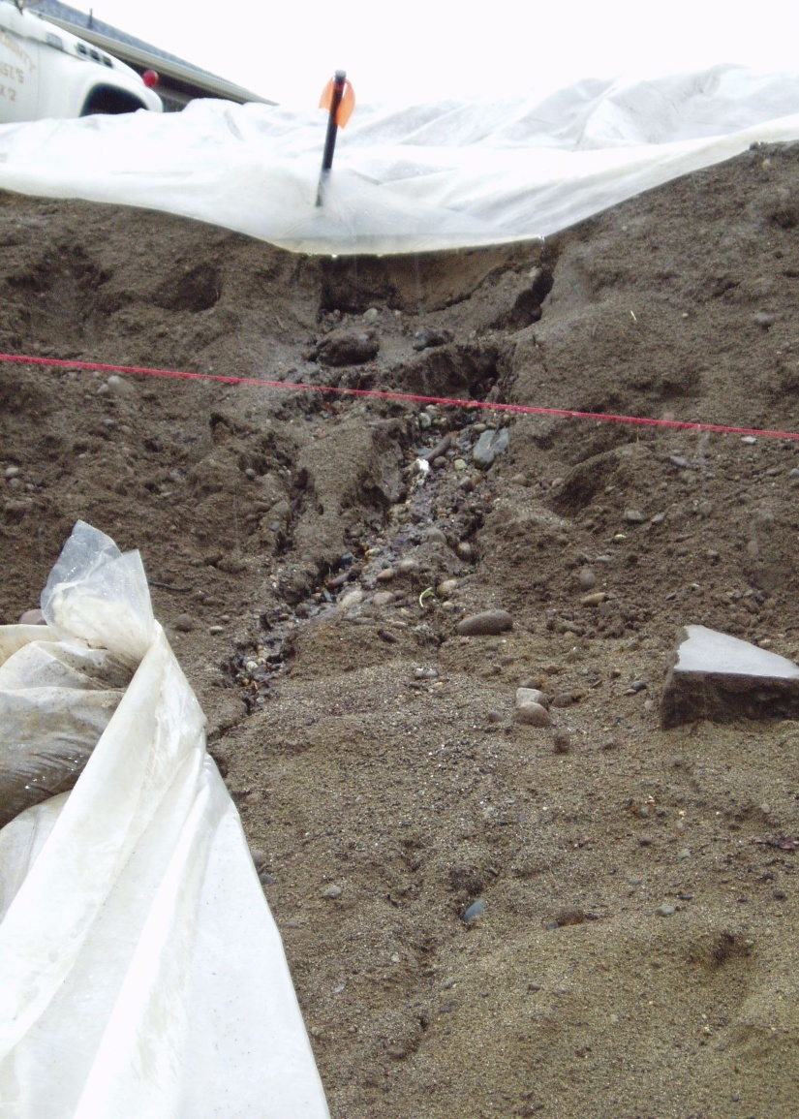

Accepting Risk Consequences
Minimize Risk
  BMPs to Manage Erosion/ Sedimentation
Terminate Risk
  Winter Shutdown
Transfer Risk
  Insurance
  Subcontract
  Notice of Transfer
Tolerate Risk
  “fines are a cost of doing business”
  “the damage won’t be that bad…”

Slide 16
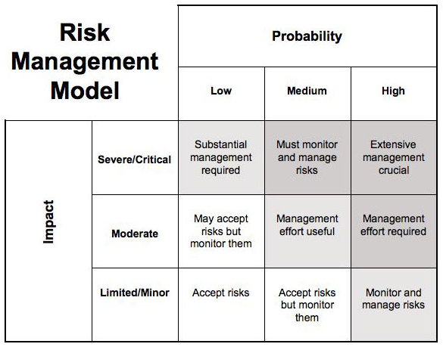
Risk Response
Examples of “acceptable” Construction Risks?
“Unacceptable” Risks: how can we reduce likelihood/ consequences?
Monitoring is Critical Element of Risk Management
Notes:
By assessing the potential risk we can guide the level of response. Note the words monitor and manage. Use BMP’s to manage, use inspections to monitor.

Slide 17
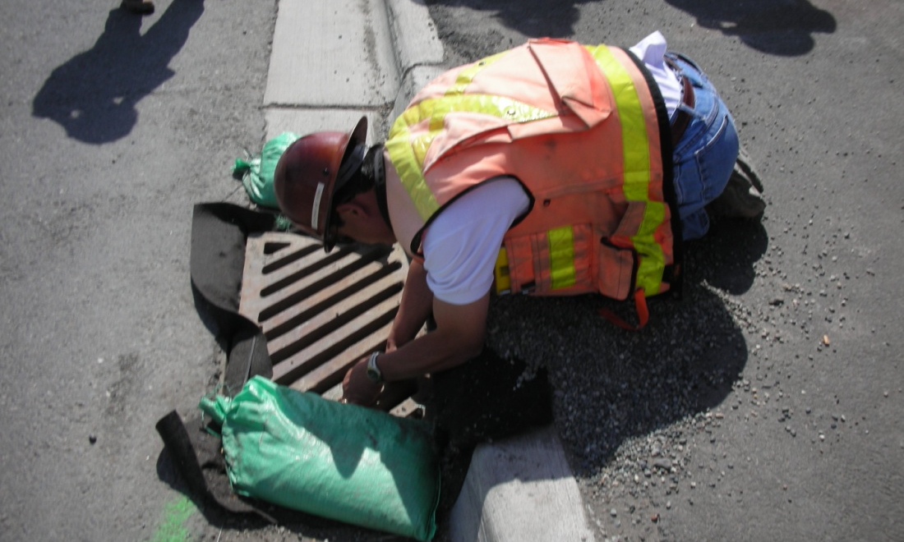
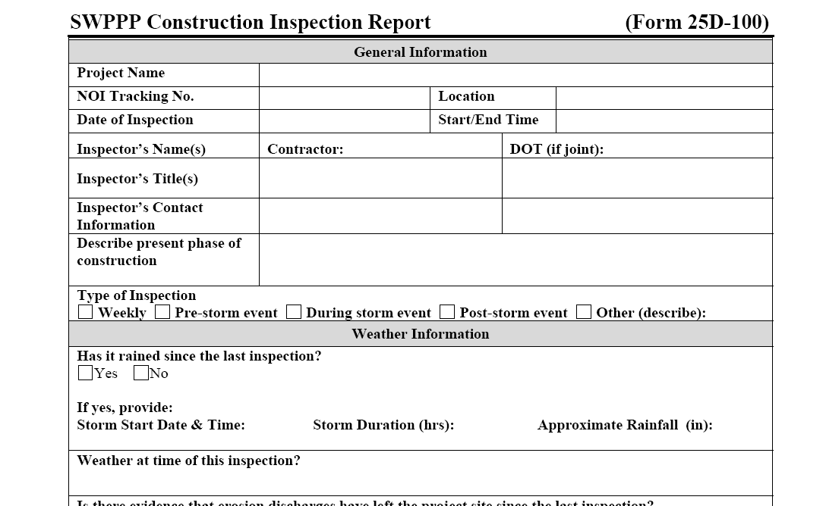
Risk Management is a Continuous Process
SWPPP
  Assess Risks
  Plan to Avoid/Mitigate
Inspection
  Review Performance
  Identify Emerging Problems
Adaptive Management
  Add or Modify Responses to Risk

Slide 18
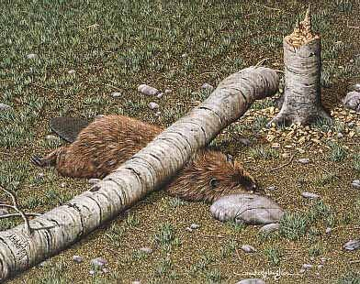
Risk Summary
Risk is…
  Negative Impact that may arise from a Future Event
  Product of Onsite Hazard & Offsite Consequence
  Uncertain in an Individual event, Certain over Multiple Events
  Proportional to Expected Loss & Probability of Event

Slide 19
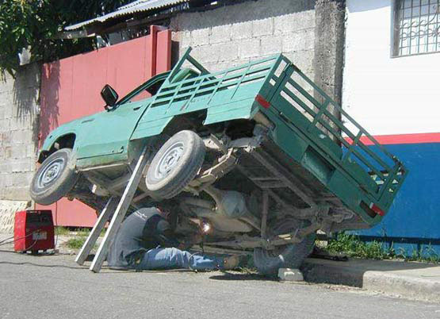
To Manage Risk
Identify Sources of Harm
Assess Likelihood & Consequences of Harm
Develop Strategies: avoid, accept, transfer, mitigate
Notes:
From the DECs perspective: storm water guides and the permit are risk management tools.
From the permittee’s perspective: SWPPP, BMPs are risk management tools. How well did this guy assess and manage the risks?

Slide 20
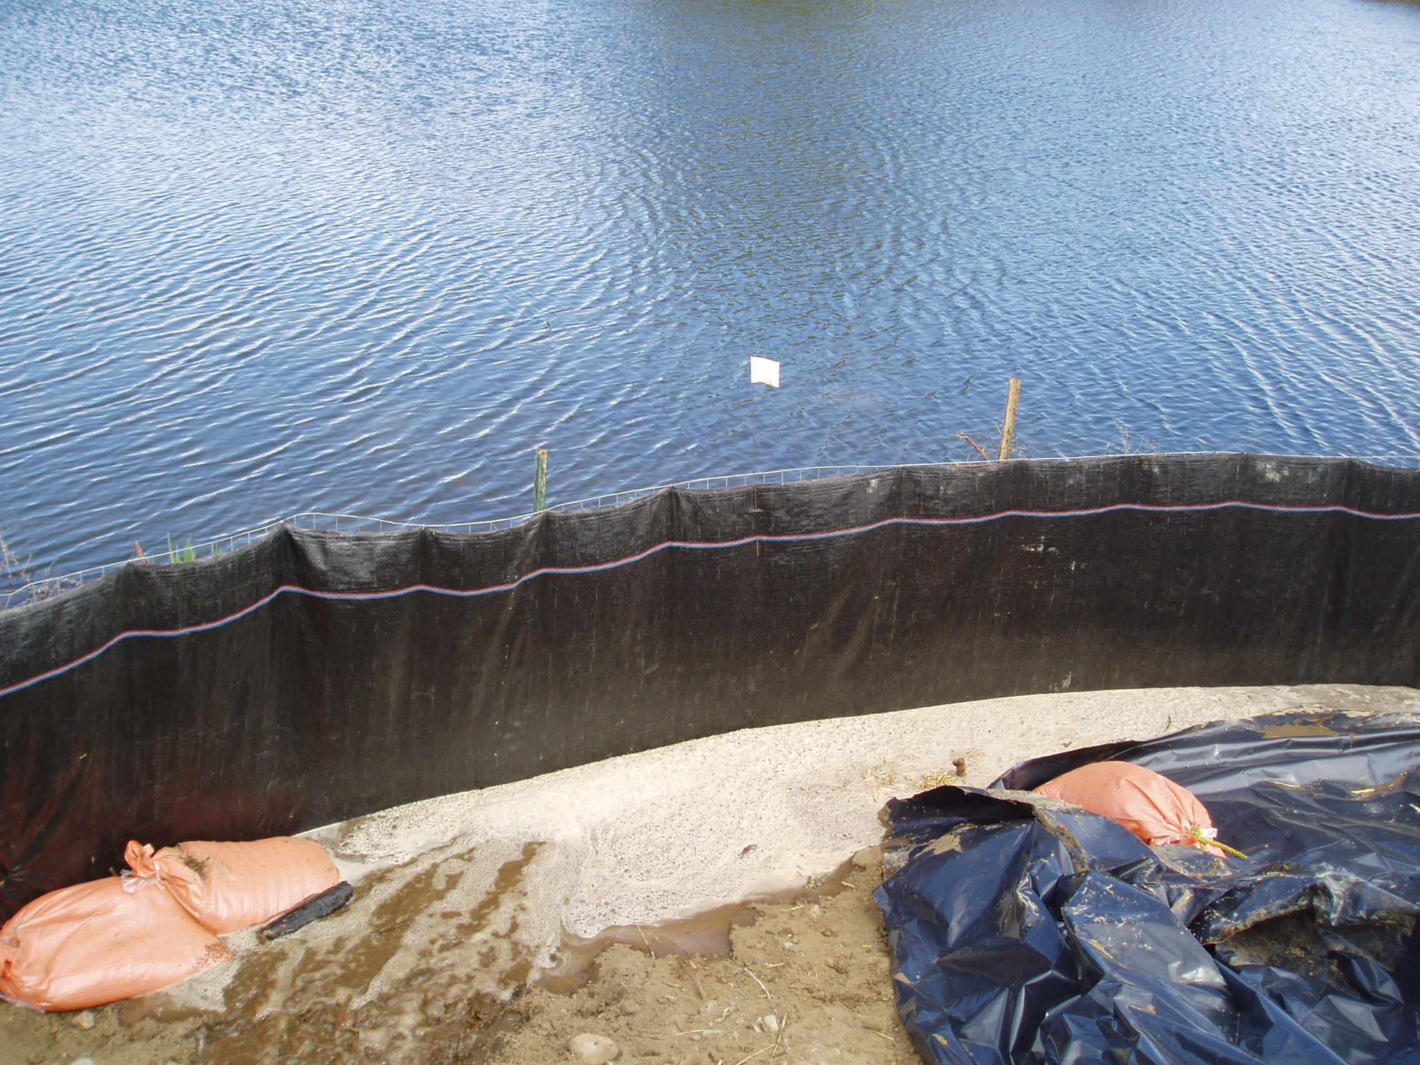
Stormwater Pollution Prevention Plan
SWPPP =
Risk Assessment, Management & Mitigation
Identify Potentials for Erosion/Sedimentation
Identify Potential Consequences
Plan to Prevent/Avoid/Contain/Mitigate Consequences

Slide 21
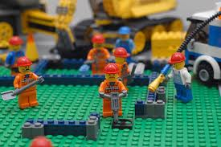

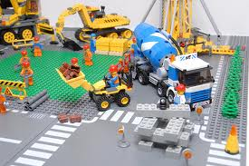

Revised Universal Soil Loss Equation (R.U.S.L.E.)
Erosion Risk Calculation Tool
A = R x K x LS x C x P
  A = Annual Rate of Erosion per unit area
  R = Rainfall Factor
  K = Soil Erodibility Factor
  LS = Slope Angle & Length Factor
  C = Soil Cover Factor
  P = Conservation Practices
default values for LS, C, P are all 1.0
Notes:
Technical, site specific tool for assessing risk of soil loss.

Slide 22
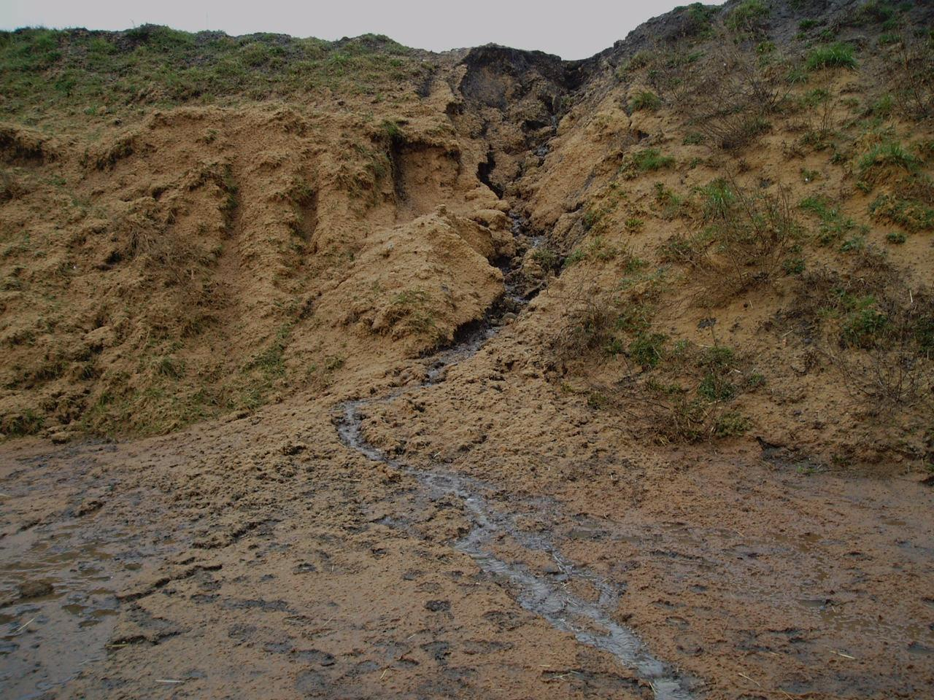
R.U.S.L.E. Example: Focus on Slope
What is the Difference in Potential Soil Loss Between 20% & 60% Slopes?
  20% Slope (10 degrees, 4:1) 100’ length, LS = 4.5
  60% Slope (30 degrees, 1 .5:1) 100’ length, LS = 9.4
60% 30 degrees
20% 10 degrees
Notes:
This is for demonstration and the math is approximate to illustrate the differences
Calculations using RUSLE demonstrate what site factors most affect risk, and by how much.

Slide 23

A = R x K x LS x C x P
SLOPE | A= | R | K | LS | C | P
20% 10 deg. 4:1 | 50 T/ac. | 40 | .28 (sandy loam) | 4.5 | 1.0 | 1.0
60% 30 deg. 1.5:1 | 106 T/ac. | 40 | .28 | 9.4 | 1.0 | 1.0
109% Increase in Soil Loss
Note: for straw mulch, “C” factor is 0.2- how will that affect soil loss?
Notes:
Increasing slope from 10 to 30 degrees increases soil loss 109%. Protecting soil with straw mulch will reduce soil loss from 105.5 Tons per acre to 21- a reduction of 80%

Slide 24
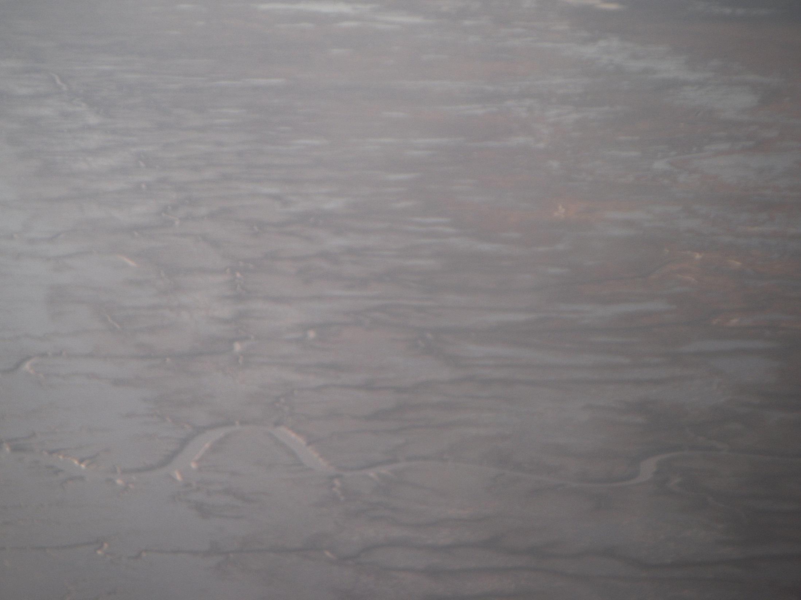
Cover Factors C
Will vary with the soil type
RECPs 0.10 – 0.25
Straw Mulch (must stay) 0.18 – 0.24
Good Hydromulch & Tack 0.1
BFM 0.02
How long will the BMP last?

Slide 25
A = R x K x LS x C x P
SLOPE | A= | R | K | LS | C | P
20% 10 deg. 4:1 | 50 T/ac. | 40 | .28 (sandy loam) | 4.5 | 1.0 | 1.0
60% 30 deg. 1.5:1 | 21 T/ac. | 40 | .28 | 9.4 | 0.2 | 1.0
Note: for straw mulch, “C” factor is 0.2- how will that affect soil loss?
Notes:
Increasing slope from 10 to 30 degrees increases soil loss 109%. Protecting soil with straw mulch will reduce soil loss from 105.5 Tons per acre to 21- a reduction of 80%
Take away message RUSLE helps us understand that if we increase the slope then we need to apply some slope treatment, in this case straw mulch, to maintain or reduce the soil loss. An easy rule of thumb
Doubling the slope length increases erosion potential by 4 times
Doubling the slope gradient increases erosion potential by 5 times

Slide 26
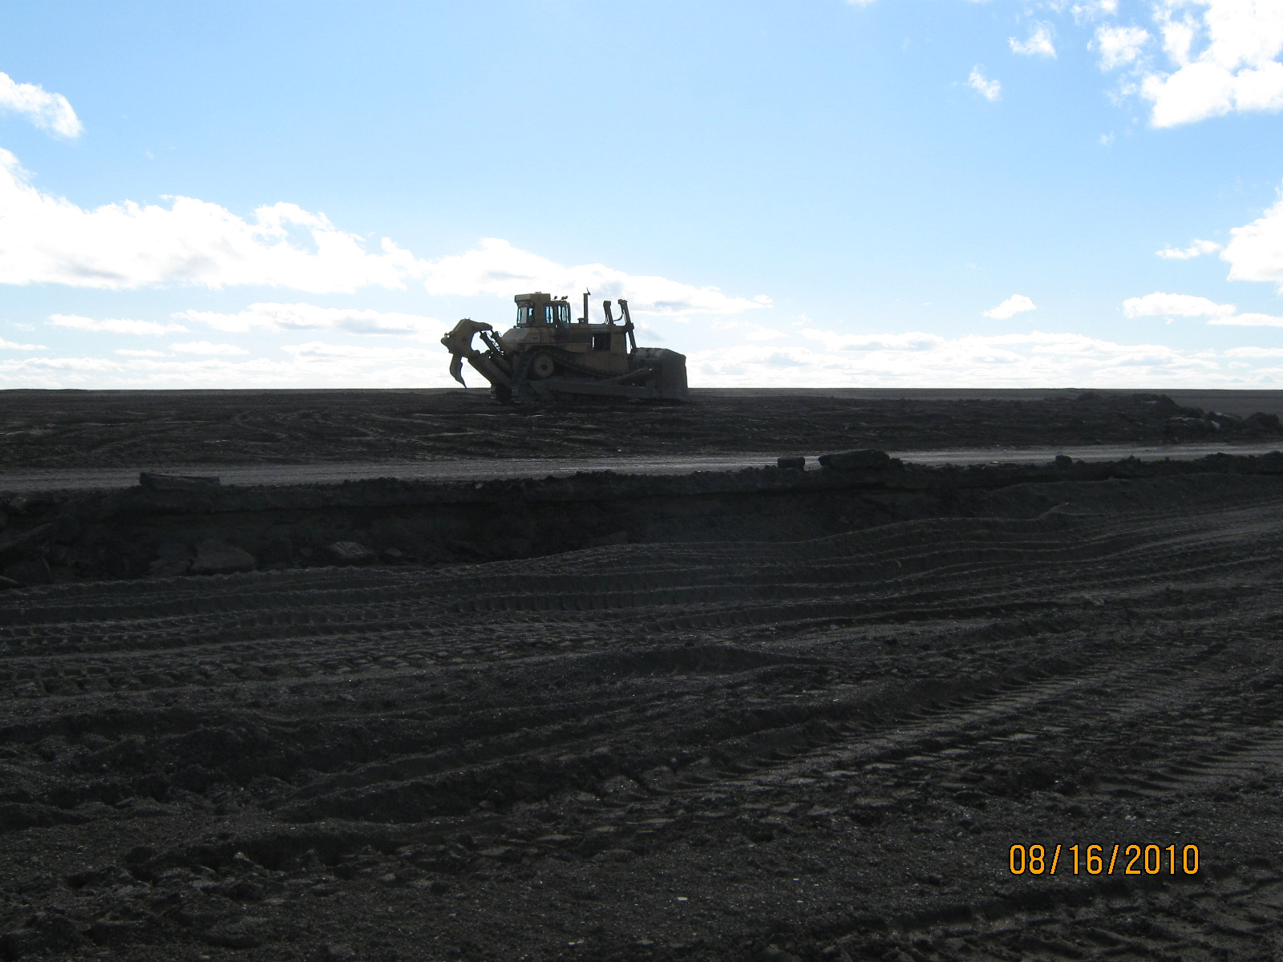
Managing Construction Site Runoff
is Not an Easy Task….
Budgets are tight, environmental protection
is often underestimated along with other
“unaccounted for” variables
The market is looking for a “one step solution”
answer and it does not exist

Slide 27


NEWS FLASH
It’s about
how you do, what you do,
and when
you do it!
Best BMPs are FREE!

Slide 28
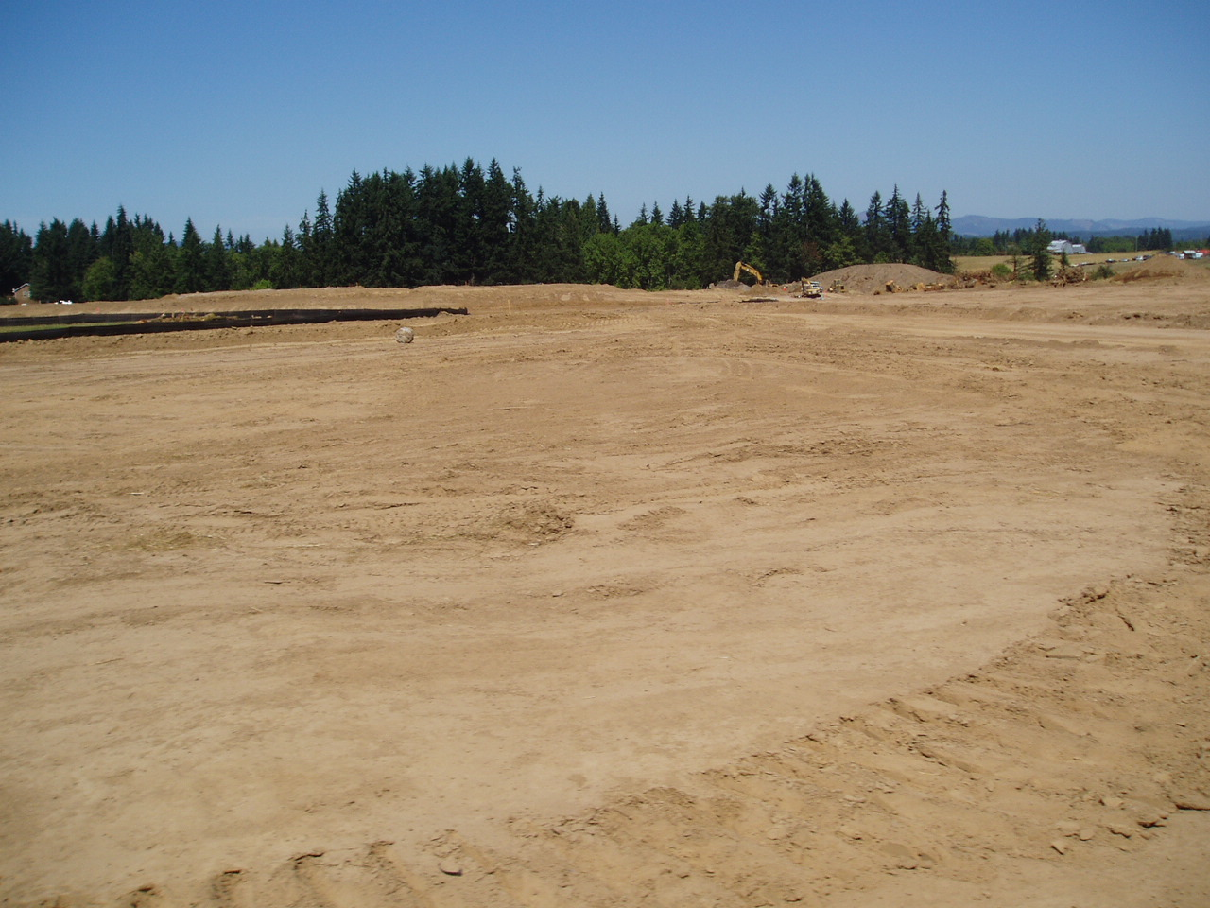
Erosion Risk Summary
Use Risk Assessment Tools:
  Site Data: area, slopes, soils, past precipitation, planned activities
  R.U.S.L.E
  Personal Experience
SWPPP Applies Data to Assess Risks, then Describes Responses
Inspection/Monitoring Assesses Performance, Identifies Emerging Risks, Guides Adaptive Management
Notes:
Personal experience is critical in accurate site risk assessment.

Slide 29
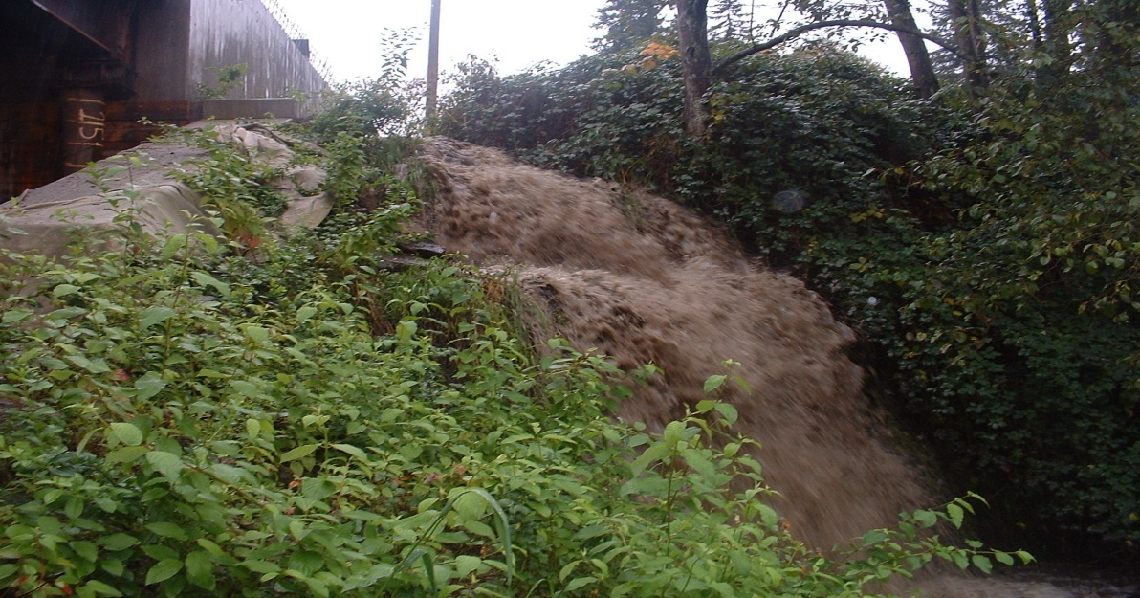
“There are only two BMPs that always, always work - leave the site vegetated and undisturbed, or pave it”
- Unnamed Erosion Professional
“Working for a company willing to spend money on erosion control is a critical BMP”
- Same Guy
Notes:
BMPs require inspection, maintenance, and, often, upgrading to work properly. Only vegetation or pavement will prevent erosion without frequent inspection and support.
Cutting corners on erosion control is risky, invest the resources necessary to do the job properly.

Slide 30
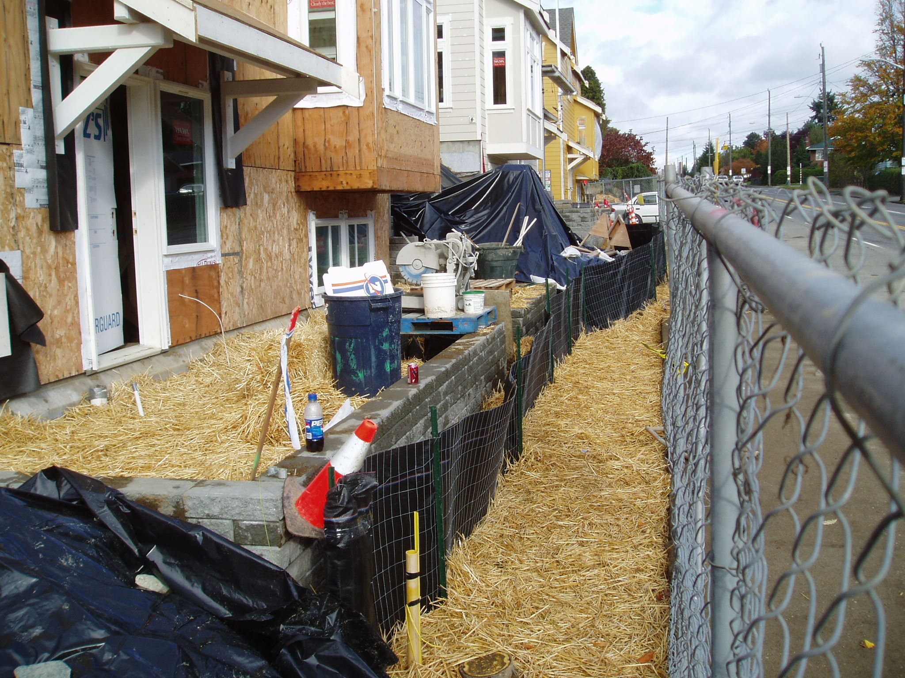
30
Notes:
Examples of risk response and consequences. Can we go too far?

Slide 31
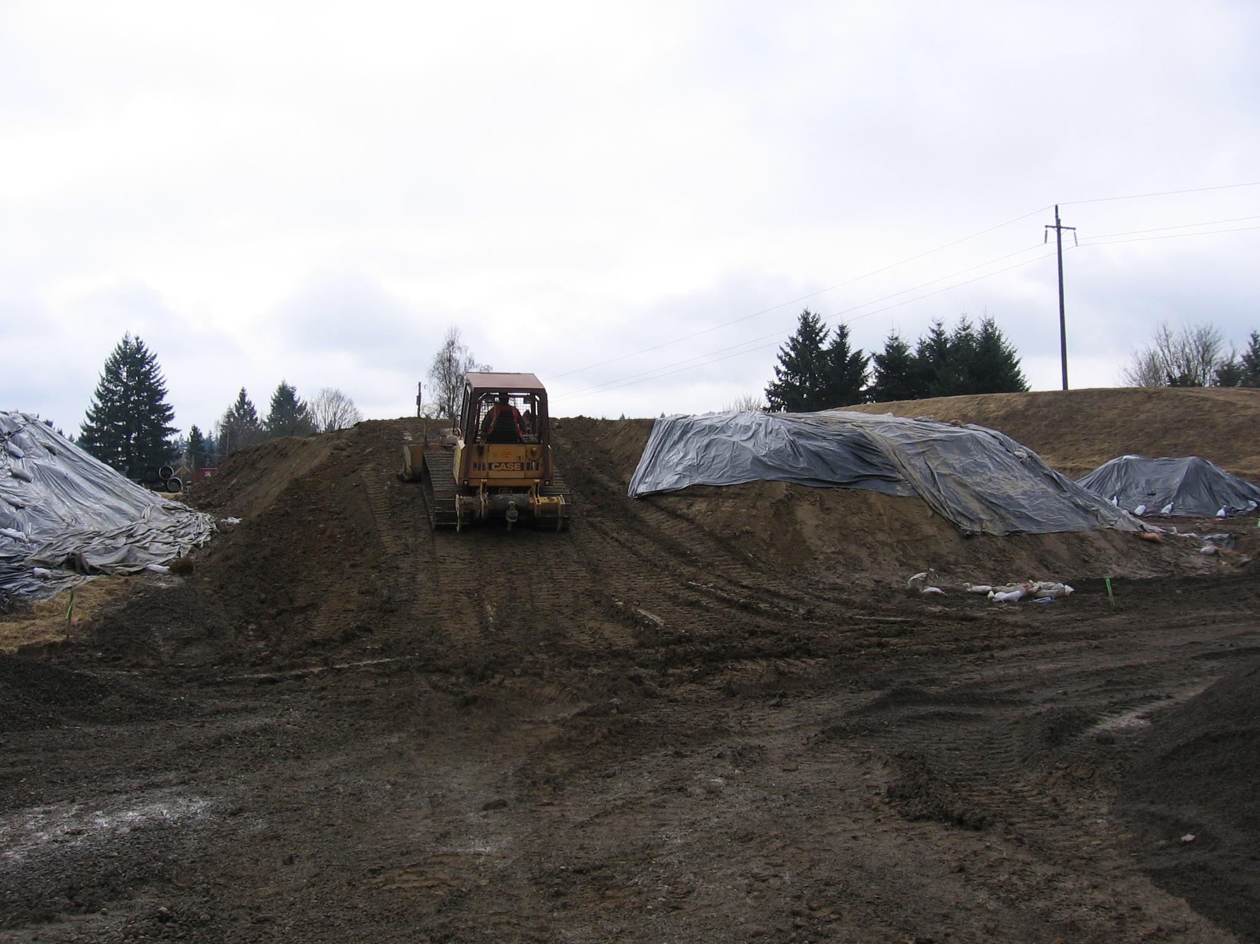
MEANS & METHODS
Its about How you do,
What you do,
and When you do it
Notes:
Work sites are dynamic, risk and consequences are determined by day to day choices.

Slide 32
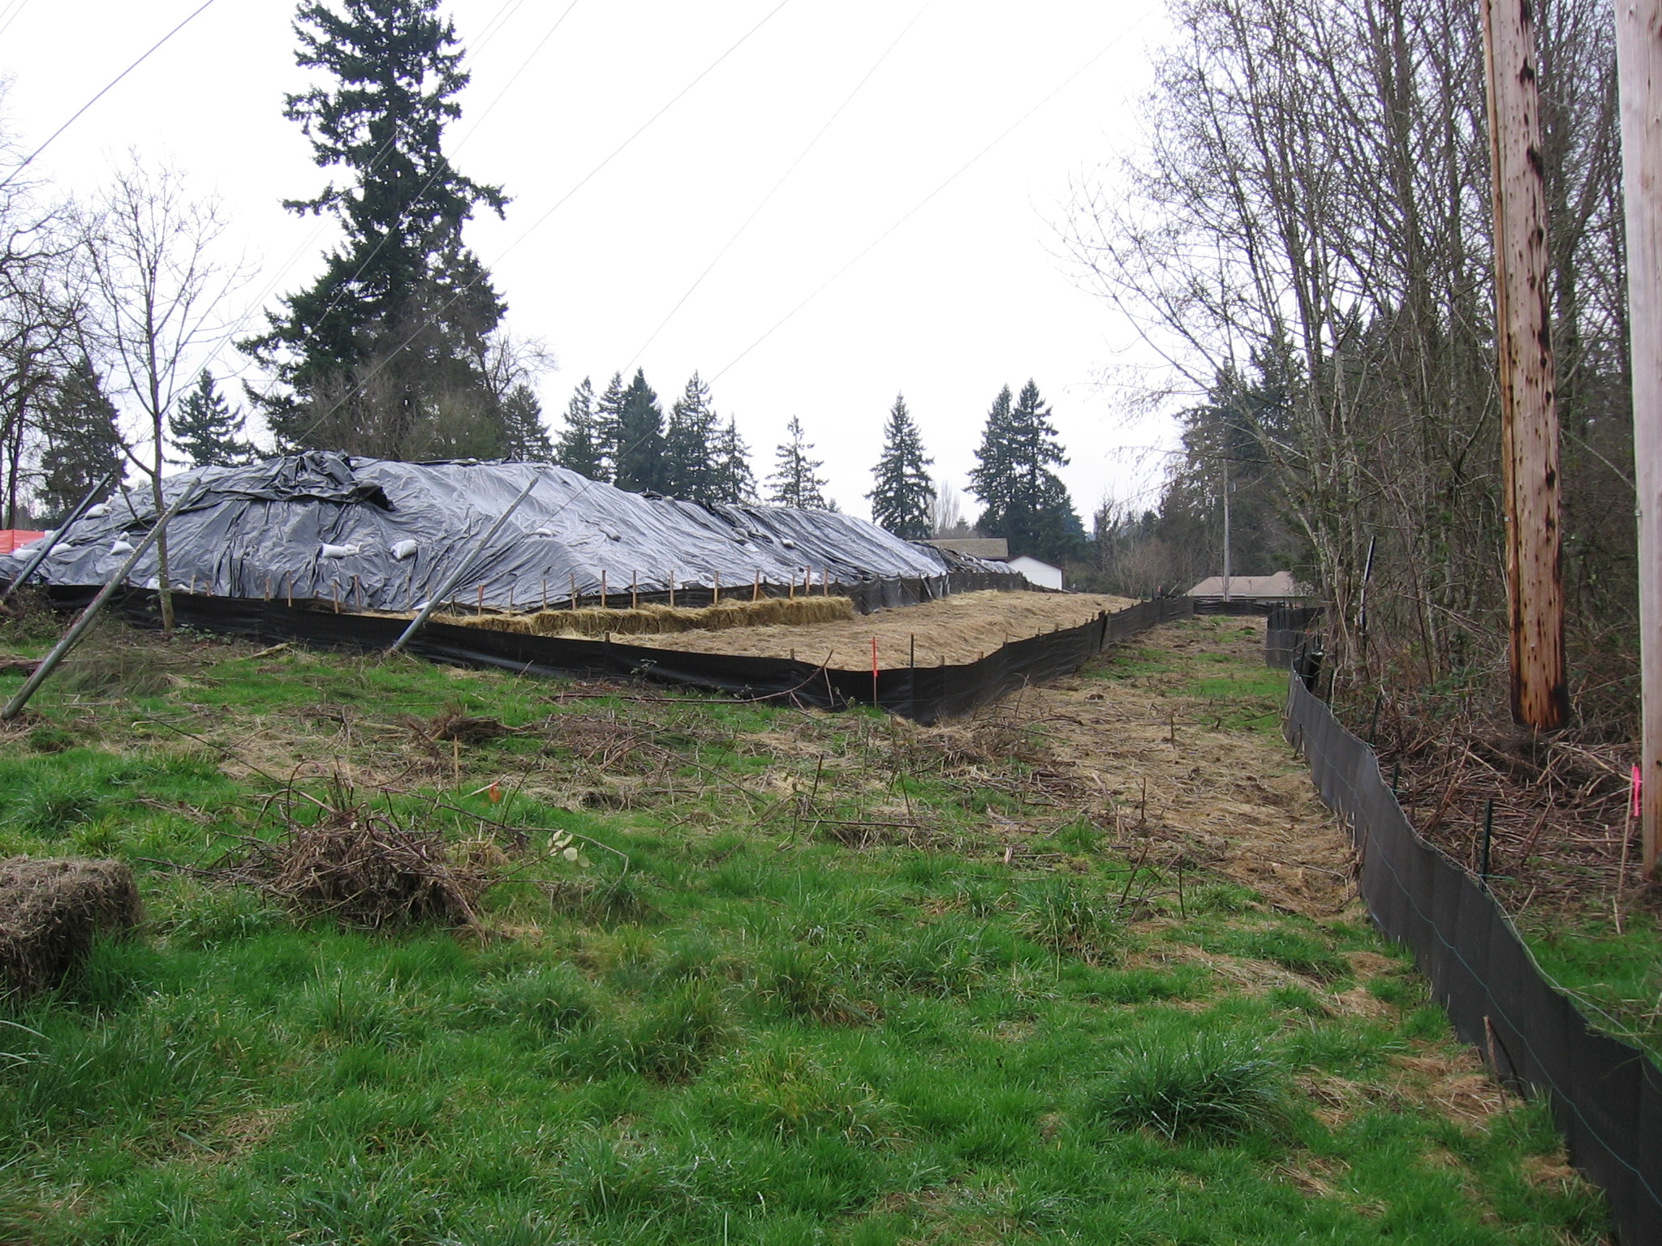
Stockpile Covered
Stockpile Silt Fence, Reinforced
Lot Grading Perimeter Silt Fence
Buffer Zone
Wire Backed Silt Fence at Site Perimeter
Notes:
Example of good risk management. Remember to document the good things you find on the project.

Slide 33
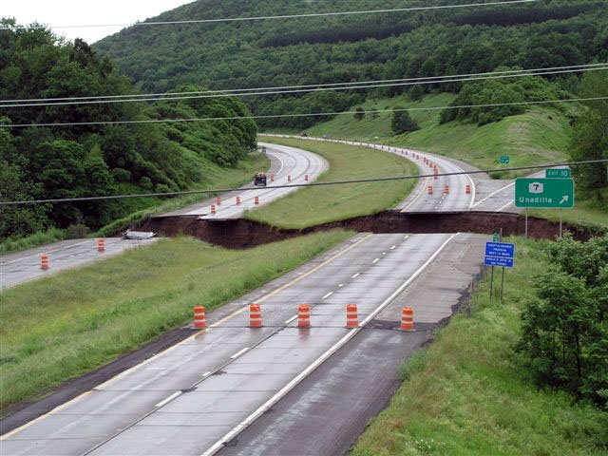
Good Stuff:
No Tracking
Grass Lined Swale
Vegetation Established
Bad Stuff:
Highway Missing in Both Directions
Off ramp relocated to Downstream Location
Repair Costs ???
Notes:
Some risks may be difficult or impossible to anticipate.

Slide 34
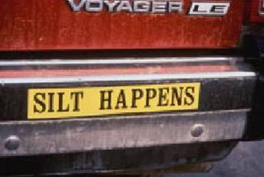
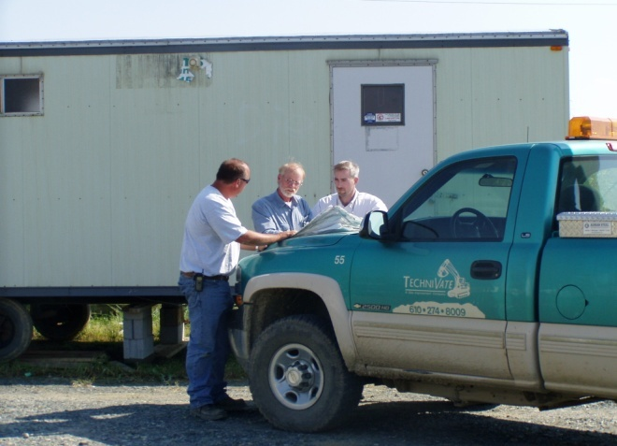
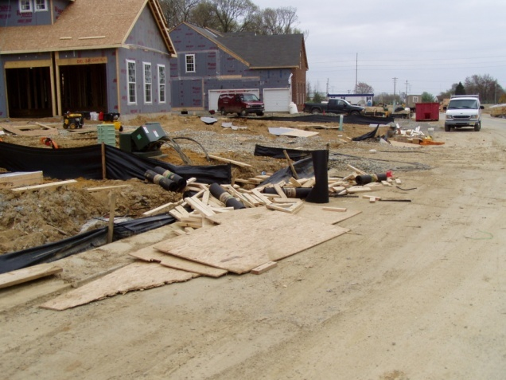
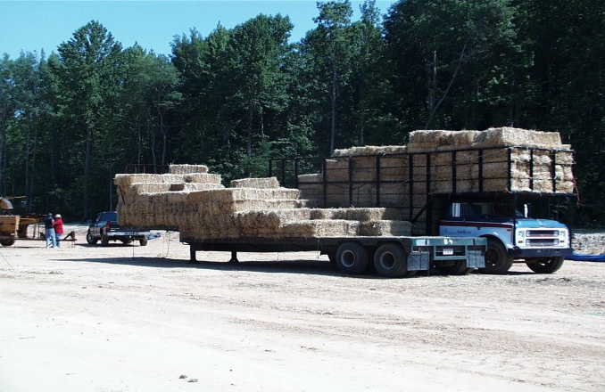
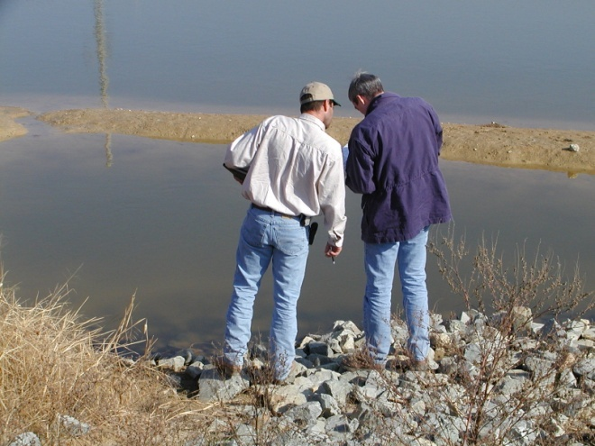
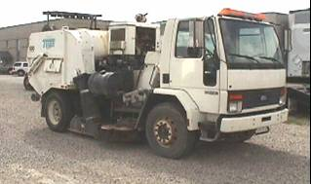
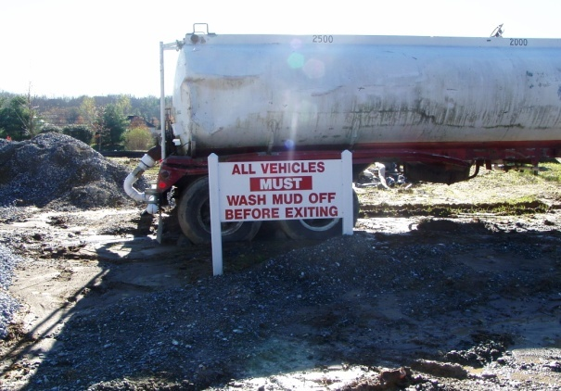
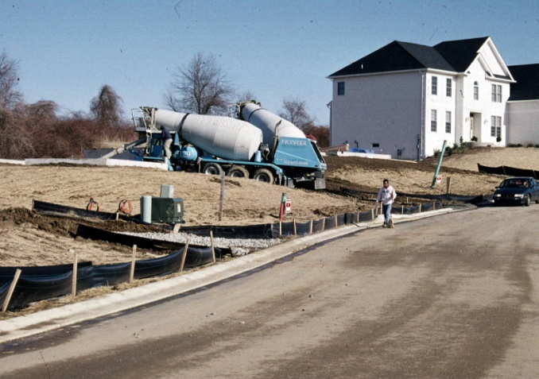
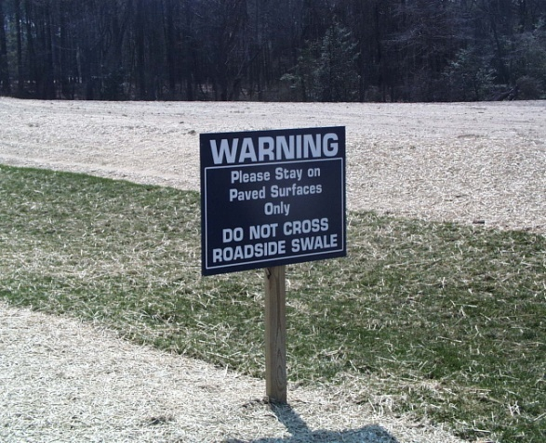
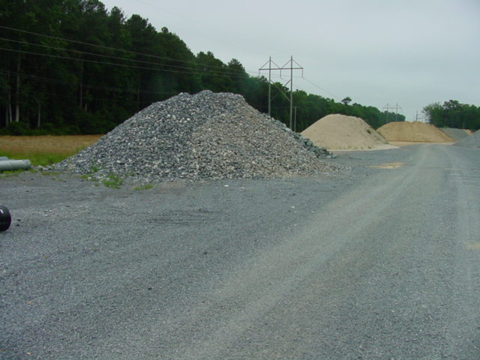
MANAGE THE PROJECT
We can’t Eliminate Risk, but We can Manage it

Slide 35
