Slide 1
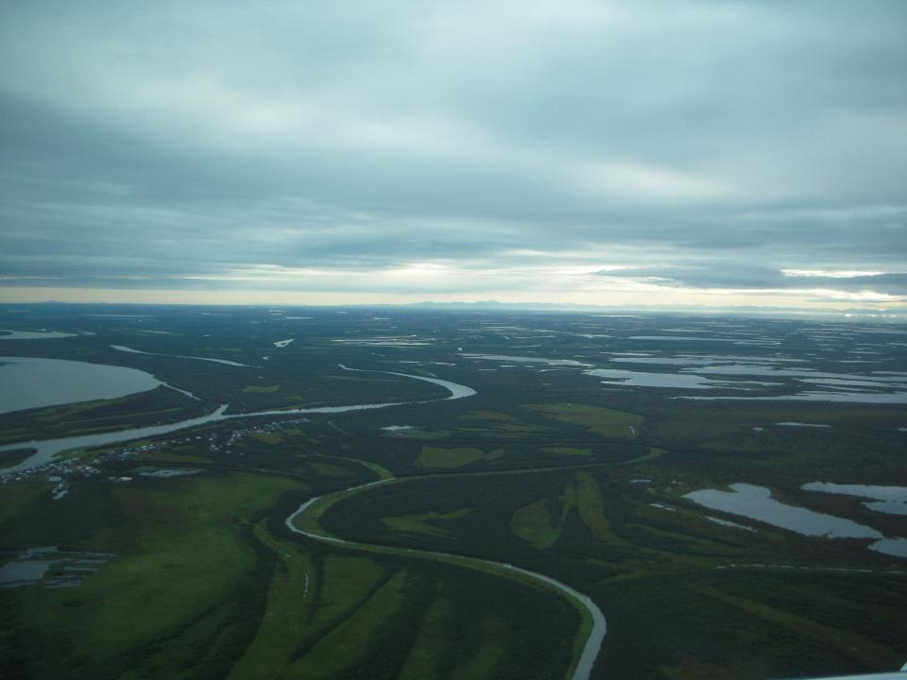


Regulations
Clean Water Act
APDES: Alaska Pollutant Discharge Elimination System General Permit for Construction Activities
Y-K Delta

Slide 2
Regulations
Goals of this section:
Learn which agencies regulate construction activity;
Understand what regulations affect construction; and
Recognize when the Construction General Permit is needed and how to get it.

Slide 3
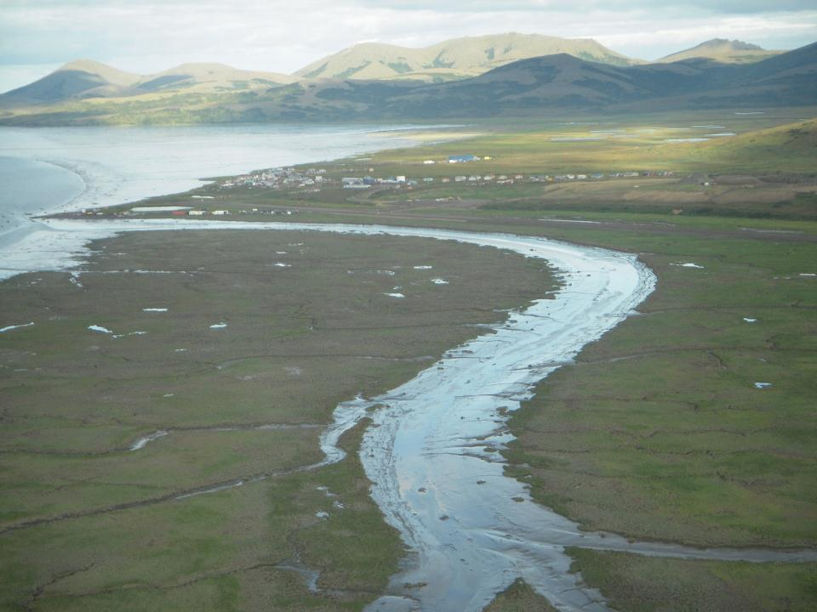
Nationally….
EPA has identified sediment from construction sites as the #1 non-point source pollutant
Goodnews Bay

Slide 4

Clean Water Act
Federal Clean Water Act
  Revised in 1987 as the Water Quality Act
Environmental Protection Agency (EPA)
  NPDES Program
State Implementation
  Alaska Department of Environmental Conservation (ADEC)

Slide 5

Local Stormwater Permitting Authorities
Local Permitting Requirements
Municipality of Anchorage
Fairbanks North Star Borough
City of Fairbanks
City of North Pole
Port Authorities
DOT&PF

Slide 6
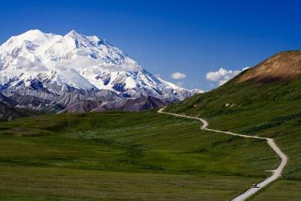
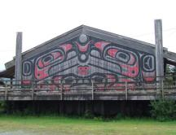
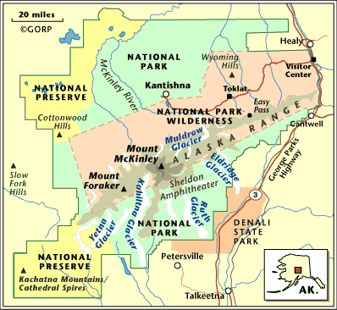
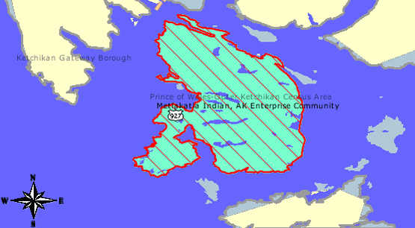
Projects within Denali National Park & Preserve &
Indian reservation of Metlakatla need EPA CGP coverage.

Slide 7
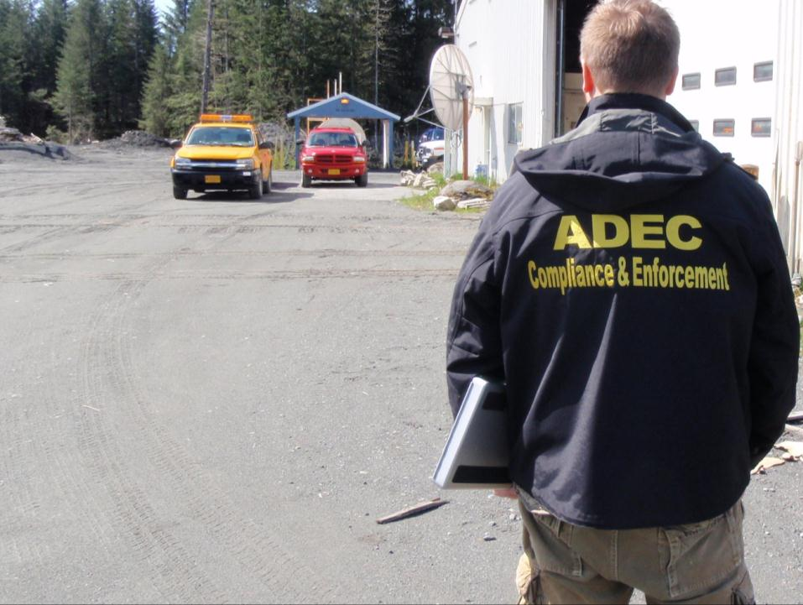
The Alaska Construction General Permit (CGP) authorizes storm water discharges from construction activities that disturb one acre or more and where those discharges enter waters of the United States (U.S.) or a municipal separate storm sewer system (MS4) leading to waters of the U.S.
CGP Part 1.1 Pg. 9

Slide 8
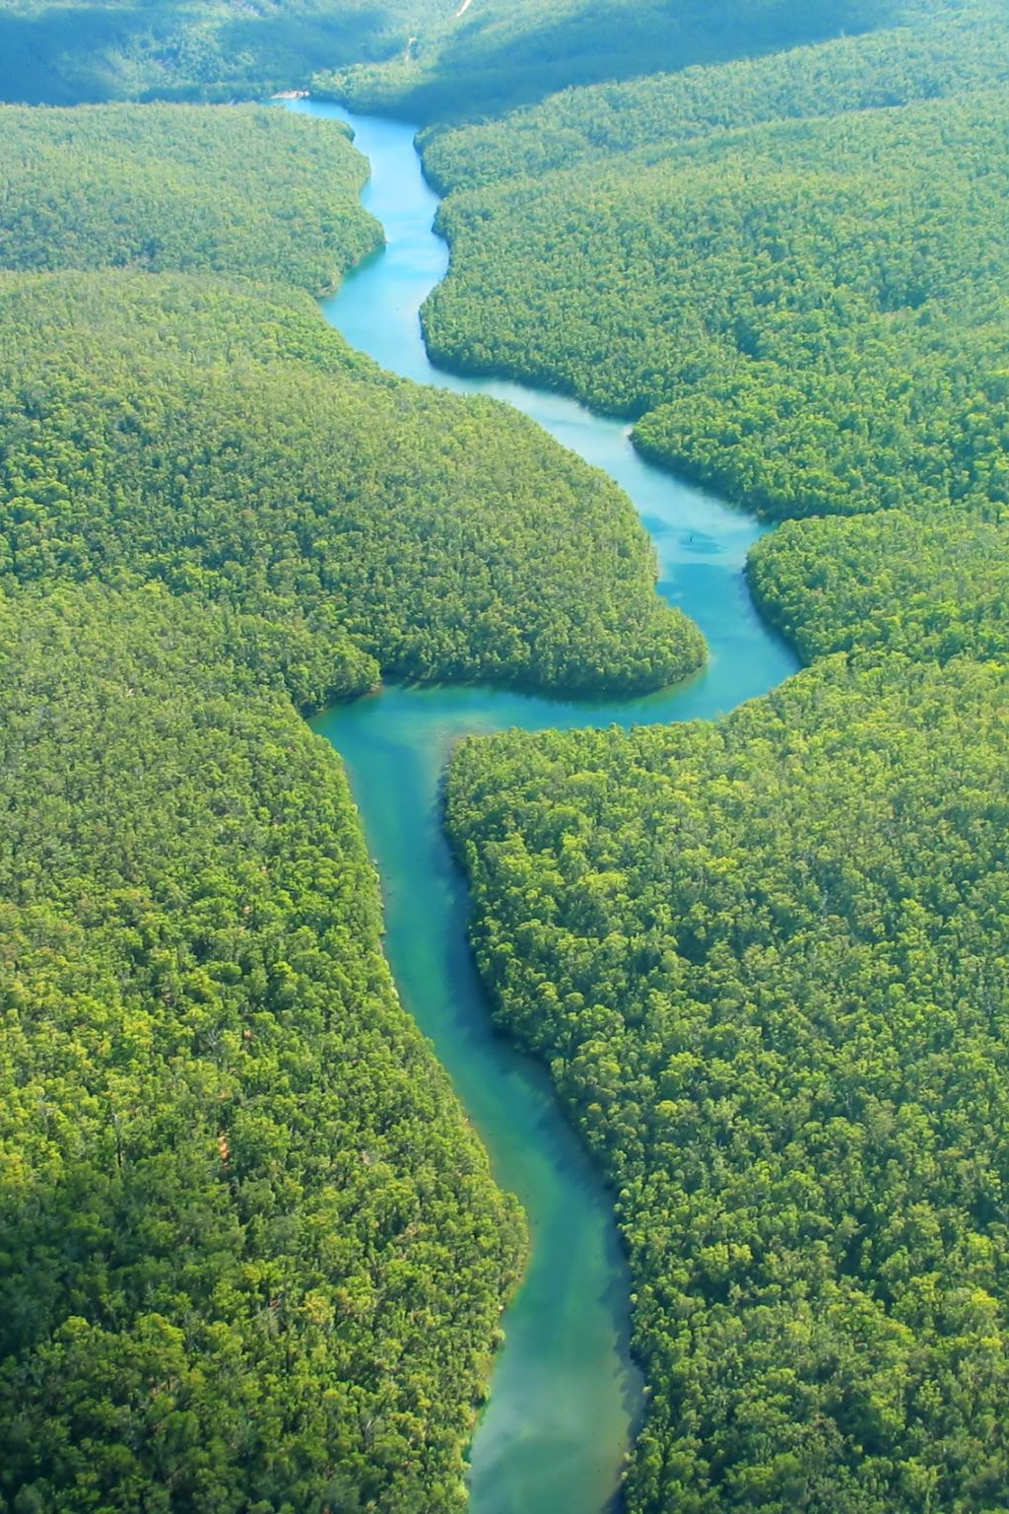
Waters of the United States (WOTUS)
Waters of the United States (WOTUS) Includes:
• Navigable waters
• Interstate waters
• Tributaries
• Adjacent wetlands with a surface connection
• Impoundments ( e.g reservoirs)

Slide 9
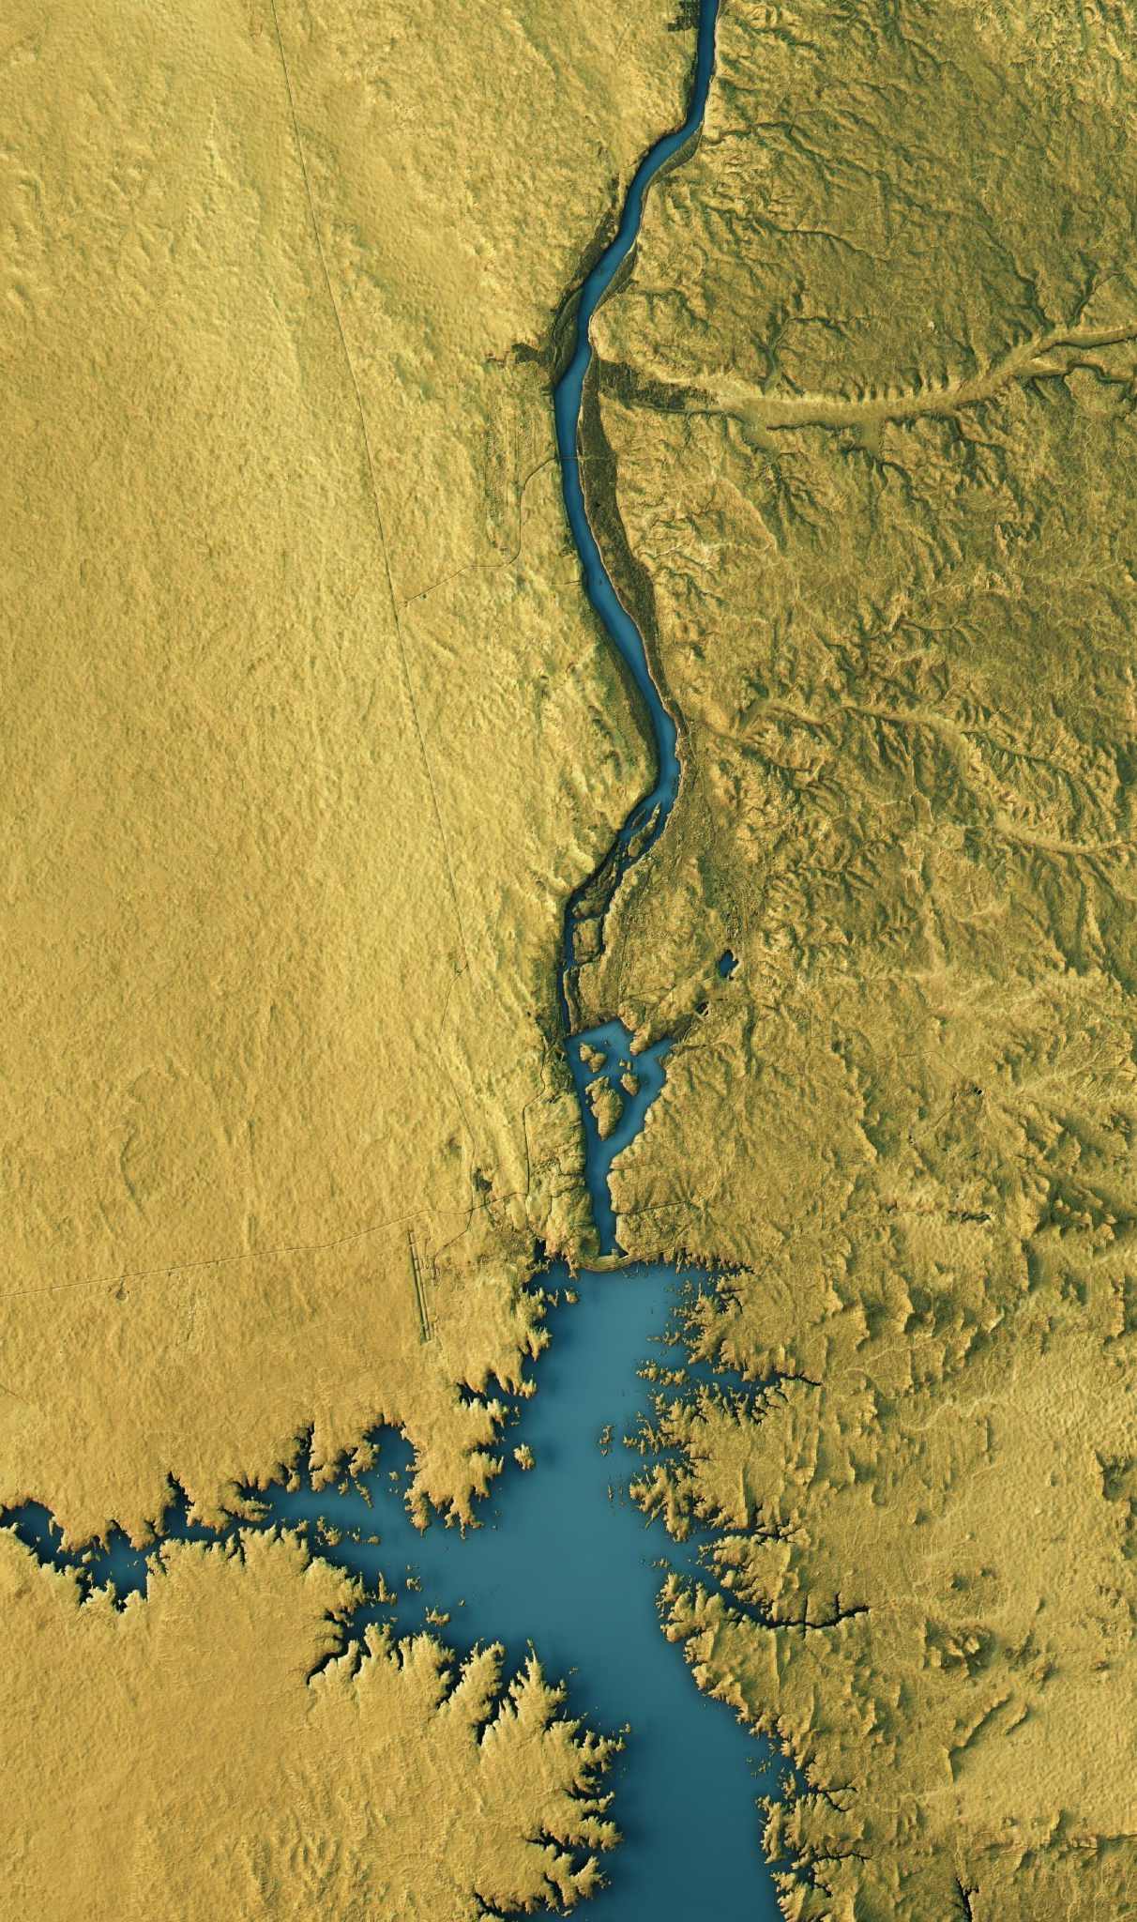
Waters that are generally NOT considered WOTUS include:
• Groundwater
• Most ditches (especially roadside or agricultural ditches)
• Rills, gullies, and erosional features formed by rainfall
• Artificial ponds and irrigation features not connected to jurisdictional waters
• Stormwater control features constructed in uplands
• Prior converted cropland

Slide 10
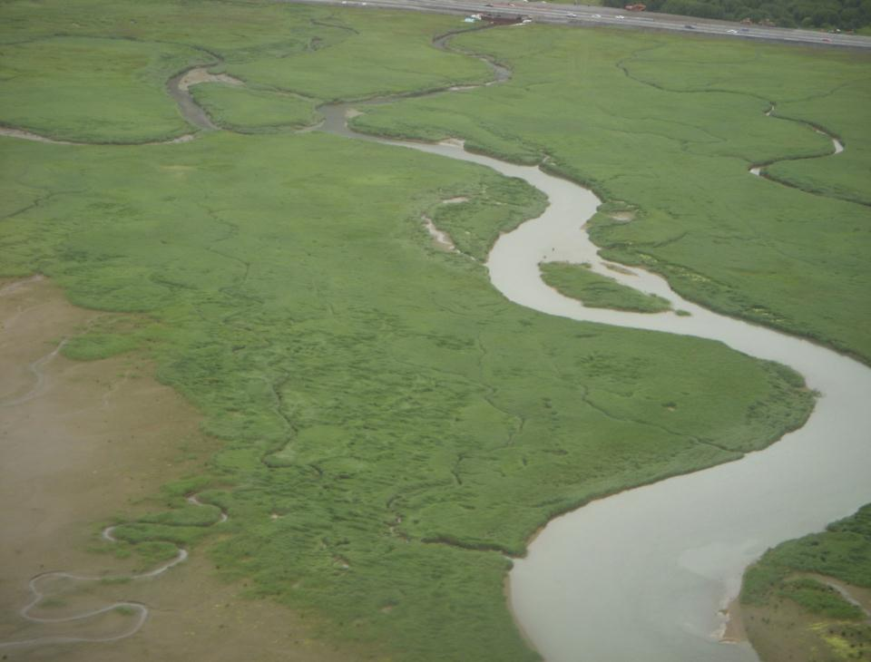
Do I Need an APDES Permit?
Site
Discharge
If your construction project will discharge stormwater into US surface waters or into storm drainage systems AND:
Disturbs one or more acres of land; OR
Is less than an acre if part of a common plan of development or sale.
Juneau
Notes:
Acreage includes letdown areas, equipment storage areas and single project offsite material staging and storage areas. Picture is of a discharge point from the Juneau interchange in the Mendenhall Wildlife Refuge. Taken while on approach to JNU
A picture of the dewatering pump comes up in the program later.

Slide 11
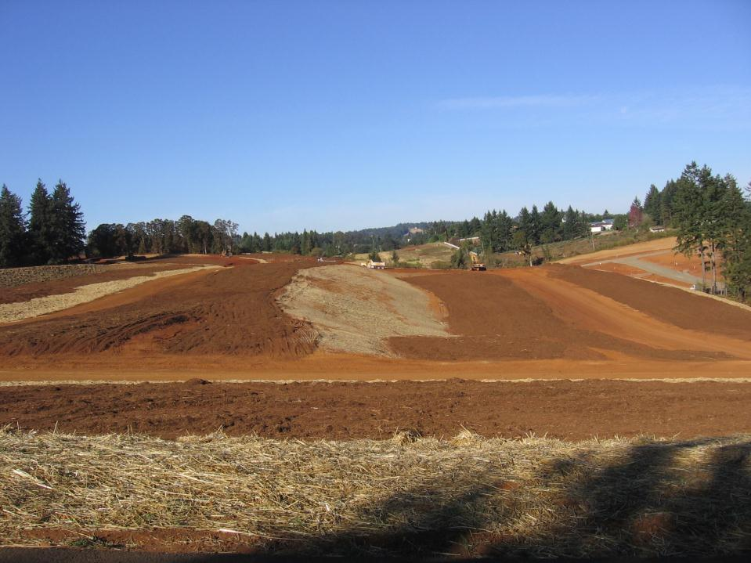
Construction project is any land disturbing activity, including clearing and grubbing, grading, excavating, and demolition.
No matter what your size:
Permit Authority can require permit coverage if it deems your project a “significant contributor of pollutants.”
Notes:
CGP defines a Disturbed Area as a portion of any site that has been altered from pre-existing conditions, including but not limited to the following: providing access to a site, grubbing and clearing of vegetation (including the roots), grading, earth moving, altering land forms, and other construction-related activities (such as placement of project related stockpiles atop a soil surface).

Slide 12
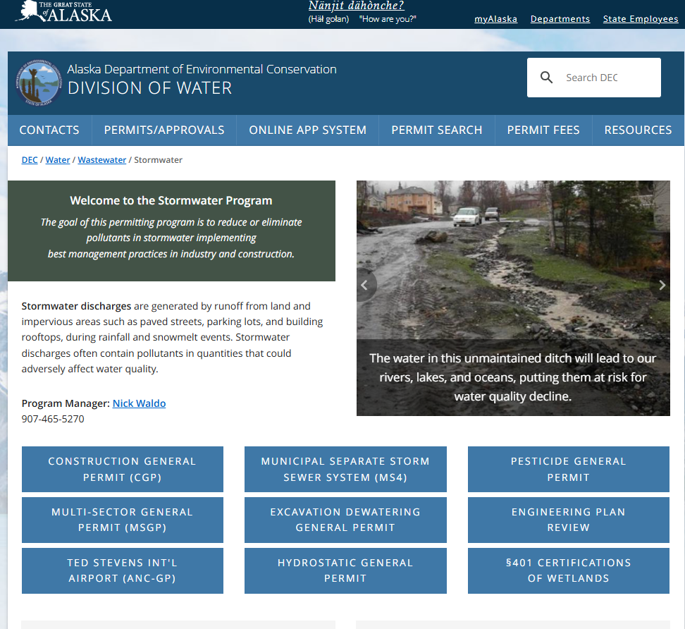
https://dec.alaska.gov/water/wastewater/stormwater/

Slide 13
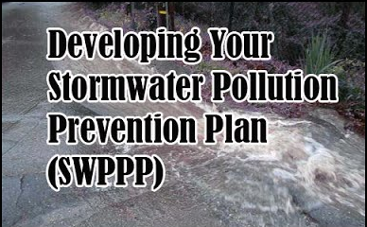
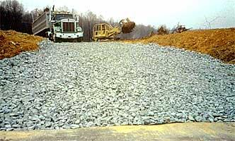
2026 Construction General Permit (CGP) Introduction
Goals of this section:
Know and understand the sections of the CGP;
Find answers in the CGP; and
Know what makes a good SWPPP.

Slide 14
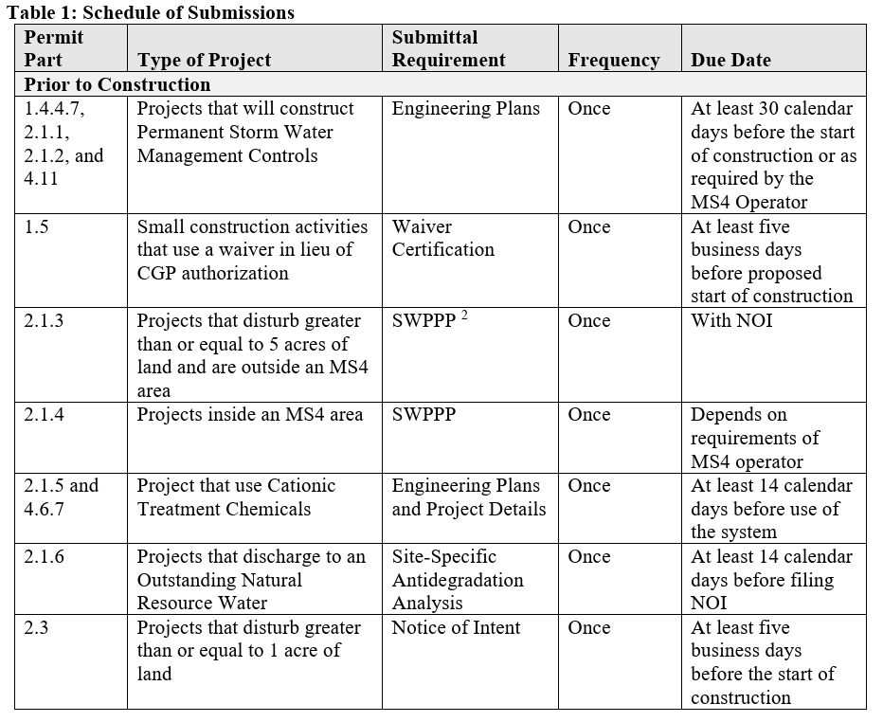

Construction General Permit (CGP)
CGP Pg. 6
Schedule of
Submissions
Prior to
Construction

Slide 15
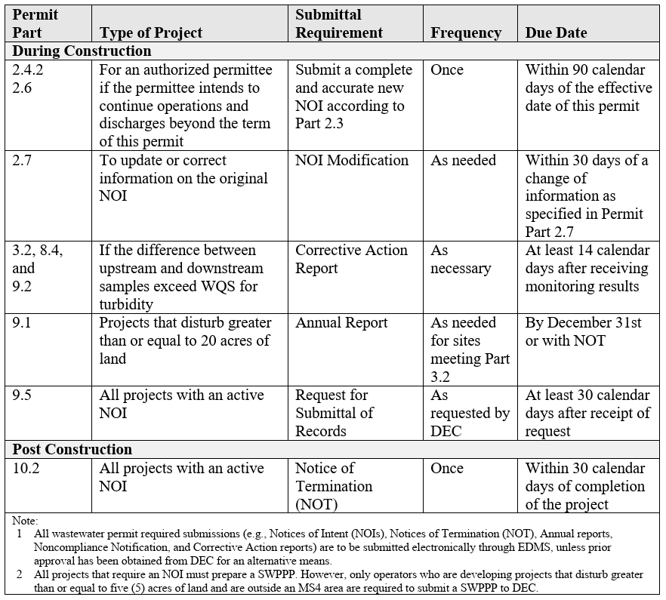
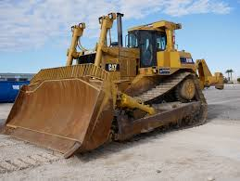
Construction General Permit (CGP)
CGP Pg. 7
Schedule of
Submissions
During
Construction

Slide 16
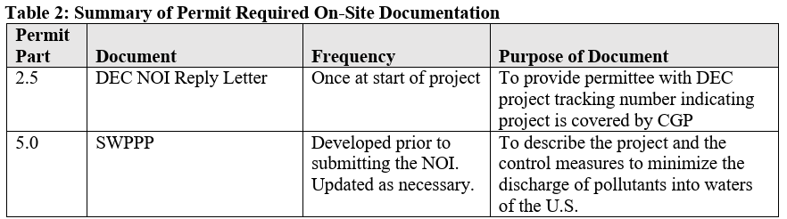
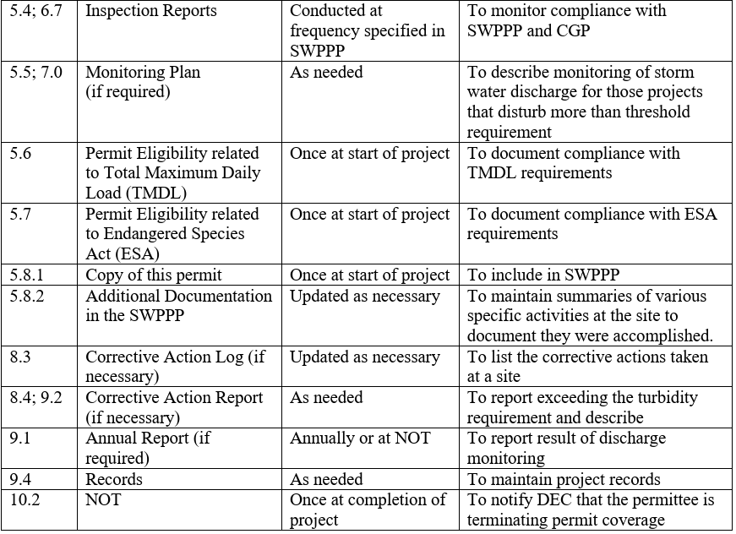
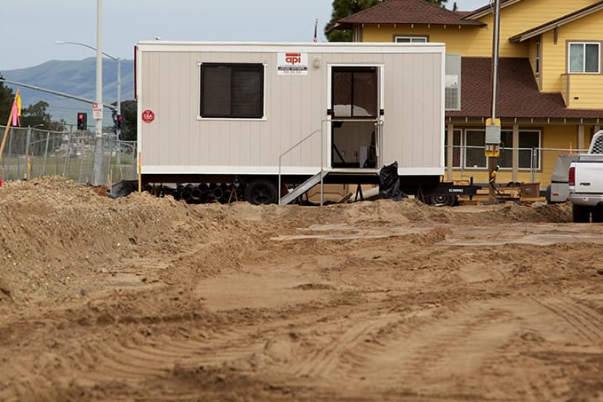
Construction General Permit (CGP)
CGP Pg. 7-8
Required
On-Site
Documentation

Slide 17
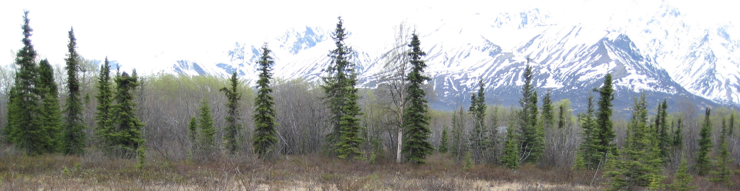
Construction General Permit (CGP)
Coverage Under the Permit
  Introduction and goal of the permit
  Persons Responsible for Obtaining Authorization under the Permit
  Permit Area
  Eligibility Requirements
  Authorized Storm Water Discharges
  Authorized Non-Storm Water Discharges
CGP Part 1.0 Pg. 9

Slide 18
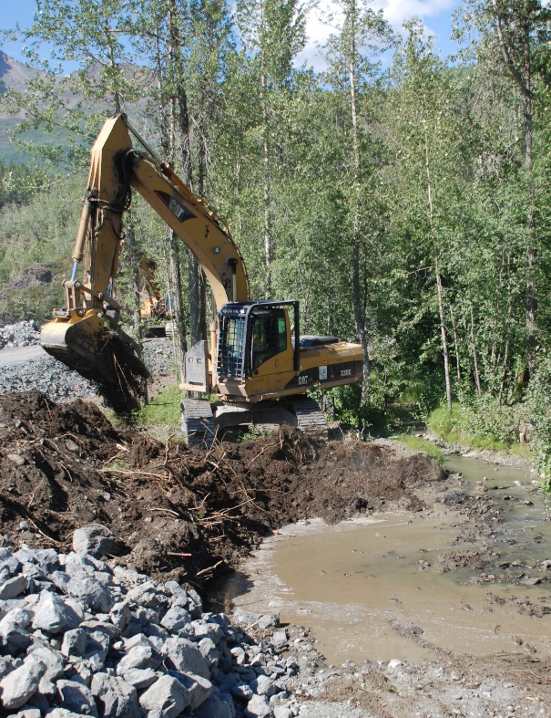
Construction General Permit (CGP)
Authorization Under the CGP
  Submittal Requirements Prior to Construction
  Permanent Storm Water Management Controls (Outside MS4)
  Permanent Storm Water Management Controls (Inside MS4)
  SWPPP Submittal
  How to obtain authorization
  How to submit a Notice of Intent (NOI)
  Submission Deadline
  Date of Authorization to Discharge
  Continuation of Expired General Permit
  Submittal of a Modification to Original NOI
  Alternative Permits
CGP Part 2.0 Pg. 13

Slide 19
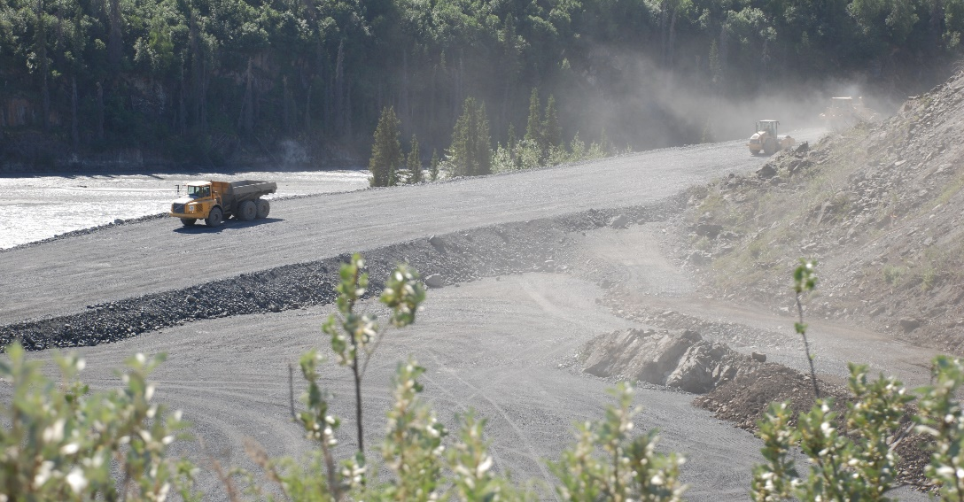
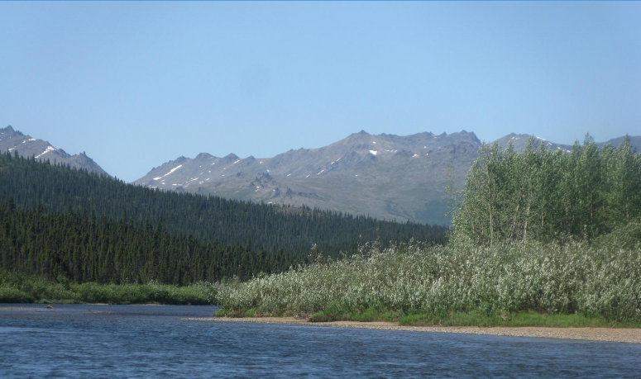
Construction General Permit (CGP)
Compliance with Standards and Limits
  Project Requirements
  Discharge to impaired water bodies
  Protection of endangered species
CGP Part 3.0 Pg. 20
Norton Bay, AK

Slide 20
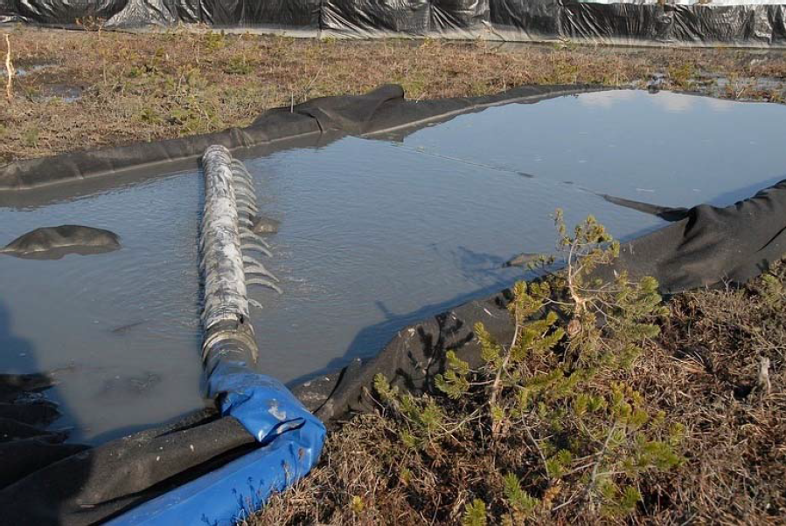
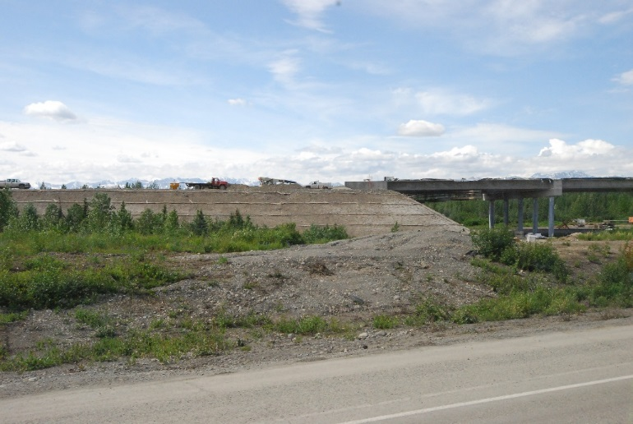
Construction General Permit (CGP)
Control Measures
  Selection and design
  Erosion control measures
  Sediment control measures
  Dewatering
  Soil Stabilization
  Treatment Chemicals
  Prohibited discharges
  Good housekeeping measures
  Spill notification
  Projects near a Public Water System
  Permanent Storm Water Mgt. Control
  Winter considerations
  Maintenance of Control Measures
  Storm water lead and training
CGP Part 4.0 Pg. 22
Petersburg, AK
Broad Pass, AK

Slide 21
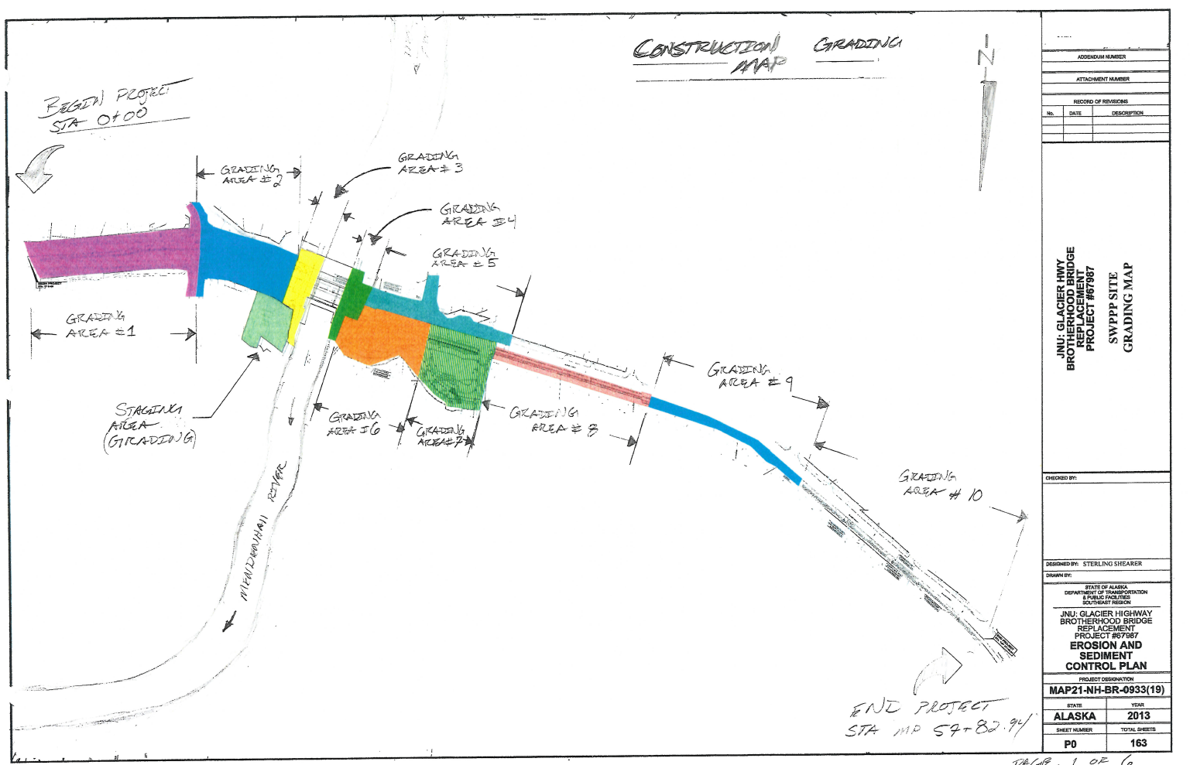
Construction General Permit (CGP)
Storm Water Pollution Prevention Plan (SWPPP)
  SWPPP preparation
  SWPPP contents
    Contacts, conditions and activity
    Site maps
    Control measures
    Inspections
    If Applicable:
    Monitoring Plan
    Eligibility Related to:
    TMDL
    Endangered Species
CGP Part 5.0 Pg. 36

Slide 22
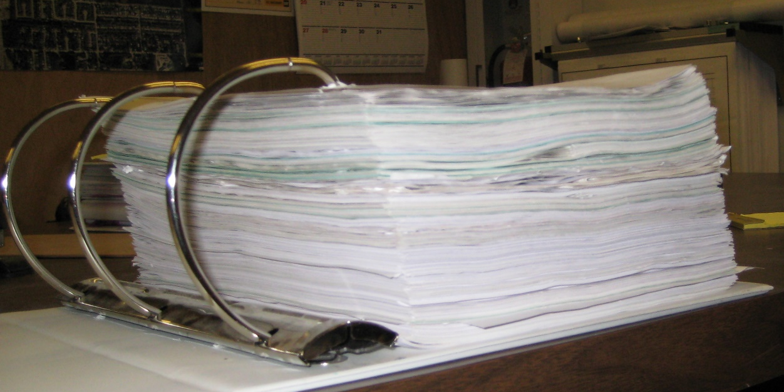
Construction General Permit (CGP)
    Additional documentation requirements:
      Grading and stabilization
      SWPPP modifications
      Employee training
      Entrance signage
      Availability of SWPPP

Slide 23
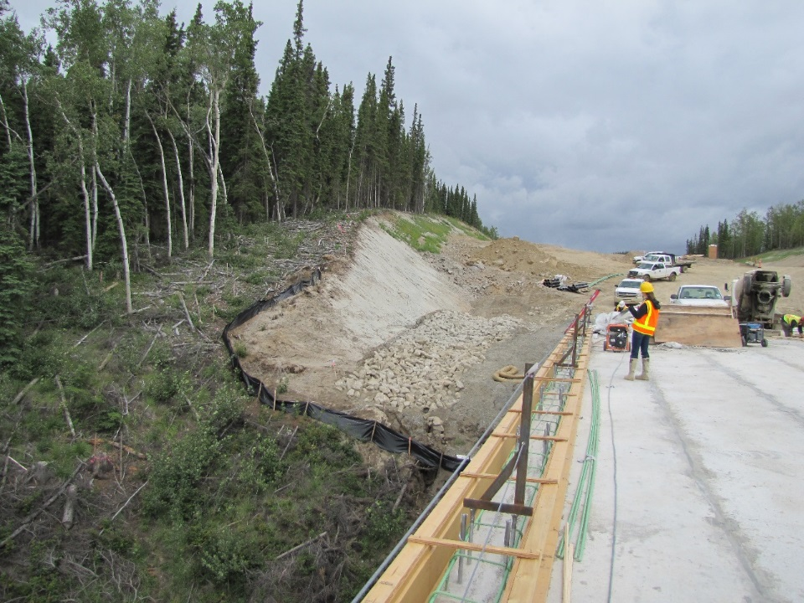
Construction General Permit (CGP)
Inspections
  Frequency
  Reductions in frequency
  Qualified Person
  Site inspections
  Linear Project Inspections
  Inspections by DEC or EPA
  Inspection report
CGP Part 6.0 Pg. 44
Tanana River Bridge

Slide 24
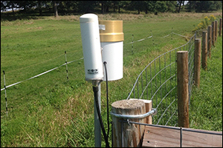

Construction General Permit (CGP)
Monitoring
  Qualified Person
  Discharge Monitoring Requirements
  Rainfall Monitoring
  Visual Monitoring
CGP Part 7.0 Pg. 47

Slide 25
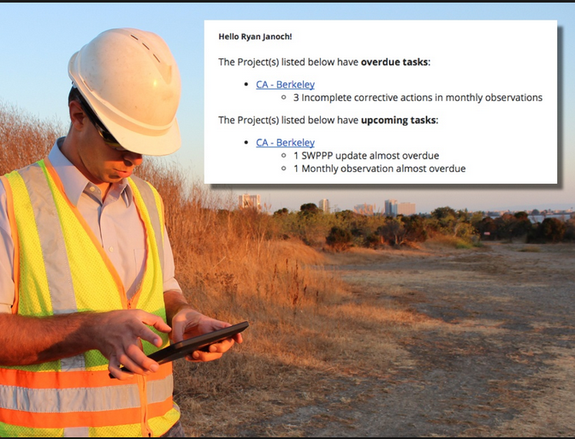
Construction General Permit (CGP)
Corrective Actions
  Conditions
  Deadlines for corrective actions
  Corrective action log
  Corrective action report
  Substantially Identical Outfalls
CGP Part 8.0 Pg. 50
Hello Ryan!
The Richardson Hwy MP 102 project has 3 incomplete corrective actions needed completed today!

Slide 26
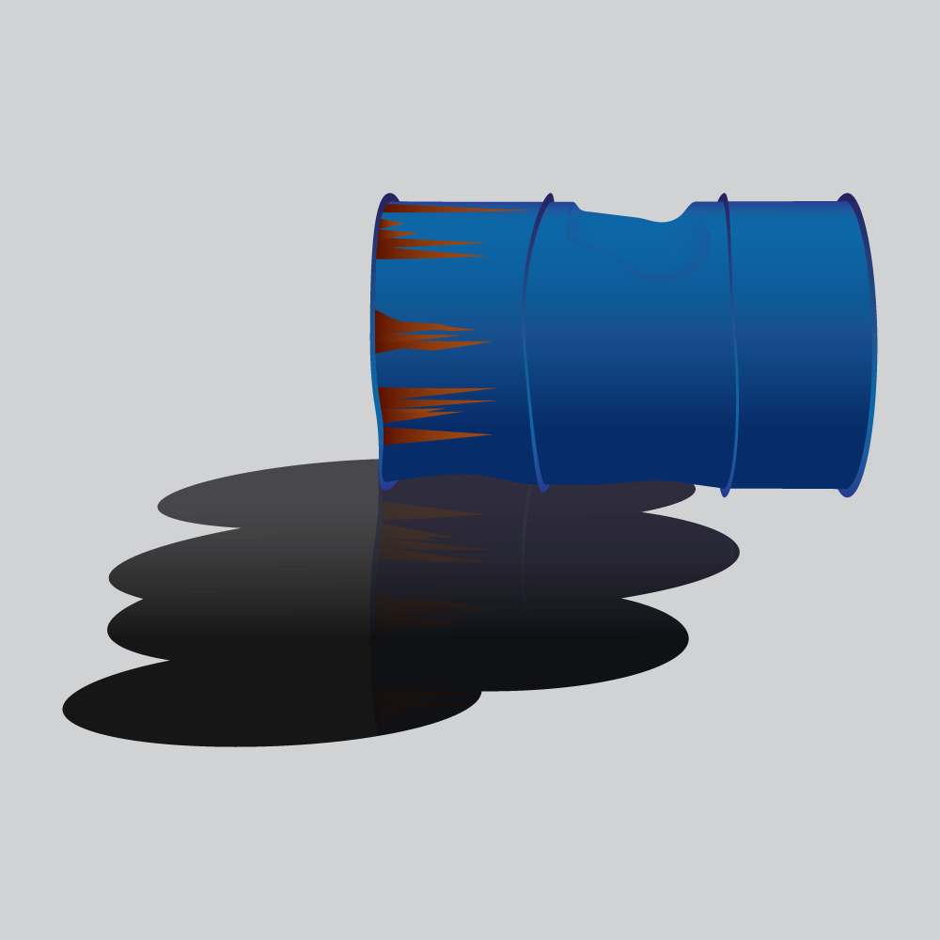
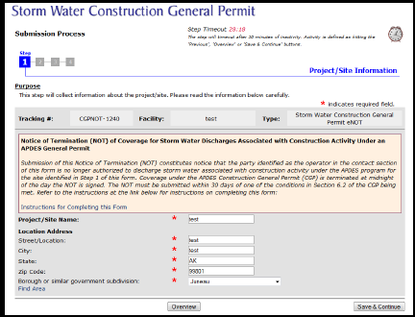
Construction General Permit (CGP)
Reporting and Recordkeeping
  Annual Report
  Corrective Action Report
  Spill of hazardous substance report
  Retention of records
Termination of the Permit Authorization
  Submitting a Notice of Termination (NOT)
Permit Reopener Clause
CGP Part 9.0 Pg. 52
CGP Part 10.0 Pg. 53
CGP Part 11.0 Pg. 54

Slide 27

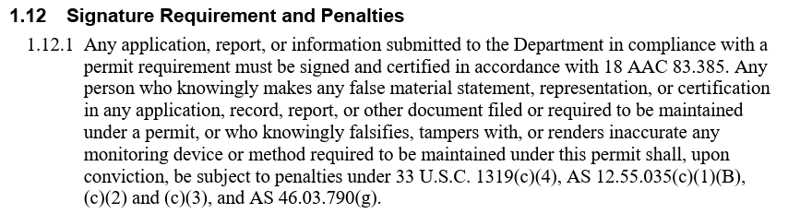
Construction General Permit (CGP)
CGP Appendix A
  Standard Conditions Applicable to All Permits (A-3)
  Signature requirement and penalties (A-6)
  Twenty-four hour reporting (A-11)

Slide 28
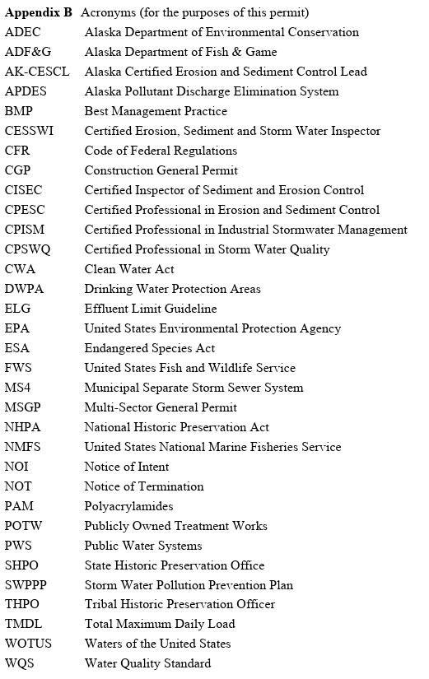
Construction General Permit (CGP)
CGP Appendix B
  Acronyms

Slide 29
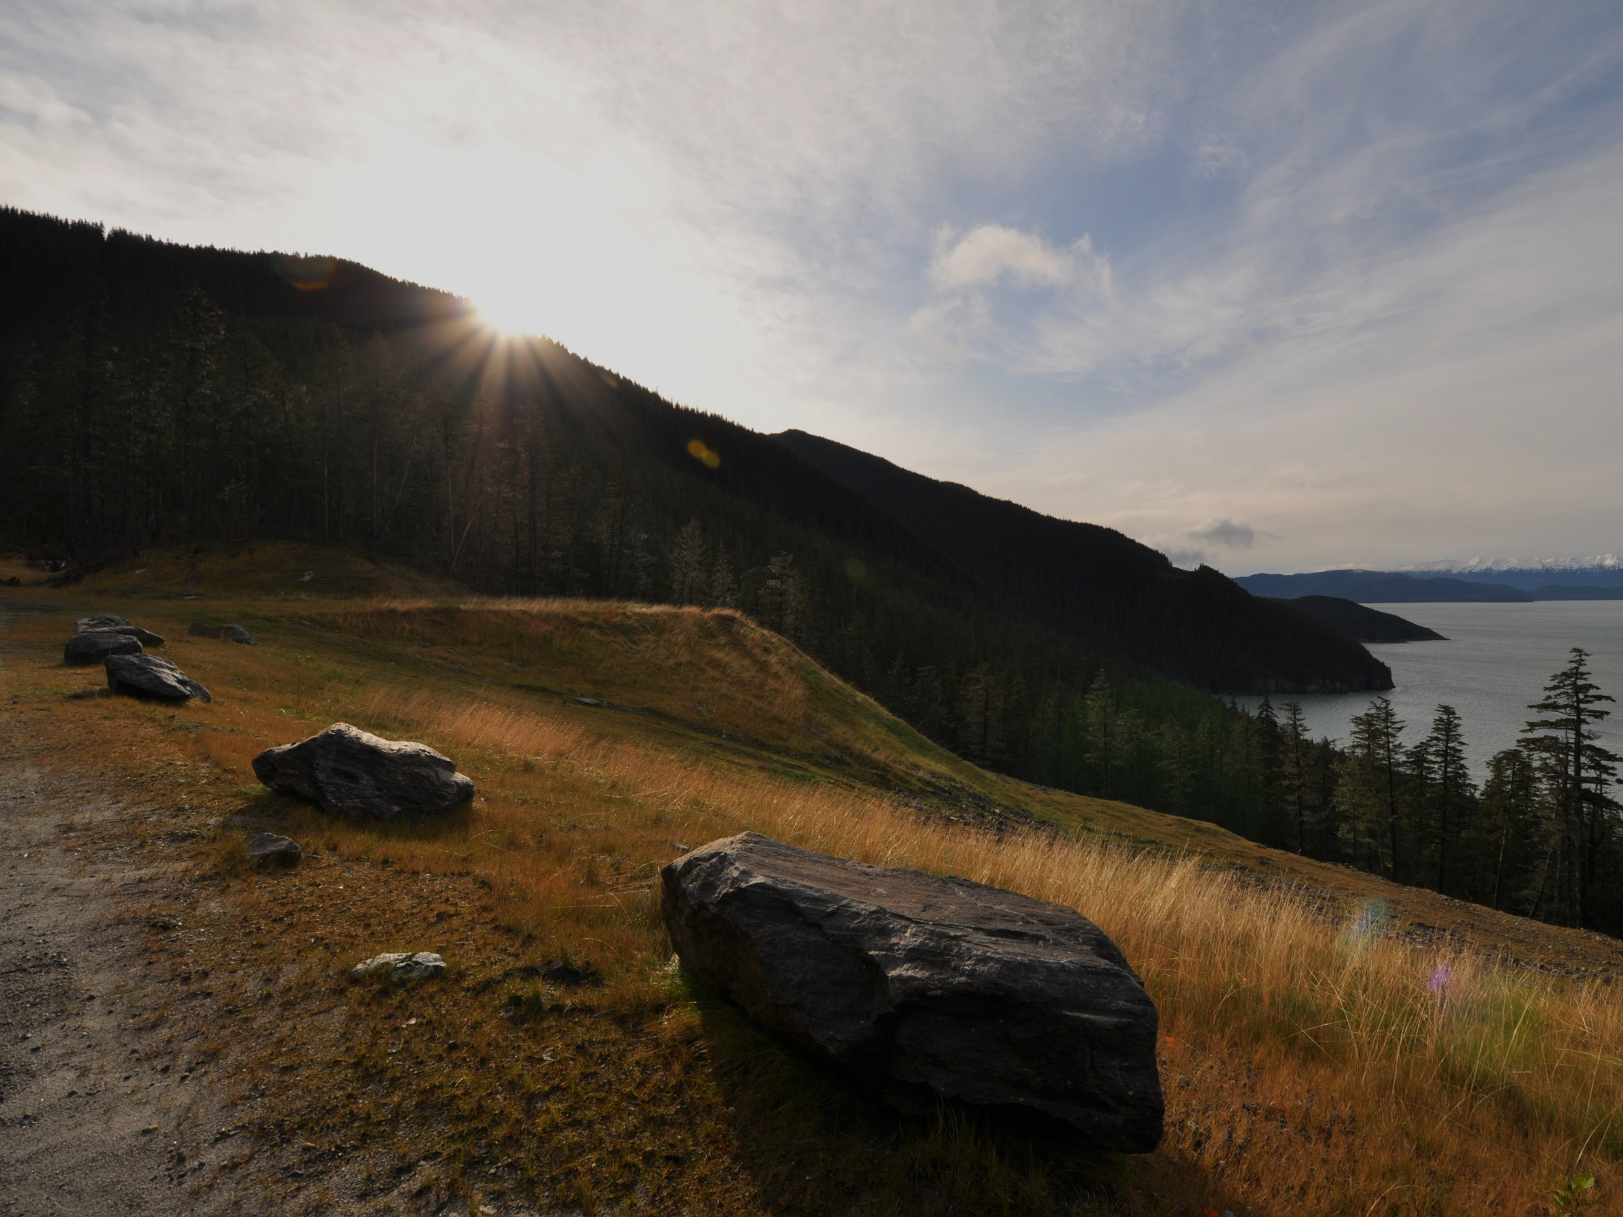
Construction General Permit (CGP)
Appendix C Definitions
Appendix D Small Construction Waivers
Appendix E Forms
  Notice of Intent (NOI)
  Notice of Termination (NOT)
  Notice of Intent Modification
  Low Erosivity Waiver
  Annual Report

Slide 30
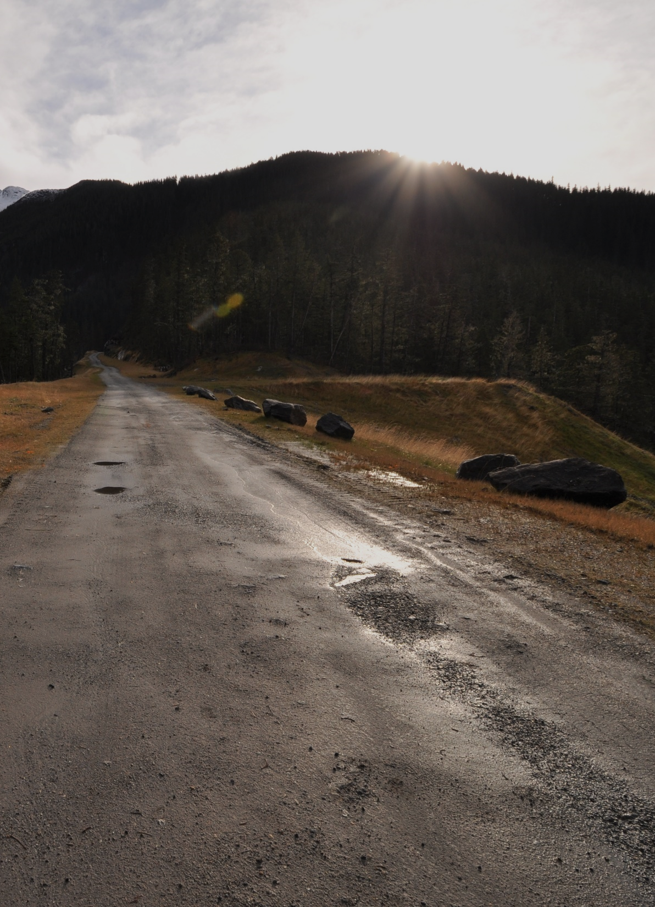
General Permit vs.
Individual Permit
General permits are a fast, one-size-fits-all permit. The applicant files a notice of intent to use the permit and agrees to abide by all the predetermined permit conditions.
An individual permit is written specifically for the site. It is expensive and time consuming because the agency writes the permit and it is subject to appeal.
Agency can require an individual permit if the general permit won’t protect water quality.

Slide 31
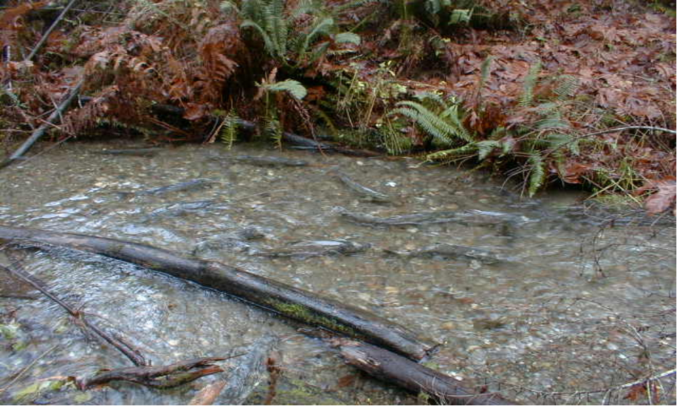
Endangered Species Act
“Prohibits the take of listed species without special permit (“take” means to harass, harm, pursue, hunt, shoot, wound, kill, trap, capture, collect or the intent to engage in such activities).”
Harm includes indirect harm to listed species by harming the habitat.
Turbidity has been considered a “take”
Notes:
One regulation in particular affects all construction activity in the Pacific Northwest.

Slide 32

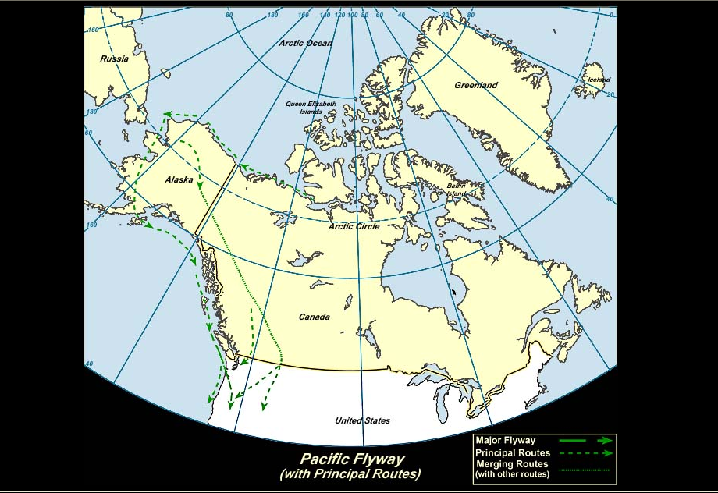
MIGRATORY BIRD TREATY ACT (16 U.S.C. 703-712)
Protects Birds and their Nesting Habitats
Avoid work at certain times of the year
Notes:
May require schedule adjustment for clearing activities.

Slide 33
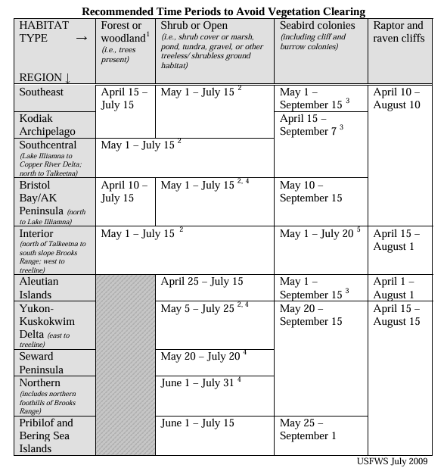
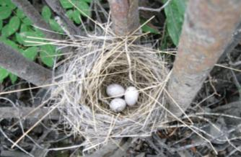
If you encounter
an active nest at any time you must leave it in place and protected until young hatch and depart.

Slide 34
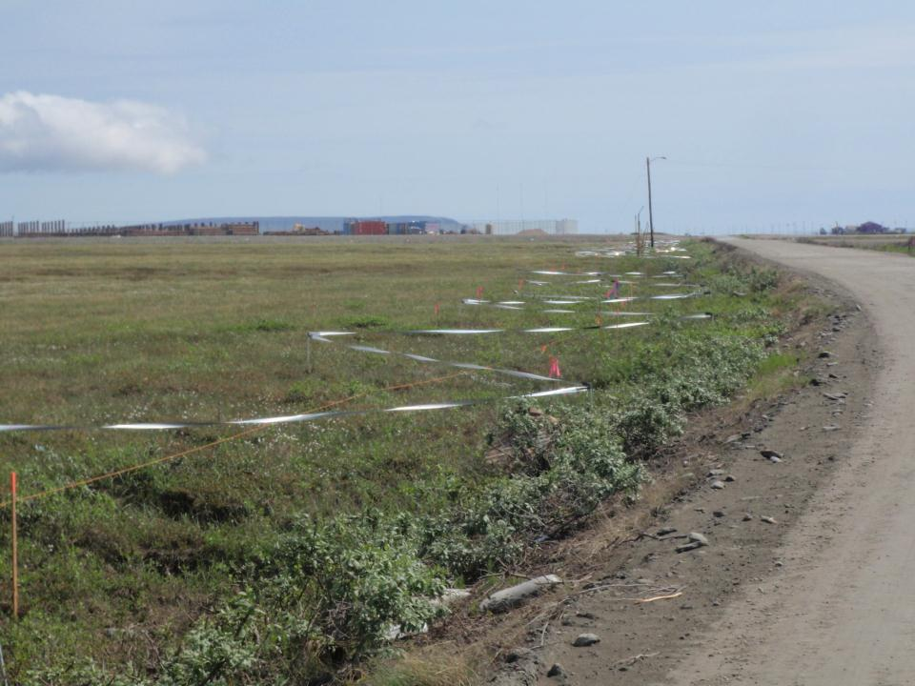
Discourage nesting
Nome

Slide 35
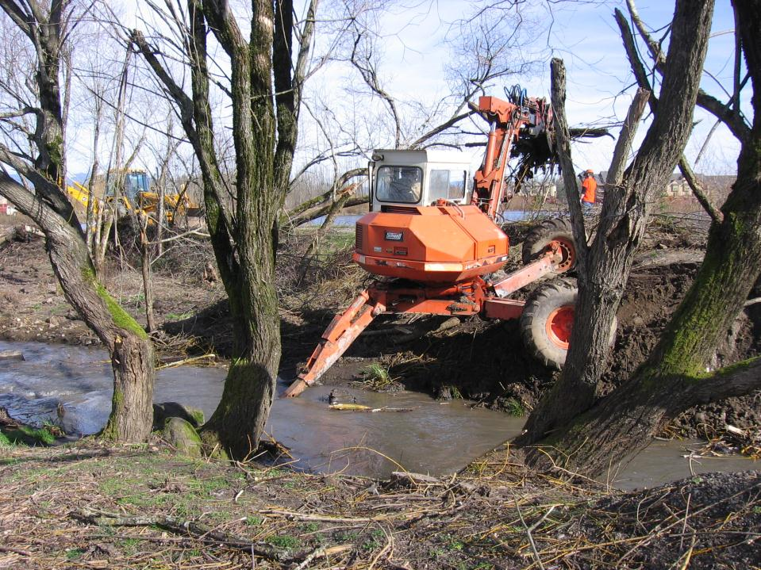
Army Corps of Engineers
Department of Fish & Game
ADF&G Fish Habitat Permit
In -Water Work Window
Notes:
As a contractor be aware the owner may have permits you don’t even know about.
Obtain & Understand all the information and requirements regarding your work.

Slide 36
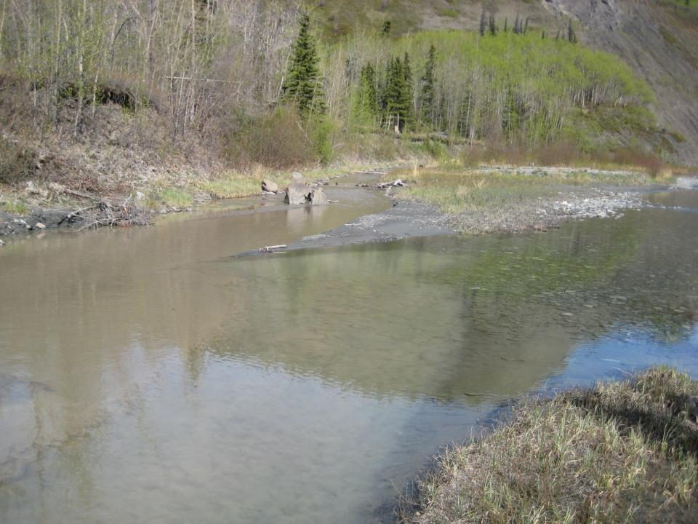
Documentation of Permit Eligibility Related to Endangered Species
CGP Part 5.7 Pg. 40
US Fish & Wildlife Clearance
The SWPPP must include documentation supporting a determination of permit compliance with regard to the Endangered Species Act
Get Consultation Letters
and retain in the SWPPP
Notes:
Get consultation letters for the Historical Sites as well as the Endangered & threatened species. If you can’t get a response from the agency document your own research and request for response from the agency. States may not have authority to give clearance on federally listed species. More coming soon.

Slide 37
ADEC Excavation Dewatering Permit
AKG002000
Dewatering discharges eligible for coverage under this general permit consist of water pumped from excavation areas through the use of temporary dewatering wells or submersible pumps to lower the water table to support a construction activity.
The dewatering of accumulated groundwater and storm water that accumulates within an excavation area is an authorized discharge under the permit.
The permit does provide discharge authorization for dewatering conducted within 1,500 feet of a permit defined “DEC-identified contaminated site” although special permit conditions apply and additional requirements may be added in the discharge authorization.
The special conditions will provide assurance that the dewatering activities does not pull contamination from known contaminated sites. See
http://dec.alaska.gov/water/wnpspc/stormwater/edhsgp.html

Slide 38
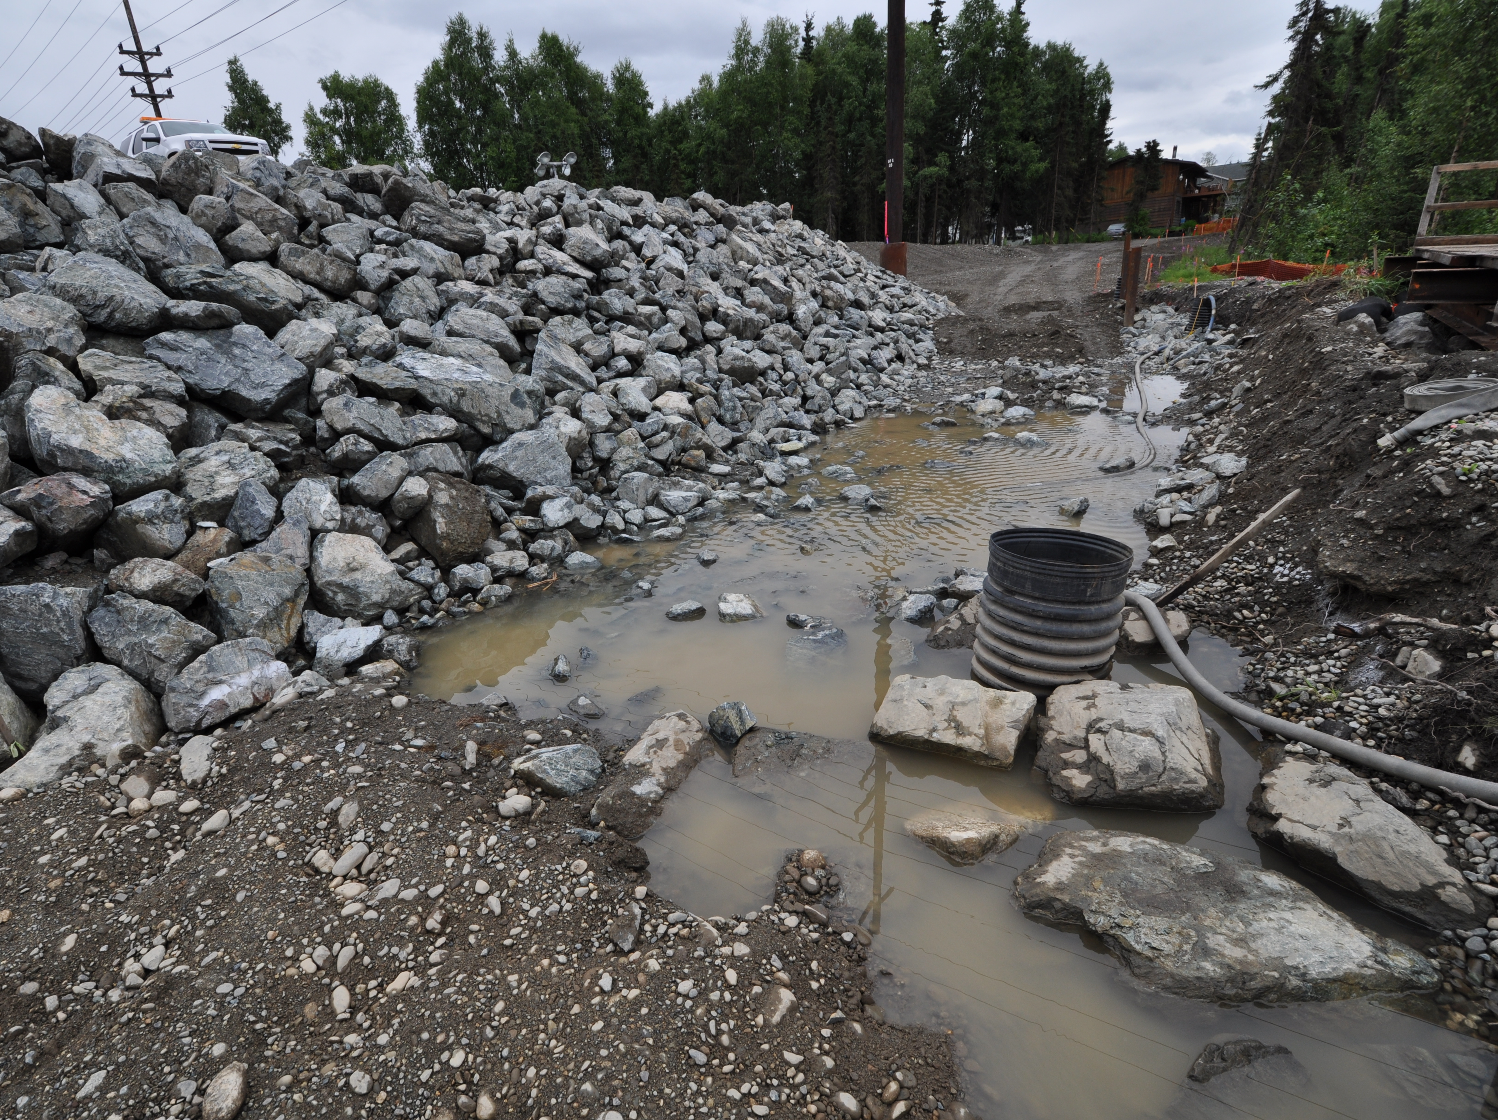

Slide 39
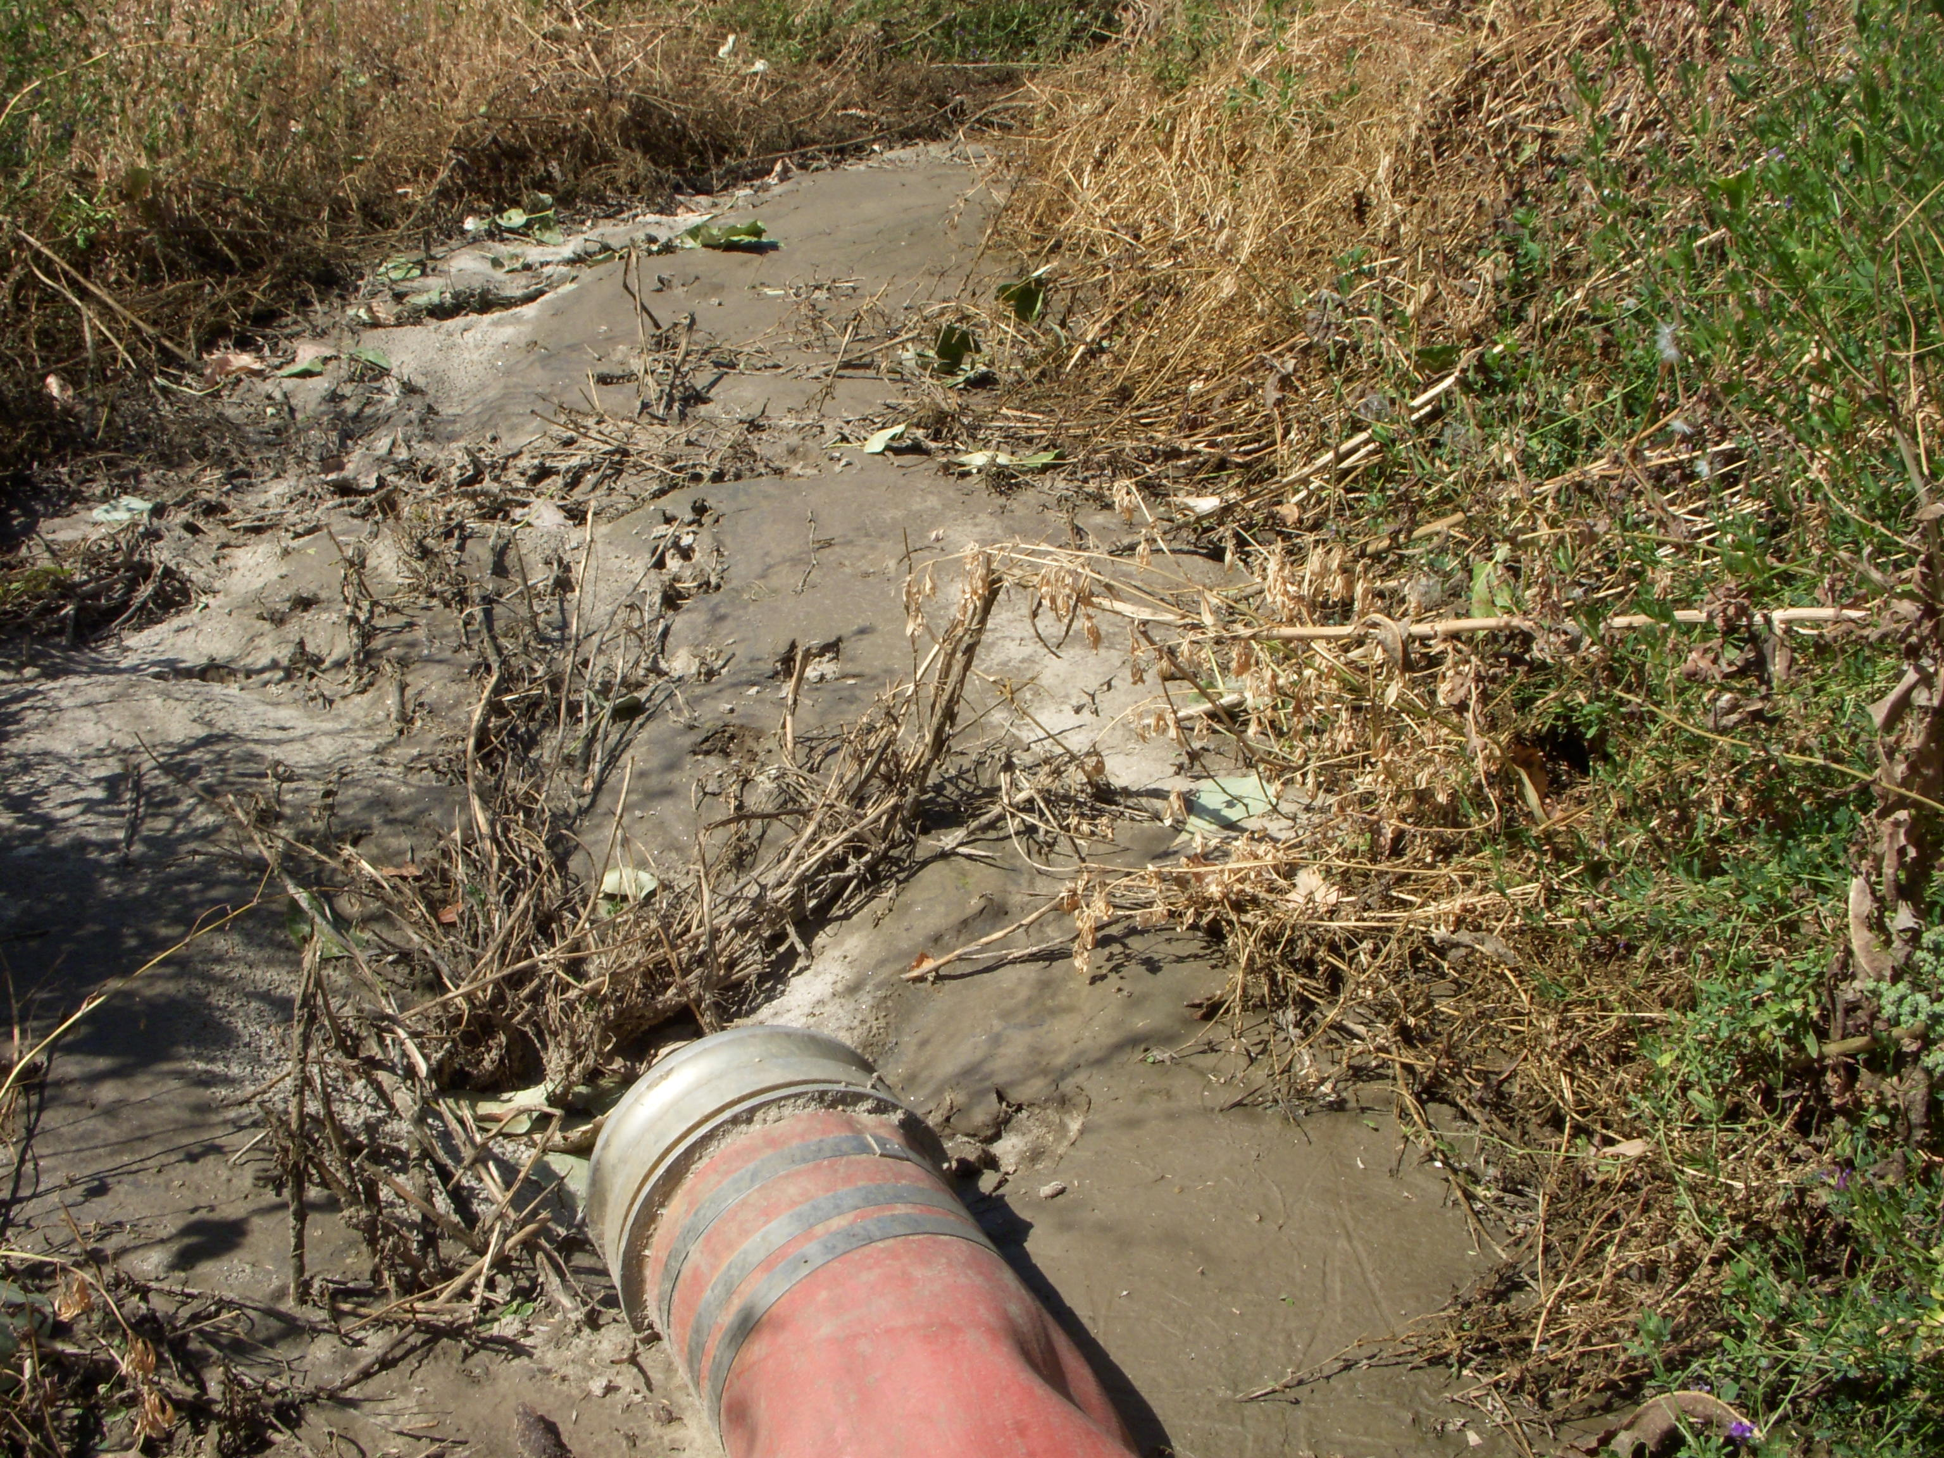
Dewatering Notice Requirements
Submit an NOI and a certified BMP Plan to receive discharge authorization, if:
  1. You have excavation dewatering activities located within 1,500 feet of a permit defined “DEC-identified contaminated site,” or
  2. You have excavation dewatering activities located within 1,500 feet of a “contaminated groundwater plume” identified by Contaminated Sites, or You have excavation dewatering discharge to waters of the U.S. not covered by the Construction General Permit
If answers to 1, 2, and 3 is No:
Then no NOI Submittal is required. Projects not requiring an NOI still must comply with the conditions of the Excavation Dewatering General Permit. Dewatering discharge to the land is authorized in accordance to Part 4.0, Control Measures; Part 5.0, Monitoring Requirements; and Part 6.0, Reporting and Recordkeeping of the Excavation Dewatering General Permit.

Slide 40
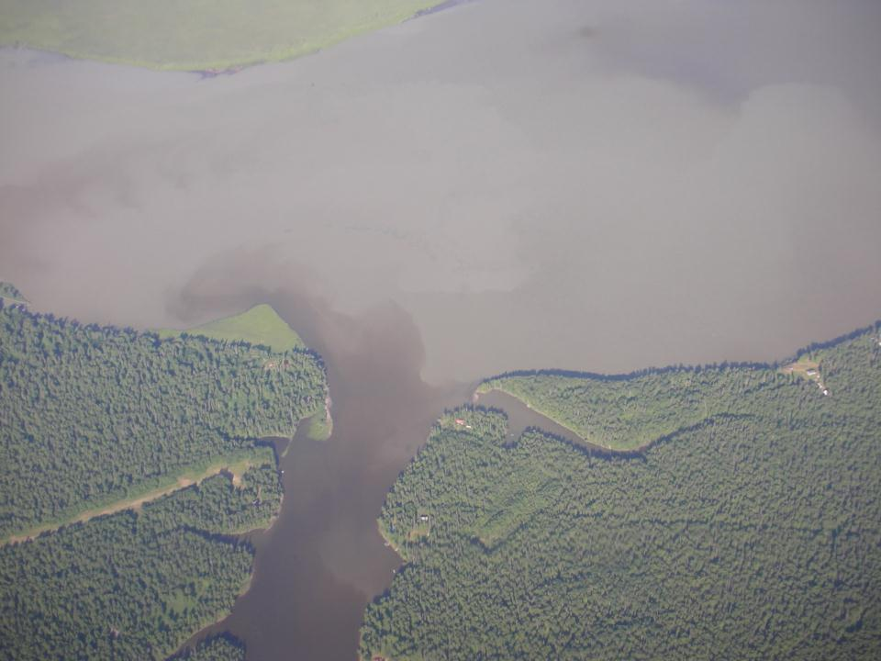
COMPLIANCE WITH WATER QUALITY STANDARDS
3.1.1 A permittee must select, install, implement and maintain control measures that minimize pollutants in the discharge as necessary to meet water quality standards (18 AAC 70). A permittee must comply with all permit conditions with respect to installation and maintenance of control measures, inspections, monitoring (if necessary), corrective actions, reporting and recordkeeping.
CGP Part 3.0 Pg. 20
Water Quality Standards
Notes:
Picture is on approach to ANC

Slide 41
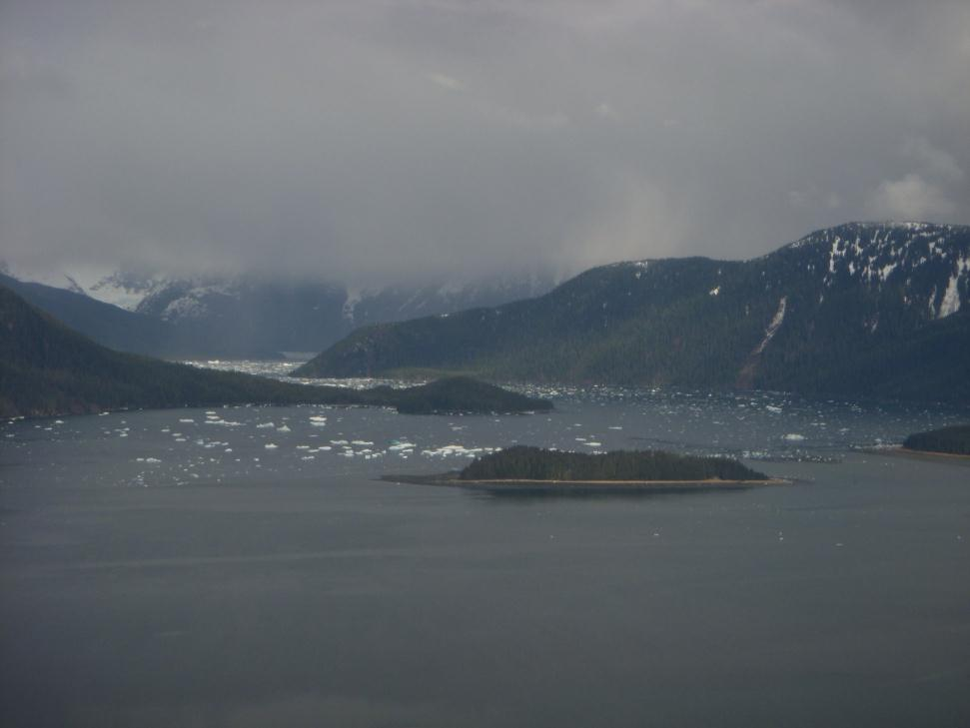

Alaska Water Quality Standards
Found in Regulation at 18 AAC 70
  Link to regulations http://www.dec.state.ak.us/regulations/index.htm
Standards may vary for freshwater and marine waters
Unless a ‘use’ has been removed for a specific water body, the most stringent standard for all uses will apply

Slide 42
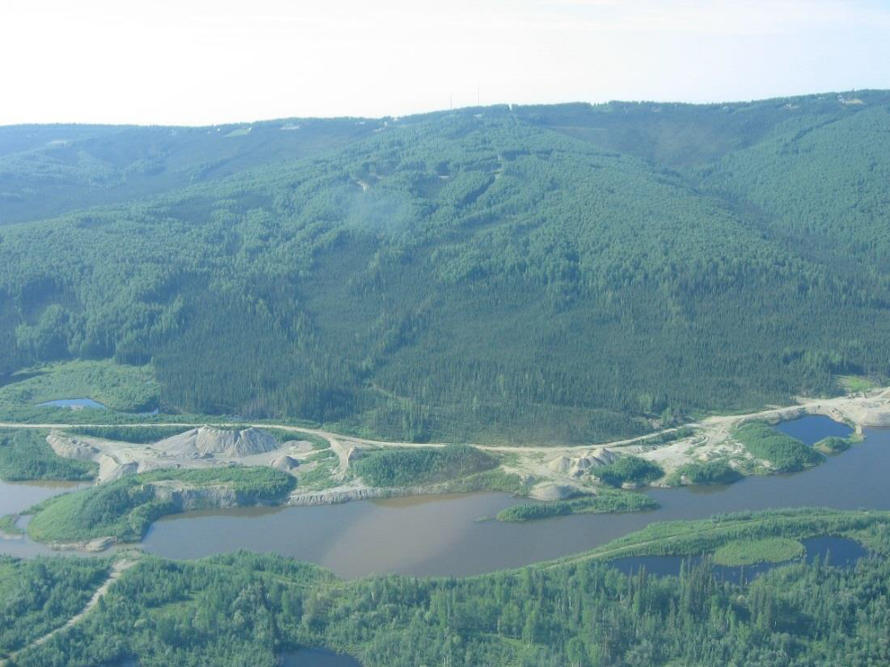
CGP Discharges
303(d) or TMDL Waterbodies
Also know as Category 5 waters that are too polluted to meet ADEC water quality standards.
Alaska is required under the federal Clean Water Act to list impaired waters and to take action to restore them.
Prevent exposing stormwater to pollutants for which the waterbody is impaired.
Types of pollutants: nutrients, sediment, bacteria, metals.
Retain documentation of efforts in the SWPPP.
Notes:
DEC uses the following guidelines to determine whether a waterbody is impaired:
1. Water quality monitoring data
2. EPA guidelines
3. Photos or video with documenting presence of residues (floating solids, debris, sludge) on or in the water, on the sub-straight, or on the shoreline
4. Water quality data or reports within the last five years
5. Documentation from a resource agency
As of 2021 Alaska has 20 impaired 303d water bodies.

Slide 43
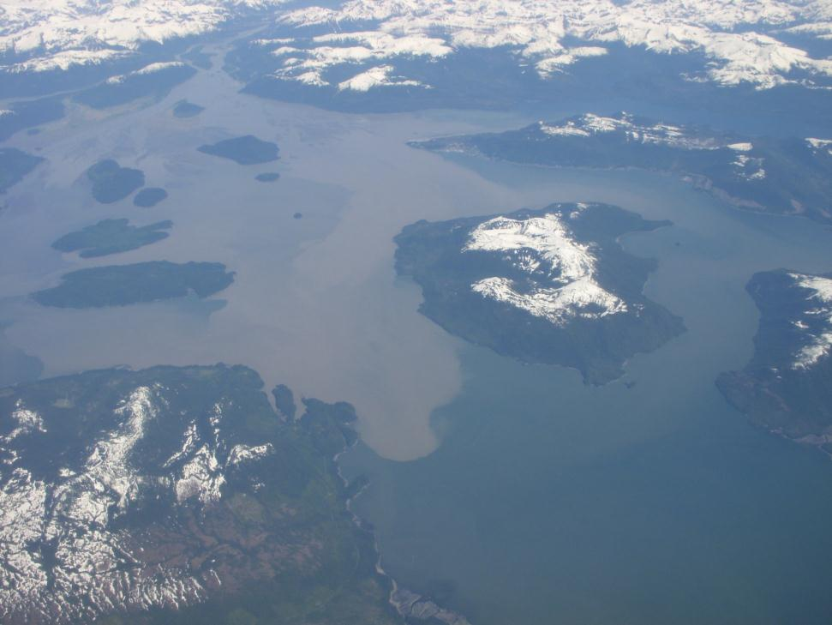
Freshwater Turbidity Standard
  Can exceed background concentration by 5 NTU if background between 0 and 50 NTU
  Can exceed background concentration by 10% of background when concentration is between 50 and 250 NTU
  Discharges to waters with background concentrations greater than 250 NTU can not be greater than 25 NTU over background
Discharge Standard

Slide 44

Marine Discharge Turbidity Standard
  Water bodies designated for all uses should not receive discharges that exceed 25 NTU
  A second method in waters such as the mouth of glacial river is use of secchi disk – do not reduce depth of visibility of disk by greater than 10%
Taku Inlet

Slide 45

Local Dust Control Regulations (AMC 15.35.090D)
Street Sweeping equipment must be equipped with filtering devices when dry sweeping
Measures must be employed to prevent dust from becoming airborne
Is this familiar?
CGP Part 4.3.6 Pg.26
Fairbanks

Slide 46

Clean Air Act
Street Sweeper
With air filtration
Notes:
Don’t have a sweeper with a plume of dust behind it.
Just like the clean water act we have the clean air act.

Slide 47

Be Aware of these & the Requirements:
§401 Cert/§404 Permit
ADEC Dewatering Permit
ADF&G Fish Habitat Permit
DNR TWUP
Critical Habitat Protections
Species Protections
Grading Permits
Clearing Permits
Notes:
ADF&G fish habitat permit is needed if a project is within or across a water body that is specified as an anadromous waterbody or will impede fish passage
As a contractor be aware the owner may have permits you don’t even know about – check with Fisheries & Army Corps of Engineers
Obtain & Understand all the information and requirements regarding your work.

Slide 48

You Need a Permit. Now What?
Develop your SWPPP.
Submit the NOI and copies of the plan to the ADEC and local agencies, if applicable.
Monitor the site
Record and report
Submit NOT. Terminate the permit
Notes:
48
SWPPP required for permit application

Slide 49

Who Is the Operator?
The operator of the construction site must apply.
Responsible for complying with permit conditions.
Has operational control over construction plans and specifications or is in charge of day-to-day activities relating to the SWPPP.
Can have co-permittees.
Glen Hwy at Hicks Creek

Slide 50


https://dec.alaska.gov/water/wastewater/stormwater/apdesenoi/

Slide 51


Slide 52

Clearing and grubbing of vegetation (including the roots), grading, altering land forms, and any sort of disturbance is permitted only if the agency is satisfied that sediment transport will be minimized.
Consideration given based on:
  Site conditions
  Proximity to receiving waters
  Activities proposed
  Extent of disturbed areas
  BMPs Specified
  Construction Schedule
APDES
Notes:
Local governments will be ramping up their enforcement and oversight of clean water act goals and NPDES requirements.

Slide 53
When filing
NOI, you must provide:
Operator name and contact information
Project name and location
Latitude / longitude
Project start and end dates
Total acreage and disturbed acreage
Type of construction activity
Receiving waters and impairment status
SWPPP certification
Endangered species eligibility
Historic property confirmation
Signed certification

Slide 54

Submittal of a Modification to Original NOI
CGP Part 2.7 Pg. 18
2.7.1 Modification. A permittee must submit an NOI modification form to DEC (see Part 2.3) to update or correct the following information on the original NOI within 30 calendar days of the change:
Owner/Operator address and contact information;
Site information;
Estimated start or end dates;
Number of acres to be disturbed;
SWPPP location and contact information.
2.7.2 Continuation of expired permit in accordance with Part 2.6.
2.7.3 If the original project disturbance was between one and less than five acres, and will now disturb five acres or more, a SWPPP must be submitted with the NOI modification.
NO FEE REQUIRED!

Slide 55

Requiring a Notice of Termination (NOT)
CGP Part 2.7.5 Pg. 19
2.7.5 NOT Instead of Modification. The permittee must submit a NOT instead of an NOI modification form to DEC within 30 calendar days when operator has changed. The new owner/operator must file a new NOI to obtain coverage under the CGP. Coverage is not transferrable.
Knik Arm

Slide 56

ADEC CGP Authorization Fee
$580

Slide 57

Retention & Availability of SWPPP
A copy of the SWPPP (including a copy of the permit), NOI, and acknowledgement letter from DEC must be retained at the site or other location easily accessible during normal business hours.

Slide 58

Main Entrance Signage
CGP Part 5.10.1 Pg.42
Permit Number
Operator Name & Number
SWPPP Location or the SWPPP Contact Name & Number
Weather worn or faded documents are potential violations.
Fairbanks
Notes:
Inspect the posting at every inspection, faded signatures, damaged documents, weathered paperwork can result in non-compliance.

Slide 59


NOI Postings
NOI authorization number
Operator Contact name and phone number
Location of the SWPPP or the name and phone number of the contact person to schedule a SWPPP review.
NEW All required posting information is located on the first page of the NOI. when personnel change!
Notes:
NOI Postings are frequently out of date and do not correctly identify the current personnel. This is a SWPPP posting where the documents have blown away, note the thumbtacks without paperwork. The paper on the board are the corps placards.

Slide 60

Define Permit Roles & Responsibilities in the contract, and READ THE CONTRACT!
-Some insurers require an Indemnification Clause
-Don’t indemnify for more than what your insurance policy covers
-Mutual indemnity
-Consult with Your Attorney
Notes:
Indemnify = indemnify (pay for losses), defend (pay legal costs), hold harmless (protect from third party or your own suit)
Builders’ insurance requires indemnity clauses of subcontractors
If CESCL has profesional liability policy, only covered for own negligent acts.
Mutual indemnity means CESCL indemnifies builder for negligent acts and vice versa.
Make sure your indemnity doesn’t transfer to new owner without your agreement.

Slide 61

Before Starting Construction
Sediment control BMPs must be installed and functional before other land disturbing activities in the up gradient area, including clearing and grubbing.
Notes:
This includes clearing and grubbing activities.
CGP 4.2.4 Clearing of vegetation that disturbs the vegetative mat and exposes soil is prohibited prior to obtaining authorization under this permit.

Slide 62

Notes:
Discharge from only a cleared site, wood chips “Hog Fuel” Was covering site.

Slide 63

If Your Project does not discharge storm water off Site:
Be careful!
SWPPP / ESCP preserves & protects designed infiltration facilities
Topography can change during the project life.
Can still track off site on roads.
If so, you still need permit coverage.
Notes:
Preserve and protect any designed infiltration facilities
Underground Injection Controls (UIC)

Slide 64

When Your
Site Discharges to Surface Waters
SWPPP & BMP’s are designed to comply with State & Federal Water Quality Standards.
Council

Slide 65

Key Points
All stormwater facilities must be constructed and made functional as one of first orders of work and stabilized.
Local permitting authority may require additional or different flow controls than State Agencies.
Infiltration systems must be protected from sediment.
Notes:
Scheduling & Permitting of all phases of development will need to consider erosion prevention and sediment control.

Slide 66

CGP vs. MSGP
Petersburg

Slide 67

Multi-Sector General Permit (MSGP)
MSGP includes coverage for the following industries:
Asphalt Batch Plants;
Concrete Batch Plants;
Material Processing;
Rock Quarries; and
Sand and Gravel Mining.
Notes:
The Multi-Sector General Permit (MSGP) for industrial storm water covers 29 industrial sectors. All the facilities covered by the permit have to develop a SWPPP to address storm water management. For 26 of these sectors the MSGP addresses storm water management after the facility is constructed. For three of the sectors – metal mining, coal mining, and sand and gravel mining – the MSGP includes requirements for a SWPPP and inspections during exploration and construction activities as well as active and inactive mining. For additional information see ADEC’s webpage on the MSGP.

Slide 68
Material Sites – Which permit covers It
CGP
Site is used for just the one project
Site is opened at beginning of project and closed at end of project
See CGP Part 1.4.2.3
MSGP
Site serves multiple unrelated construction projects by different permittees
Site is a commercial operation or landowner allows multiple users of the site
See MSGP Sector J
Notes:
In the Construction General Permit (CGP) material sites are considered support activities. How a material site is developed, managed, and used will determine whether the material site is regulated by either the CGP or the Multi-Sector General Permit (MSGP). A material site can not be permitted by both permits at the same time. Part 1.4.1.3 of the CGP explains that 1) the material site must be directly related to the construction site required to have permit coverage, 2) the material site is not a commercial operation serving multiple unrelated construction projects by different permittees, 3) the material site does not operate beyond the completion of the construction activity at the project that supports it, and 4) appropriate control measures are identified in the project SWPPP. (There are some exceptions for projects off the road system – see definition for “support activities” in Appendix C of the CGP.)
Sector J of the MSGP explains Sand and Gravel operations from exploration through, construction, active mining, inactive mining and restoration. For example, a commercial material site that sells material for multiple CGP Projects would have MSGP coverage. For example, a material site on DNR land leased by DOT and used for multiple projects would need MSGP coverage. For example, a material site in a community that is used for multiple projects.

Slide 69

What If I Don’t Comply?
NPDES Strike Force
Civil & Criminal Penalties
Third Party Lawsuits
Civil penalties
  EPA: $64,600 per day/per violation/
  Adjusted Annually
  ADEC monetary penalties enforced
Stop Work Orders
  Requires formal notice from Permitting authority
Criminal Sanctions
  If violation knowing & willful, criminal penalties up to $10,000 and possible jail time
Citizen Suits
  Permit noncompliance is violation of Clean Water Act
  Citizens can use SWPPPs, inspection reports, log entries, and DMRs to sue you
Construction Delays
Notes:
Keep in mind that with increased oversight or enforcement will come extra paperwork and legal fees. These costs often exceed the fines.

Slide 70

Citizen Inspection Programs
Clean Water Act Allows
Third Party Lawsuits
Mitigation of Impacts
Compliance With
Permit Conditions
is IMPERATIVE!
www.getthedirtout.org
Notes:
Even more so than Agency Inspectors understand the potential of the Third Party Lawsuit.

Slide 71

Notes:
Third Party Inspection Materials. We are being asked to self police, consider the alternative.

Slide 72


Slide 73

Termination of Permit Authorization
Must Submit Within 30 Days if:
Final Stabilization has been achieved
A new permittee assumes control over all areas
Coverage has been obtained under an alternative permit
CGP Part 10.0 Pg.53

Slide 74

This project is complete, and all areas are stabilized.
We do not want permit responsibility or need permit coverage any longer.

Slide 75

Efforts to Stabilize prior to Permit Termination
Cougar, WA
Notes:
Read your permit and NOT for stabilization requirements

Slide 76

What Is Stabilization?
Concrete or asphalt
Quarry spall ditch lining
Arid areas: Three-year designed stabilization plan
70% of Natural Vegetative cover
Cougar, WA

Slide 77

Straw Wattles
Grass on Slope
Check Dams
Geotextile
Rock lined swale
Concrete
&Asphalt
Site Stabilized?
Notes:
Remove Silt Fence? For termination of permit coverage and maintenance issues.

Slide 78

Permit Conditions & Responsibilities are
in effect until Notice of Termination
Notes:
This subdivision is still under permit but homeowner is doing the work.
Many developers send out letters of notice regarding permit requirements and bill back subcontractors for clean up costs.

Slide 79

Regulatory Requirements Summary
Federal Clean Water Act
NPDES, EPA Phase I and II
ADEC Construction General Permit
APDES permit application process
ADF&G Fish Habitat Permit
ADEC Dewatering Permit
USFWS ESA / USACE Section 404
Local permit standards
SWPPP should provide the blueprint for compliance
with all regulatory requirements

Slide 80

The Regulation Train is Here
Increased Monitoring
Silt Fence
Grass Lined Channel
Brush Barrier
Notes:
Your sites are being monitored, Transportation projects are highly visible.

Slide 81

Feeling Overloaded?
APDES
NOI
ESA
Permit
SWPPP
Clean
Water Act
BMP’s

