Slide 1
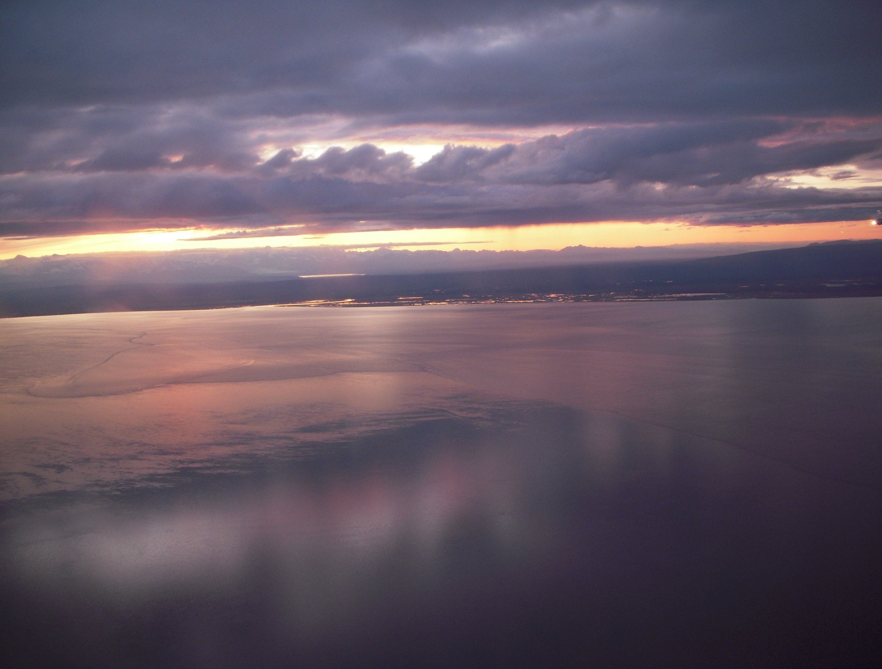

3. Regulations & Permitting
EPA – NPDES
DEC – APDES
Local requirements
What's new?
September 2022

Slide 2
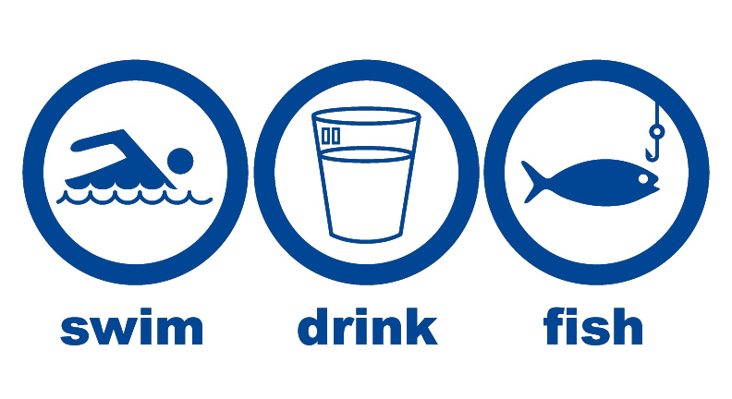
Regulations & Permitting
Clean Water Act = Protect & Restore
Notes:
Swimmable, drinkable, fishable. The goals are protecting and restoring.

Slide 3
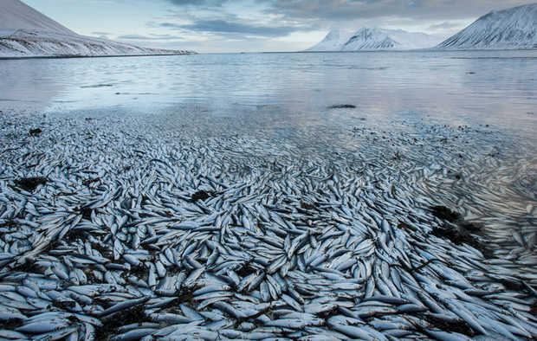
We have had problems!
We will have problems!
Can we reduce the problems?
Kolgrafafjordur Iceland, as reported in the ADN
Notes:
A fish kill due to lack of oxygen thought to have been caused by a landfill and bridge constructed across the fjord. This is the second occurrence in two months in February of 2013.

Slide 4
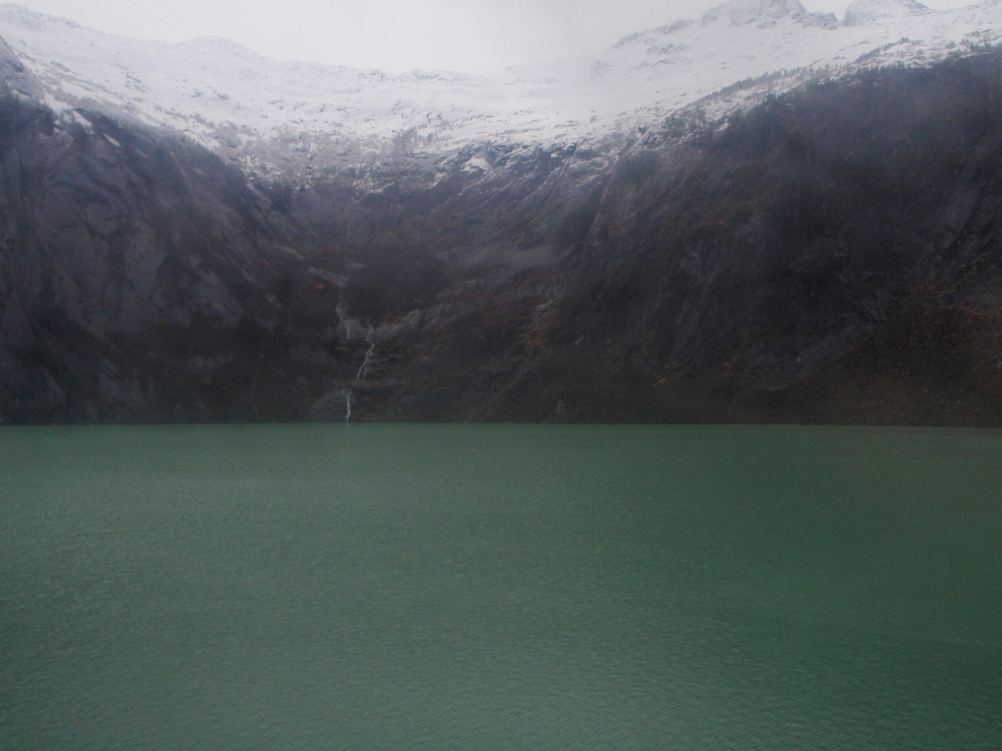


NPDES
National Pollutant Discharge Elimination System
Protect & Restore Waters of the U.S.
Notes:
EPA always has authority, Implementing the NPDES program is a very difficult order. Eliminating pollutants nationally in our discharge, Or APDES: eliminating pollutants in Alaska's discharges.

Slide 5
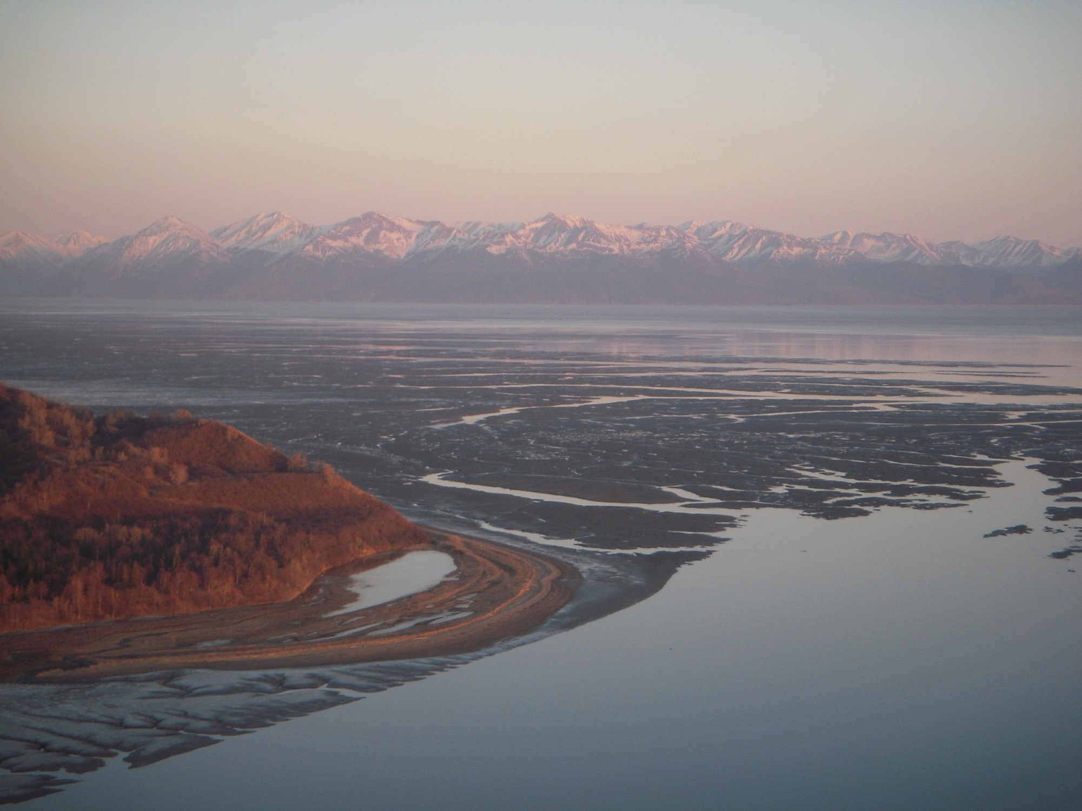
APDES
Alaska Pollutant Discharge Elimination System
Kincaid Park
DEC received primacy from EPA in 2009

Slide 6
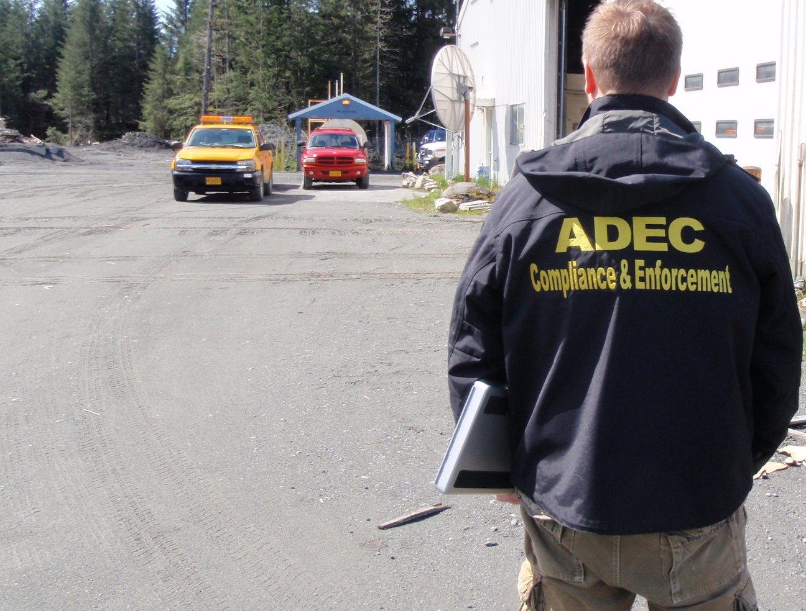
The Alaska Construction General Permit (CGP) authorizes storm water discharges from construction activities that disturb one acre or more and where those discharges enter waters of the U.S. or a municipal separate storm sewer system (MS4) leading to waters of the U.S.

Slide 7
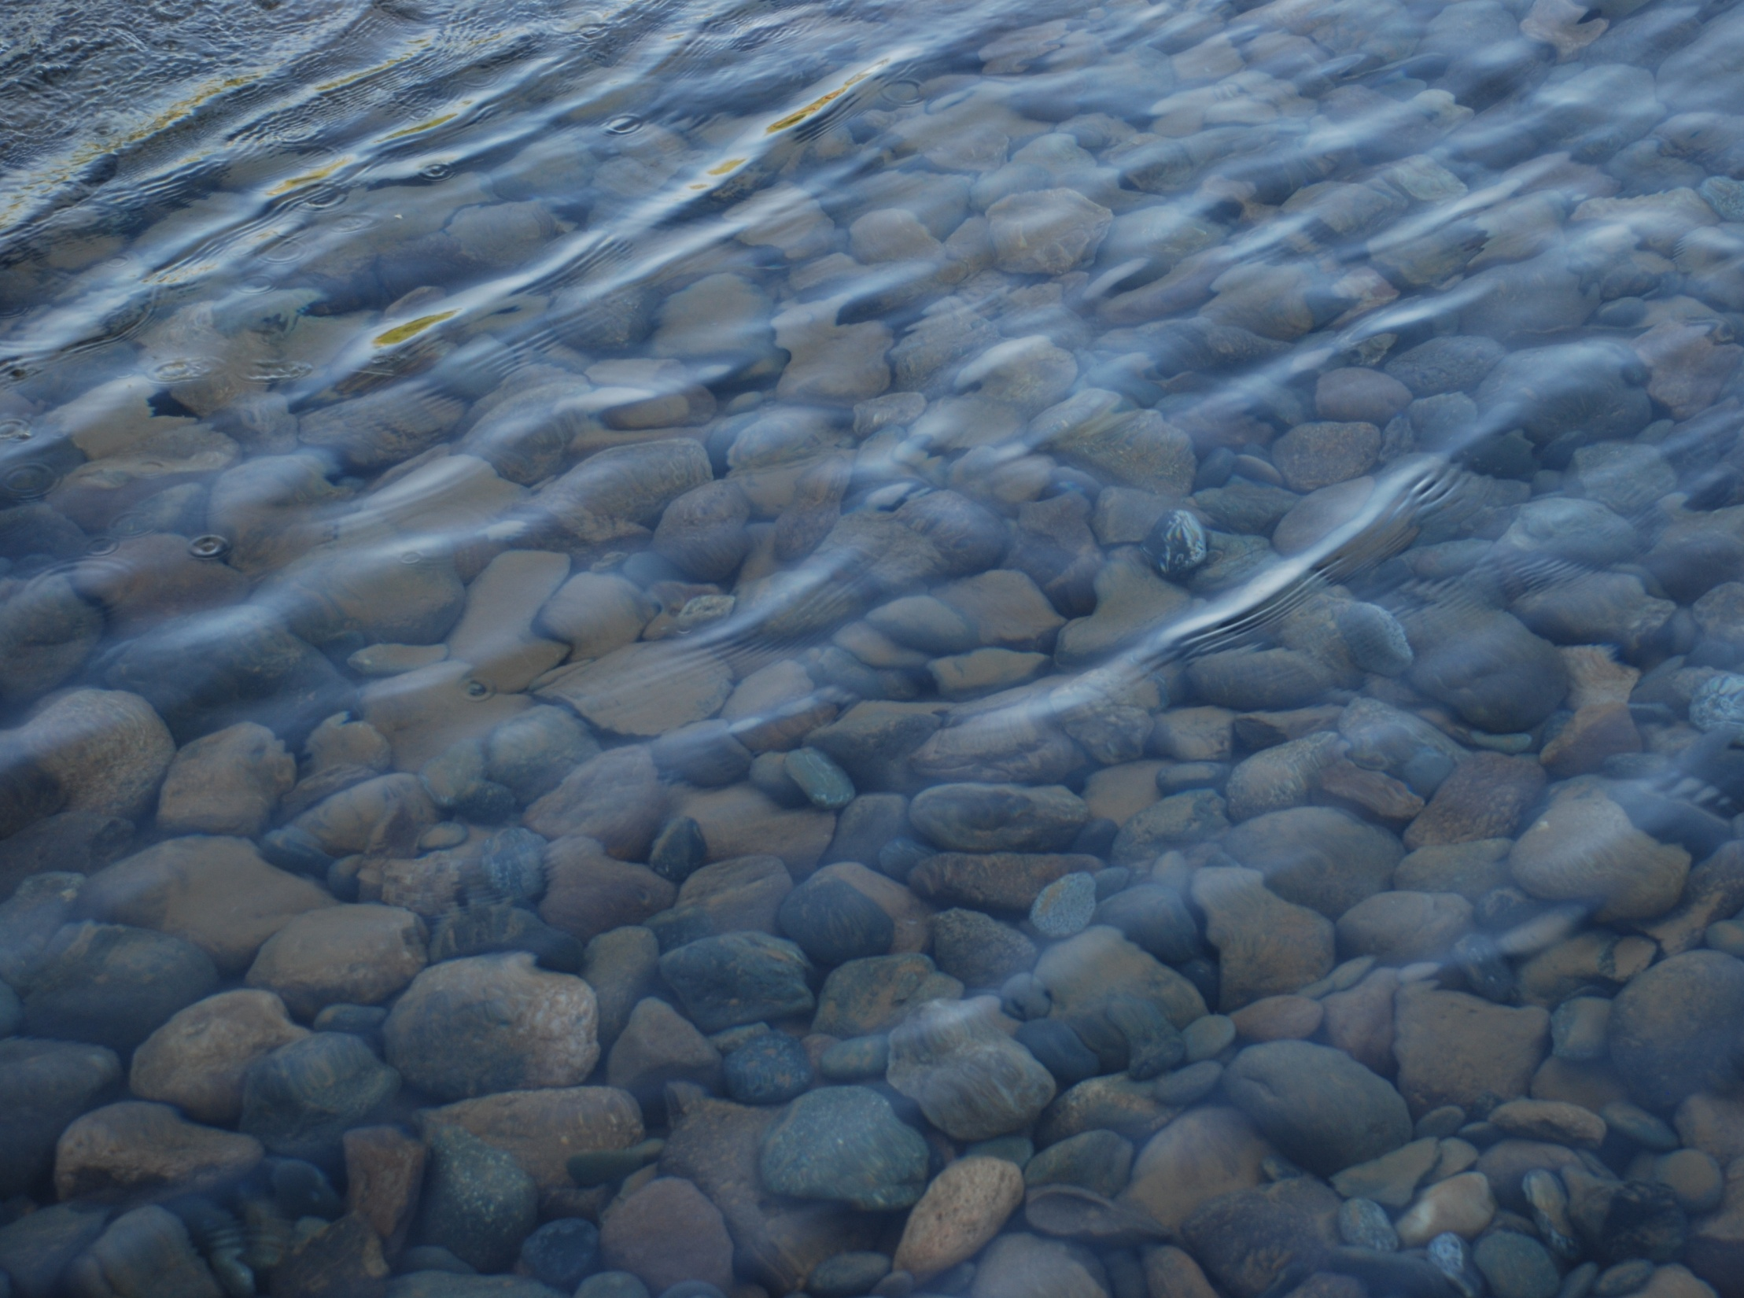
Waters of the U.S. defined in 40 CFR 122.2
Waters of the U.S. are rivers, lakes, ponds, streams, inland waters, salt waters, and wetlands.
If it there is flowing water near your project, it is considered Water of the U.S..
The new definition does not protect any new types of waters; regulate most ditches; apply to groundwater; apply to rills, gullies or erosional features; create any new permitting requirements for agriculture; or address land use or private property rights.
No Discharge = No Permit Necessary
However 100% Infiltration is very rare.
Notes:
This is the definition from the CFR that is referred to by the CGP. Basically if its wet protect it unless you have an interest in arguing your opinion at an hourly rate set by your attorney.

Slide 8
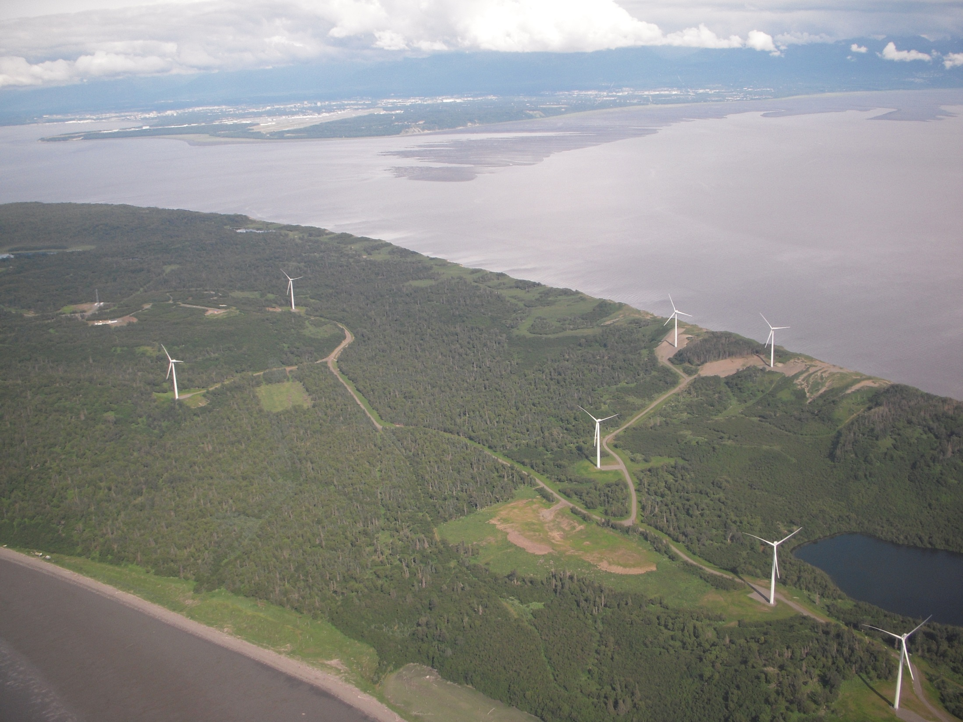
Do all sites that discharge go to waters of the U.S.?
Most in Alaska do.
Fire Island
Notes:
It is possible to sheet flow only to uplands but this is very rare. A site investigation must be performed and documented to verify. No drainage to a ditch, channel, concentrated flow to a stream, lake, pond or wetland.

Slide 9
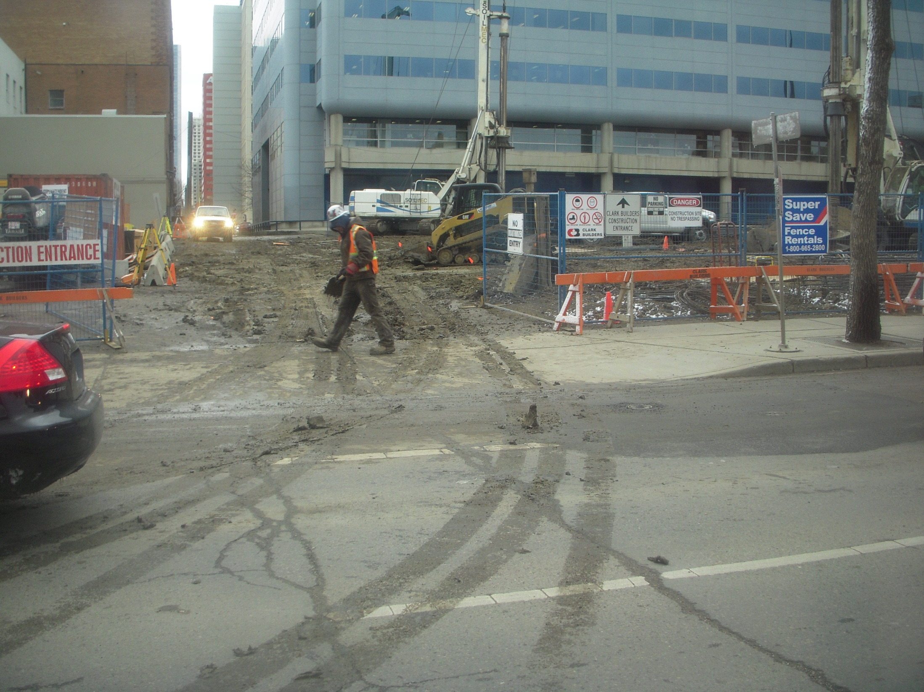
Even if there is no discharge to waters of the U.S.;
Track-out can be considered a discharge.
Notes:
The curb and gutter can connect directly to waters of the US, even if via a storm manhole and pipe.

Slide 10
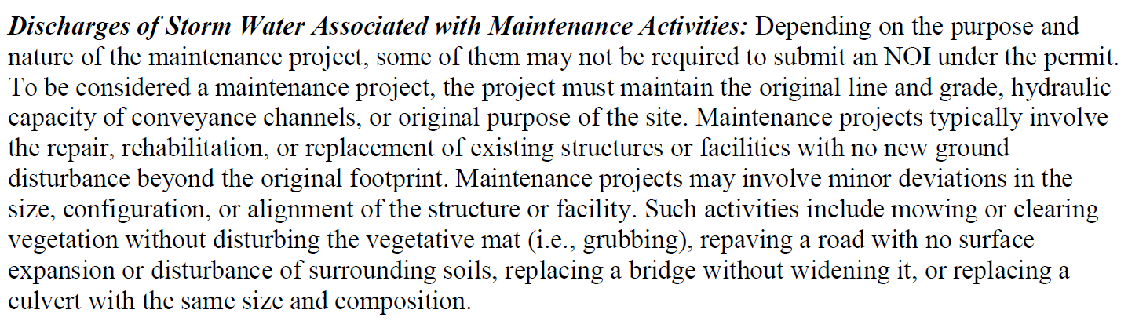
Routine Maintenance
2021 Fact Sheet Page 16
Notes:
If the maintenance is not annual then there should be a written standard Operating Procedure that demonstrates that it truly is “routine”.

Slide 11
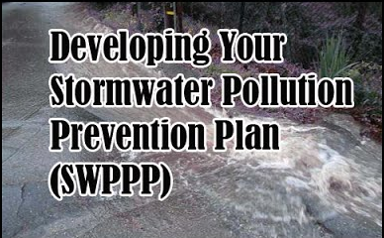
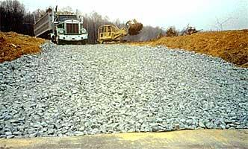
2021 Construction General Permit (CGP) Introduction
Goals of this section:
Know and understand the sections of the CGP;
Find answers in the CGP; and
Know what makes a good SWPPP.

Slide 12
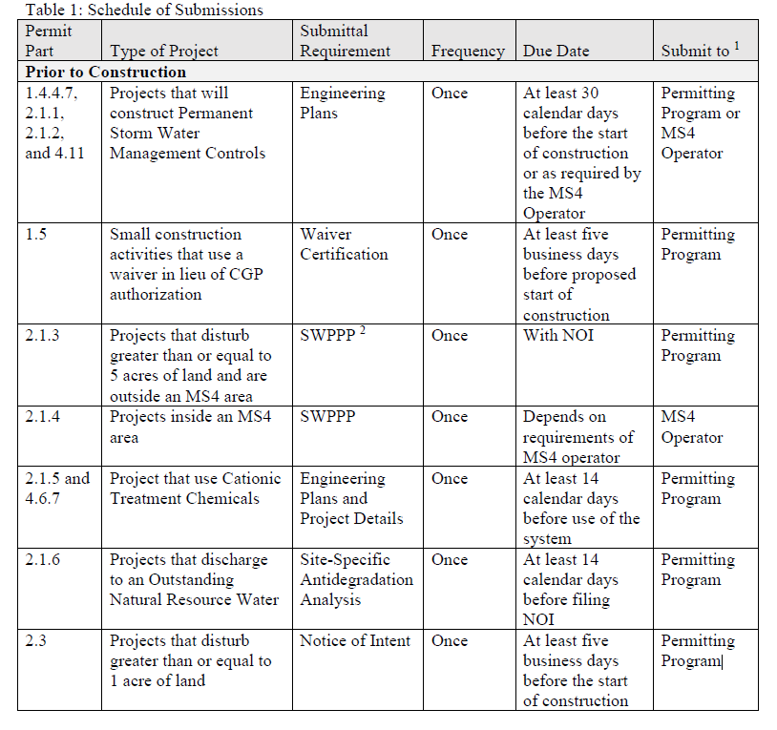
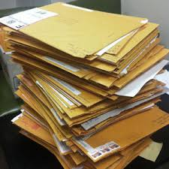
2021 Construction General Permit (CGP)
Table 1: (page 6)
Schedule of
Submissions
Prior to
Construction

Slide 13
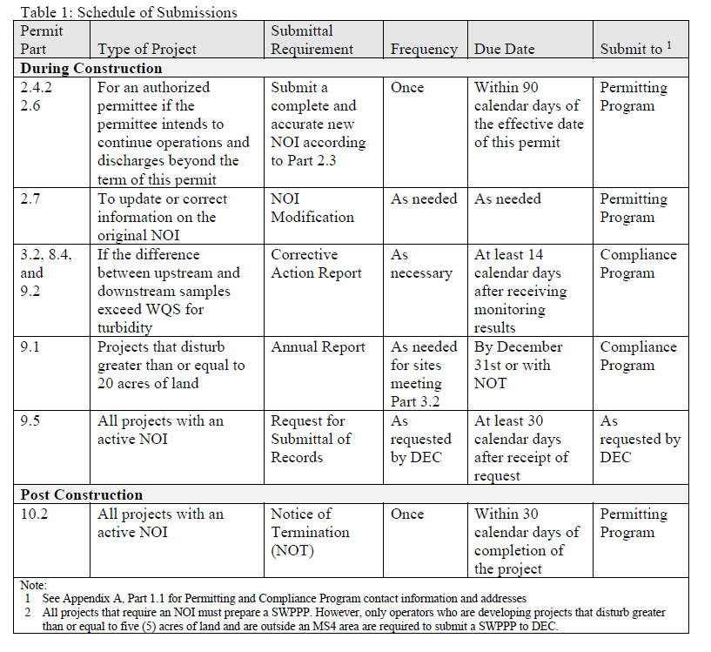
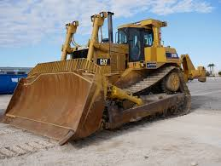
2021 Construction General Permit (CGP)
Table 1: (page 7)
Schedule of
Submissions
During
Construction

Slide 14
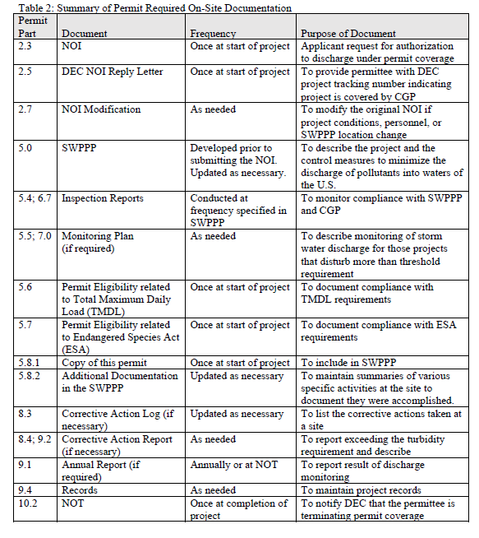
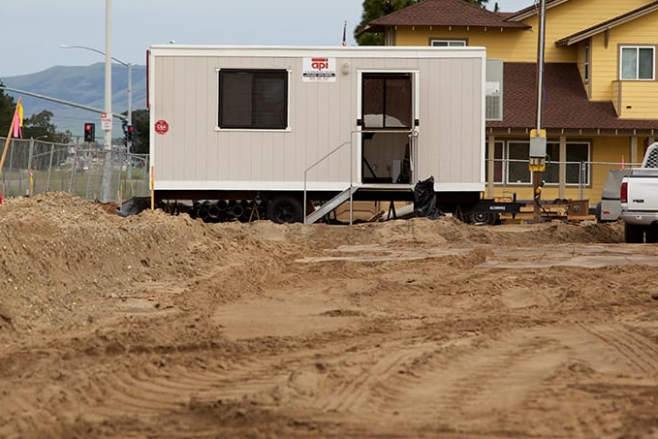
2021 Construction General Permit (CGP)
Table 2: (page 8)
Required
On-Site
Documentation

Slide 15
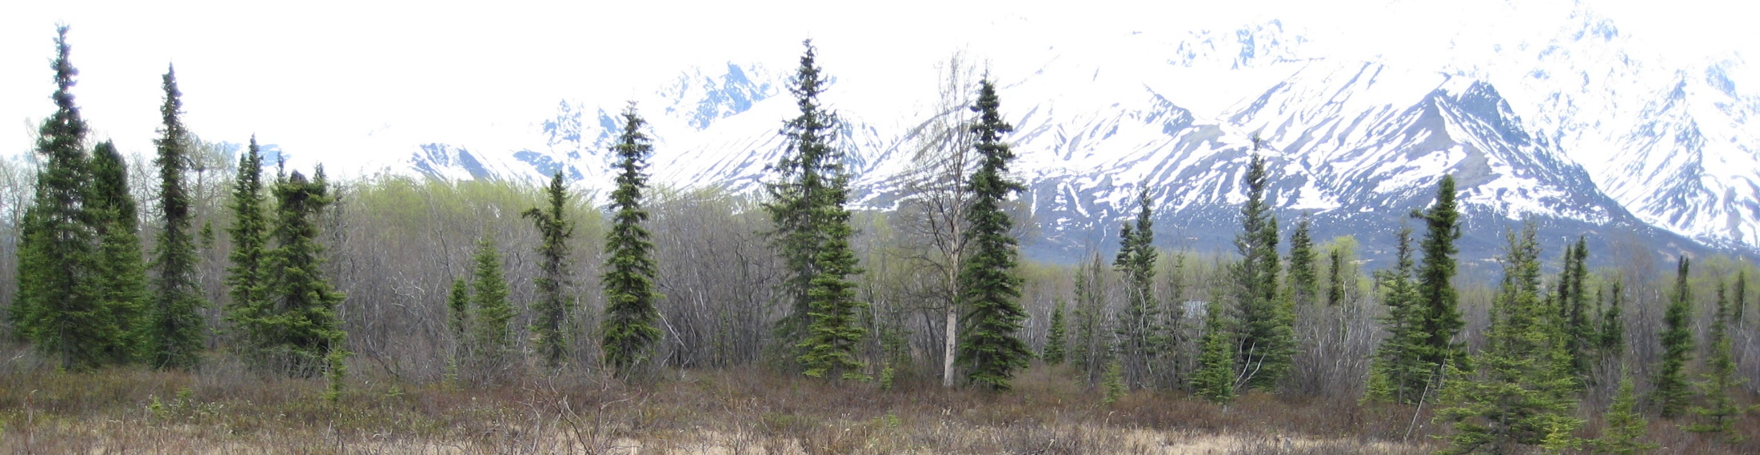
2021 Construction General Permit (CGP)
Section 1.0 Coverage Under the Permit (page 9)
  Introduction and goal of the permit
  Persons Responsible for Obtaining Authorization under the Permit
  Permit Area
  Eligibility Requirements
  Authorized Storm Water Discharges
  Authorized Non-Storm Water Discharges

Slide 16
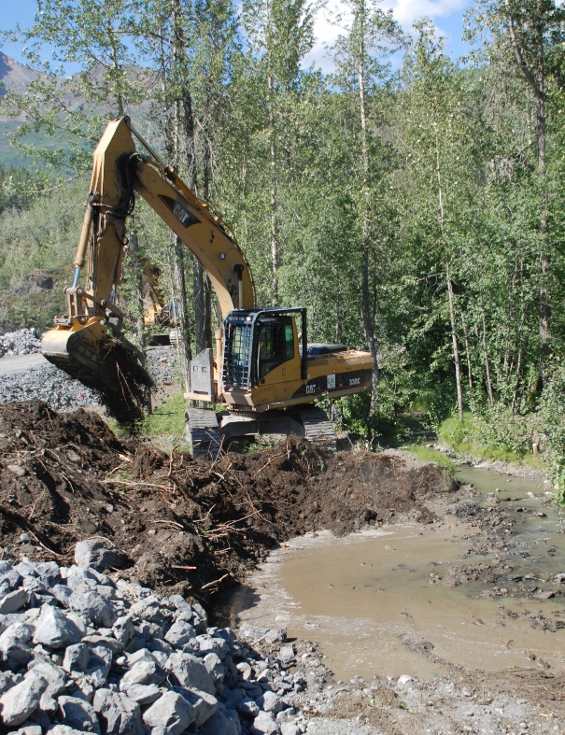
2021 Construction General Permit (CGP)
Section 2 Authorization Under the General Permit (page 13)
  Submittal Requirements Prior to Construction
  Permanent Storm Water Management Controls (Outside MS4)
  Permanent Storm Water Management Controls (Inside MS4)
  SWPPP Submittal
  How to obtain authorization
  How to submit an Notice of Intent (NOI)
  Submission Deadline
  Date of Authorization to Discharge
  Continuation of Expired General Permit
  Submittal of a Modification to Original NOI
  Alternative Permits

Slide 17
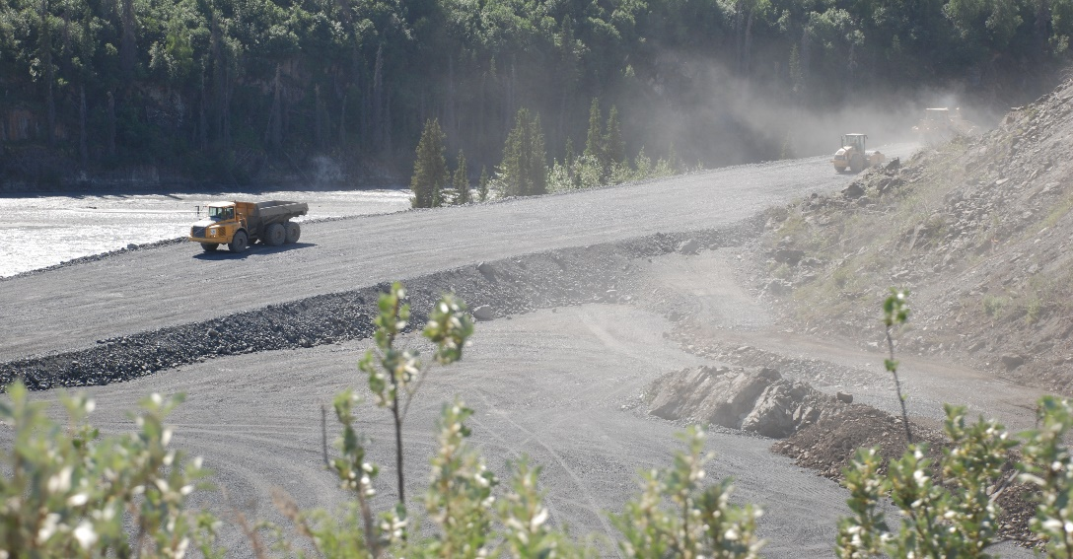
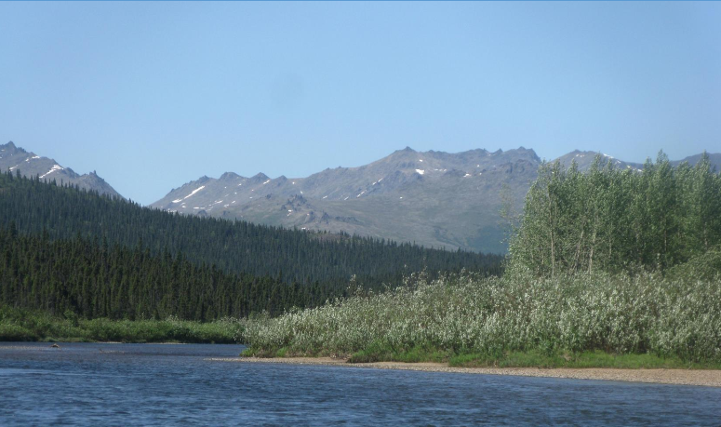
2021 Construction General Permit (CGP)
Section 3 Compliance with Standards and Limits (page 20)
  Project Requirements
  Discharge to impaired water bodies
  Protection of endangered species
Norton Bay, AK

Slide 18
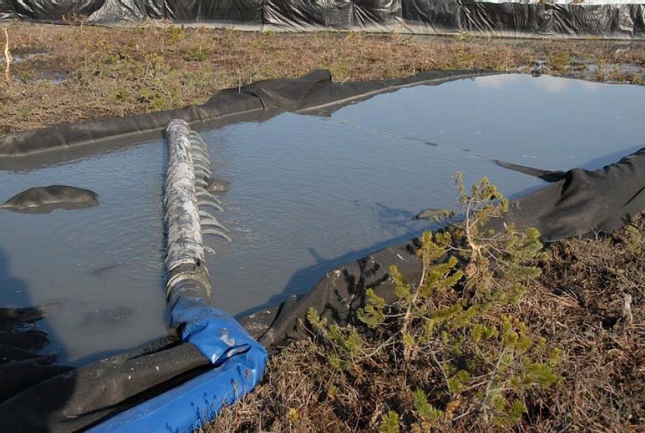
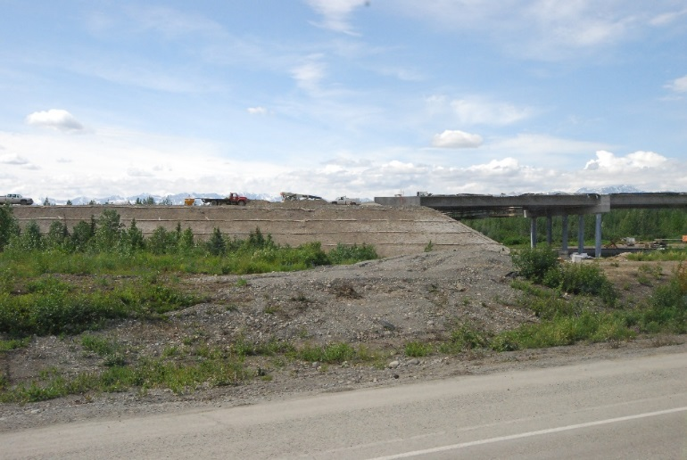
2021 Construction General Permit (CGP)
Section 4 Control Measures (page 22)
  Selection and design
  Erosion control measures
  Sediment control measures
  Dewatering
  Soil Stabilization
  Treatment Chemicals
  Prohibited discharges
  Good housekeeping measures
  Spill notification
  Projects near a Public Water System
  Permanent Storm Water Mgt. Control
  Winter considerations
  Maintenance of Control Measures
  Storm water lead and training
Petersburg, AK
Broad Pass, AK

Slide 19
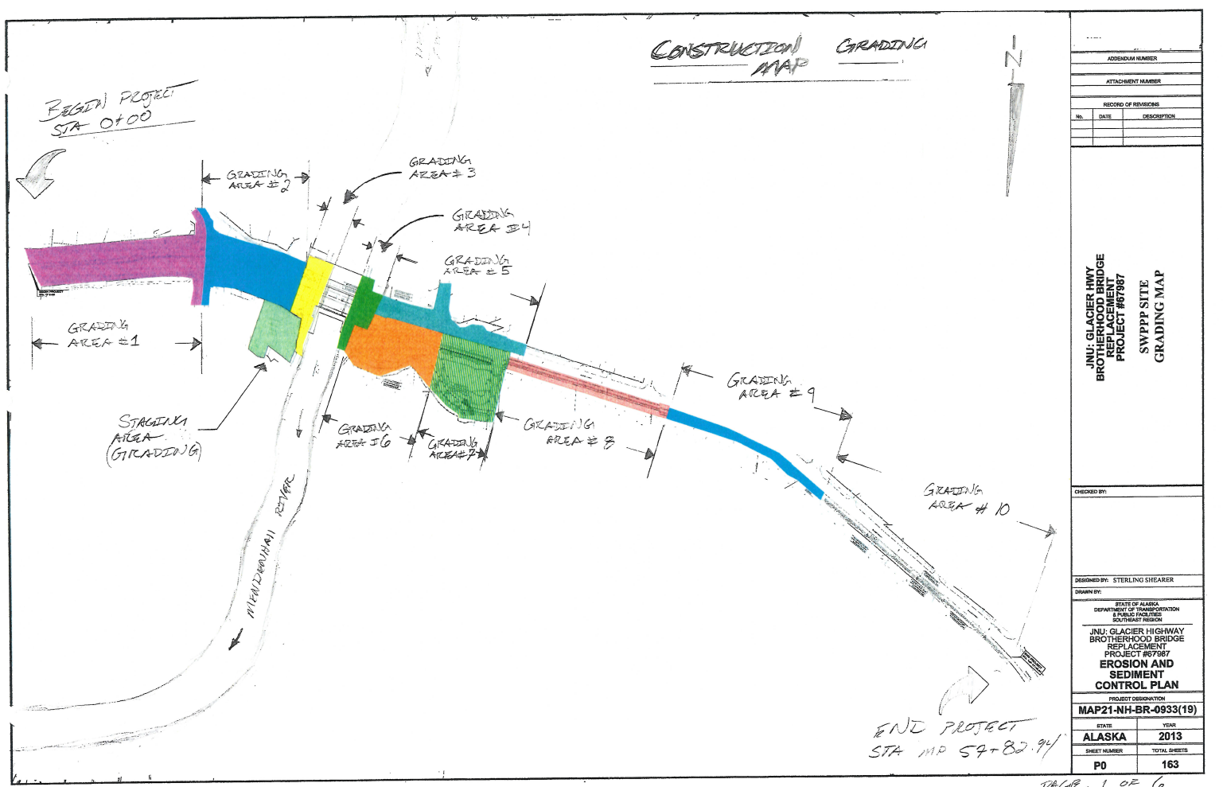
2021 Construction General Permit (CGP)
Section 5 Storm Water Pollution Prevention Plan (SWPPP) (page 36)
  SWPPP preparation
  SWPPP contents
    Contacts, conditions and activity
    Site maps
    Control measures
    Inspections
    If Applicable:
    Monitoring Plan
    Eligibility Related to:
    TMDL
    Endangered Species

Slide 20
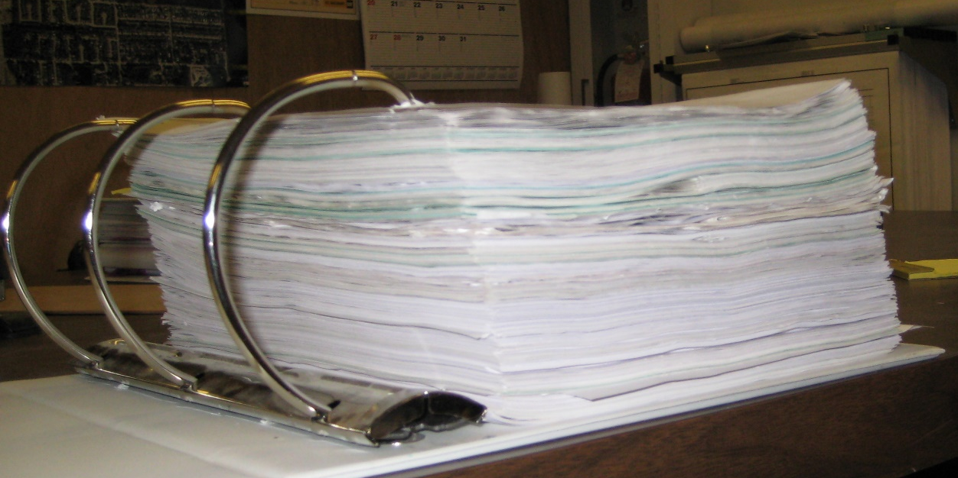
2021 Construction General Permit (CGP)
    Additional documentation requirements:
      Grading and stabilization
      SWPPP modifications
      Employee training
      Entrance signage
      Availability of SWPPP

Slide 21
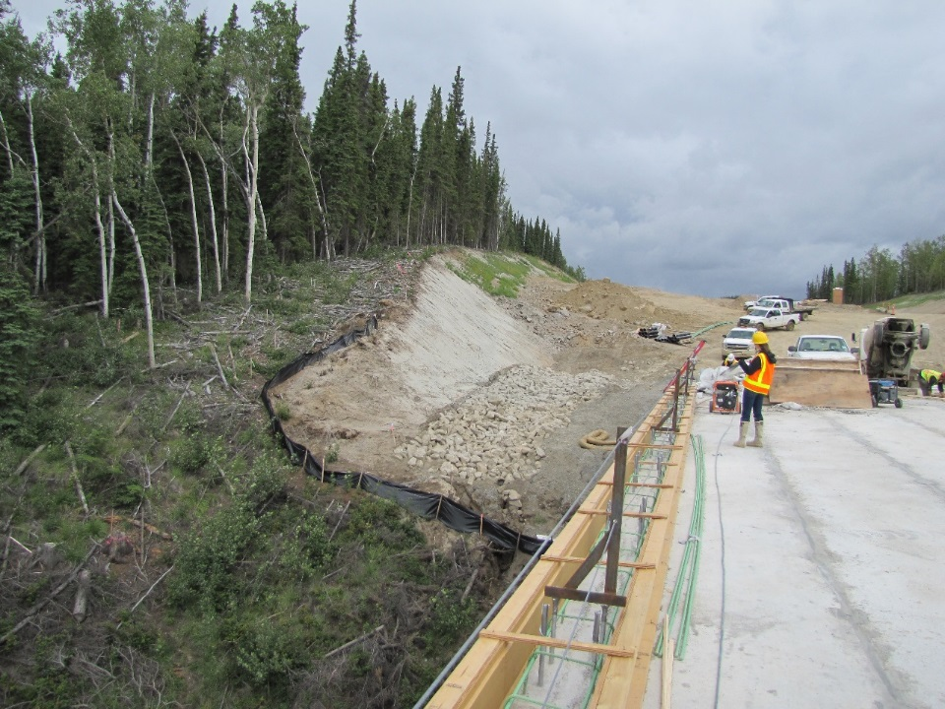
2021 Construction General Permit (CGP)
Section 6 Inspections (page 44)
  Frequency
  Reductions in frequency
  Qualified Person
  Site inspections
  Linear Project Inspections
  Inspections by DEC or EPA
  Inspection report
Tanana River Bridge

Slide 22
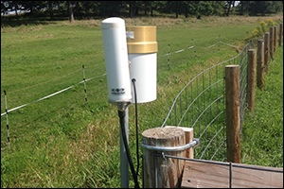

2021 Construction General Permit (CGP)
Section 7 Monitoring (page 47)
  Qualified Person
  Discharge Monitoring Requirements
  Rainfall Monitoring
  Visual Monitoring

Slide 23
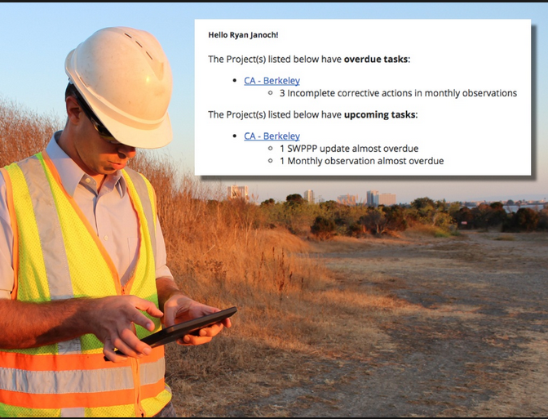
2021 Construction General Permit (CGP)
Section 8 Corrective Actions (page 50)
  Conditions
  Deadlines for corrective actions
  Corrective action log
  Corrective action report
  Substantially Identical Outfalls
Hello Ryan!
The Richardson Hwy MP 102 project has 3 incomplete corrective actions needed completed today!

Slide 24
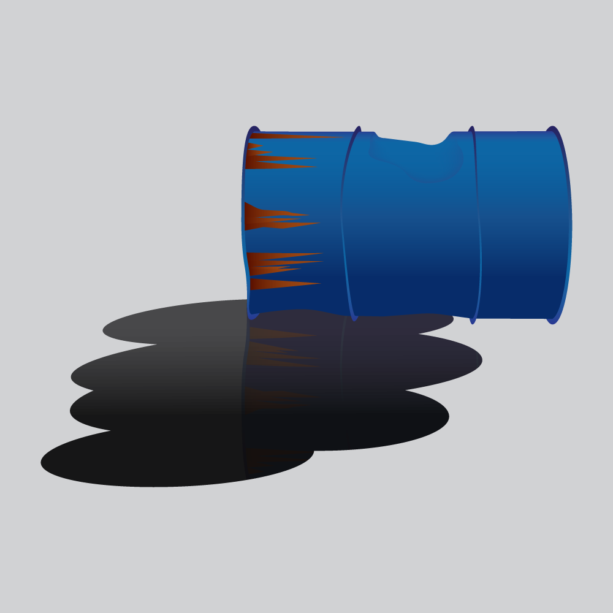
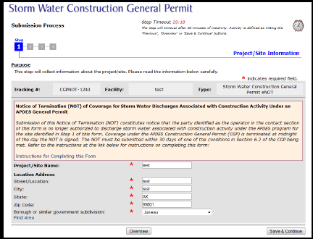
2021 Construction General Permit (CGP)
Section 9 Reporting and Recordkeeping (page 52)
  Annual Report
  Corrective Action Report
  Spill of hazardous substance report
  Retention of records
Section 10 Termination of the Permit Authorization (page 53)
  Submitting a Notice of Termination (NOT)
Section 11 Permit Reopener Clause (page 54)

Slide 25
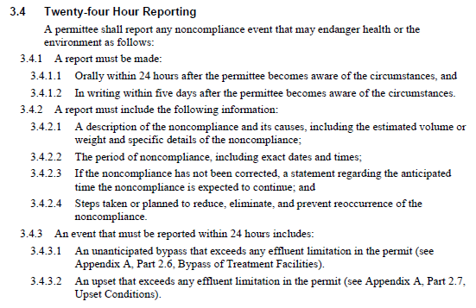

2021 Construction General Permit (CGP)
Appendix A (page A3)
  Standard Conditions Applicable to All Permits
  Signature requirement and penalties (page A6)
  Twenty-four hour reporting (page A11)

Slide 26
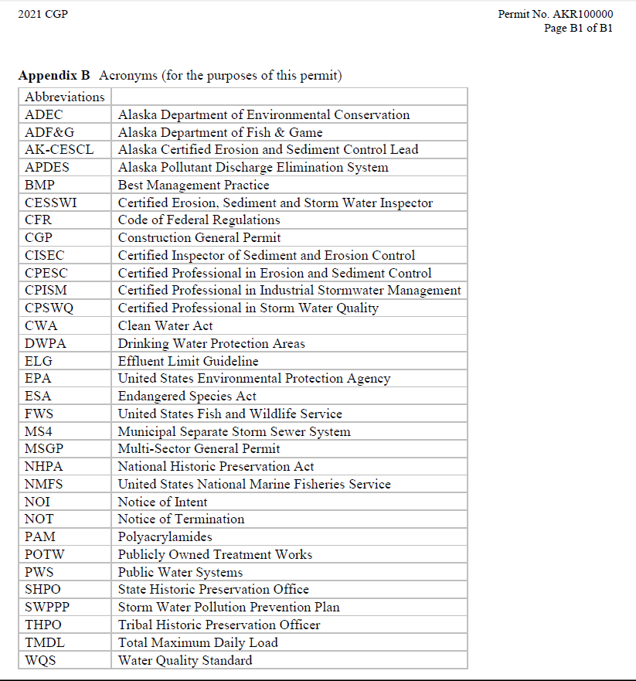
2021 Construction General Permit (CGP)
Appendix B (page B1)
  Acronyms

Slide 27
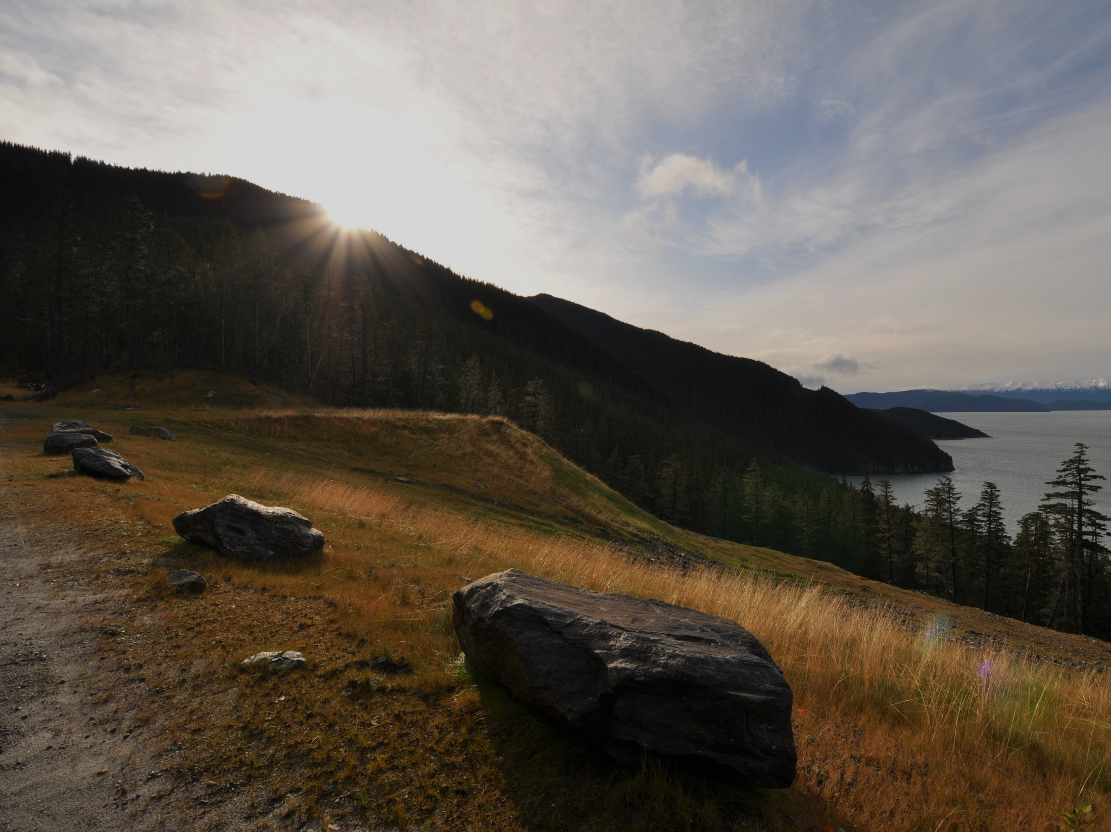
2021 Construction General Permit (CGP)
Appendix C Definitions (page C1)
Appendix D Small Construction Waivers
Appendix E Forms
  Notice of Intent (NOI)
  Notice of Termination (NOT)
  Notice of Intent Modification
  Low Erosivity Waiver
  Annual Report

Slide 28
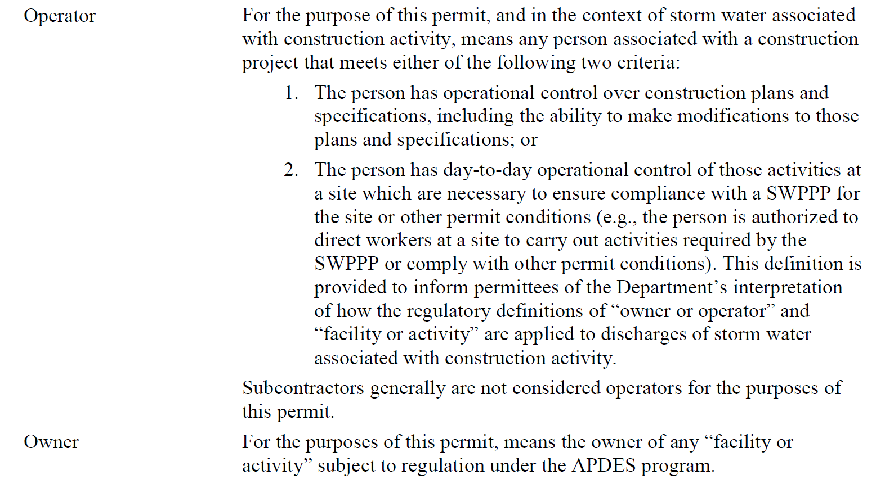
DEC CGP Appendix C Definitions

Slide 29
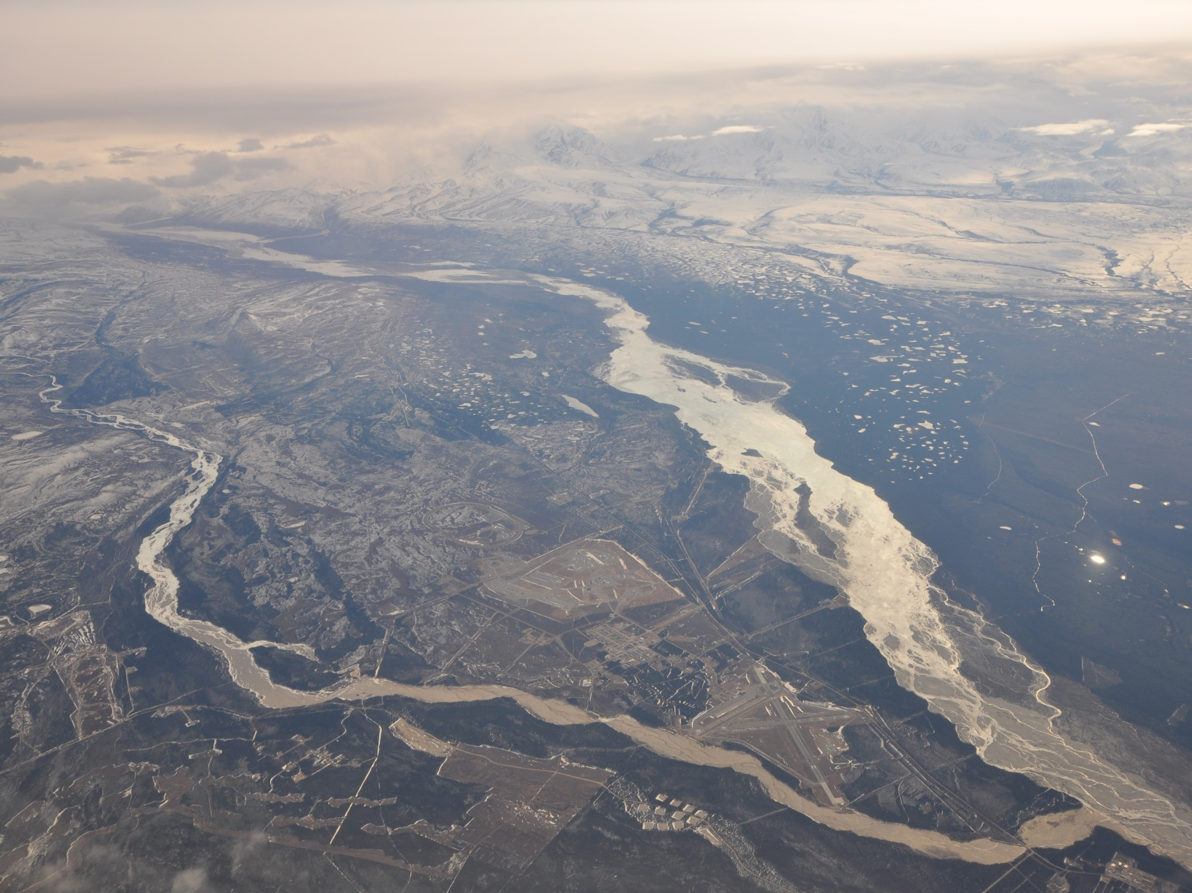
Operators who need CGP Coverage
Owners with
Plans & Specs
Approval
Operators
Day to Day
Control
Operators of
Design Build
Greely

Slide 30
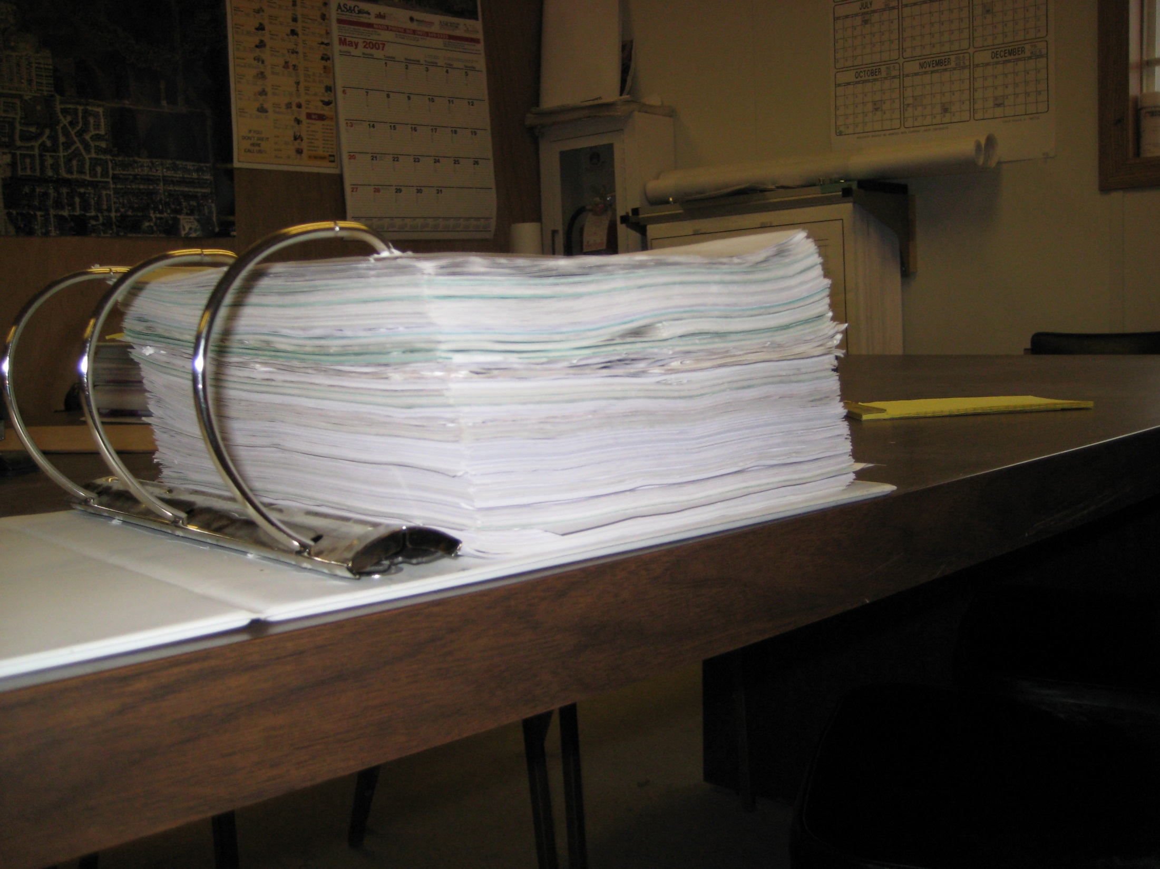
Develop SWPPP prior to filing a NOI

Slide 31
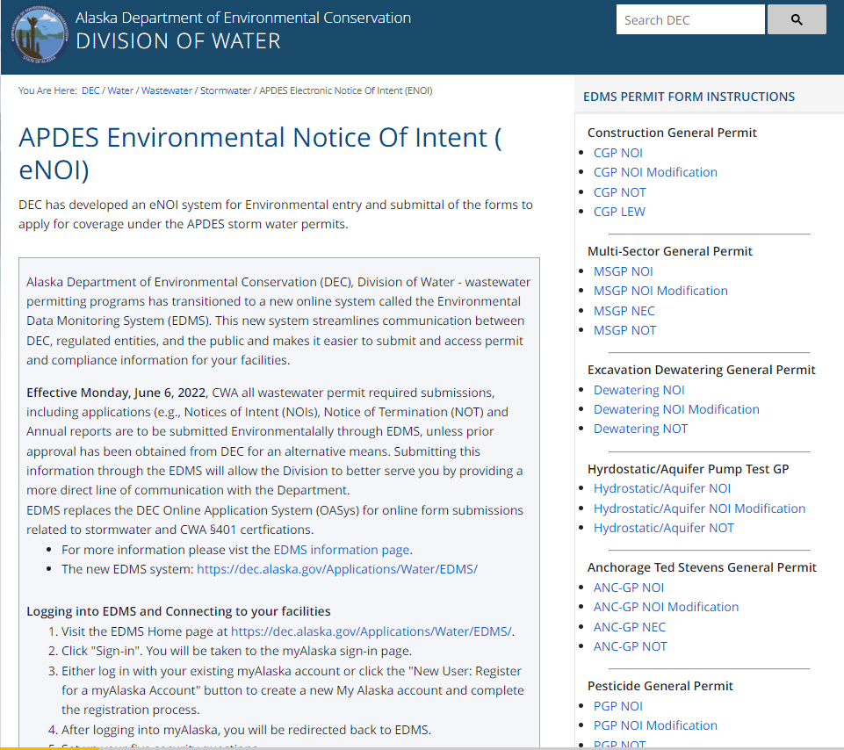
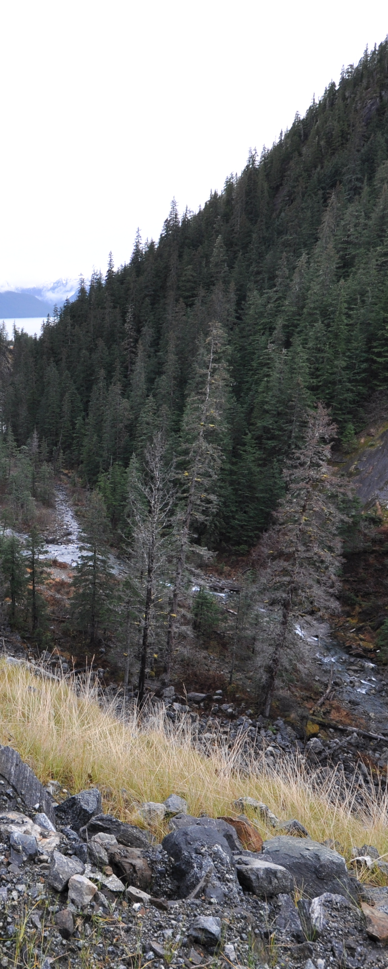

https://dec.alaska.gov/water/wastewater/stormwater/apdesenoi/

Slide 32
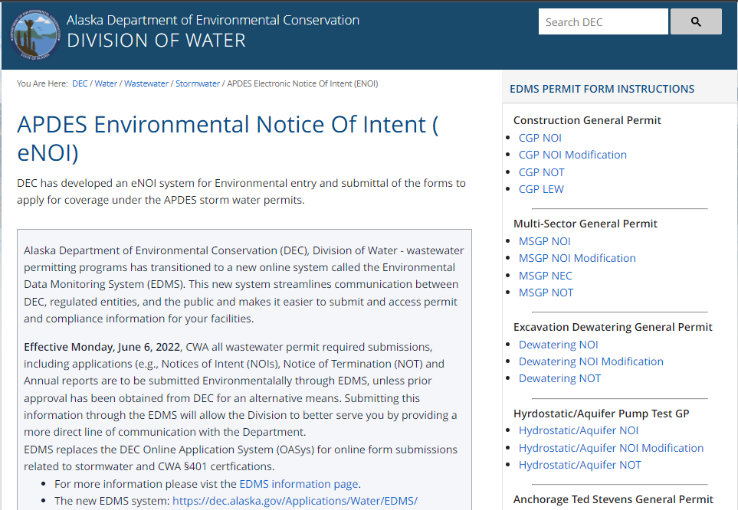
Notice of Intent
NOI
File Online

Slide 33
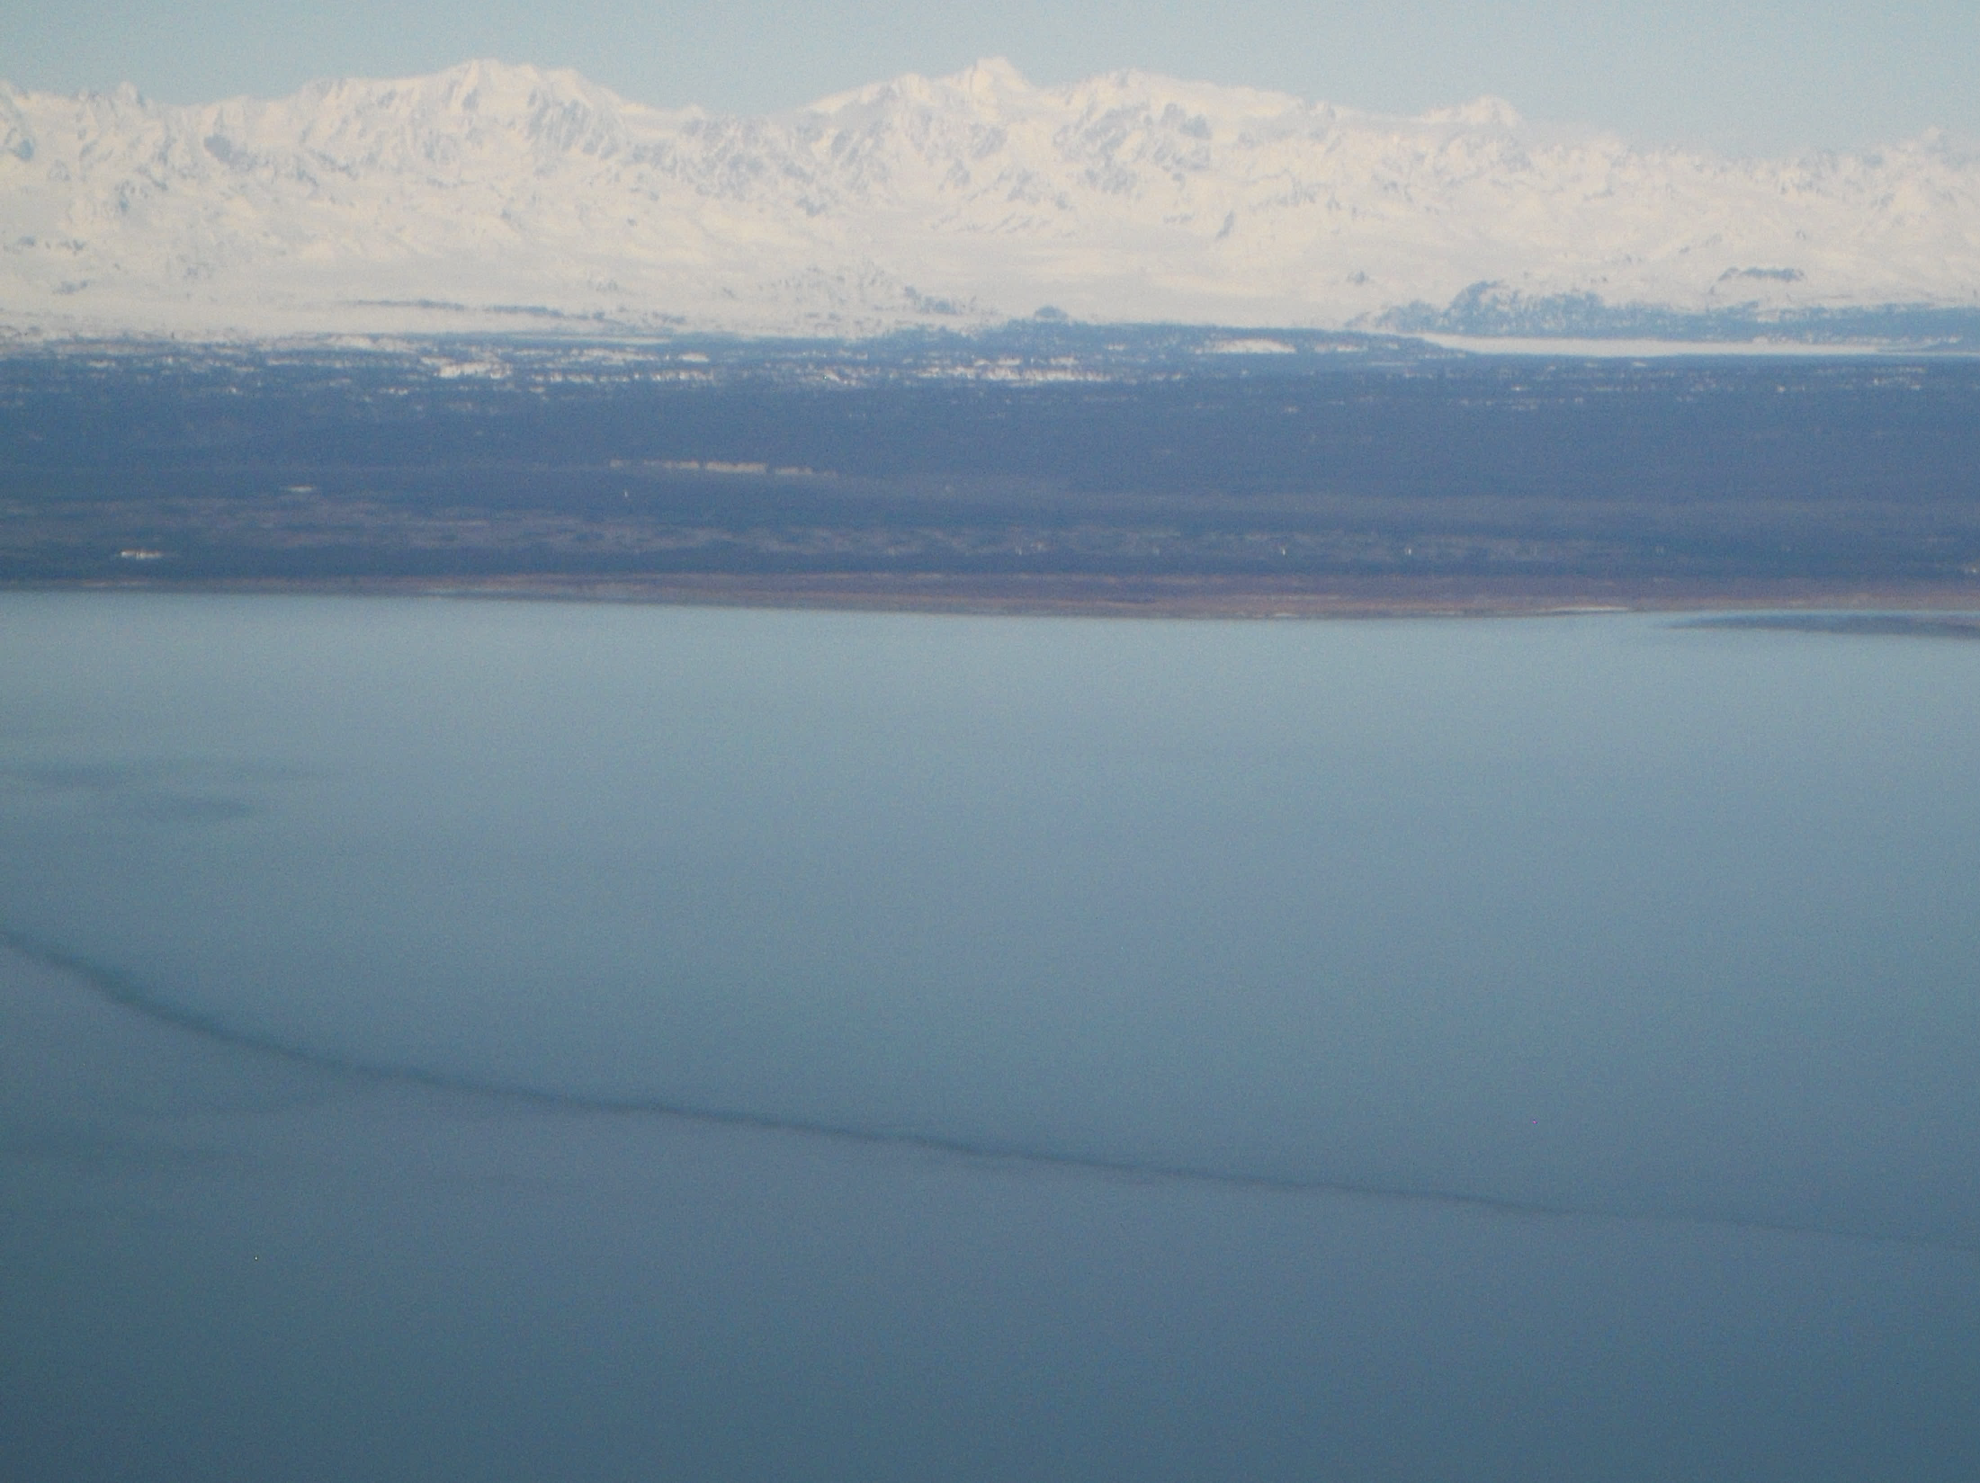
2.7 Submittal of a Modification to Original NOI
2.7.1 Modification. A permittee must file an NOI modification form to DEC (see Part 2.3) to update or correct the following information on the original NOI within 30 calendar days of the change:
2.7.1.1 Owner/Operator address and contact information;
2.7.1.2 Site information;
2.7.1.3 Estimated start or end dates;
2.7.1.4 Number of acres to be disturbed; or
2.7.1.5 SWPPP location and contact information.
2.7.2 Continuation of expired permit in accordance with Part 2.6.
2.7.3 If the original project disturbance was between one and less than five acres, and will now disturb five acres or more, a SWPPP must be submitted with the NOI modification.

Slide 34
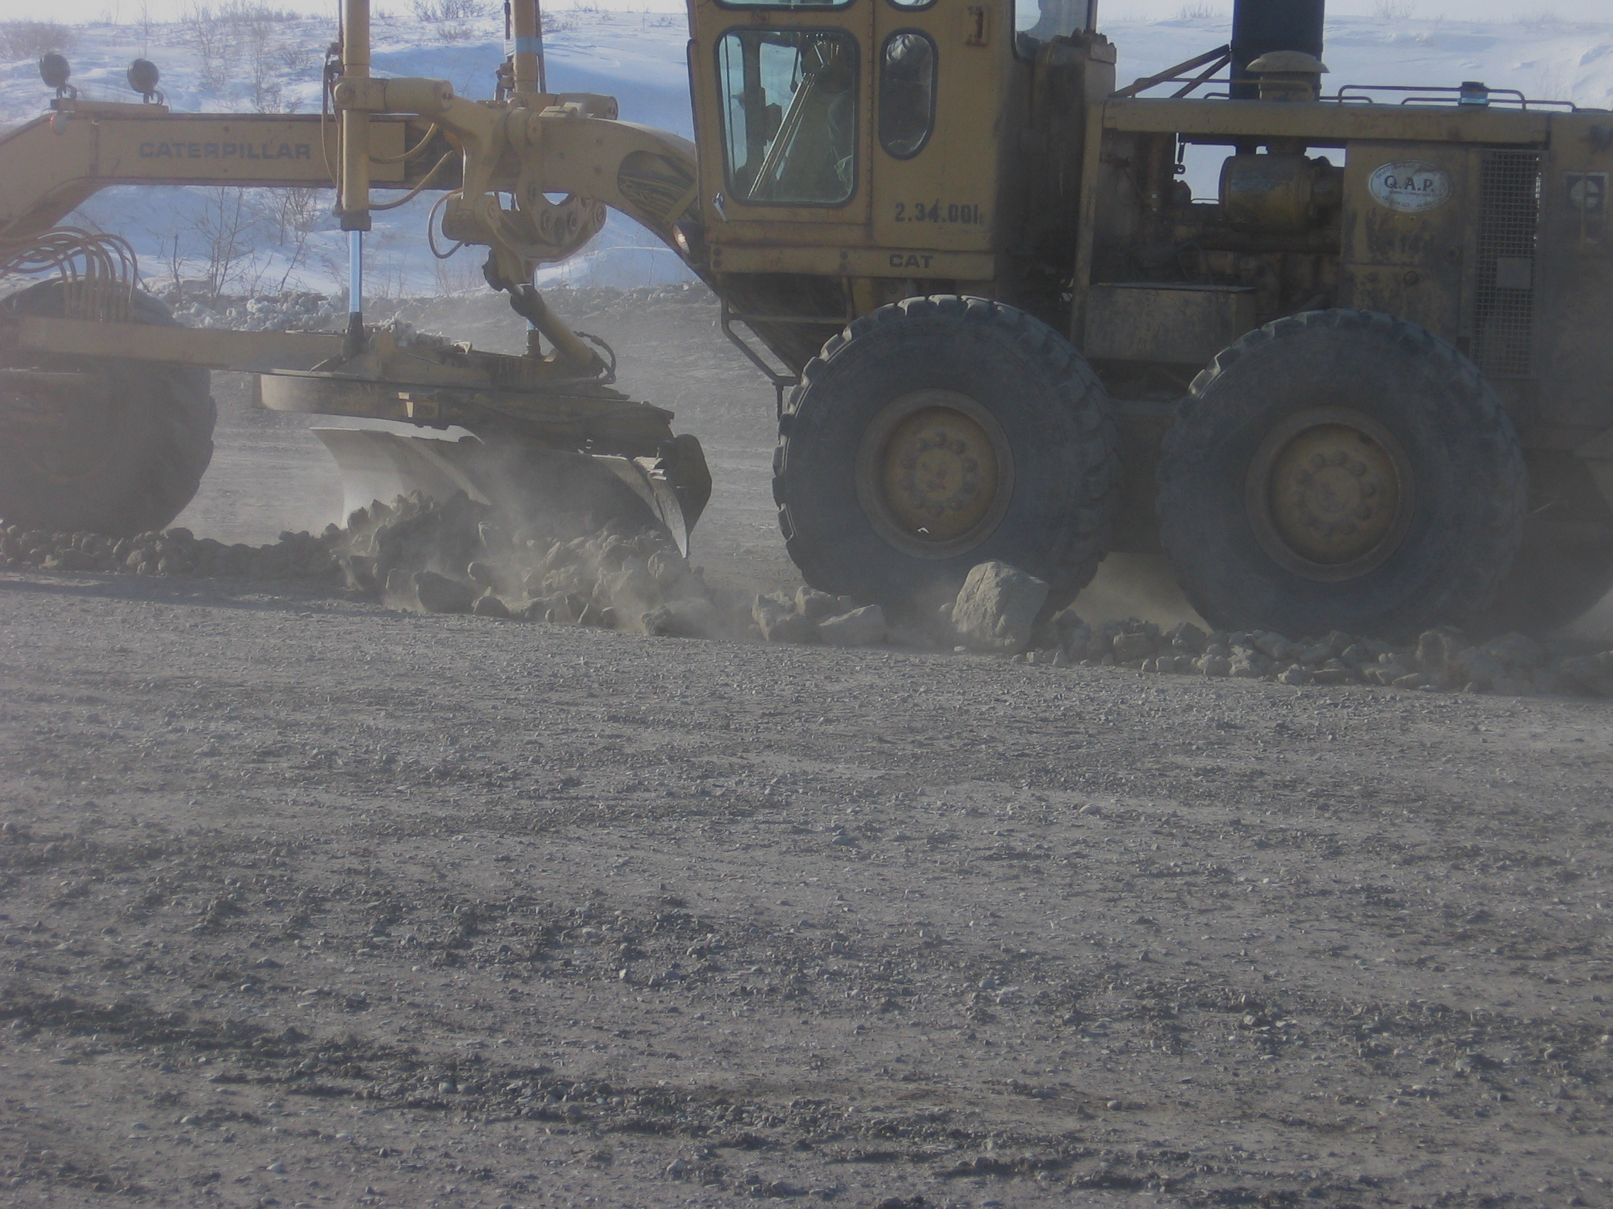
2.7.5 NOT Instead of Modification. The permittee must submit a NOT instead of an NOI modification form to DEC within 30 calendar days when the operator has changed. A change of operator in this case means when an organization changes control of the project. It does not mean when a corporate officer of the organization changes while the organization continues with the project. The new owner/operator must file a new NOI to obtain coverage under the CGP. Coverage is not transferrable.

Slide 35
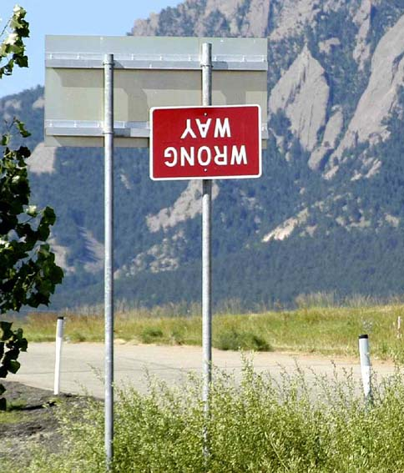
NOI Postings
Must be updated when personnel change!
NOI authorization number
Operator Contact name and phone number
Location of the SWPPP or the name and phone number of the contact person to schedule a SWPPP review.
Notes:
NOI Postings are frequently out of date and do not correctly identify the current personnel. This is a SWPPP posting where the documents have blown away, note the thumbtacks without paperwork. The paper on the board are the corps placards.

Slide 36
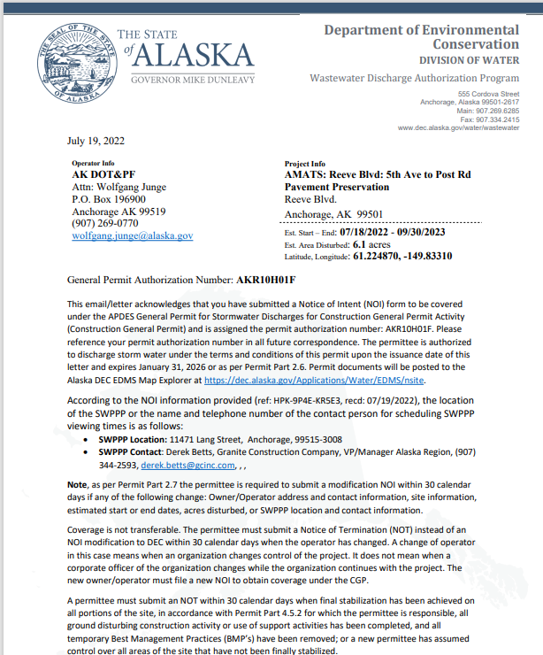
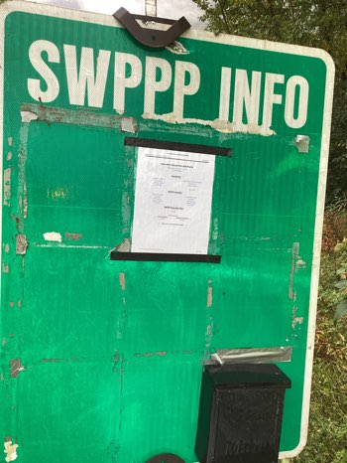
NOI Postings
NEW All required posting information is located on the first page of the NOI. when personnel change!
Notes:
NOI Postings are frequently out of date and do not correctly identify the current personnel. This is a SWPPP posting where the documents have blown away, note the thumbtacks without paperwork. The paper on the board are the corps placards.

Slide 37
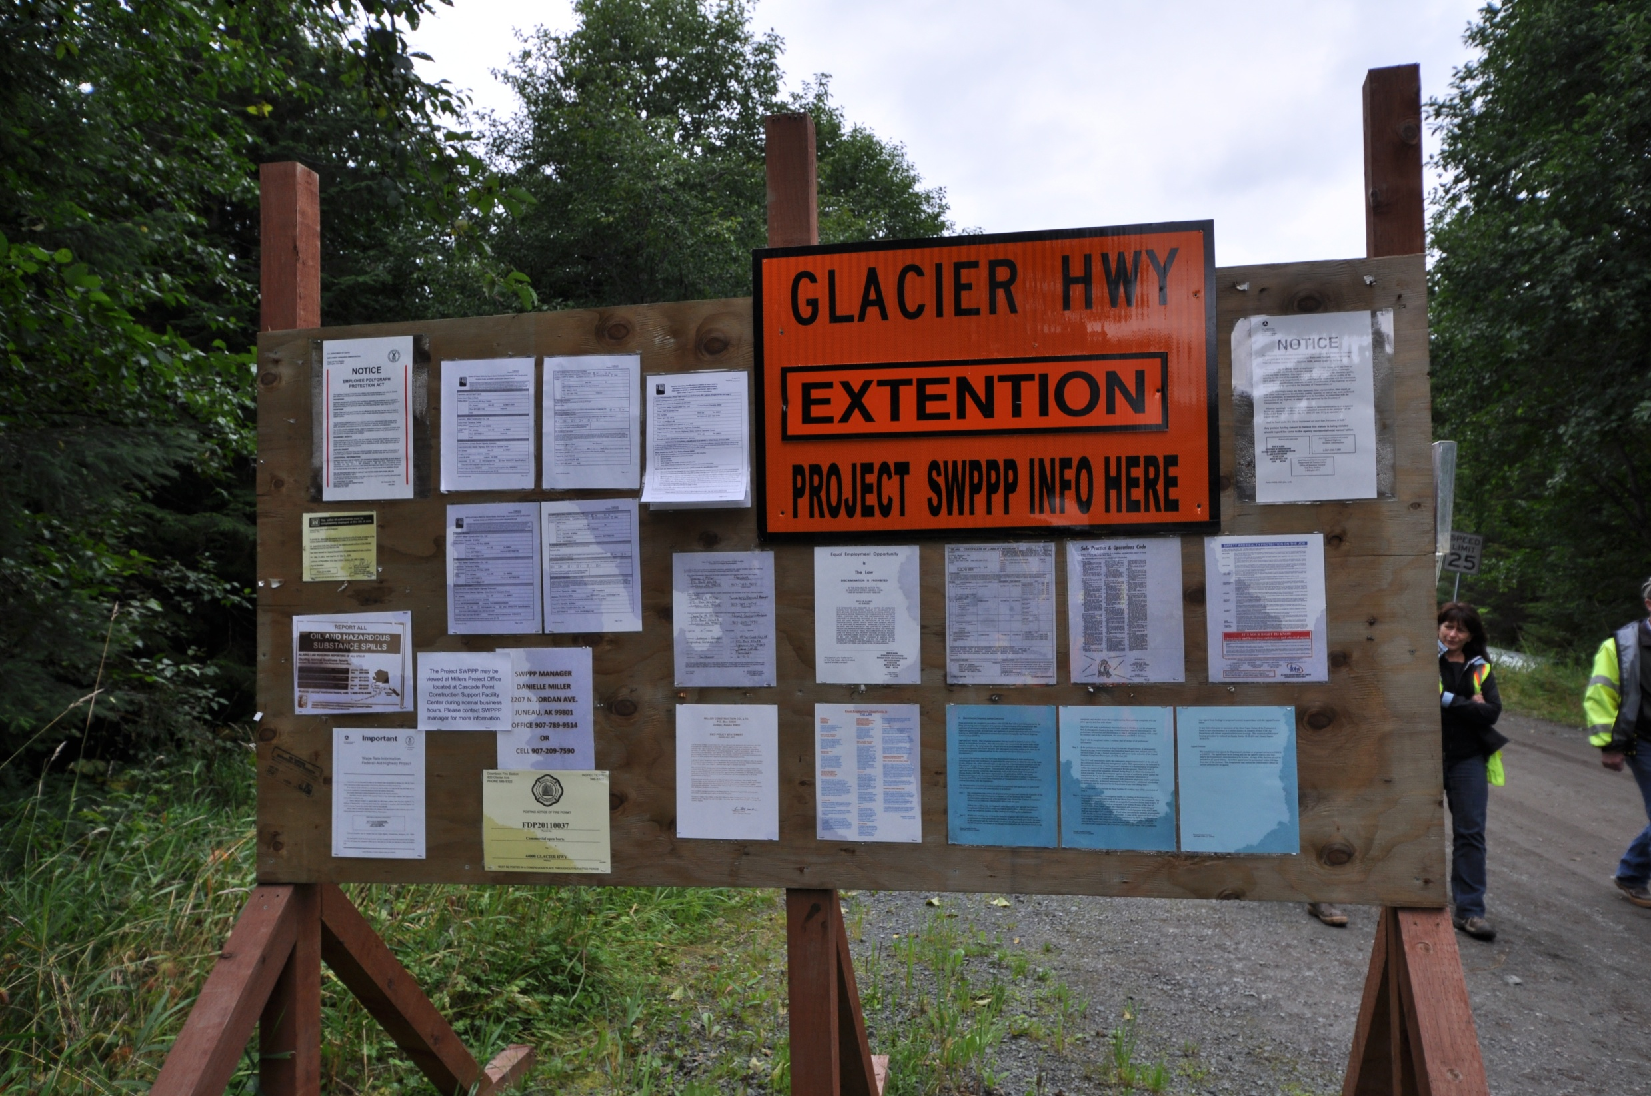
Keep Signage info updated
Replace worn & faded postings
Inspect postings regularly

Slide 38
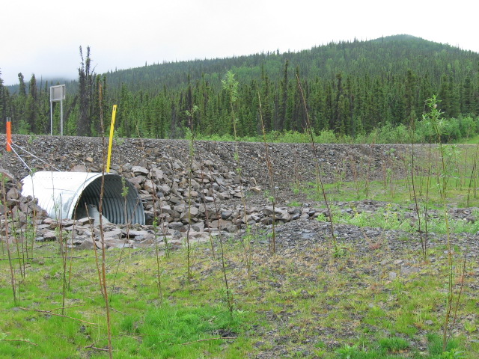
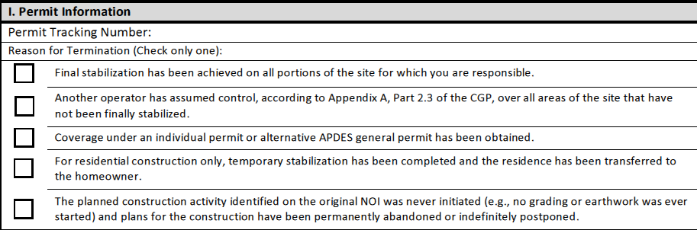
Notice of Termination
We no longer need permit coverage because…
Must be submitted within 30 days of one of the above.
Notes:
As important as it is to get permit coverage make sure you terminate when the time comes. Plan for the eventual termination.

Slide 39
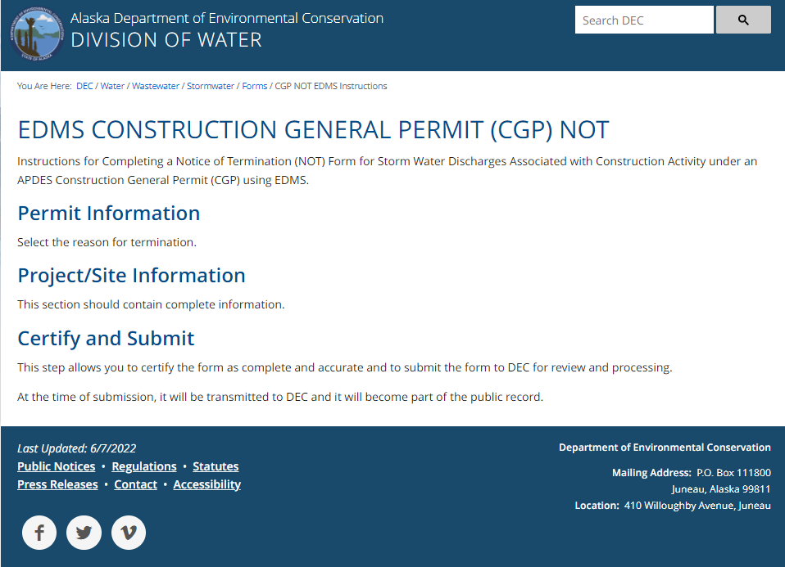
This project is complete, and all areas are stabilized.
We do not want permit responsibility or need permit coverage any longer.

Slide 40
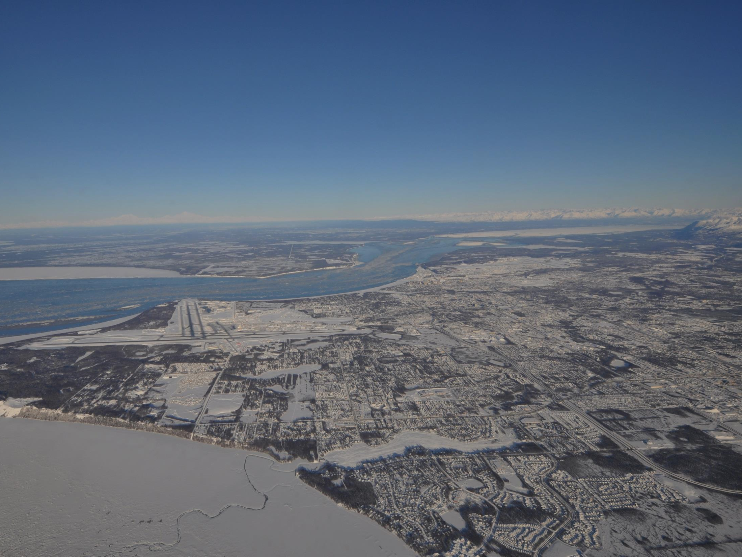
MS4 = Municipal Separate Storm Sewer System
Municipality of Anchorage
Port of Anchorage
Fairbanks / North Pole
Fairbanks North Star Borough*
Joint Base Elmendorf Richardson
Fort Wainwright
DOT&PF Central Region
Conveyance that discharges to US Waters
Anchorage
Notes:
Explain that the municipality operates a storm sewer that conveys flow to waters of the US. The storm sewer operator must have a permit for the discharge and abide by the permits conditions. Note that the North Star borough is only partially covered. The road system drives the areas that are covered.
Juneau has a combined storm and sanitary system and is not a separate storm system. The North Star Borough MS4 is for the Road Service Areas only (it’s not the road system that drives it, but the method of funding road maintenance). Here’s some text from the NSB web page:
The Fairbanks North Star Borough does not have area-wide powers for road construction or maintenance, fire or police protection, water and sewer services, or other local services. A service area is a taxing jurisdiction of the Borough established at the request of the voters within a geographical area to provide certain of these services within their specific area.

Slide 41








Projects within the MS4 may have additional requirements.
  Plan submittal & review
Fairbanks
Notes:
Fairbanks

Slide 42


MS4
Anchorage
Stormwater Treatment Plan – SWTP
SWPPP Review with 500sf disturbance

Slide 43

MS4 Fairbanks Urban Area
Notes:
Note the road service areas

Slide 44

Multi Sector General Permit
MSGP
Discharges from Industrial Activities

Slide 45

Multi-Sector General Permit (MSGP)
MSGP includes construction coverage for the following industries:
Metal mining;
Coal mining;
Sand and Gravel Mining.
Notes:
The Multi-Sector General Permit (MSGP) for industrial storm water covers 29 industrial sectors. All the facilities covered by the permit have to develop a SWPPP to address storm water management. For 26 of these sectors the MSGP addresses storm water management after the facility is constructed. For three of the sectors – metal mining, coal mining, and sand and gravel mining – the MSGP includes requirements for a SWPPP and inspections during exploration and construction activities as well as active and inactive mining making the requirements the same as the CGP. These three sectors are single projects covered under the MSGP. Make the class aware of the distinction between the MSGP and CGP industries. For example the sectors – Batch Plants, Asphalt Plants, and Material Sites these are multiple used industries that are covered under the CGP. For additional information see DEC’s webpage on the MSGP.

Slide 46
Material Sites
Which permit covers It?
CGP
Site is used for just the one project
Site is opened at beginning of project and closed at end of project
See CGP 1.4.2.3
  Waste Sites
MSGP
Site serves multiple unrelated construction projects by different permittees
Site is a commercial operation or landowner allows multiple users of the site
See MSGP Sector J
Notes:
In the Construction General Permit (CGP) material sites are considered support activities. How a material site is developed, managed, and used will determine whether the material site is regulated by either the CGP or the Multi-Sector General Permit (MSGP). A material site can not be permitted by both permits at the same time. Part 1.4.2.3 of the CGP explains that 1) the material site must be directly related to the construction site required to have permit coverage, 2) the material site is not a commercial operation serving multiple unrelated construction projects by different permittees, 3) the material site does not operate beyond the completion of the construction activity at the project that supports it, and 4) appropriate control measures are identified in the project SWPPP. (There are some exceptions for projects off the road system – see definition for “support activities” in Appendix C of the CGP.)
Sector J of the MSGP explains Sand and Gravel operations from exploration through, construction, active mining, inactive mining and restoration. For example, a commercial material site that sells material for multiple CGP Projects would have MSGP coverage. For example, a material site on DNR land leased by DOT and used for multiple projects would need MSGP coverage. For example, a material site in a community that is used for multiple projects.

Slide 47

Regulations Summary
Clean Water Act – Protect & Restore
NPDES – APDES = Permits for Clean Water
  Storm water
  CGP-MS4-MSGP
  Local Regulations – Municipal / Borough
Haines

Slide 48

Regulatory Updates
Ongoing EPA Rulemaking
DEC Excavation Dewatering Permit Reissue 2019
DEC revised MSGP 2020
Port of Anchorage MS4
JBER / Wainwright MS4 permits
DEC revised CGP 2021
ANC Individual permit 2019 (replaces the MSGP)
Hoonah
Notes:
EPA is required by court order to make rules regarding discharge that are technologically feasible. While this had been expected to include the ELG this will probably not happen as the data used for the ELG has been contested. MS4’s are likely to expand their coverage area and expand the required use of post-construction BMP’s for storm water runoff treatment.

Slide 49

Notes:
At the end of each section we will allow time for questions

