Slide 1
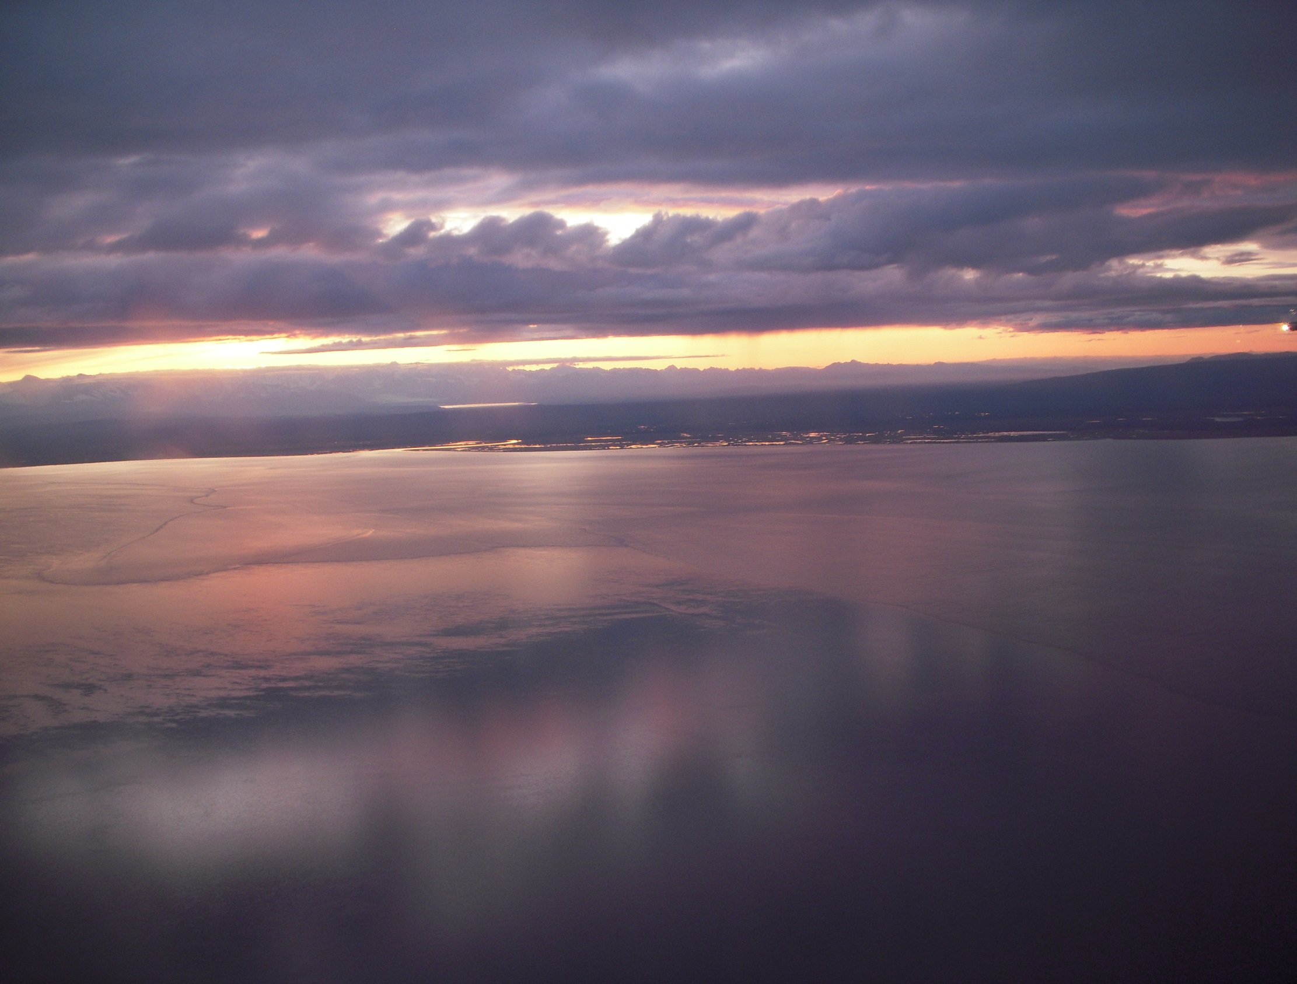

Regulations & Permitting
EPA – NPDES
DEC – APDES
Local requirements
What's new?
September 2022

Slide 2
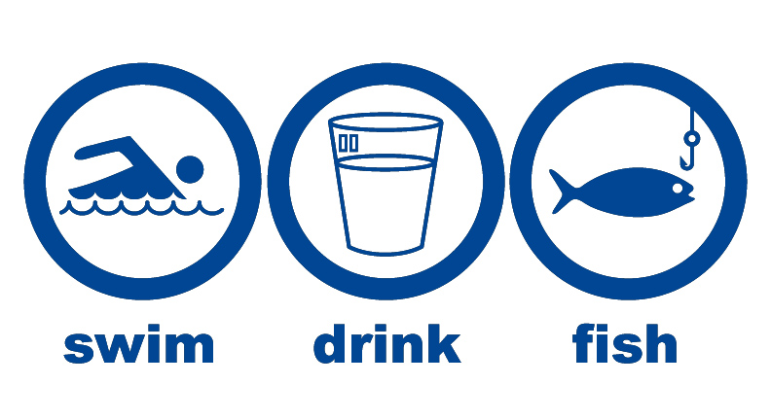
Regulations & Permitting
Clean Water Act = Protect & Restore
Notes:
Swimmable, drinkable, fishable. The goals are protecting and restoring.

Slide 3

Clean Water Act
Federal Clean Water Act
  Revised in 1987 as the Water Quality Act
Environmental Protection Agency (EPA)
  NPDES Program
State Implementation
  Alaska Department of Environmental Conservation (ADEC)

Slide 4

Local Stormwater Permitting Authorities
Local Permitting Requirements
Municipality of Anchorage
Fairbanks North Star Borough
City of Fairbanks
City of North Pole
Port Authorities
DOT&PF

Slide 5
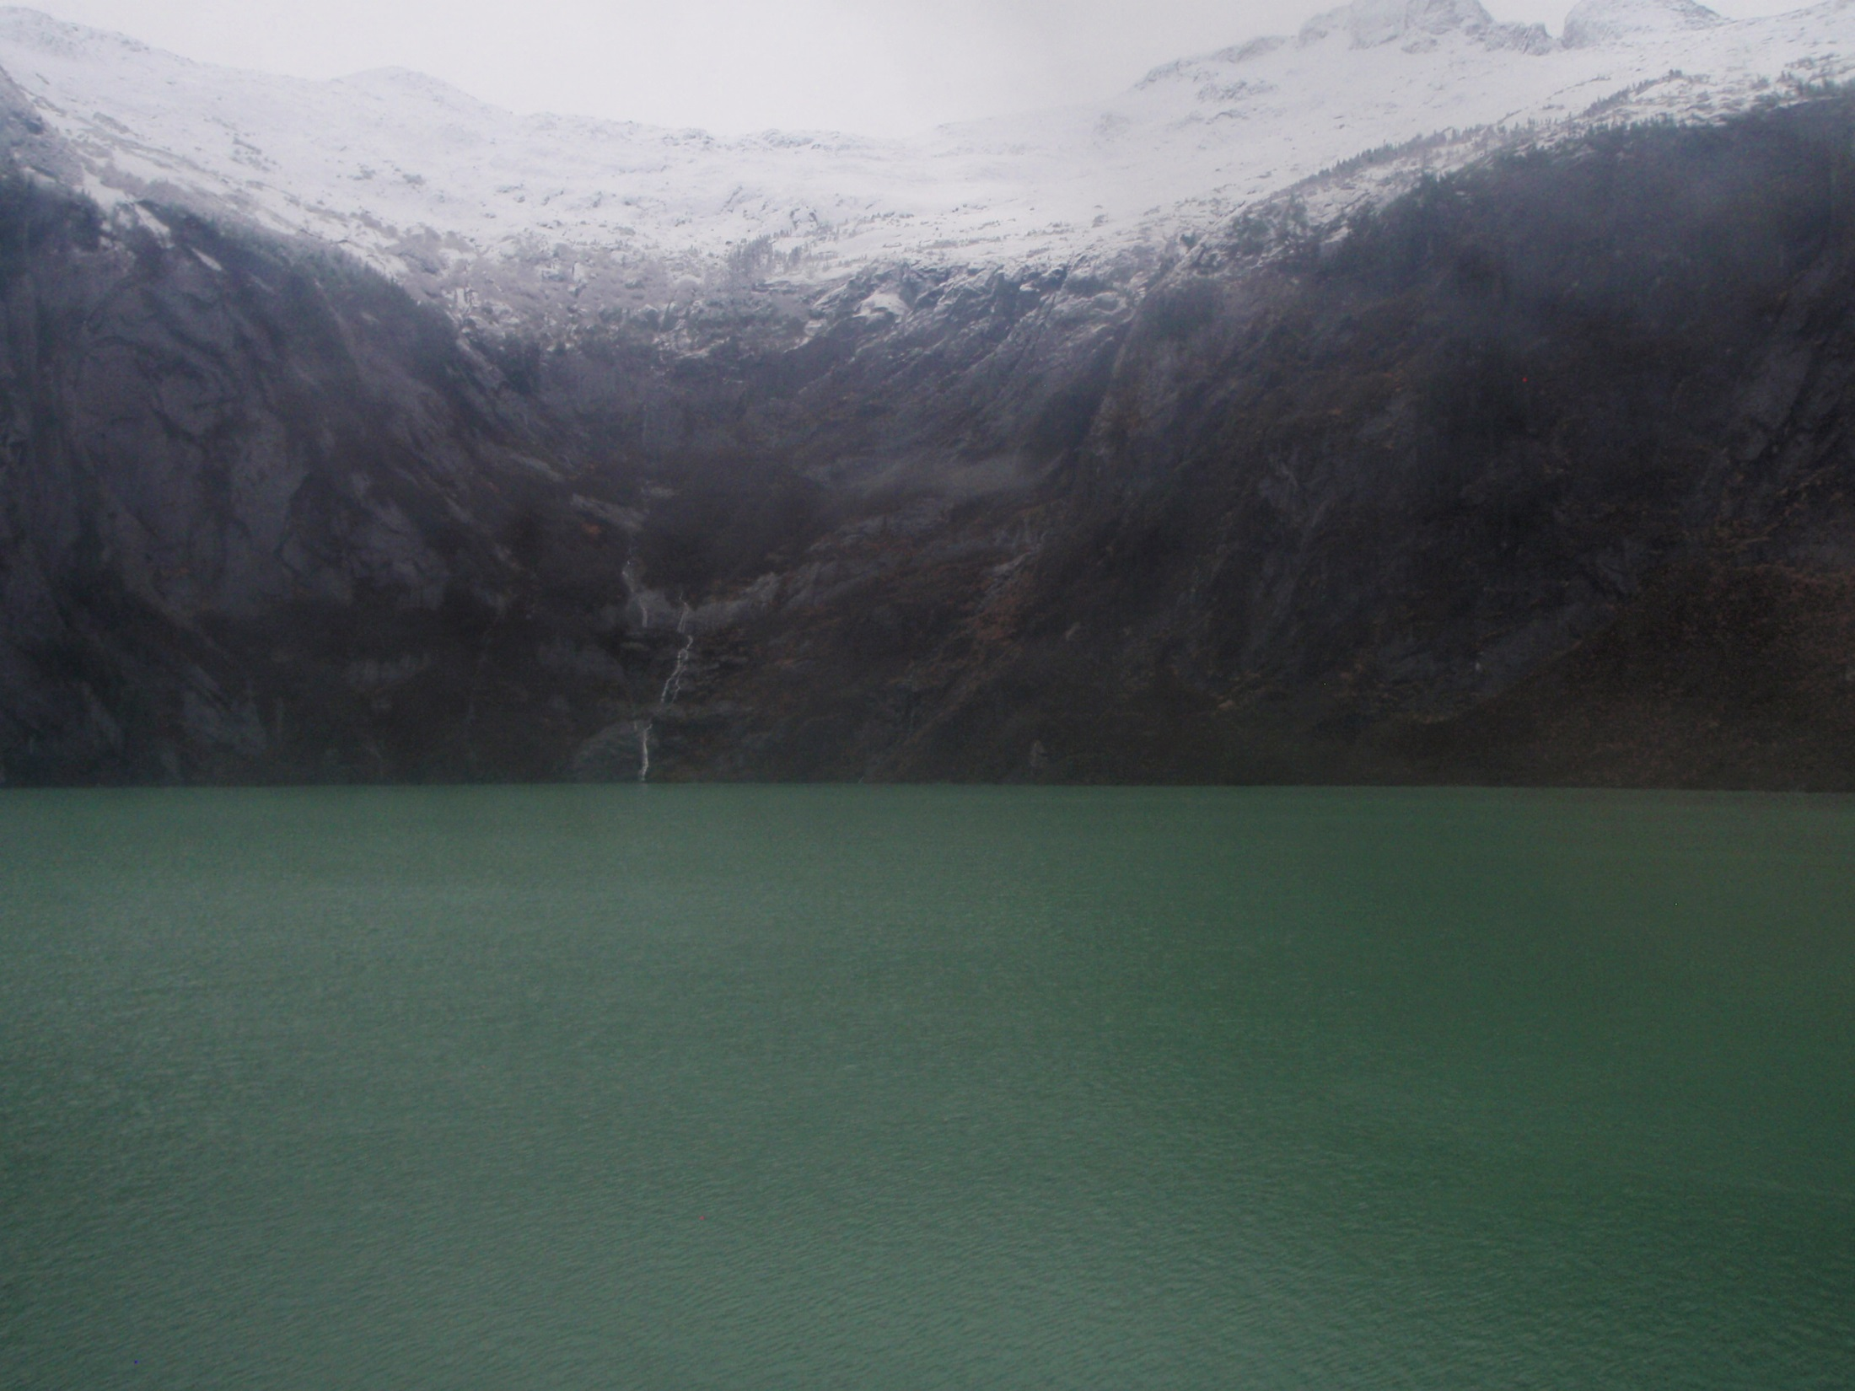


NPDES
National Pollutant Discharge Elimination System
Protect & Restore Waters of the U.S.
Notes:
EPA always has authority, Implementing the NPDES program is a very difficult order. Eliminating pollutants nationally in our discharge, Or APDES: eliminating pollutants in Alaska's discharges.

Slide 6
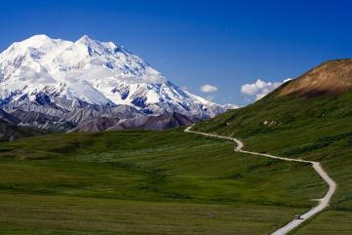
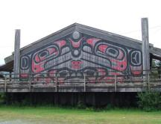
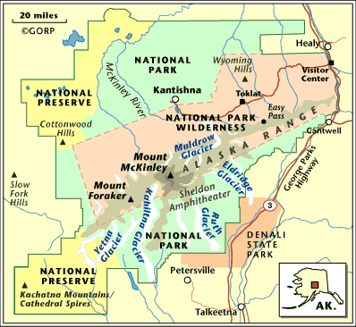
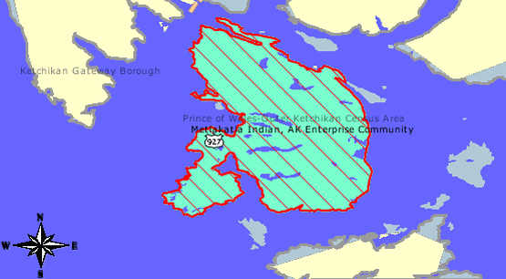
Projects within Denali National Park & Preserve &
Indian reservation of Metlakatla need EPA CGP coverage.

Slide 7
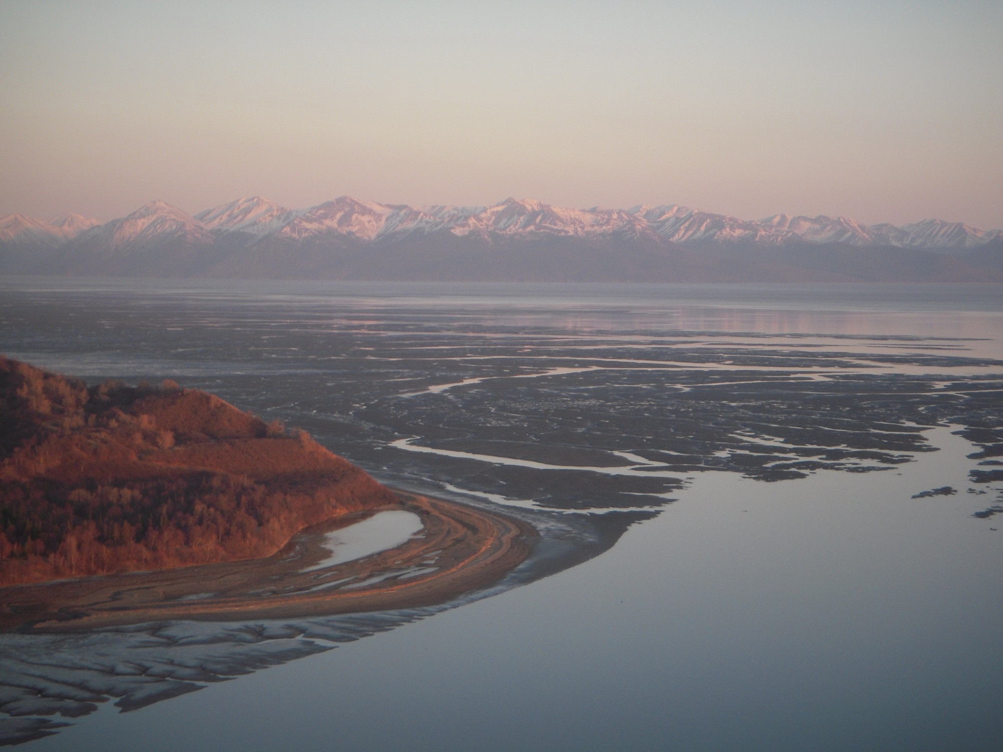
APDES
Alaska Pollutant Discharge Elimination System
Kincaid Park
DEC received primacy from EPA in 2009

Slide 8
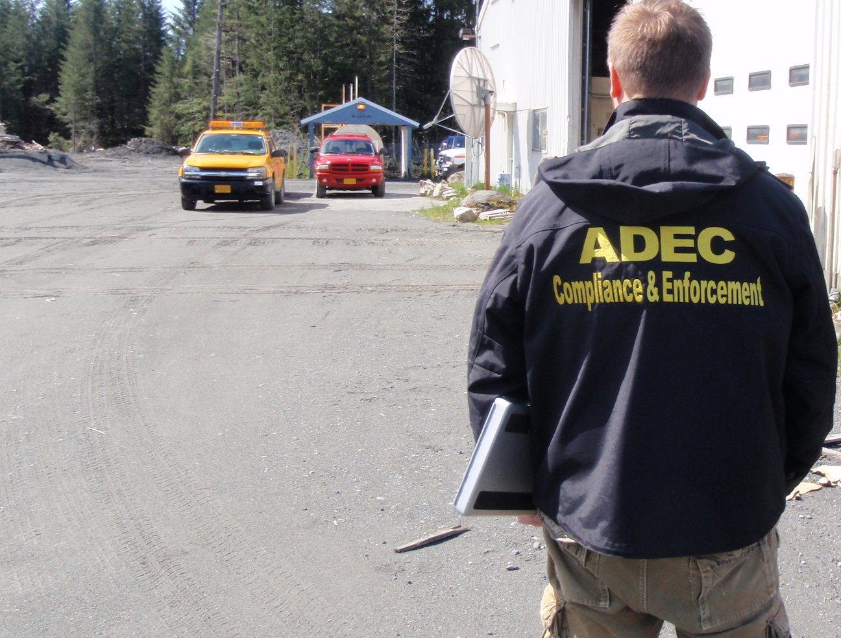
The Alaska Construction General Permit (CGP) authorizes storm water discharges from construction activities that disturb one acre or more and where those discharges enter waters of the U.S. or a municipal separate storm sewer system (MS4) leading to waters of the U.S.

Slide 9
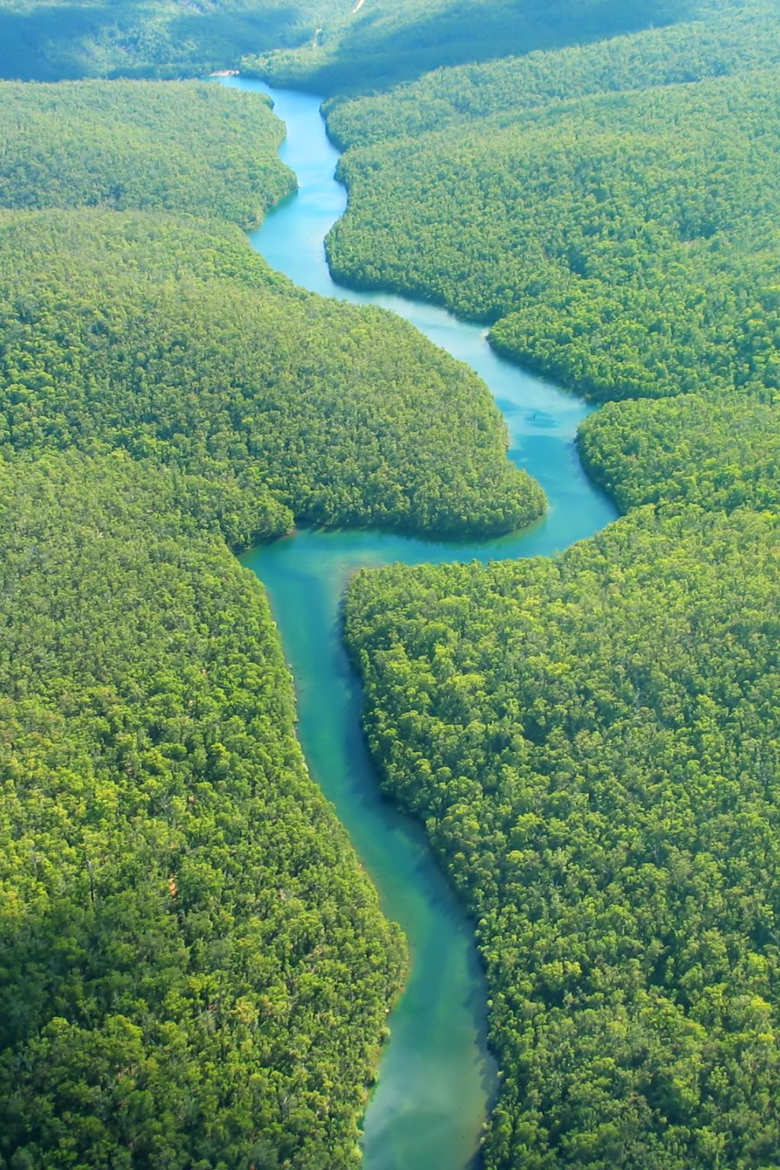
Waters of the United States (WOTUS)
Waters of the United States (WOTUS) Includes:
• Navigable waters
• Interstate waters
• Tributaries
• Adjacent wetlands with a surface connection
• Impoundments ( e.g reservoirs)

Slide 10
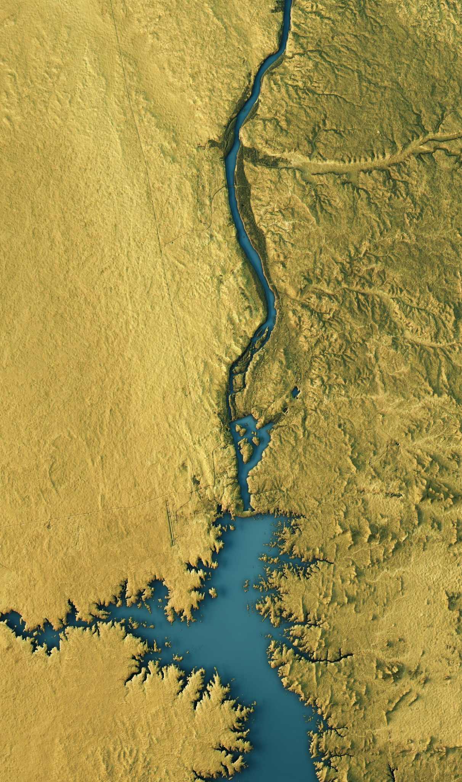
Waters that are generally NOT considered WOTUS include:
• Groundwater
• Most ditches (especially roadside or agricultural ditches)
• Rills, gullies, and erosional features formed by rainfall
• Artificial ponds and irrigation features not connected to jurisdictional waters
• Stormwater control features constructed in uplands
• Prior converted cropland

Slide 11
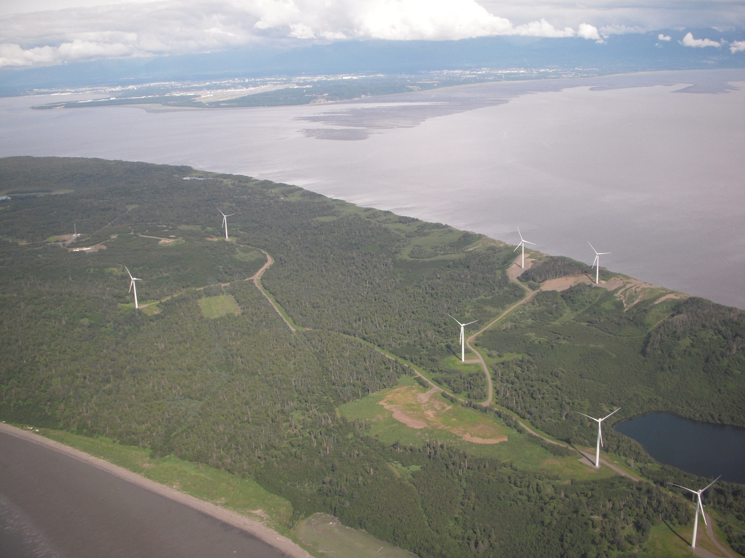
Do all sites that discharge go to waters of the U.S.?
Most in Alaska do.
Fire Island
Notes:
It is possible to sheet flow only to uplands but this is very rare. A site investigation must be performed and documented to verify. No drainage to a ditch, channel, concentrated flow to a stream, lake, pond or wetland.

Slide 12
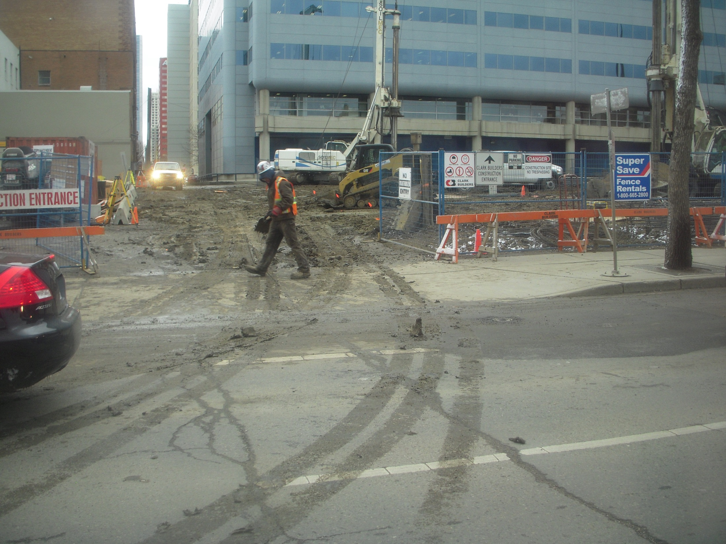
Even if there is no discharge to waters of the U.S.;
Track-out can be considered a discharge.
Notes:
The curb and gutter can connect directly to waters of the US, even if via a storm manhole and pipe.

Slide 13
Maintenance
Depending on the purpose and nature of the maintenance project, some of them may not be required to submit an NOI under the permit.
To be considered a maintenance project, the project must maintain the original line and grade, hydraulic capacity of conveyance channels, or original purpose of the site.
Maintenance projects typically involve the repair, rehabilitation, or replacement of existing structures or facilities with no new ground disturbance beyond the original footprint.
Maintenance projects may involve minor deviations in the size, configuration, or alignment of the structure or facility. Such activities include mowing or clearing vegetation without disturbing the vegetative mat (i.e., grubbing), repaving a road with no surface expansion or disturbance of surrounding soils, replacing a bridge without widening it, or replacing a culvert with the same size and composition.
CGP Appendix C &
Fact Sheet Pg. 15
Notes:
If the maintenance is not annual then there should be a written standard Operating Procedure that demonstrates that it truly is “routine”.

Slide 14
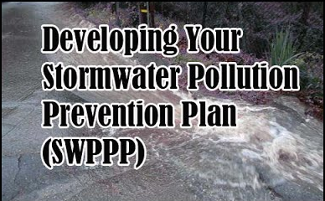
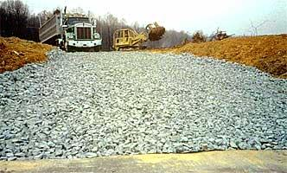
2026 Construction General Permit (CGP) Introduction
Goals of this section:
Know and understand the sections of the CGP;
Find answers in the CGP; and
Know what makes a good SWPPP.

Slide 15
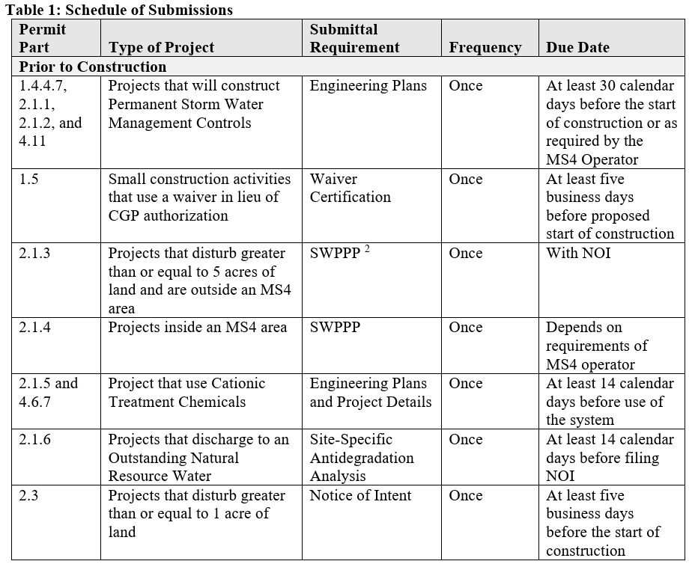

Construction General Permit (CGP)
CGP Pg. 6
Schedule of
Submissions
Prior to
Construction

Slide 16
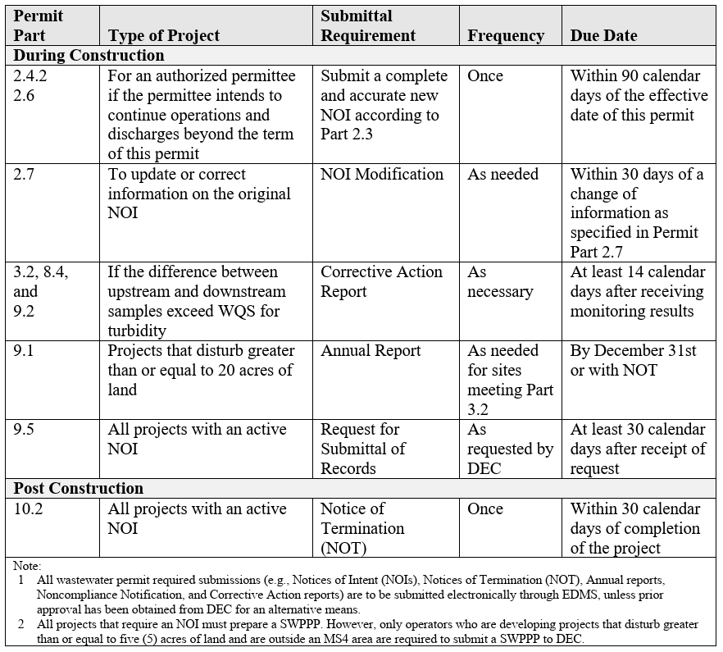
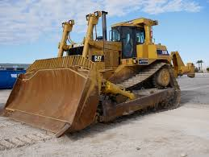
Construction General Permit (CGP)
CGP Pg. 7
Schedule of
Submissions
During
Construction

Slide 17
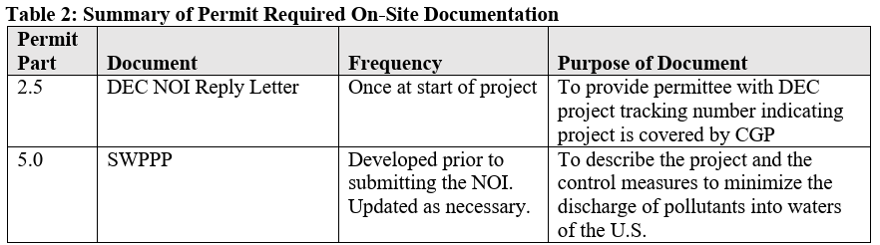
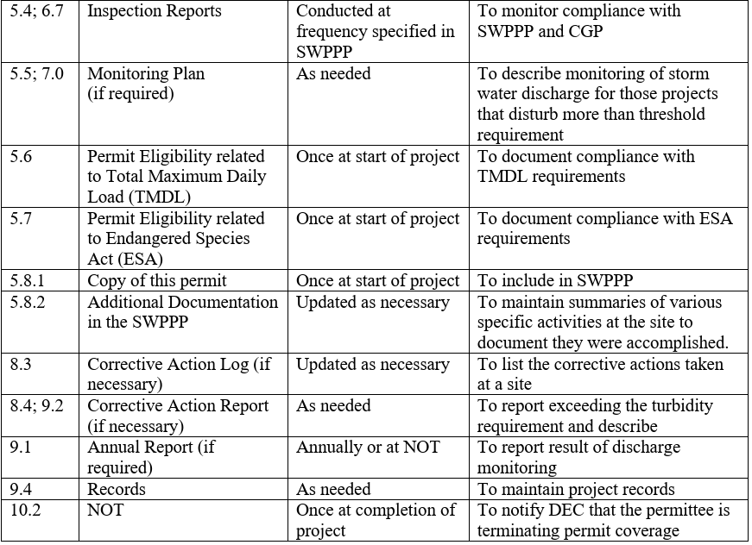
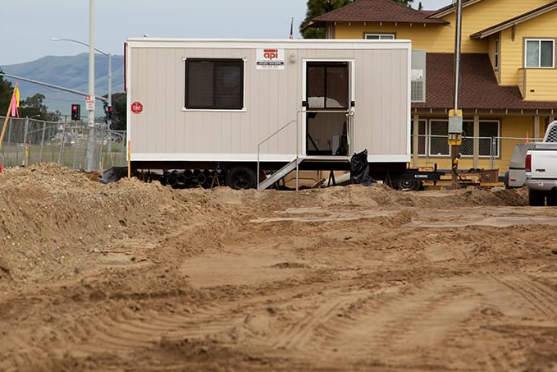
Construction General Permit (CGP)
CGP Pg. 7-8
Required
On-Site
Documentation

Slide 18
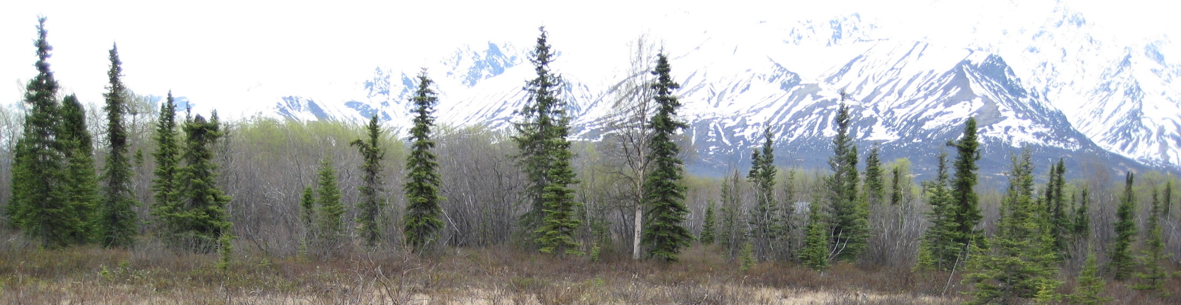
Construction General Permit (CGP)
Coverage Under the Permit
  Introduction and goal of the permit
  Persons Responsible for Obtaining Authorization under the Permit
  Permit Area
  Eligibility Requirements
  Authorized Storm Water Discharges
  Authorized Non-Storm Water Discharges
CGP Part 1.0 Pg. 9

Slide 19
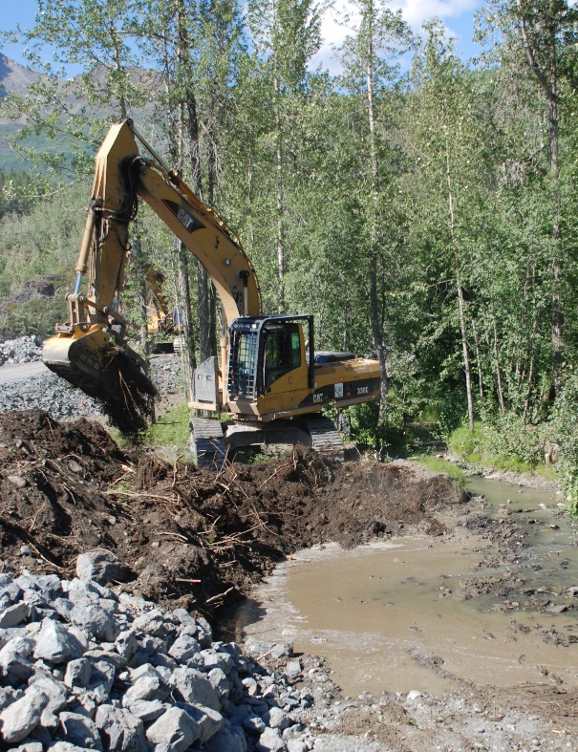
Construction General Permit (CGP)
CGP Part 2.0 Pg. 13
Authorization Under the General Permit
  Submittal Requirements Prior to Construction
  Permanent Storm Water Management Controls (Outside MS4)
  Permanent Storm Water Management Controls (Inside MS4)
  SWPPP Submittal
  How to obtain authorization
  How to submit an Notice of Intent (NOI)
  Submission Deadline
  Date of Authorization to Discharge
  Continuation of Expired General Permit
  Submittal of a Modification to Original NOI
  Alternative Permits

Slide 20
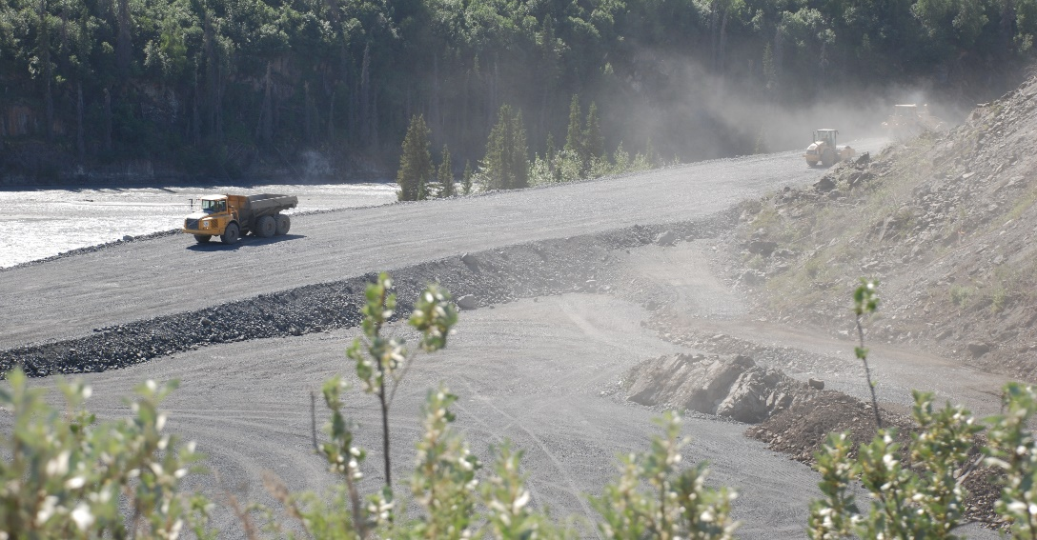
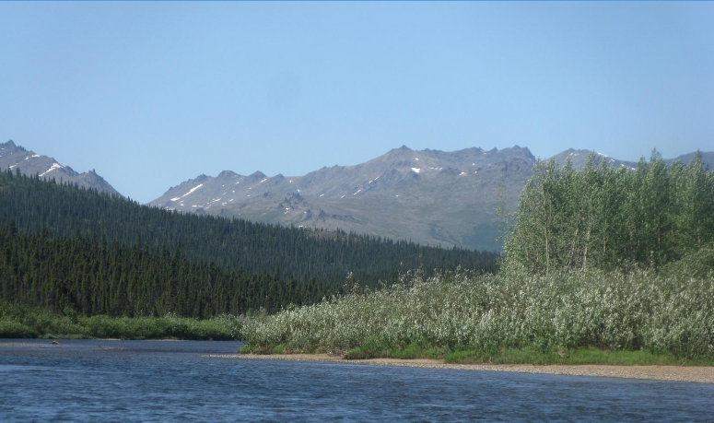
Construction General Permit (CGP)
CGP Part 3.0 Pg. 20
Compliance with Standards and Limits
  Project Requirements
  Discharge to impaired water bodies
  Protection of endangered species
Norton Bay, AK

Slide 21
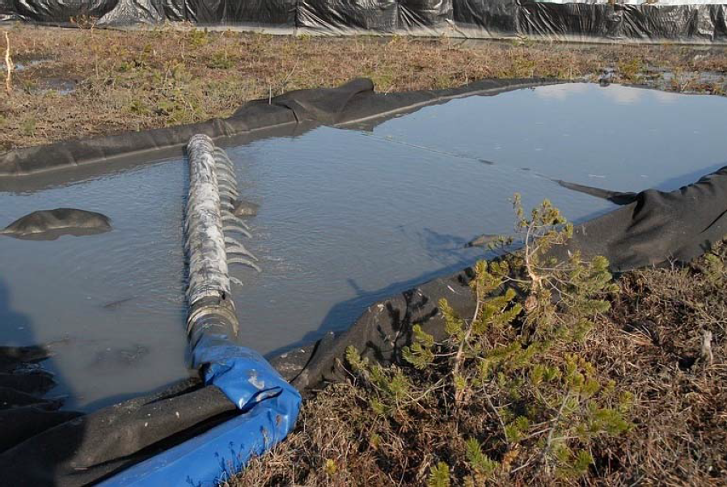
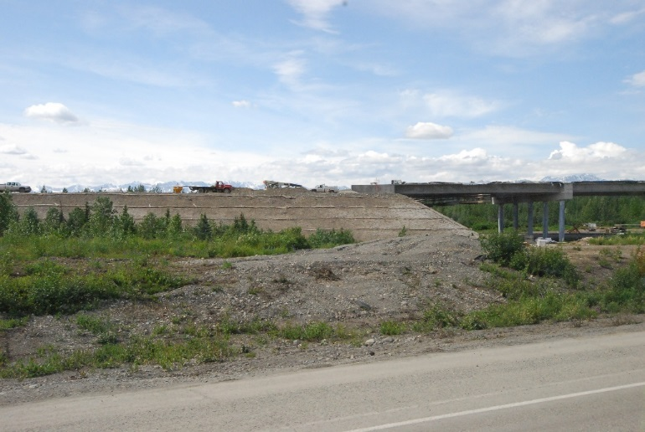
Construction General Permit (CGP)
Section 4 Control Measures
  Selection and design
  Erosion control measures
  Sediment control measures
  Dewatering
  Soil Stabilization
  Treatment Chemicals
  Prohibited discharges
  Good housekeeping measures
  Spill notification
  Projects near a Public Water System
  Permanent Storm Water Mgt. Control
  Winter considerations
  Maintenance of Control Measures
  Storm water lead and training
CGP Part 4.0 Pg. 22
Petersburg, AK
Broad Pass, AK

Slide 22
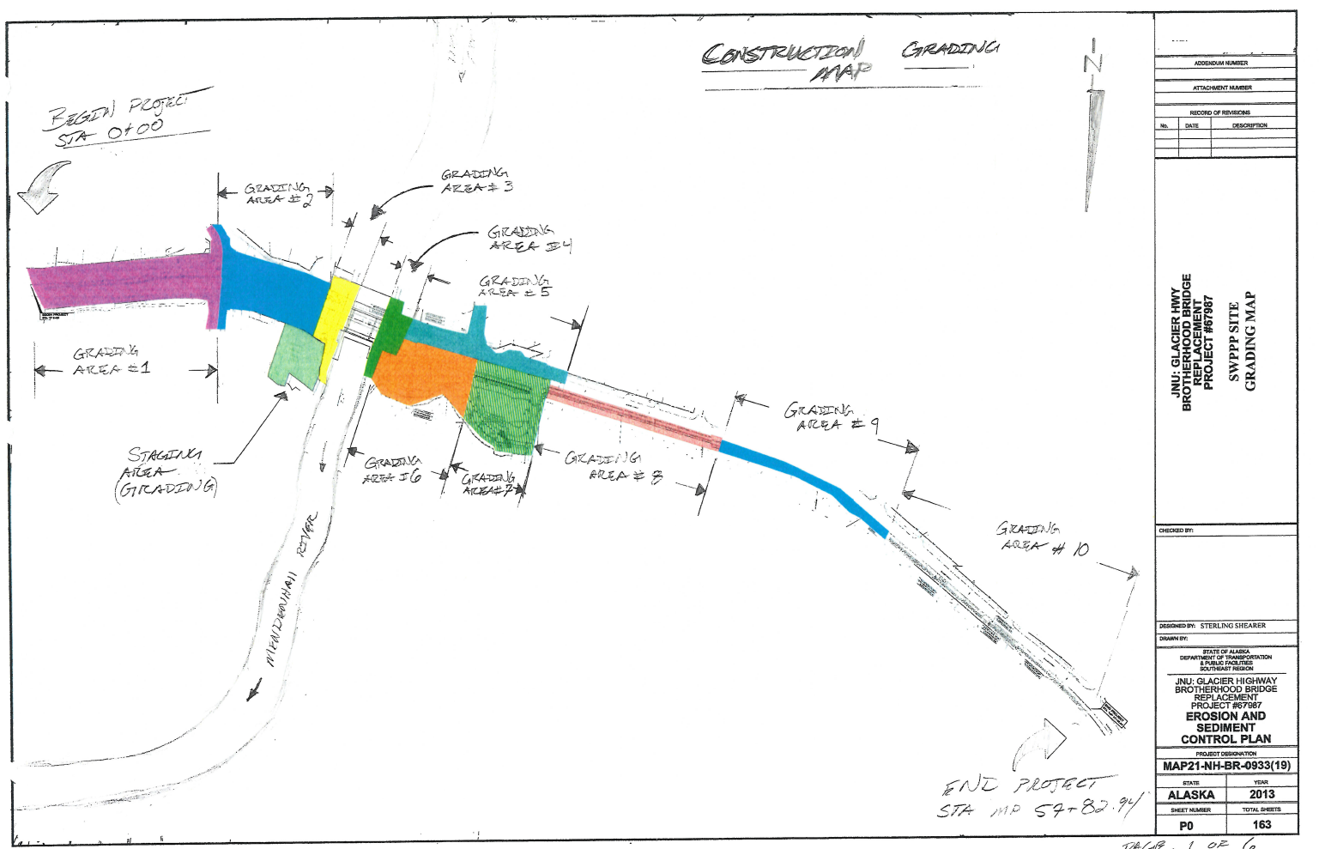
Construction General Permit (CGP)
Storm Water Pollution Prevention Plan (SWPPP)
  SWPPP preparation
  SWPPP contents
    Contacts, conditions and activity
    Site maps
    Control measures
    Inspections
    If Applicable:
    Monitoring Plan
    Eligibility Related to:
    TMDL
    Endangered Species
CGP Part 5.0 Pg. 36

Slide 23
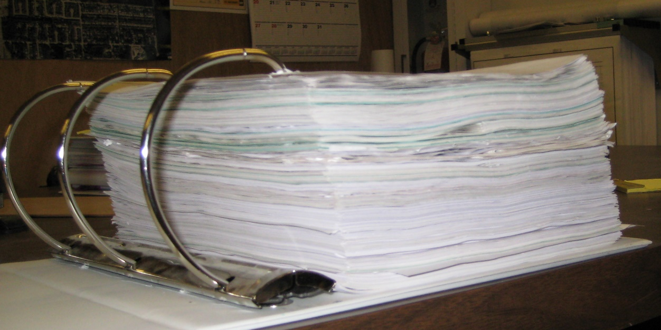
Construction General Permit (CGP)
    Additional documentation requirements:
      Grading and stabilization
      SWPPP modifications
      Employee training
      Entrance signage
      Availability of SWPPP

Slide 24
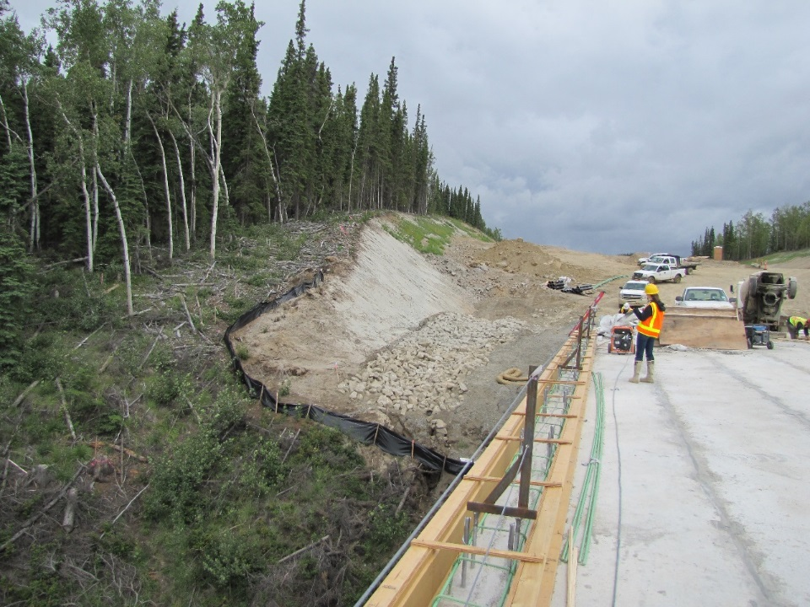
Construction General Permit (CGP)
Inspections
  Frequency
  Reductions in frequency
  Qualified Person
  Site inspections
  Linear Project Inspections
  Inspections by DEC or EPA
  Inspection report
CGP Part 6.0 Pg. 44
Tanana River Bridge

Slide 25
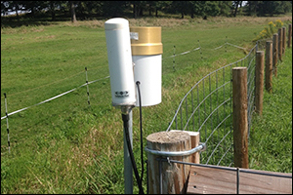

Construction General Permit (CGP)
Monitoring
  Qualified Person
  Discharge Monitoring Requirements
  Rainfall Monitoring
  Visual Monitoring
CGP Part 7.0 Pg. 47

Slide 26
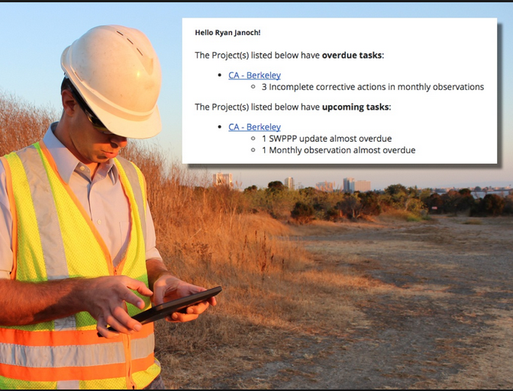
Construction General Permit (CGP)
Corrective Actions
  Conditions
  Deadlines for corrective actions
  Corrective action log
  Corrective action report
  Substantially Identical Outfalls
CGP Part 8.0 Pg. 50
Hello Ryan!
The Richardson Hwy MP 102 project has 3 incomplete corrective actions needed completed today!

Slide 27
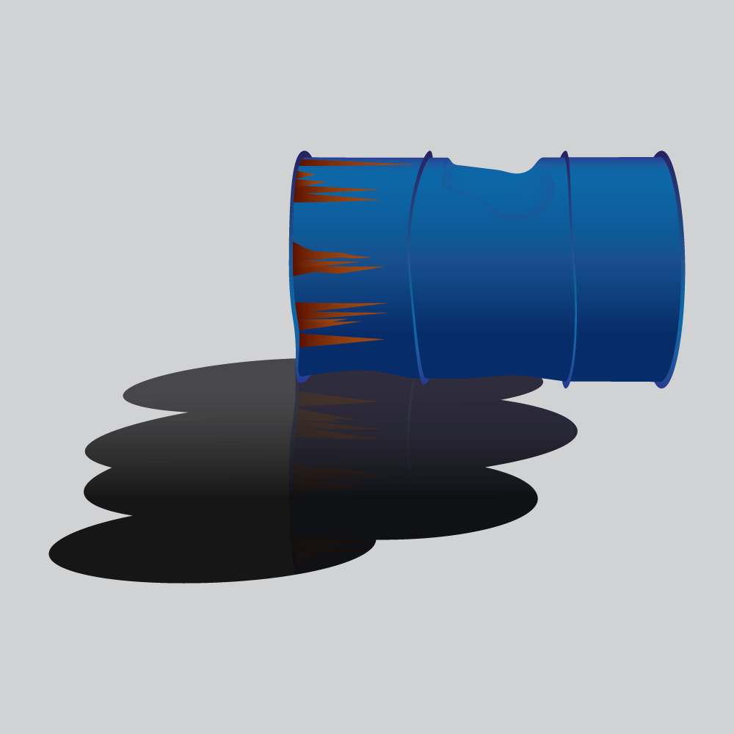
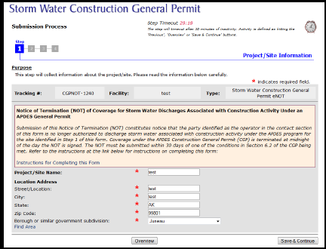
Construction General Permit (CGP)
Reporting and Recordkeeping
  Annual Report
  Corrective Action Report
  Spill of hazardous substance report
  Retention of records
Termination of the Permit Authorization
  Submitting a Notice of Termination (NOT)
Permit Reopener Clause
CGP Part 9.0 Pg. 52
CGP Part 10.0 Pg. 53
CGP Part 11.0 Pg. 54

Slide 28

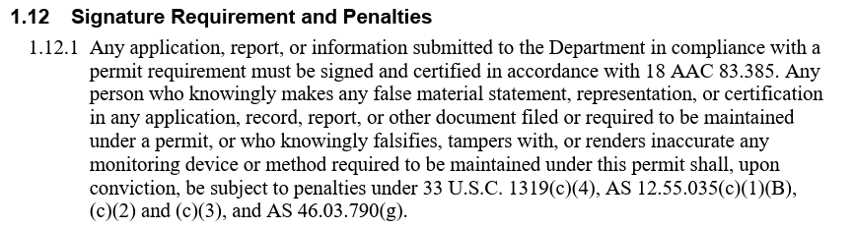
Construction General Permit (CGP)
CGP Appendix A
  Standard Conditions Applicable to All Permits (A-3)
  Signature requirement and penalties (A-6)
  Twenty-four hour reporting (A-11)

Slide 29
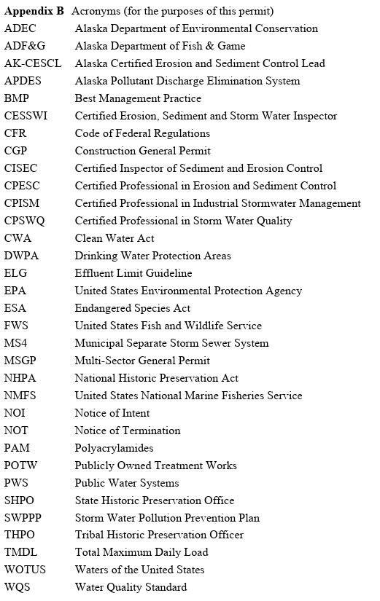
Construction General Permit (CGP)
CGP Appendix B
  Acronyms

Slide 30
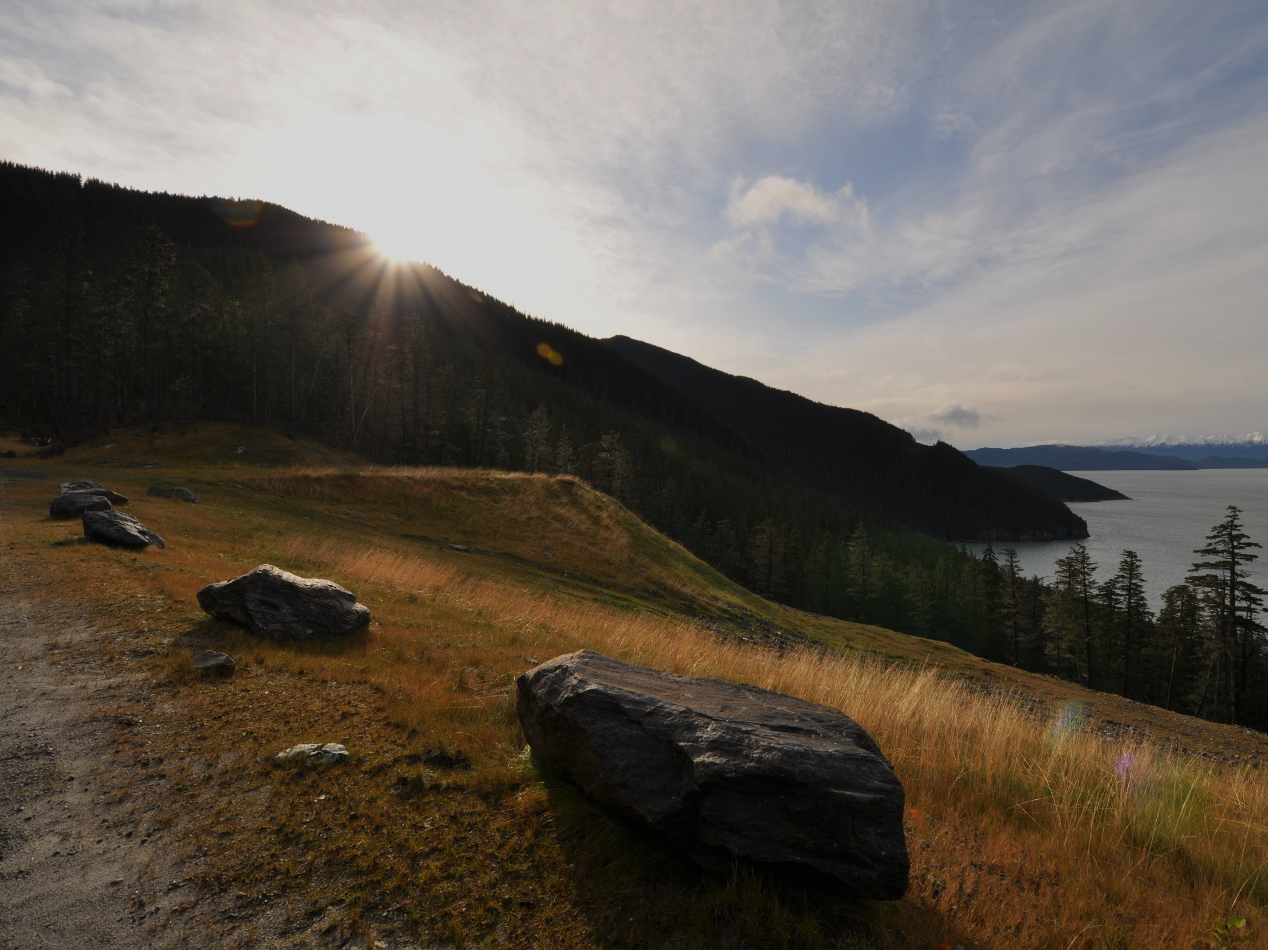
Construction General Permit (CGP)
Appendix C Definitions (C-1)
Appendix D Small Construction Waivers
Appendix E Forms
  Notice of Intent (NOI)
  Notice of Termination (NOT)
  Notice of Intent Modification
  Low Erosivity Waiver
  Annual Report

Slide 31
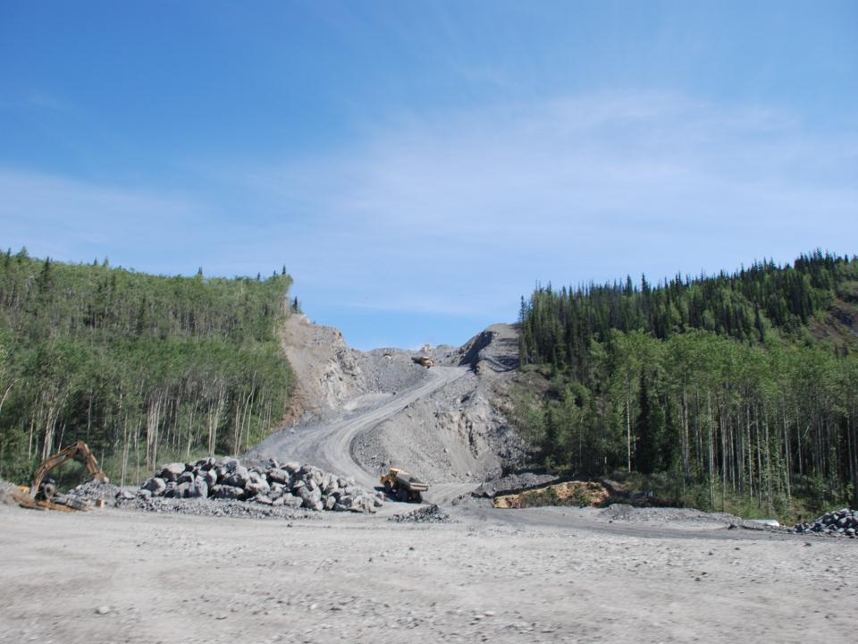
Who Is the Operator?
The operator of the construction site must apply.
Responsible for complying with permit conditions.
Has operational control over construction plans and specifications or is in charge of day-to-day activities relating to the SWPPP.
Can have co-permittees.
Glenn Hwy at Hicks Creek

Slide 32
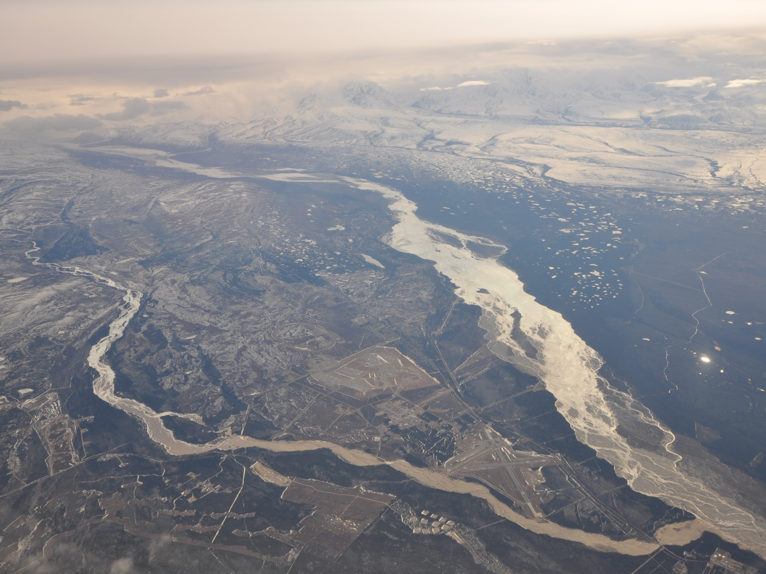
Operators who need CGP Coverage?
Owners with
Plans & Specs
Approval
Operators
Day to Day
Control
Operators of
Design Build
Greely

Slide 33
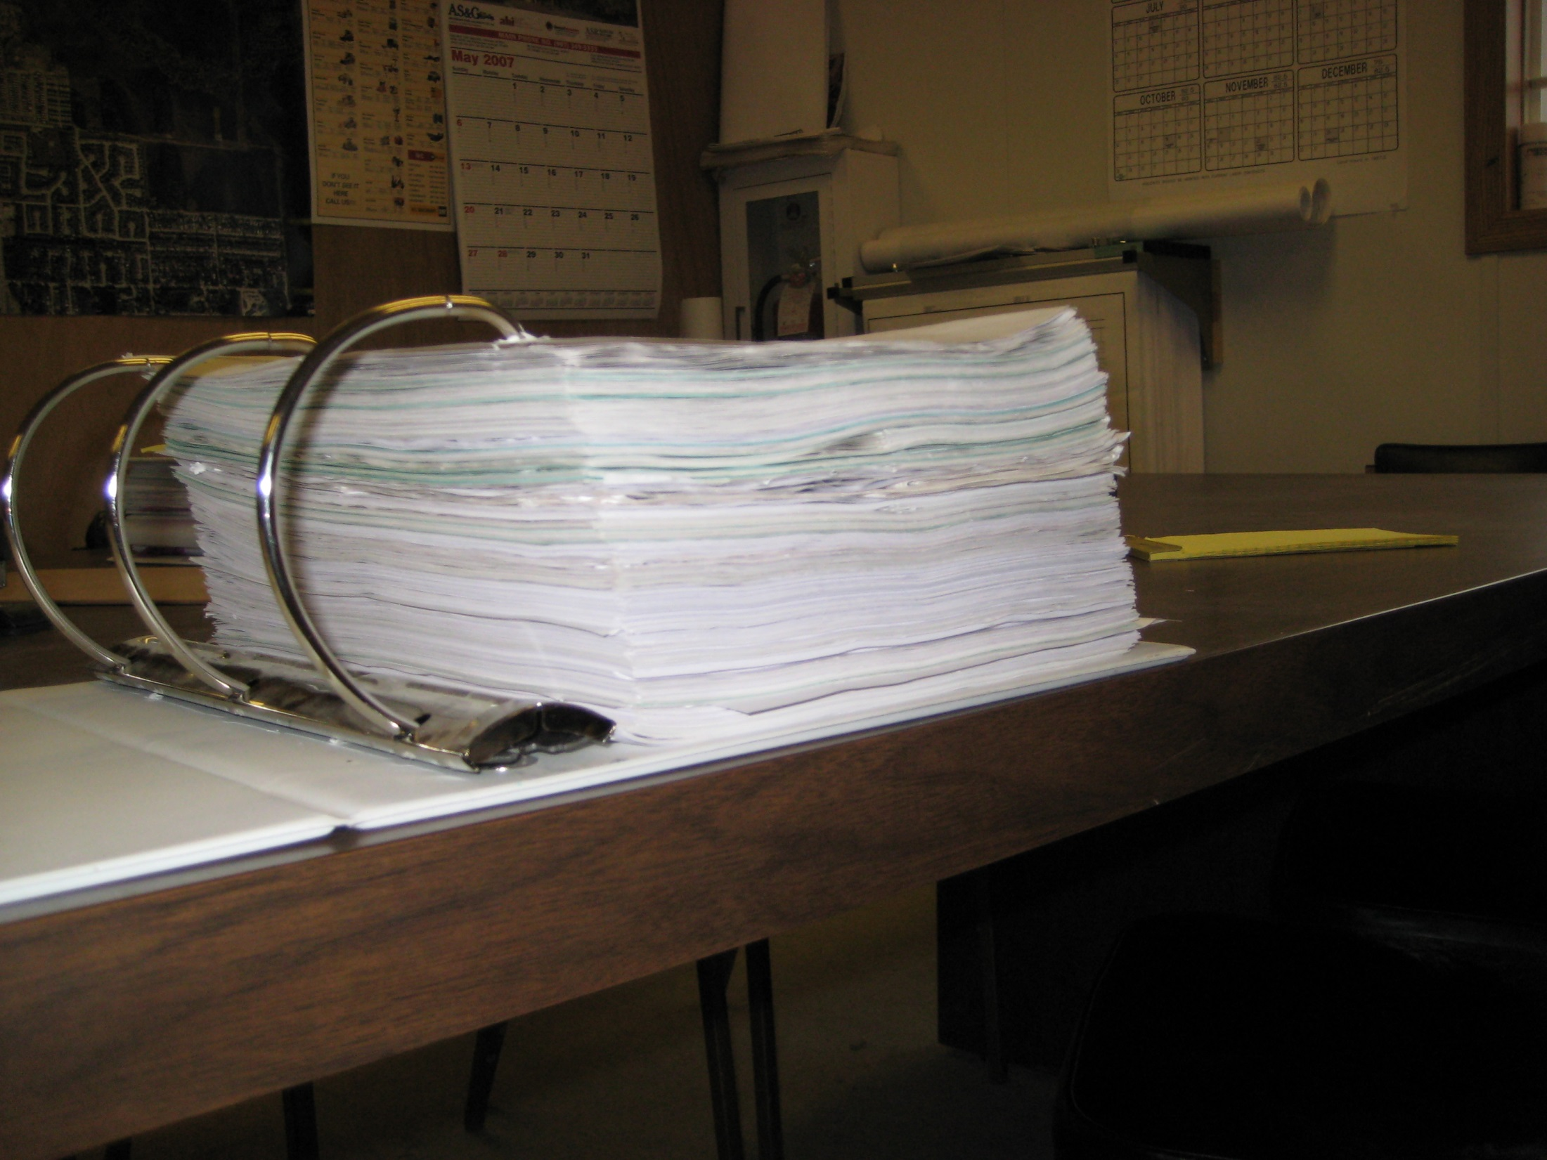
Develop SWPPP prior to filing a NOI

Slide 34
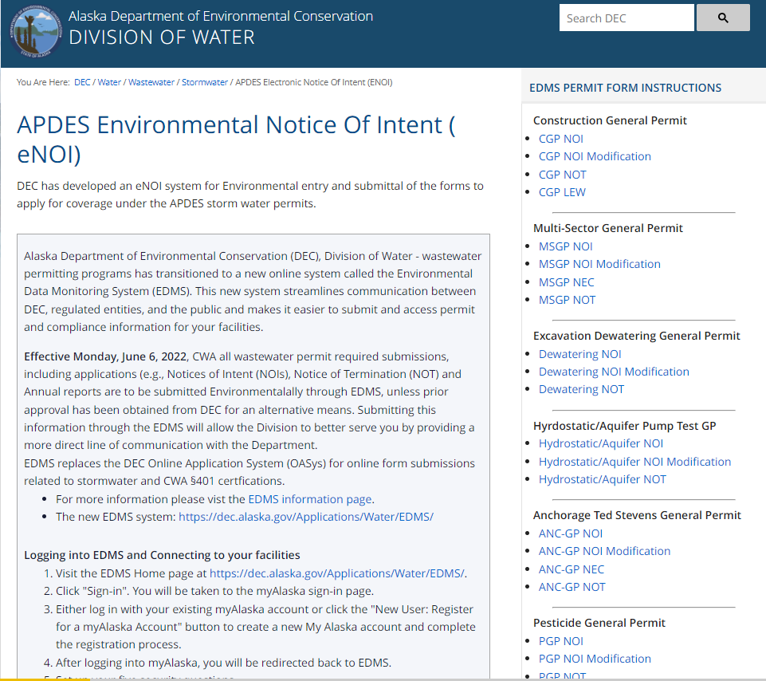
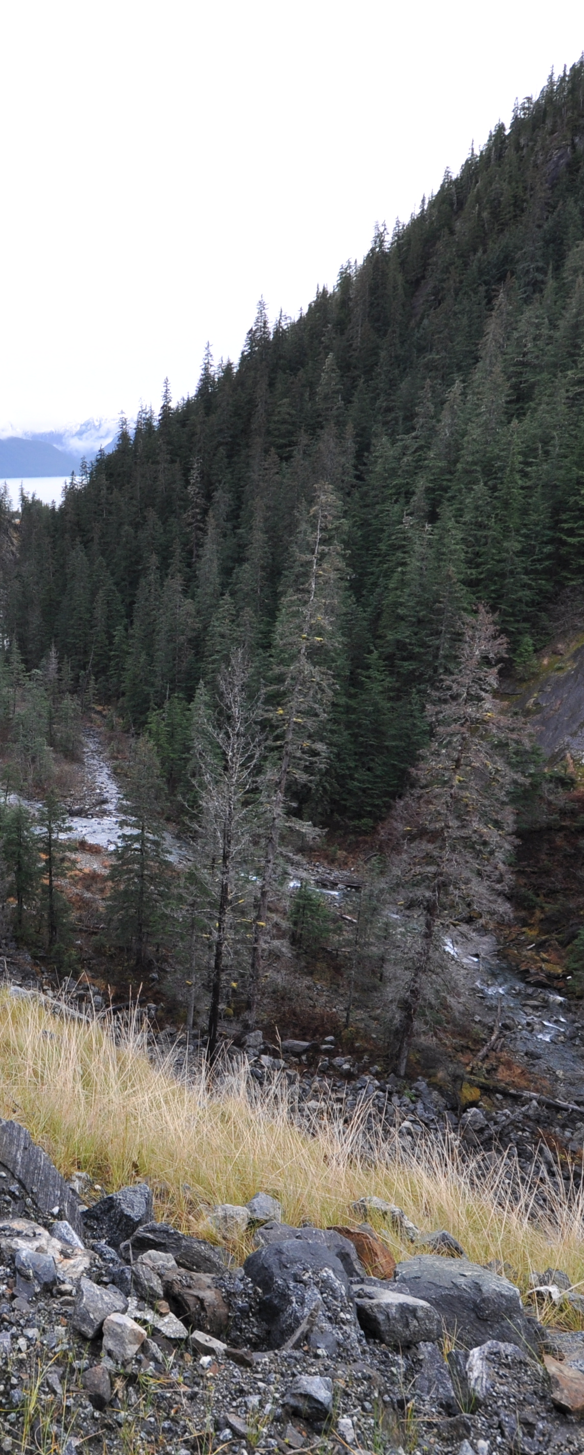

https://dec.alaska.gov/water/wastewater/stormwater/apdesenoi/

Slide 35
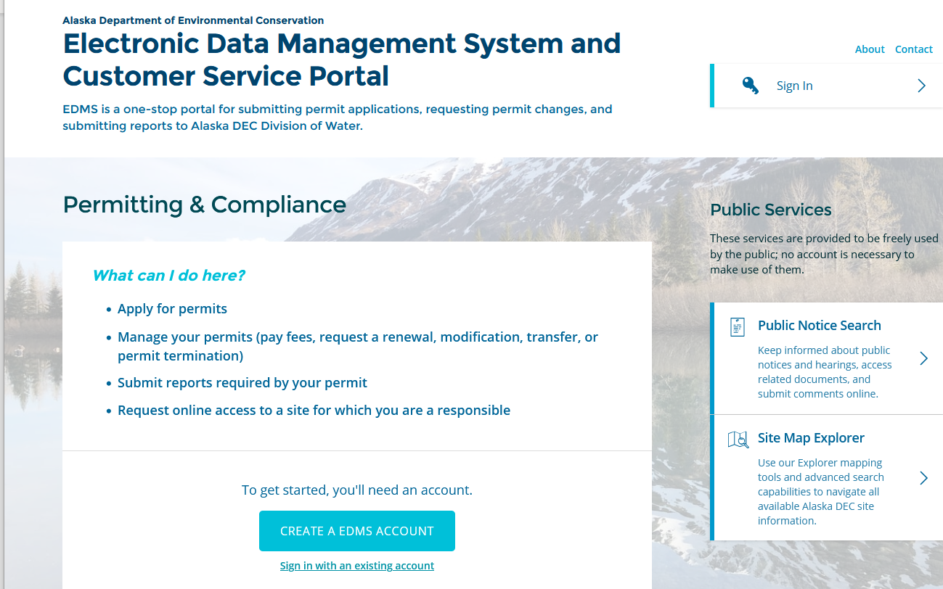
Filing is all mandatory online

Slide 36
Operator name and contact information
Project name and location
Latitude / longitude
Project start and end dates
Total acreage and disturbed acreage
Type of construction activity
Receiving waters and impairment status
SWPPP certification
Endangered species eligibility
Historic property confirmation
Signed certification
When filing​
NOI, you must provide:

Slide 37
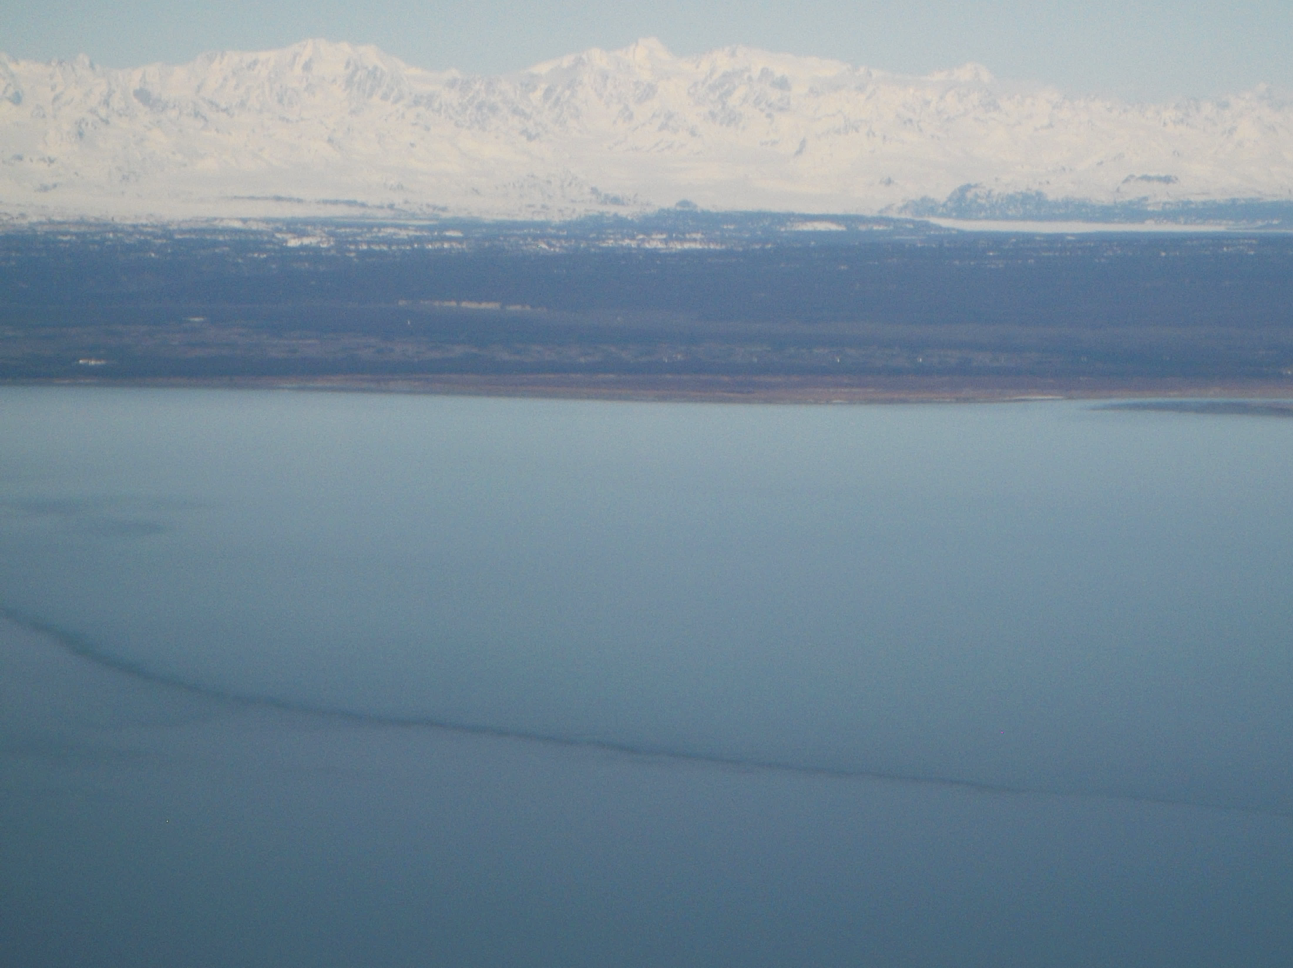
Submittal of a Modification to Original NOI
CGP Part 2.7 Pg. 18
Modification. A permittee must file an NOI modification form to DEC (see Part 2.3) to update or correct the following information on the original NOI within 30 calendar days of the change:
Owner/Operator address and contact information;
Site information;
Estimated start or end dates;
Number of acres to be disturbed; or
SWPPP location and contact information.
Continuation of expired permit in accordance with Part 2.6.
If the original project disturbance was between one and less than five acres, and will now disturb five acres or more, a SWPPP must be submitted with the NOI modification.

Slide 38
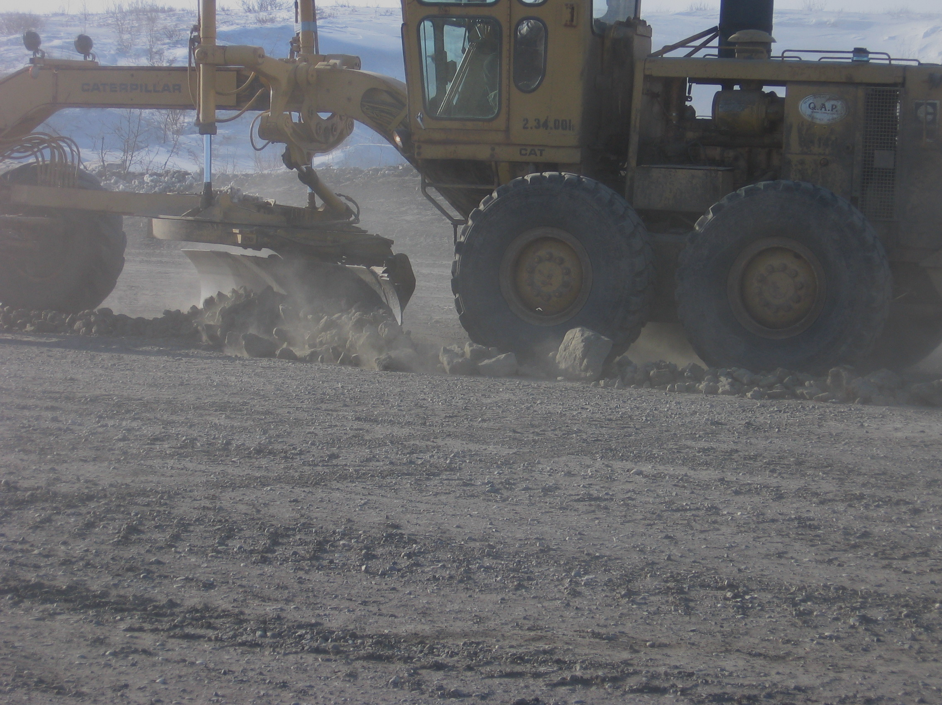
CGP Part 2.7.5 Pg. 19
NOT Instead of Modification
The permittee must submit a NOT instead of an NOI modification form to DEC within 30 calendar days when the operator has changed. A change of operator in this case means when an organization changes control of the project. It does not mean when a corporate officer of the organization changes while the organization continues with the project. The new owner/operator must file a new NOI to obtain coverage under the CGP. Coverage is not transferrable.

Slide 39
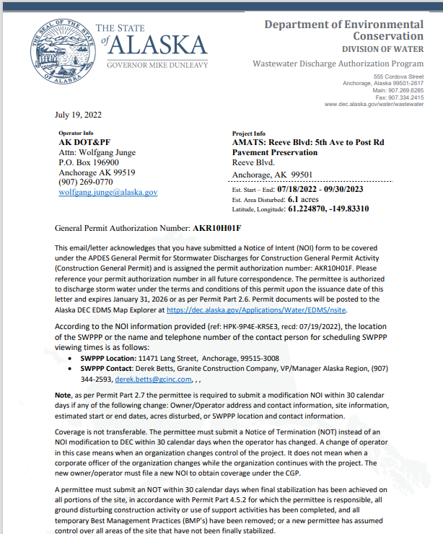
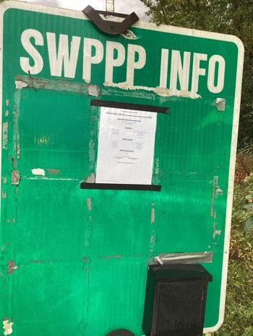
NOI Postings
All required information is located on the first page of the NOI acknowledgment letter personnel change!
Notes:
NOI Postings are frequently out of date and do not correctly identify the current personnel. This is a SWPPP posting where the documents have blown away, note the thumbtacks without paperwork. The paper on the board are the corps placards.

Slide 40
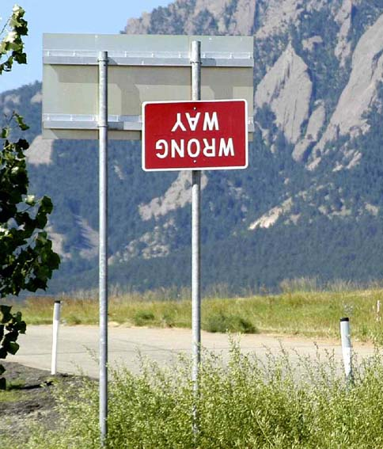
NOI Postings
Must be updated when personnel change!
NOI authorization number
Operator Contact name and phone number
Location of the SWPPP or the name and phone number of the contact person to schedule a SWPPP review.
Notes:
NOI Postings are frequently out of date and do not correctly identify the current personnel. This is a SWPPP posting where the documents have blown away, note the thumbtacks without paperwork. The paper on the board are the corps placards.

Slide 41
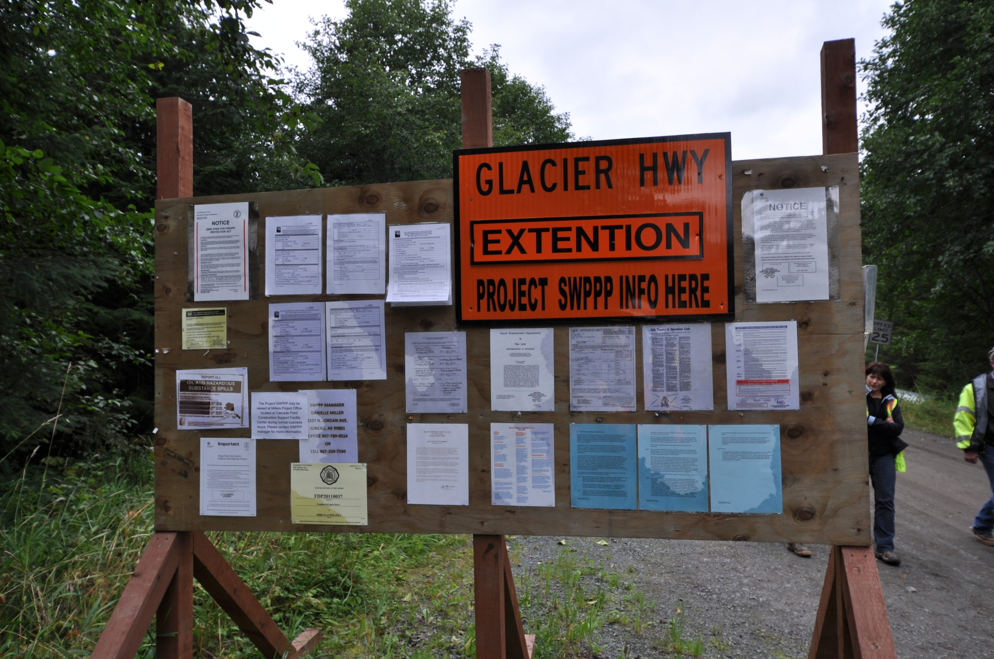

Keep SWPPP Contact info updated
Replace worn & faded postings
Inspect postings regularly

Slide 42
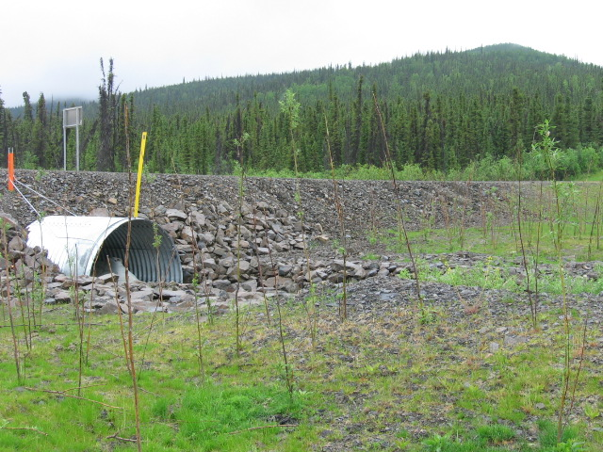

Notice of Termination
We no longer need permit coverage because…
Must be submitted within 30 days of one of the above.
Notes:
As important as it is to get permit coverage make sure you terminate when the time comes. Plan for the eventual termination.

Slide 43

This project is complete, and all areas are stabilized.
We do not want permit responsibility or need permit coverage any longer.

Slide 44

MS4 = Municipal Separate Storm Sewer System
Municipality of Anchorage
Port of Anchorage
Fairbanks / North Pole
Fairbanks North Star Borough*
Joint Base Elmendorf Richardson
Fort Wainwright
DOT&PF Central Region
Conveyance that discharges to US Waters
Anchorage
Notes:
Explain that the municipality operates a storm sewer that conveys flow to waters of the US. The storm sewer operator must have a permit for the discharge and abide by the permits conditions. Note that the North Star borough is only partially covered. The road system drives the areas that are covered.
Juneau has a combined storm and sanitary system and is not a separate storm system. The North Star Borough MS4 is for the Road Service Areas only (it’s not the road system that drives it, but the method of funding road maintenance). Here’s some text from the NSB web page:
The Fairbanks North Star Borough does not have area-wide powers for road construction or maintenance, fire or police protection, water and sewer services, or other local services. A service area is a taxing jurisdiction of the Borough established at the request of the voters within a geographical area to provide certain of these services within their specific area.

Slide 45








Projects within the MS4 may have additional requirements.
  Plan submittal & review
Fairbanks
Notes:
Fairbanks

Slide 46


MS4
Anchorage
Stormwater Treatment Plan – SWTP
SWPPP Review with 500sf disturbance

Slide 47

MS4 Fairbanks Urban Area
Notes:
Note the road service areas

Slide 48

Multi Sector General Permit
MSGP
Discharges from Industrial Activities

Slide 49

Multi-Sector General Permit (MSGP)
MSGP includes coverage for the following industries:
Asphalt Batch Plants;
Concrete Batch Plants;
Material Processing;
Rock Quarries; and
Sand and Gravel Mining.
Notes:
The Multi-Sector General Permit (MSGP) for industrial storm water covers 29 industrial sectors. All the facilities covered by the permit have to develop a SWPPP to address storm water management. For 26 of these sectors the MSGP addresses storm water management after the facility is constructed. For three of the sectors – metal mining, coal mining, and sand and gravel mining – the MSGP includes requirements for a SWPPP and inspections during exploration and construction activities as well as active and inactive mining. For additional information see ADEC’s webpage on the MSGP.

Slide 50
Material Sites
Which permit covers It?
CGP
Site is used for just the one project
Site is opened at beginning of project and closed at end of project
See CGP Part 1.4.2.3
  Waste Sites
MSGP
Site serves multiple unrelated construction projects by different permittees
Site is a commercial operation or landowner allows multiple users of the site
See MSGP Sector J
Notes:
In the Construction General Permit (CGP) material sites are considered support activities. How a material site is developed, managed, and used will determine whether the material site is regulated by either the CGP or the Multi-Sector General Permit (MSGP). A material site can not be permitted by both permits at the same time. Part 1.4.2.3 of the CGP explains that 1) the material site must be directly related to the construction site required to have permit coverage, 2) the material site is not a commercial operation serving multiple unrelated construction projects by different permittees, 3) the material site does not operate beyond the completion of the construction activity at the project that supports it, and 4) appropriate control measures are identified in the project SWPPP. (There are some exceptions for projects off the road system – see definition for “support activities” in Appendix C of the CGP.)
Sector J of the MSGP explains Sand and Gravel operations from exploration through, construction, active mining, inactive mining and restoration. For example, a commercial material site that sells material for multiple CGP Projects would have MSGP coverage. For example, a material site on DNR land leased by DOT and used for multiple projects would need MSGP coverage. For example, a material site in a community that is used for multiple projects.

Slide 51

Regulations Summary
Clean Water Act – Protect & Restore
NPDES – APDES = Permits for Clean Water
  Storm water
  CGP-MS4-MSGP
  Local Regulations – Municipal / Borough
Haines

Slide 52

Regulatory Updates
Ongoing EPA Rulemaking
DEC Excavation Dewatering Permit Reissue 2025
DEC revised MSGP 2020 = Administrative Continuance
  Waiting for new permit to be issued
MS4 permits renew at different times
DEC revised CGP 2026 NEW
Hoonah
Notes:
EPA is required by court order to make rules regarding discharge that are technologically feasible. While this had been expected to include the ELG this will probably not happen as the data used for the ELG has been contested. MS4’s are likely to expand their coverage area and expand the required use of post-construction BMP’s for storm water runoff treatment.

Slide 53

Notes:
At the end of each section we will allow time for questions

