Slide 1
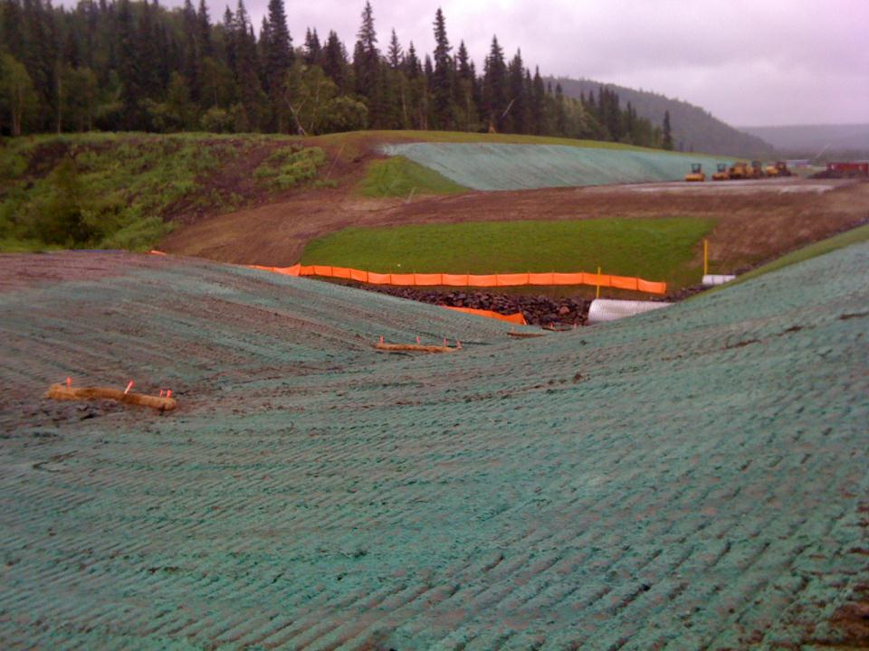
Factors that Influence Erosion
Soils
Precipitation
Vegetation
Surface Area
Slope Length
Slope Gradient
Surface Texture
Grayling
January 2022

Slide 2
Factors that Influence Erosion
Goal of this section:
Be able to name the erosion factors:
Soils
Climate
Vegetation
Slope length and gradient
Surface area and texture

Slide 3
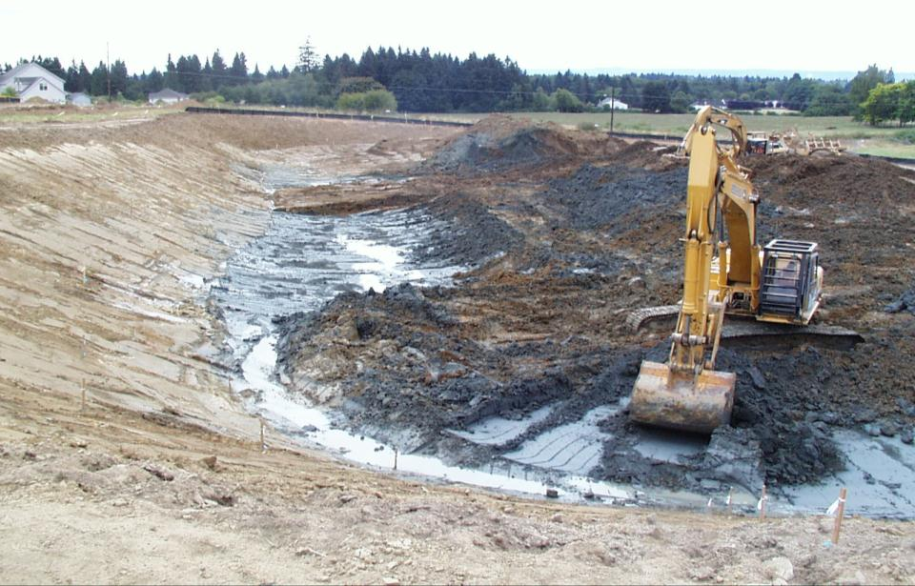
Most Sites Have Various Soils
How Deep will you be Digging?
How will the Soil Change?
Notes:
Your soil is what it is, what do you have to do to work with it?
How does the soil change on your site? Where do we want the grey dirt? Not on the top of our job sites.

Slide 4
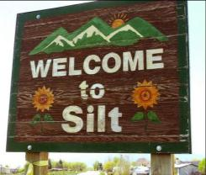
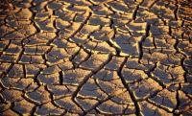

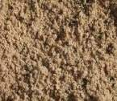
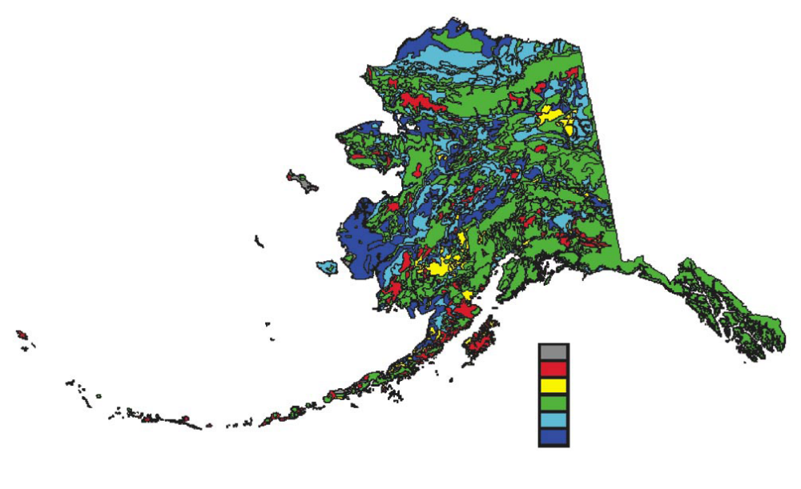

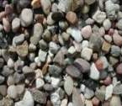
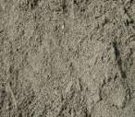
Differing Soil Types
Clay
Clay Loam
Sand
Clay
Gravel
Loamy sand
Notes:
Some soils erode much more easily than others & they erode in different ways. Gravel does not erode – sandy soils erode rapidly but because sand particles are heavy – they settle quickly and yield low turbidity levels – Clay does not erode easily but settles very slowly n(Silt is also a town in Colorado)

Slide 5
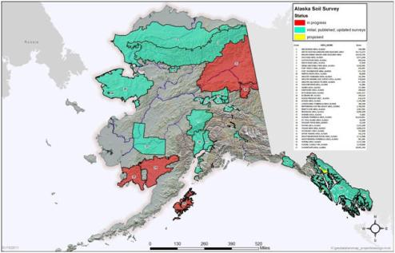
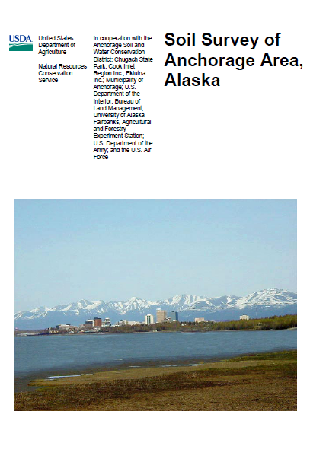
Soil Surveys
USDA Soil Conservation Service
NRCS
Notes:
Know what you will be dealing with, Most surveys are now available online, Alaska data is limited.

Slide 6
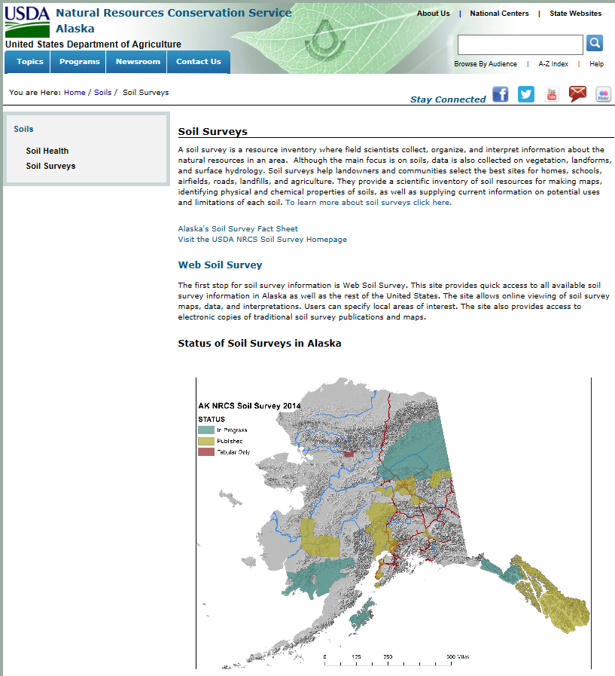
http://www.nrcs.usda.gov/wps/portal/nrcs/main/ak/soils/surveys.html
Notes:
While Alaska has limited soils info the geotechnical reports for specific sites are very useful.

Slide 7
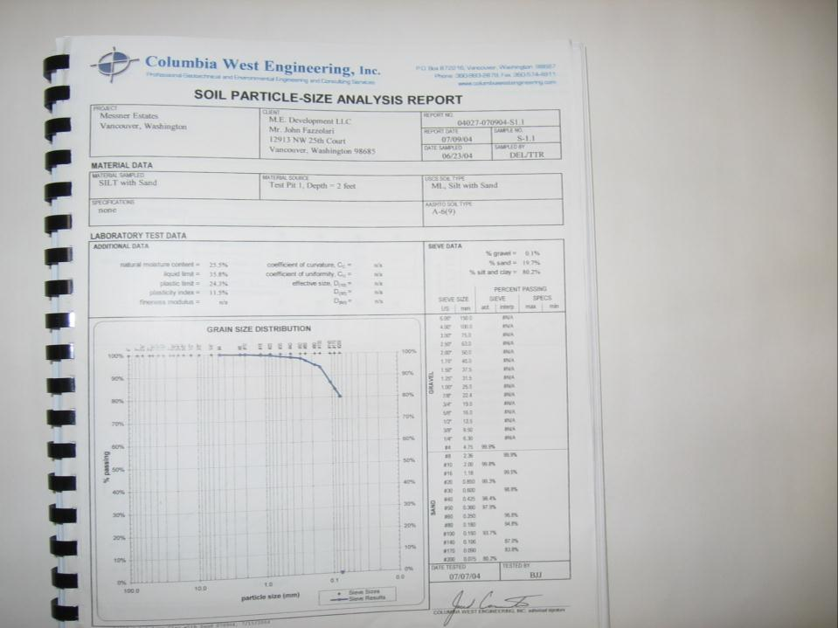
Most sites
have specific
Geotechnical
reports and
Bore Logs
available
My Next Job Site
Woeisme Acres
200 Sieve
This report
indicates that
80% of the
soil is .01mm
or smaller
Notes:
Many projects have extensive information compiled in previous reports, Get all the information you can.

Slide 8
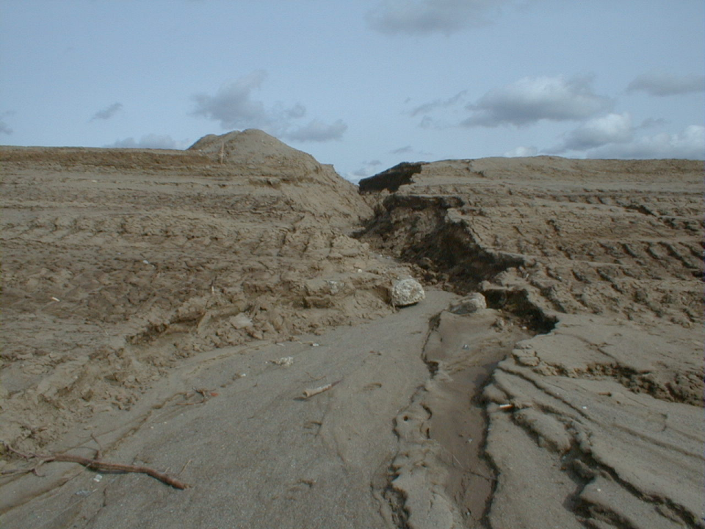
Sandy Soils
Erode & Settle Quickly
Notes:
In GEO Reports know what “TYPE” Means, A – B- C- D
Type A Is great until it blows, or washes away, this soil settles quickly HSG is hydrological soil group.

Slide 9
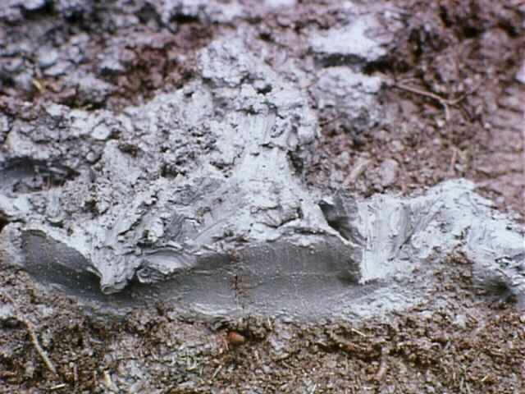
Clay Soils
Low Erosion Potential, but…
Once Suspended it’s Very Difficult to Settle!
Notes:
Type D is Tough to work with, can be expansive
Type B & C are in the middle, B is good for farming, C is usually hard, rocky, low infiltration.

Slide 10
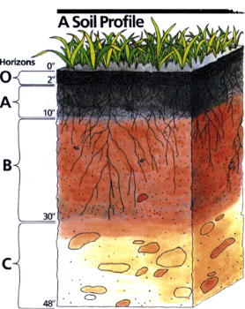
Soil Horizons
Organic
Matter
Root Zone
Sub Grade
Graphic by USDA, NRCS
Notes:
Organic matter creates a favorable soil structure, improving its stability and permeability. This increases infiltration capacity, delays the start of erosion, and reduces the amount of runoff.
In GEO Reports know what Horizon means
Organic matter and particle size affect soil structure. When protected from compaction, decomposing organic material maintains a healthy soil food web which includes worms and other soil organisms. These organisms help maintain porosity which increases infiltration and enhances transfer of nutrients to plant roots.

Slide 11
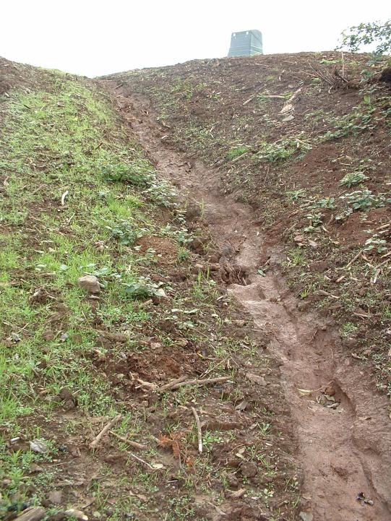
Soil Texture
& Erodibility
Erodibility Increases
as the % of Silt &
Sand Increases
Erodibility Decreases
as the % of Clay
& Organic Material
Increases
Notes:
The soil has washed away down to a clay layer that doest not erode as fast

Slide 12
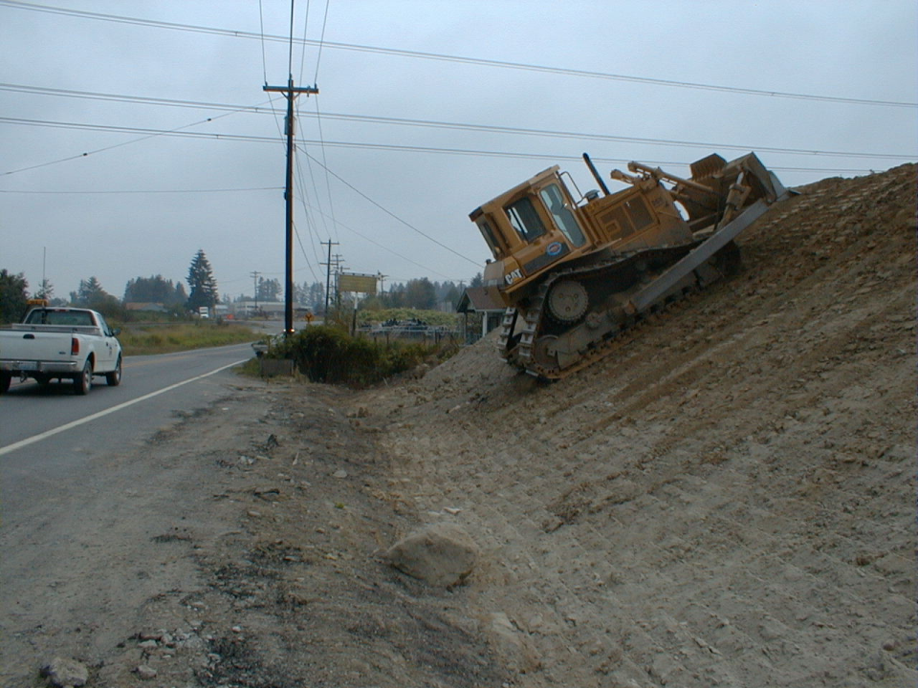
Surface Texture
Track Walking
Increases Roughness
Notes:
Grouser imprints reduce the slope length, seed deposits, moisture collects, plants grow….

Slide 13
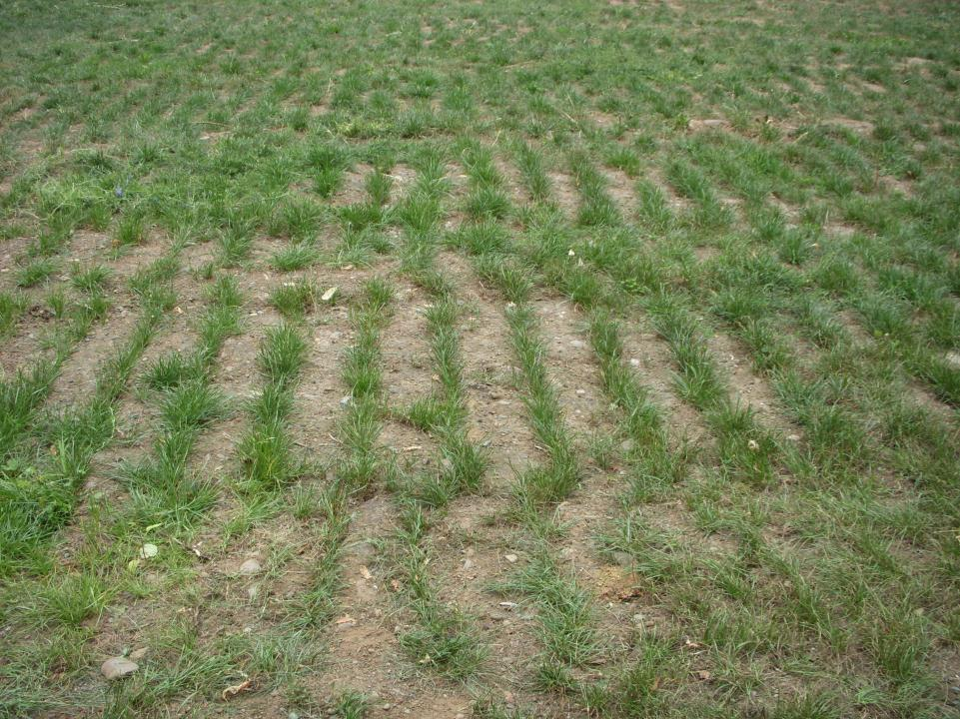
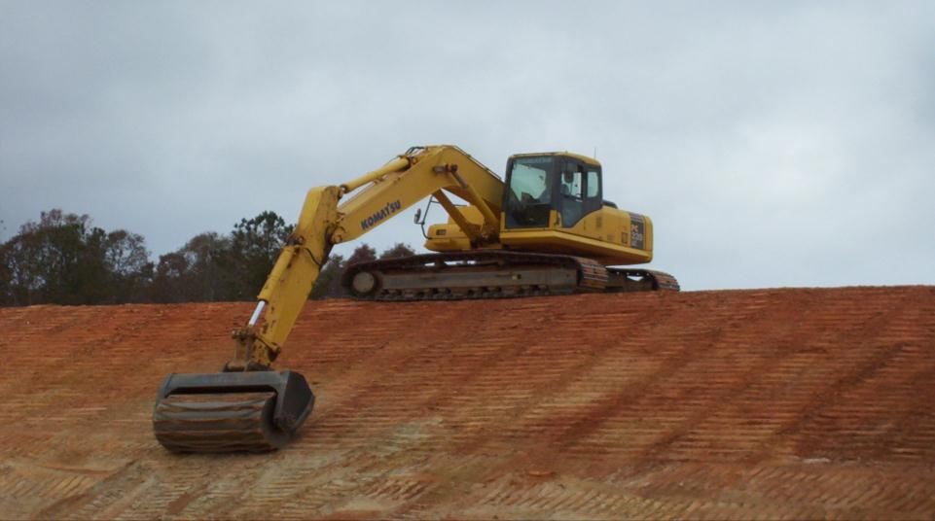
Imprinting Slopes Increases Texture & Assists Vegetation
Notes:
The imprinting makes depressions for the seed moisture and nutrients to deposit. This why we see better growth in the groves.

Slide 14
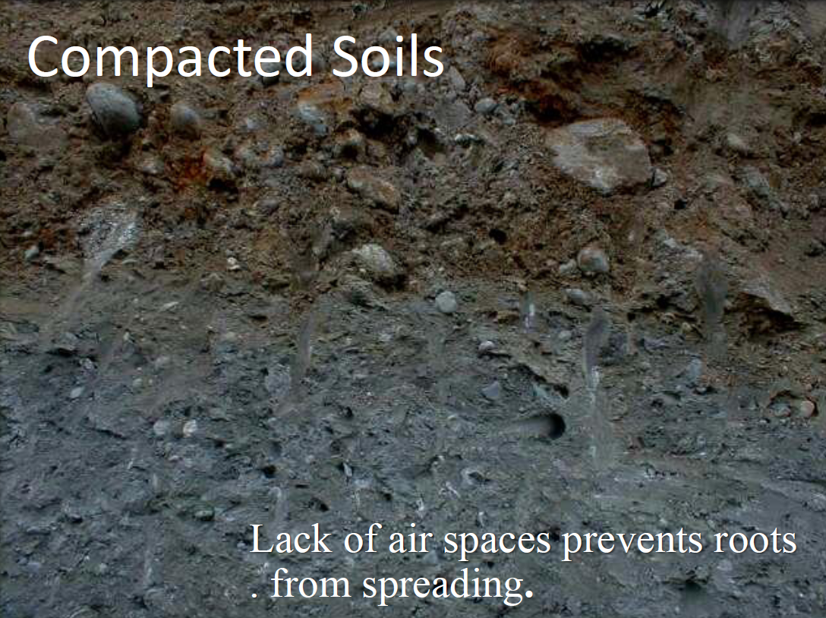

Slide 15
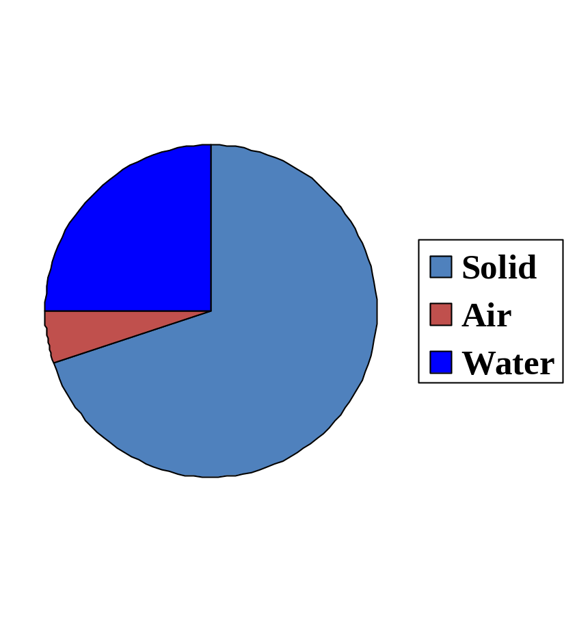
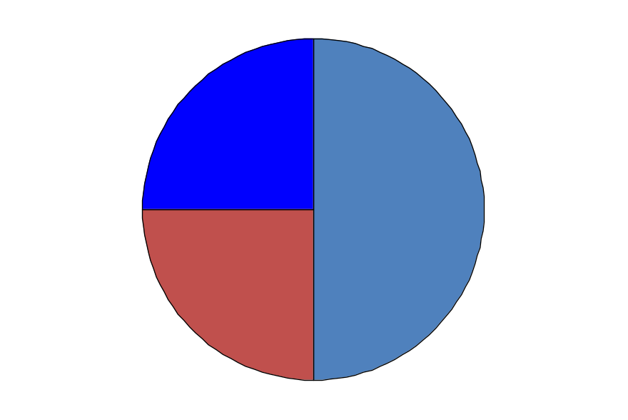
Composition of a Compacted Soil
Before
After
50%
70%
Note the reduced air space in a compacted soil.
Notes:
In a compacted soil, the air space may be reduced to as little as 5 percent, reducing the ability of the soil to support plant growth.

Slide 16
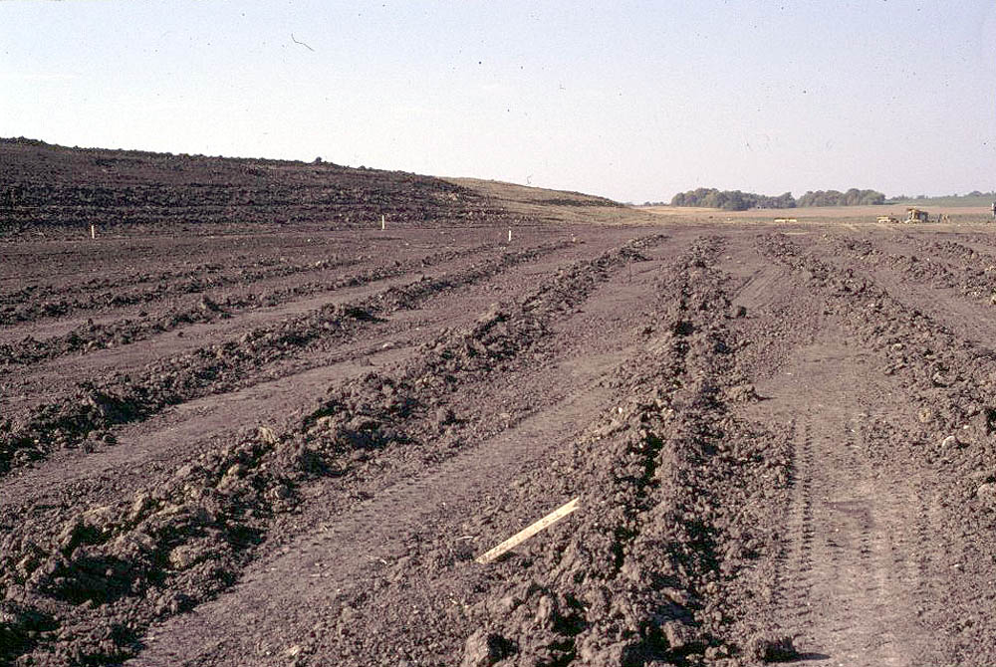
Soil Ripping
Reduces Compaction
Increases Infiltration
Courtesy Dwayne Stenlund CPESC MNDOT
Notes:
On contour has many other benefits.

Slide 17
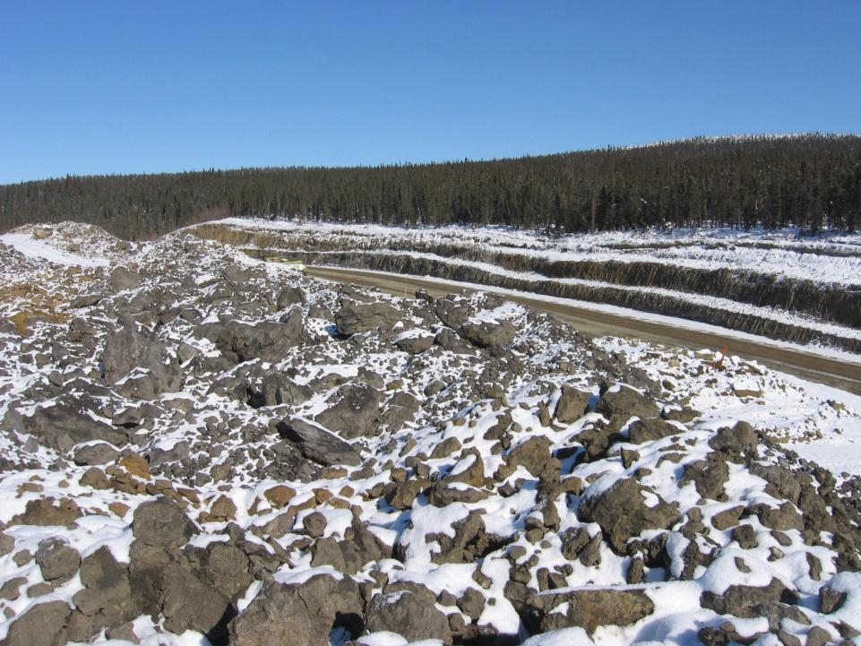
Thermal Degradation / Freeze Thaw Erosion
Freezing & Thawing detaches soil particles and causes down-slope movement
Frost loosened soil is more susceptible to erosion by rain and snowmelt
Eroded soil can become saturated with spring breakup resulting in mass movement

Slide 18
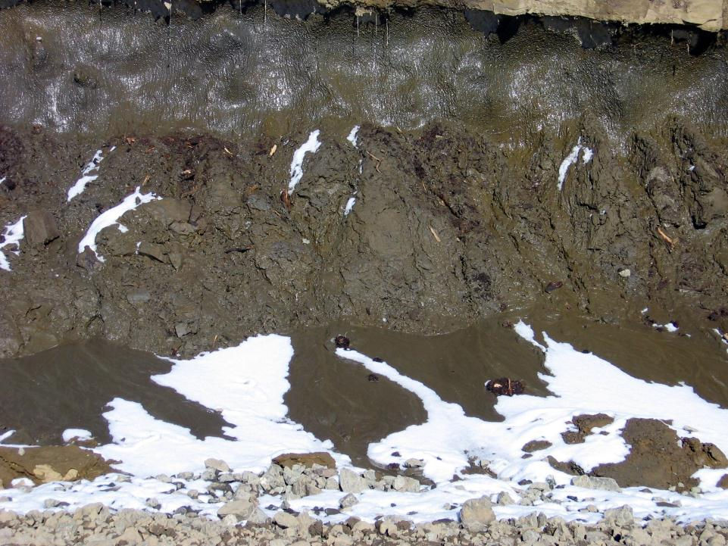
Notes:
Freeze thaw causes soil particles to detach and migrate downhill. The detached particles are much more prone to further erosion by rainfall and snowmelt runoff. Frozen soil below can prevent water from infiltrating resulting in mass wasting erosion of saturated soils.

Slide 19
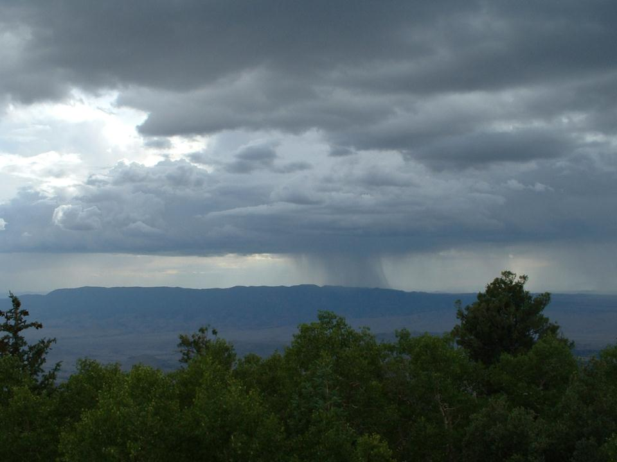
Precipitation
Notes:
Does the rain affect anyone here?

Slide 20
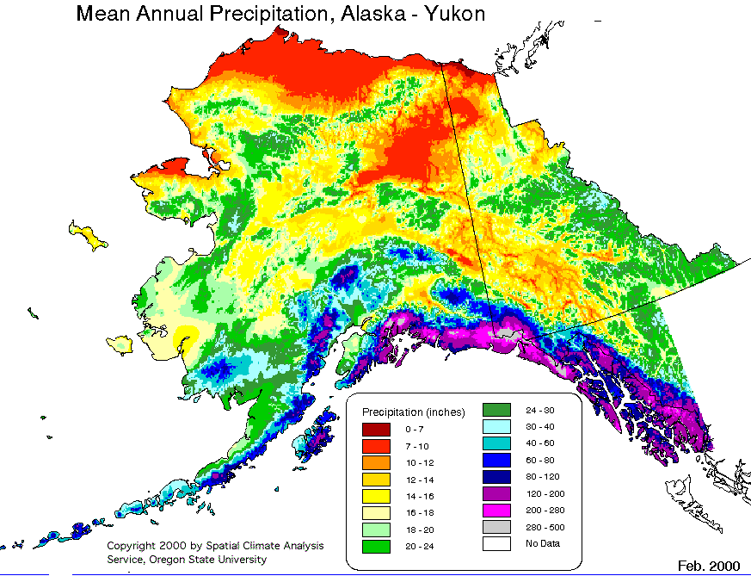
Climate

Slide 21
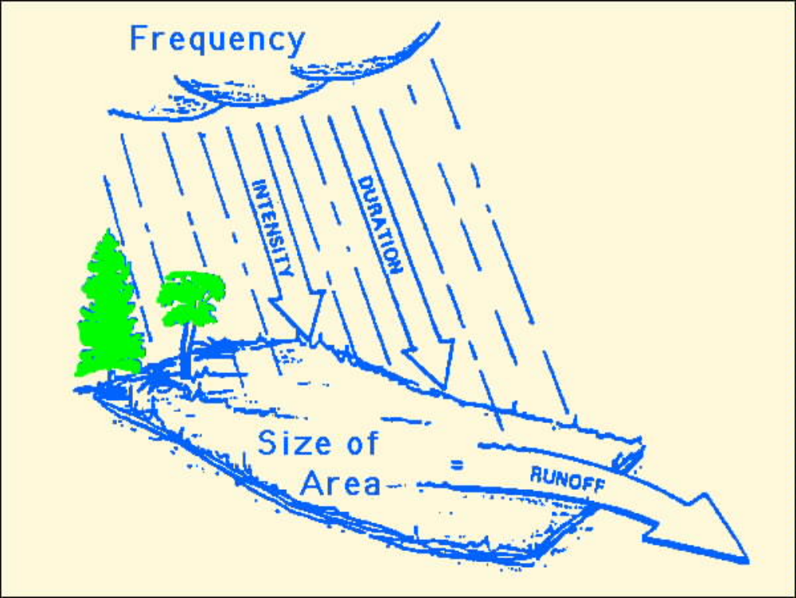
Rainfall
factors that
influence
erosion
Notes:
Rainfall effects are driven by Frequency, Intensity, & Duration.
The surface area will determine the runoff amount.

Slide 22
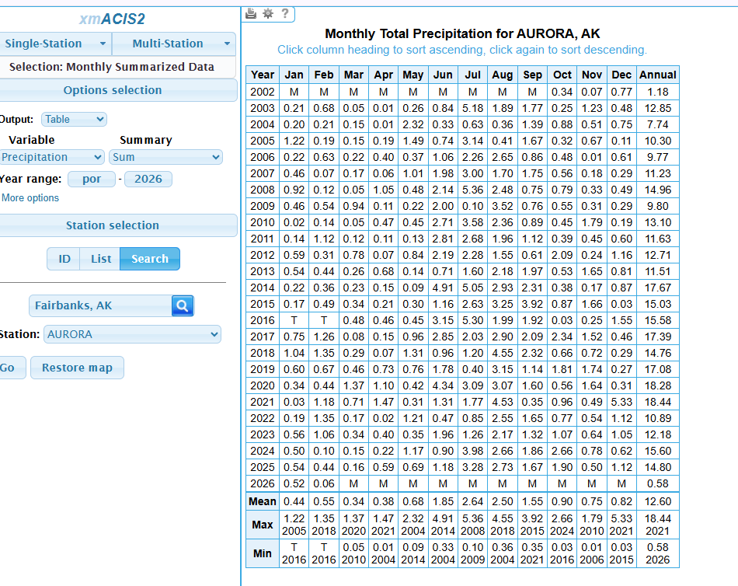
https://xmacis.rcc-acis.org
Use the NOAA Regional Climate Center xmACIS site to pull precipitation data for the nearest climate station when completing the SWPPP climate section.”

Slide 23
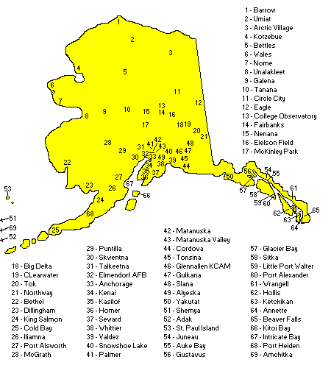
Rainfall Data
On the Internet
https://xmacis.rcc-acis.org/
SWPPP
Source
Material
Notes:
Need climate data in the SWPPP

Slide 24
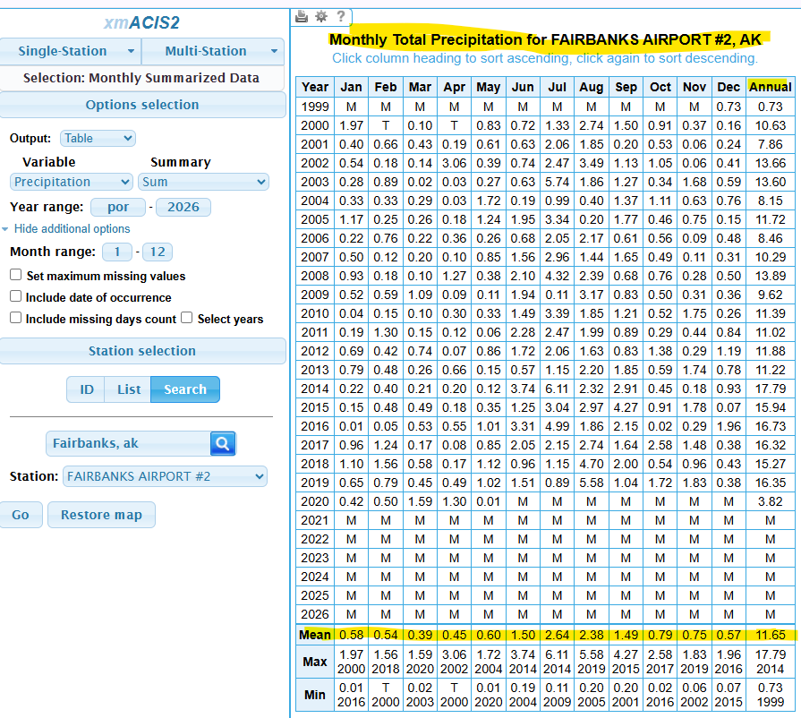
Fairbanks Airport

Slide 25
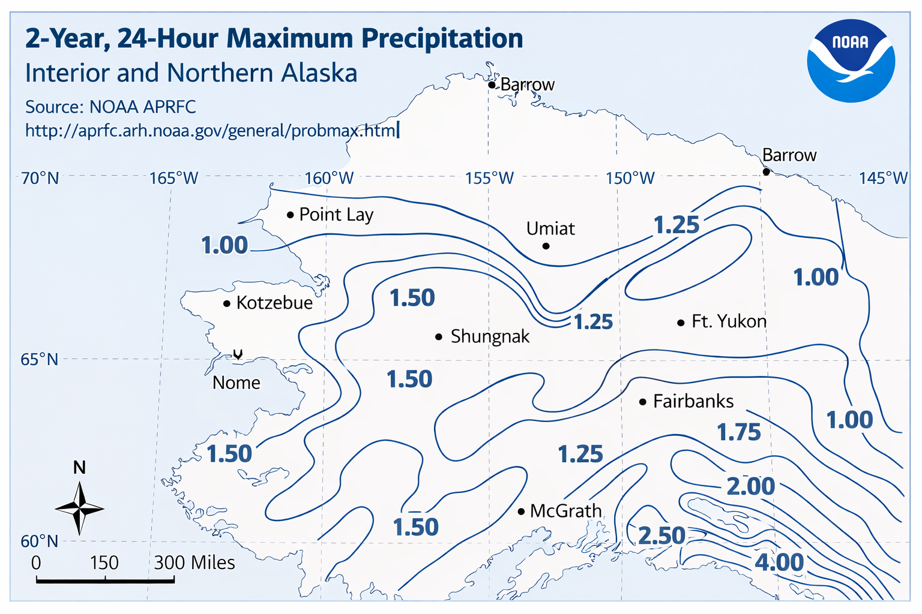

Slide 26
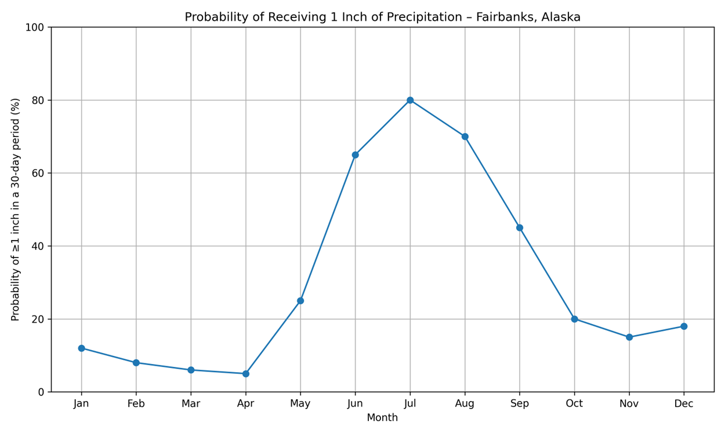
80% Probability of 1 Inch in July

Slide 27
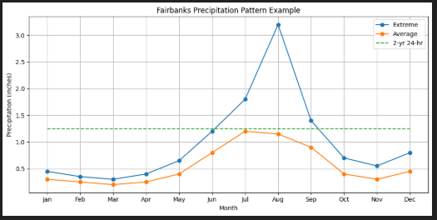
BMP Designs & Standards are affected by Flow and Velocity
Notes:
EPA CGP Requires Sediment Basins and traps be designed for 2 year 24 hour events. (EPA CGP Pg 13 Sec.3.13 E.) BMP’s from the AKDOT SWPPP guide have 2 and 10 year peak design standards.

Slide 28
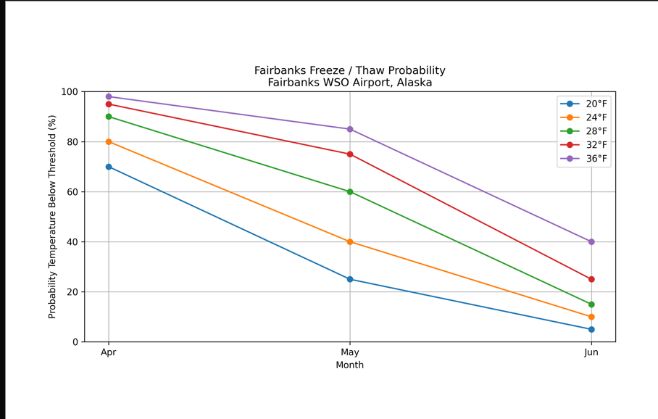
Fairbanks Freeze / Thaw Probability

Slide 29
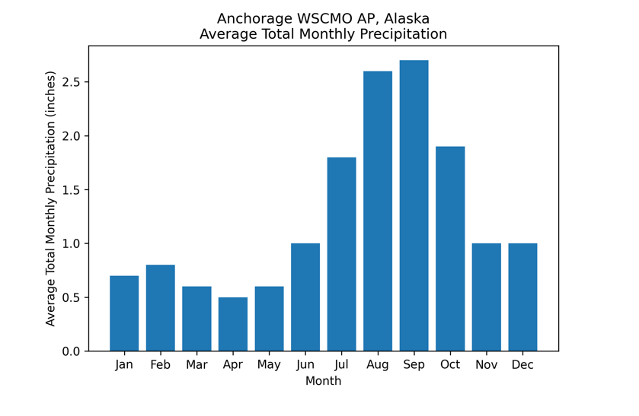
Rainfall Prediction for SWPPP
Notes:
When Preparing, Implementing, Modifying and Implementing you need information

Slide 30
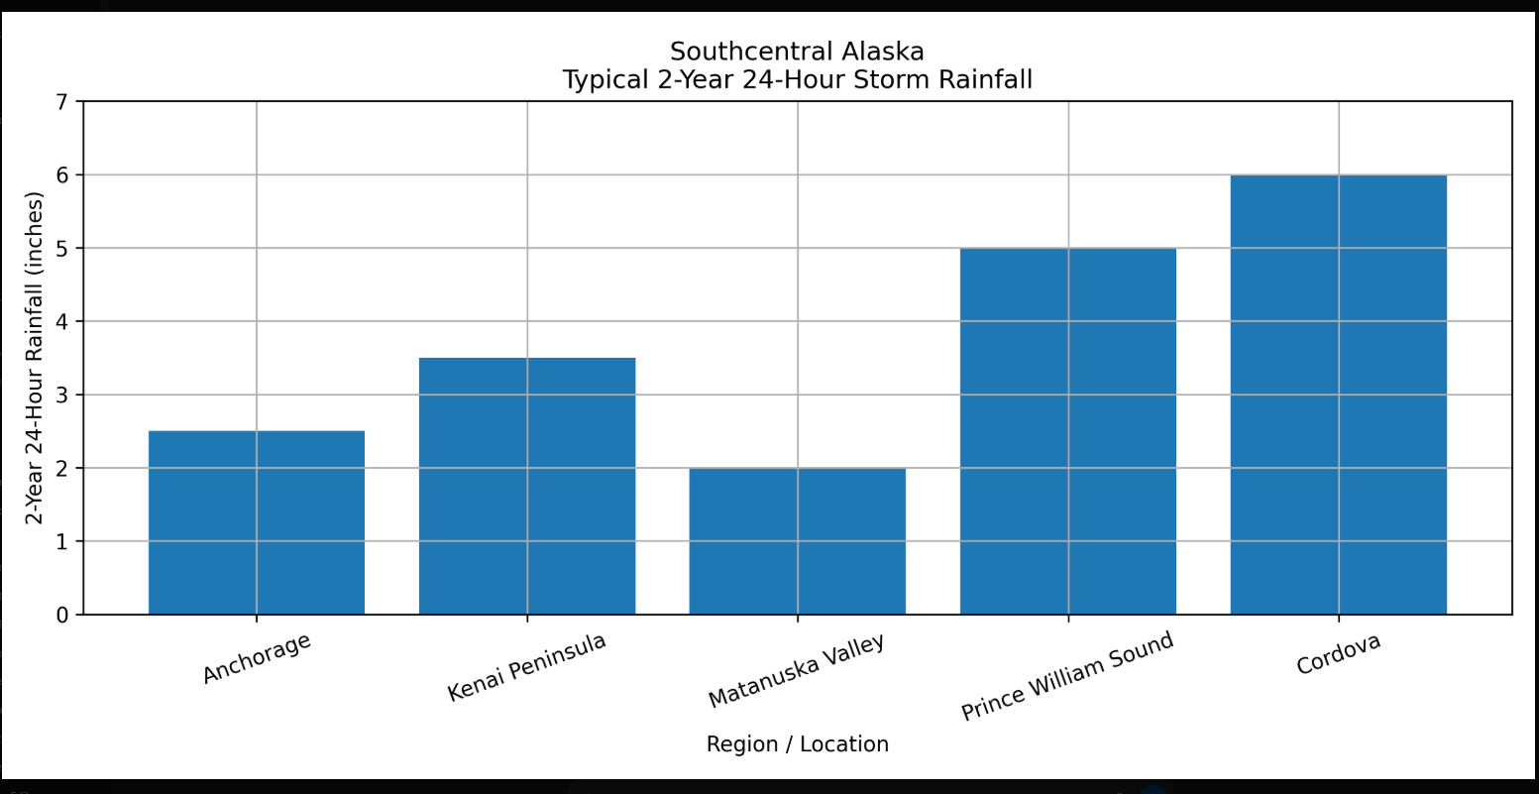

1.5 to 6 inches
Source: NOAA

Slide 31
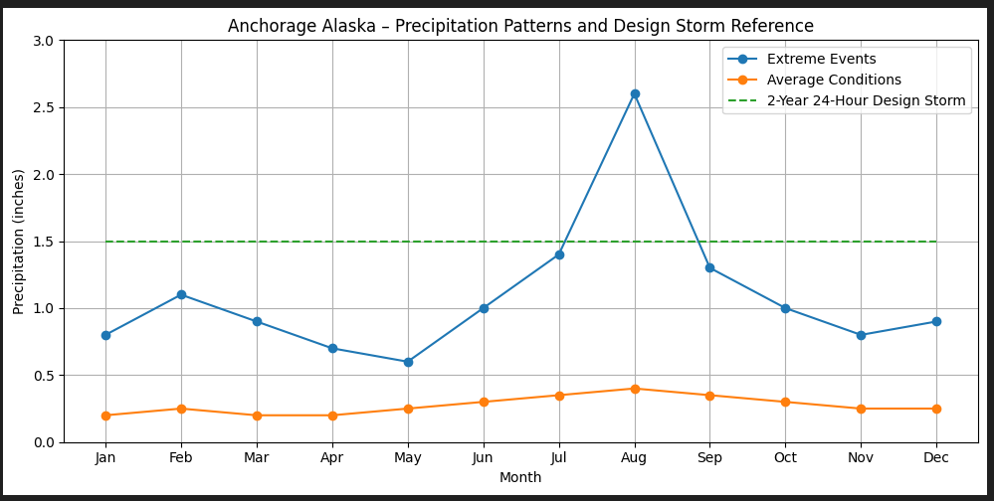
What are the Design Standards?
2 yr –24hr
What are the Performance Goals?

Slide 32
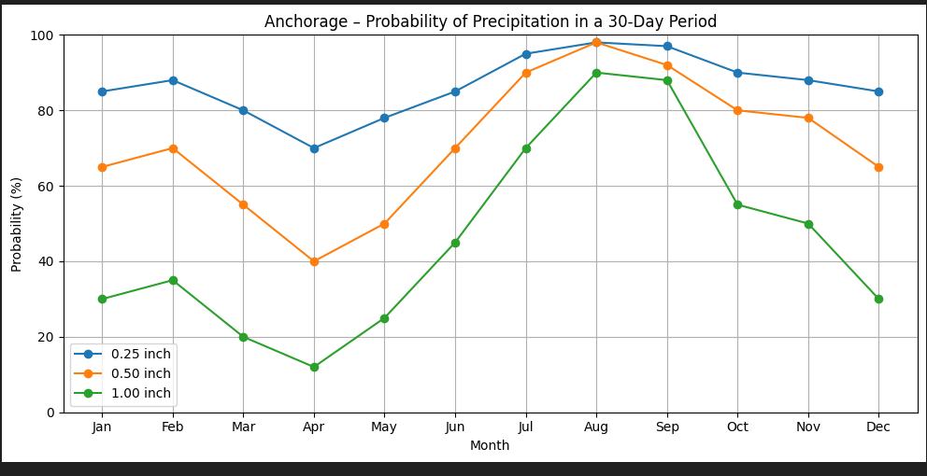
Preparation & Planning
In any month

Slide 33
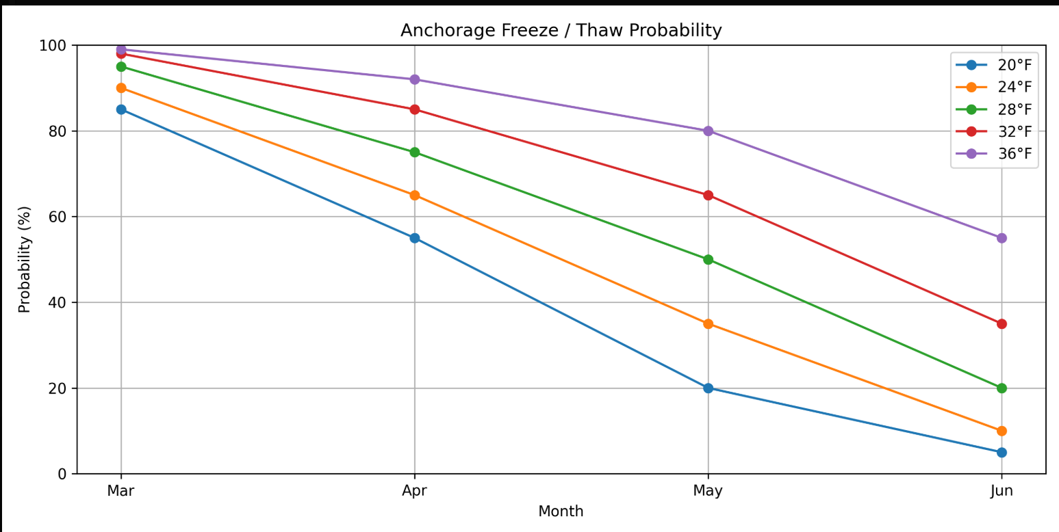
Anchorage Freeze / Thaw Probability
Notes:
Freeze Thaw Conditions Require Inspection. Stabilization measures need to be completed before freezing conditions. Spring breakup will cause big problems and violations if pre freeze stabilization practices are not implemented.

Slide 34
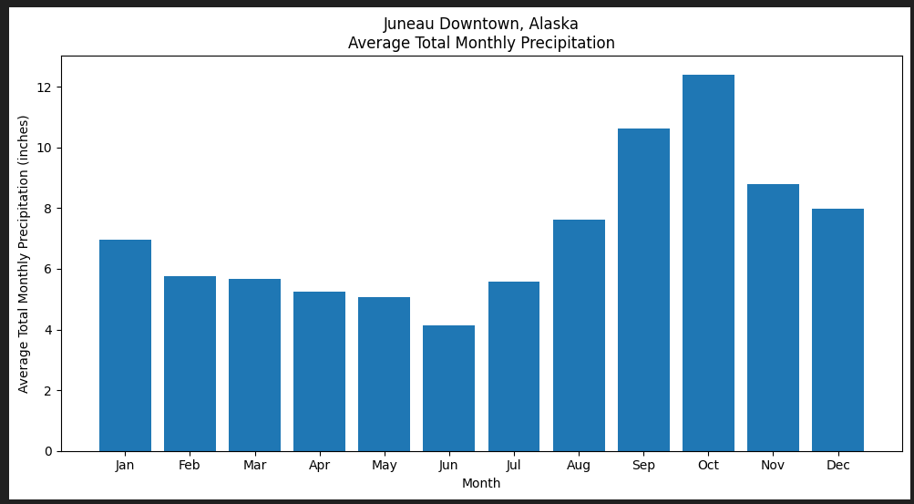
Rainfall Prediction for SWPPP
Notes:
So use the information in the SWPPP Review, preparation etc.

Slide 35
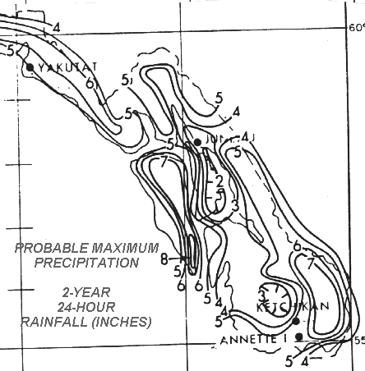
SE Alaska
2yr 24hr
2 to 8 inches
Source: NOAA

Slide 36
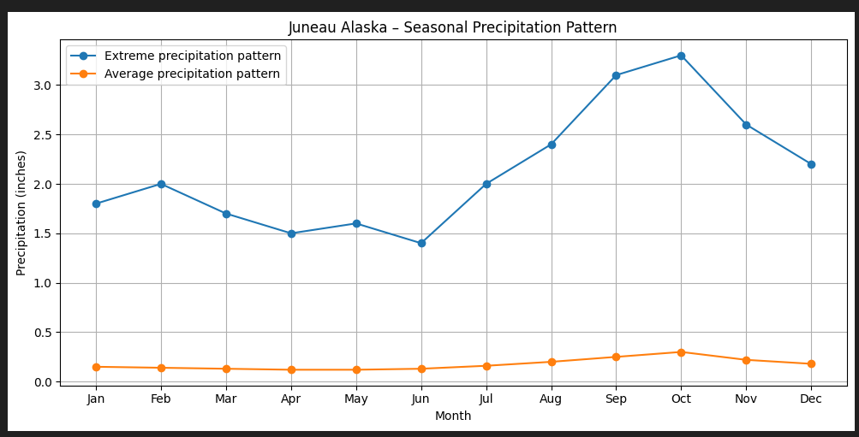
What are the Design Standards?
2 yr 24hr
2yr – 24 hrs
What are the Performance Goals?
Notes:
Ask Yourself

Slide 37
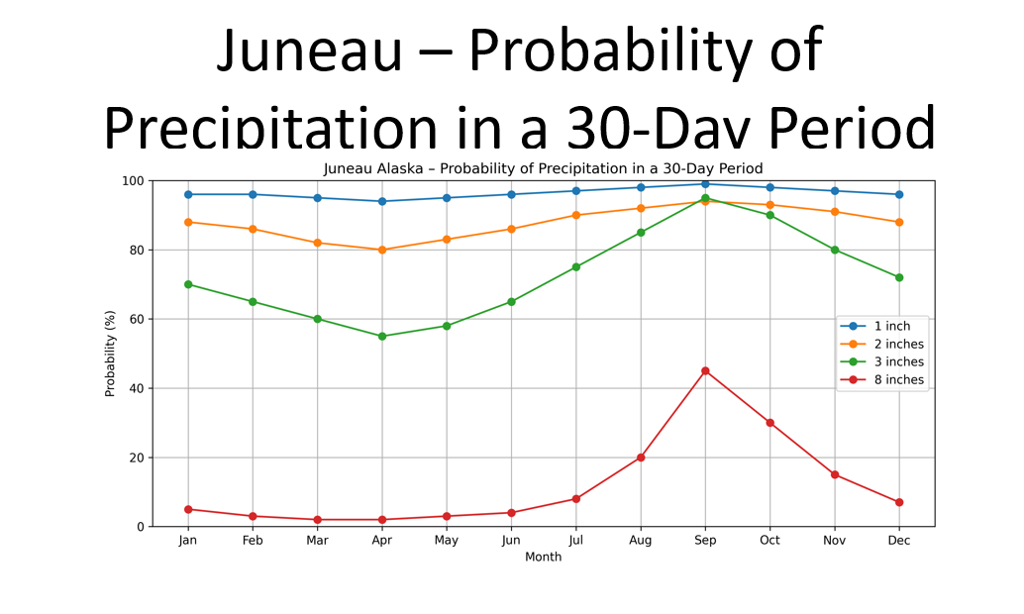
Prepare for the Inevitable
Juneau Airport 2yr 24 hr = 2.5 inches
Notes:
If we are to prepare for the inevitable what are the design standards?

Slide 38
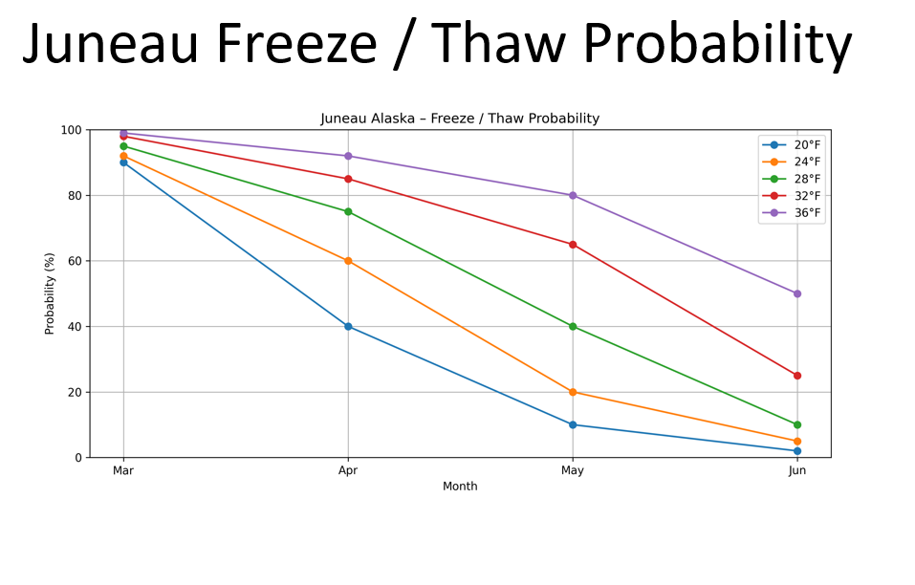
Juneau Freeze / Thaw Probability

Slide 39
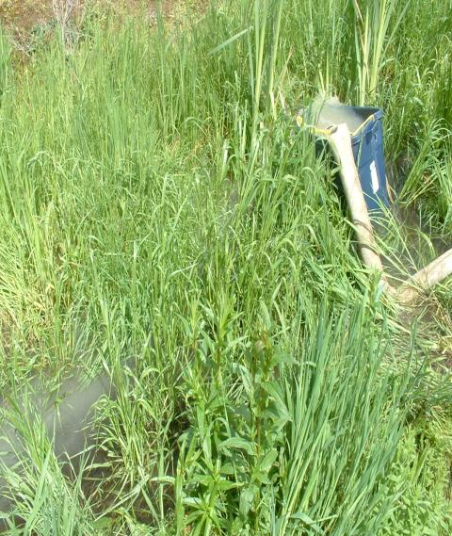
Benefits of Vegetation
Reduces Runoff Volume
Reduces Flow Velocity
Sediment Filtration
Energy Absorption
Pollution Reduction
Soil Retention

Slide 40

Photo by USDA - NRCS
Notes:
Erosion can be reduced by:
Limiting removal of existing vegetation
Decreasing duration of soil exposure to rain
Phasing clearing and grubbing
Preservation of existing vegetation on erodible soils, steep slopes, drainage ways, and stream banks.

Slide 41
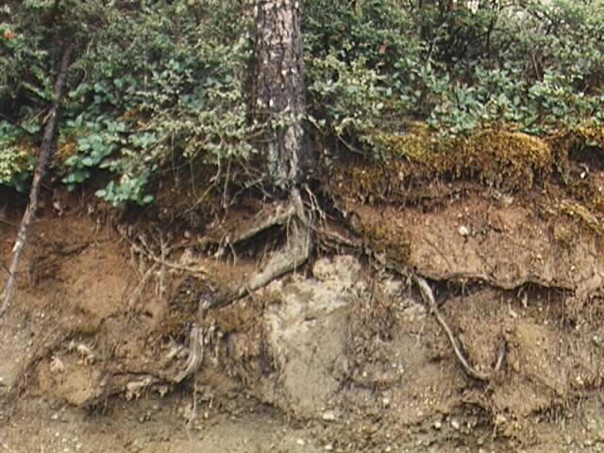
Trees
Shrubs
Moss
Duff
Roots

Slide 42
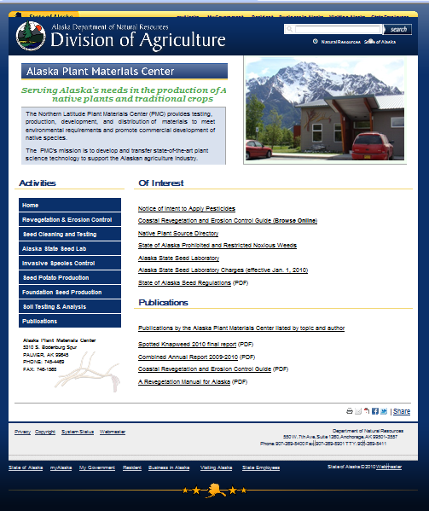
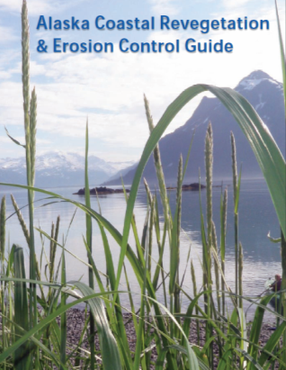
http://plants.alaska.gov/
Notes:
Select for success. Use the information for your unique area to help with seed selection and planting methods.

Slide 43
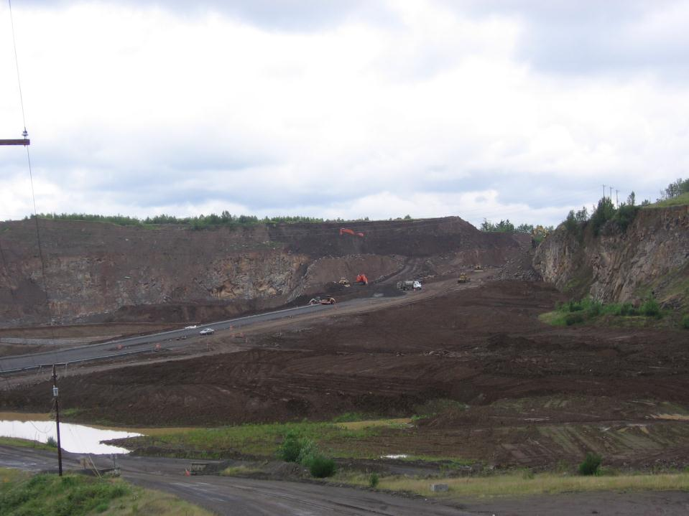
TOPOGRAPHY
Slope Length & Gradient
Doubling the slope length increases erosion potential by 4 times.
Doubling the slope gradient increases erosion potential by 5 times.
Notes:
Most of the good, easy ground is gone
How will your topography change during the life of your project?

Slide 44

Surface Area
Larger bare areas contribute larger volumes
& greater velocities of runoff
Notes:
How do the surface areas changes of my site affect erosion potential
What is the erosion potential for various soils and their condition? RUSLE

Slide 45


Slide 46

Factors that Influence Erosion
Precipitation
Basin Area
Slope Length
& Gradient
Vegetation
Soil Characterization
Surface Texture
= Erosion Losses
Notes:
Discuss the relationship between the factors and the site phasing. If we seed the slopes how much less risk will we have?

Slide 47




Revised Universal Soil Loss Equation (R.U.S.L.E.)
Erosion Risk Calculation Tool
A = R x K x LS x C x P
  A = Annual Rate of Erosion per unit area
  R = Rainfall Factor
  K = Soil Erodibility Factor
  LS = Slope Angle & Length Factor
  C = Soil Cover Factor
  P = Conservation Practices
default values for LS, C, P are all 1.0
Notes:
Technical, site specific tool for assessing risk of soil loss.

Slide 48

R.U.S.L.E. Example: Focus on Slope
What is the Difference in Potential Soil Loss Between 20% & 60% Slopes?
  20% Slope (10 degrees, 4:1) 100’ length, LS = 4.5
  60% Slope (30 degrees, 1 .5:1) 100’ length, LS = 9.4
60% 30 degrees
20% 10 degrees
Notes:
This is for demonstration and the math is approximate to illustrate the differences
Calculations using RUSLE demonstrate what site factors most affect risk, and by how much.

Slide 49

A = R x K x LS x C x P
SLOPE | A= | R | K | LS | C | P
20% 10 deg. 4:1 | 50 T/ac. | 40 | .28 (sandy loam) | 4.5 | 1.0 | 1.0
60% 30 deg. 1.5:1 | 106 T/ac. | 40 | .28 | 9.4 | 1.0 | 1.0
109% Increase in Soil Loss
Note: for straw mulch, “C” factor is 0.2- how will that affect soil loss?
Notes:
Increasing slope from 10 to 30 degrees increases soil loss 109%. Protecting soil with straw mulch will reduce soil loss from 105.5 Tons per acre to 21- a reduction of 80%

Slide 50

Cover Factors C
Will vary with the soil type
RECPs 0.10 – 0.25
Straw Mulch (must stay) 0.18 – 0.24
Good Hydromulch & Tack 0.1
BFM 0.02
How long will the BMP last?

Slide 51
A = R x K x LS x C x P
SLOPE | A= | R | K | LS | C | P
20% 10 deg. 4:1 | 50 T/ac. | 40 | .28 (sandy loam) | 4.5 | 1.0 | 1.0
60% 30 deg. 1.5:1 | 21 T/ac. | 40 | .28 | 9.4 | 0.2 | 1.0
Note: for straw mulch, “C” factor is 0.2- how will that affect soil loss?
Notes:
Increasing slope from 10 to 30 degrees increases soil loss 109%. Protecting soil with straw mulch will reduce soil loss from 105.5 Tons per acre to 21- a reduction of 80%
Take away message RUSLE helps us understand that if we increase the slope then we need to apply some slope treatment, in this case straw mulch, to maintain or reduce the soil loss. An easy rule of thumb
Doubling the slope length increases erosion potential by 4 times
Doubling the slope gradient increases erosion potential by 5 times

Slide 52

Location
Location
Location
Notes:
So… if your next job is a dead end on the corner of edge cliff way & water street, you might need some extra planning.

Slide 53

Erosion Risk
Assessment
How much risk does your site pose?
Consider:
Soil type- above and below the surface
Climate- frequency, intensity, and duration of rainfall
Vegetation
Surface Area
Slope Length & Gradient
Surface Texture

