Slide 1
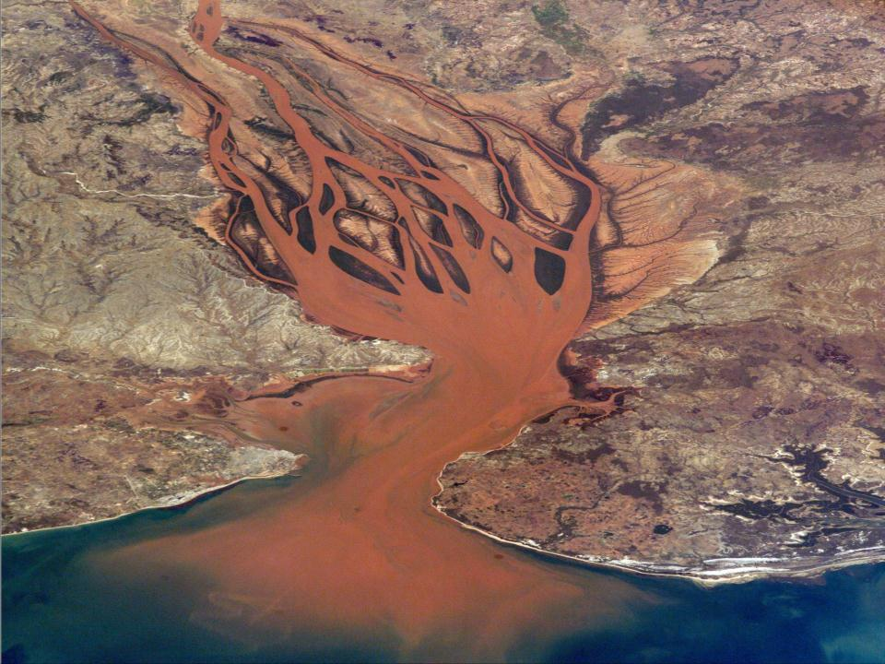
EROSION & SEDIMENTATION PROCESSES
Photo by NASA
Notes:
The smaller the particle the farther away it goes.
That’s why the boulder was in the road.

Slide 2
Erosion and Sedimentation Processes
Goal of this section:
Learn the definitions and effects of the different types of erosion:
  Types of Water Erosion
  Types of Wind Erosion

Slide 3
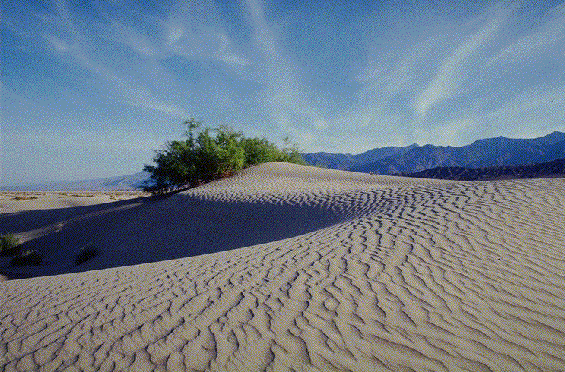
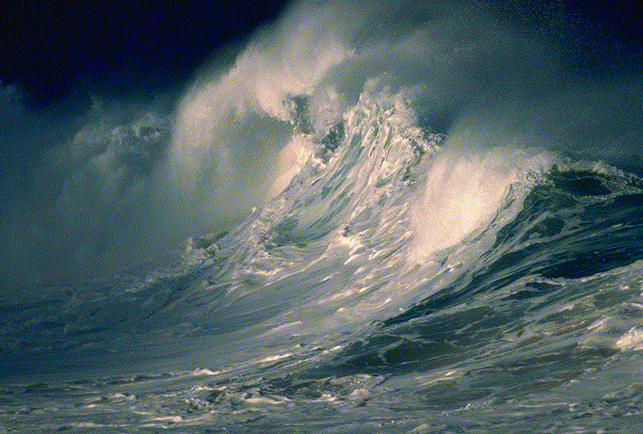
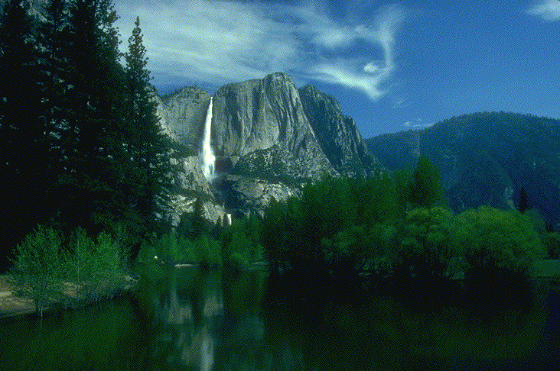
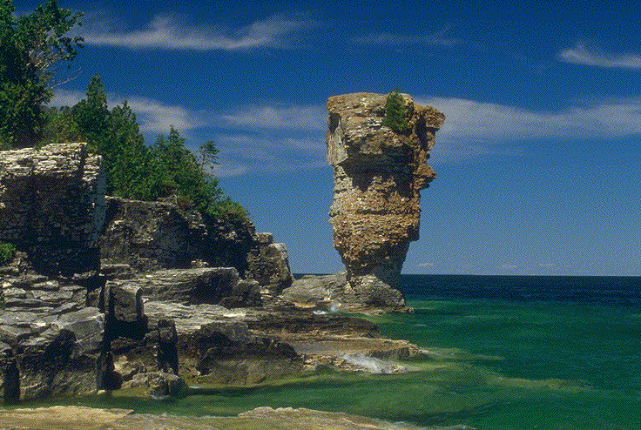
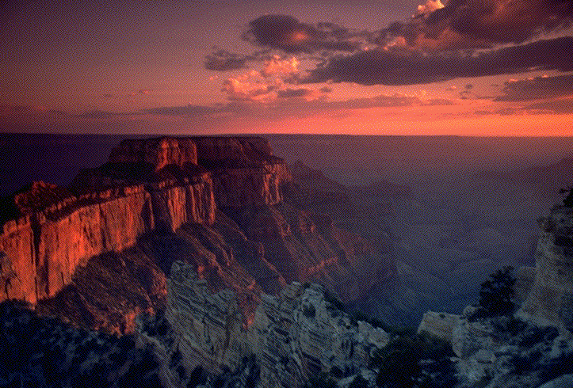
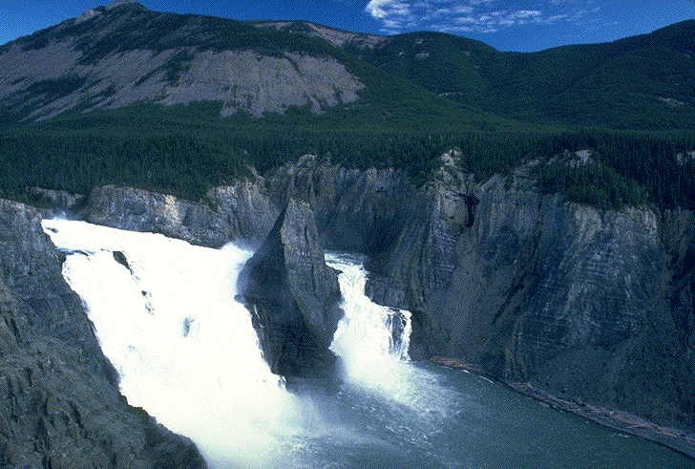
SOIL EROSION – Is the process of wearing away of the land surface by water, wind, ice, gravity or other geologic agents.
Modified Courtesy Florida DEP
Notes:
Starting out in a very definitive manner, Erosion is defined as the removal and loss of soil by the action of water, gravity or wind. For this course, we will primarily be looking at water erosion during land disturbing activities.

Slide 4
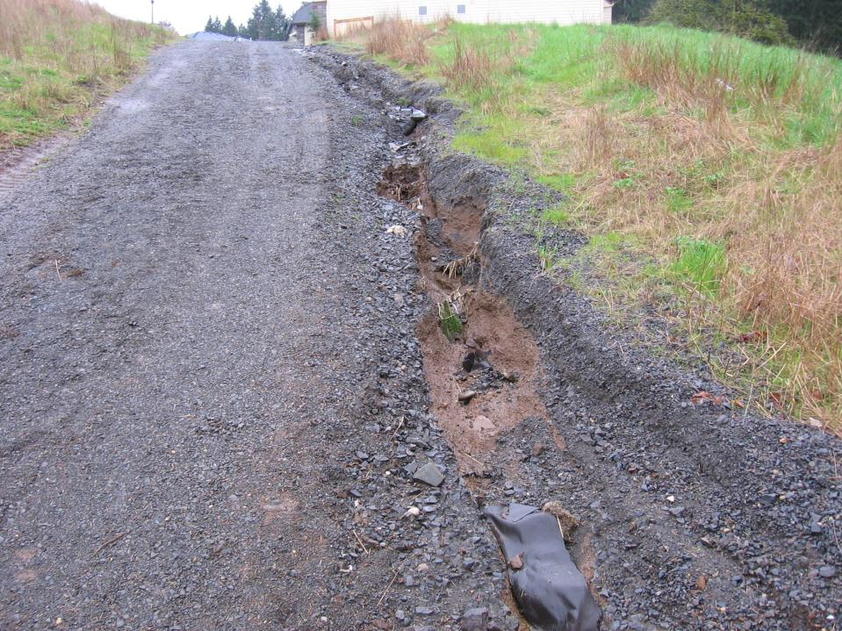
Construction Site Erosion
Notes:
Construction Site Erosion is another animal. We alter the water courses, historical flow volumes and travel paths, etc….
The nature of construction is to channel water to some of the least resistant to the erosion processes. We build new gutters on the planet.

Slide 5
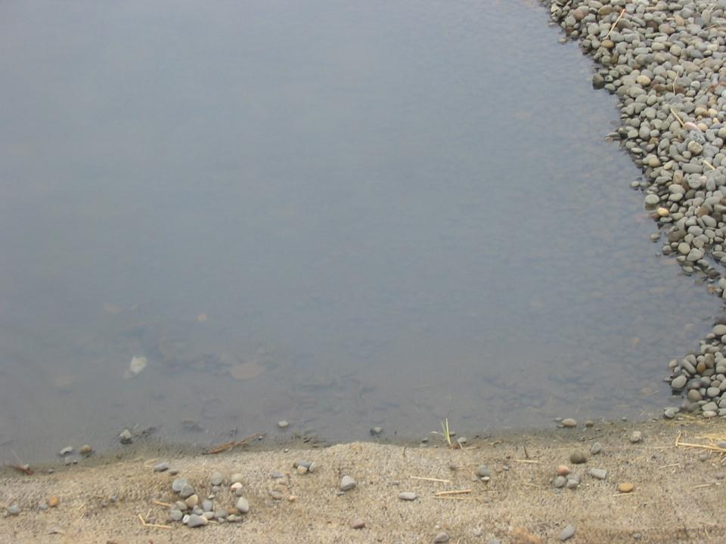
Erosion - The process of wearing away the land surface by water, wind, ice, gravity, or other geologic agents.
Sediment - Eroded material that is suspended in water or wind
Sedimentation - The deposition or settling of eroded material
Turbidity - The measure of the relative clarity of a liquid ( muddiness )
  *Measured in NTU’s or Transparency

Slide 6
Types of Erosion
Raindrop – Movement of soil particles caused by the direct impact of raindrops on bare soil.
Sheet – Runoff which flows over the ground surface as a think, even layer.
Rill – A small, intermittent water course with steep sides, usually only a few inches deep.
Gully – A channel caused by concentrated flow of surface and stormwater runoff over unprotected, erodible soil.
Stream & Channel Bank – Bank and bed erosion of existing stream channel caused by increased peak flows.
Notes:
The last three, Rill, Gully, and Stream/Channel are really degrees of the same process. More volume in less time in the same area.

Slide 7
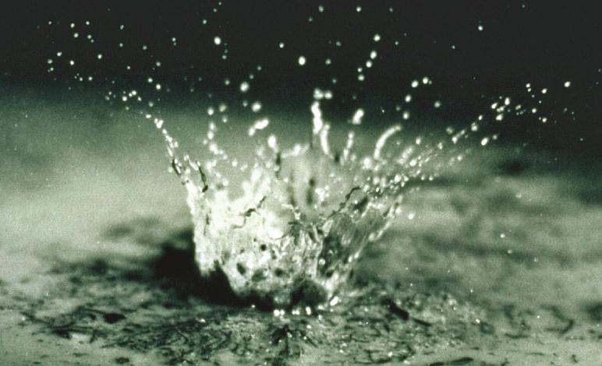
Raindrop Impact Erosion
Notes:
Raindrops falling on exposed areas will detach soil particles to be suspended in runoff water – it can reach 30mph & their impacts are like small bombs dislodging soil particles
Rain may move soil directly: this is known as 'splash erosion'.

Slide 8
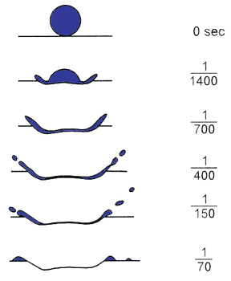
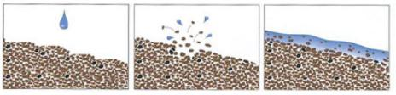
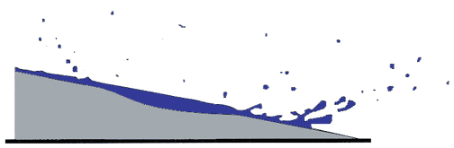
Raindrop Impact
Surfaces become “puddled”
Lower infiltration rates
Increased runoff
= Increased Turbidity
Source: Environmental Soil Physics, Hillel

Slide 9
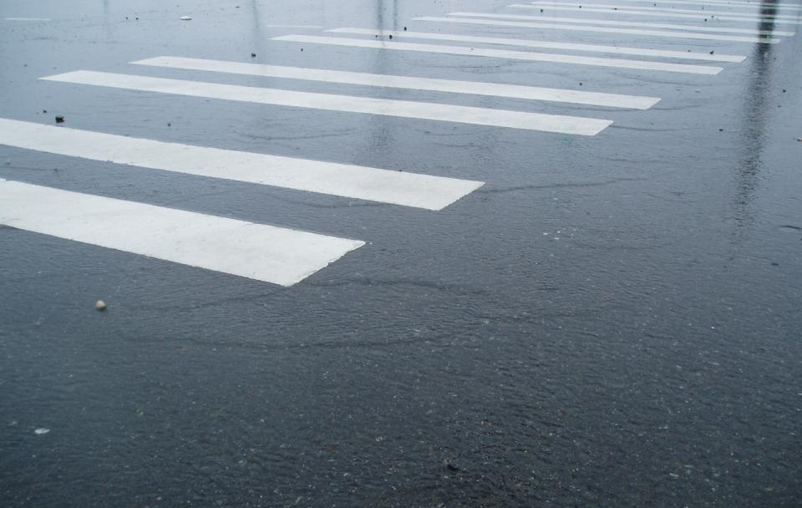
Sheet Flow Erosion
Sheet flow is easy to see on pavement
Notes:
While thin and seemingly insignificant sheet flow has potential energy and can cause erosion.

Slide 10
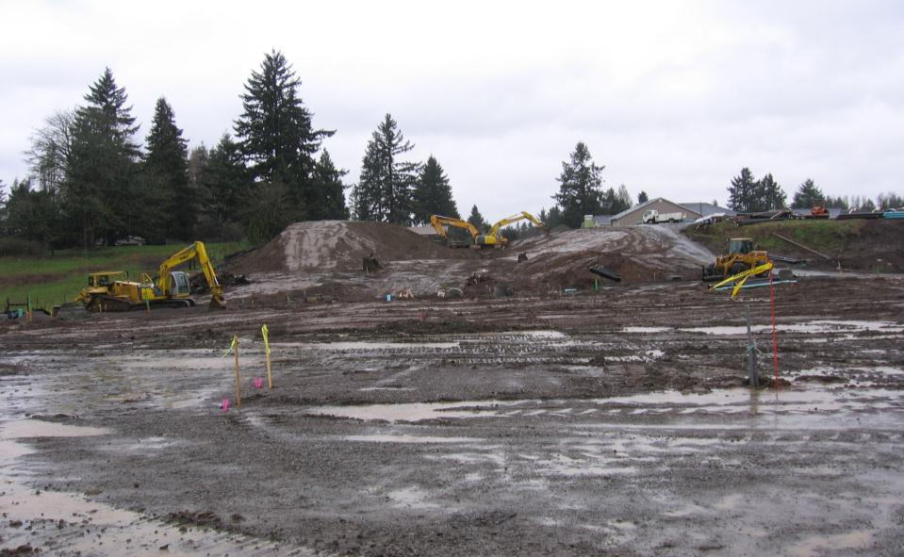
“Shiny” Dirt is Sheet Flow
Notes:
On construction site sheet erosion turns to rill quickly
It gathers in a depression, rut, windrow etc and concentrates. Now we have so real energy and erosive potential.

Slide 11
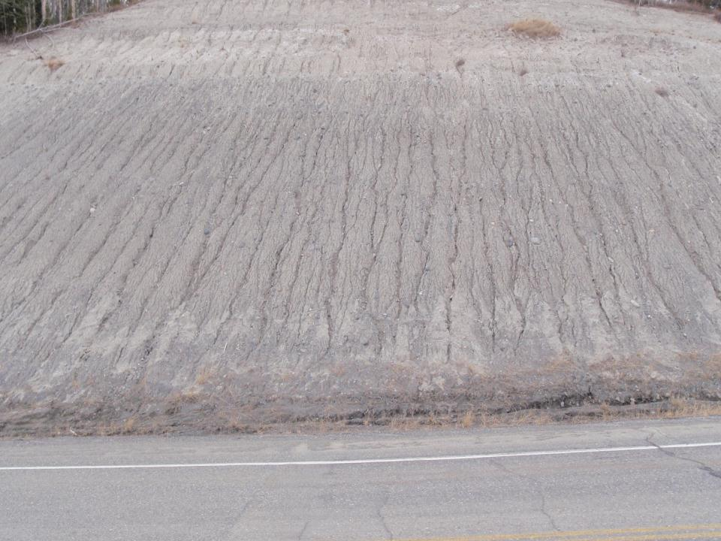
RILL EROSION ON A CUT SLOPE

Slide 12
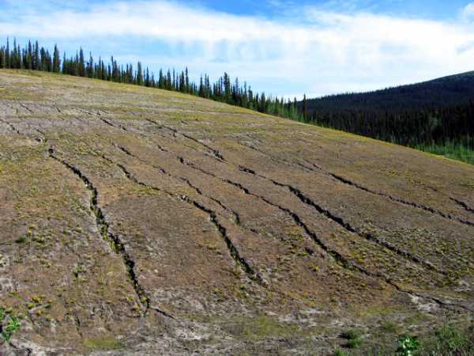
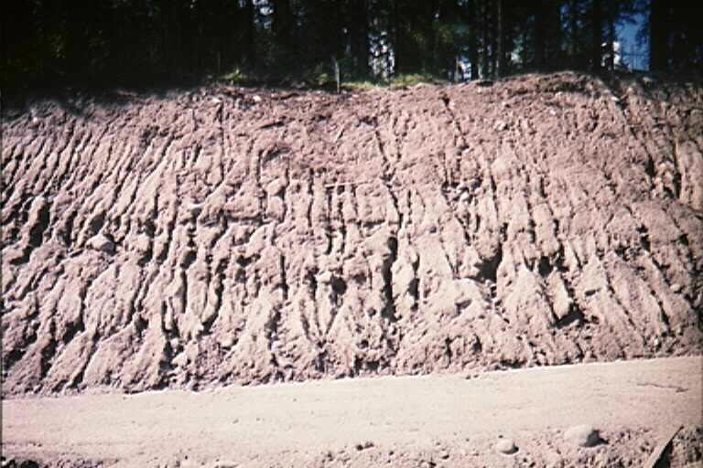
Rills turning into Gullies
Notes:
What will be required to fix this?
What could have been done to prevent it?

Slide 13
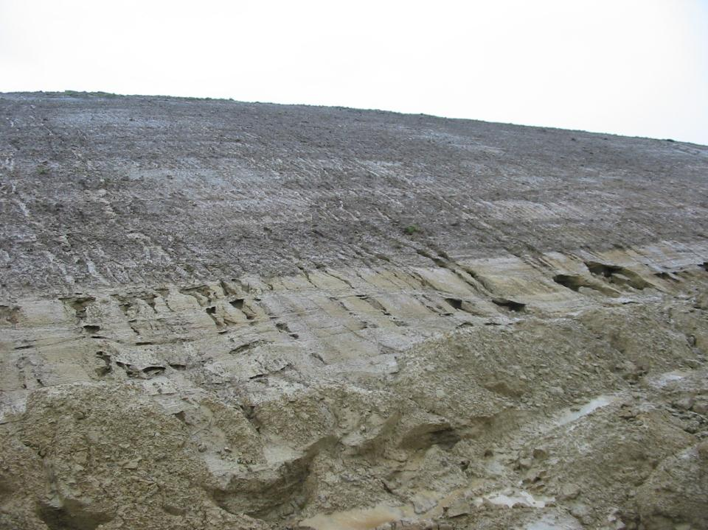
Effects of
Soil Change
& Improper Tracking
Rill Erosion
Gully Erosion
Notes:
The tracking, if done across the slope, can increase the rill erosion, different soils erode at different rates.

Slide 14
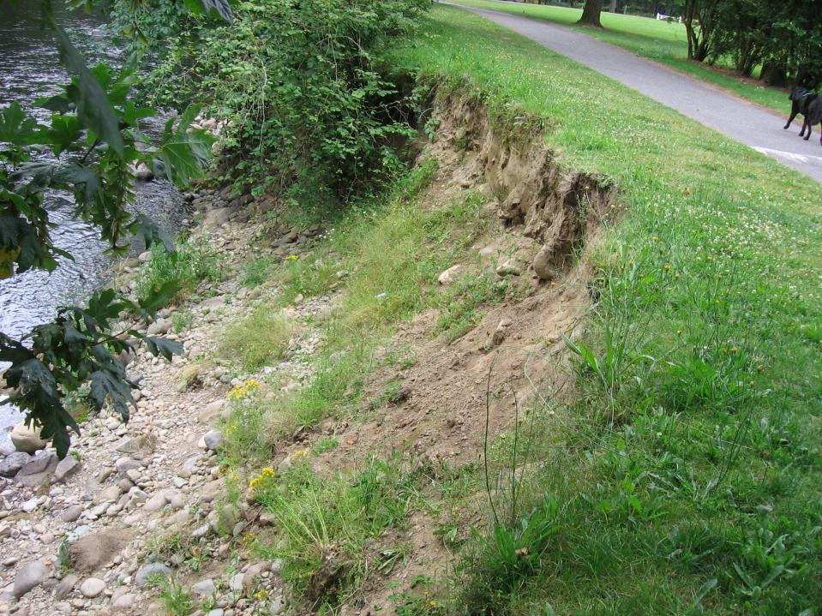
Streambank Erosion
Notes:
The increased flows from development and construction sites have cumulative effects on streams far away.

Slide 15
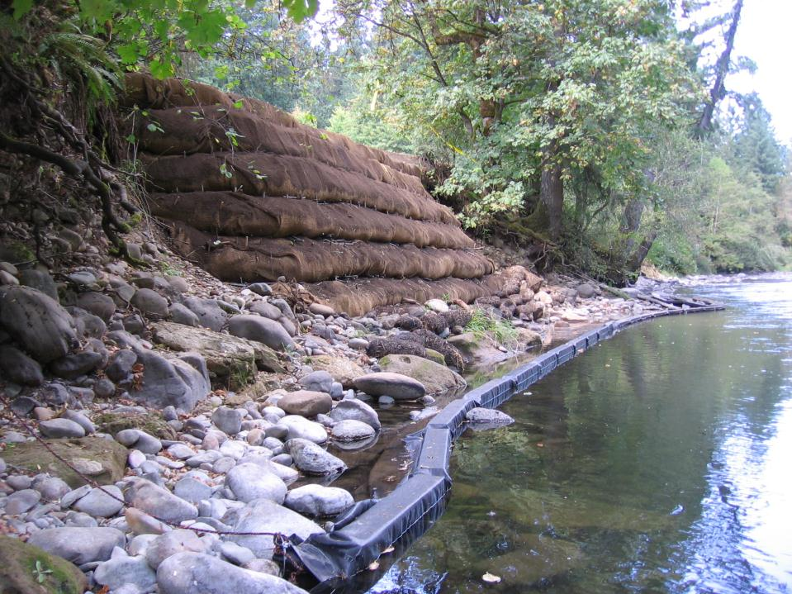
Efforts to Correct
the Problems
$$$$$$$
Notes:
Most repairs that need to be done are looking for funding.
Will you be funding the next streambank repair project?

Slide 16
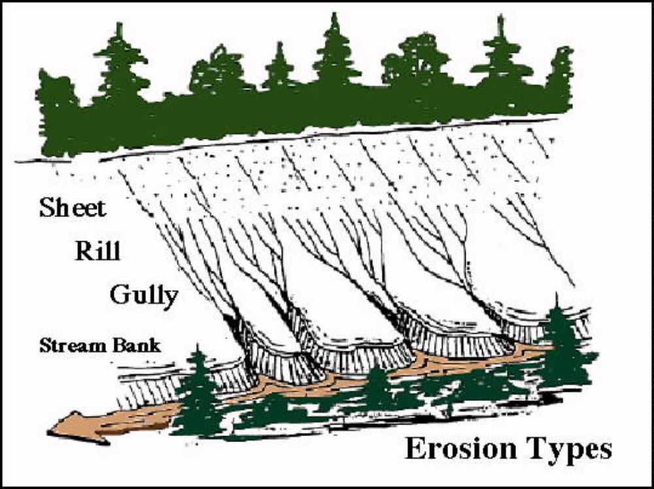

Raindrop

Slide 17
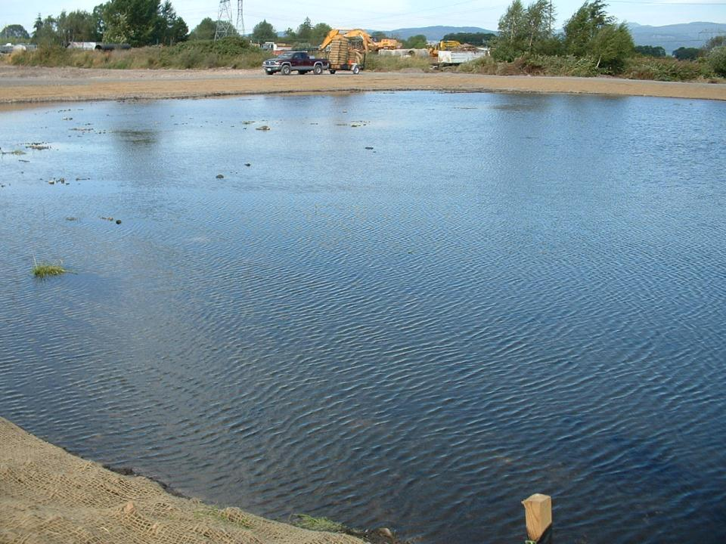
Bed Load - Soil particles that are dragged, rolled, skipped, or saltated
Suspension - Soil particles that are lifted up by the flow energy and moved long distances down stream before settling to the bed
Colloidal Suspension - Same as suspension but includes only the fine, colloidal soil particles that may never settle to the bed
Notes:
Sediment behaves the same in all moving water, the smaller the particle, the farther it will travel.

Slide 18
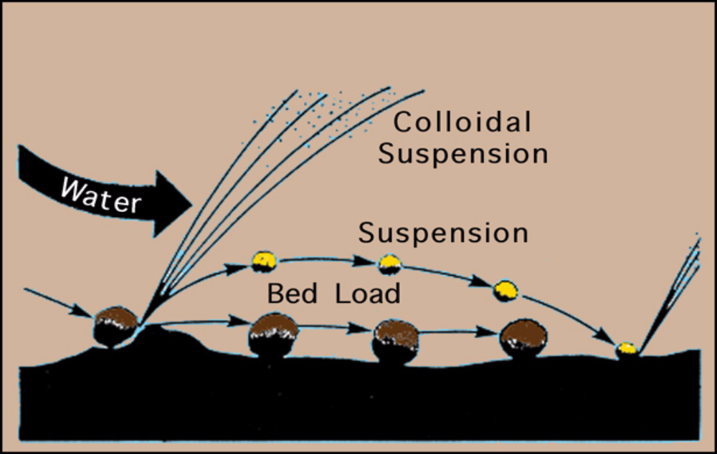
Water Erosion
Notes:
Studies have shown that rain drops can throw soil particles as much as five feet horizontally and two feet vertically.

Slide 19
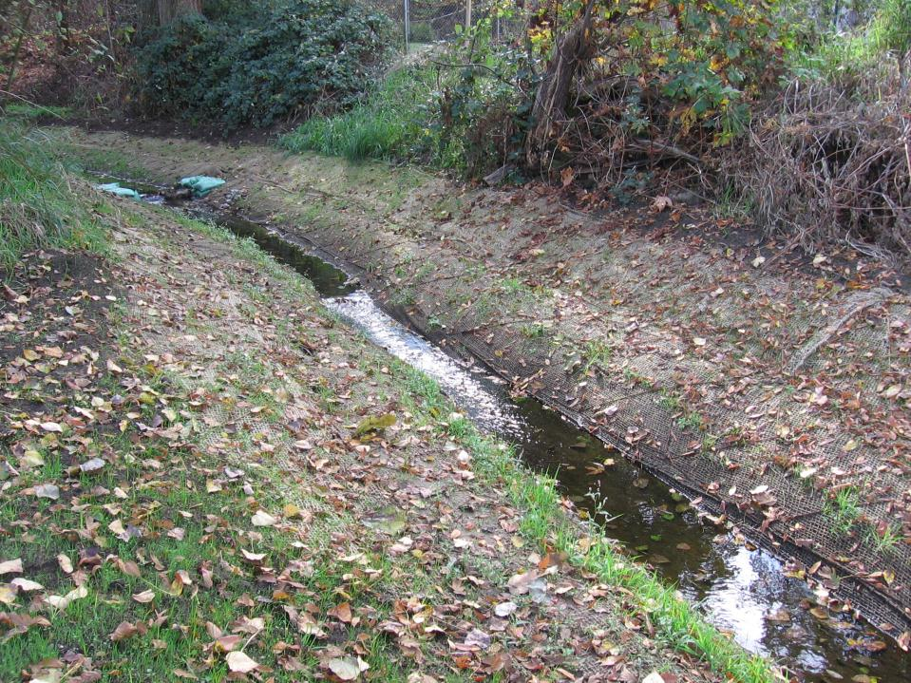
Stream Bank After Mitigation

Slide 20
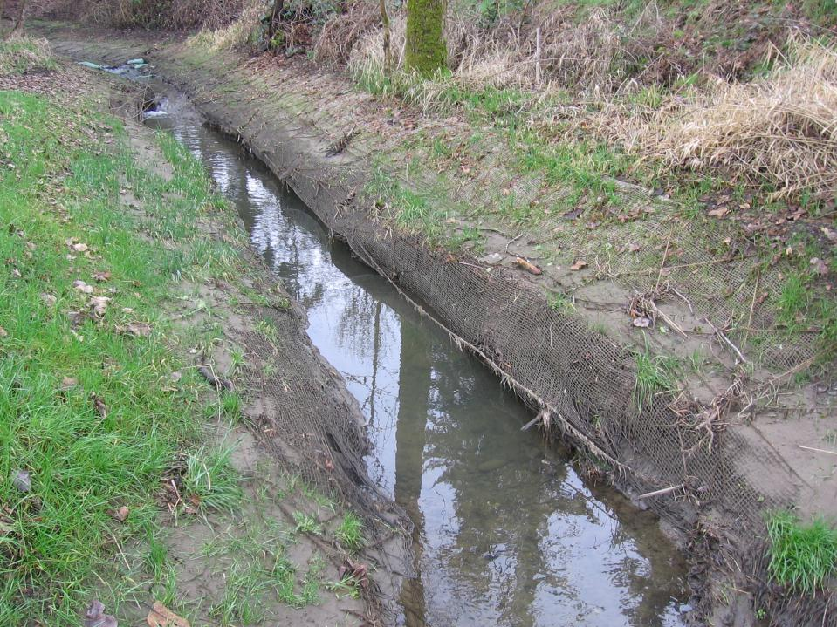
Mitigation After Heavy Flows Created Stream Bank Erosion
Notes:
The stakes are hanging in the air - where did the soil go?

Slide 21
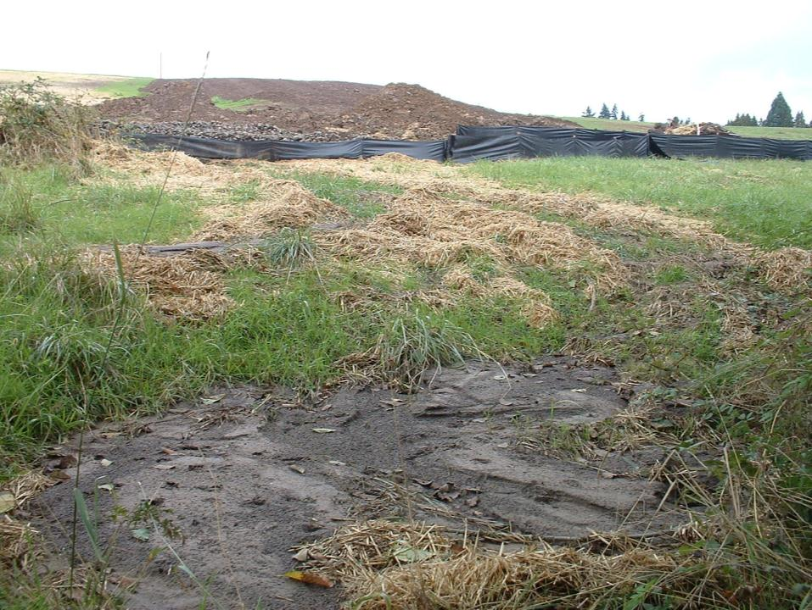
Sedimentation
Notes:
Soil that washes away is deposited somewhere.
It costs someone something.
The smaller it is the further it goes.

Slide 22
    Surface Area Requirements of Sediment Traps
Size mm | Particle | Settling Velocity ft/sec | Settling Velocity m/sec | Surface Area ft.² per ft³/sec discharge | Surface Area m² per m³/sec discharge
0.5 | Coarse sand | 0.19 | 0.058 | 6.3 | 20.7
0.2 | Medium sand | 0.067 | 0.020 | 17.9 | 58.7
0.1 | Fine sand | 0.023 | 0.0070 | 52.2 | 171.0
0.05 | Coarse silt | 0.0062 | 0.0019 | 193.6 | 635.0
0.02 | Medium silt | 0.00096 | 0.00029 | 1250.0 | 4101.0
0.01 | Fine silt | 0.00024 | 0.000073 | 5000.0 | 16404.0
0.005 | Clay | 0.00006 | 0.000018 | 20000.0 | 65617.0
Fine Silt
will only
fall out
slowly,
very slowly.
1 CFS =
450GPM
For every
450 GPM
You need
5000SF of
pond surface
to settle
fine silt.
*Pore Size of Silt Fence. The smaller the particle, the bigger
the settling basin. Will it fit in your ROW?
Notes:
The problem with settling out suspended sediments, do you have enough space to get gravity deposition?

Slide 23
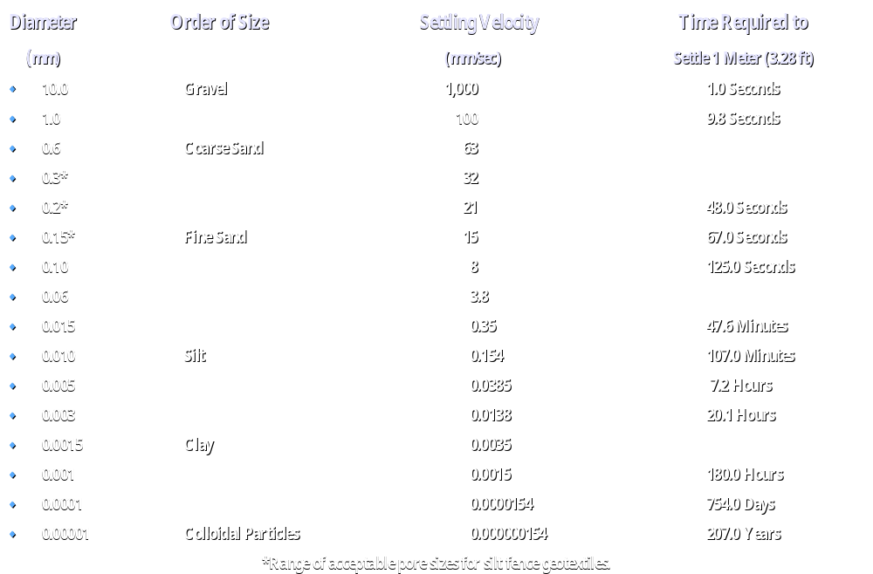
SOIL PARTICLE SETTLING TIME

Slide 24
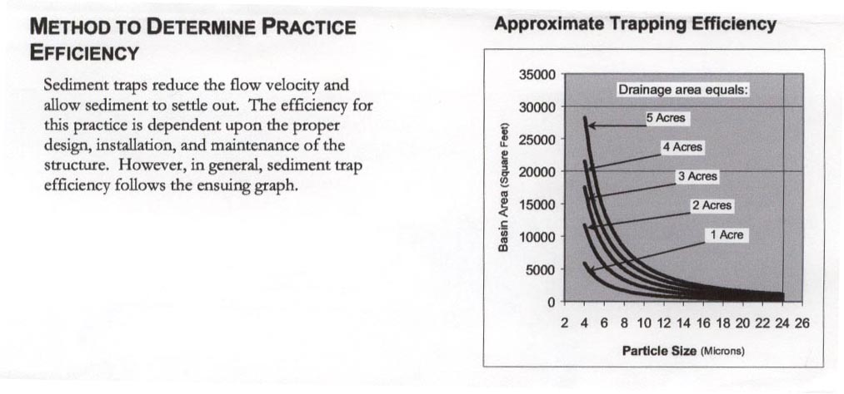
4 acres needs
½ Acre of pond
for 4 micron
particles
Notes:
For 5 acres you would need over ½ acre of pond, that’s only for 4 micron particles

Slide 25
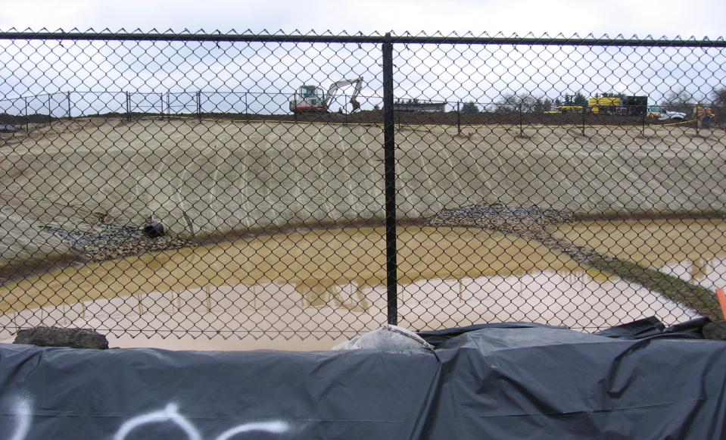
It is Difficult to Treat Fine Silts & Clays Suspended in Water
Notes:
When your soil is full of fines expect pond inefficiency

Slide 26
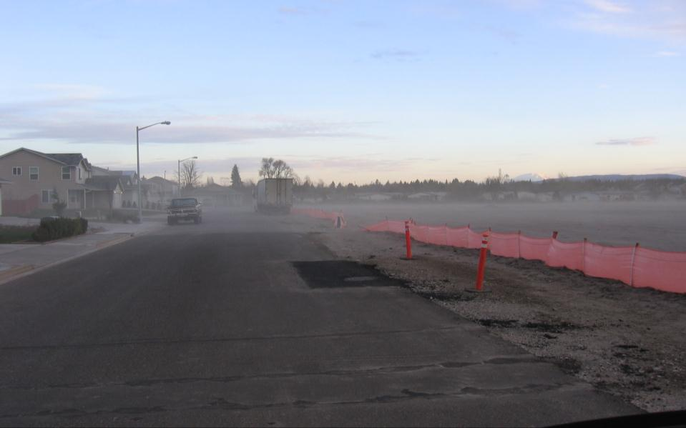
Wind Erosion
Notes:
This sand site is coating the neighborhood in a layer of blow sand.
How do you clean this up? What will it cost?

Slide 27
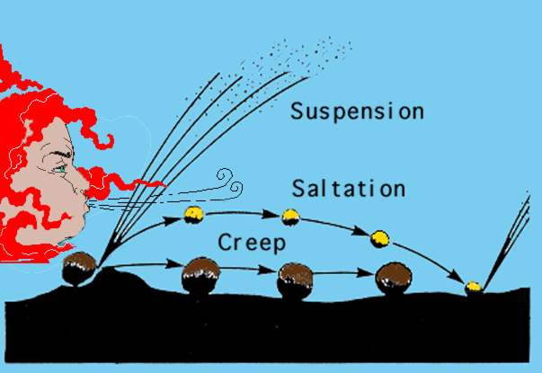
Wind Erosion
Notes:
As with water-borne sediment, the larger the particle the more energy it takes to get it airborne. The larger particles “creep along the soil surface and rarely become airborne. Smaller particles bounce along, sometimes airborne, then hitting the ground, then moving in the air stream. The saltating particles rarely travel above 3 to 4 feet from the ground surface.
Small particles become entrained in the wind very easily and may remain in the air for hours or days.

Slide 28
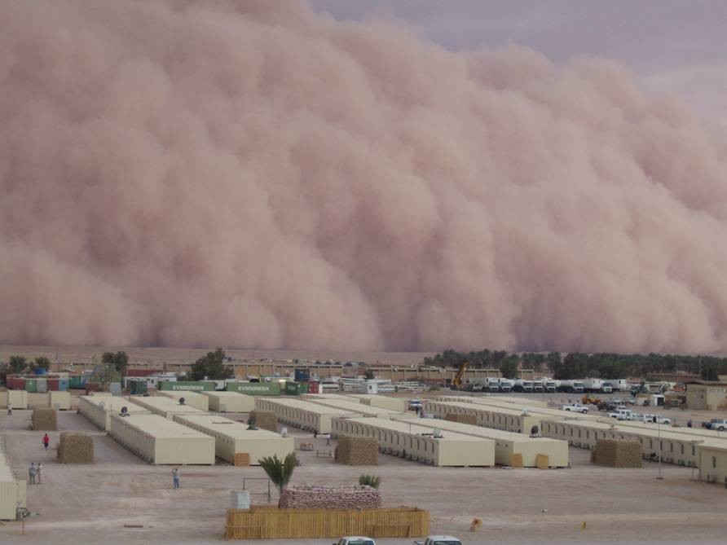
Notes:
Would you believe there are only three excavators at work laying pipe on the other side of the cloud?
That is the public perception of some construction activities.

