Slide 1
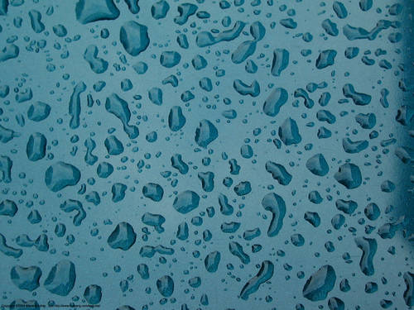
ALASKA CERTIFIED
EROSION & SEDIMENT
CONTROL LEAD
TRAINING
AK-CESCL
INSTRUCTOR:
Copyright
Alaska Stormwater Steering Committee & Creative Courses
Notes:
Emergency Exits – Bathrooms – Cell Phones
Breaks – Lunch
Sponsors

Slide 2
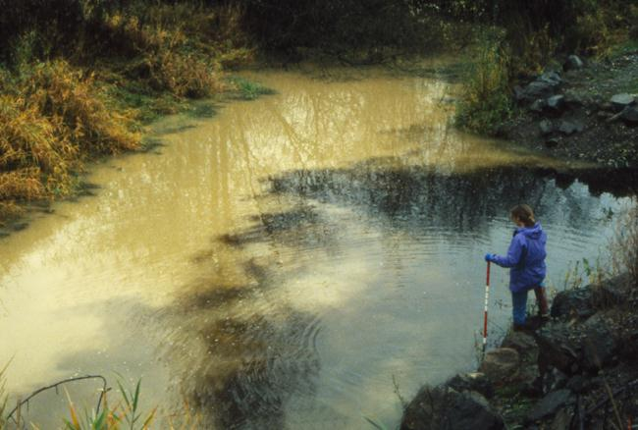
COURSE OBJECTIVES
Assess and manage risks of erosion and sedimentation on construction sites
Obtain and comply with the APDES general permit for construction activities
Plan, install, monitor and maintain BMPs that comply with the Clean Water Act, EPA, & ADEC
AK-CESCL certification with passing test score
Notes:
Learn from each other, interactive learning process.

Slide 3
What We’ll Cover:
1. Erosion and Sedimentation Impacts
2. Erosion & Sedimentation Processes
3. Factors that Influence Erosion
4. Regulations
5. SWPPP Introduction
6. Alaska Permit Requirements - Erosion
7. Requirements - Sediment
8. Requirements - Good Housekeeping
9. Inspections
Notes:
All through the day we will have opportunities to talk about the pictures, please ask questions

Slide 4
Training Workbook
For use as a reference later on
Contains text of most slides
If you want a copy of the actual slides, download from: ak-cescl.com
see Course Materials

Slide 5
Is your name spelled correctly on the sign-in sheet?
If there is an error, you must correct it with the training sponsor prior to the end of class.

Slide 6
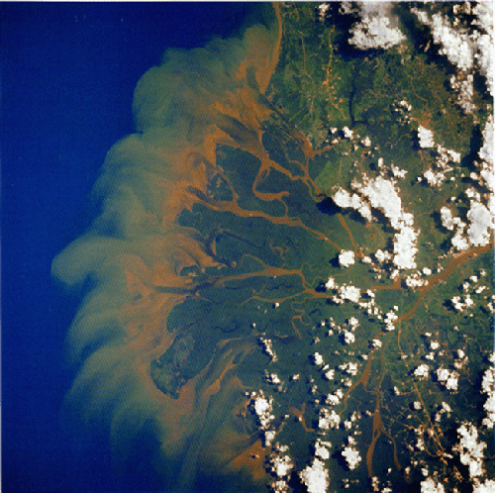
Erosion & Sedimentation Impacts
View from Space
Photo Courtesy: NASA
Notes:
Keep in mind it all goes somewhere, the smaller the soil particle the farther it goes

Slide 7
1. Erosion and Sedimentation Impacts
Goal of this section:
Understand the impacts and consequences of construction site erosion:
Schedule changes
Additional costs
Fish and aquatic environment impacts
Cleanup and mitigation

Slide 8
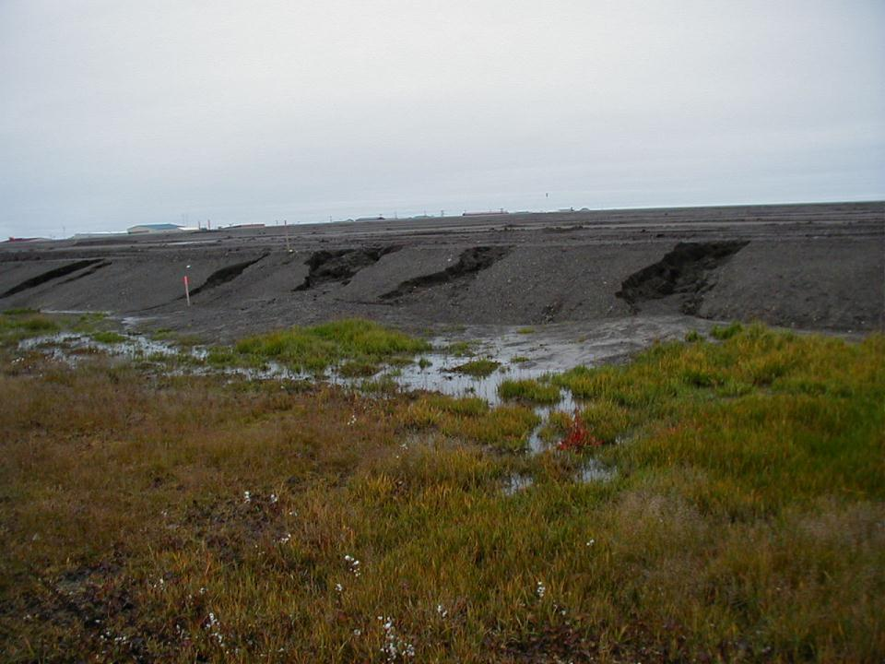
Our focus will be construction site erosion
& Impacts to the Environment, Production, & Profitability
Barrow, AK
Notes:
Who will fix it? Does this cost someone money?

Slide 9
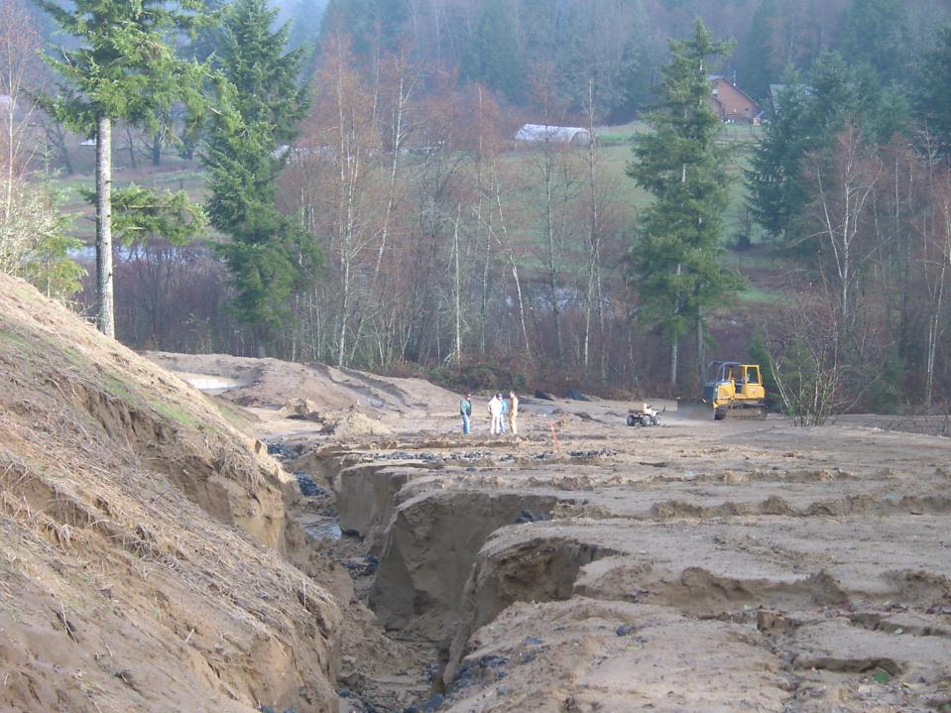
Extreme Impacts to Construction Sites
Have extreme costs!
Environmental
Production
Profitability
Photo Courtesy WADOE
Notes:
This is definitely going to cost someone some money.

Slide 10
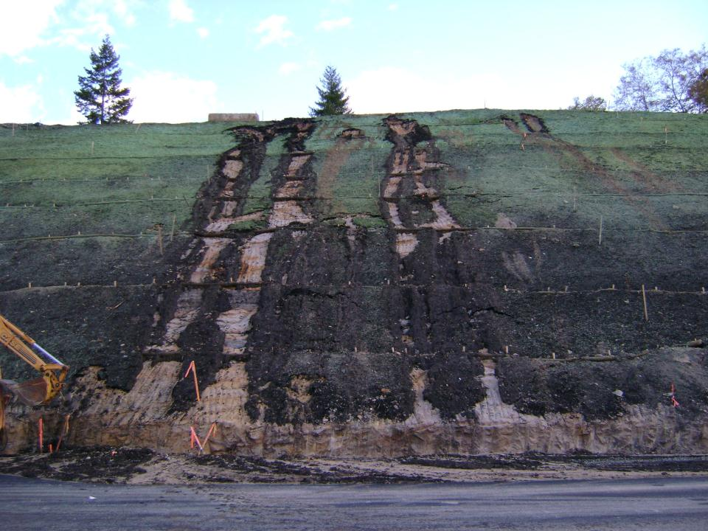
Impacts to Schedule

Slide 11
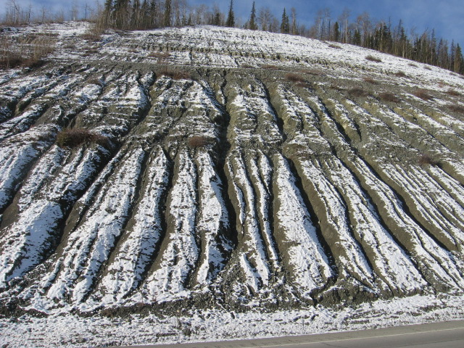
Erosion is the same everywhere.
Just different, depending on the soils.

Slide 12
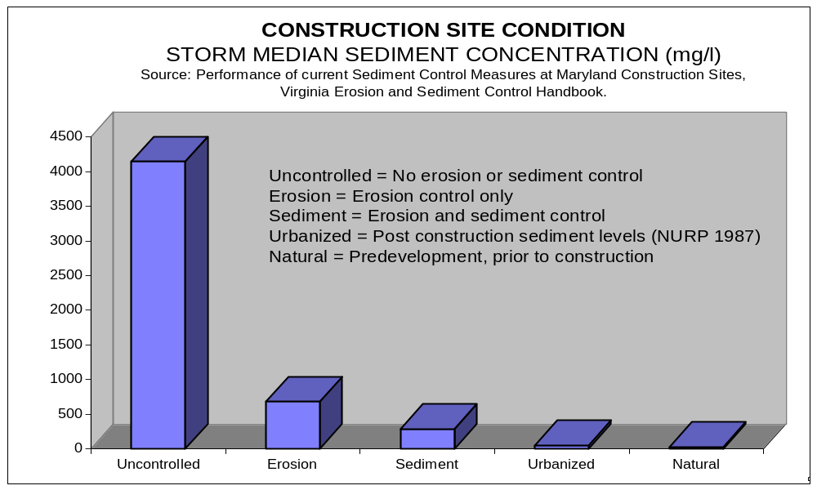
Why is this Erosion Control
Stuff such a Big Deal?
Notes:
Studies have consistently shown that construction is a huge sediment contributor
The silts and clays that erode from sites are perfect carriers fro other pollutants i.e.. Heavy metals, Phosphorus, etc.

Slide 13
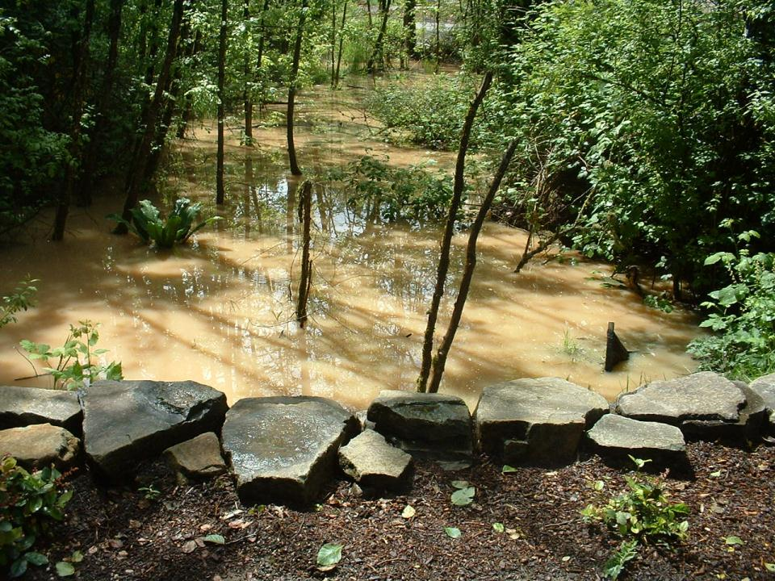
Wetland Filled With 8+ inches of Sediment from Construction Activity
Notes:
Uncontrolled erosion & runoff crossed the road and filled this wetland along a nature trail

Slide 14
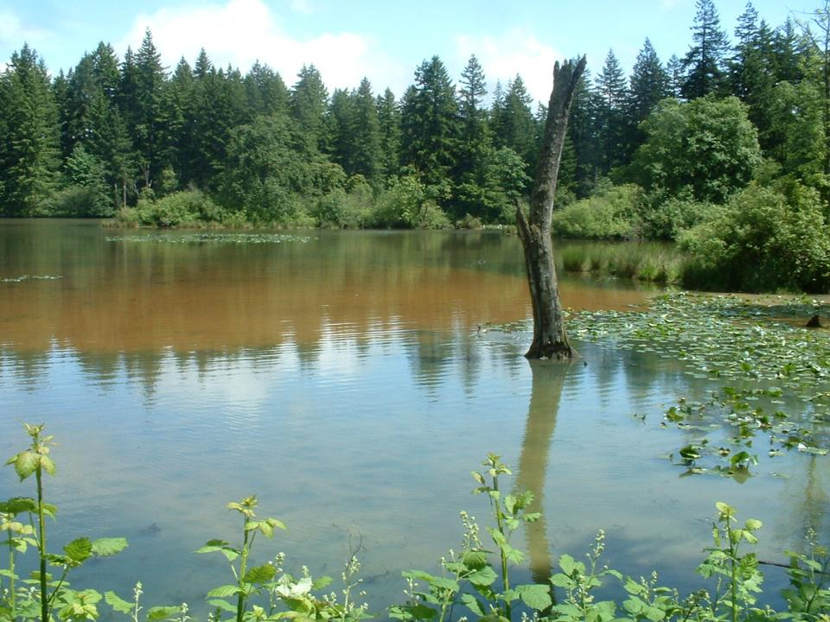
Sediment Plume from Construction Site - $$$$ & Stop Work Order
Notes:
The wetland discharged to this lake, DOE Fine

Slide 15
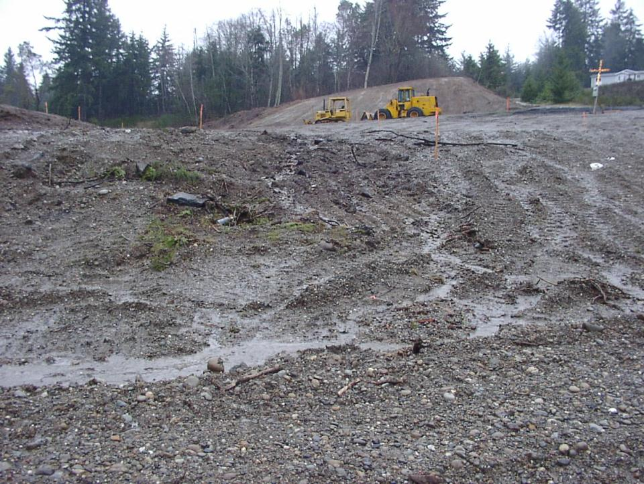
Sediment Plumes Come from Construction Sites Like this
Notes:
Landscape has been completely denuded with no BMPs anywhere on site

Slide 16
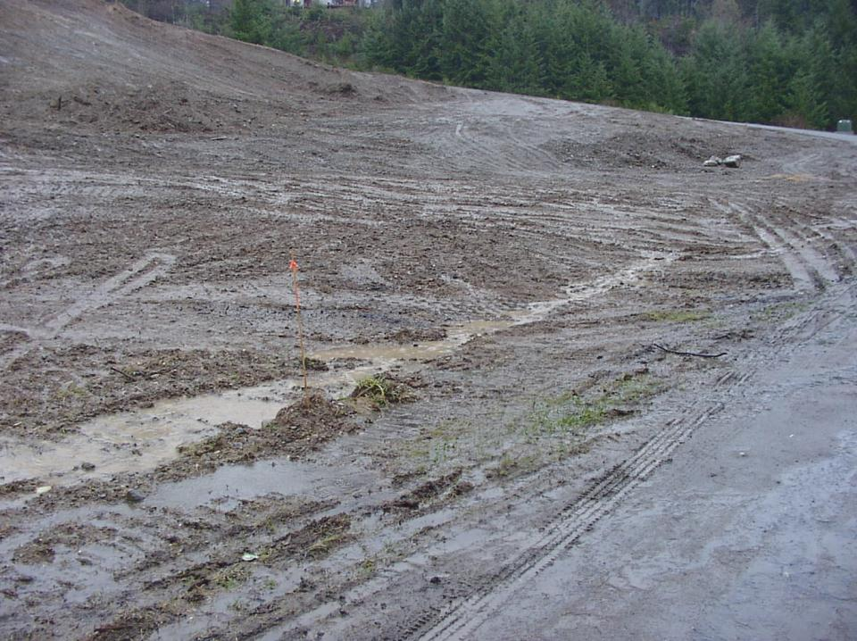
Notes:
At bottom of slope rills turn into channels of flowing water

Slide 17
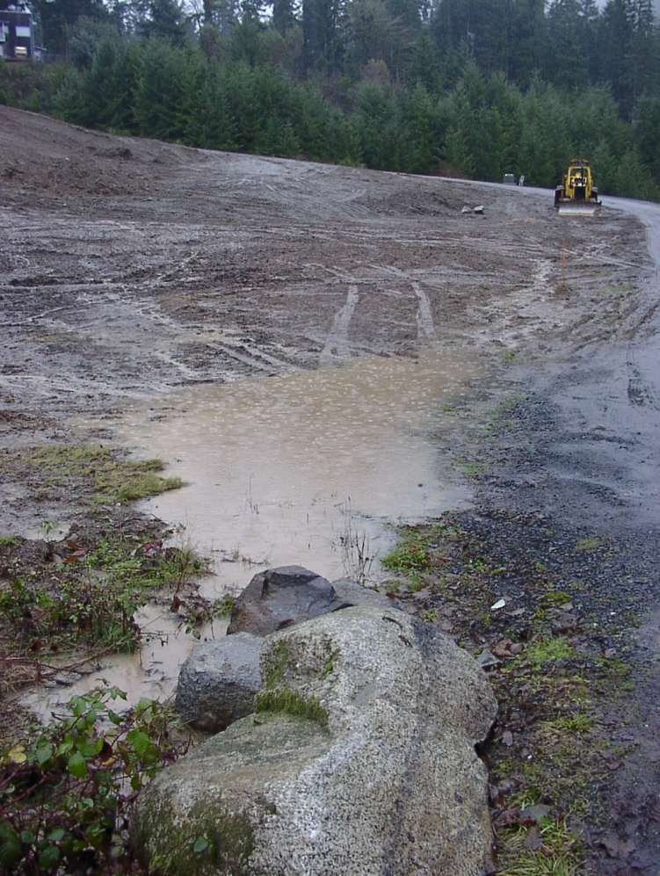
Notes:
Silty water flows into a culvert underneath rock and the road

Slide 18
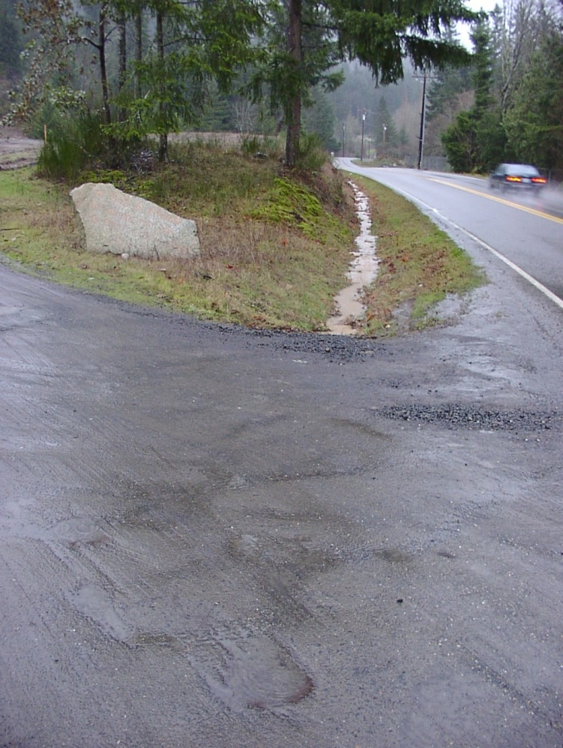
Notes:
Here the silty stormwater flows off of the construction site into a ditch – which is considered US waters – and eventually into the neighborhood ecosystem downslope

Slide 19
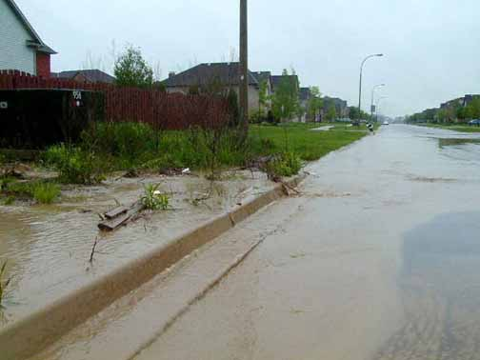
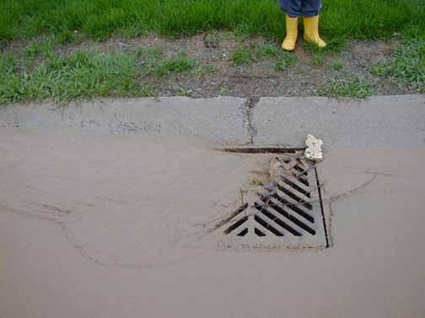
Where Will Sediment
From Your Site Go?

Slide 20
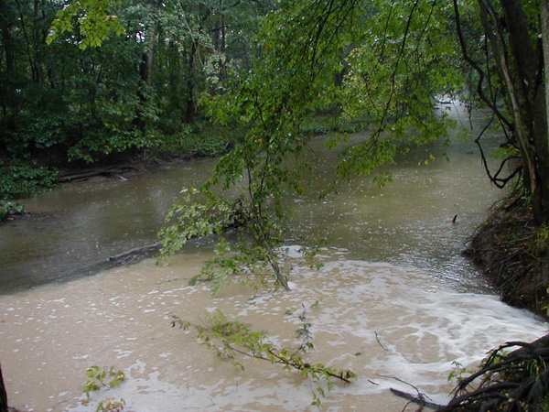
Turbidity in Stream

Slide 21
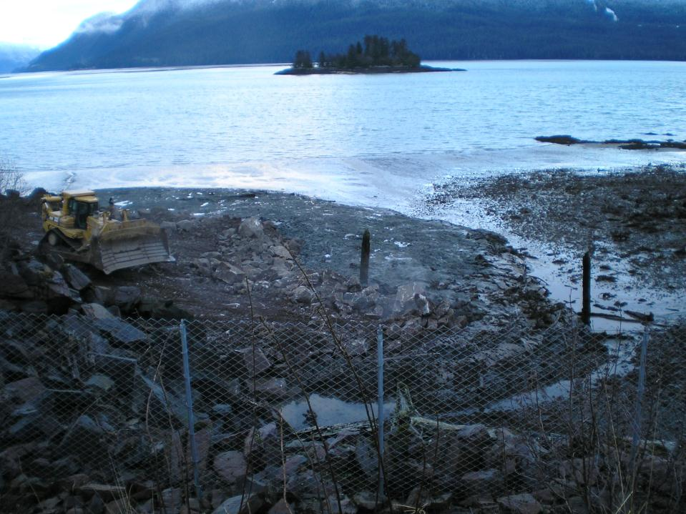
Water…..
“Water is the most critical resource issue of our lifetime
& our children’s lifetime. The health of our waters
is the principal measure of how we live on the land.”
Luna Leopold
Chief Hydrologist U.S. Geological Survey

Slide 22
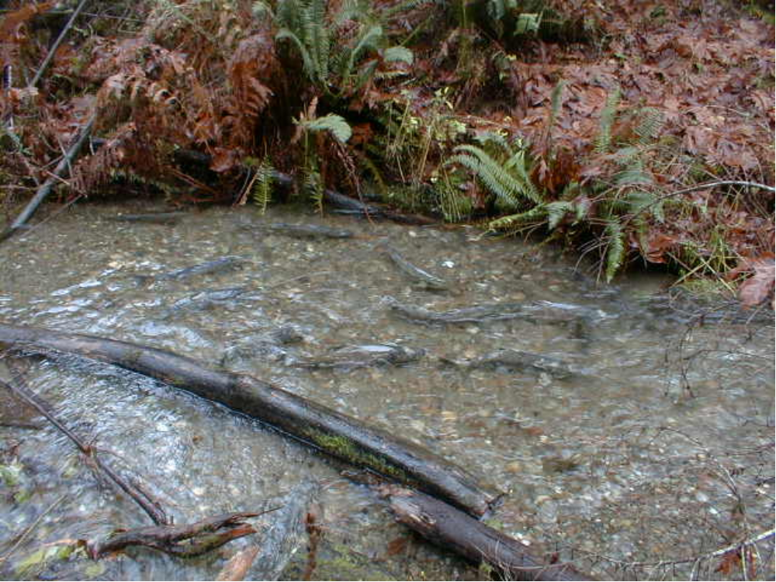
Impacts to Aquatic Environment
Decrease Food-Chain Organisms
Impair Feeding
Clog Gills
Reduce Photosynthesis
Diminished Spawning
Smothered Eggs and Fry
Notes:
Construction sediment is perfect for filling in spawning gravels, deposition in creeks can cause elevated temperatures.
The silts and clays that escape are perfect carriers for other pollutants, heavy metals, phosphorous, etc.
Salmon and Trout are greatly affected, Fish coughing to clear their gills

Slide 23
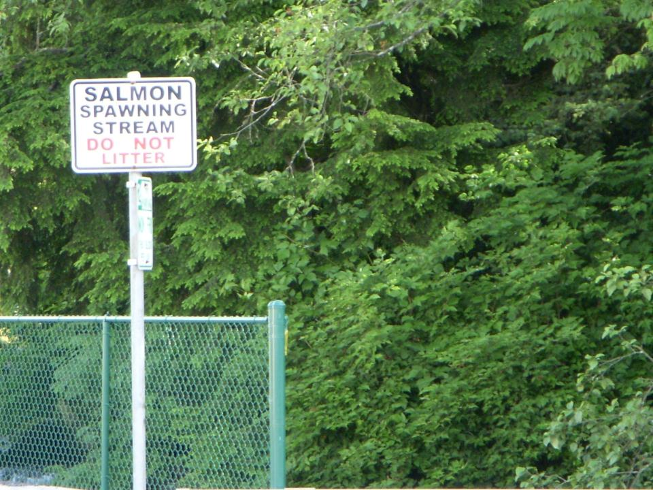
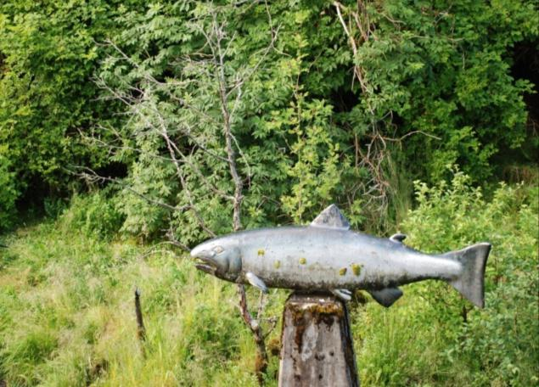
What is this worth to
Protecting Human Health and the Environment?
Notes:
Dirt in the aquatic environment is a pollutant. We don’t want this to be the only salmon in our waters. Photo from Ketchikan.

Slide 24
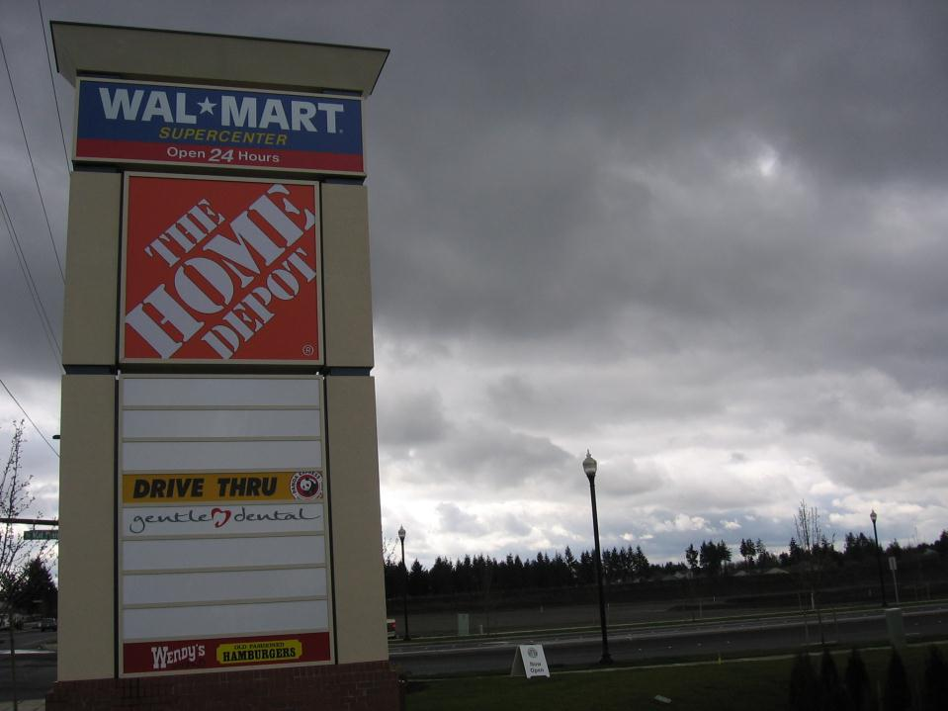
WAL MART
$3.1 Million Dollar Fine
Dept. Of Justice
Consent Decree
Details in no uncertain terms
what will be done
Home Depot
Starts their own program
1.3 Million Dollar Fine
Notes:
EPA can effect many contractors with one action. Wal-Mart builders must take training at company headquarters before doing any work.
Wal-Mart figures the cost of initial action was over 5 million. Program implementation over 15 million.
Show consent decree. Here is a large part of their stormwater pollution prevention plan signed by the EPA, DOJ, etc.
Home Depot takes notice and starts its own compliance program company wide. Home Depot gets fined 1.3 million, Juneau store is a part of the settlement. How many companies are affected with one EPA action?

Slide 25
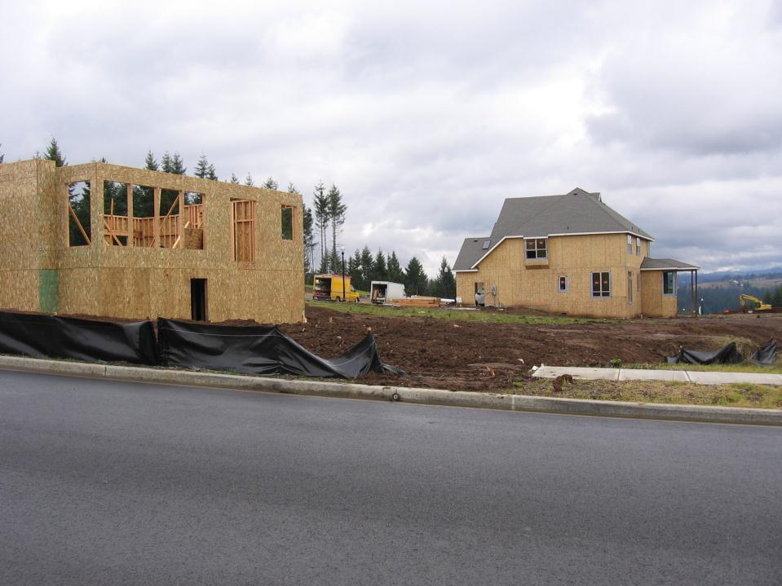
Some national home builders already have
their own consent decrees with the EPA & DOJ
Notes:
Just like Wal-Mart, how many contractors can EPA affect with one big action.

Slide 26
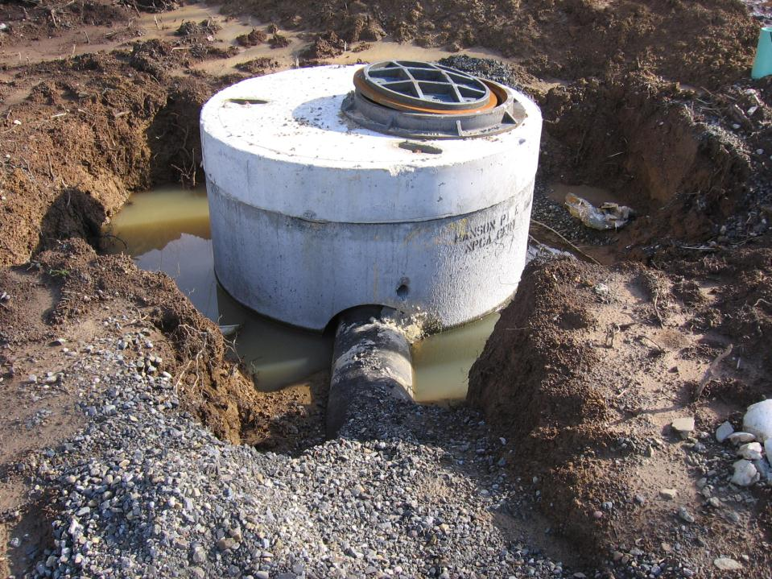
Cleanup Costs :
Storm System Clean-out & Repair
Notes:
No one wants to accept a contaminated storm system, as these systems get more complicated the expense of clean up due to sediment increases.
Infiltration systems may need to be completely rebuilt
GROUT EARLY, GROUT OFTEN

Slide 27
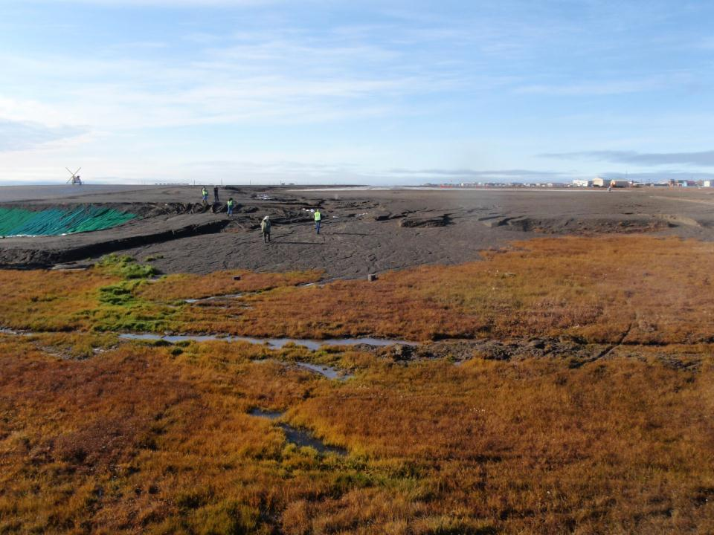
Visualize Drainage
Barrow

Slide 28
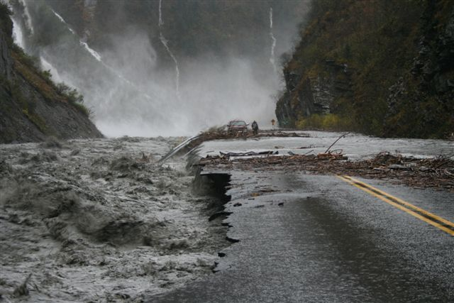

Moving Water is a Powerful Thing Indeed
Notes:
Highway in Alaska after Heavy Rains Fall 2006 Keystone Canyon

Slide 29
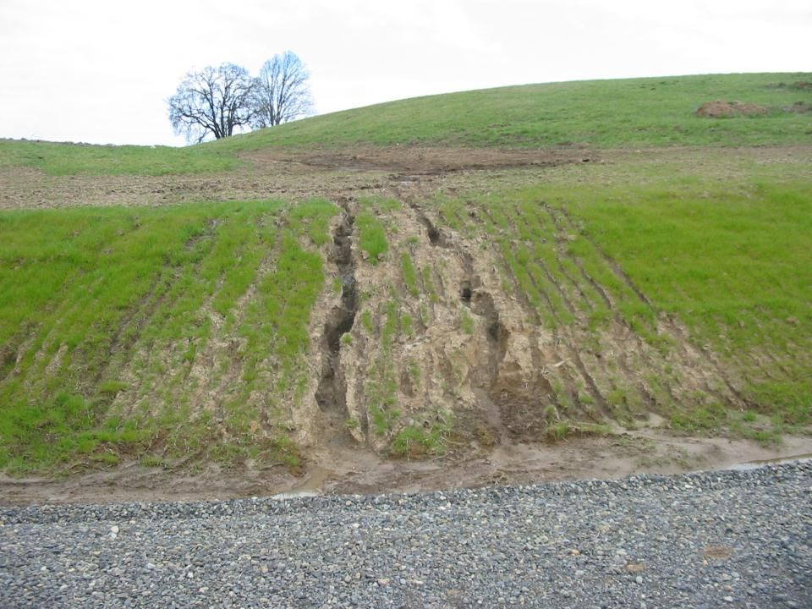
Construction Site Repairs, Retainer Release, Owner Satisfaction
Uncontrolled erosion can lead to rework, delays, sediment cleanup,
and permit violations, all of which increase project costs.
Notes:
What does your contract require you to deliver?
Someone has to fix this

Slide 30
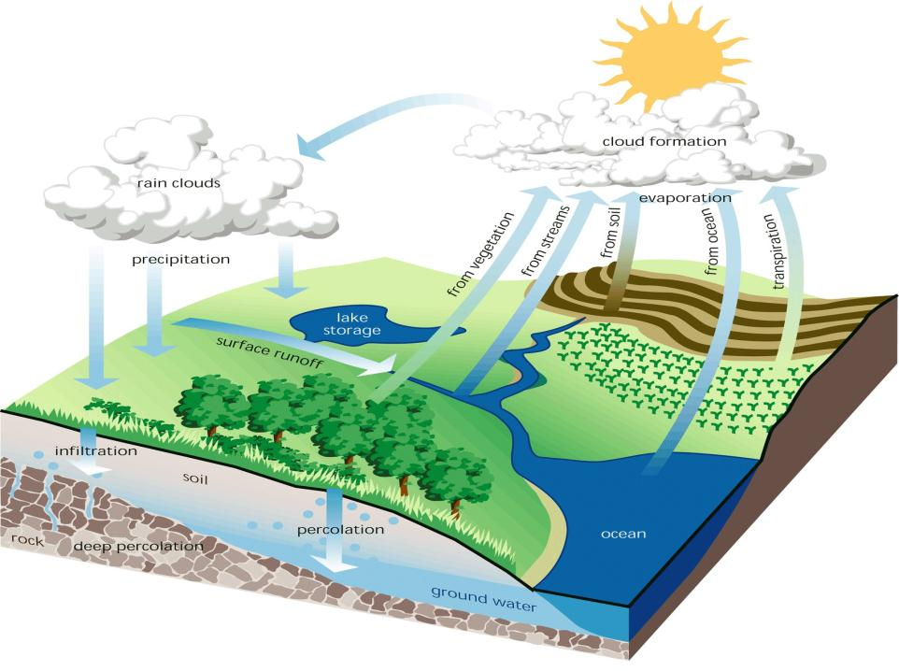
Hydrologic Cycle
Pre & Post Development

Slide 31
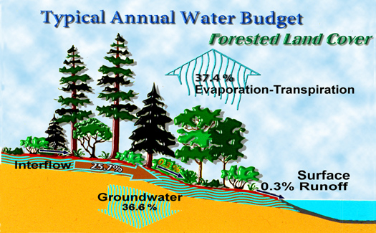
Natural Conditions
Courtesy May, U of W
Notes:
Low Impact Development practices can help protect the natural hydrology of watersheds.
Under natural conditions in Alaska, about 75 percent of the water from each rainfall event is either intercepted by the forest and returned to the atmosphere through evapotranspiration or trapped on the forest floor, where it slowly soaks, or infiltrates, into the ground. There is very little surface runoff. The water that infiltrates is critical to maintaining the base flows of streams for fish and other aquatic life. The temperature, volume and quality of this base flow are crucial to maintaining the habitat for species, such as salmon.

Slide 32
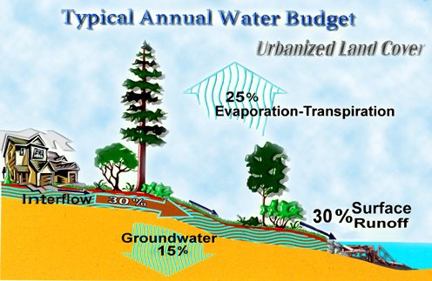
Developed Conditions
Courtesy May, U of W
Notes:
When land is developed, the frequency, volume and rate of flow of surface runoff increases dramatically. This is because of increased impervious areas, such as roads, driveways and buildings. The reduction of vegetation from development also decreases the amount of rainfall returning to the atmosphere through evapotranspiration and the amount that infiltrates to the ground. This increased volume of runoff and reduction in groundwater recharge destabilizes stream channels and in-stream habitat. The amount of sediments and pollutants also increases, which further degrades the habitat.

Slide 33
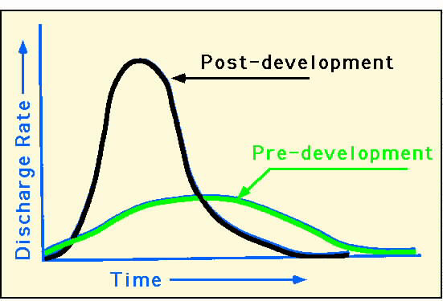
Runoff Hydrograph
Notes:
Development increases the impervious surfaces, this increases the runoff, more runoff = more erosion potential

Slide 34
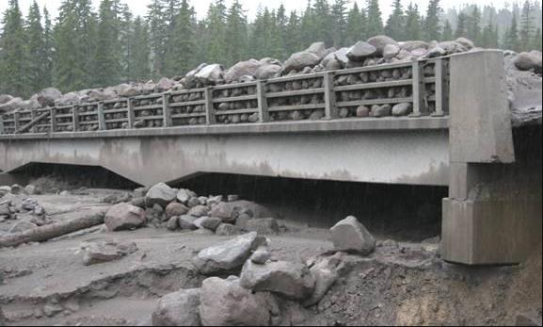
Runoff Calculations
R = Vegetated/Non-Vegetated Soils x Precipitation x Area
.5” of rain in one hour on 1000 sq. ft. of undisturbed, vegetated area…
R = .40 x .5 x 1000 = 200 gallons
.5” of rain in one hour on 1000 sq. ft. of exposed glacial till…
R = .91 x .5 x 1000 = 455 gallons
Mt Hood
Notes:
Tell about forest conditions – use with hydrograph curve

Slide 35
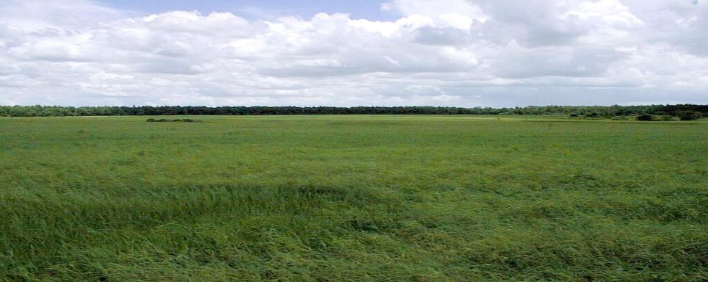
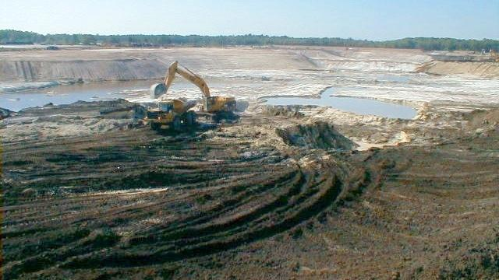
Predevelopment
Construction
Courtesy Florida DEP
Notes:
Land use is forever changed once development occurs. Consider the Impact of your actions during Construction.

Slide 36
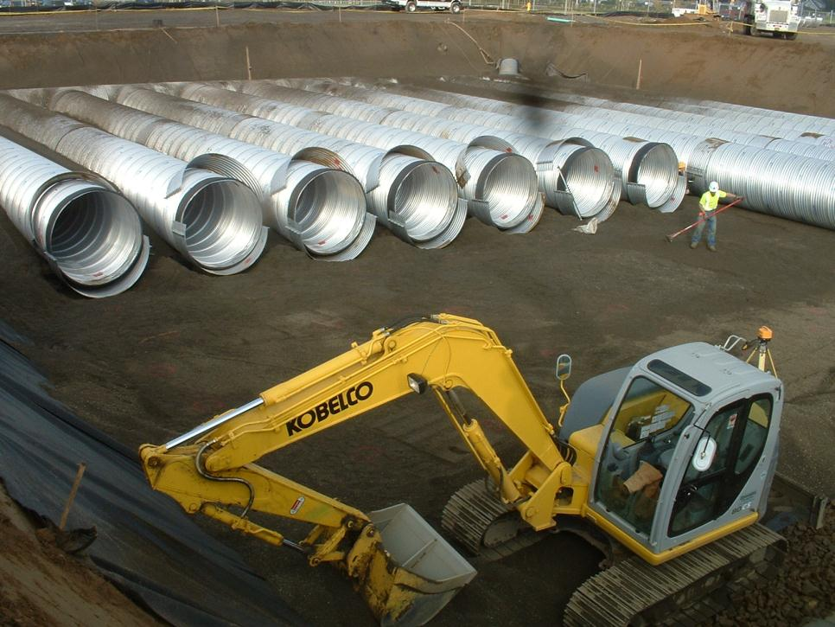
Detention & Retention
Notes:
Design elements from these structures will give an indication of the runoff potential.
STORY SLIDE 1: Construction of detention system, backfill placed to spring line of pipe. Note: Fabric, laser level, finish detail

Slide 37
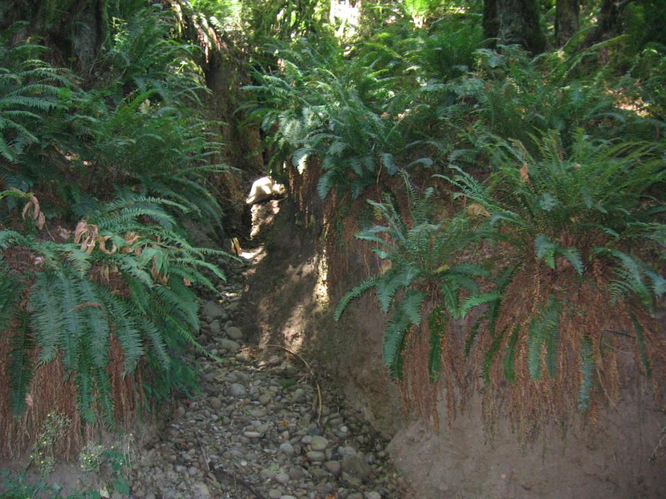
8’
DEEP
Extreme Down-cutting
Increased Flows
From Construction Sites
Must be Controlled
Notes:
This gully is over 8 feet deep. The increased flows from construction related activities must be managed to prevent offsite and downstream damage.

Slide 38
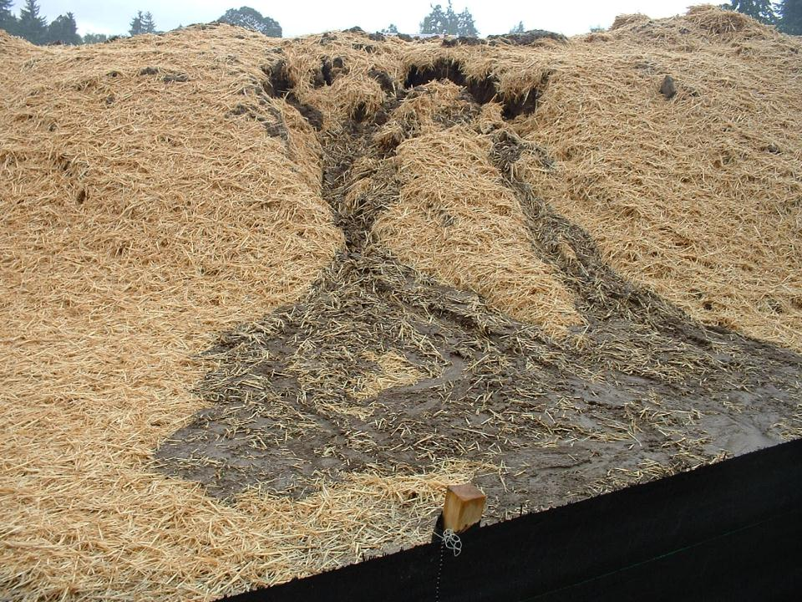
Erosion Impacts to Construction
Schedules and Costs
Diversion of Resources - Erosion damages forces materials, manpower, and equipment to be diverted from construction (money making) activities
Stop Work Orders - Water quality violations lead to stop work orders from cities and boroughs and fines which delay construction and increase costs
Notes:
When erosion control takes over the focus of your job who bears the cost?

Slide 39
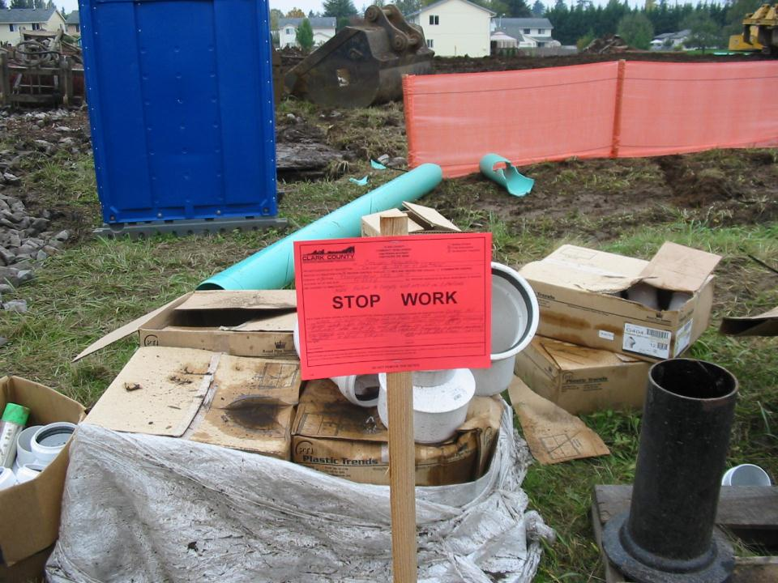

What Does this Cost You?
Notes:
Stop Work Orders cost everybody, employees, developers, delays prevent payments.

Slide 40
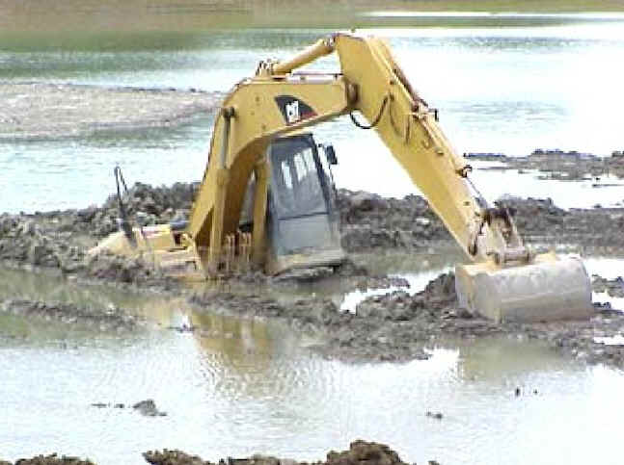
Impacts of Erosion and Sedimentation
Construction Delays & Increased Costs
Legal Costs
Mitigation Costs
Fisheries Impacts
Profitability Impacts
Digging yourself
Out of a hole
Notes:
Once the enforcement line has been crossed the costs escalate at an alarming rate.

Slide 41
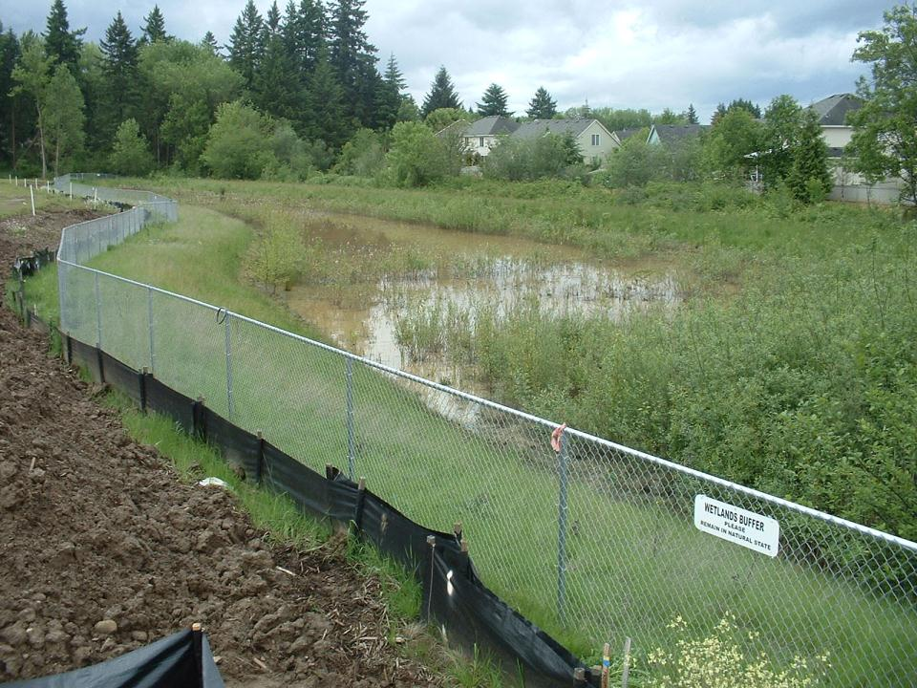
Mitigation Costs
Offsite Damage to Private Property
  Remove Sediments
  Repair Slopes/ Grades
Offsite Damage to Water Resources
  Wetland Mitigation
  Natural Resource Damage Assessments
Notes:
There is no cheap way to mitigate the impacts of erosion.
Sign Says “Wetland Buffer Please Leave in Natural State.”
There may have a mitigation project or cost for impacts.

Slide 42
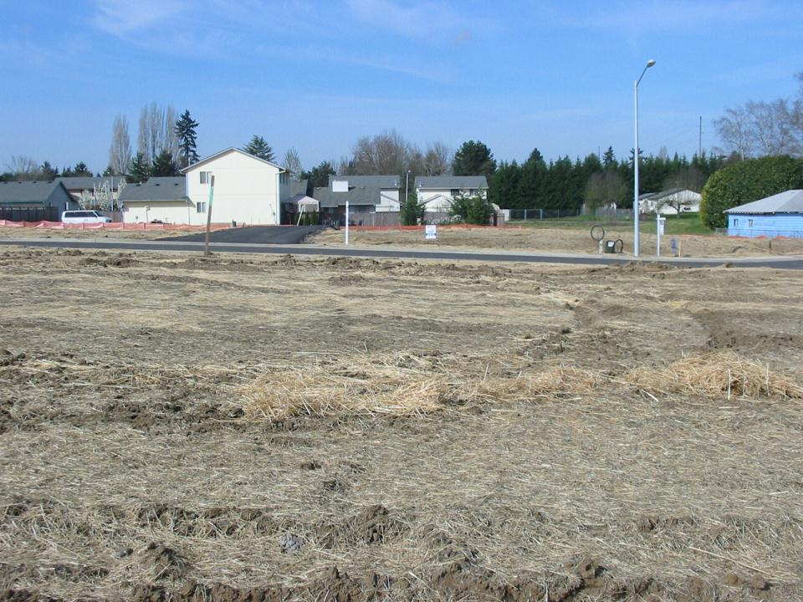
What needs to be done to ensure compliance
and avoid regulatory enforcement action?
How much will it cost?
The Million Dollar Questions
How much will it rain? What will the duration
and intensity be? When will it happen?
What’s on the schedule while it’s raining?
Notes:
Think about what the following situations should do to prevent erosion related costs.

Slide 43
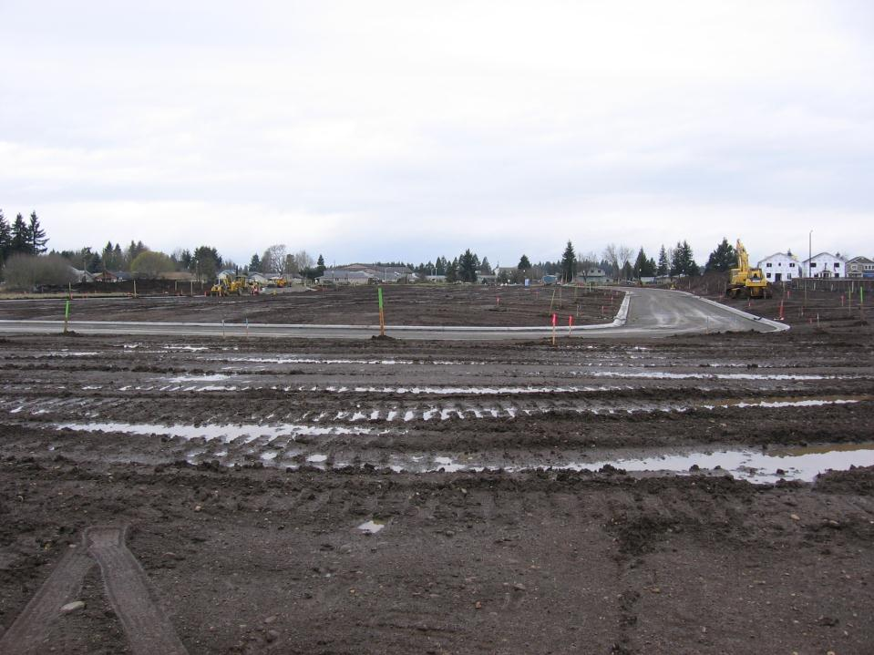
Typical Subdivision
What erosion or sediment controls should be in place?
What controls “shall” be in place for compliance?
Notes:
Bare Soil, perimeter controls, do they change when we build new roads?, inlet protection, construction access.

Slide 44
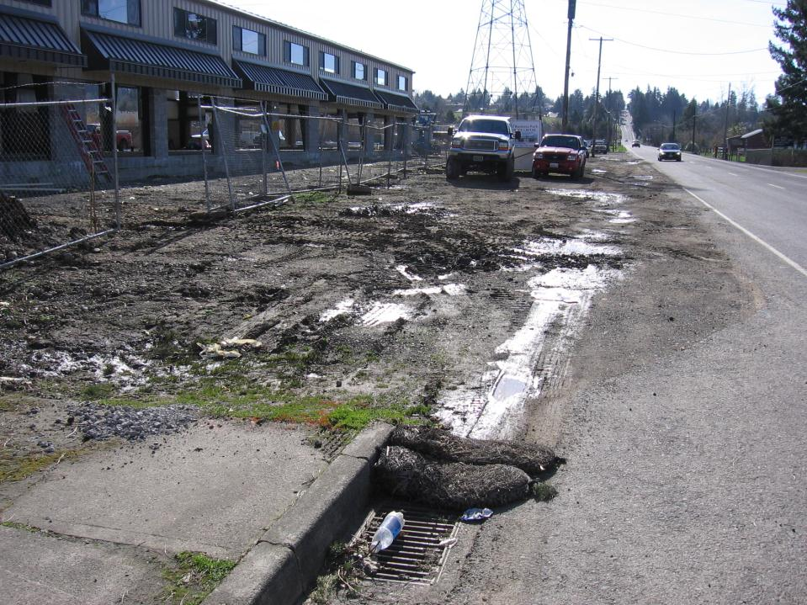
Light
Industrial
Notes:
Perimeter control, construction entrance, bare soil, inlet protection

Slide 45
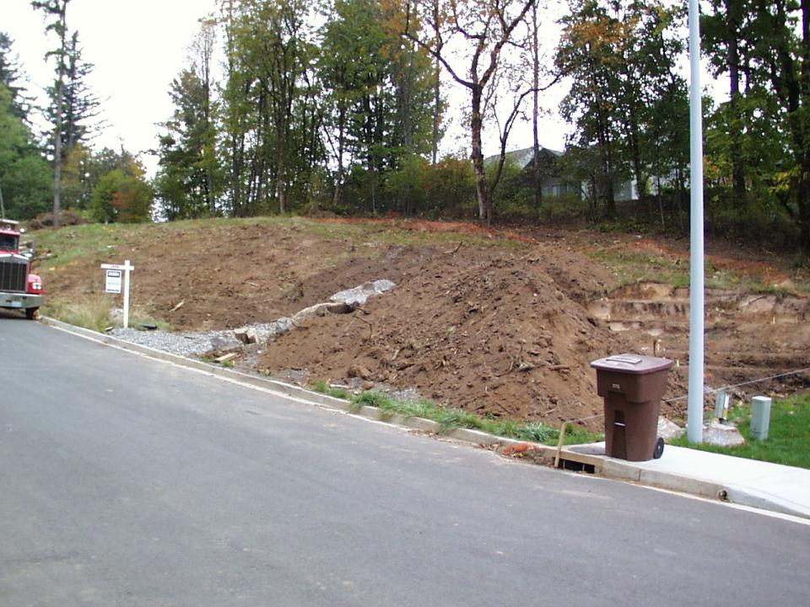
Single Family Residential
Notes:
Is there any effort to prevent erosion or control sediment

Slide 46
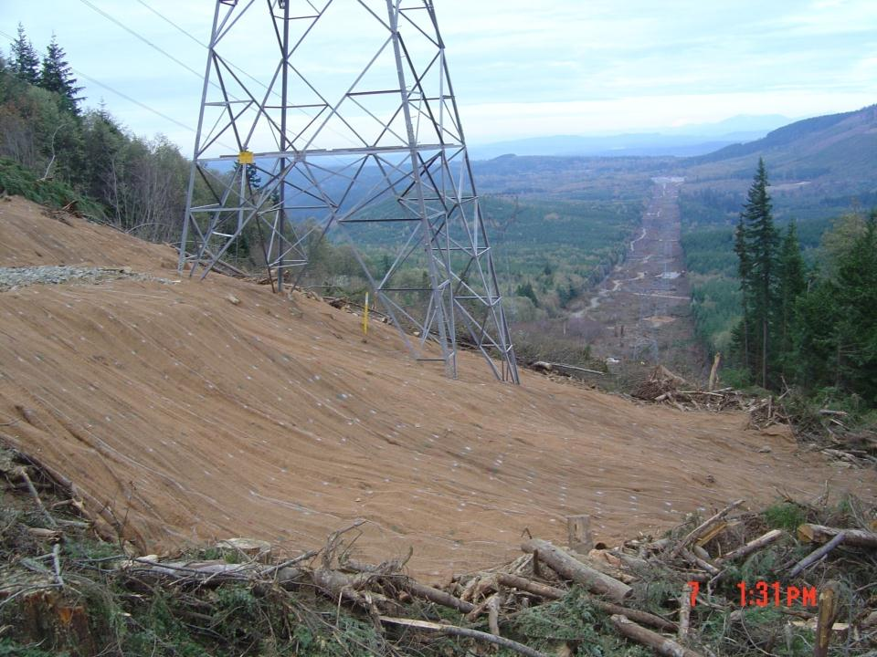
Linear Construction
Notes:
Linear Construction Poses special problems

Slide 47
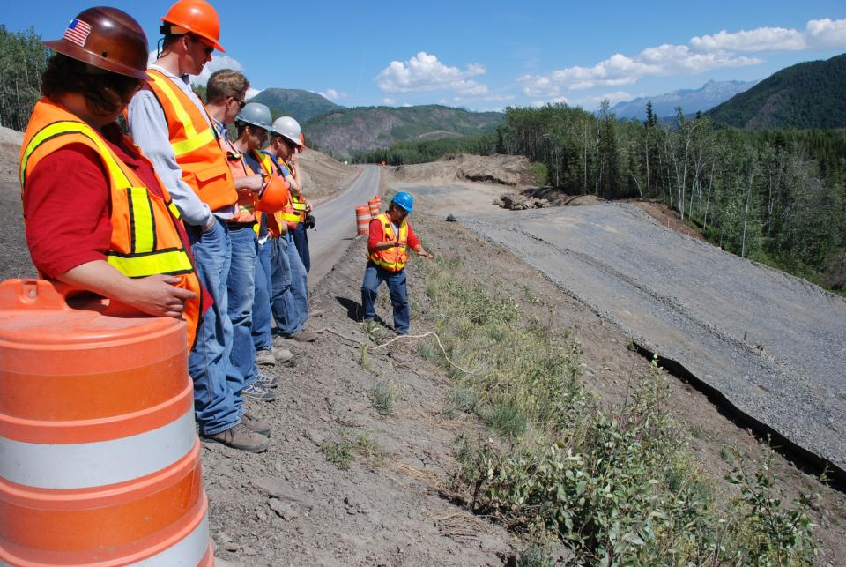
Linear Highway Construction

Slide 48
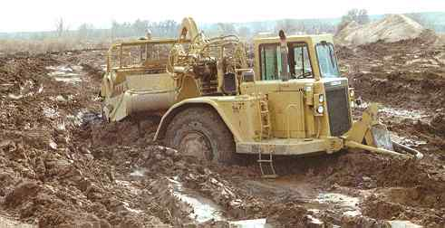
How do I work when my site looks like this?
There are questions we can’t answer!
Notes:
Just so you all know. Some questions we will not be able to answer

Slide 49
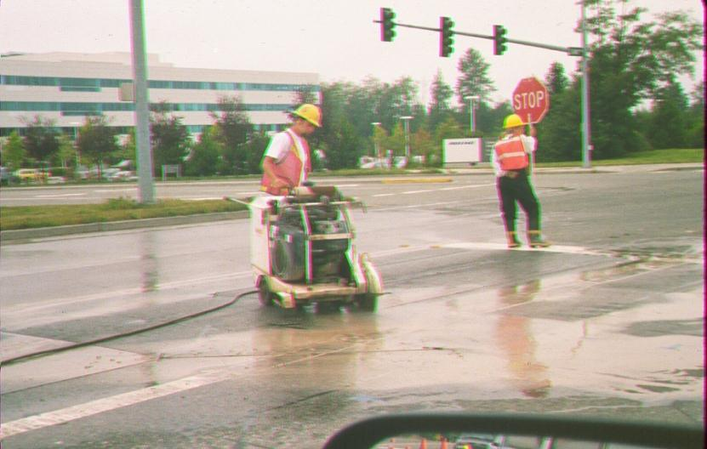
Every Task Must be Assessed for Water Quality Impacts
Photo: Puget Sound Clean Air Agency

Slide 50
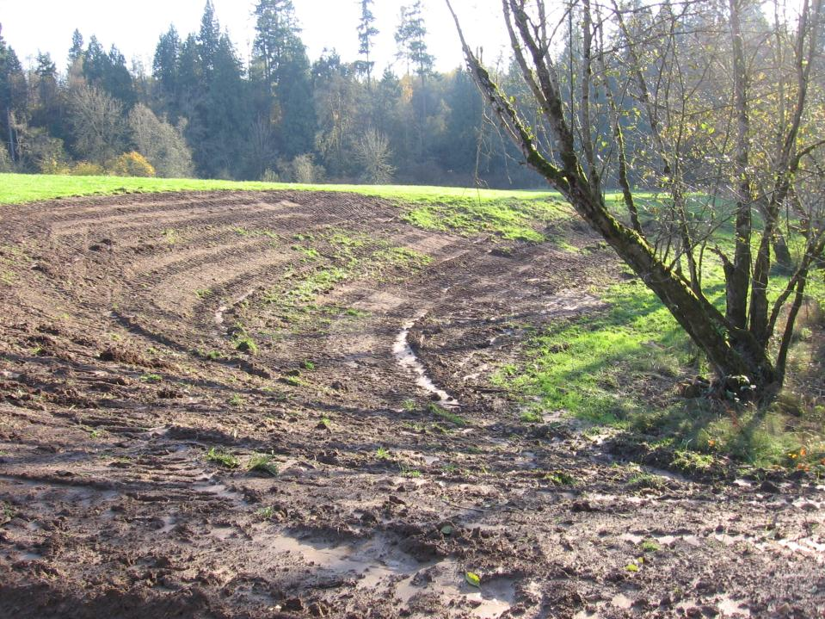
Identify Problems &
Suggest Remedies
Notes:
We hope to learn how to make better decisions and avoid unnecessary oversight and costs.

Slide 51
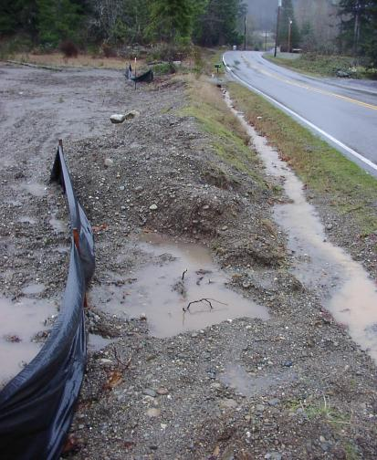

Erosion Prevention is Far Better & Far Cheaper Than Sediment Treatment

Slide 52


Notes:
Multiple failures & photo documentation

Slide 53

Questions ?

