Slide 1

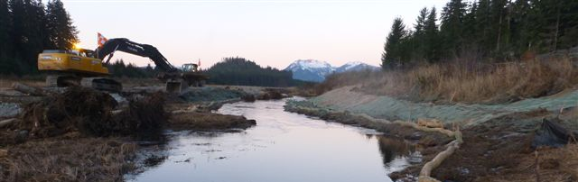
Recertification Training
Hoonah
In Cooperation with the Alaska Storm Water Steering Committee
January 2026

Slide 2
Goals:
Increase awareness of storm water impacts.
Provide training for Qualified Personnel.
  Reporting & Recordkeeping
Increase understanding of BMPs.
Standardize expectations statewide.
Answer your questions.
Assist project development while protecting what makes this such a great place to live!

Slide 3
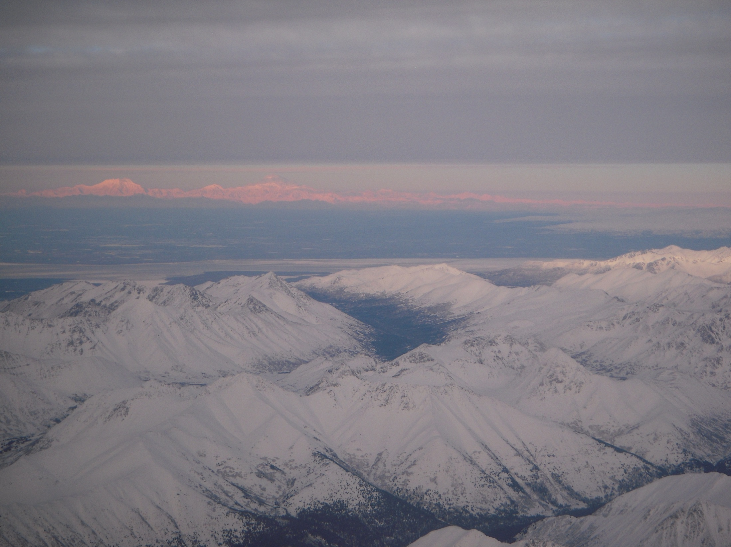
Course Overview
Erosion Processes
Factors That Influence Erosion
Regulations & Permitting
Risk Management
Inspections & Recordkeeping
SWPPP Basics for Inspectors
Erosion Control
Sediment Control
Good Housekeeping

Slide 4

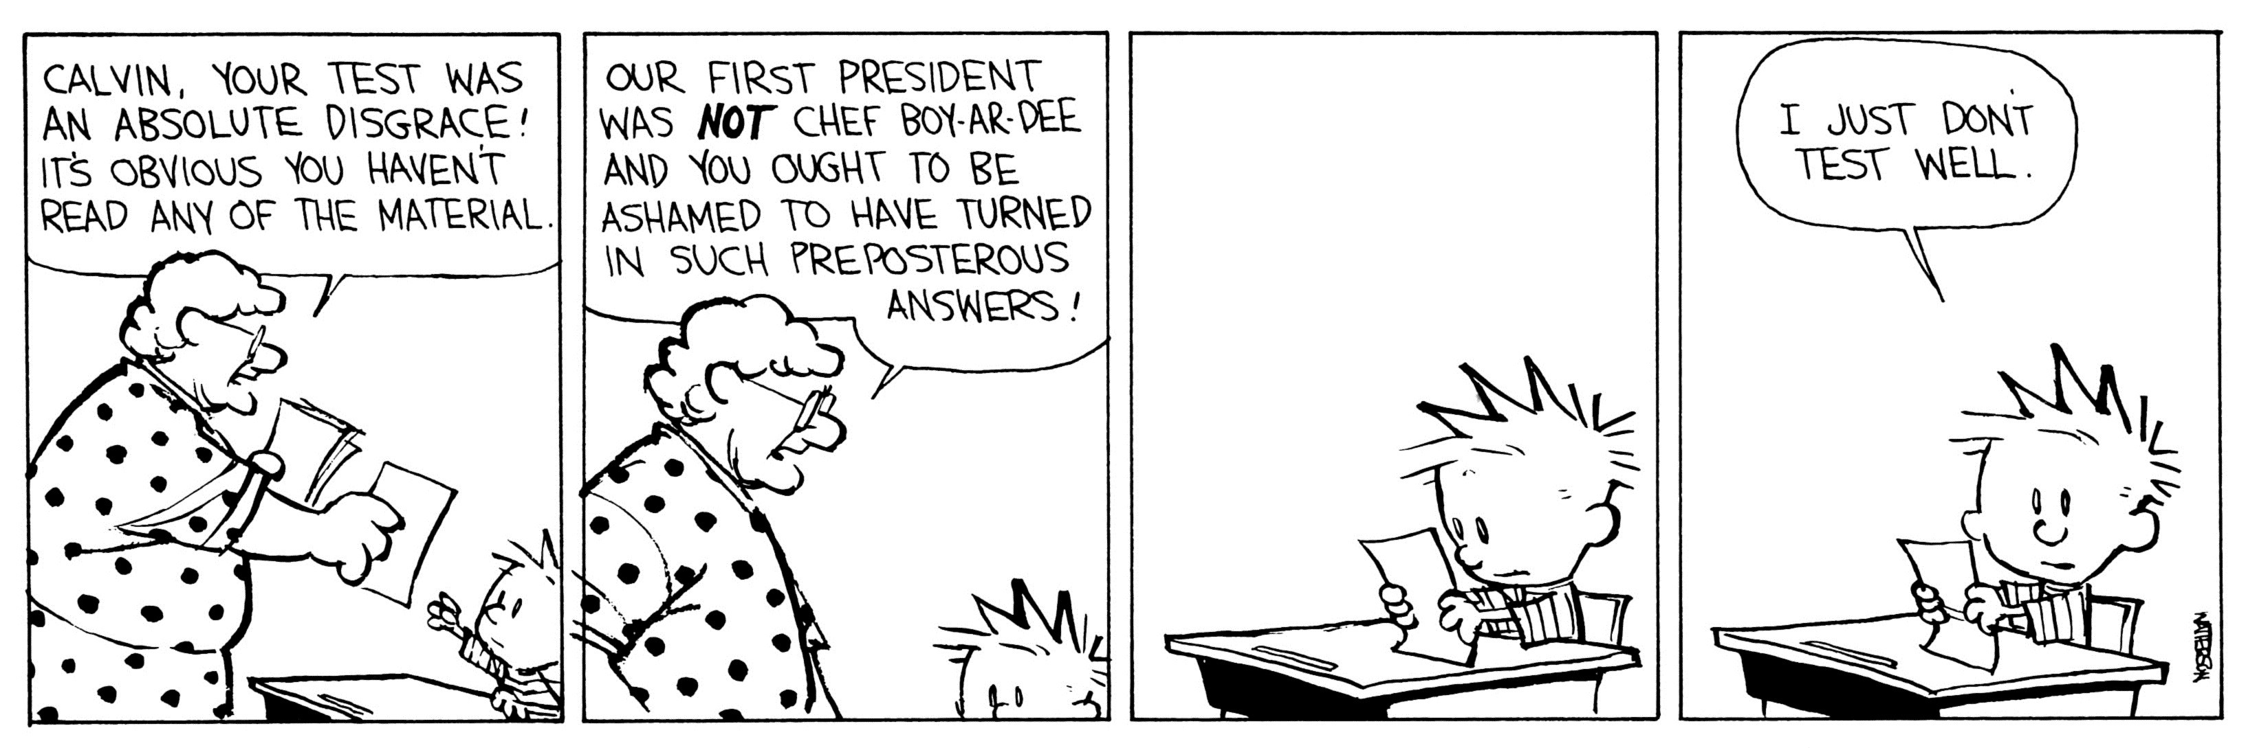
Recertification Requires
Passing test score is required to avoid retaking the two day AK-CESCL training.

Slide 5

Please Ask
Questions
*This training will
Yield to Questions!
Notes:
Offer to “yield to any other questions at any time.

Slide 6
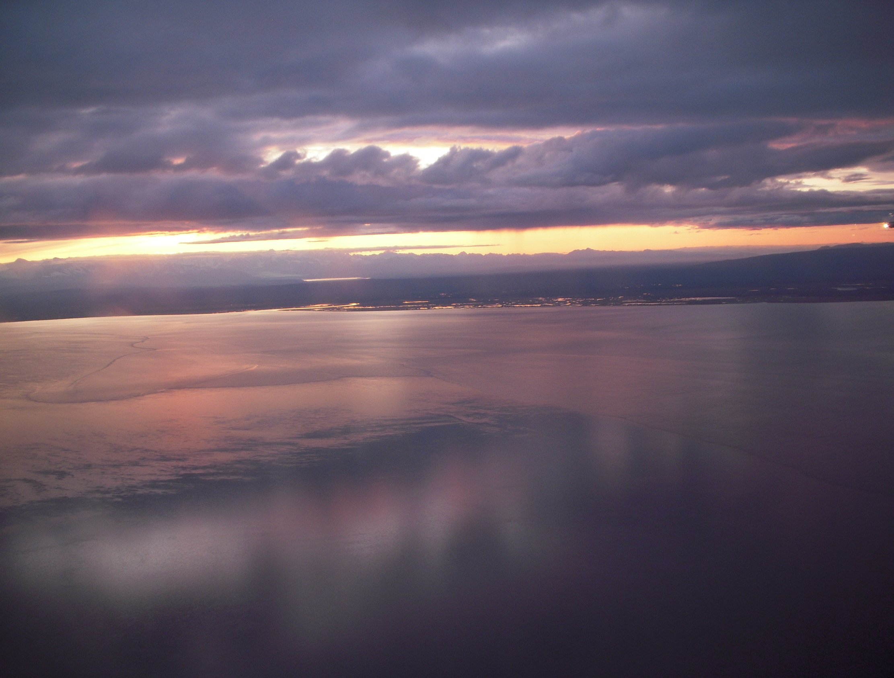

Erosion Processes
Can we better understand
erosion to make better decisions?

Slide 7
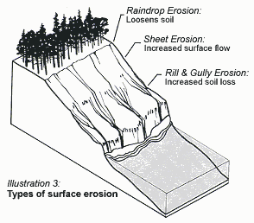
Erosion Processes
Raindrop
Sheet
Rill
Gully
Stream & Channel

Slide 8
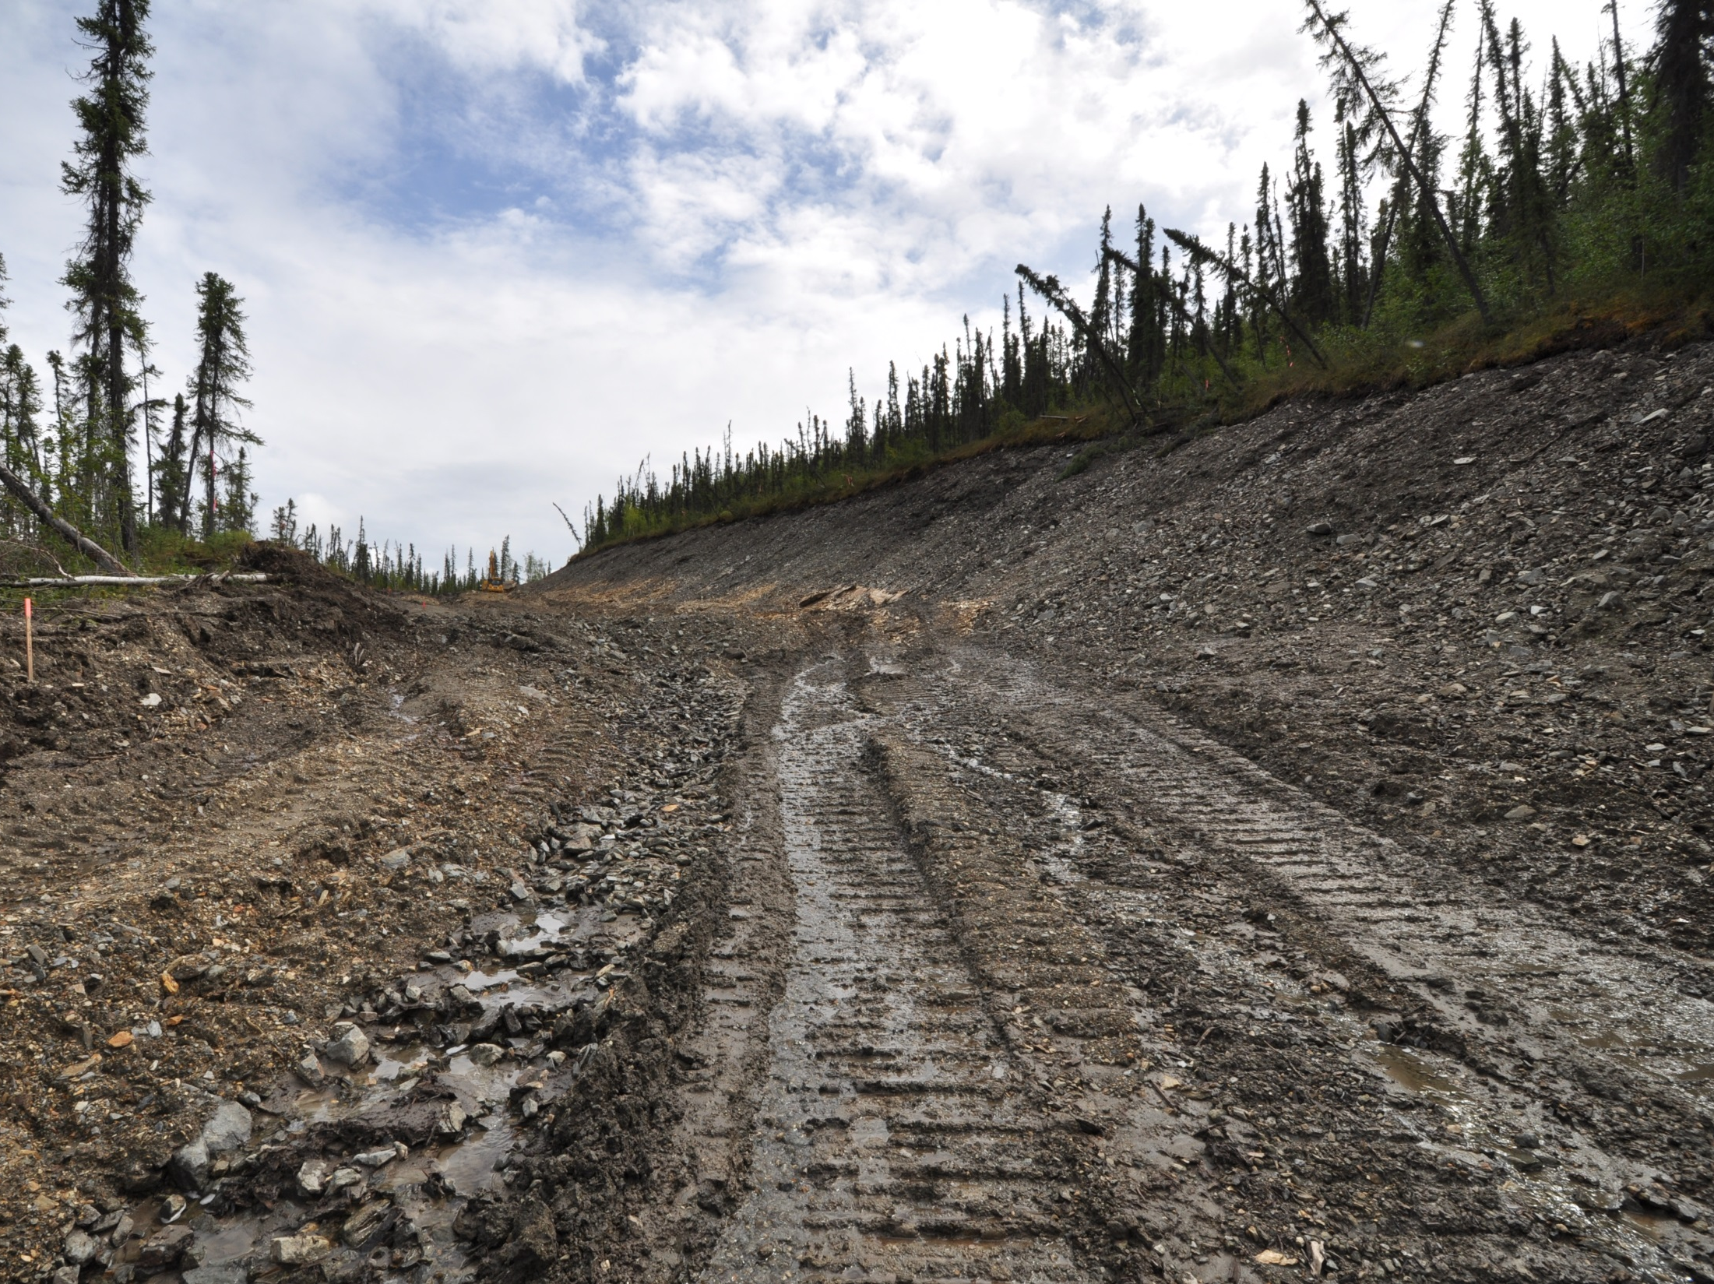
Where will erosion on your site occur?
Raindrop-Sheet
Rill-Gully
Rill
Rill
Rill
Sheet
Gully
Rill
Gully
Rill
Tok
Notes:
Explain how the processes will start and evolove as flows increase and water concentrates. Raindrop erosion everywhere, sheet erosion on saturated soils and the rapid concentration of flow that will rill and begin to form gullies.

Slide 9
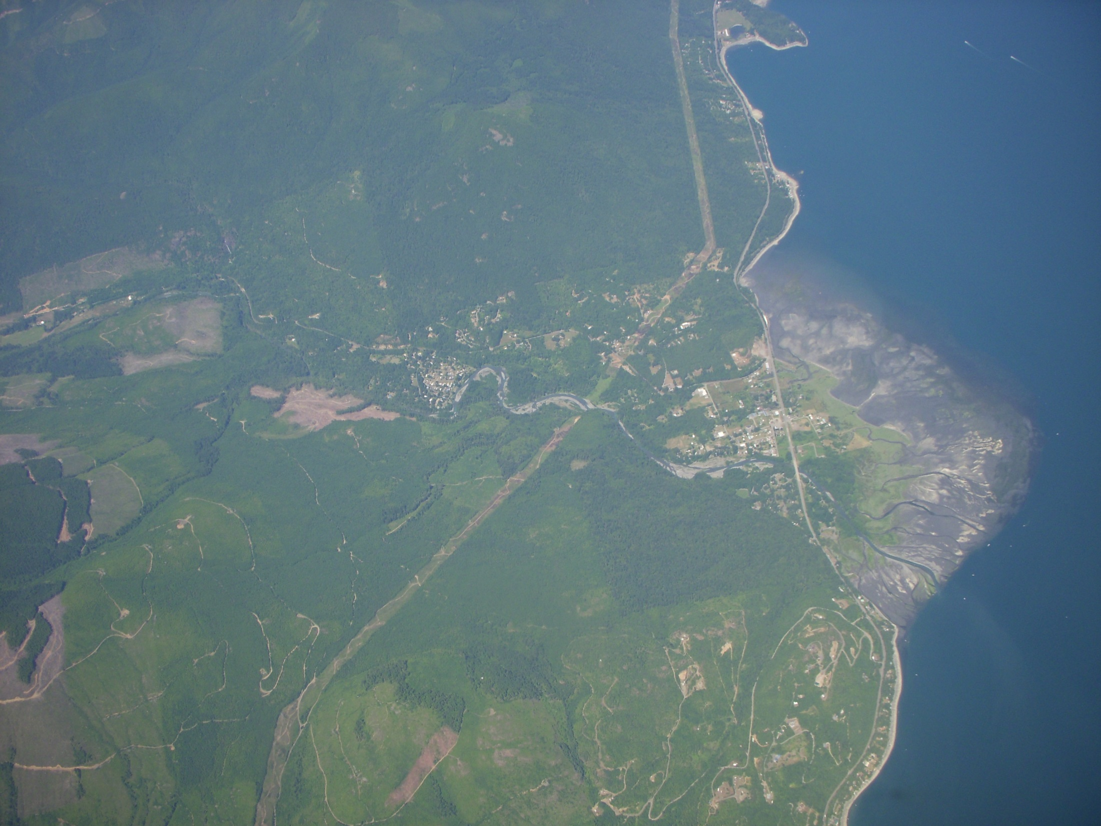
Stream & Channel Bank Erosion
More Volume
- Time
= More Velocity
& Scour Erosion
Brinnon WA
Notes:
More water due to the construction process discharged faster will contribute to off site stream and channel erosion. The picture shows vegetation removal, logging, and development in the watershed. Point out the large fan of sediment deposition.

Slide 10
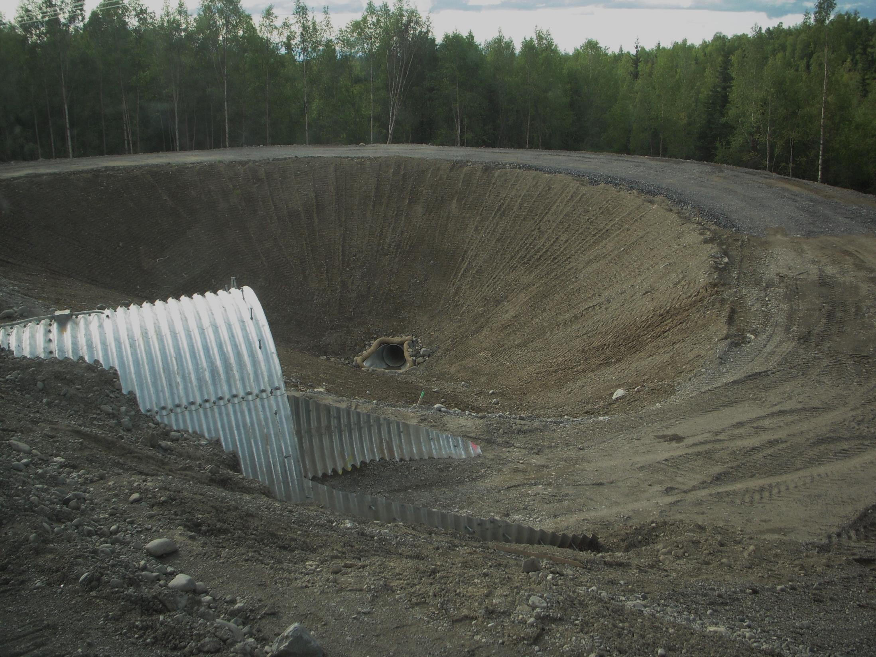
Three best ways to reduce volume & velocity?
Maintain vegetation
Preservation of topsoil
Surface roughening
Construction 101
Notes:
Most projects through design and construction are efficient and drive the water to the toughest point of compliance in the shortest time possible. Usually if there are more smaller discharges the water quality is better. Construction practices naturally increase the discharge and thus the risks.

Slide 11
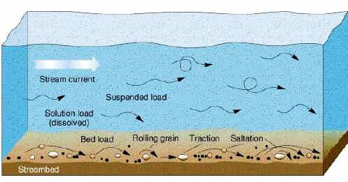
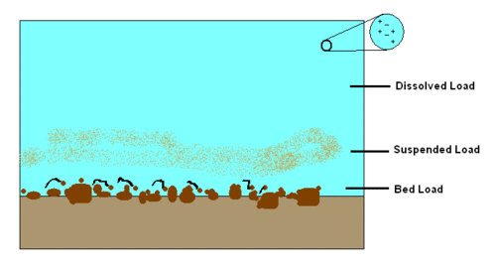
Bed Load
Suspension
Colloidal Suspension
Notes:
Within the flowing water there are processes in play. Colloidal suspension is unique in that the particles have a charge, usually negative, and they do not naturally want to agglomerate and stick together. This allows them to stay in suspension even longer.

Slide 12
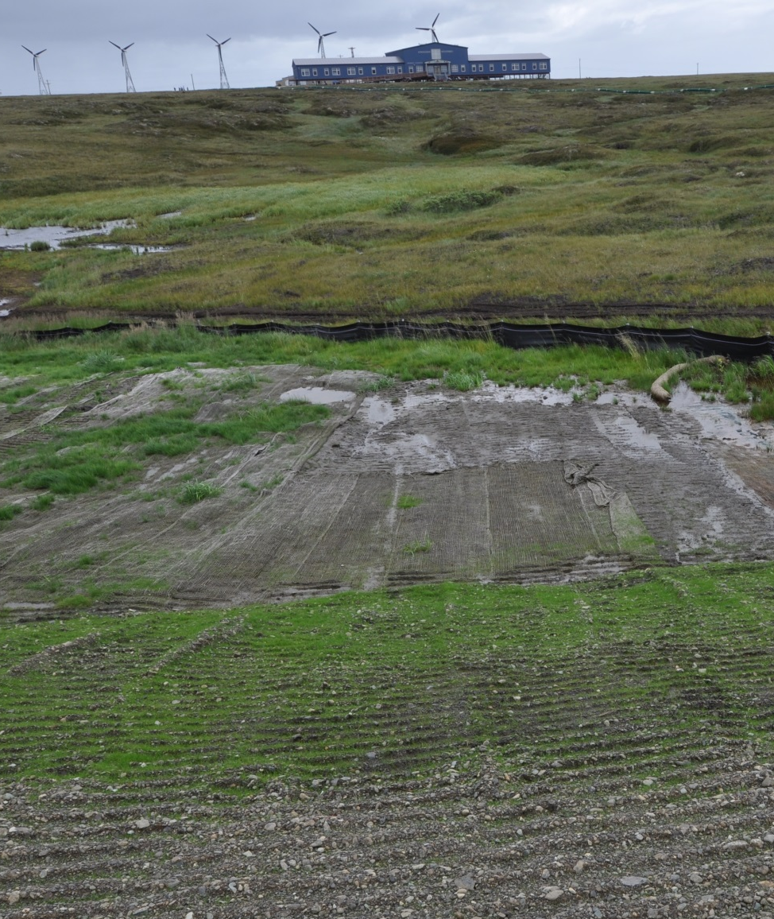
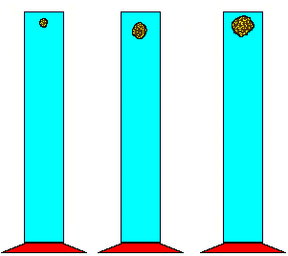
Size matters in settling time!
& sediment control
Clay Silt Sand
Clay
Silt
Sand
Gravel
Kongiganak
Notes:
The larger the particle the faster it will settle.

Slide 13
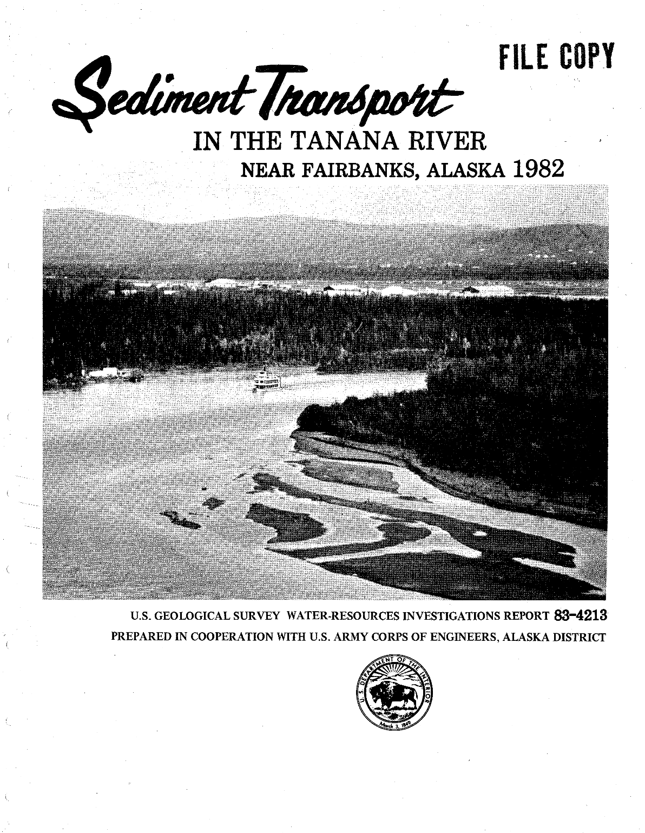
Nothing new….
Erosion processes have been studied extensively for years.
However,
Planning construction activities to minimize erosion and sediment transport; that may be new to many people.
Notes:
The erosion processes have been the same forever. Construction simply exasperates the problems and many sites do not manage the processes to limit the damage.

Slide 14
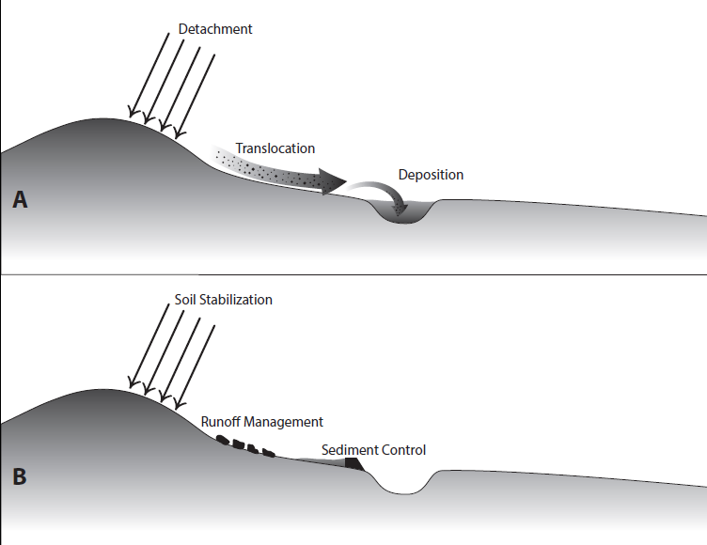
Stabilize Soils & Control the Flow
Erosion
Transport
Sedimentation
Notes:
Pretty easy to manage the risks, stabilize the soil as this is around 80% of the problem, then control how the water comes onto, moves through and leaves the project so that you prevent it from causing erosion and you are home free.

Slide 15
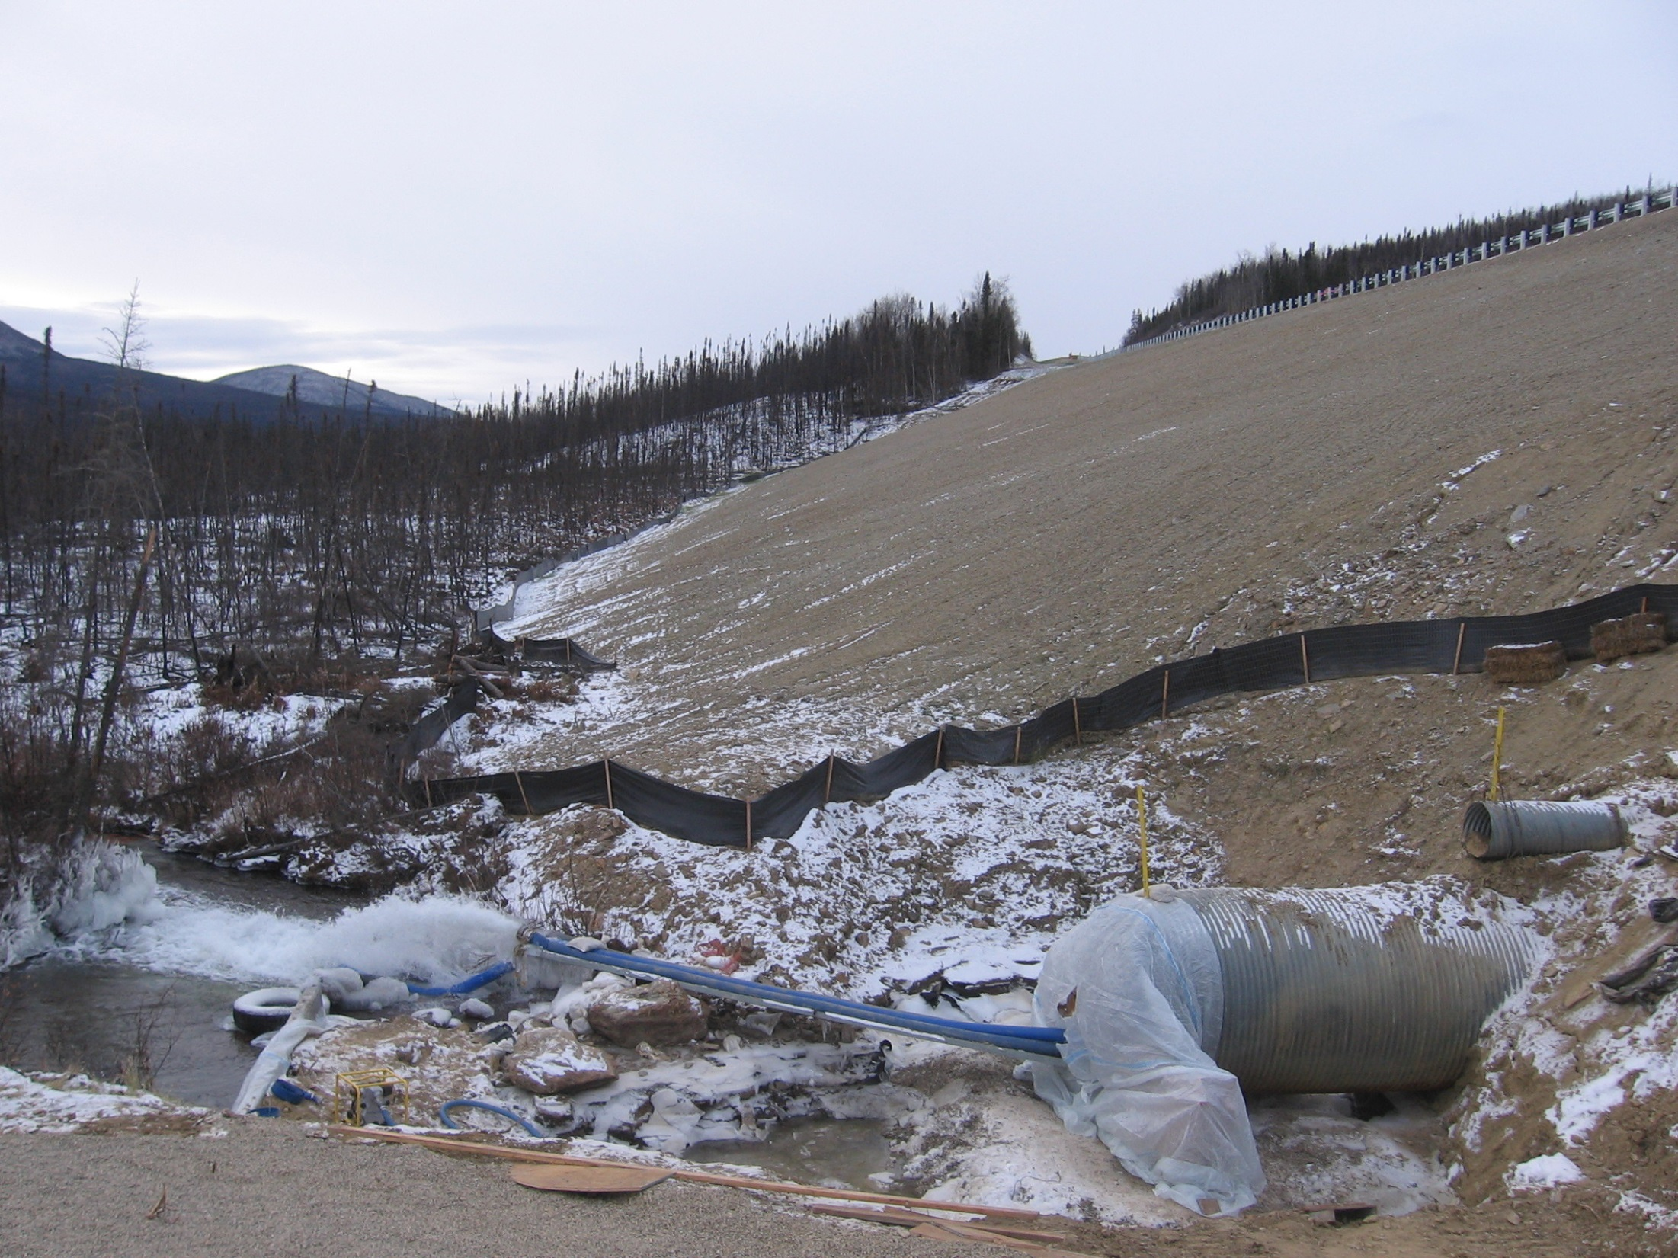
Where will soil detach on your project?
Where will it deposit?
Notes:
The detachment areas will be areas that need to be repaired, The deposition areas will need maintenance. Deposition off site could require remediation and clean up.

Slide 16
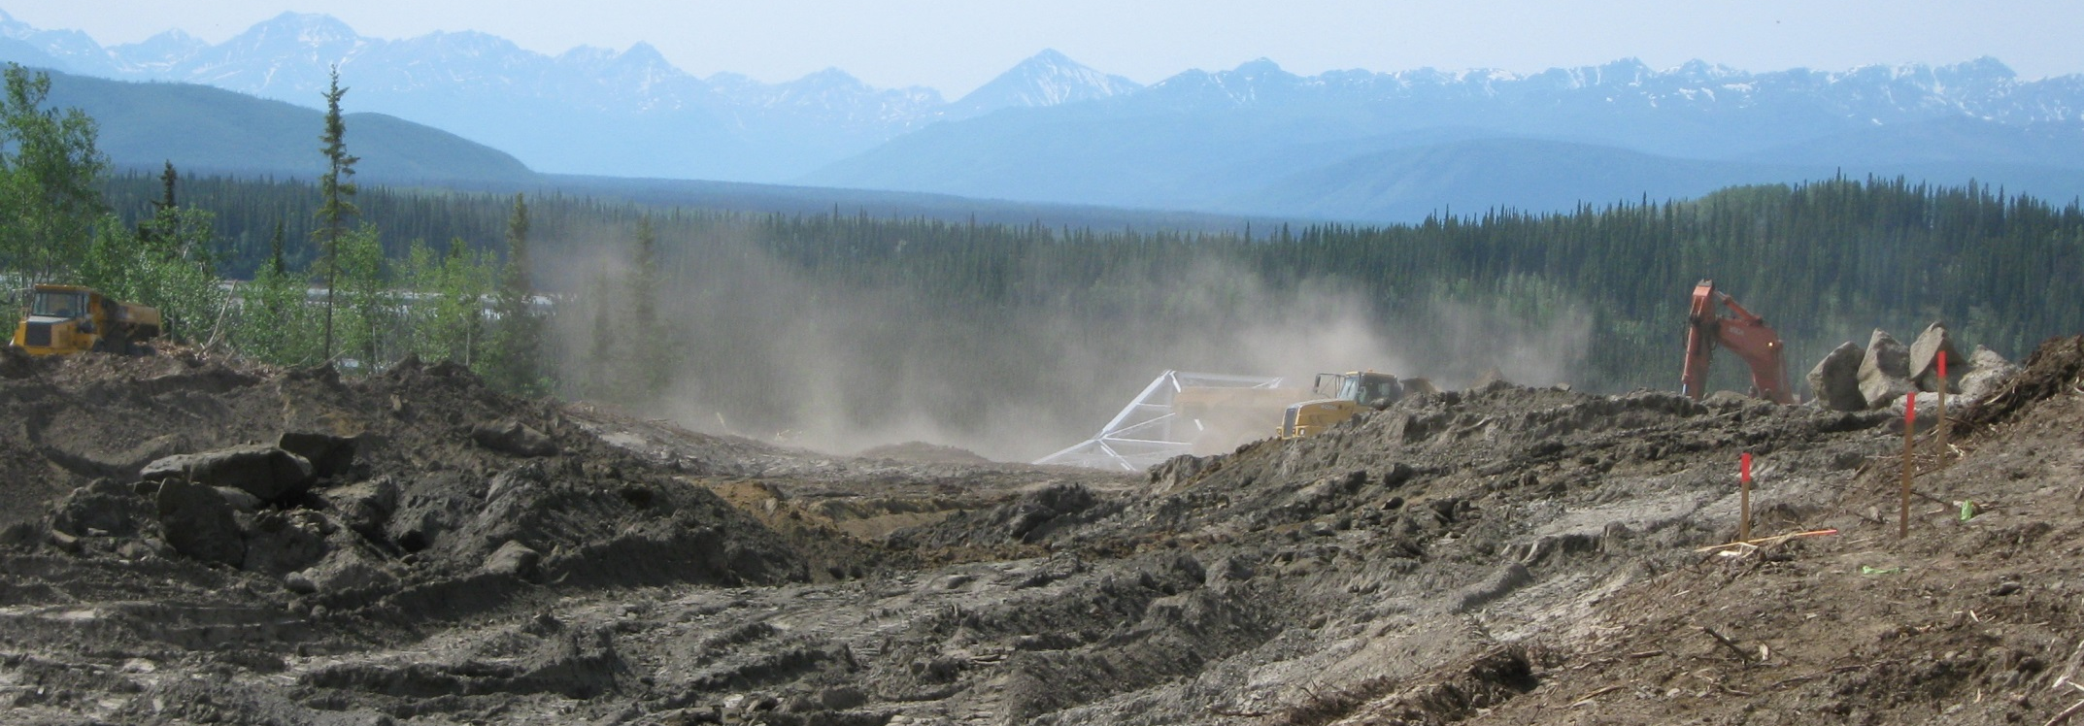

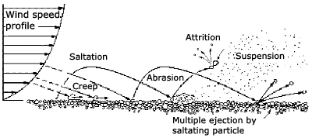
Wind Erosion
Tok
Notes:
Wind erosion can transport lots of particles as well. Discuss the difference between wind erosion and fugitive dust.

Slide 17
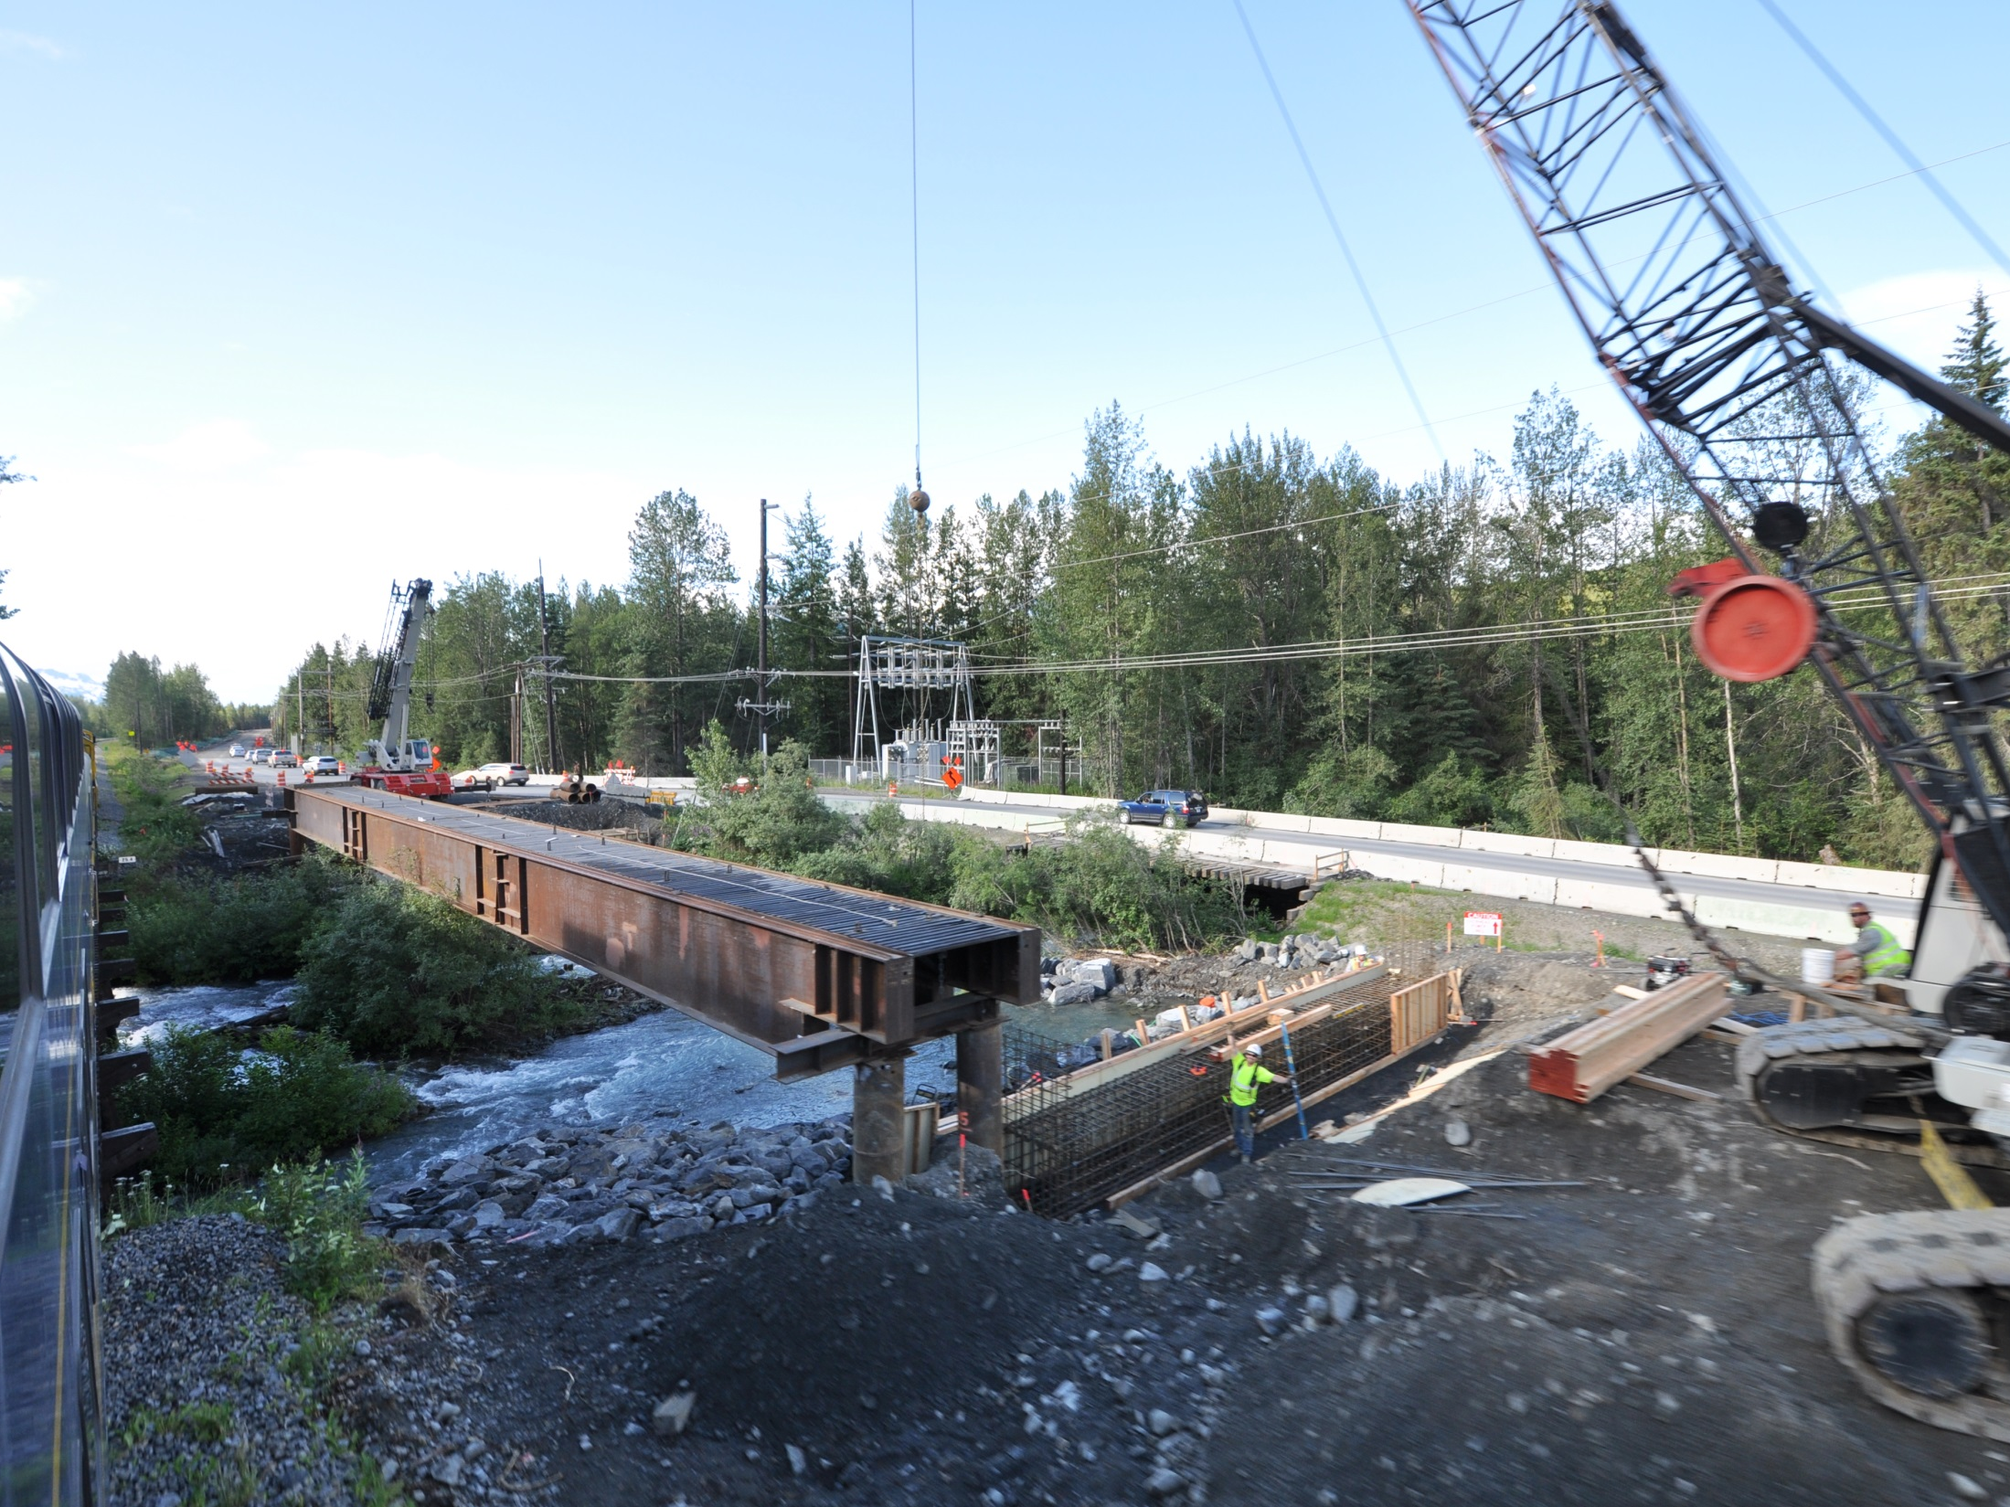
What do we need to do to successfully deliver our projects?
Production
Profitability
Compliance
Notes:
Erosion control is simply part of project management, with successful erosion prevention we can avoid controlling sediment so we can achieve the goals of delivering our projects.

Slide 18
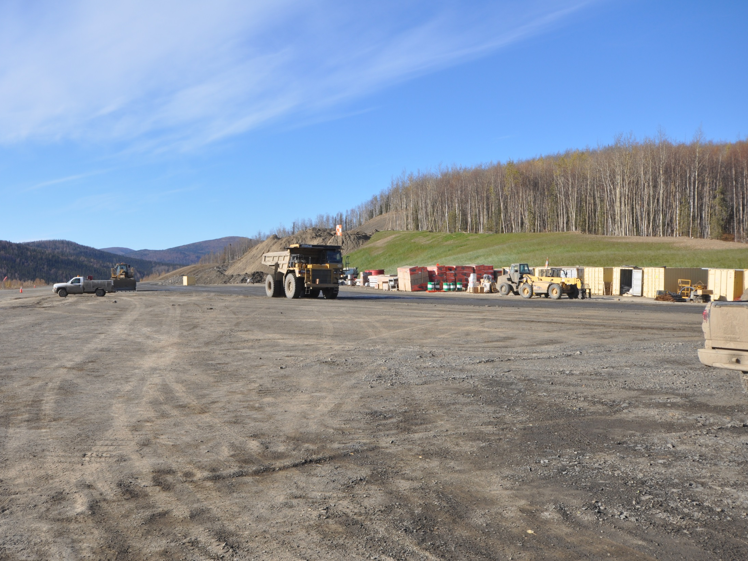
What do we need to do to succeed with
erosion and sediment control?
Stabilize Soils
Manage Flows
Control Sediment
Good Housekeeping
Takotna
Notes:
The management principals are simple. The costs will be somewhere between 2 and 10 percent of the budget, how much effort do we put toward effectively managing such a big part of the project budget?

Slide 19
Factors That Influence Erosion
What affects the rates of erosion?

Slide 20
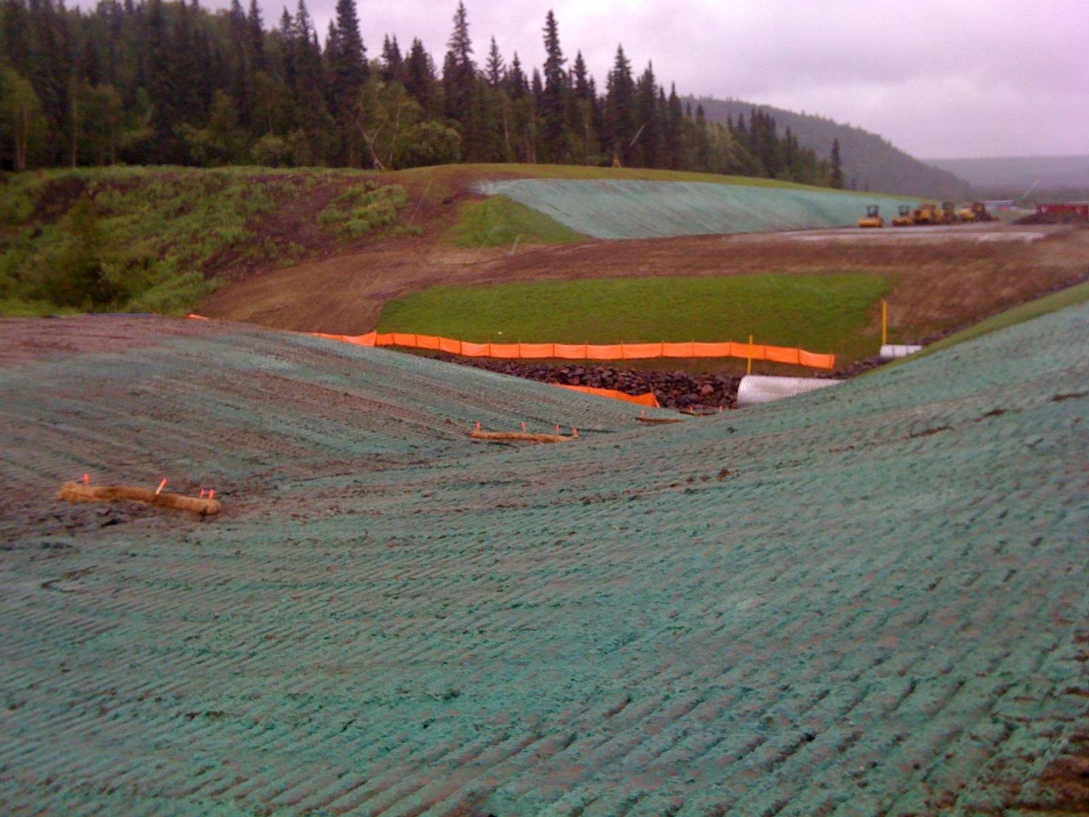
Factors That Influence Erosion
Soils
Precipitation
Vegetation
Surface Area
Slope Length
Slope Gradient
Surface Texture
Grayling

Slide 21
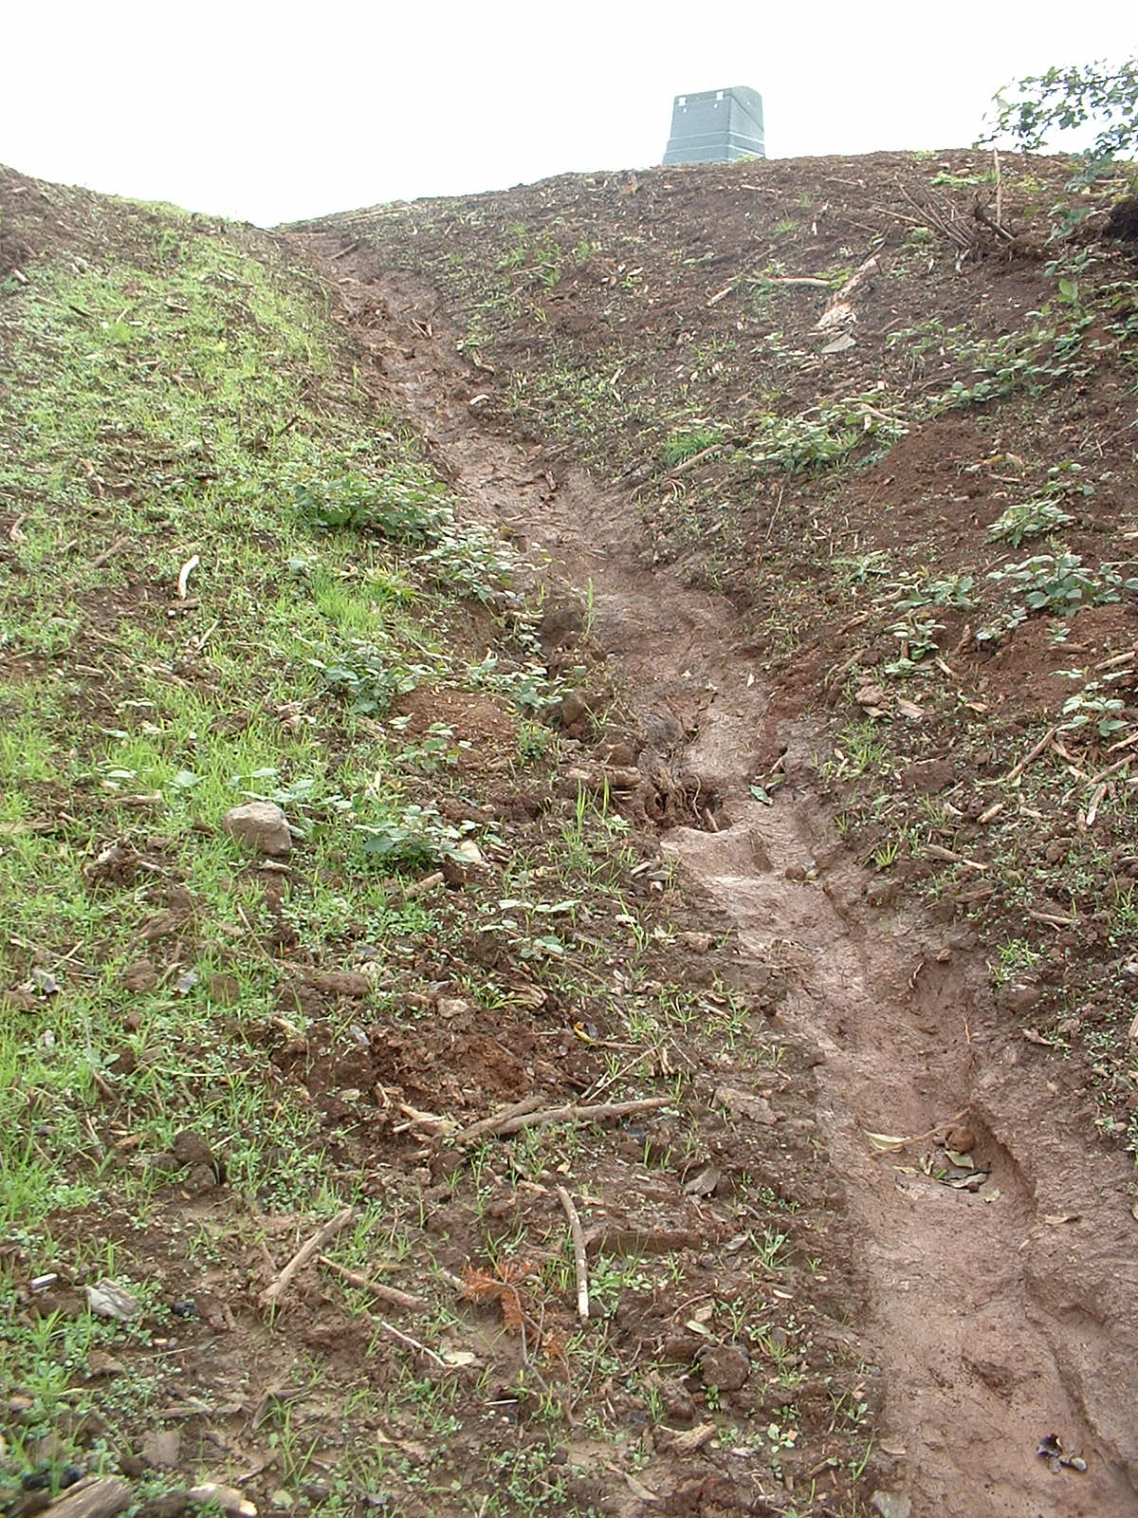
Soil Texture
& Erodibility
Erodibility Increases
as the % of Silt &
Sand Increases
Erodibility Decreases
as the % of Clay
& Organic Material
Increases
Notes:
Soil texture is what the soil is made of, this is different from soil surface texture that can reduce the erosion potential by increasing the surface roughness. The soil has washed away down to a clay layer that does not erode as fast. Some soils will infiltrate water very effectively.

Slide 22
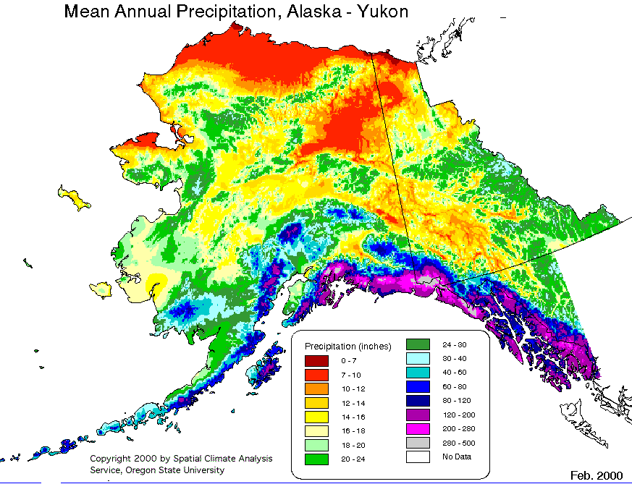
Precipitation & Climate

Slide 23
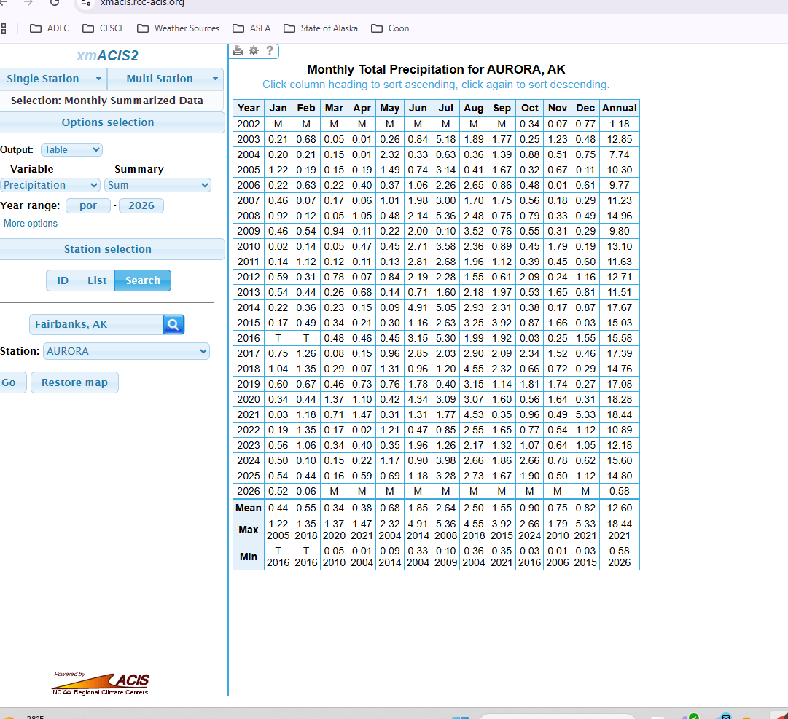
https://xmacis.rcc-acis.org
Use the NOAA Regional Climate Center xmACIS site to pull precipitation data for the nearest climate station when completing the SWPPP climate section.”
Notes:
Be sure to include that this is a great source for SWPPP material. Climate planning for winter shutdown and spring breakup.

Slide 24
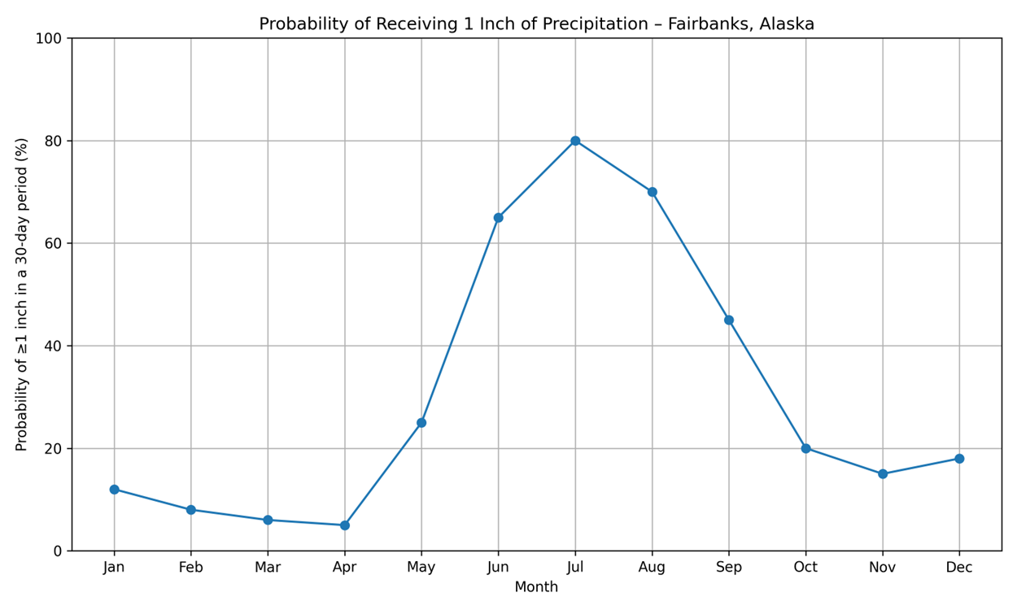
80% Probability of 1 Inch in July

Slide 25
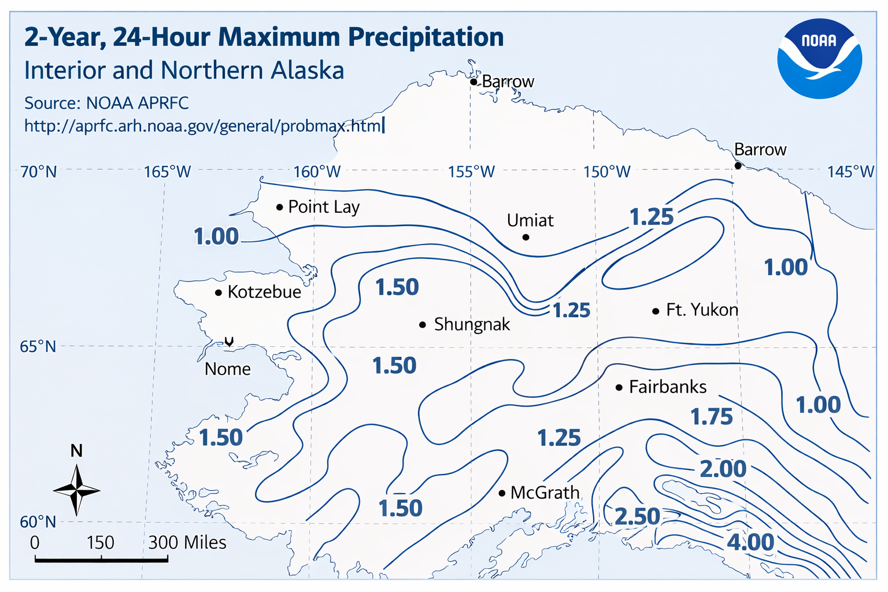

Slide 26
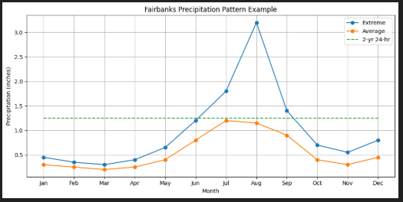
BMP Designs & Standards are affected by Flow and Velocity
Notes:
EPA CGP Requires Sediment Basins and traps be designed for 2 year 24 hour events. (EPA CGP Pg 13 Sec.3.13 E.) BMP’s from the AKDOT SWPPP guide have 2 and 10 year peak design standards.

Slide 27
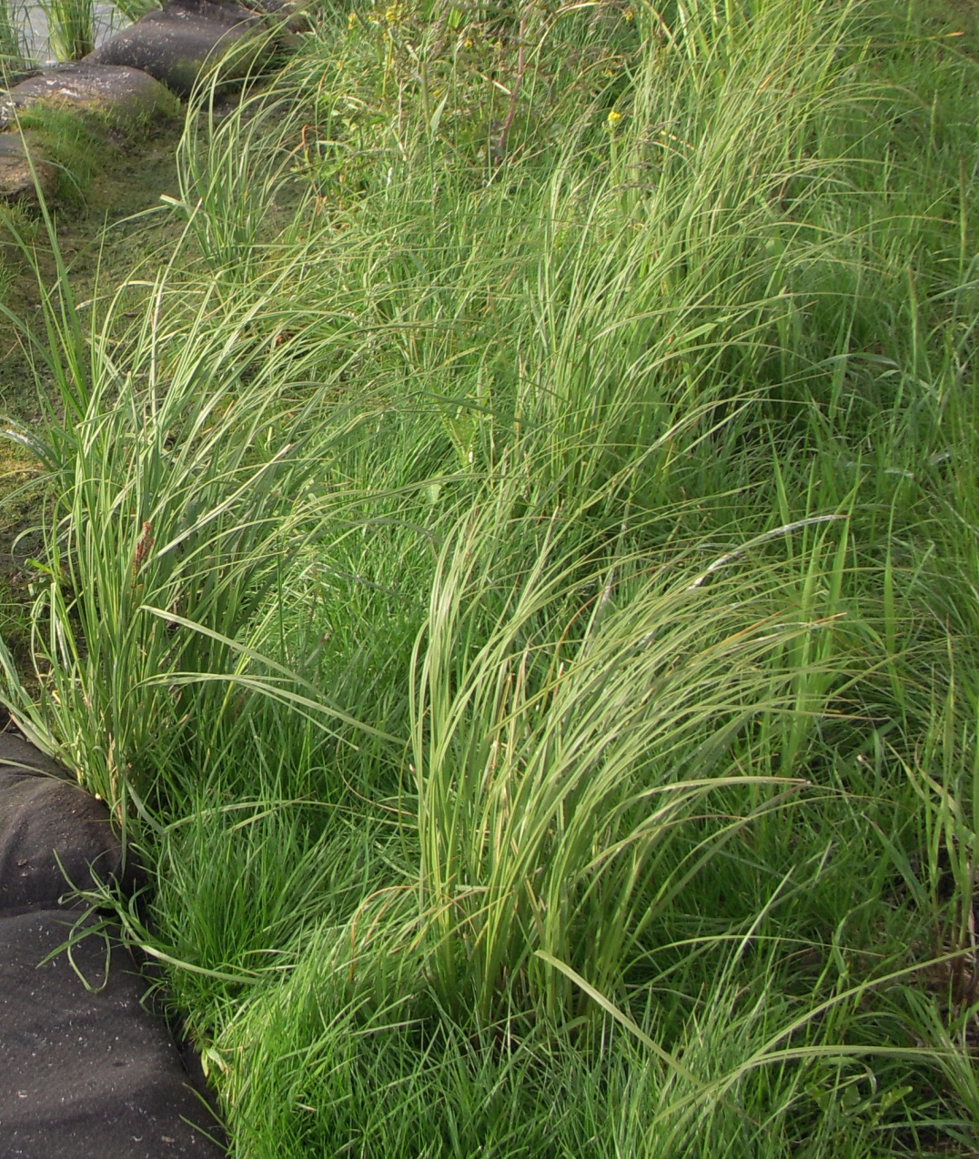
Benefits of Vegetation
Reduces Runoff Volume
Reduces Flow Velocity
Sediment Filtration
Energy Absorption
Pollution Reduction
Soil Retention
Lake Hood
Notes:
The volume is reduced by uptake and evapotranspiration, velocity is reduced by sheet flow interrupted by plants protruding from the soil.

Slide 28
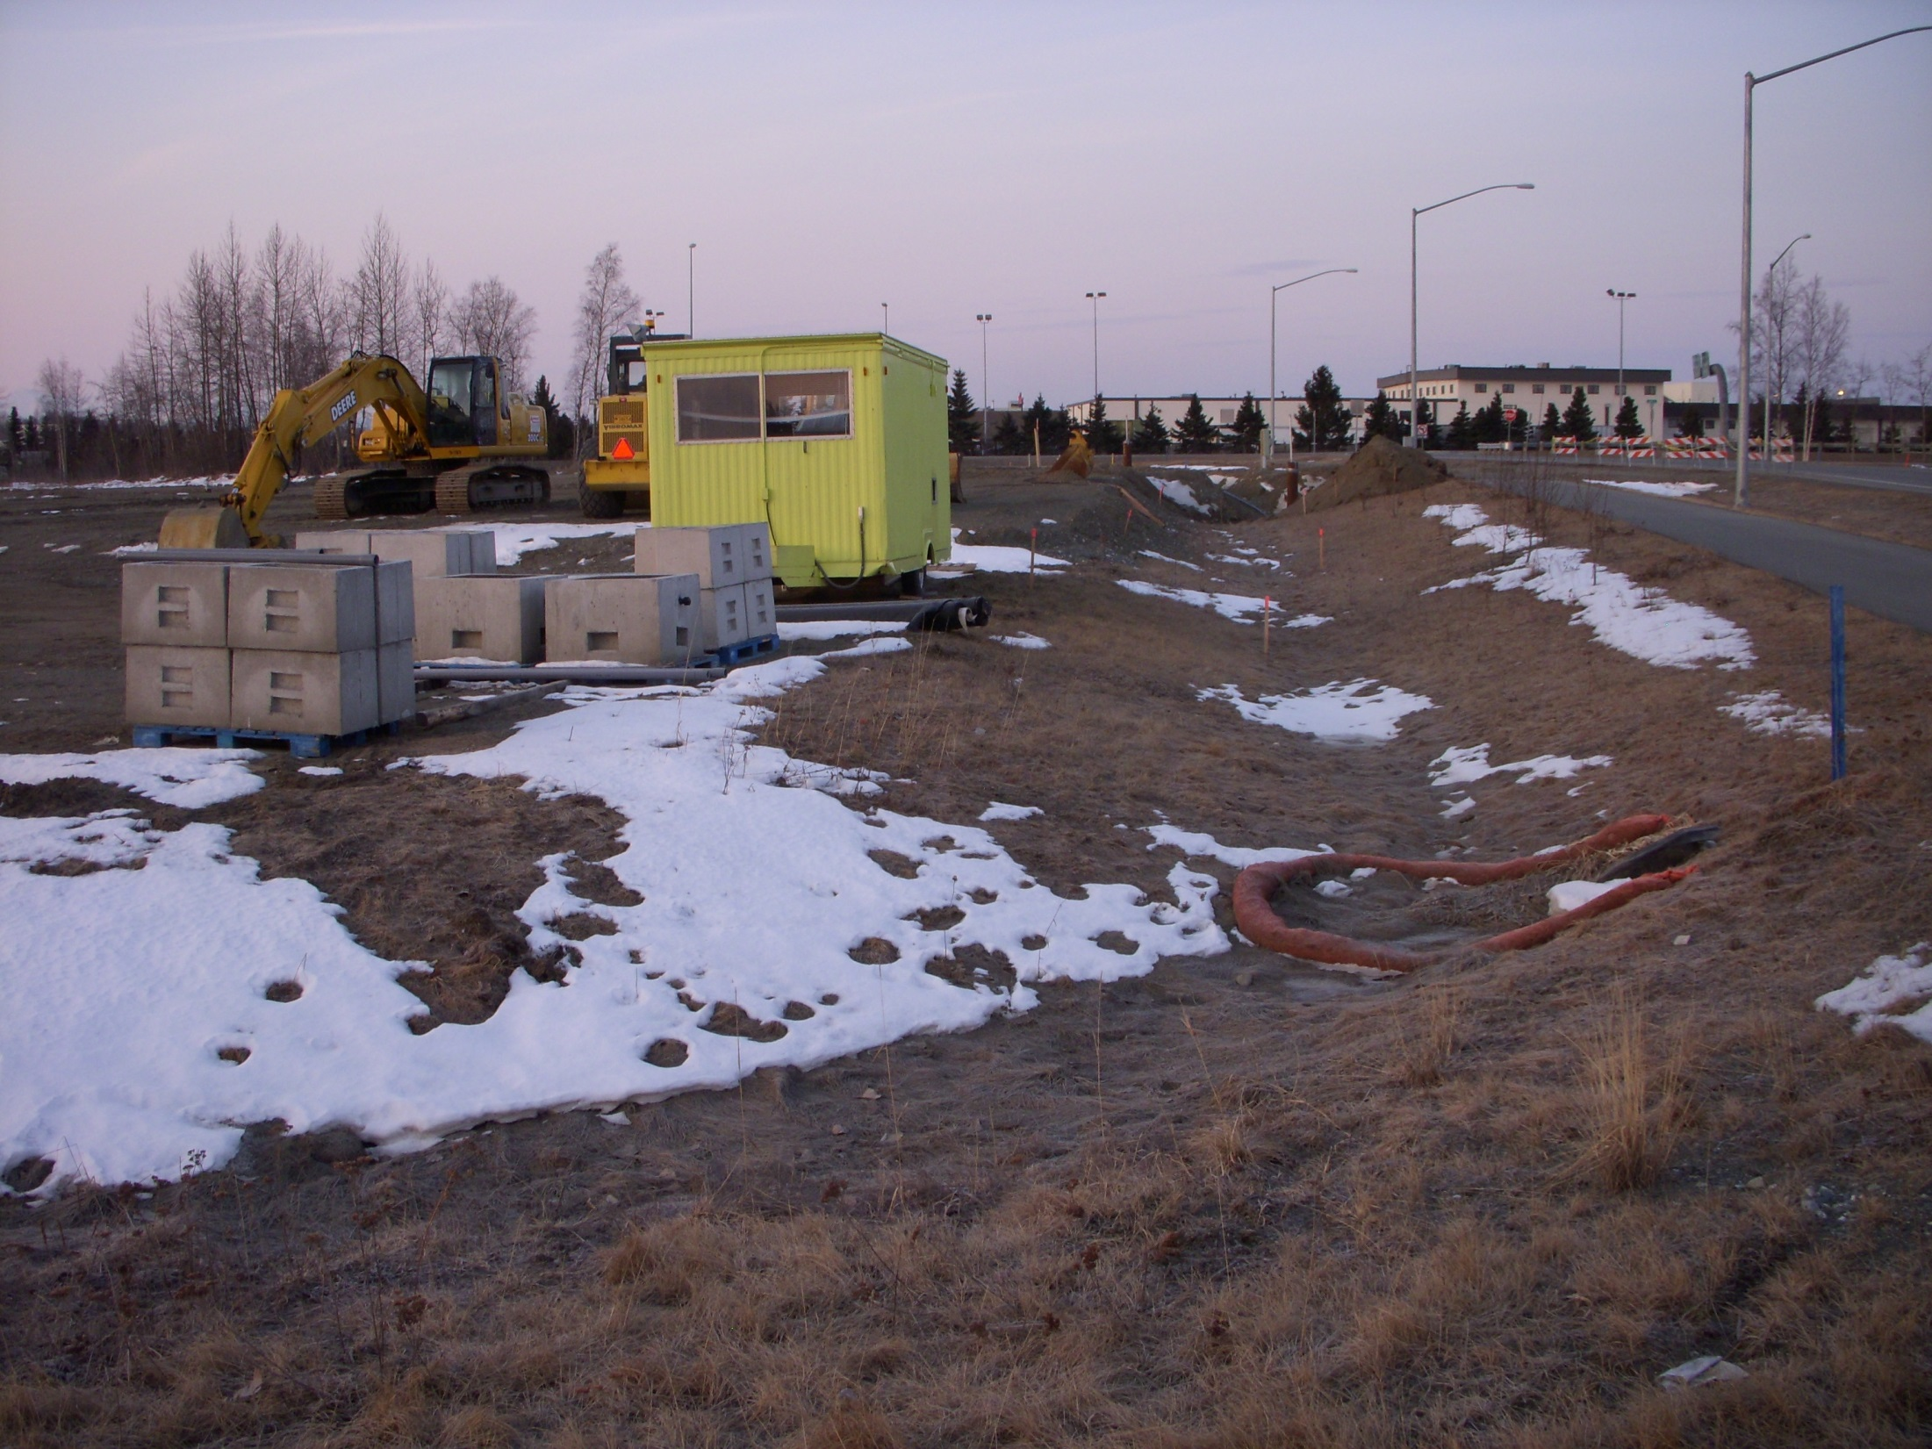
Can you leave existing vegetation in place?
Anchorage
Notes:
Are there opportunities to leave existing vegetation in place? The benefits of vegetation may outweigh any perceived production of tearing it all up. This operator left grass in place that was growing on the road fill slope.

Slide 29
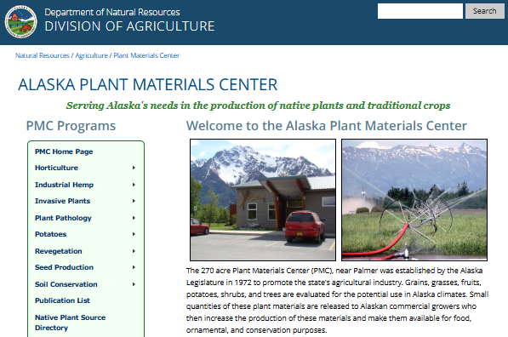
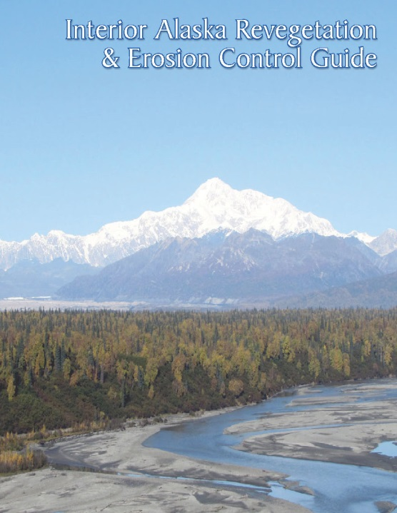
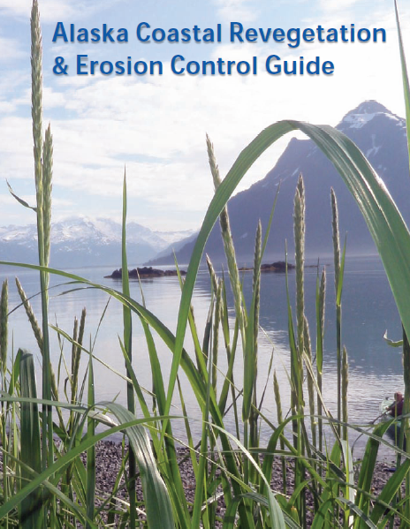
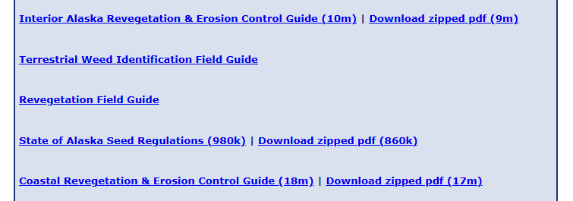
http://plants.alaska.gov/
Quick Links
Notes:
Select for success. Use the information for your unique area to help with seed selection and planting methods. There are great resources that have been published for Alaska.

Slide 30

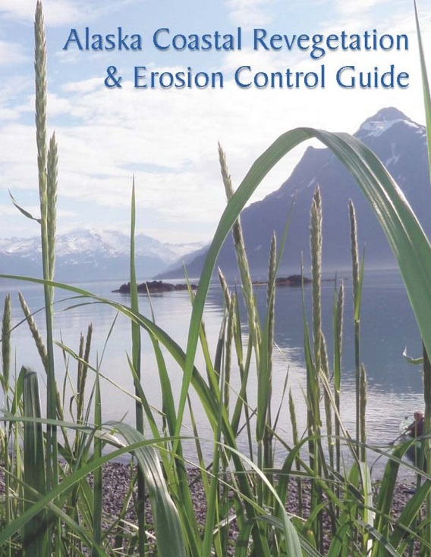

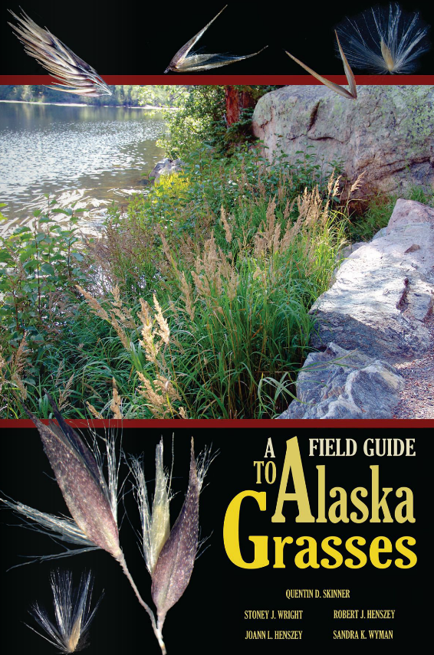
Plant Material Center
5310 S Bodenburg Spur
Palmer, AK 99645
Soil Erosion Control / Revegetation
907-745-4469

Slide 31
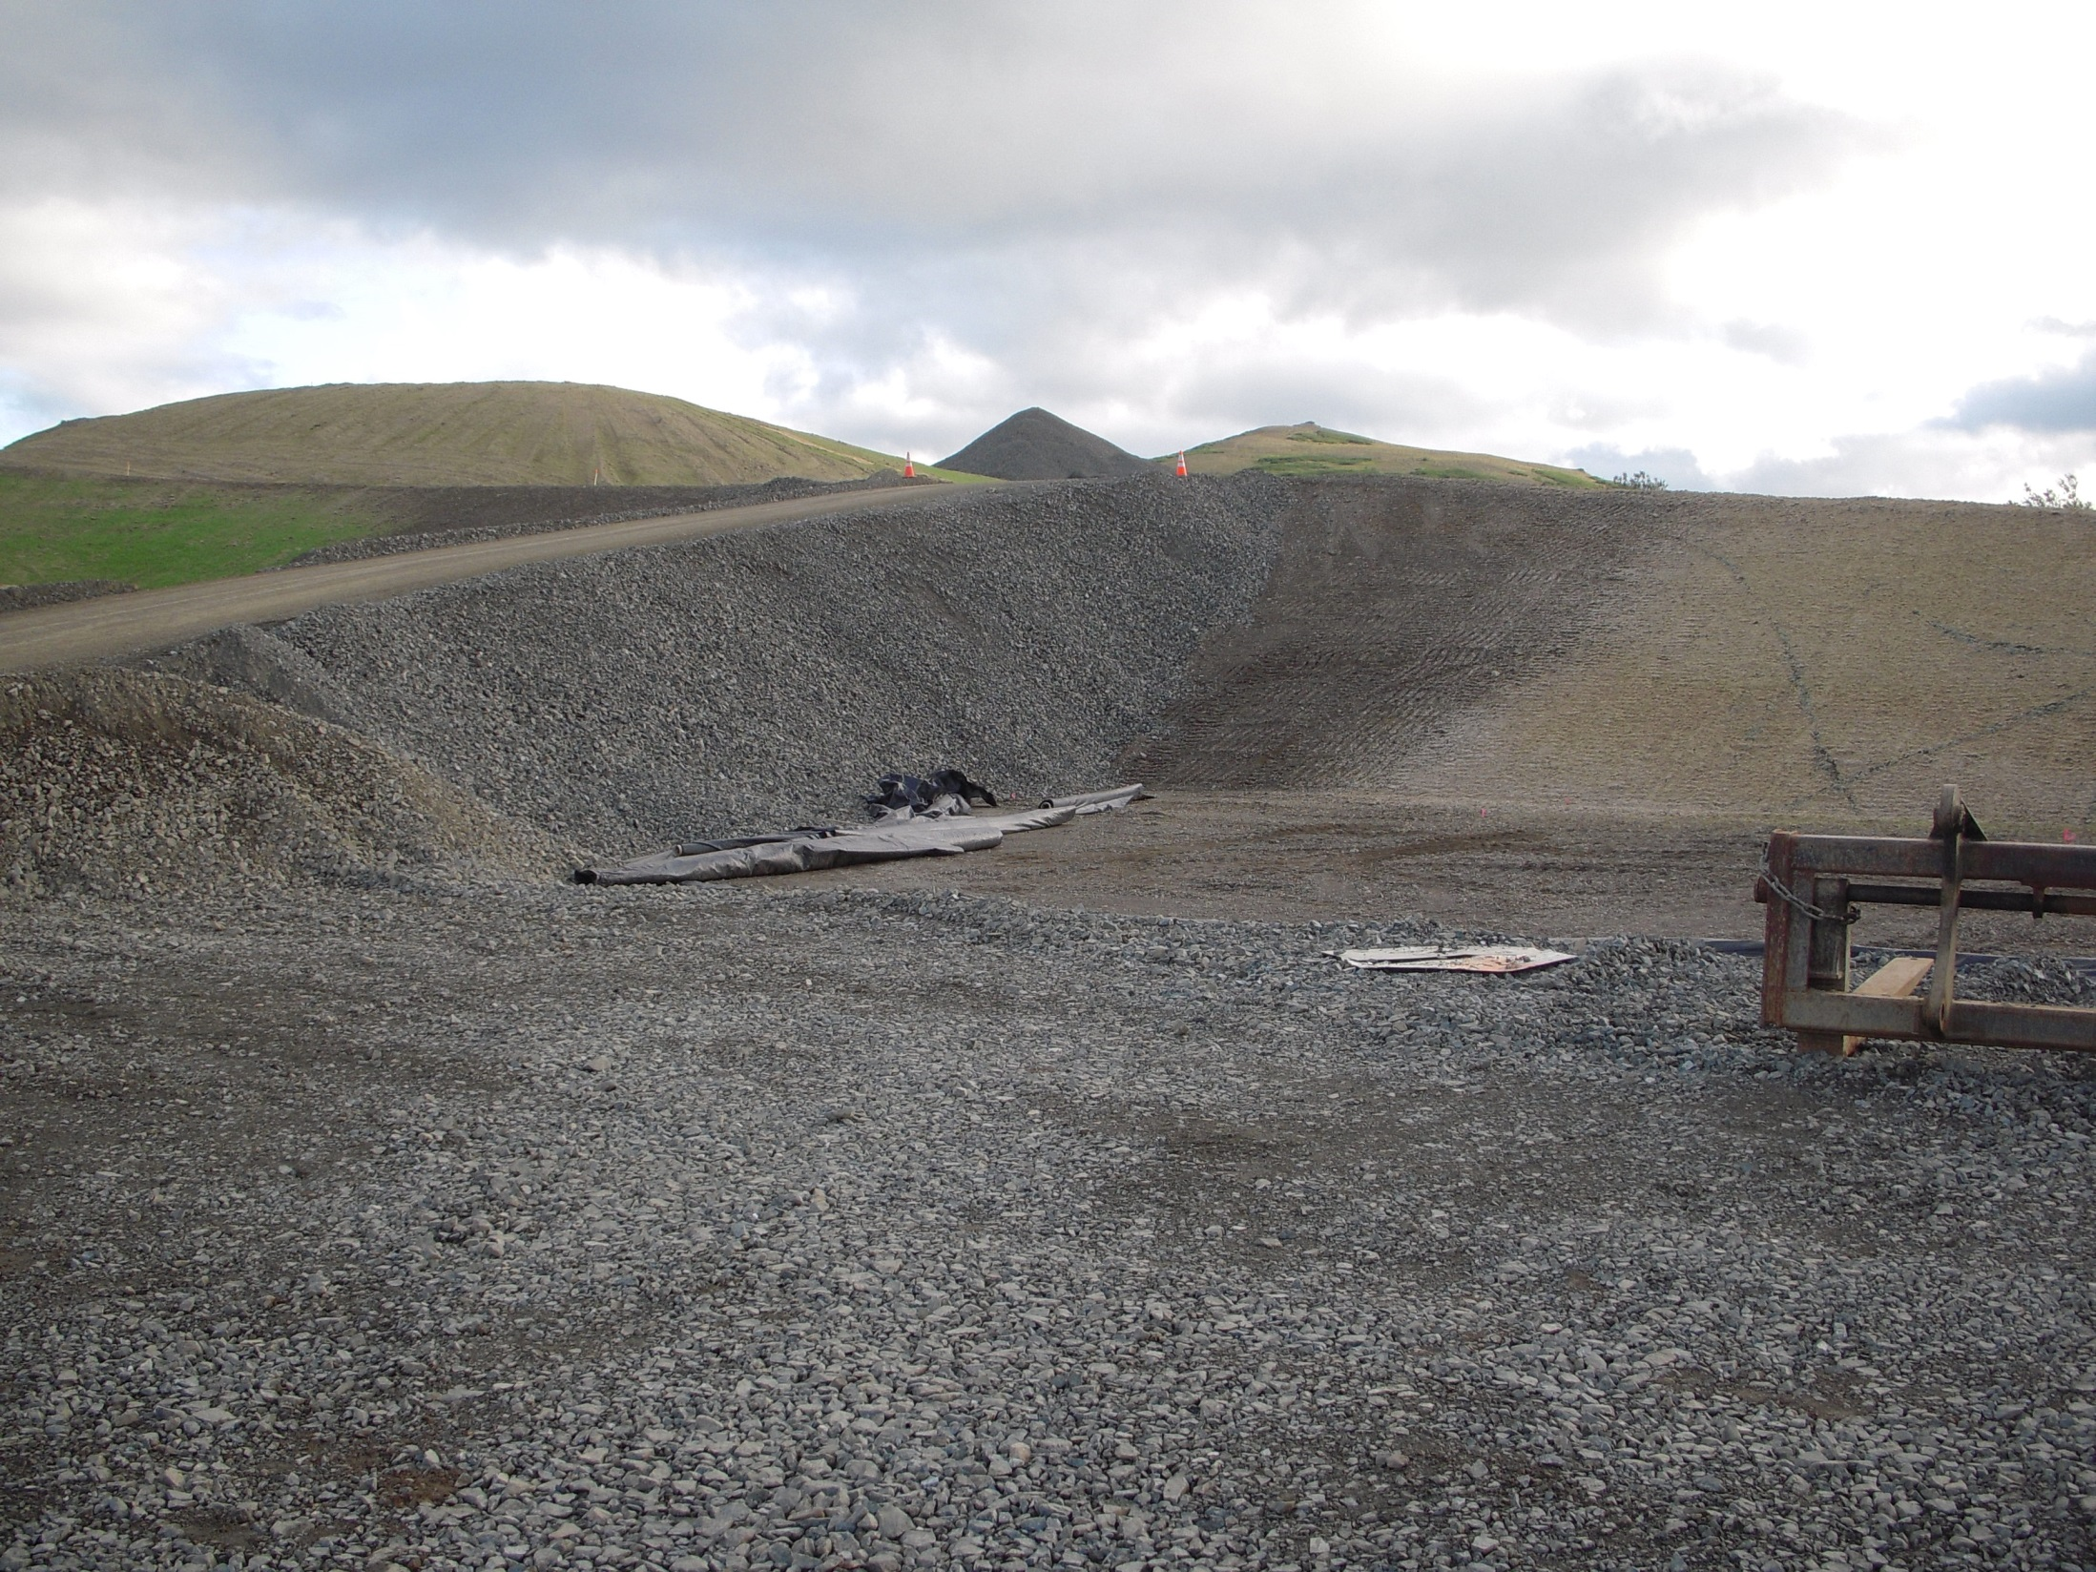
Surface Area
Hydroseed
Grass
Gravel Mulch
Hydroseed
Larger bare areas contribute larger volumes
& greater velocities of runoff
Goodnews Bay
Notes:
How do the surface areas changes of my site affect erosion potential
What is the erosion potential for various soils and their condition? RUSLE
Note the stabilization that has been initiated and the grass that was seeded in phases

Slide 32
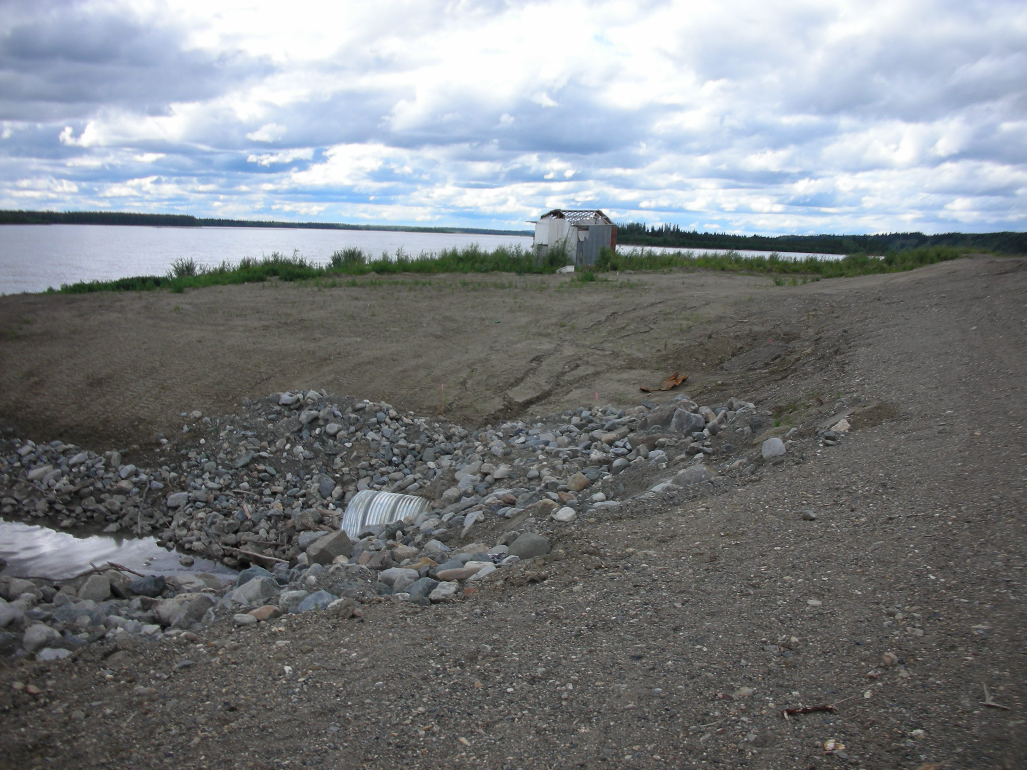
How soon can you stabilize exposed soils?
Can you take areas out of sediment production?
Tanana
Notes:
The greater the extent of exposed soil the greater the risk

Slide 33
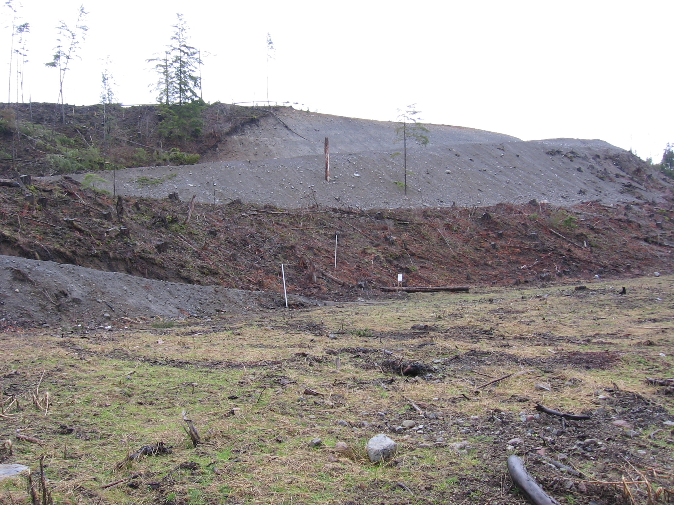
TOPOGRAPHY
Slope Length & Gradient
Doubling the slope length increases erosion potential by 4 times.
Doubling the slope gradient increases erosion potential by 5 times.
Notes:
Most of the good, easy ground is gone
How will your topography change during the life of your project?

Slide 34
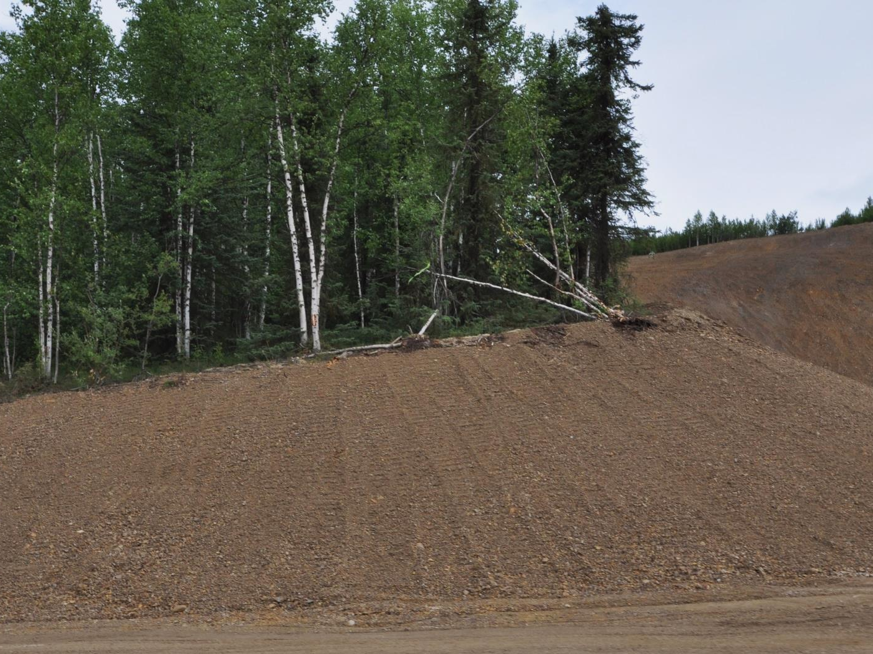
Surface Texture
Roughened Soils Reduce Erosion
Dalton Highway
Notes:
Rough soils reduce both wind and water caused erosion.

Slide 35
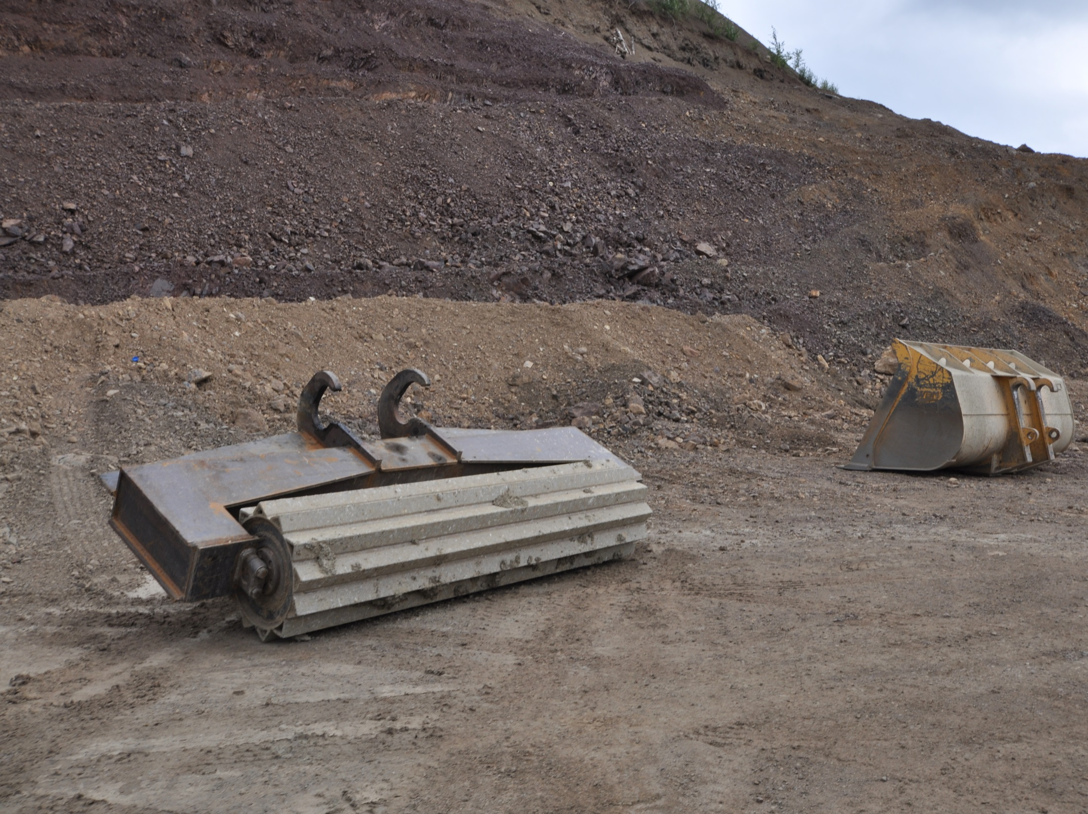
Alaska style innovation
from the front lines
Dalton Highway
Notes:
This is a homemade imprinter made in Alaska for Alaska projects.

Slide 36
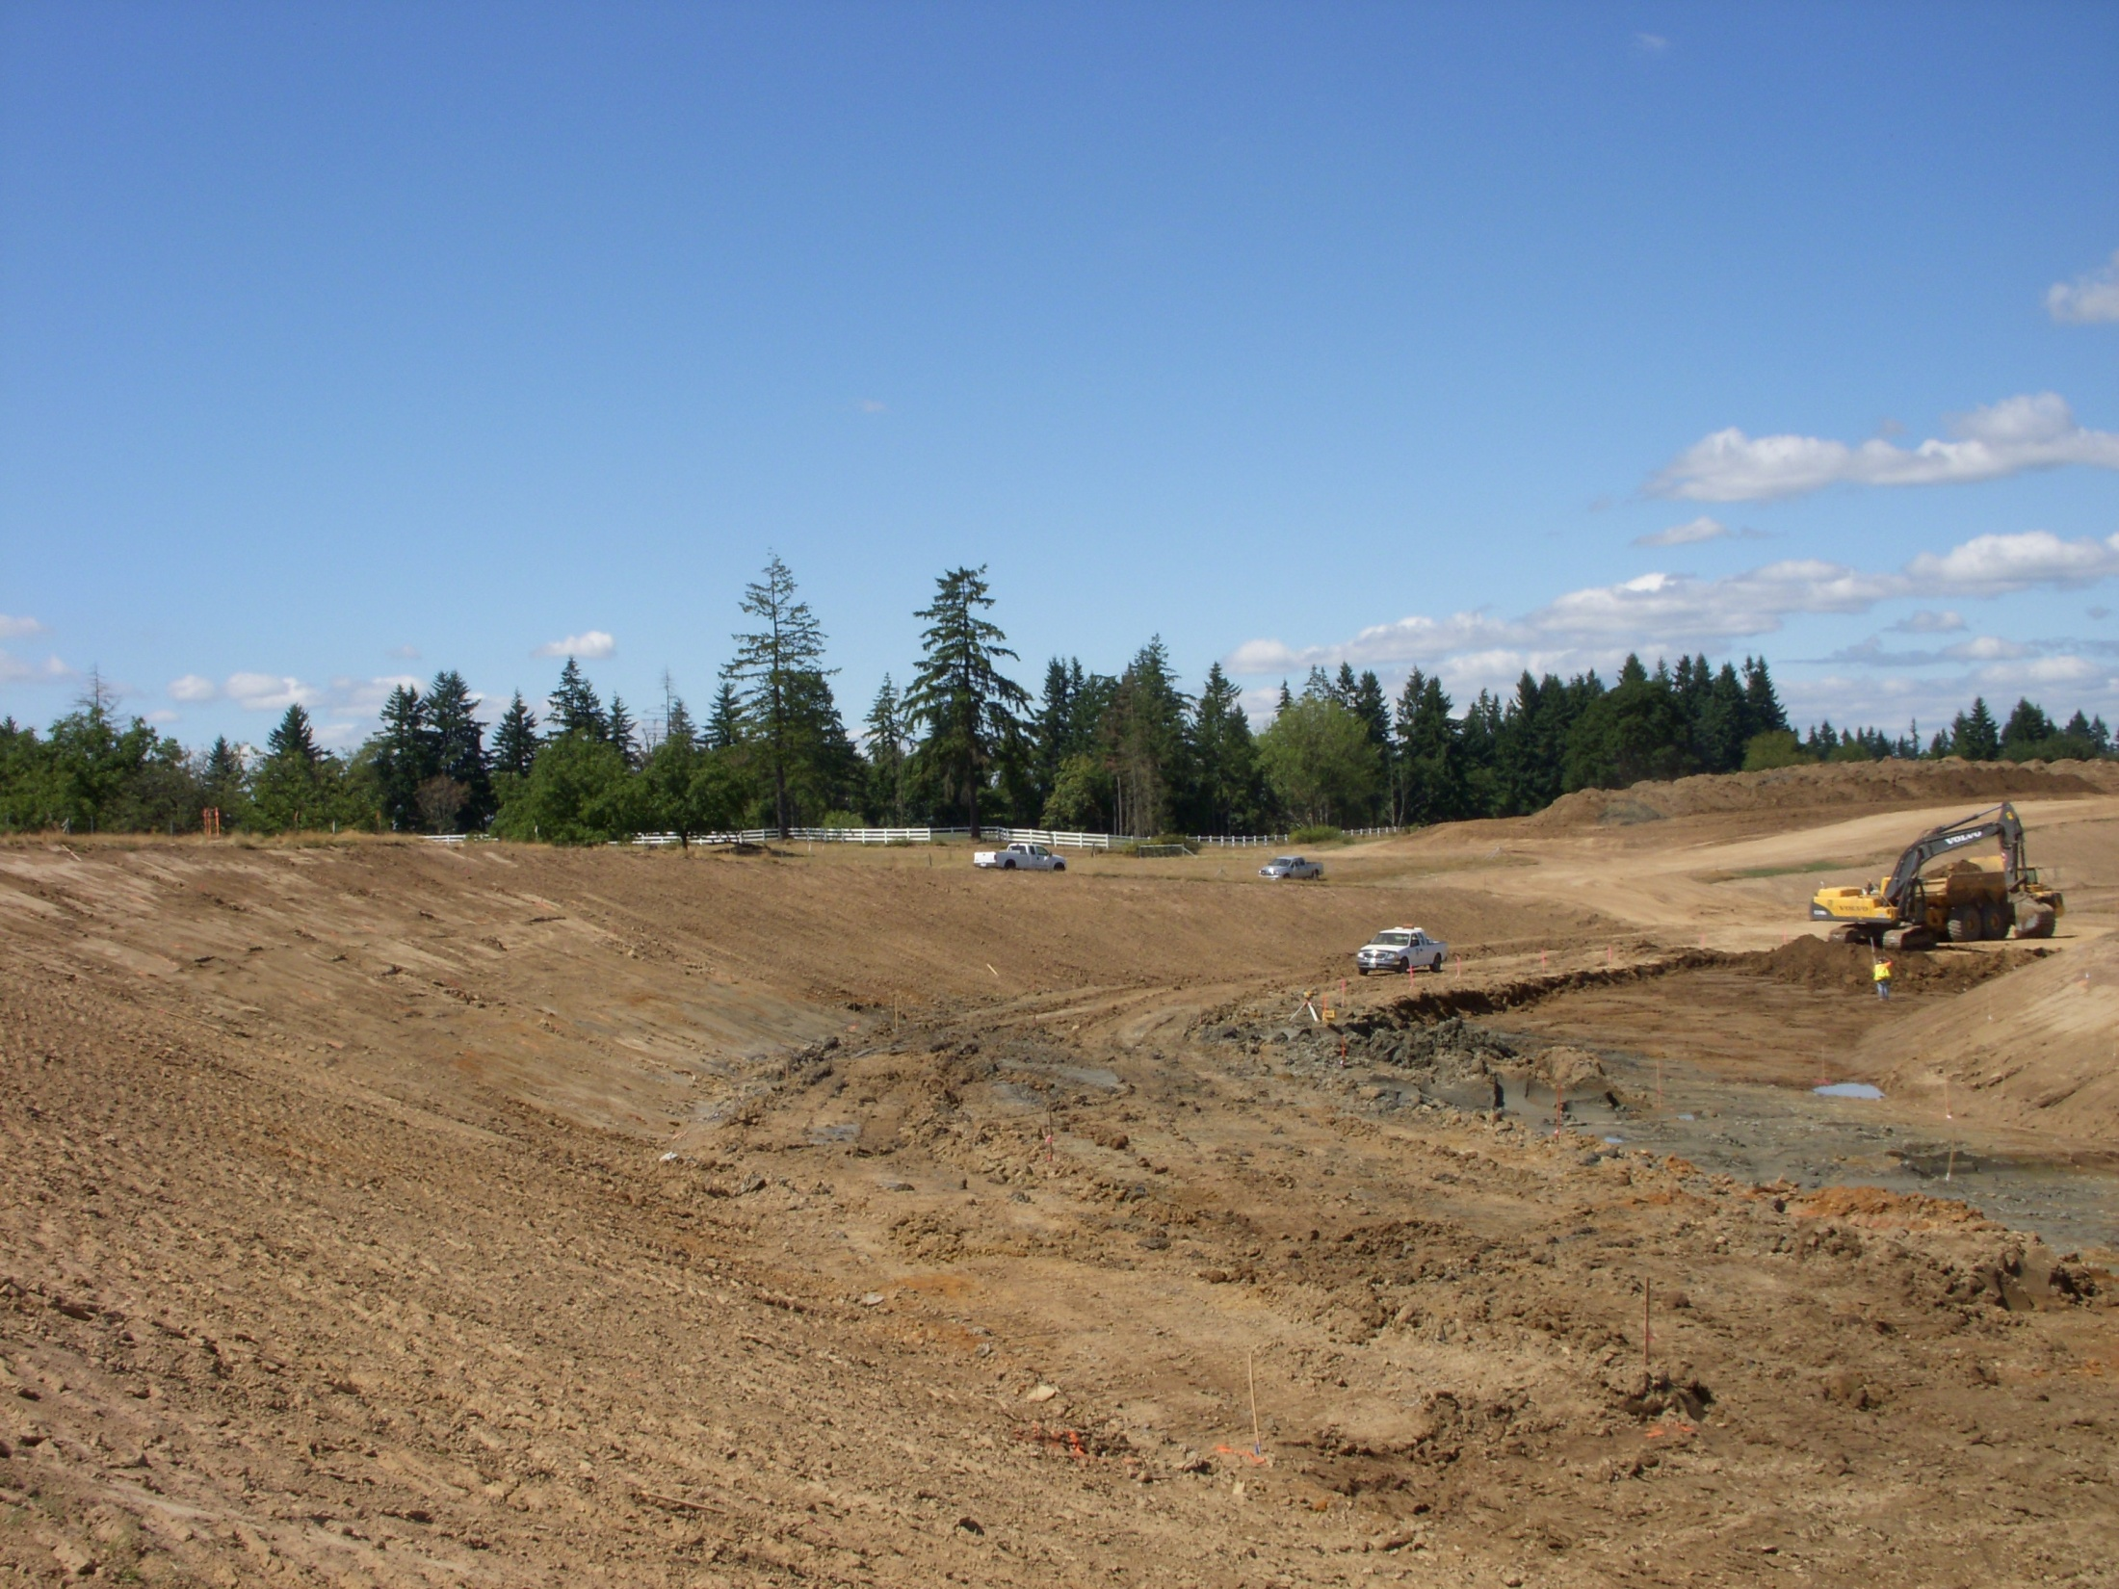
Factors that Influence Erosion
Precipitation
Basin Area
Slope Length
& Gradient
Vegetation
Soil Characteristics
Surface Texture
= Erosion Losses
Notes:
Discuss the relationship between the factors and the site phasing. If we seed the slopes how much less risk will we have?

Slide 37
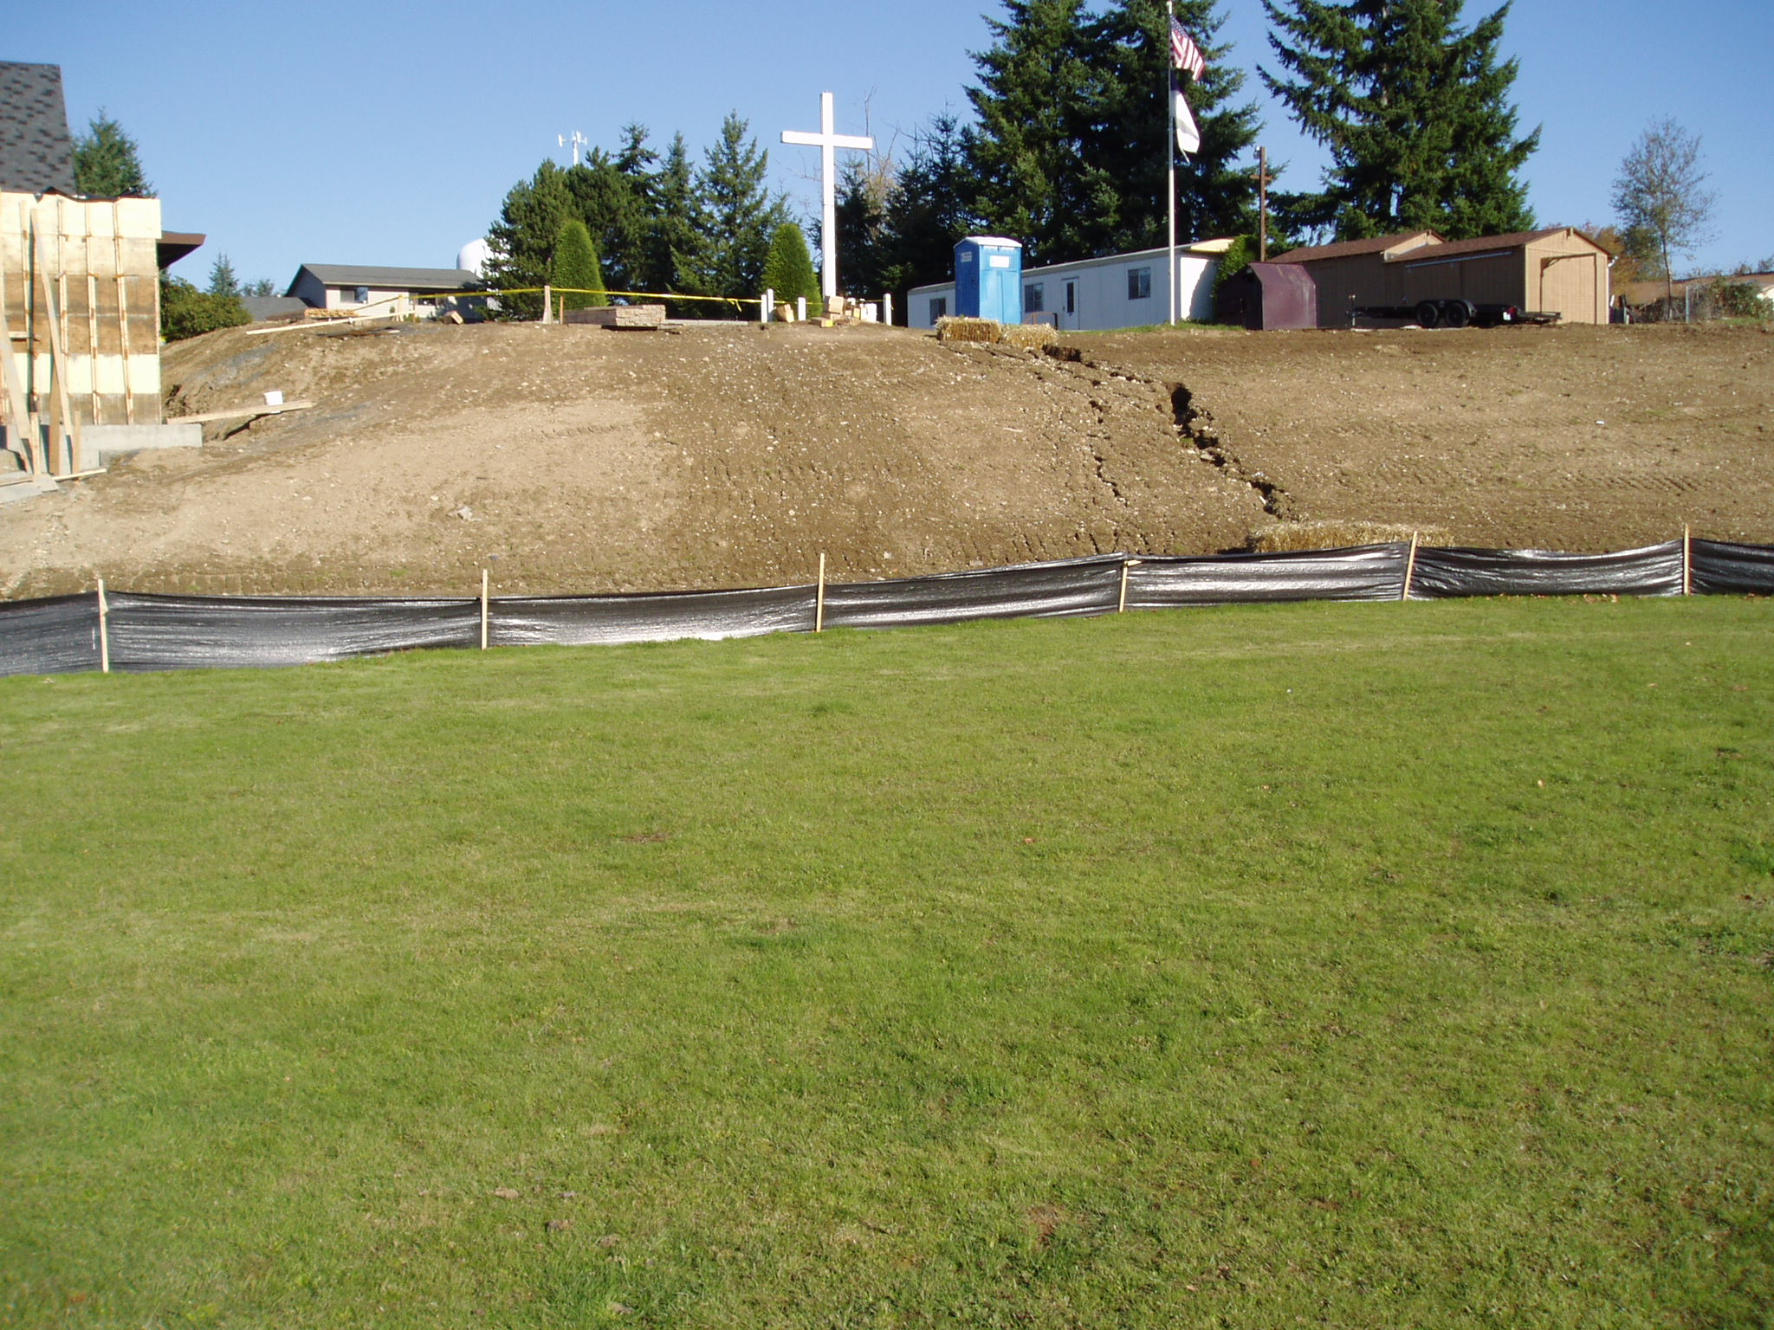
Erosion Risk
Assessment
How much risk does your site pose?
Consider:
Soil type- above and below the surface
Climate- frequency, intensity, and duration of rainfall
Vegetation
Surface Area
Slope Length & Gradient
Surface Texture
Notes:
Saying prayers and having to fix problems is not effective erosion control and is not productive or profitable.

